Slide 1
Term Project 2
Data Engineering 1
Prepared by: Shahana Ayobi, Ákos Almási,
Alima Dzhanybaeva
Notes:
The main question for our project: Whether there is a correlation between pay-gap and gender ratio and GDP?

Slide 2
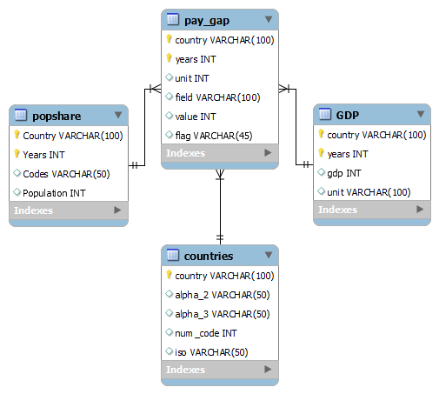
Data sources
MongoDB:
Gender Pay Gap from Eurostat
Postman:
GDP at Market Prices from Eurostat API
MySQL
Gender Ratio from Kaggle
Country Codes from Kaggle
Notes:
We used MongoDB, postman and mySQL to deliver our project. MongoDB was used on the gender pay-gap data, postman was used to connect to the Eurostat API and receive data on the GDP at market prices, and we used mySQL workbench to load data on gender-ratio and country codes. Also We created an EER diagram so you can check how our data sources are related to each other.

Slide 3
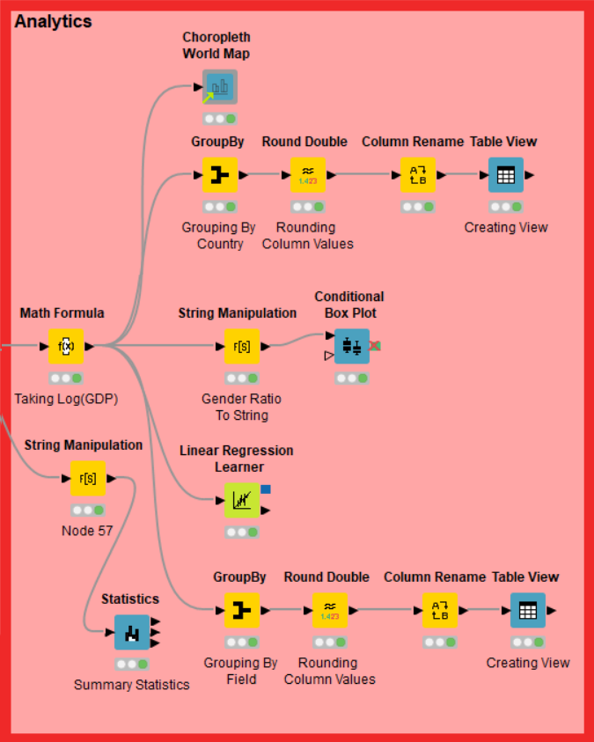
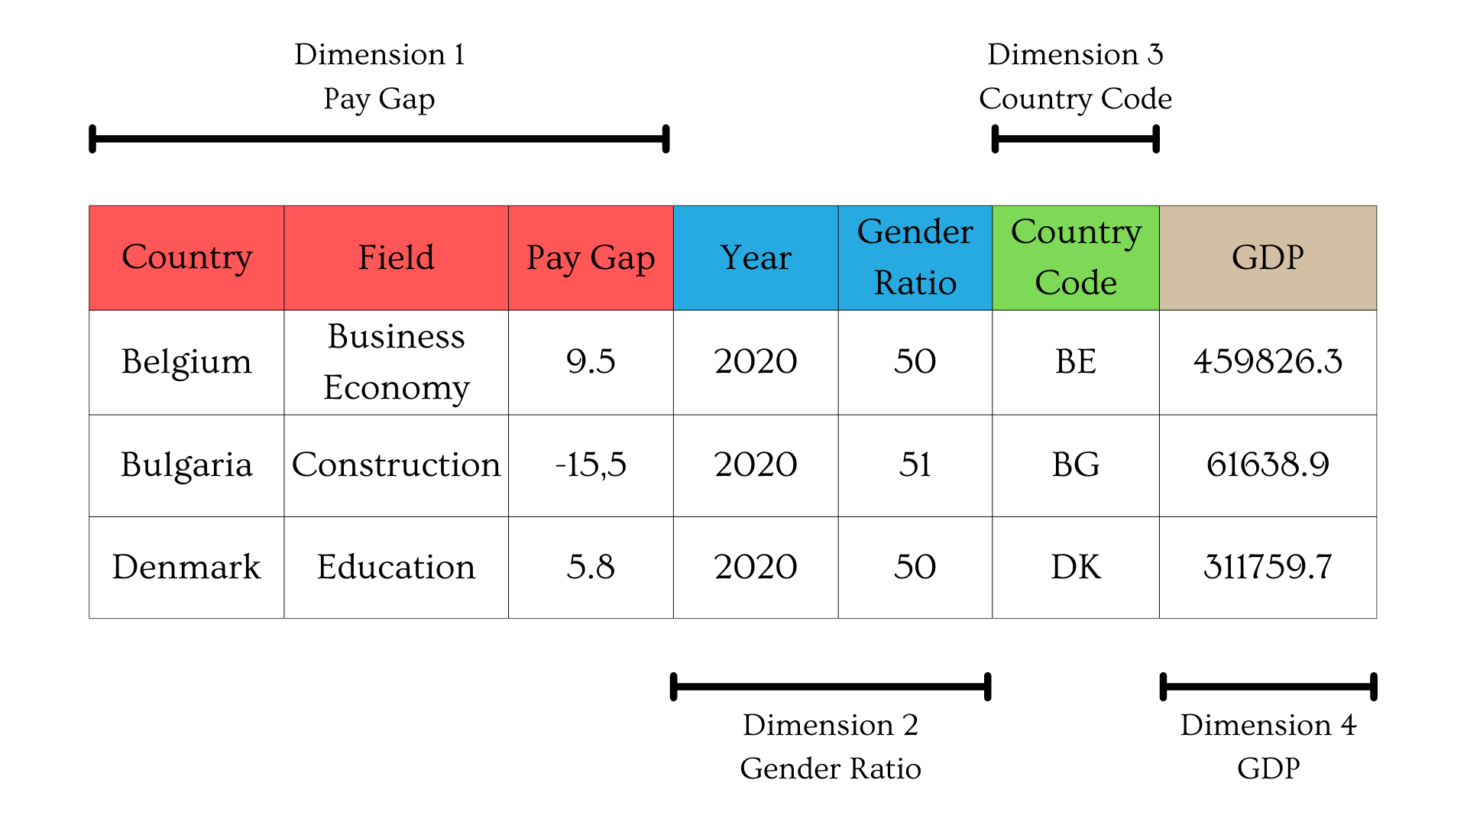
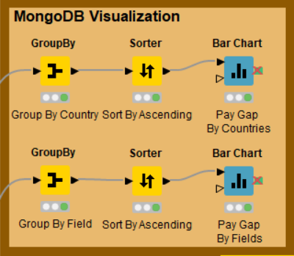
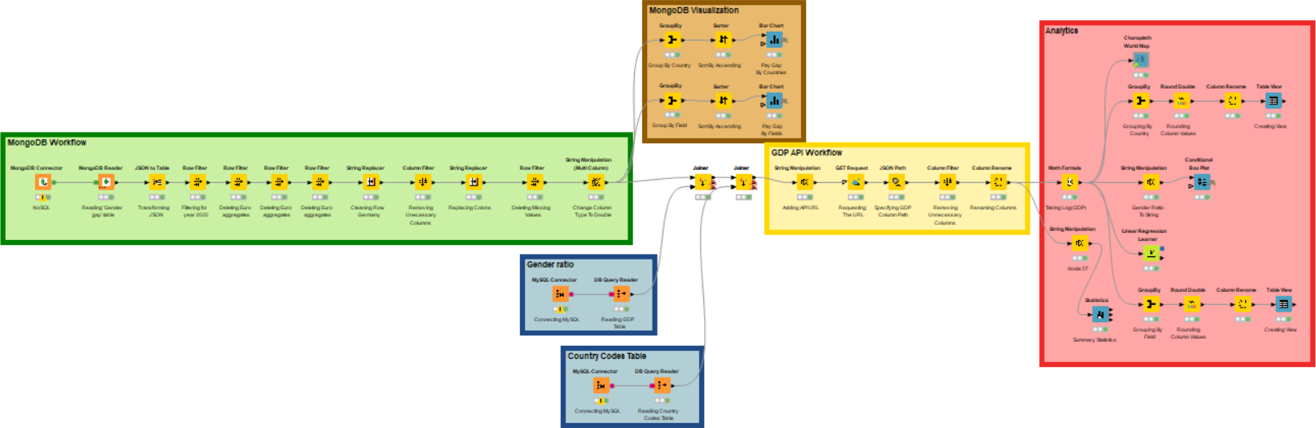
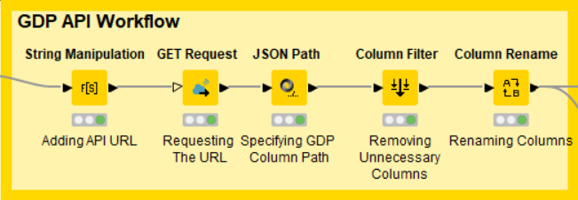
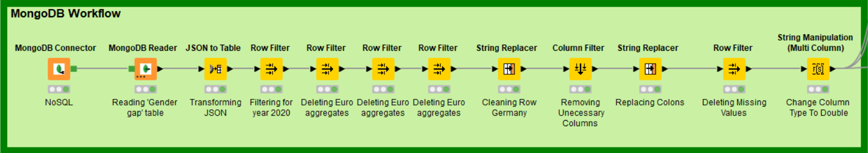
Knime Workflow
Notes:
In this picture you can see our whole process in knime, we divided it visually to different segments so you can check what are the most important components of the workflow.
MongoDB:
The first segment is the MongoDB part, we added MongoDB Connector and then we applied MongoDB Reader node to be able to read the pay gap table. For the next step we transformed the obtained JSON to a Table and filtered the data to our needs, such as: including only 2020, cleaning the germany row, deleted the missing values, changing the column type to double etc.
SQL:
The second segment is the mySQL part, we used MySQL workbench to access the gender ratio and the country codes csv files, and we used the MySQL connector node to import it to Knime, and we configured the Query Reader for 2020.
API:
The third one is the API part, We configured the string manipulation node to access the GDP dataset, pasted the country codes to acquire GDP information for each country. We then used the get request node to access the JSON URL for each country. We used the JSON Path node to extract the GDP at market prices, country names, country codes, year, and unit. We then performed a basic data cleaning by removing unnecessary columns.
Analytics for MongoDB:
The next one is the mongoDB analytics part, here we created two bar charts based on the average pay gap in each country and in different fields. Further information on them in the upcoming slides.
Analytics for data warehouse:
Our Data Warehouse consists of four dimensions, and we have 7 columns in them(Country, field, pay-gap, year, gender-ratio, country code, GDP). We included two dynamic views, one box-plot, summary statistics and a linear regression.

Slide 4
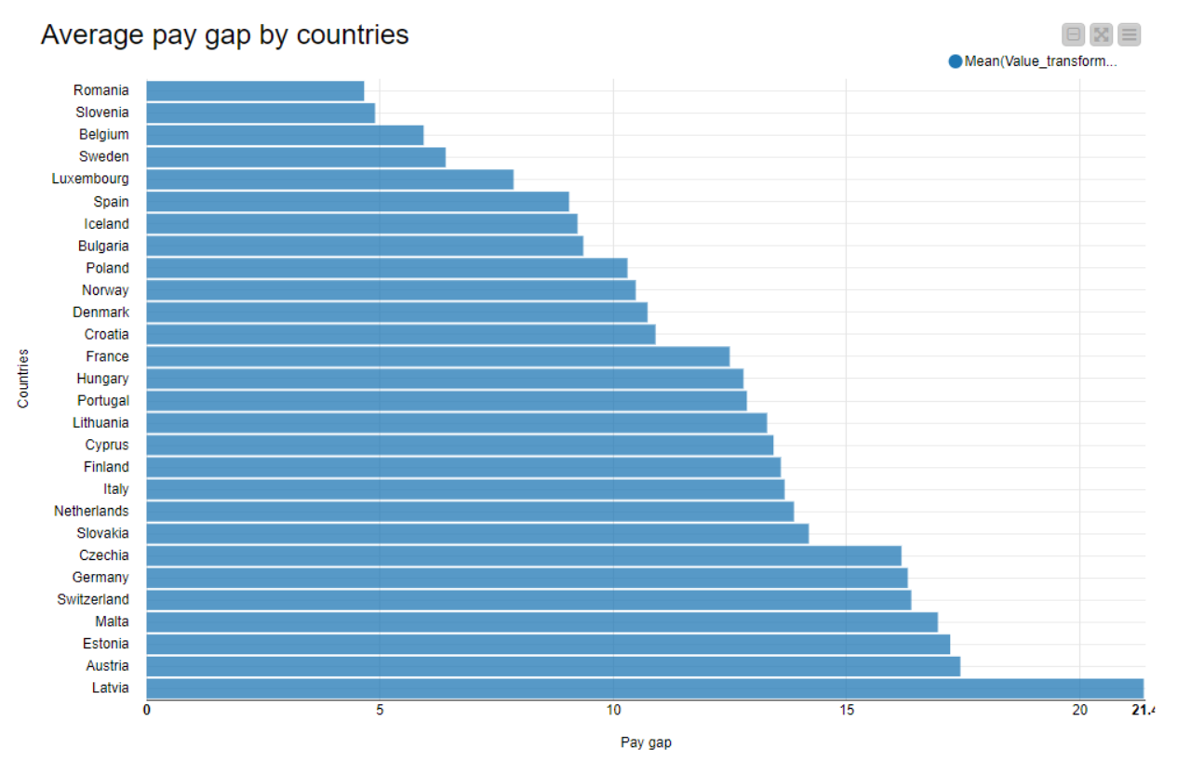
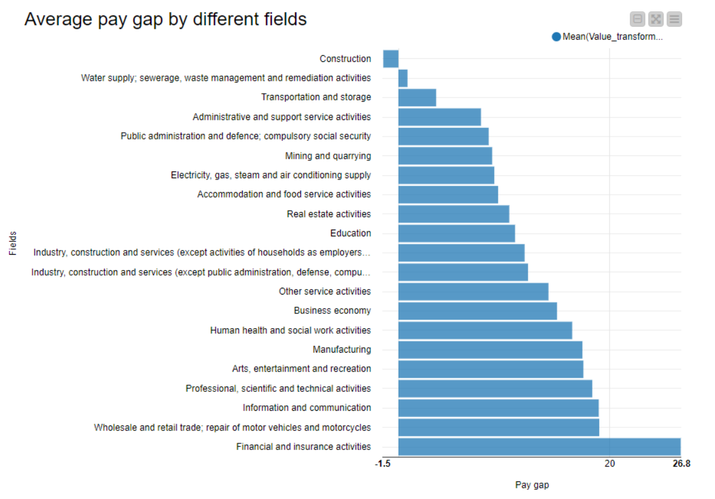
Analytics on MongoDB
Average pay gap by country
The highest gap is in Latvia (21.3%)
The lowest is in Romania(4.7%)
Average pay gap by field
The highest gap is in Finance and Insurance sector (26.7%)
The lowest is in Construction (-1.4%)
Notes:
First one describes the average pay gap in each country we can see that the lowest is in Romania roughly around 4.7%, and the highest is in Latvia around 21.3%
The second one describes the average pay gap in each field, we can see that the lowest is in Construction, actually women tend to earn more in this field since its -1.4%. Probably it's because there aren't many women in this occupation or most of the time they are in higher average salary positions compared to men who work on construction sites. The highest gap is in Finance and insurance sector around 26.7%.

Slide 5
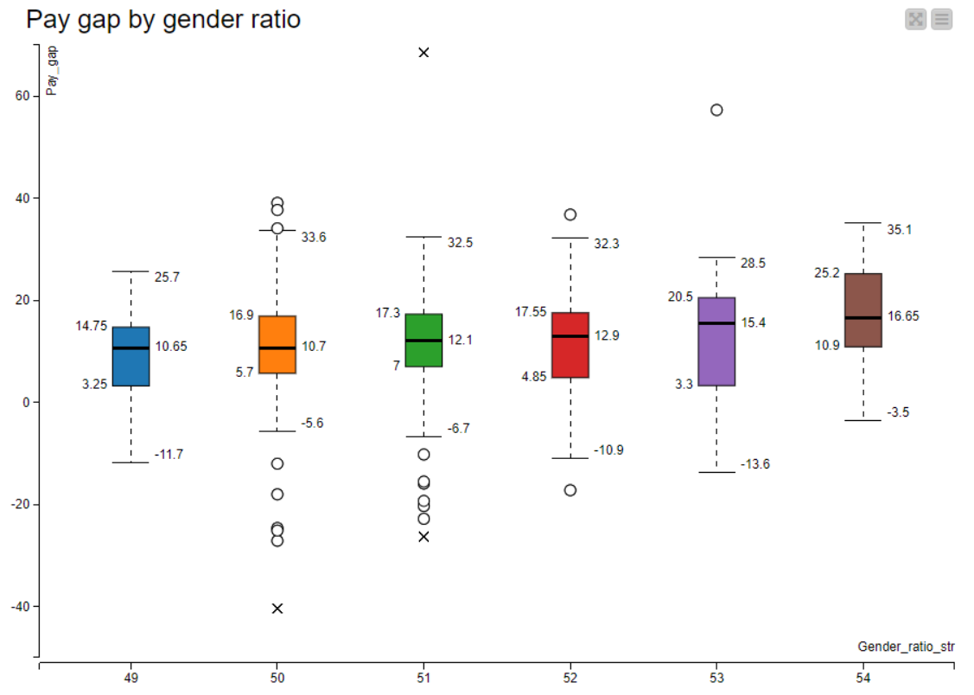
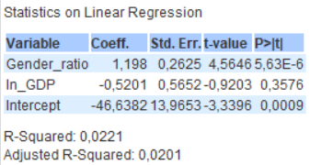
Analytics on the Data Warehouse
Linear regression on pay gap conditioned on gender ratio and log(GDP);
Positive correlation between gender gap and gender ratio.
Notes:
Since we found a significant relationship between gender ratio and pay gap, we wanted to visualize this correlation using a box plot. The plot confirms the regression result, the mean pay gap has an increasing trend meaning that as the proportion of women in the country rises the difference between average wage of men and women becomes bigger.

Slide 6
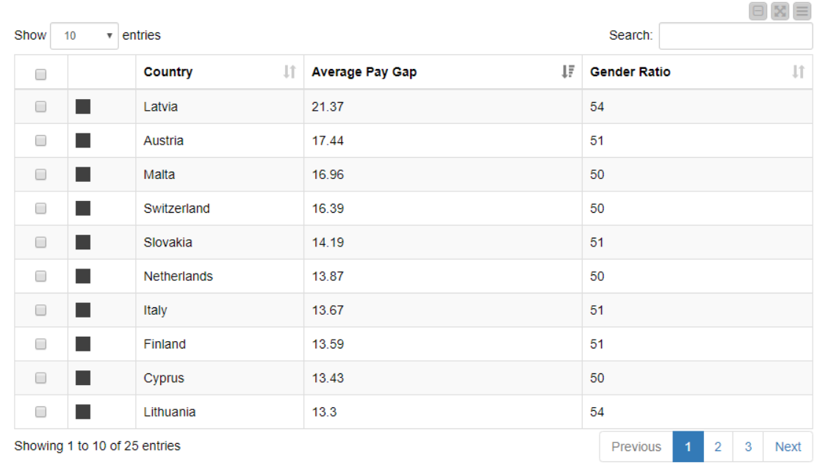
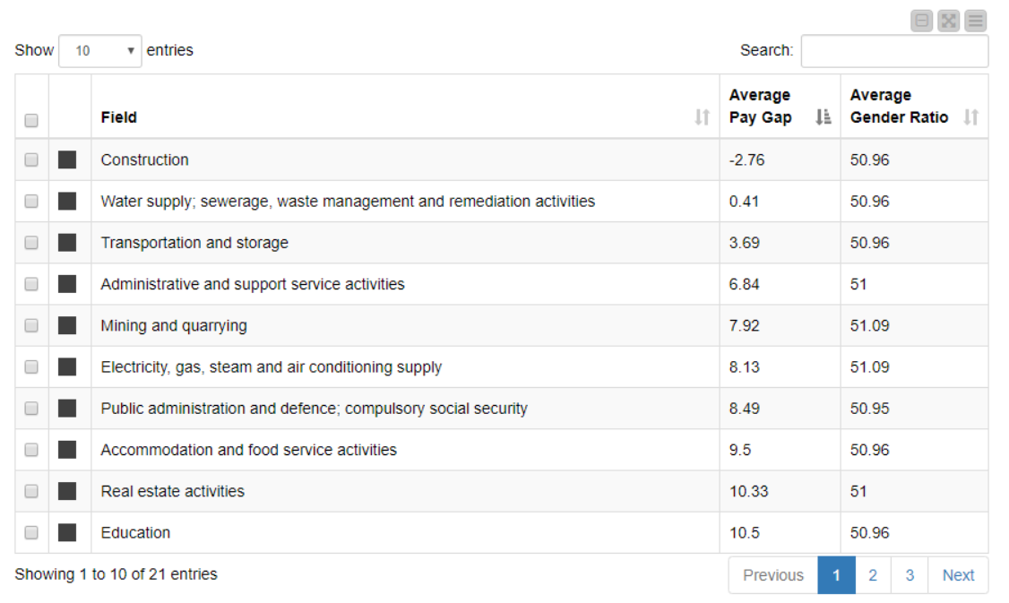
Views
Notes:
Additionally, we created two interactive table views that demonstrate the average pay gap and gender ratio by countries and by different fields. The user can specify the country displayed, the order of the observations based on the two indicators (Average pay gap, Average gender ratio).

Slide 7

THANK YOU!
Questions?
Notes:
Q&A session

