Slide 1
CSE Git Tutorial
Adam Kosiorek, 2014
reference: http://git-scm.com/book
ppt based on: http://tinyurl.com/UW-git

Slide 2
Agenda
We will:
  Motivate version control
  Discuss the basic Git model
  Use command line a lot
  Work with local repo
  Branch, merge and resolve conflicts
  Work with remote repo
  Discuss Git Workflow
We won't:
  Discuss Git GUIs

Slide 3
Git History
Came out of Linux development community
Linus Torvalds, 2005
Initial goals:
  Speed
  Support for non-linear development (thousands of parallel branches)
  Fully distributed
  Able to handle large projects like Linux efficiently
Notes:
Initial goals were to support development of Linux

Slide 4


Git uses a distributed model
Centralized Model
Distributed Model
(CVS, Subversion, Perforce)
(Git, Mercurial)
Result: Many operations are local
Notes:
http://git-scm.com/book/en/Getting-Started-About-Version-Control

Slide 5

Git takes snapshots

Slide 6
Git uses checksums
Commits: Unique SHA-1 hash – 40 character string
we only see the first 7 characters:
  1677b2d Edited first line of readme
  258efa7 Added line to readme
  0e52da7 Initial commit

Slide 7
Git Resources
At the command line: (where verb = config, add, commit, etc.)
$ git help <verb>
$ git <verb> --help
$ man git-<verb>
Free on-line book: http://git-scm.com/book
Git tutorial: http://schacon.github.com/git/gittutorial.html
Reference page for Git: http://gitref.org/index.html
Git website: http://git-scm.com/
Git for Computer Scientists http://eagain.net/articles/git-for-computer-scientists/

Slide 8
Get ready to use Git!
  Installing Git: http://tinyurl.com/installing-git
  Set the name and email globally:
$ git config --global user.name “Bugs Bunny”
$ git config --global user.email bugs@gmail.com
Call git config --list to verify
Set variables on a project-only without the --global flag.
Commit message editor:
$ git config --global core.editor vim

Slide 9
Create a local copy of a repo
  Two common scenarios:
    To clone an already existing repo:
$ git clone <url> [dir name]
  To create a repo in your current directory:
    $ git init
    $ git add README.md
    $ git commit –m “initial commit”
    $ git remote add origin https://github.com/<user>/<repo>
    $ git push origin master

Slide 10
So what is github?
On-line storage of Git repositories.
  Continuous Integration powered by Travis-CI
Open source projects → free
Private projects → pay
Other options:
Local
Different hosting

Slide 11

A Local Git project has three areas
Unmodified/modified
Files
Staged
Files
Committed
Files
Note: working directory sometimes called the “working tree”, staging area sometimes called the “index”.

Slide 12


1 → 4: git add <file> (file wasn't tracked before)
4 → 3 modify a file that was already staged
3 → 4: git add <file> (file was tracked before)
4 → 2: git commit <file> (puts <file> to the repo)

Slide 13
2 → 3: modify a file that was already tracked (commited)
3 → 2: git checkout <file>
4 → 1: git reset HEAD <file> (<file wasn't tracked previously)
4 → 3: git reset HEAD <file> (<file> was tracked previously)
(2, 3, 4) → 1: git rm --cached <file>

Slide 14
Staging files
Add to the staging area:
$ git add README.txt hello.java
Add all untracked and modified in the current dir:
$ git add .
Add all modified and deleted (but not new!)
$ git add -u (--update)

Slide 15
Commiting files
Move into the repo:
$ git commit
Bypass staging area:
$ git commit -a
Short message:
$ git commit -m “Fixing bug #22”
  Note: To unstage a change on a file before you have committed it:
  $ git reset HEAD filename
  Note: To unmodify a modified file:
  $ git checkout HEAD filename
Note: These commands are just acting on your local version of repo.

Slide 16
Status and Diff
To view the status of your files in the working directory and staging area:
$ git status
$ git status -s (one line version)
To see what is modified but unstaged:
$ git diff
Staged changes:
$ git diff --cached
Changes between HEAD and a commit:
$ git diff <hash>

Slide 17
Viewing logs
To see a log of all changes in your local repo:
$ git log
$ git log --oneline (to show a shorter version)
$ git log -5 (n last commits)
$ git log -p (commit content)
$ git log --author=”Adam Kosiorek”
$ git log --since=”1 week”
$ git log --graph (commit tree)

Slide 18
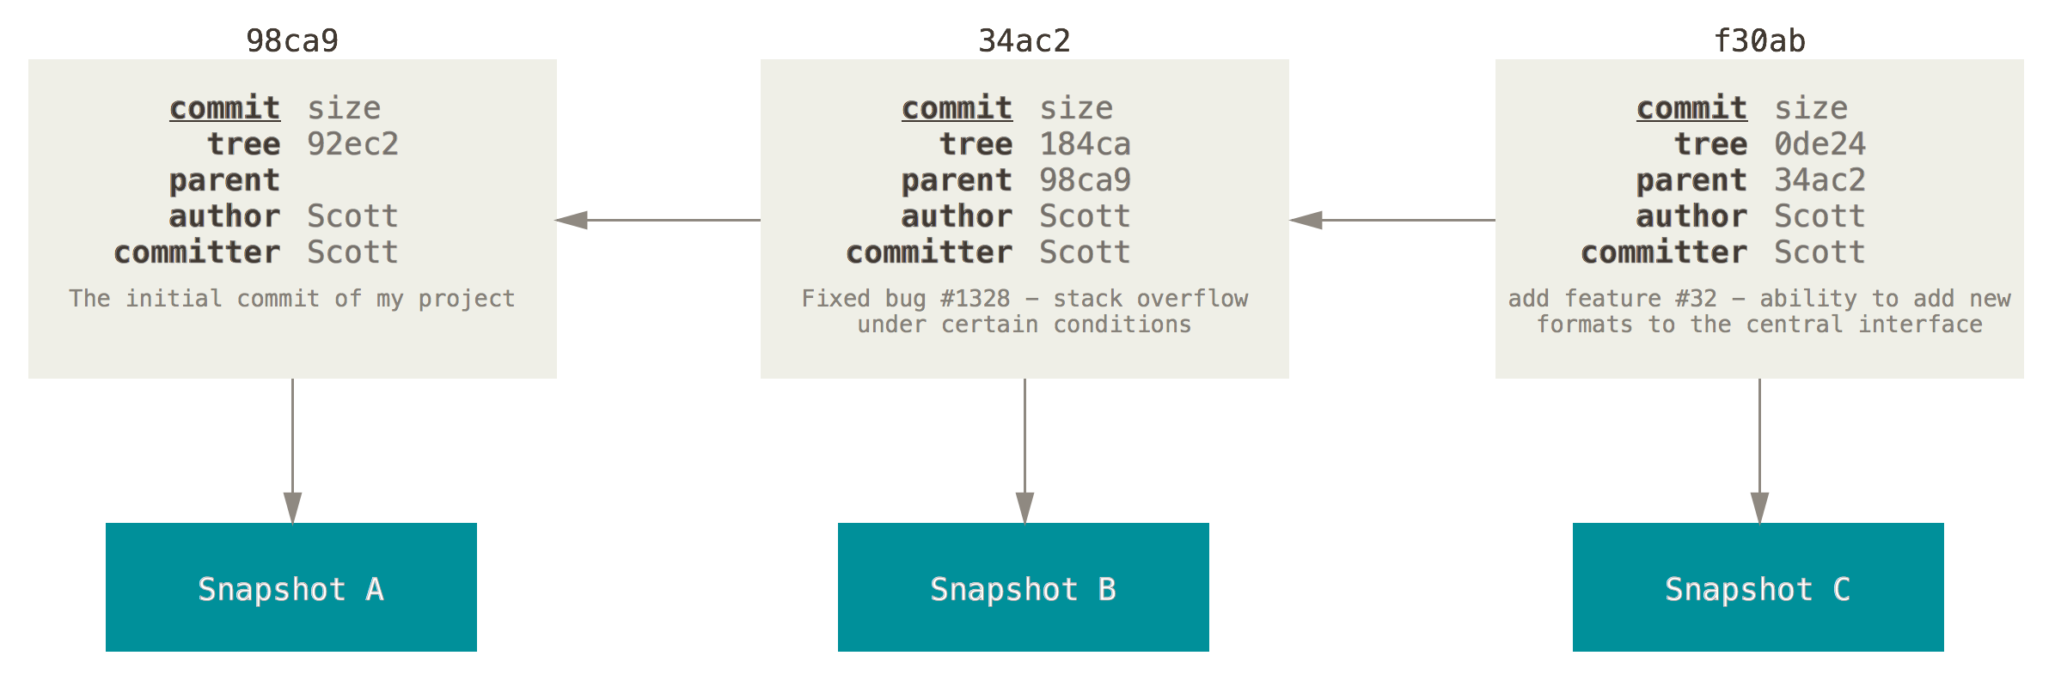
What is a commit?
Snapshot of the repo

Slide 19
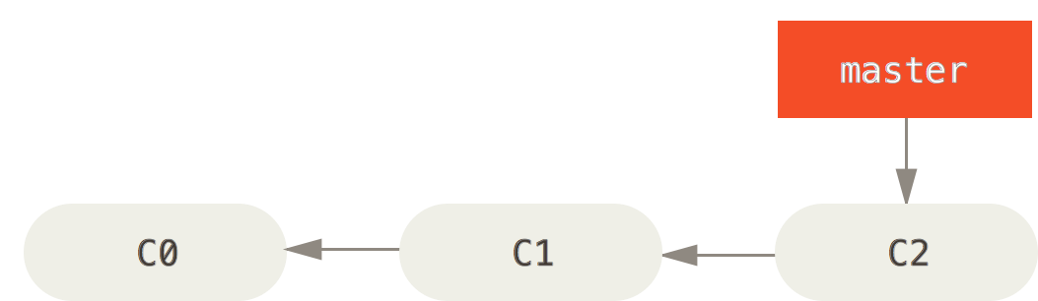
Branching – Master Branch

Slide 20
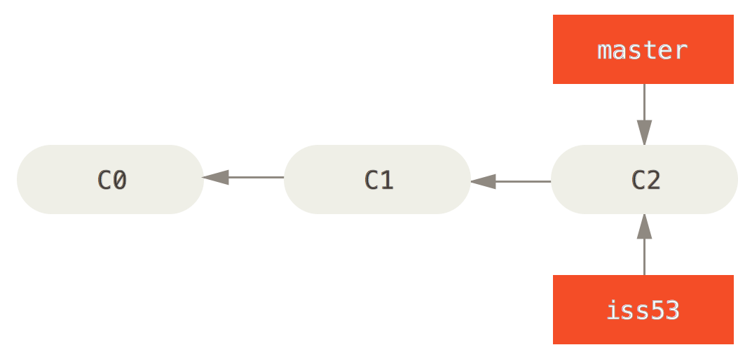
Branching – Topic branches

Slide 21
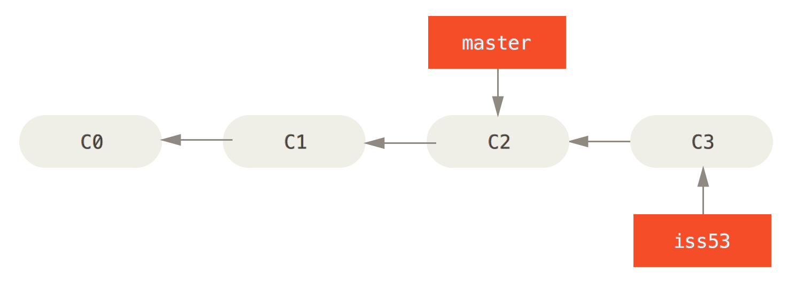
Branching – Topic branches

Slide 22
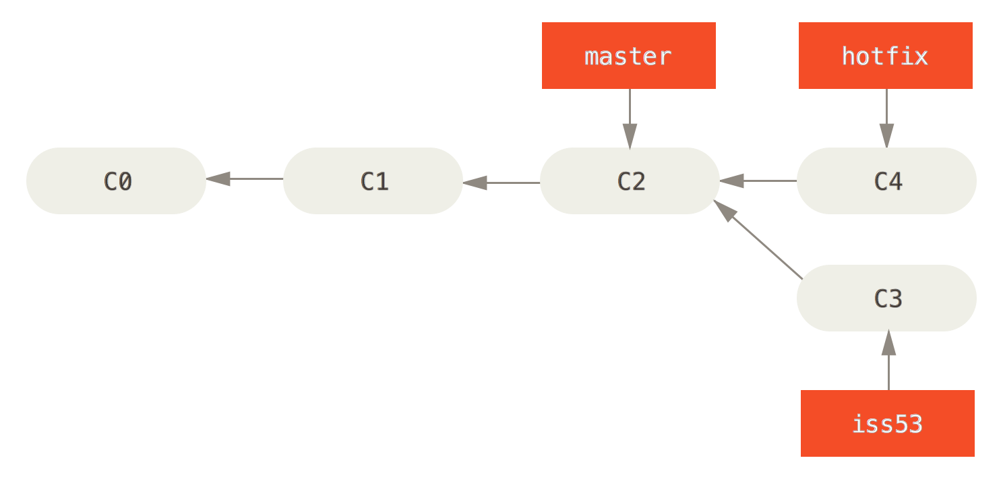
Branching – Topic branches

Slide 23
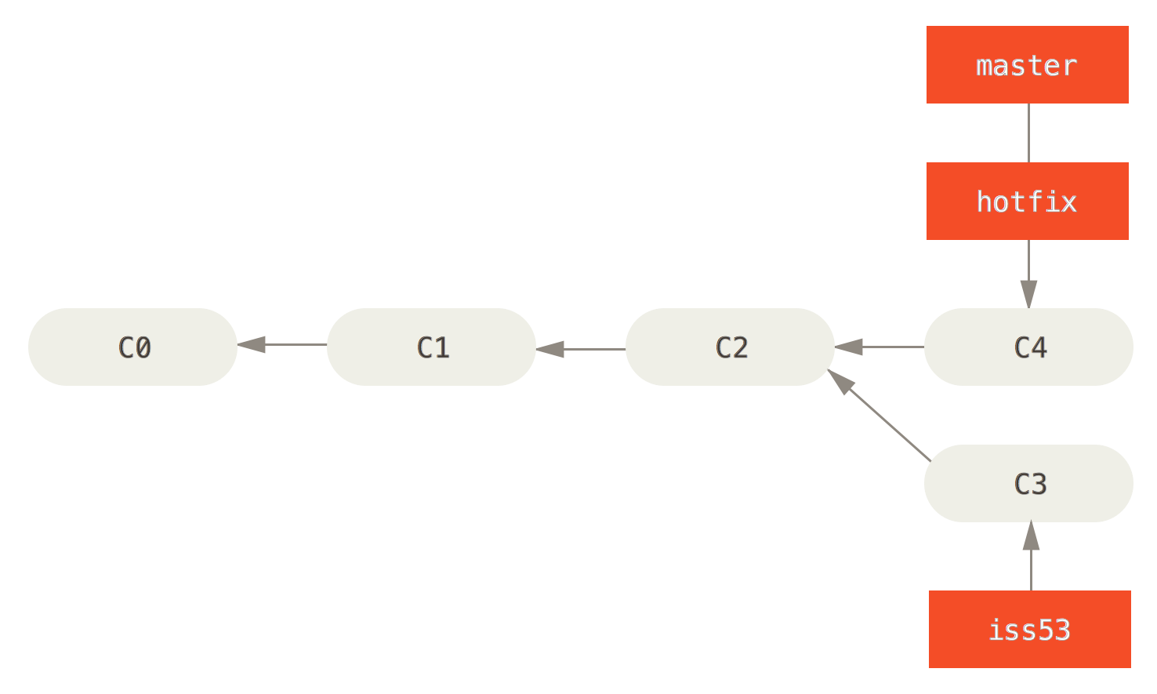
Merging – Fast-Forward Merge

Slide 24
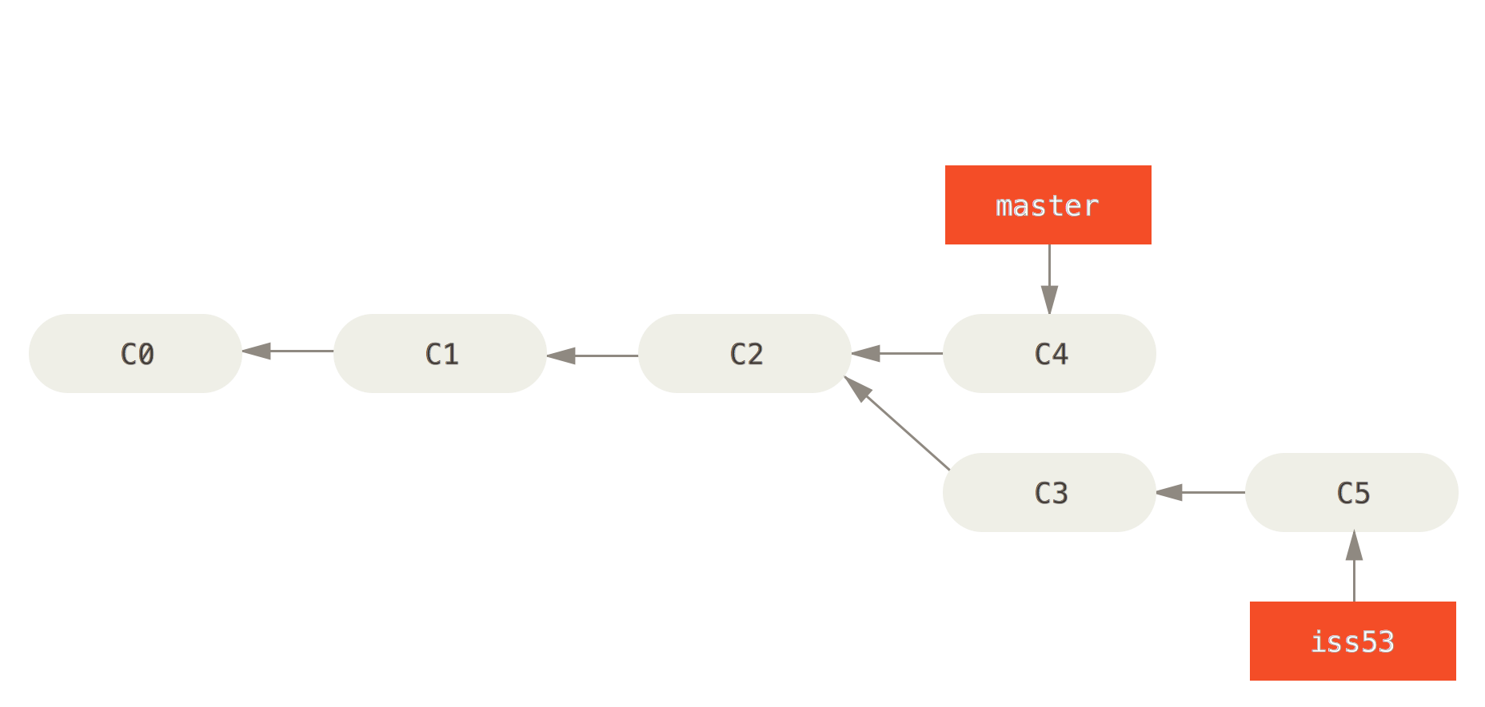
Merging – 3-way Merge

Slide 25
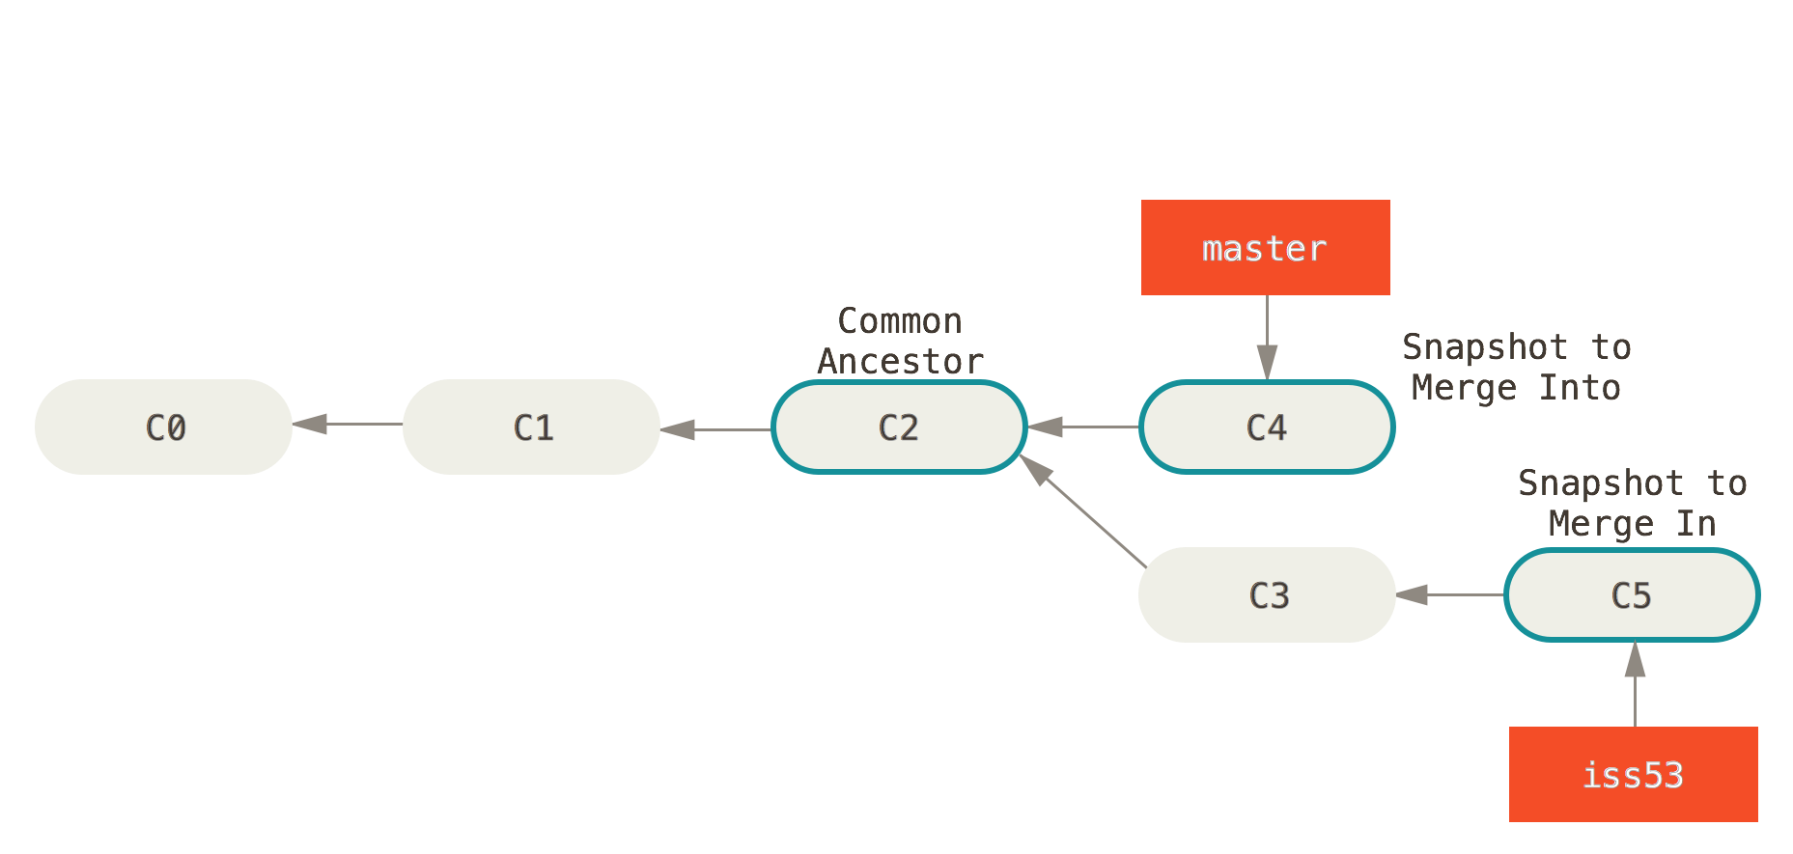
Merging – 3-way Merge

Slide 26
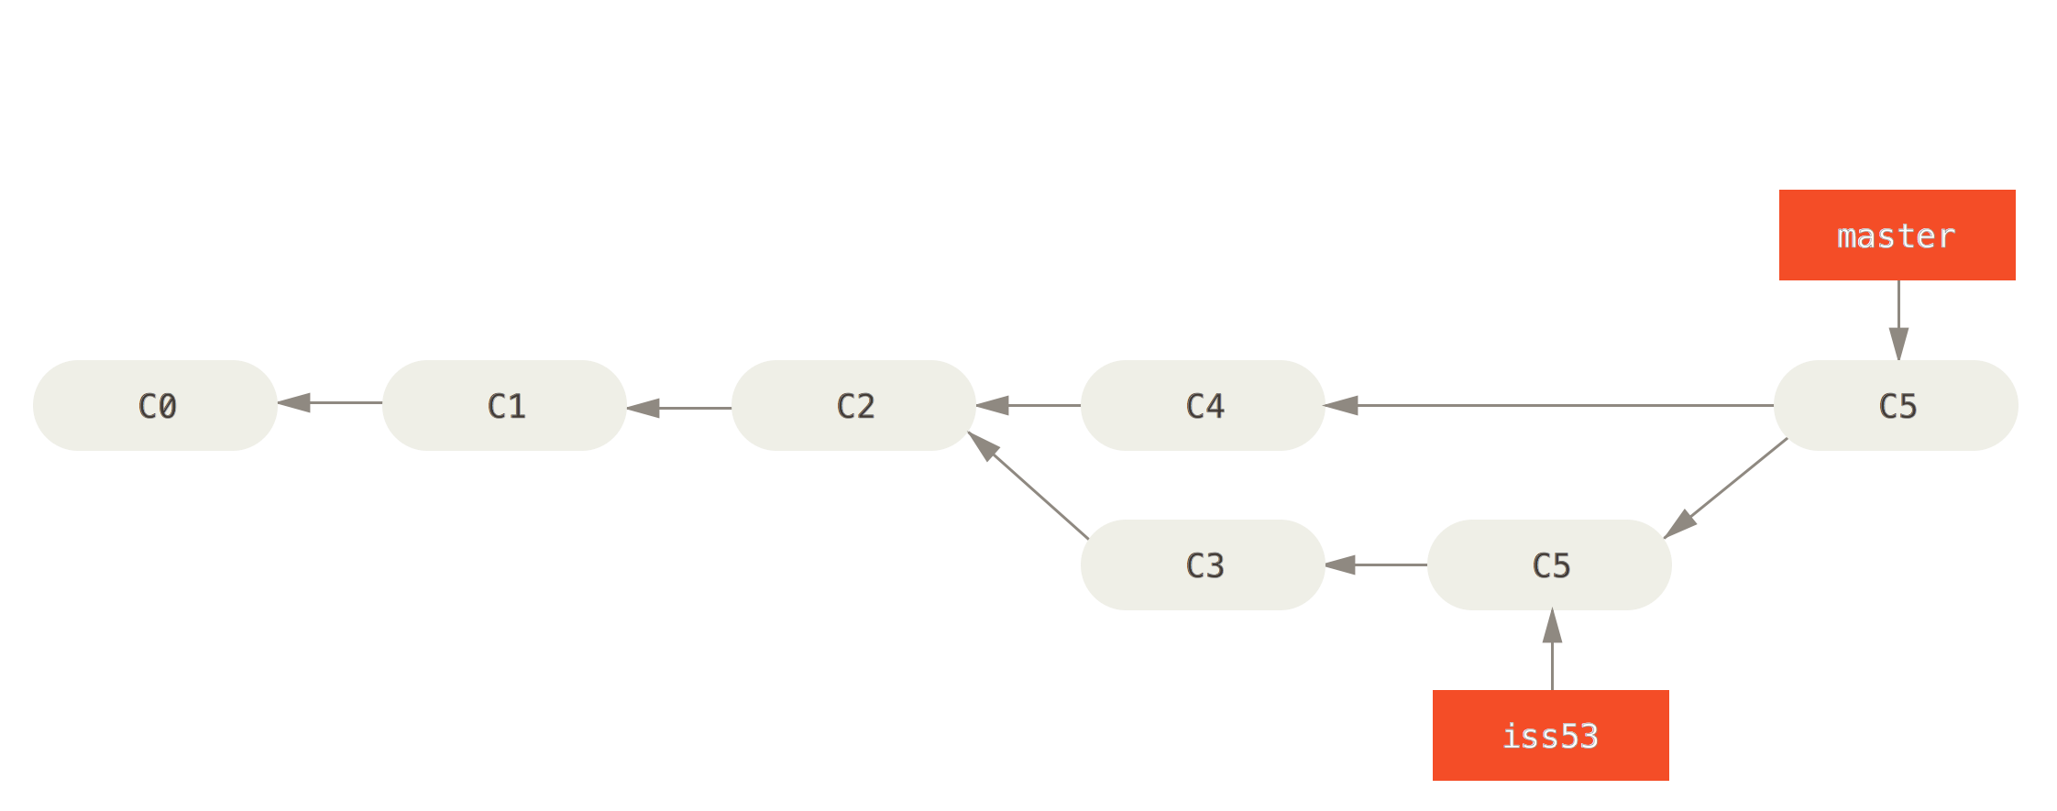
Merging – 3-way Merge

Slide 27
Branching
To create a branch:
$ git branch <name>
To list all branches:
$ git branch
To switch to a branch:
$ git checkout <name>
To merge a branch:
$ git checkout master
$ git merge <name>
Note: git log --graph can be useful for showing branches.
Note: These branches are in your local repo!

Slide 28
Branching Exercise 1
1. print 2 + 2 = 5 → commit (C1)
2. print Hello World! → commit (C2)
3. 2 + 2 != 5 → we have a bug!
  Create branch hotfix
  Fix bug → commit
  Checkout branch master
  Add a file and commit
  Merge with hotfix
  Delete branch hotfix

Slide 29
Branching Exercise 2
Create branch mulitply
  implement float mulitply(float, float) function
  print multiplication instead of sum
Create branch divide
  implement float divide(float, float) function
  print division instead of sum
Checkout master
  Merge with mulitply
  Merge with divide
What happens?

Slide 30
Merge Conflicts
<<<<<<< HEAD
  std::cout << "2 / 2 = " << divide(2f, 2f)
        std::cout << std::endl;
=======
  std::cout << "2 * 2 = " << multiply(2, 2);
        std::cout << std::endl;
>>>>>>> multiply
resolve
add
commit

Slide 31
Remote Repository
Immutable
Used for:
  Sharing your work
  Backups
Add new remote:
$ git remote add <remote_name> <url>
Cloning → default origin remote
Notes:
$ git remote -v
origin https://github.com/rea2000/santalist.git (fetch)
origin https://github.com/rea2000/santalist.git (push)

Slide 32
Pulling and Pushing
Add and Commit often
$ git add (…)
$ git commit (…)
Pull from remote repo
$ git pull (<repo> <branch>)
Push your changes to the remote repo
$ git push (<repo> <branch>)
Notes:
$ git remote -v
origin https://github.com/rea2000/santalist.git (fetch)
origin https://github.com/rea2000/santalist.git (push)

Slide 33
Pushing Branches
When you want to collaborate:
$ git push <remote> <branch>
$ git push <remote> <local_branch>:<remote_branch>
Deleting branch
$ git push <remote> :<remote_branch>
Nobody sees that → why?
Notes:
$ git remote -v
origin https://github.com/rea2000/santalist.git (fetch)
origin https://github.com/rea2000/santalist.git (push)

Slide 34
Fetching & Pulling
Fetch data from remote:
$ git fetch <remote> <branch>
Pull from remote:
$ git pull <remote> <branch>
To pull branches:
$ git checkout -b <local_branch> <remote>/<remote_branch>
$ git checkout --track <remote>/<branch>
Notes:
$ git remote -v
origin https://github.com/rea2000/santalist.git (fetch)
origin https://github.com/rea2000/santalist.git (push)

Slide 35
Tracking Branches
Local branch tracks remote branch
$ git branch --set-upstream-to <remote>/<branch>
$ git push <remote> <local_branch>:<remote_branch>
Show tracking branches:
$ git branch -vv
Pull/push know what to do
$ git push
$ git pull
Notes:
$ git remote -v
origin https://github.com/rea2000/santalist.git (fetch)
origin https://github.com/rea2000/santalist.git (push)

Slide 36
Remote Repo Exercise
Add a Remote Repository
Push to your Repo
Clone Repo to another dir
Add some changes, commit and push
Go back to the previous dir
Pull

Slide 37
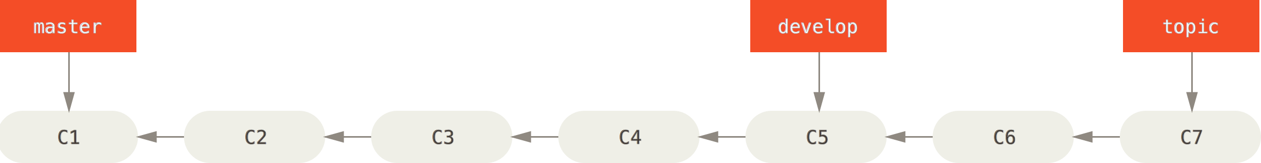
Branching Workflows – Pointers

Slide 38
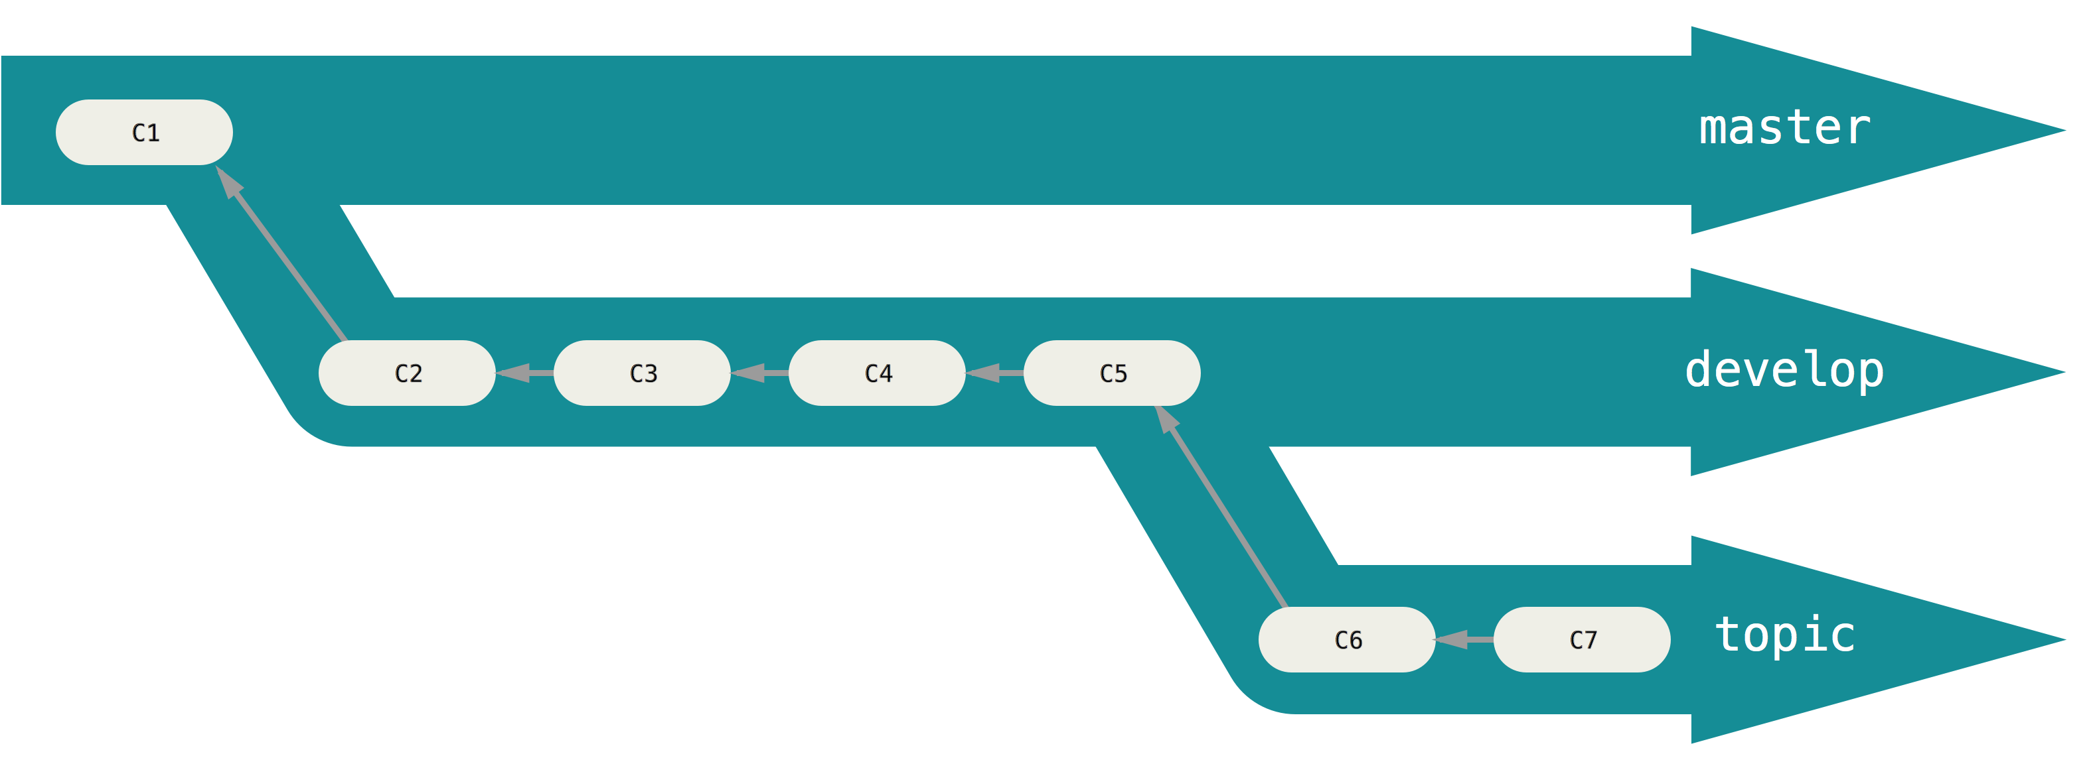
Branching Workflows – Work Silos

Slide 39
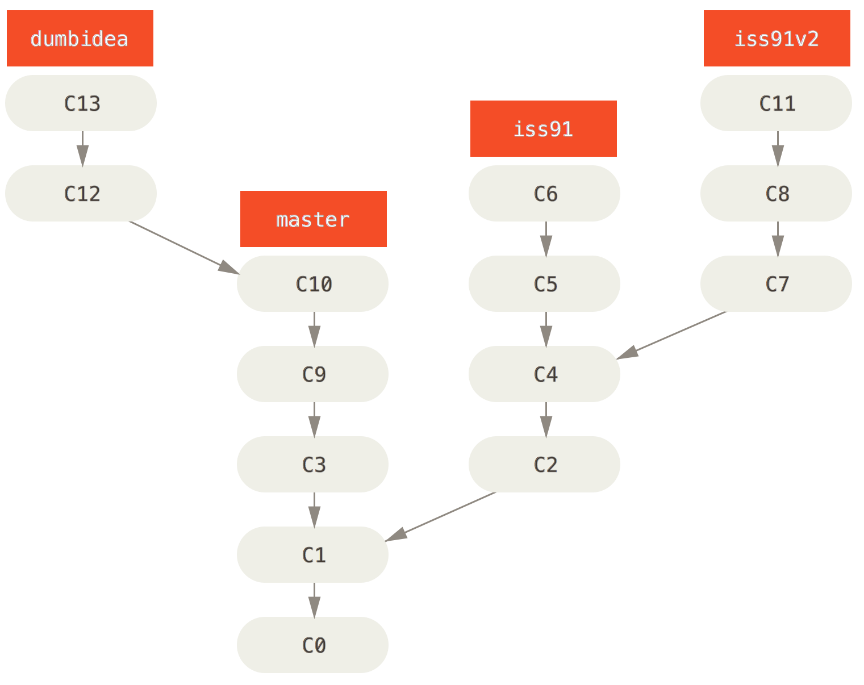
Branching Workflows – Topic Branches

Slide 40
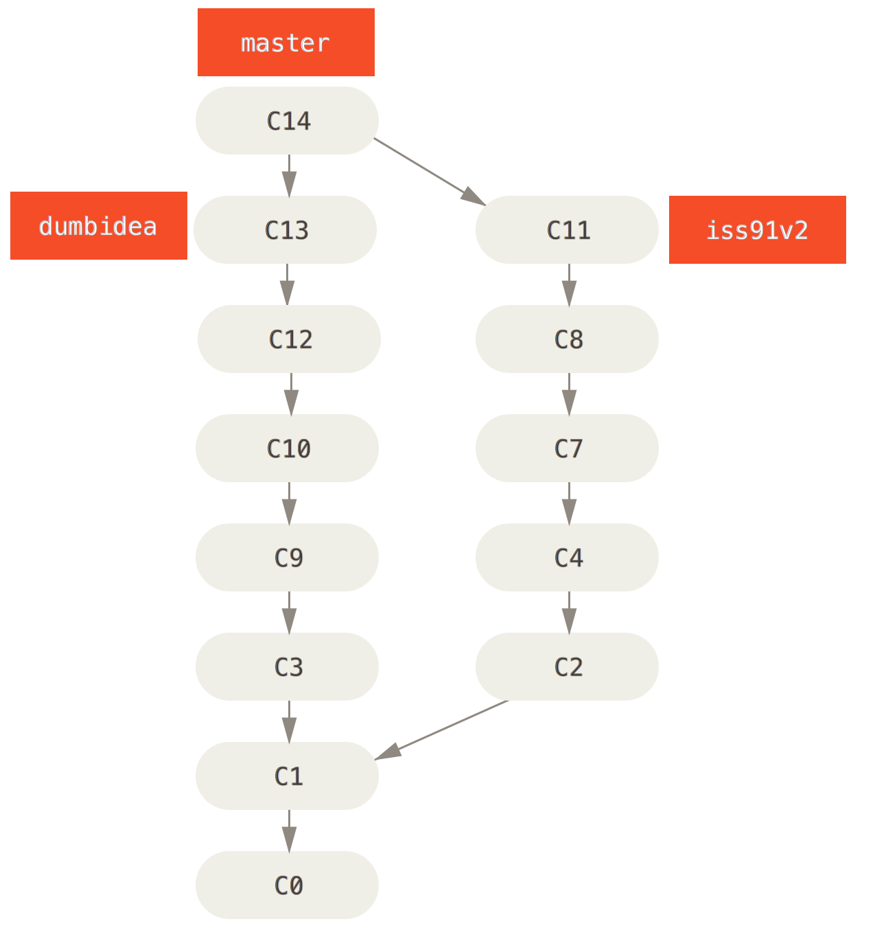
Branching Workflows – Topic Branches

Slide 41
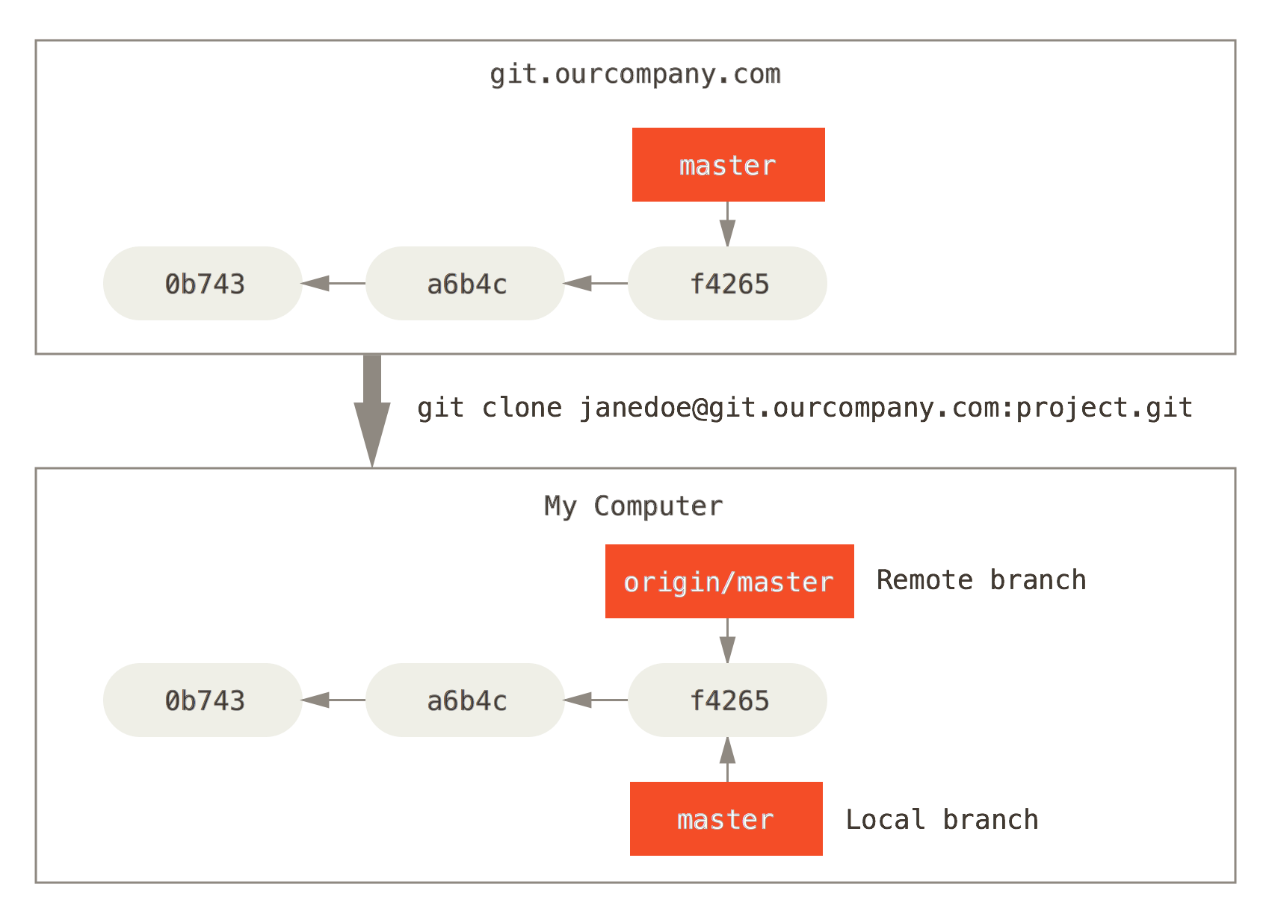
Remote Branches

Slide 42
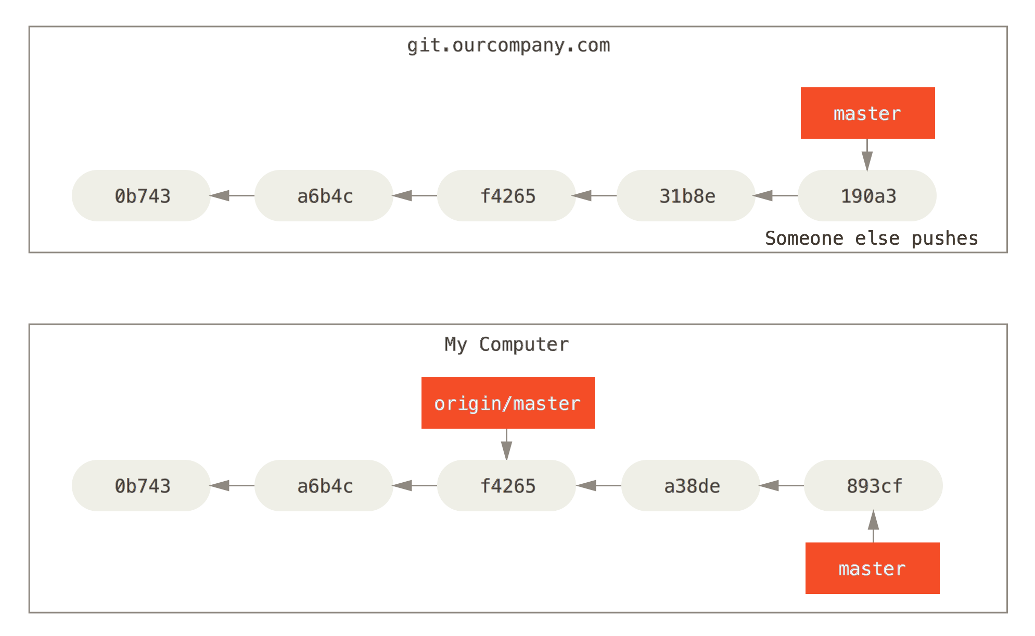
Remote Branches

Slide 43
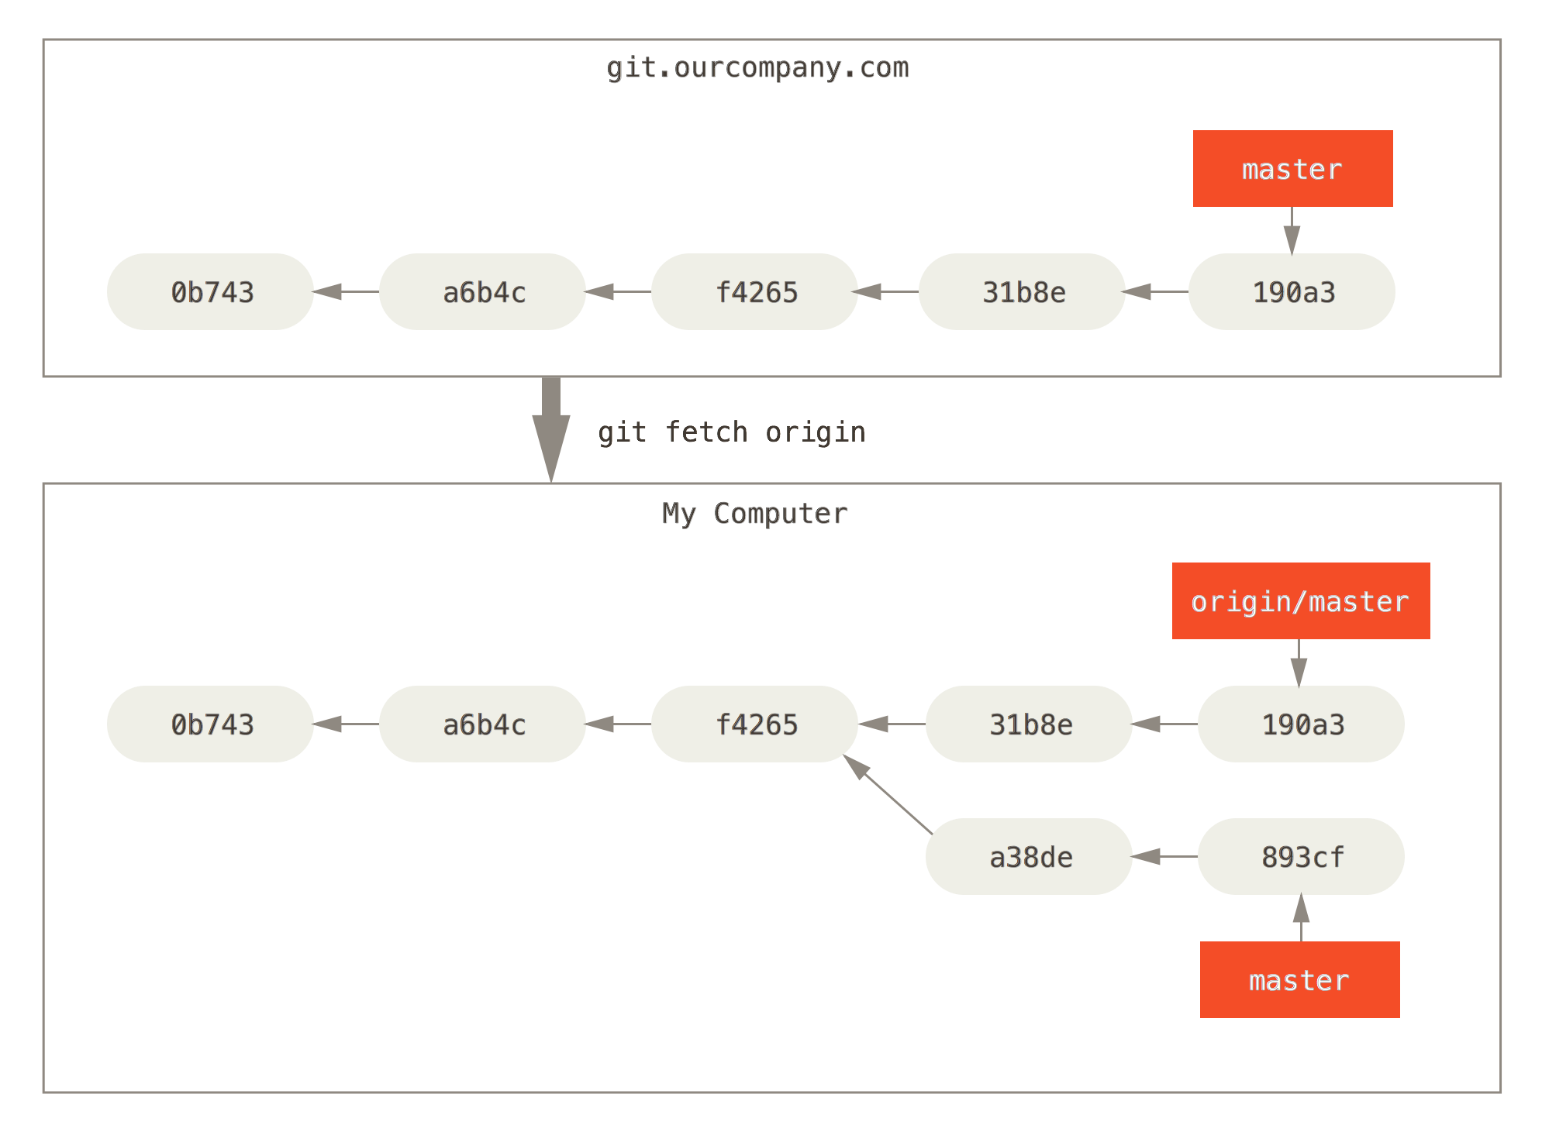
Remote Branches

Slide 44
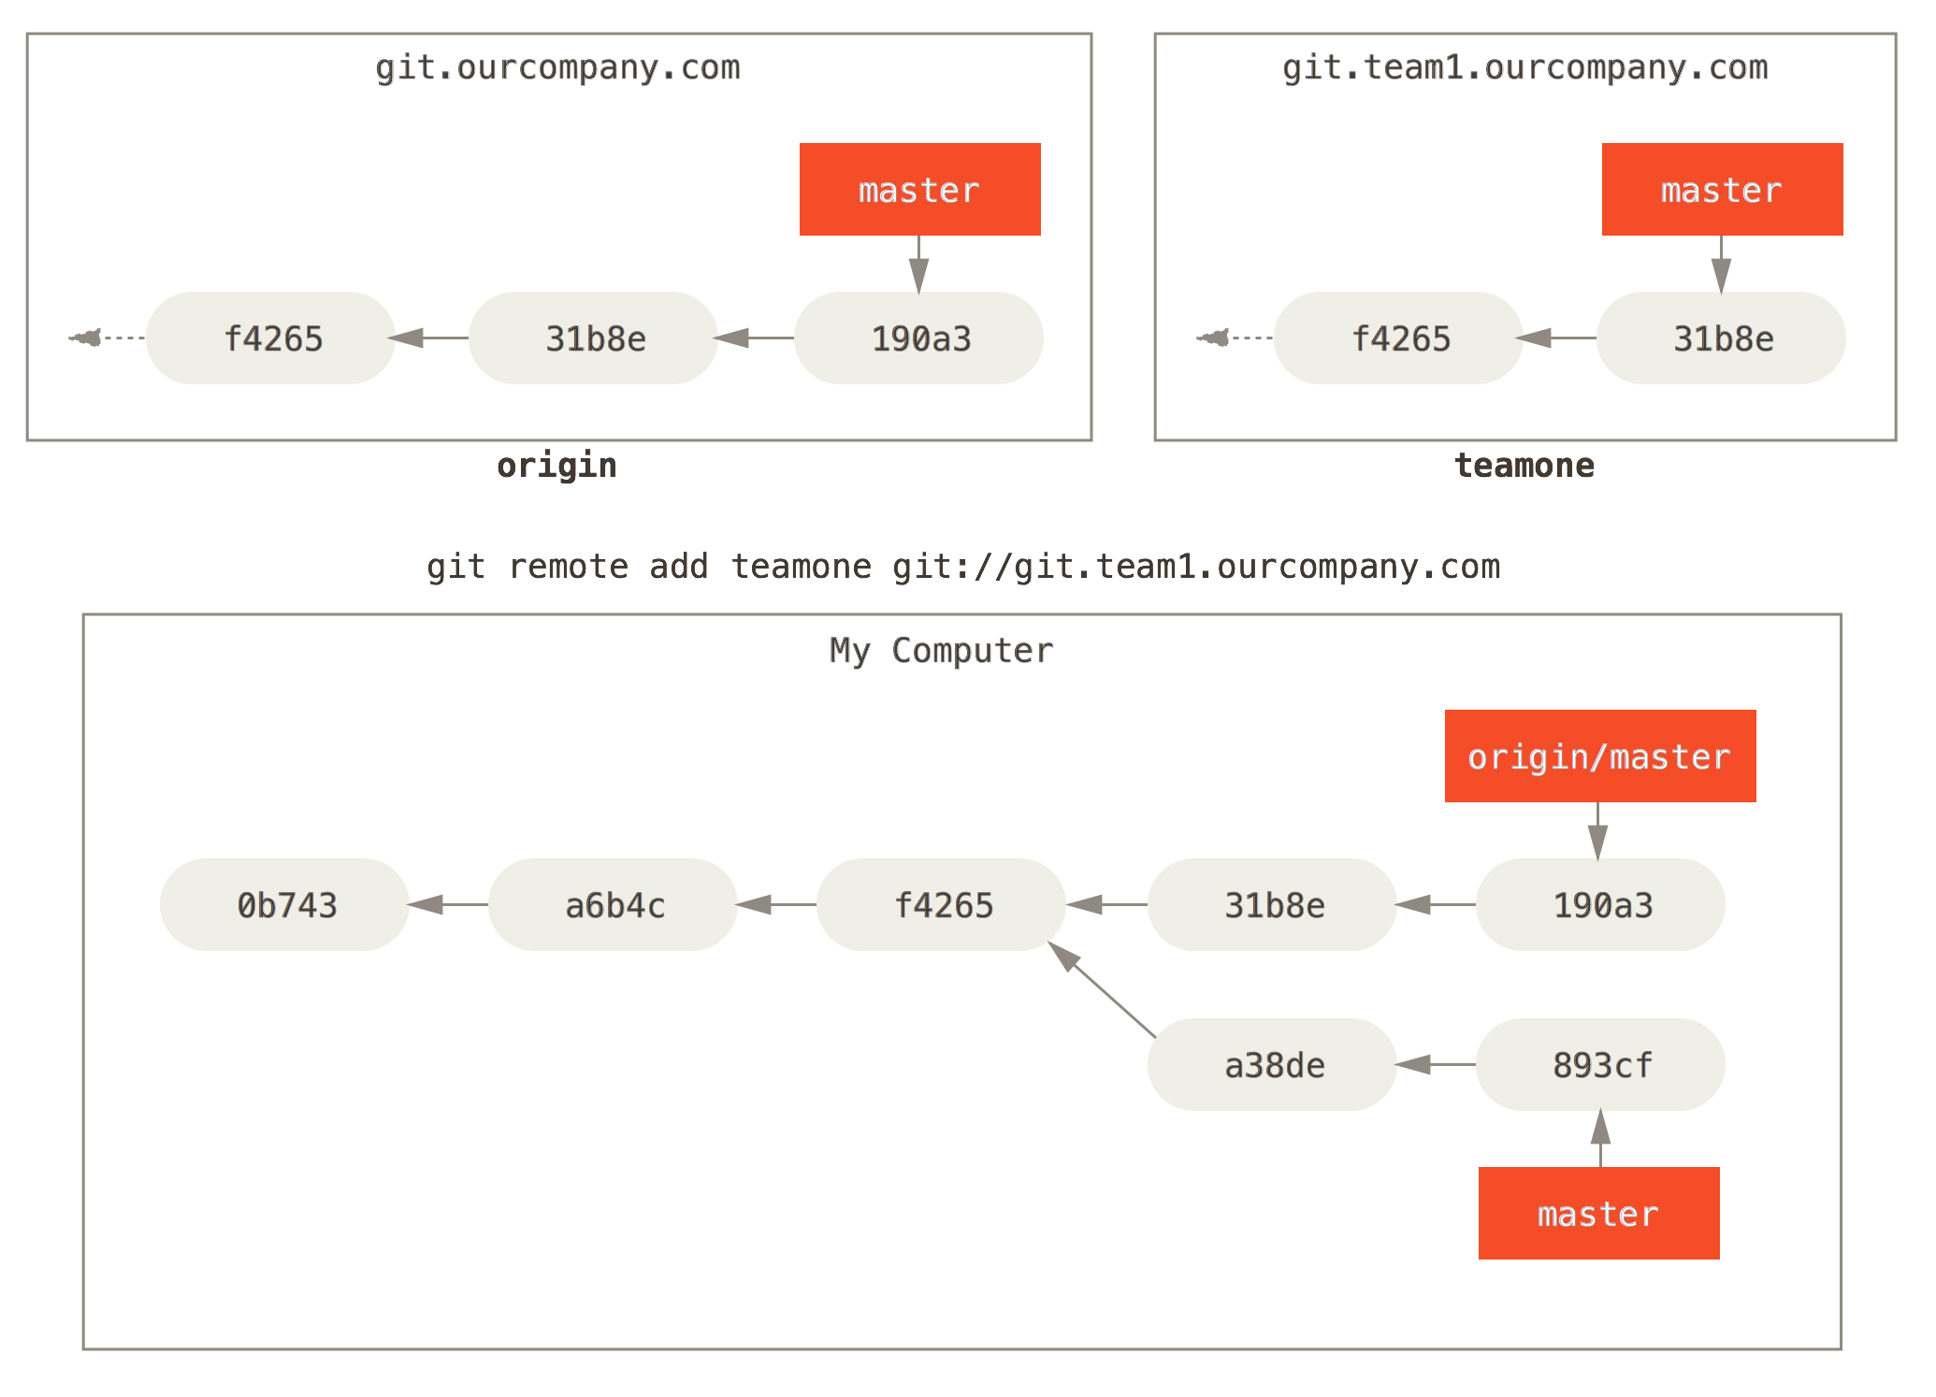
Multiple Remote Branches

Slide 45
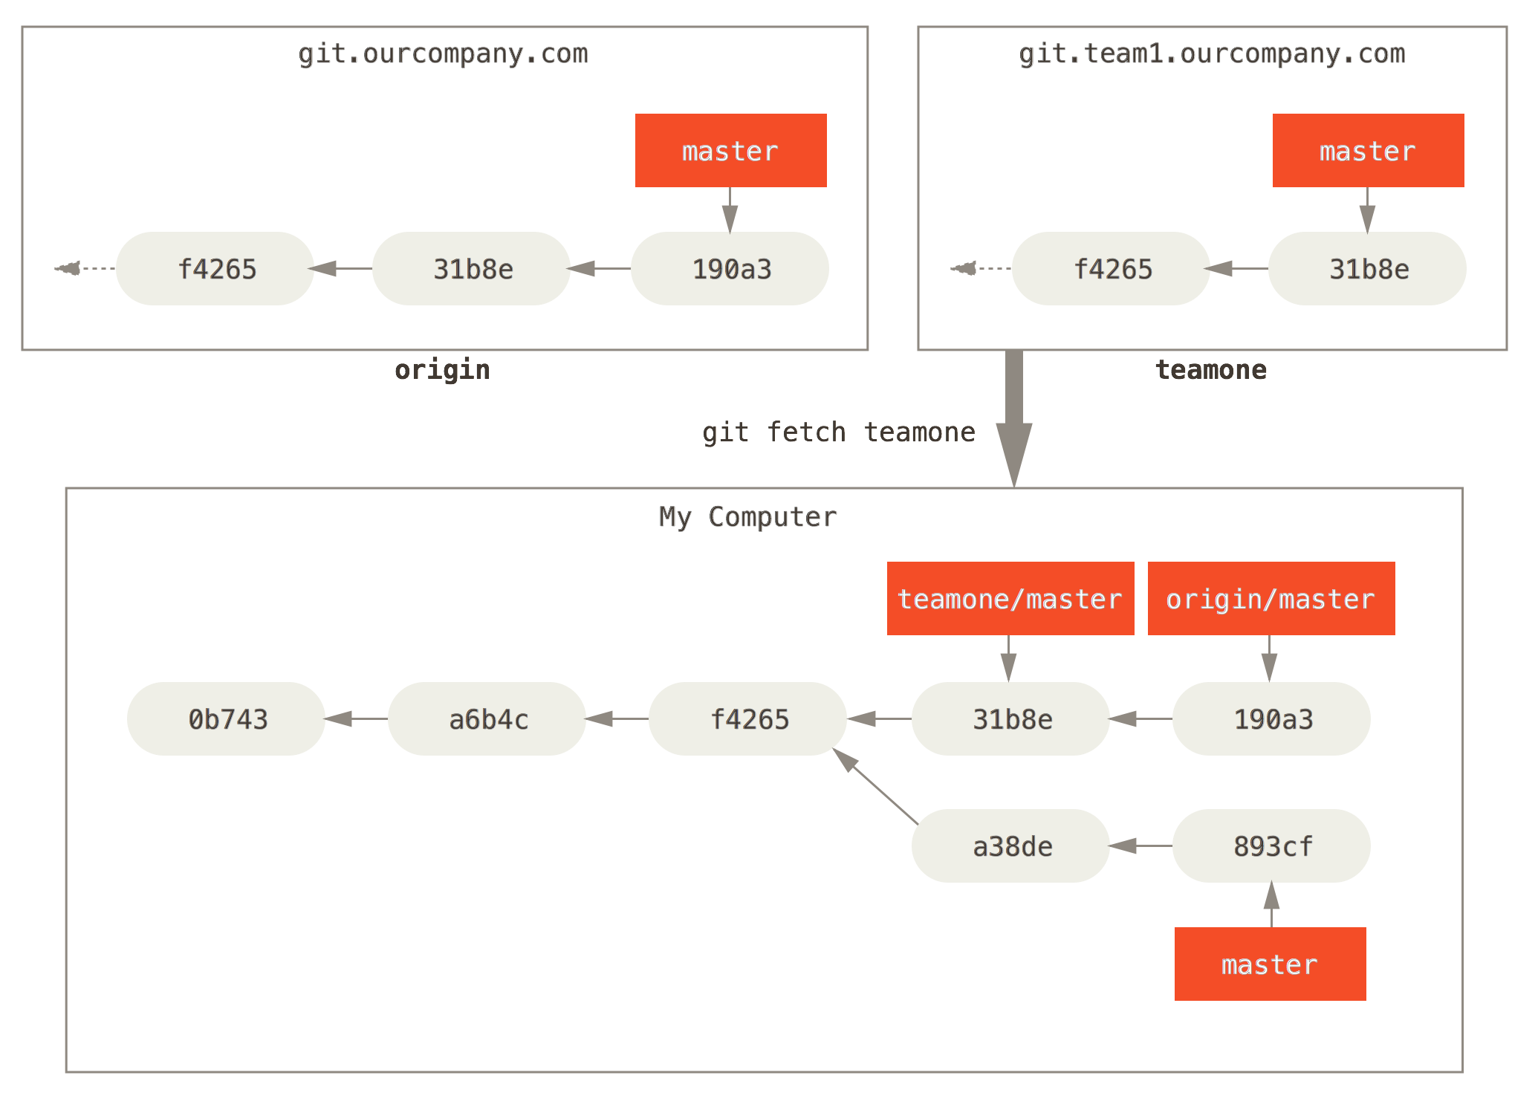
Multiple Remote Branches

Slide 46
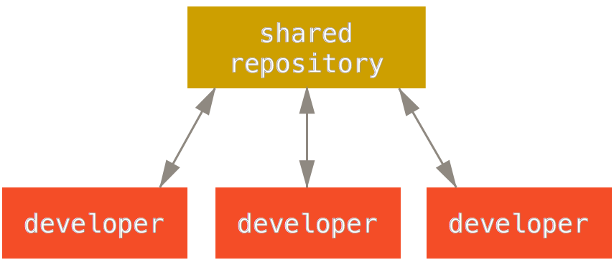
Branching Workflows - Centralized

Slide 47
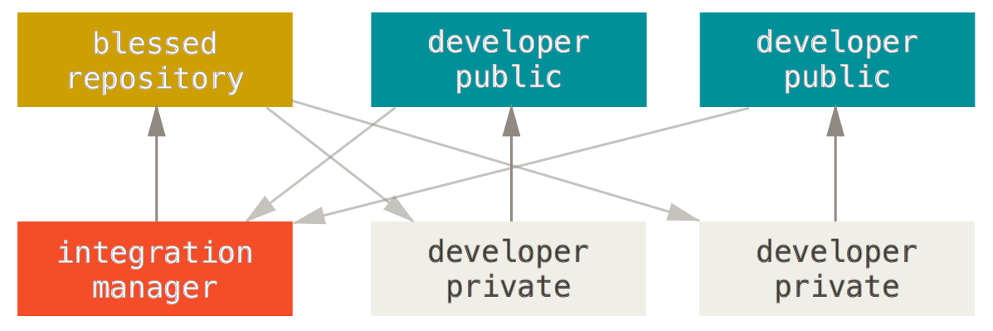
Branching Workflows – Pull Request

Slide 48
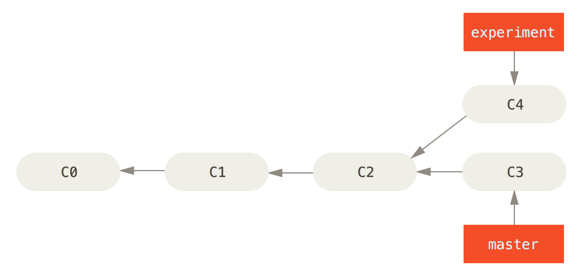
Rebasing

Slide 49
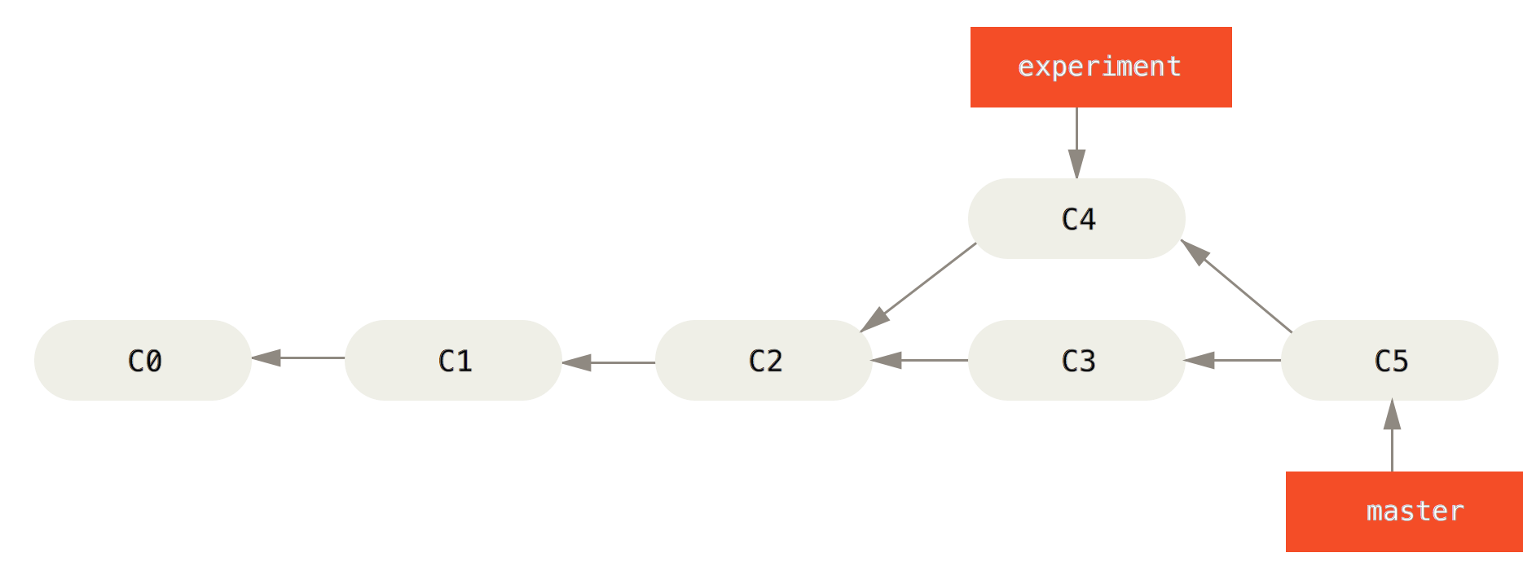
Rebasing

Slide 50
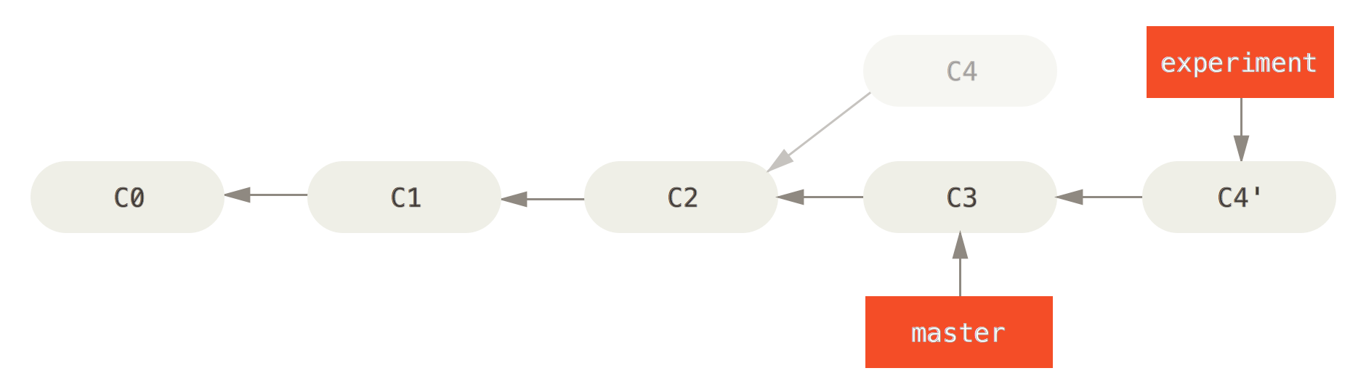
Rebasing

Slide 51
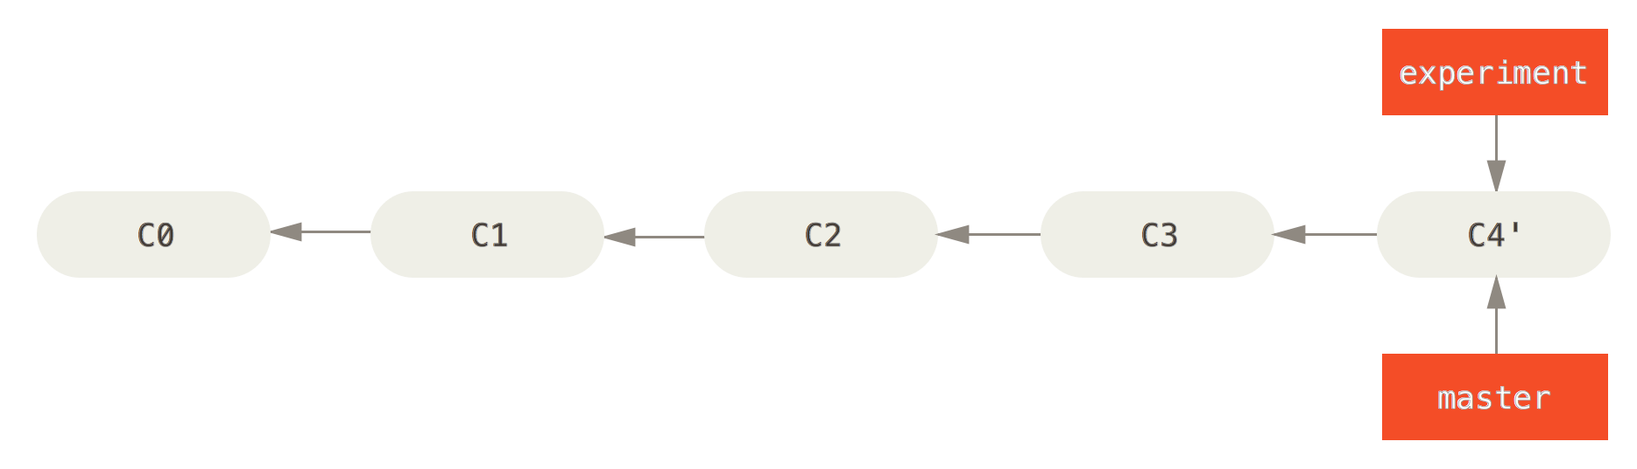
Rebasing

Slide 52
Rebasing
Rebase master on origin/master
$ git checkout master
$ git fetch
$ git rebase origin/master
Notes:
$ git remote -v
origin https://github.com/rea2000/santalist.git (fetch)
origin https://github.com/rea2000/santalist.git (push)

Slide 53
Further Topics
bisect
stash
cherry-pick
flow

Slide 54
Git commands
command | description
git clone url [dir] | copy a git repository
git add files | adds file contents to the staging area
git commit | records a snapshot of the staging area
git status | view the status of your files in the working directory and staging area
git diff | shows diff of what is staged and what is modified but unstaged
git help [command] | get help info about a particular command
git pull | fetch from a remote repo and try to merge into the current branch
git push | push your new branches and data to a remote repository
others: init, reset, branch, checkout, merge, log, tag

