Slide 1
Machine Learning for Applications in Computer Vision
Confidence Learning
Kareem Ahmeed, Benjamin Helgert, Adam Kosiorek
Supervisor:
Caner Hazirbas

Slide 2
Problem statement
Neural Nets learn to classify
Is it correct?
What if your life depends on it?
=> We need a confidence measurement!
Can a network tell us how confident it is?

Slide 3
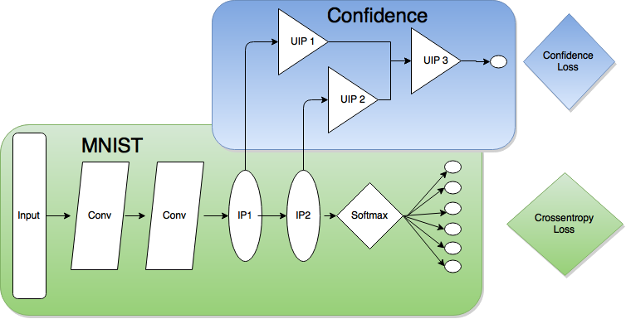
Setup
LeNet-5 for the MNIST dataset
  Simple, fast to train, highly effective
Additional layers for confidence prediction
Custom cost function
Notes:
Init: Gaussian mean = 0, std = 1
Sparse (autoencoder) Inner product with 15% sparsity
ReLU activations
Sigmoid on top to normalize results to [0, 1]

Slide 4
Milestones
Confidence Loss Layer
Balance Dataset
Model that works
Compare configurations
How to apply?
Online learning
Notes:
- We worked together on most of the things

Slide 5
Confidence Loss Function
Assumptions:
  Correct classification => high confidence
  False classification => low confidence
Loss
Gradient
where: c – predicted class
l – groundtruth class
p(c) – predicted confidence
Notes:
c=l p(c) loss grad
1 1 0 0
0 1 0.5 -1 | network learns
1 0 0.5 1 | here
0 0 0 0

Slide 6
Unbalanced dataset problem
LeNet does very well on MNIST
  Accuracy > 99%
Too few negative samples
Need to balance the train set
Solution: InfiMNIST
  Generate MNIST samples via geometric transformations
Drawback:
Need different datasets for each problem!
Notes:
Unbalanced data => confidence ~ 1 all the time
InfiniMNIST transforms train set => no new data!

Slide 7
Network splitting 1.0
Split classification and confidence networks
Finetune the latter
  Fully train LeNet on MNIST data
  Add Confidence layers
  Train Confidence layers on InfiMNIST

Slide 8
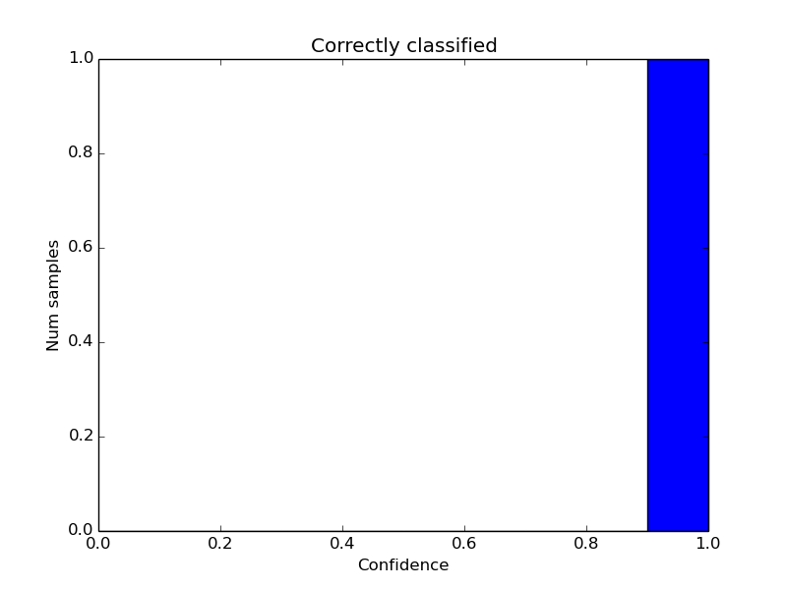
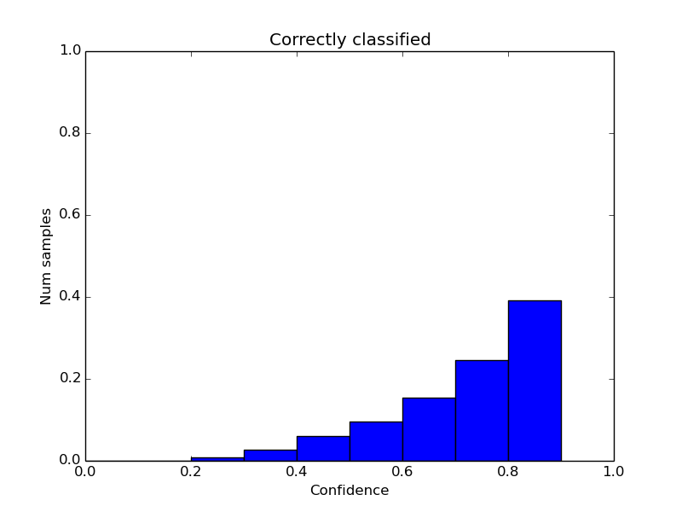
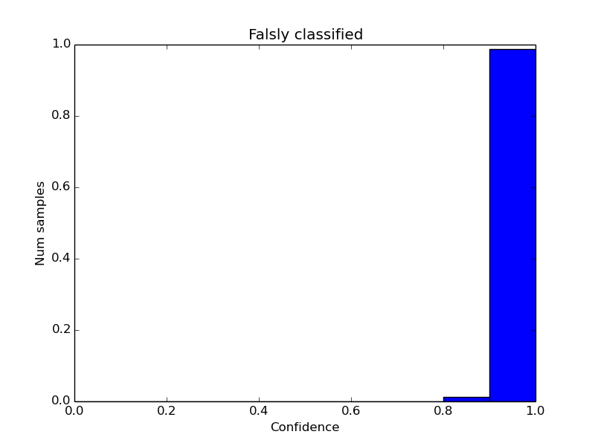
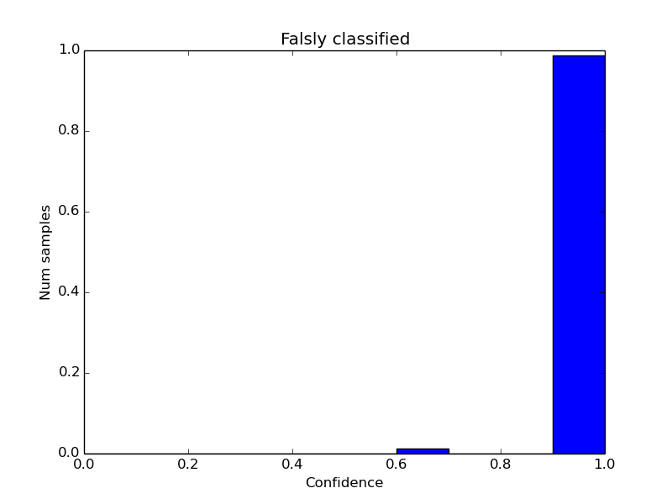
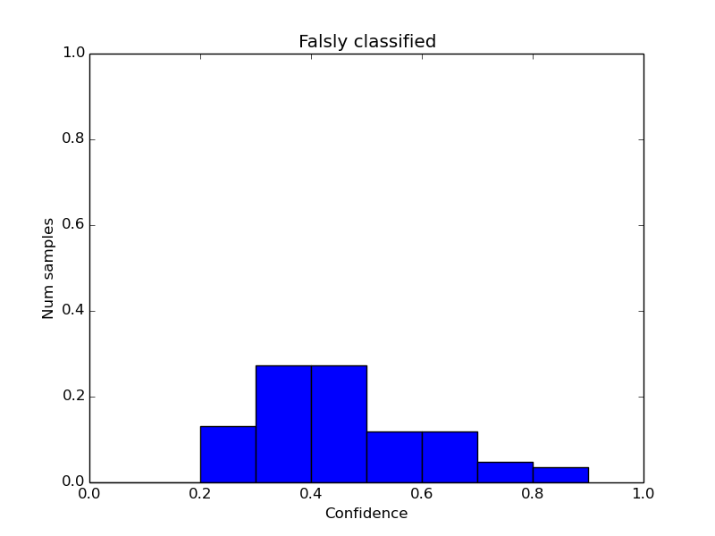
Network splitting 1.0 - Results
  3-layer confidence
  network
  2nd MAX
  Entropy

Slide 9
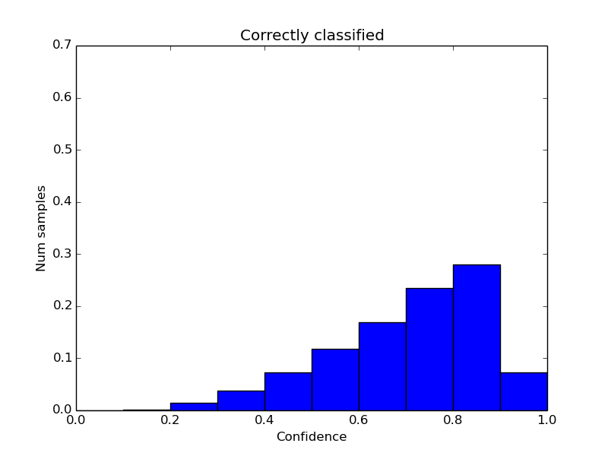
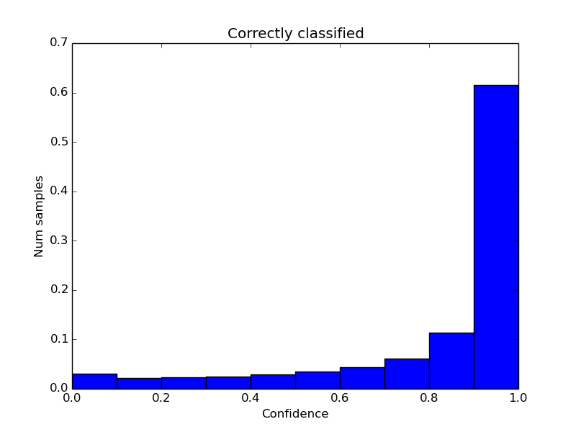
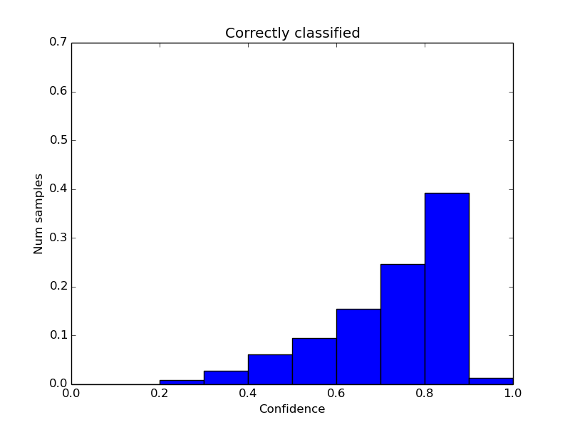
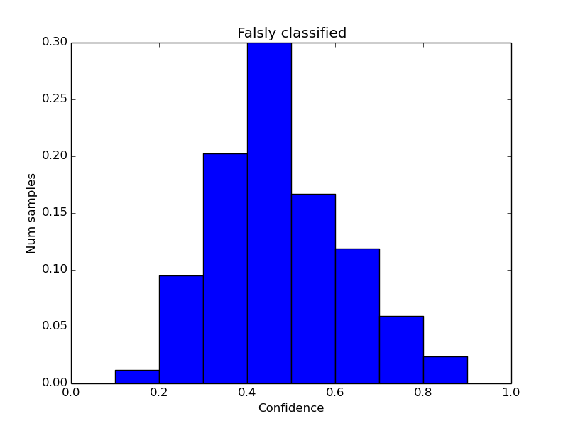
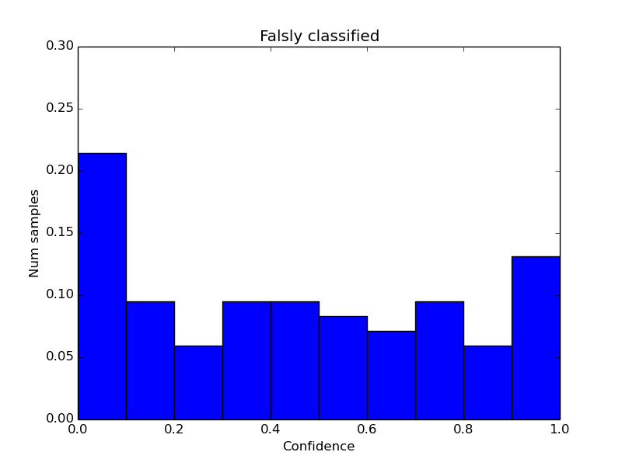
Is the problem really tough?
  1-layer
  2-layers
  3-layers
Notes:
Source: concatenated ip1 + ip2

Slide 10
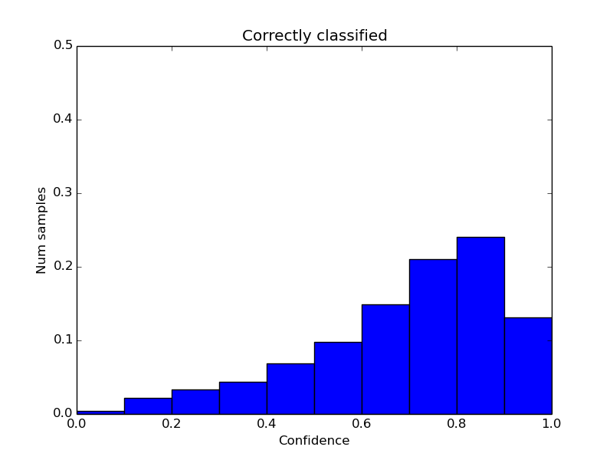
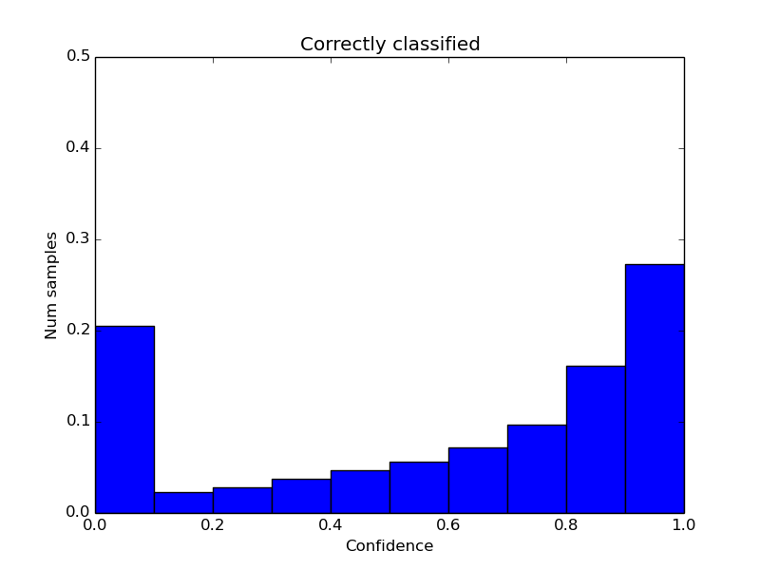
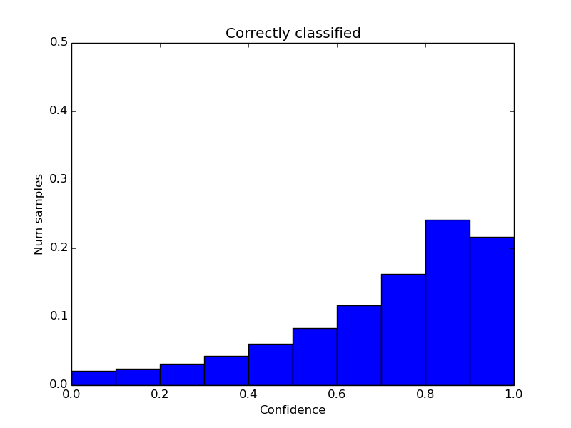
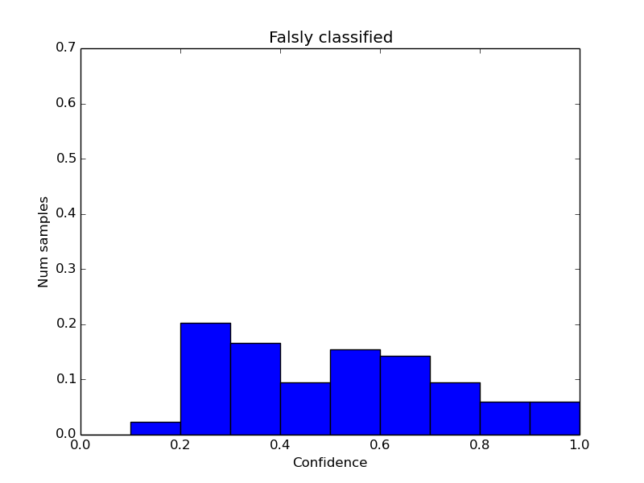
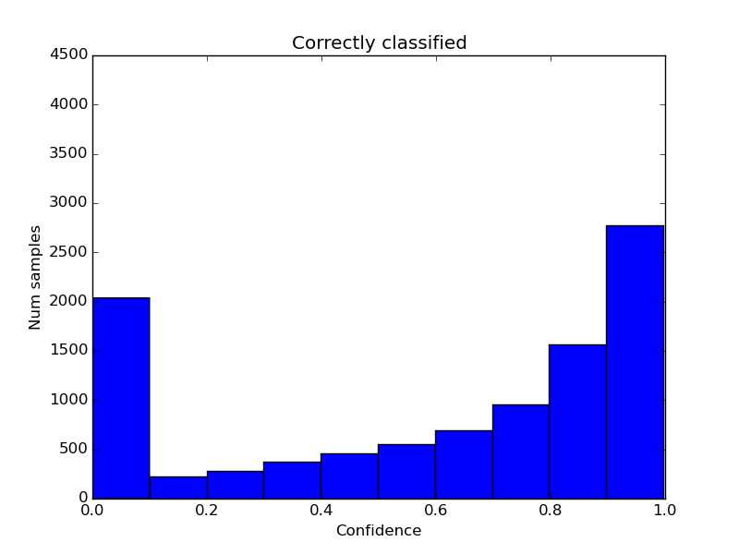
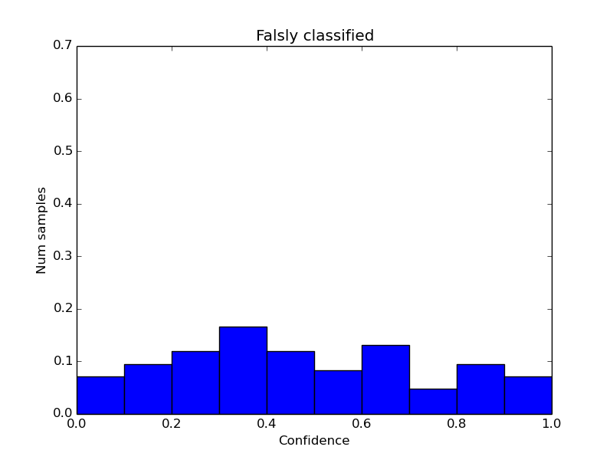
MNIST evolution
MNIST iterations
1k
2k
3k

Slide 11
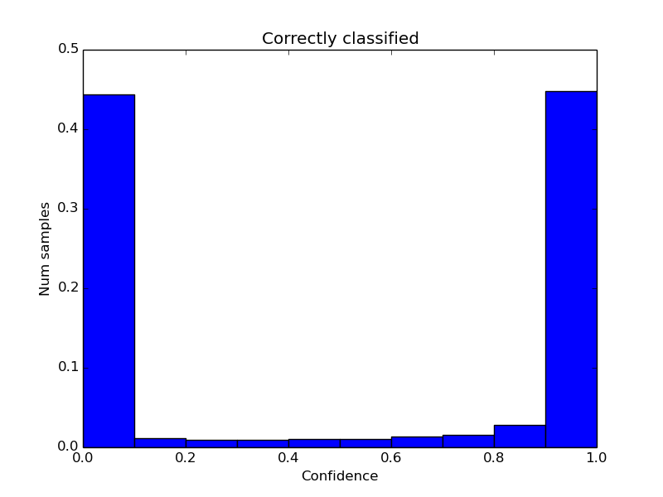
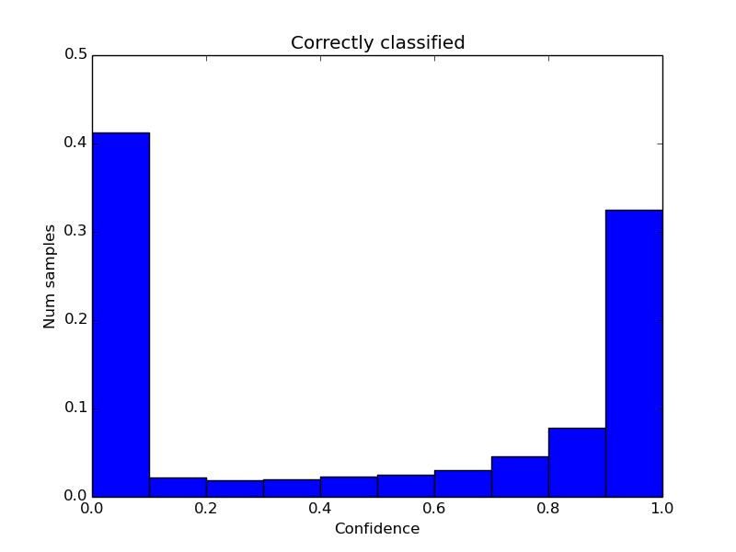
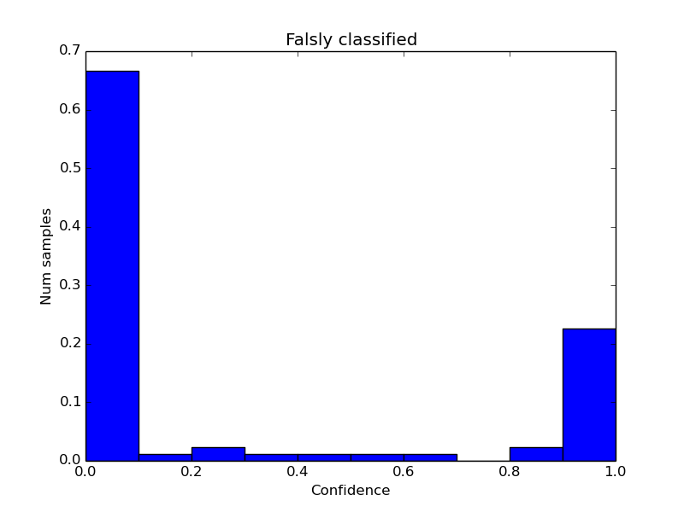
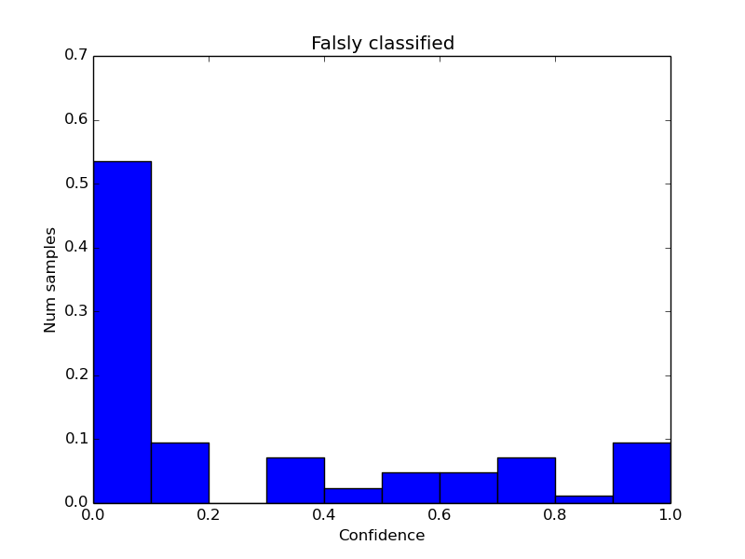
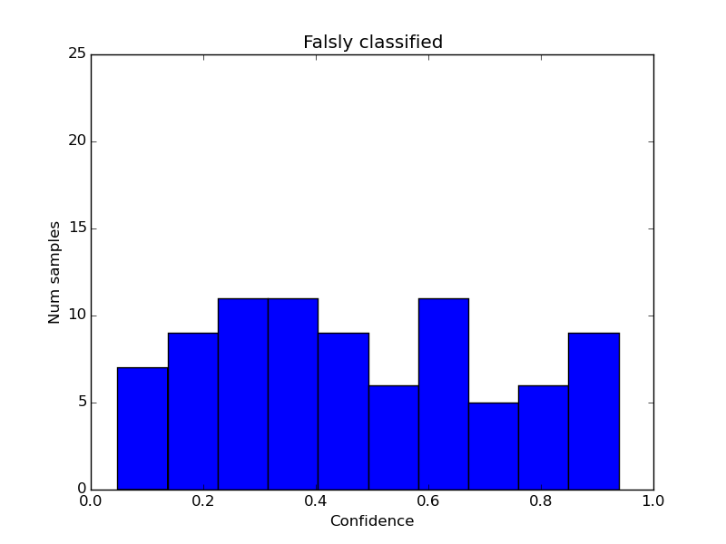
Confidence evolution
Confidence iterations
1k
1.5k
2k

Slide 12
Network splitting 2.0
Combine classification and confidence networks
Finetune the latter
  Train LeNet and Confidence on MNIST data
  Finetune Confidence on InfiMNIST
  Repeat

Slide 13
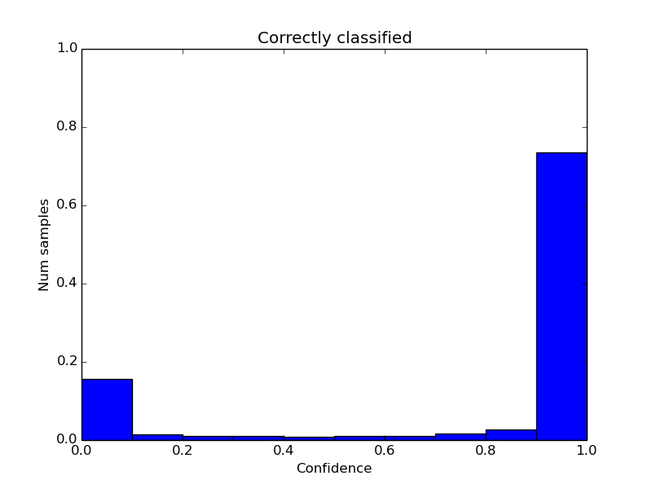
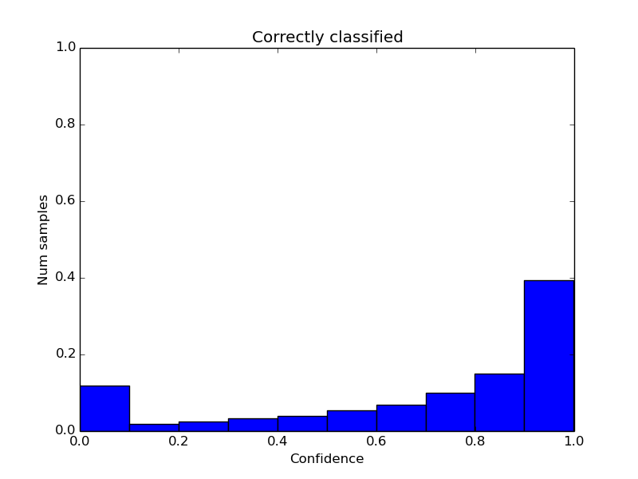
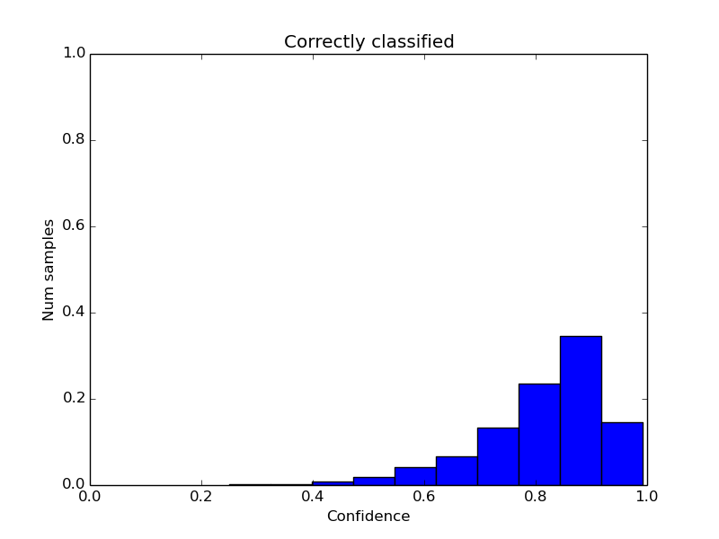
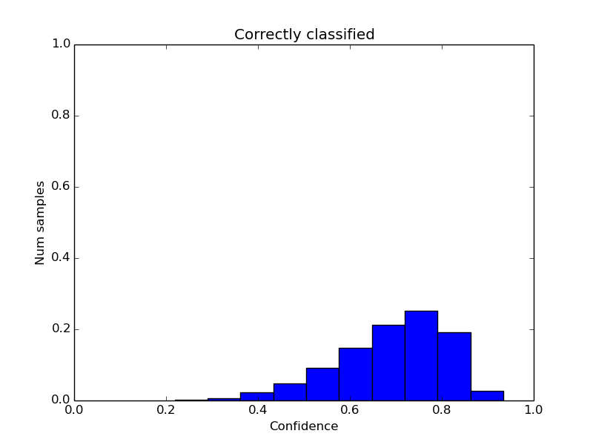
Network splitting 2.0 – Positive samples
2k
2k + FT
4k
4k + FT

Slide 14
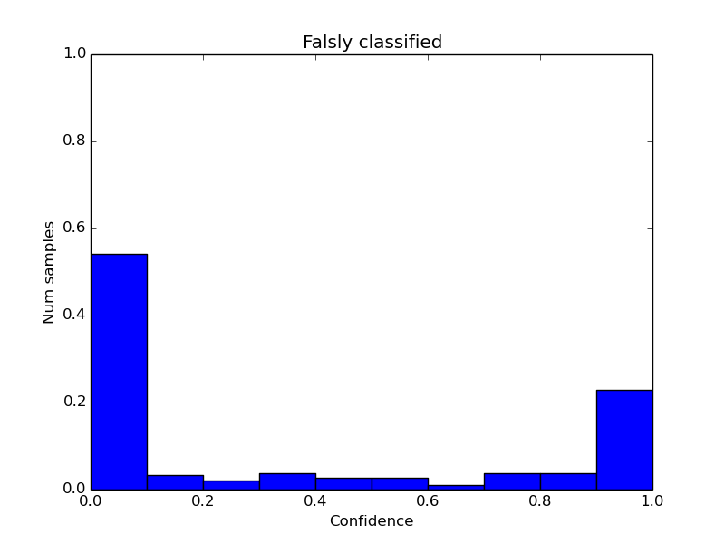
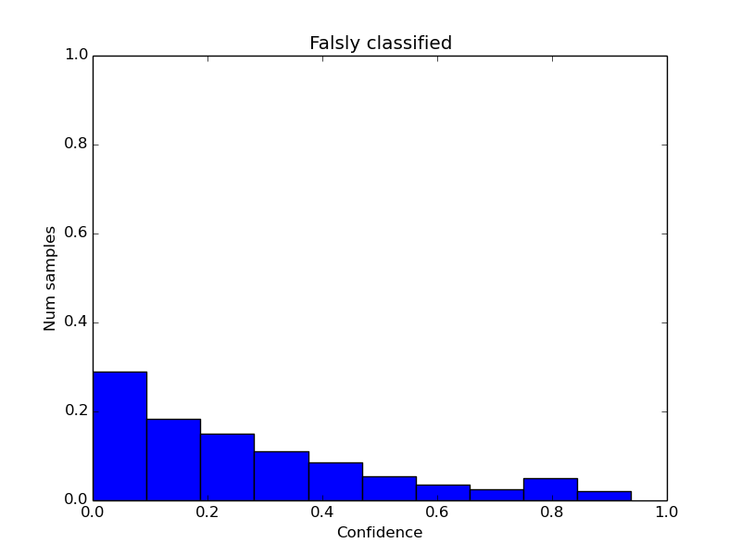
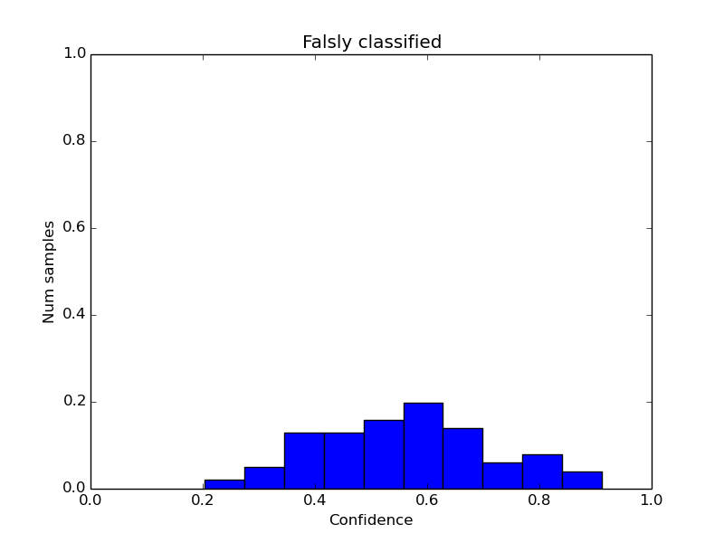
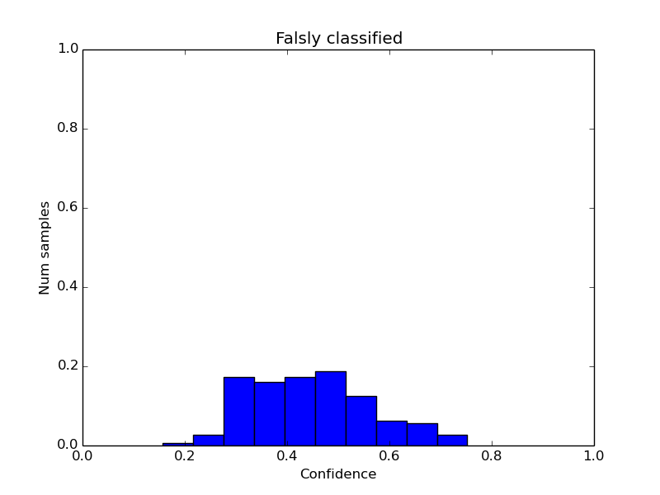
Network splitting 2.0 – Negative samples
2k
2k + FT
4k
4k + FT

Slide 15
Online Learning

Slide 16
Discussion
Is unified approach possible?
How to avoid the unbalaned dataset problem?
Do we know our goal?

