Slide 1

Modeling Crypto Time Series
A Machine Learning Approach to a Regression Problem
D. Giordano | D. Rasner | A. Redey

Slide 2
Our Goal
Develop prediction algorithms for bitcoin prices, based on a time series dataset, consisting of financial, blockchain-related, technical analysis and sentiment daily signals.

Slide 3

the way we want to go: Machine Learning

Slide 4
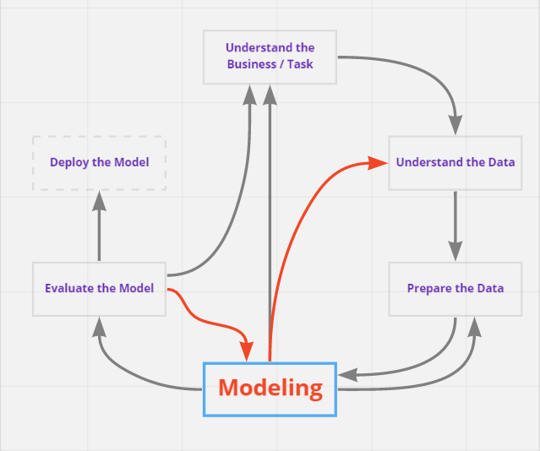
Problem Statement

Slide 5

Approach
… and a machine learning problem
Ah, OK. I get it… So it is a statistical problem…
… and a multiple regression problem
… and a time series problem
… and a neural network problem
… and a Deep Learning problem

Slide 6
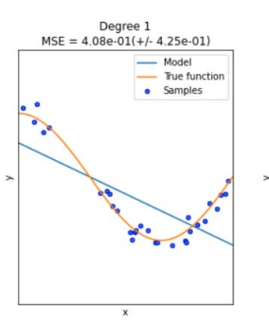

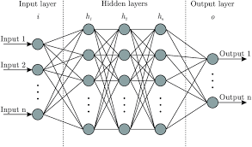
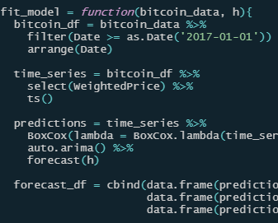
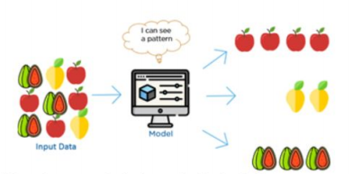
Challenge

Slide 7
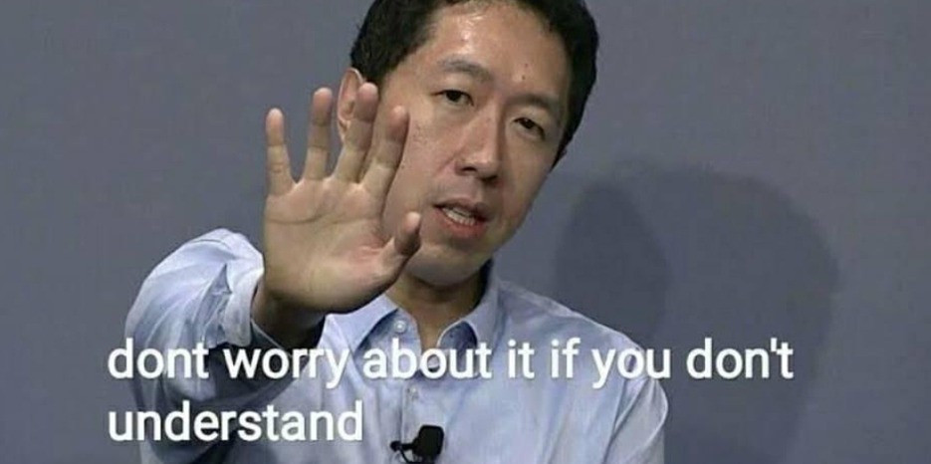
Our initial thoughts…

Slide 8
Process
STATISTICAL TESTS
EVALUATION
Test the assumptions of multiple linear regression and the requirements for modeling
Based on the selected and tuned models, make a prediction on the test set, measure the performance.
FEATURE SELECTION
BUILDING & TUNING MODELS
Check the correlation between predictors and their justification to be included
Split the dataset into training and validation sets, train your models, perform cross-validation, tune the hyperparamers and select the best performing estimators

Slide 9


Statistics

Slide 10
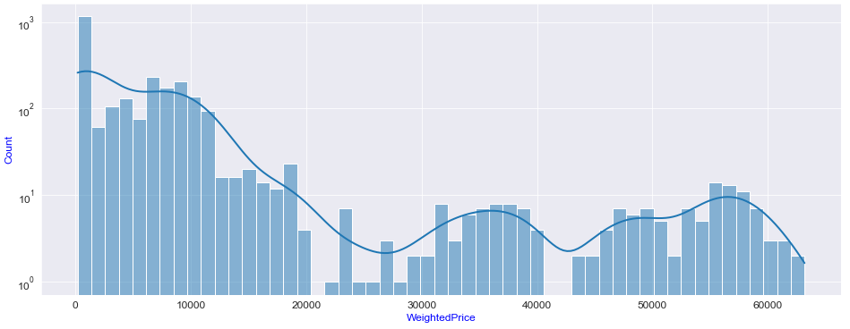
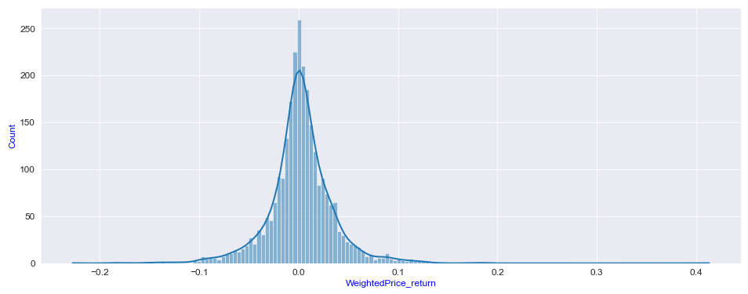
Statistics
Distribution
Original
Transformed

Slide 11
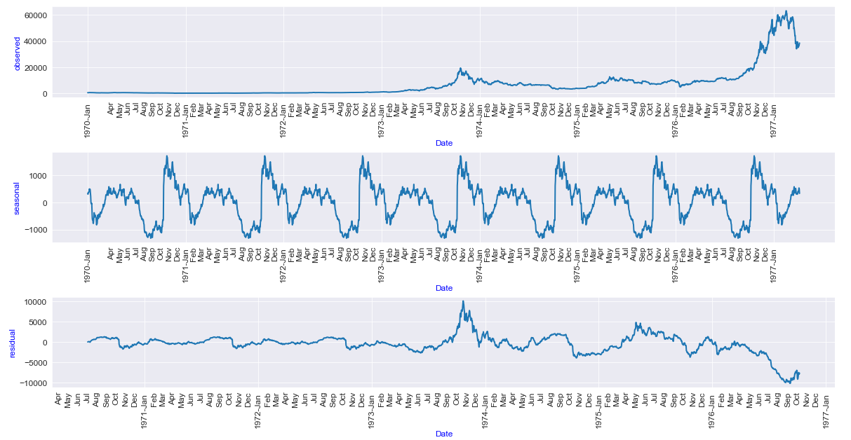
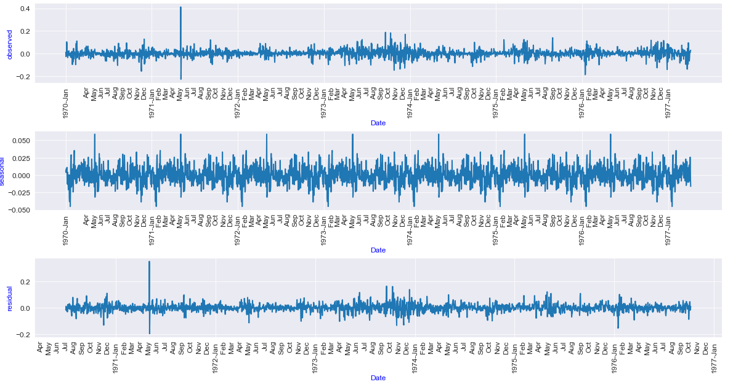


Statistics
Stationarity
Decomposition Original
Decomposition Transformed

Slide 12
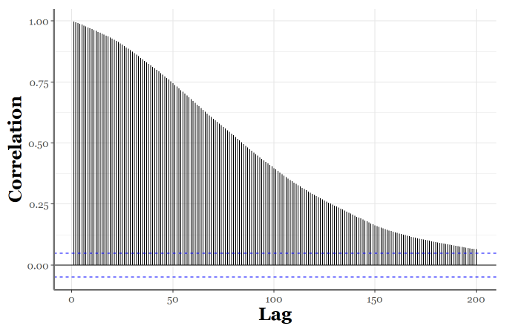
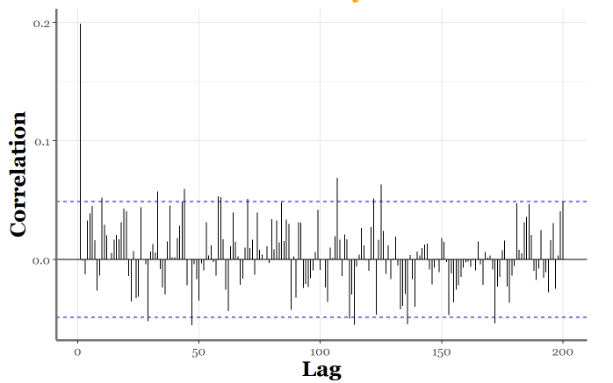
Statistics
Autocorrelation
ACF Original
ACF Transformed

Slide 13
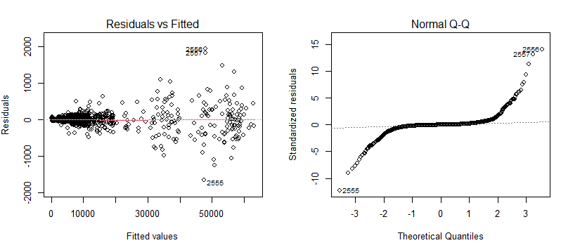
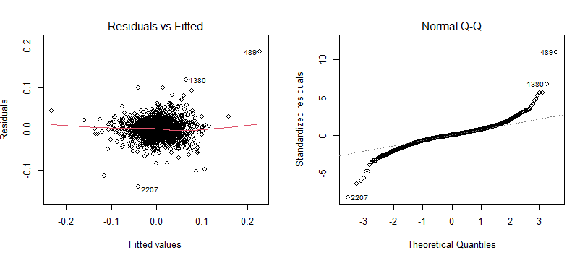
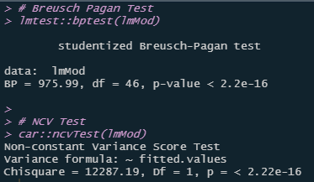
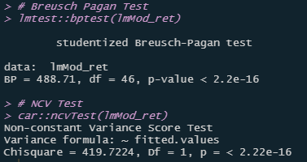
Statistics
Heteroskedasticity

Slide 14

OK, but …

Slide 15
Outcome of Statistical Tests
Test | Outcome | Meaning
ADF Stationarity test | Daily returns stationary | Linear Models can be used
ACF Plot (Autocorrelation) | Autocorrelation | Possible use case for ARIMA*
Breusch-Pagan test (Homoskedasticity) | Heteroskedasticity present: Errors vary | Possible use case for volatility clustering (GARCH)*
* ARIMA and GARCH models were not in scope of the project, although we experimented them in R a possible forecast with ARIMA in Appendix

Slide 16
Feature Selection

Slide 17
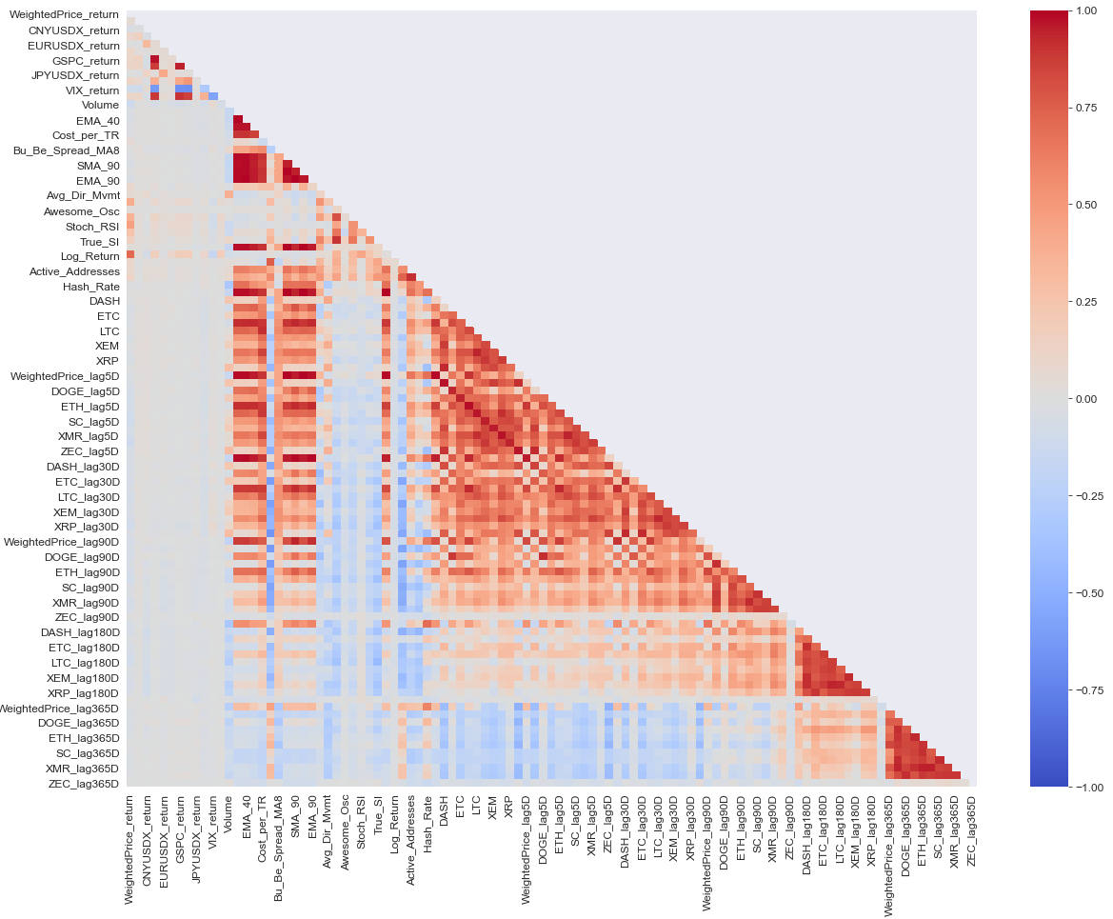
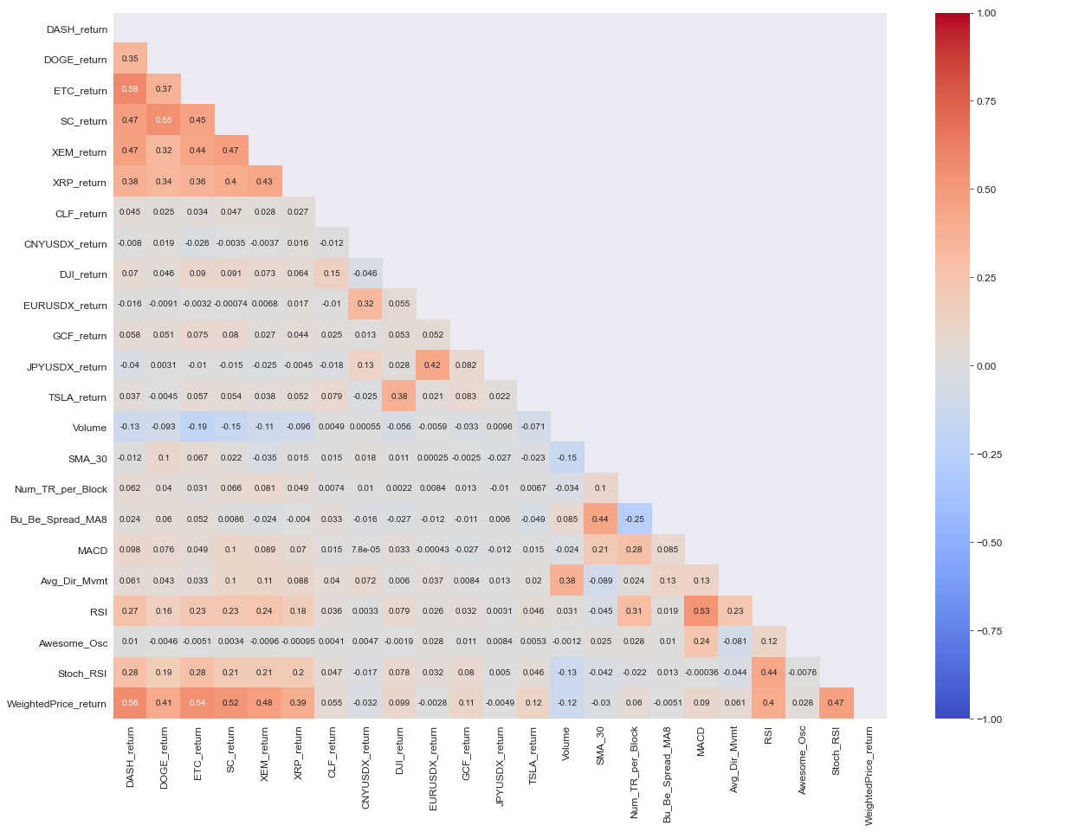
Focus: Correlation Matrix

Slide 18
Model Building & Tuning

Slide 19
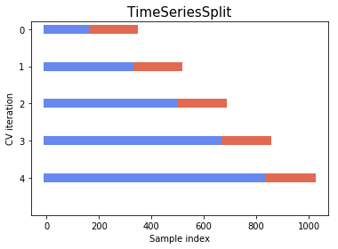
Focus: Cross-Validation & Grid Search
Train/Test Split not shuffled
Test Data saved for prediction
Training – > Cross Validation with base models
Extract parameters, define grid around it –> perform grid search with cross validation
Select best estimators
Save model artifacts
Load models and perform prediction on the separated test dataset

Slide 20
Evaluation

Slide 21
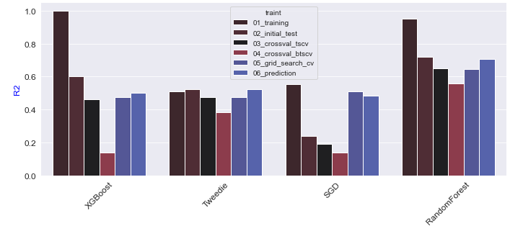
Metrics: Model Fit

Slide 22
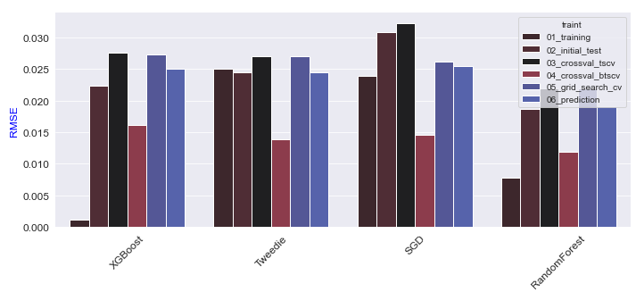
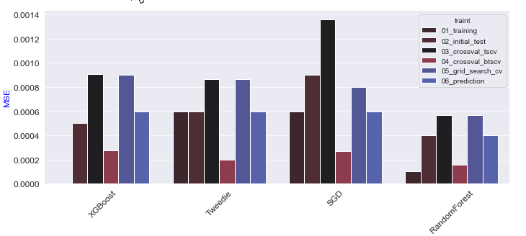
Metrics: Errors

Slide 23
SUMMARY
Our main focus was that we select the models, which show the best fit and tried to optimize their R-Squared.
We also checked that the errors either decrease or do not get worse.
Our 4 models, which stayed in scope of our optimization were the following:
Tweedie Regressor
Random Forest Regressor
Stochastic Gradient Descent
XGBoost Regressor
The most robust model in our analysis was the Tweedie Regressor, which is a Generalized Linear Model and is used to model data that follow Tweedie or Poisson distribution, which is the case in our project.

Slide 24
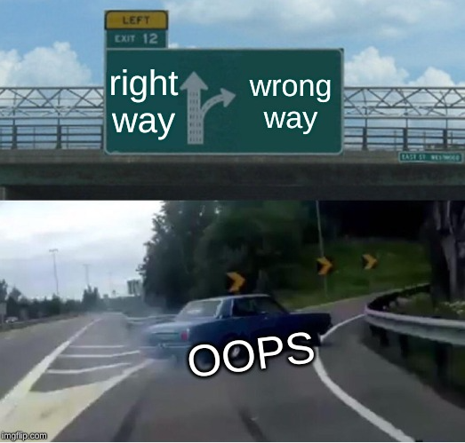
Then we’re going to the right direction, right?

Slide 25
Possible Extensions
Look for more / different features data (however data quality is a challenge)
Get data with more granularity and frequency (eg. minutely, secondly)
Try to approach the problem from a different angle (eg. Classification problem, Volatility clustering…)
Transform the problem to a Deep learning project
….

Slide 26
THANK YOU
Akos Redey​
akosredey@hotmail.com
https://github.com/akosredey

Slide 27
Appendix: Prediction with Arima

Slide 28
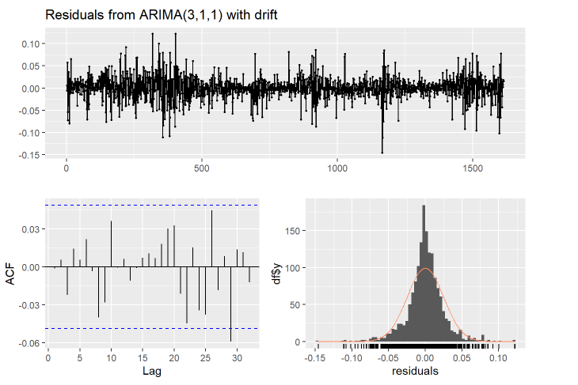

Slide 29


