Slide 1
www.car-maniacs.co.uk
An awesome car rating website
by mustached-ninja

Slide 2
What is it?
A simple website
People can rate cars
Star-based system
Browse cars by rating

Slide 3
Stand Out Features
Simple
Easy to use
No need to register
Unbiased
Ethics Statement
Transparency

Slide 4
User Personas
Owner
Visitor
Browse cars (4/5)
Rate that car (5/5)
Compare their car to others (2/5)
Browse cars (5/5)
See ratings (5/5)
Compare those ratings (5/5)
See ranking (5/5)
Administrator
Reviews ratings
Deletes malicious ratings
Manages ads and price engine

Slide 5
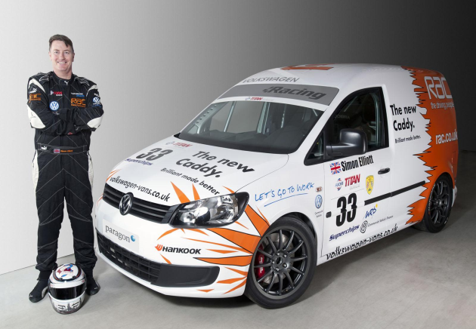

Personas
Alex, has a big crush on cars
I have always been passionate about cars. I chose to become a mechanical engineer just because I wanted to know intimate details about how the car works. I need an website were I could find exciting news about the cars/car manufacturers.
Dean, father of two
I need a platform that could help me find a suitable car. I am currently commuting from Glasgow to Stirling. I need a reasonably-priced car which does not consume a lot of fuel. I would really appreciate a comparing facility to help me make up my mind faster, I already have a shortlist.

Slide 6
Main Screen
Search Bar
Dropdown box for manufacturers
Rankings
Pictures, news

Slide 7
Must Have
Database about cars
Ratings
Ranking bar (best and worst)
Browsing
Comparing cars

Slide 8
Should Have
Comments (text)
Searchable comments
Search bar
Users

Slide 9
Could Have
Price engine provided by a 3rd party
Car of the Month
E.g. most visited
Ads?
From companies that aren’t car manufacturers
No way to purchase biased reviews

Slide 10
Won’t Have
A fancy UI for administrators

Slide 11
3-tier Architecture
URL
params
SQL
queries
Clicking
HTML/CSS/JS
Web browser on a desktop or mobile
e.g. Chrome, Safari
Client
Application Server built using
Django 1.7
Middleware
Database Server
running
MySQL 1.7
Database
Visual
HTML
CSS
Results
User
SMTP to provider
E-mail server

Slide 12


Home
Browse
Top Rated
Rate
Brand
Results
Brand
Results
List of Cars
Model
Results
Model
Results
Type
Brand
Year
Results
Year
Results
Car Profile
Rate
Compare

Slide 13
Domain Design
/compare?car1=id1&car2=id2
/search?term=huge+boot
/login
/logout
/
/cars/toyota/corolla/2003-2005
/rate - POST-ing reviews
/top?type=suv&brand=toyota &order=reliability

Slide 14
ER Diagram
1
Users
Id
written by
Users_Id
N
Reviews
N
Vehicle_Id
is about
Id
Cars
1

Slide 15
Users
Field | Type
Id | Integer
UserName | Char(16)
Email | Char(128)
PasswordHash | Char(128)
PasswordSalt | Char(128)
IsAdmin | Boolean

Slide 16
Cars
Field | Type
Id | Integer
Manufacturer | Char(64)
Type | Char(64)
Year | Char(64)
Model | Char(64)
Picture | Char(64)
etc

Slide 17
Reviews
Field | Type
Vehicles_Id | Integer
Users_Id | Integer
OverallRating | Integer
MaintenanceCostRating | Integer
ComfortRating | Integer
PerformanceRating | Integer
ReliabilityRating | Integer
MechanicRating | Integer
PersonalPreferenceRating | Integer
AverageRating | Float
Comment | Char(256)
Hidden | Boolean
Timestamp | Date

Slide 18
github.com/akoss/mustached-ninja

