Slide 1
www.car-maniacs.co.uk
An awesome car rating website
by mustached-ninja

Slide 2
What is it?
People can rate cars
Star-based system
Browse cars by rating

Slide 3
Stand Out Features
Simple
Easy to use
No need to register
Unbiased
Ethics Statement
Transparency

Slide 4
User Personas
Owner
Visitor
Browse cars (4/5)
Rate that car (5/5)
Compare their car to others (2/5)
Browse cars (5/5)
See ratings (5/5)
Compare those ratings (5/5)
See ranking (5/5)
Administrator
Reviews ratings
Deletes malicious ratings
Manages ads and price engine

Slide 5
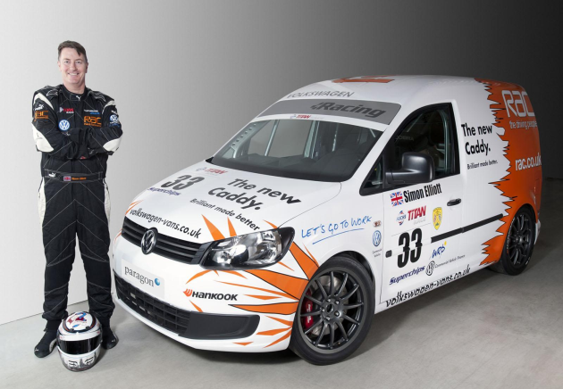

Personas
Alex, has a big crush on cars
I have always been passionate about cars. I chose to become a mechanical engineer just because I wanted to know intimate details about how the car works. I need an website were I can rate the cars that I’ve driven and browse interesting content.
Dean, father of two
I need a platform that could help me find a suitable car. I am currently commuting from Glasgow to Stirling. I need a reasonably-priced car which does not consume a lot of fuel. I would really appreciate a comparing facility to help me make up my mind faster, I already have a shortlist.

Slide 6
3-tier Architecture
URL
params
SQL
queries
Clicking
HTML/CSS/JS
Web browser on a desktop or mobile
e.g. Chrome, Safari
Client
Application Server built using
Django 1.7
Middleware
Database Server
running
MySQL 1.7
Database
Visual
HTML
CSS
Results
User
SMTP to provider
E-mail server

Slide 7
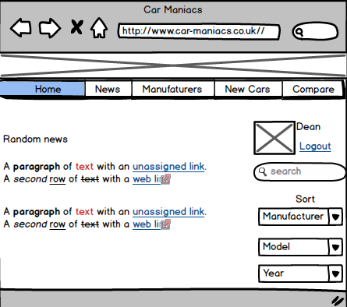

Slide 8
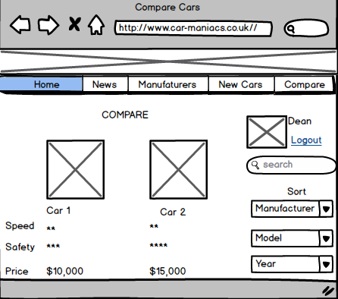

Slide 9
Specification list
Must Have
Database about cars
Users
Ratings
Rankings bar
Should Have
Comments
Searchable comments
Search Bar
Comparing cars
Could Have
Price engine provided by a 3rd party
Car of the month (E.g. Mos
Visited)
Ads
Won’t have
Multiple ratings for the same car
Fancy UI for the administrators

Slide 10


Home
Browse
Top Rated
Rate
Brand
Results
Brand
Results
List of Cars
Model
Results
Model
Results
Type
Brand
Year
Results
Year
Results
Car Profile
Rate
Compare

Slide 11

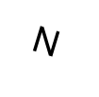
ER Diagram
1
Users
Id
written by
Users_Id
N
Reviews
N
Vehicle_Id
Type
is about
Id
Cars
1
1
Manufacturer

Slide 12
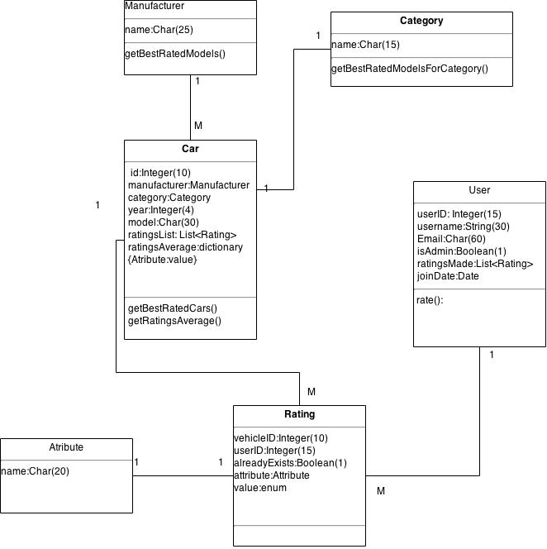

Slide 13
github.com/akoss/mustached-ninja

