Slide 1


Project Initiation
12. September 2024.

Slide 2
Agenda
Presentation of derived requirements
Scope of project
Project Schedule

Slide 3
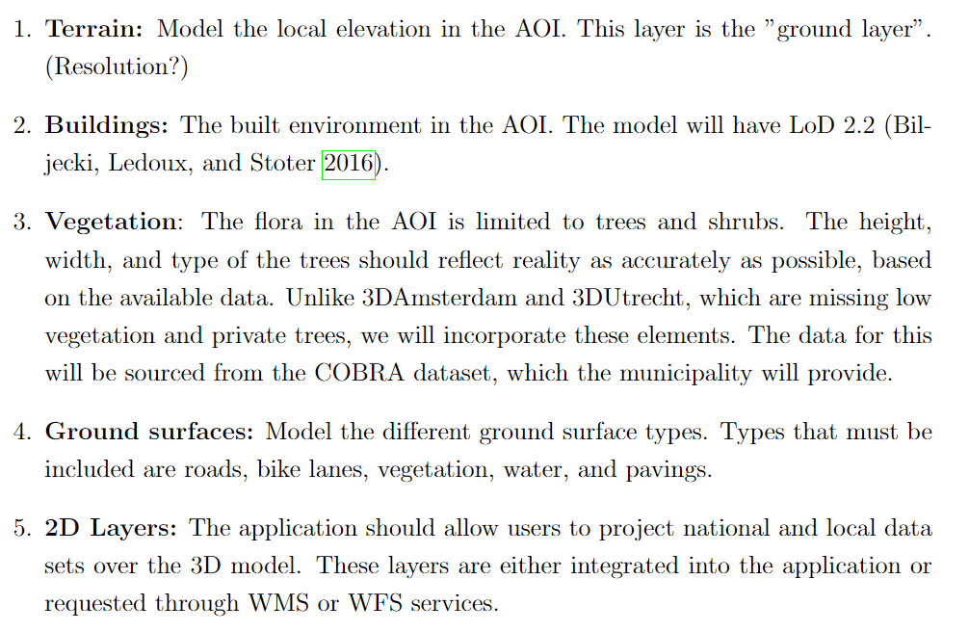
Requirements – Base product

Slide 4
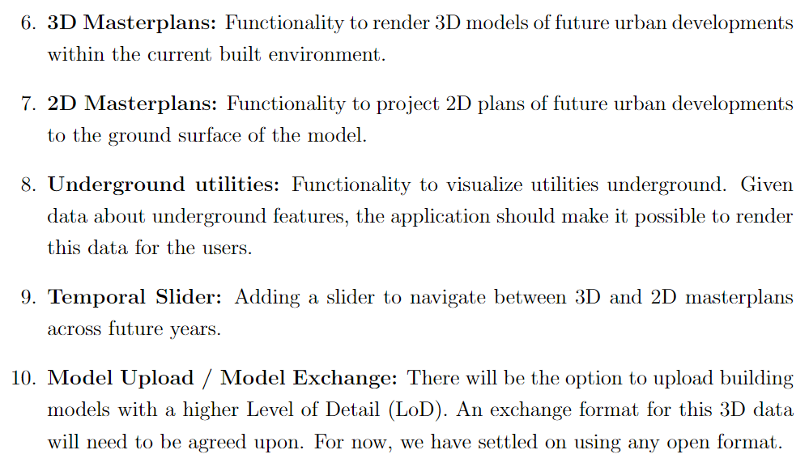
Requirements – Important Features

Slide 5
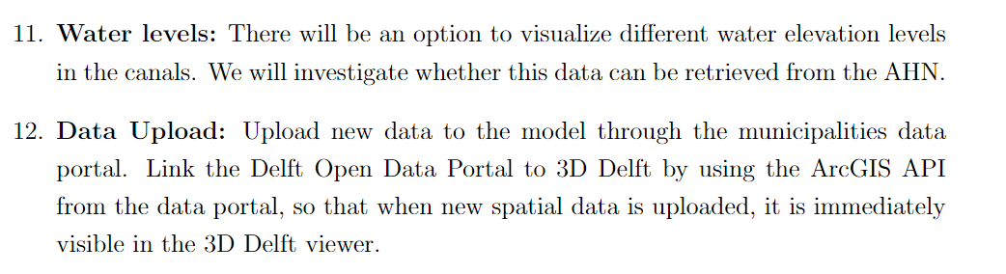
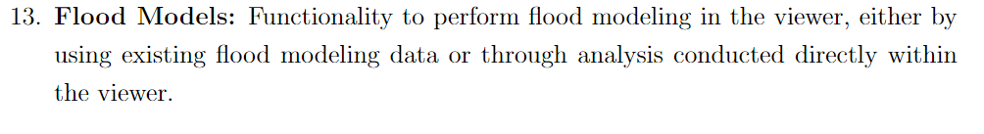
Requirements – Other

Slide 6
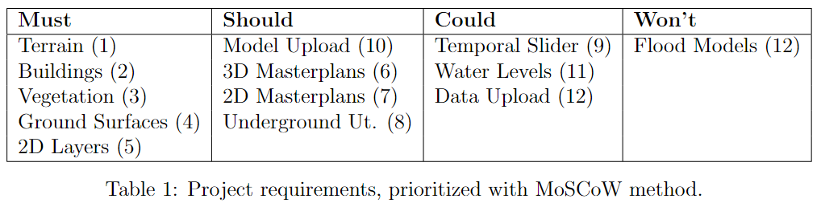
MoSCoW

Slide 7
