Slide 1
SPEECH RECOGNITION MODEL DEVELOPMENT USING THE SPEECHDATA DATASET

Slide 2
TASK
The challenge was to develop a deep learning model to recognize a Ghanaian dialect and transcribe its equivalent speech audio into text.

Slide 3
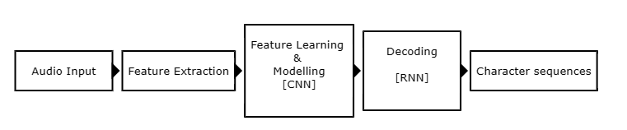
GENERAL OVERVIEW OF ASR MODEL
In order to solve this task, a model based on the Convolutional Neural Network algorithm was developed and trained on the Akan dialect.
Notes:
The CNN model does not include a separate decoding stage; instead, it directly predicts the output sequence (characters) from the learned representations.
Convolutional Neural Network → CNN

Slide 4
DATASET
During the completion of the task, 7,514 recordings of Akan language audio data were retrieved from the SpeechData dataset provided.
The dataset was provided in mp3 format, however to help in the easy preprocessing of the dataset, each data sample was converted into wav format.
Notes:
2349.377333333149 hours of speech data
With a sample rate of 16000 Hz
Processing WAV files typically requires less preprocessing compared to MP3 files. Since WAV files are uncompressed and contain raw audio samples, they can be directly loaded and used for feature extraction (e.g., MFCC computation) without the need for additional decoding or decompression steps.
WAV files are a widely accepted and standardized format for storing uncompressed audio data. They are natively supported by many audio processing libraries and tools used in ASR research and development

Slide 5
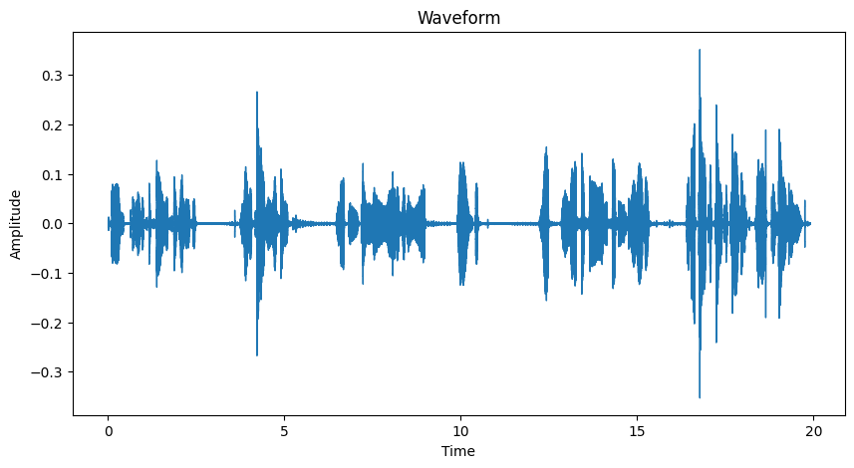
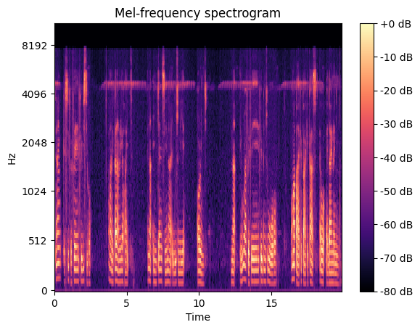
PREPROCESSING
The preprocessing phase was done in two phases;
preprocessing the raw speech audios
preprocessing their corresponding transcriptions

Slide 6
PREPROCESSING: TRANSCRIPTS
In preprocessing the transcripts, a subset of the transcripts was extracted to include only the 7,514 audio recordings.
The labels in the transcript files were converted into lower cases to normalize the texts.
In the next step, only unique labels in the selected transcriptions were extracted. This was an attempt to preprocess and clean the data by removing duplicate labels.
Notes:
Pitch shifting alters the pitch of the audio waveform
Mine was 10 semitones in the pitch shifting
spectrogram representations ➔ spectograms

Slide 7
PREPROCESSING: TRANSCRIPTS
In the text preprocessing stage, each unique transcription was encoded into its corresponding numerical representation using a predefined dictionary mapping letters from the Akan language alphabet to numeric values
Lastly, while encoding each label, data augmentation techniques were applied by duplicating each unique label to introduce variation and diversity in the training dataset
Notes:
Pitch shifting alters the pitch of the audio waveform
Mine was 10 semitones in the pitch shifting
spectrogram representations ➔ spectograms

Slide 8
PREPROCESSING: AUDIO
Random samples of the raw data samples were examined and visualized using wave plots and Mel-frequency spectrograms to understand data characteristics, assess quality, guide feature engineering.
Following the examination of raw data samples, fourteen (14) features were extracted from the dataset using Mel-Frequency Cepstral Coefficients (MFCC)

Slide 9
PREPROCESSING: AUDIO
After the feature extraction stage, Pitch shifting as a data augmentation technique was considered to enhance model generalization by exposing it to variations in pitch. A total of 15, 028 audio samples were generated for training the model.
Finally, the MFCC features of the pitch-shifted audio waveform were expanded into spectrograms by adding a new dimension to the data, to make it compatible with the Convolutional Neural Network (CNN) model
Notes:
15028 audio samples for training
Pitch shifting alters the pitch of the audio waveform
Mine was 10 semitones in the pitch shifting
spectrogram representations ➔ spectograms

Slide 10
AUDIO TRAINING DATASET
The training dataset consisted of 11, 228 audio samples, where each sample was represented as a four dimensional (4D) array with dimensions (14, 2000, 1)
The MFCC spectrogram features extracted from the audio signals were computed over a time window of 2000 frames, and a single channel
Notes:
The training dataset consisted of 11, 228 audio samples, where each sample was represented as a four dimensional (4D) array with dimensions (14, 2000, 1)
The shape of the training dataset was (3800, 14, 2000, 1)
a single channel → monophon
frames (time steps)

Slide 11
AUDIO TESTING DATASET
The testing dataset comprises 3800 audio samples, also represented as four dimensional (4D) NumPy array.
Notes:
Shape: (11228, 14, 2000, 1)

Slide 12
TRANSCRIPTION TRAINING AND TESTING DATASET
Each transcription was represented as a sequence of a maximum 1756 elements of numerical representations derived from the original transcribed sentence for both the training and testing datasets.
Notes:
Shape: (3800, 1756)

Slide 13
MODEL ARCHITECTURE
The encoder model is a 2D CNN that was been implemented using Python and the Keras deep learning library with a TensorFlow backend
Notes:
Two Dimensional CNN model

Slide 14
MODEL ARCHITECTURE
Layer Name | Input Shape | Output Shape | Activation
Conv2D_1 | (14, 2000, 1) | (7, 1000, 32) | Leaky ReLU
BatchNormalization_1 | (7, 1000, 32) | (7, 1000, 32) | -
Activation_1 | (7, 1000, 32) | (7, 1000, 32) | -
MaxPooling2D_1 | (7, 1000, 32) | (2, 333, 32) | -
Dropout_1 | (2, 333, 32) | (2, 333, 32) | -
Conv2D_2 | (2, 333, 32) | (2, 333, 128) | ReLU
BatchNormalization_2 | (2, 333, 128) | (2, 333, 128) | -
Activation_2 | (2, 333, 128) | (2, 333, 128) | -
Dropout_2 | (2, 333, 128) | (2, 333, 128) | -
Conv2D_3 | (2, 333, 128) | (1, 166, 512) | ReLU
BatchNormalization_3 | (1, 166, 512) | (1, 166, 512) | -
Notes:
Two Dimensional CNN model

Slide 15
MODEL ARCHITECTURE
Layer Name | Input Shape | Output Shape | Activation
Activation_3 | (1, 166, 512) | (1, 166, 512) | -
MaxPooling2D_2 | (1, 166, 512) | (1, 166, 512) | -
Dropout_3 | (1, 83, 512) | (1, 83, 512) | -
Conv2D_4 | (1, 83, 512) | (1, 83, 512) | -
BatchNormalization_4 | (1, 83, 512) | (1, 83, 512) | ReLU
Activation_4 | (1, 83, 512) | (1, 83, 512) | -
Dropout_4 | (1, 83, 512) | (1, 83, 512) | -
Dense_1 | (1, 83, 512) | (1, 83, 512) | -
Dropout_5 | (512,) | (512,) | Leaky ReLU
Conv2D_5 | (1, 83, 512) | (1, 83, 32) | -
Flatten | (1, 83, 32) | (2656,) | -

Slide 16
MODEL ARCHITECTURE
Layer Name | Input Shape | Output Shape | Activation
Dense_2 | (2656,) | (256,) | Softmax
BatchNormalization_5 | (256,) | (256,) | -
Dropout_6 | (256,) | (256,) | -
Activation_5 | (256,) | (256,) | -
Dense_3 | (256,) | (34,) | Softmax
Dense_4 | (512,) | (512,) | Softmax
BatchNormalization_6 | (512,) | (512,) | -
Dropout_7 | (512,) | (512,) | -
Activation_6 | (512,) | (512,) | -
Dense_5 (Output) | (512,) | (1756,) | Softmax

Slide 17
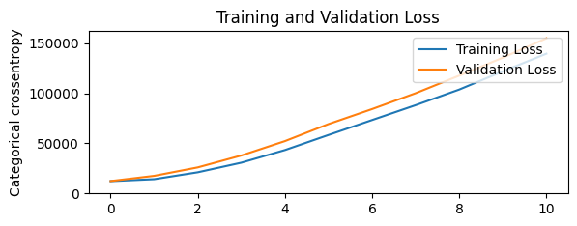
MODEL TRAINING
The model was trained on 80 percent of the dataset on 10 epochs.
The model was trained at a learning rate of 0.001while using a dropout of 0.15
The loss function used was the categorical_crossentropy

Slide 18
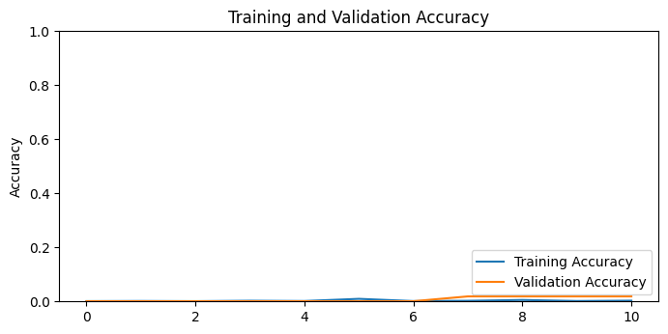
MODEL EVALUATION
The model was evaluated on the accuracy metric with an accuracy of 0.5% indicating that the model did not learning poorly

Slide 19
POTENTIAL IMPROVEMENTS OF THE MODEL
Remove background noise from raw audio recordings, especially for recordings that were made outdoor
Further normalize text transcription to reduce numerical translations into its Akan representation
Experiment with varying values for hyperparameters of the model such as dropout, learning rate, batch size, number of layers, and filter sizes.
Use different models to design ASR models and compare the performance of the models
Set up a decoding algorithm or layer to transform numerical predictions into text

Slide 20
CHALLENGES
Extraction of adequate samples of dataset for training the model
Inadequate machine specifications to develop and train the model
Notes:
Working with audio data

Slide 21
THANK YOU

Slide 22
REFERENCES
https://www.intechopen.com/chapters/63017
https://medium.com/strategio/using-librosa-to-change-the-pitch-of-an-audio-file-49efdb2dd6c

