Slide 1
Geometriák és algebrák mesélős emlékeztető
Szirmay-Kalos László

Slide 2
Euklideszi síkgeometria
Euklideszi síkgeometria axiómái:
Két pont meghatároz egy egyenest.
Egy egyenesnek van legalább két pontja.
Egy egyeneshez egy rajta kívül fekvő ponton át egy nem metsző egyenes húzható (párhuzamosság).
Átmozgatható (egybevágó) dolgok mérete megegyező
A részek összege az egész mérete
…
Axiómák
Alapigazság (tapasztalat)
Alapfogalmak implicit definíciója
Definíciók és tételek
T1. Két különböző egyenes legfeljebb
egy pontban metszi egymást
T2. Ha egy egyenes metsz két párhuzamos egyenest, akkor a keletkező szögösszeg 180 fok.
T3. A háromszög szögeinek
összege 180 fok
180 fok
Ennek is
180 foknak
kell lennie
180 fok
T4. Pitagórasz: a²+b² = c²
Notes:
Computer graphics works with shapes. The field of mathematics that describes shapes is the geometry, so geometry is essential in computer graphics.
Geometry, like other fields of formal science, has axioms that are based on experience and cannot be argued but are accepted as true statements without arguments. From axioms other true statements, called theorems, can be deducted with logic reasoning.
For example, axioms of the Euclidean geometry include the following three postulates. Axioms have two purposes, on the one hand, they are accepted as true statements. On the other hand, axioms implicitly define basic concepts like points, lines etc. because they postulate their properties.
Based on the axioms and the applied tools, there are several different geometries that are different models of the world. Everybody knows the Euclidean geometry of the plane and of the space. We know that it is metric, i.e. we can talk of the distance between objects and size is an important concept in it. In Euclidean geometry parallel lines do not intersect, that is, a point at infinity is not part of the Euclidean plane.
However, if we define axioms differently, we can add points at infinity to the plane making all lines, even parallel lines, intersecting. Clearly, this is a different geometry with different axioms and theorems, which is called the projective geometry. Projective geometry is not metric since distance cannot be defined in it. The reason is that the distance from points at infinity is infinite, but infinite is not a number.
In Euclidean geometry size is an important issue, curves are measured by their length, surfaces by their area, and solids by their volume. However, when we try to apply these concepts to natural phenomena, like a snow crystal or a cloud, we fail. We have to realize that natural objects do not have a precise size, so Euclidean geometry is not appropriate for their description. For natural phenomena, we use fractal geometry.

Slide 3
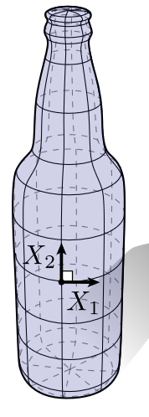
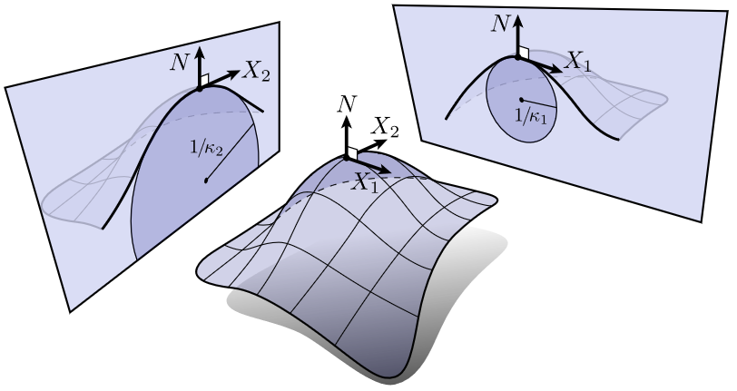
Görbék: görbület
-
+
κ = 1/r
K =κ₁κ ₂

Slide 4
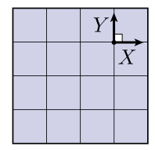
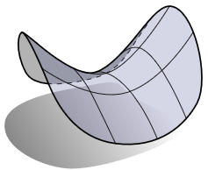
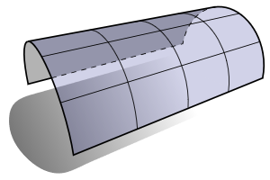
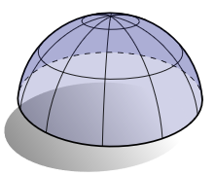
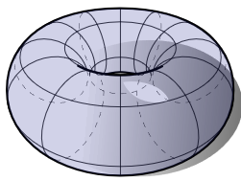
Gauss görbület, és fő görbületi irányok
K =κ₁κ ₂
K >0
K <0
K =0

Slide 5
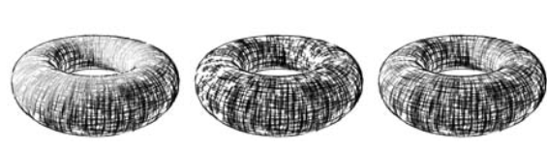
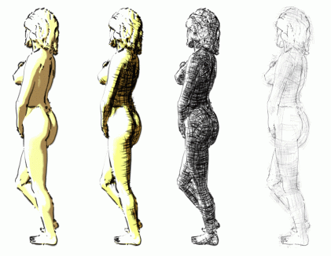
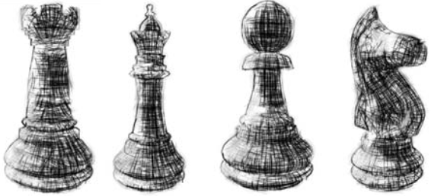
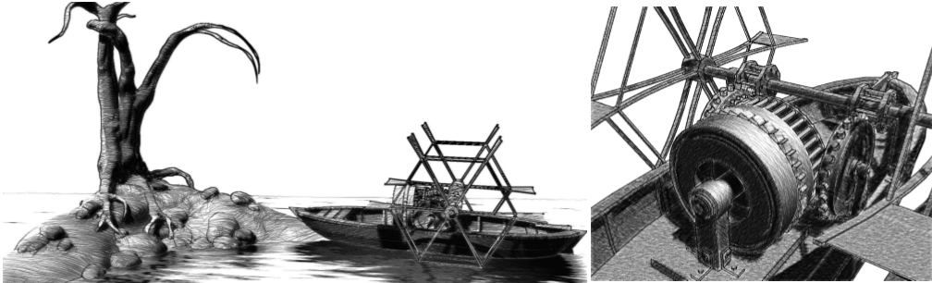
Mire jó? NPR

Slide 6
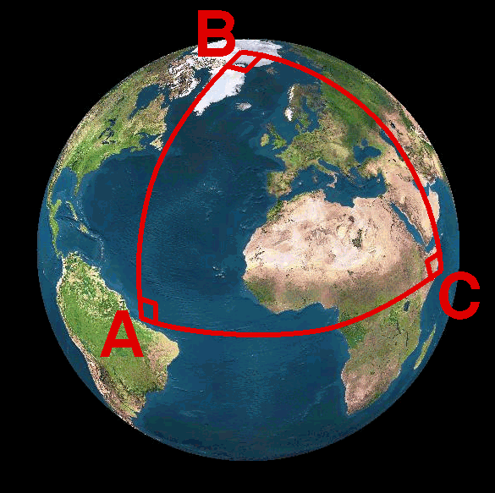
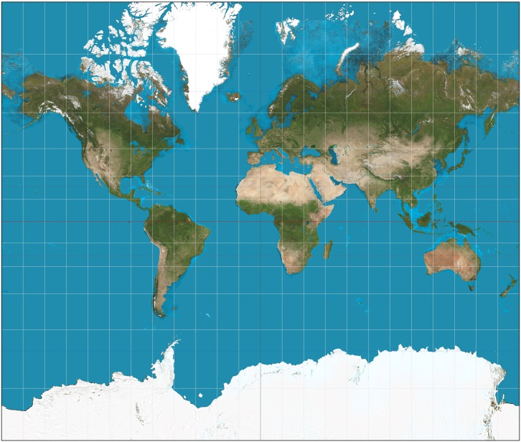
Gömbi geometria
Euklideszi geometria axiómái nem jók:
Két pont nem mindig határoz meg egyértelműen egy egyenest.
Egy egyenesnek van legalább két pontja.
Két egyenes mindig metszi egymást két pontban.
Átmozgatható (egybevágó) dolgok mérete megegyező
A részek összege az egész mérete
…
Pozitív görbület
Egyenes = főkör (legrövidebb út)
Egyenesek mindig metszők
Háromszög szögeinek összege > 180 fok (arányosan a területtel)
Derékszögű háromszög: a²+b² > c²
Hasonlóság = Egybevágóság
Mercator

Slide 7
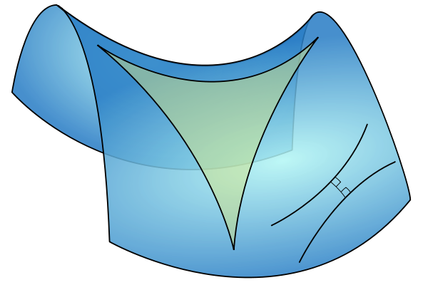
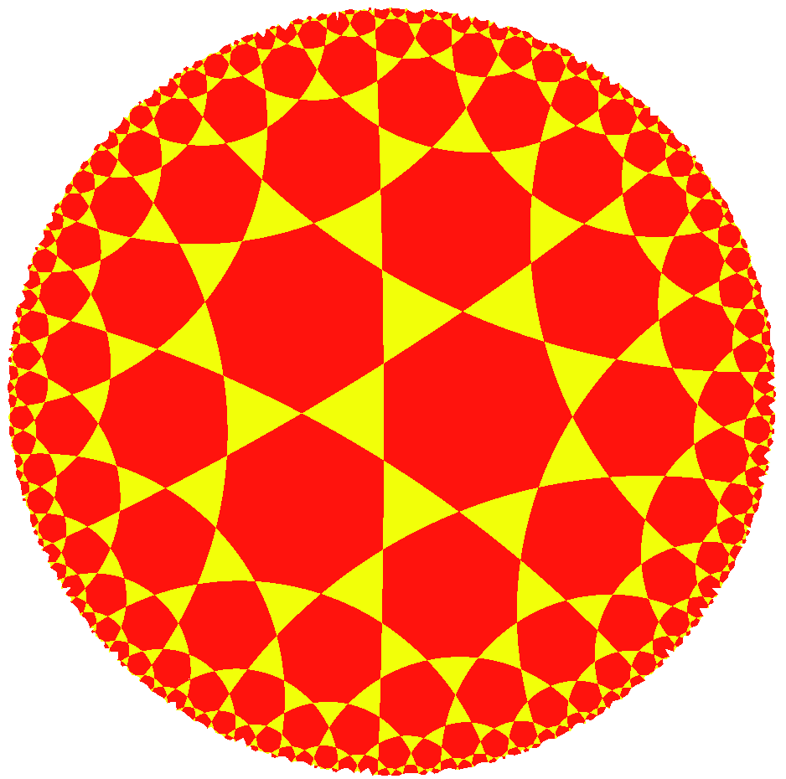
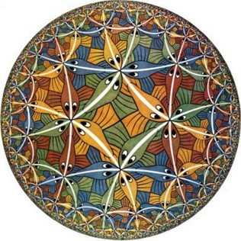
Hiperbolikus (Bólyai) geometria
Hiperbolikus geometria axiómái:
Két pont meghatároz egy egyenest.
Egy egyenesnek van legalább két pontja.
Egy egyeneshez egy rajta kívül fekvő ponton át több nem metsző egyenes húzható.
…
Negatív görbület
Egyenes = legrövidebb út
Több párhuzamos
Háromszög szögeinek összege < 180 fok (arányosan a területtel)
Derékszögű háromszög: a²+b² < c²
Hasonlóság = Egybevágóság

Slide 8
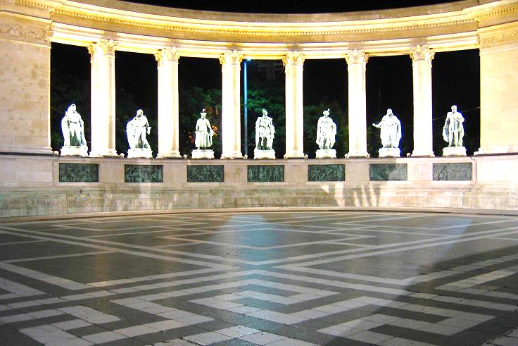
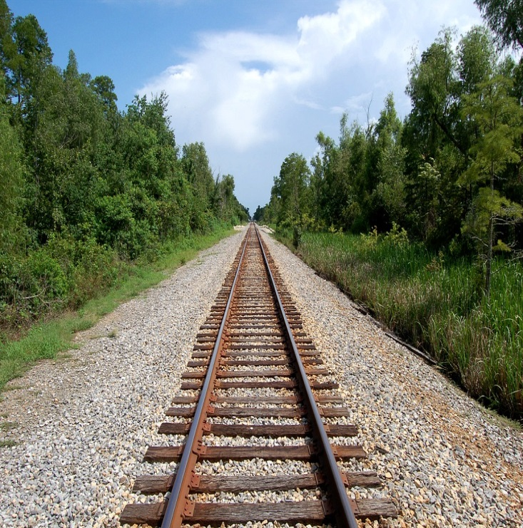
Projektív geometria
Projektív geometria axiómái:
Két pont meghatároz egy egyenest.
Egy egyenesnek van legalább két pontja.
Két egyenes pontosan egy pontban metszi egymást
…
A „végtelen” is része a síknak
Nincsenek párhuzamosok
Programozási előny: nincs szingularitás és speciális eset
Descartes és polár (és bármilyen távolsági) koordináták nem jók

Slide 9
Mindent számmal: Analitikus geometria
Két pont meghatároz egy egyenest.
Egy egyenesnek van legalább két pontja.
Egy egyeneshez egy rajta kívül fekvő ponton át egy nem metsző egyenes húzható.
axiómák
pont
számok
sík
egyenes
megfeleltetés
művelet
metszi
egyenlet
illeszkedik
függvény
1 geometriához is
többféle algebra és megfeleltetés lehetséges!
geometria
algebra
Notes:
In computer graphics, we should also take into account that a computer is programmed, which cannot do anything else but calculations with numbers. A computer is definitely not able to understand abstract concepts like point, line etc. So for the application of a computer, geometric concepts must be translated to numbers, calculation and algebra.
A geometry based on algebra, equations and numbers is called analytic geometry or coordinate geometry. To establish an analytic version of a geometry, we have to find correspondences between geometric concepts and concepts of algebra in a way that axioms of the geometry will not contradict to the concepts of algebra. If it is done, we can forget the original axioms and work only with numbers and equations.

Slide 10
Pontok definíciója koordinátarendszerrel
Y_{h}
y
r
w
X_{h}
1
φ
x
1
1
Baricentrikus
Homogén
Descartes
Polár
Számokkal!
Koordinátarendszer (=referencia geometria)
Koordináták(=mérés)
Notes:
The goal is the definition of points with numbers and primitives with equations or functions.
The definition of points with numbers requires a coordinate system and then the measuring of the point with respect to this coordinate system. A Cartesian coordinate system contains two orthogonal lines or axes, and a unit on them, and we measure how far we should walk along them to arrive at the identified point.
A 2D polar coordinate system is a half line, and a point is defined by an angle and a distance. The angle specifies the direction in which we should go from the origin and the distance is interpreted between the origin and the identified point. Note that while we require that all points can be expressed by coordinates, this is not necessarily unambiguous, i.e. in a polar system the origin can be defined with arbitrary angle and with distance zero.
In computer graphics barycentric coordinate systems are also popular. Here, the coordinate system is a set of points (at least 3 in 2D) where we put weights. The resulting mechanical system has a center of mass somewhere, which are identified by the numbers of the weights. Barycentric coordinates are often called homogeneous, due to the property that if we multiply all weights with the same non-zero scalar, then the center of mass is not affected.
However, for such constructions we have already applied many non-trivial concepts like vectors, distance, angles. First, let us start from scratch and revisit these basic building blocks.

Slide 11
Pontok kombinálása
r₂
r₃
r₄
r₁
r
m₃
m₄
m₂
m₁
r az r₁, r₂,…, r_{n} pontok kombinációja
Súlyok a baricentrikus koordináták
Ha a súlyok nem negatívak: konvex kombináció
Konvex kombináció a konvex burkon belül van
Egyenes (szakasz) = két pont (konvex) kombinációja
Sík (háromszög) = három pont (konvex) kombinációja
Notes:
Defining a point as the center of mass of a system where masses placed at finite number of reference points is also called the combination of these points with barycentric coordinates equal to the weights.
Note that we can do this in real life without mathematics and coordinate systems, center mass exists and is real without mathematics and abstraction.
If all weights are non-negative, which has direct physical meaning, then we talk of convex combination since the points that can be defined in this way are in the convex hull of the reference points. By definition, the convex hull is the minimal set of points that is convex and includes the original reference points. For example, when presents are wrapped, the wrapping paper is on the convex hull of the presents.
Using the term combination or convex combination, we can define a line as a combination of two points and a line segment as a convex combination of two points. Similarly, the convex combination of three not collinear points is the triangle, the convex combination of four points not being in the same plane is a tetrahedron.

Slide 12
Vektor algebra
pont
Vektor = eltolás: v
Irány és hossz (|v|)
Helyvektor
DE vektor ≠ pont !!!
Vektor összeadás
v = v₁ + v₂ (kommutativ, asszoc.)
v₁ = v - v₂ (van inverz)
Skálázás (skalárral szorzás)
v₁ = a⋅v (disztributív)
helyvektor
origó
v₂
v₁
*
v₁
v₂
v
a⋅v
Notes:
In addition to combining points, we can also translate them. By definition a translation is a vector, which has direction and length. The length is denoted by the absolute value of the vector.
If we select a special reference point, called the origin, then every point has a unique vector that translates the origin to here, or from the other point of view, every vector unambiguously defines a point that is reached if the origin is translated by this vector. Such vectors are called position vectors. The fact that there is a one-to-one correspondence between points and position vectors does not mean that points and vectors would be identical objects (wife and husband are also strongly related and unambiguously identify each other, but are still different objects with specific operations).
Concerning vector operations, we can talk of addition that means the execution of the two translations one after the other. The resulting translation is independent of the order, so vector addition is commutative (parallelogram rule). If we have more than two vectors, parentheses can rearranged so it is also associative. Vector addition has an inverse, because we can ask which vector completes the translation of v2 to get a resulting translation v.
Vectors can be multiplied by a scalar, which scales the length but does not modify the direction. Scaling is distributive, i.e. scaling a sum of two vectors results in the same vector as adding up the two scaled versions.
We have to emphasize that the nice properties of commutativity, associativity, and distributivity are usually not evident and sometimes not even true for vector operations. Be careful!

Slide 13
Skalár (dot, belső) szorzat
v1
Definíció
v1⋅v2 = |v1|⋅|v2|⋅cosα
Jelentés
Egyik vektor vetülete a másikra * másik hossza
Tulajdonság
Nem asszociatív!!!
Kommutatív
v1⋅v2 = v2⋅v1
Disztributív az összeadással
v3⋅(v2+v1) = v3⋅v2 + v3⋅v1
v⋅v = |v|²
Két vektor merőleges ha a skalárszorzatuk zérus
v2
α
|v1|⋅cosα
v2
v1
α
v3
|v1|⋅cosα
Notes:
Vectors can be multiplied in different ways. The first possibility is the scalar product (aka dot or inner product) that assigns a scalar to two vectors. By definition, the resulting scalar is equal to the product of the lengths of the two vectors and the cosine of the angle between them.
The geometric meaning of scalar product is the length of projection of one vector onto the other, multiplied by the lengths of the others.
Scalar product is commutative (symmetric), which is obvious from the definition.
Scalar product is distributive with the vector addition, which can be proven by looking at the geometric interpretation. Projection is obviously distributive (the projection of the sum of two vectors is the same as the sum of the two projections.
Scalar product is NOT associative!
There is a direct relationship between dot product and the absolute value. The scalar product of a vector with itself is equal to the square of its length according to the definition since cos(0)=1.

Slide 14
Vektor (kereszt) szorzat
v1 × v2
Definíció
|v1 × v2| = |v1|⋅|v2|⋅sinα
Merőleges, jobb kéz szabály
Jelentés
Terület és merőleges vektor,
(Egyik vektor vetülete a másikra merőleges síkra + 90 fokos elforgatás) * másik hossza
Tulajdonságok
Nem asszociatív!!!
Nem kommutatív: Antiszimmetrikus
v1 × v2 = - v2 × v1
Disztributív az összeadással
v3 × (v2+v1) = v3 × v2 + v3 × v1
Két vektor párhuzamos ha vektorszorzatuk zérus.
v2
α
v1
v2
v1
α
|v1|⋅sinα
90 fok
v1×v2
Notes:
Vectors can be multiplied with the rules of the vector (aka cross) product as well. The result is a vector of length equal to the product of the lengths of the two vectors and the sine of their angle. The resulting vector is perpendicular to both operands and points into the direction of the middle finger of our right hand if our thumb points into the direction of the first operand and our index finger into the direction of the second operand (right hand rule).
Cross product can be given two different geometric interpretations. The first is a vector meeting the requirements of the right hand rule and of length equal to the area of the parallelogram of edge vectors of the two operands.
The second geometric interpretation is the projection of the second vector onto the plane perpendicular to the first vector, rotating the projection by 90 degrees around the first vector, and finally scaling the result with the length of the first vector.
Cross product is NOT commutative but anti-symmetric or alternating, which means that exchanging the two operands the result is multiplied by -1.
Cross product is distributive with the addition, which can be proven by considering its second geometric interpretation. Projection onto a plane is distributive with addition, so are rotation and scaling. Cross product is NOT associative.

Slide 15
Descartes koordináta rendszer
v = xi + yj
Egyértelmű (x = v⋅i, y = v⋅j)
Operációk koordinátákban
Összeadás:
v₁ + v₂ = (x₁+x₂)i + (y₁+y₂)j
Skalár szorzat:
v₁ ⋅ v₂ = (x₁i + y₁ j) ⋅ (x₂i + y₂ j) = (x₁ x₂ + y₁y₂)
Vektor szorzat:
v₁ × v₂ = (x₁i + y₁ j + z₁k) × (x₂i + y₂ j + z₂k) =
(y₁z₂ – y₂z₁) i + (x₂z₁ – x₁z₂) j + (x₁y₂ – y₁x₂)k
Hossz:
|v| = √ v⋅v = √ x² + y² + z² Pitagórász tétele!
y j
j
i
x i
origó
i j k
x₁ y₁ z₁
x₂ y₂ z₂
Notes:
Having vectors and operations, we are ready to establish a Cartesian coordinate system. Let us select one point of the plane and two unit (length) vectors i and j that are perpendicular to each other. A vector has unit length if its scalar product with itself is 1 and two vectors are perpendicular if their scalar product is zero since cos(90)=0 (formally:i ⋅i =j ⋅j =1 and i ⋅j= 0).
Now, any position vector v can be unambiguously given as a linear combination of basis vector i and j, i.e. in the form v = xi + yj, where x and y are scalars, called the coordinates. Having v, scalar products determine the appropriate coordinates: x = v⋅i, y = v⋅j . To prove this, let us multiply both sides of v = xi + yj by i and j.
As there is a one-to-one correspondence between vectors and coordinate pairs in 2D (and coordinate triplets in 3D), vectors can be represented by coordinates in all operations.
Based on the associative property of vector addition and on distributive property of multiplying a vector by a scalar with addition, we can prove that coordinates of the sum of two vectors are the sums of the respective coordinates of the two vectors.
Similarly, based on the distributive property of dot product with vector addition, we can prove that the dot product equals to the sum of the products of respective coordinates. Here we also exploit that i ⋅i =j⋅j=1 and i ⋅j= 0.
Finally, based on the distributive property of the cross product with vector addition, we can also express the cross product of two vector with their coordinates. We should also use the cross products of the base vectors i ×i =0, i ×j=k, etc. The result can be memorized as a determinant where the first row contains the three basis vectors, the second the coordinates of the first operand, the third the coordinates of the second operand.
The absolute value of a vector is the square root of the scalar product of the vector with itself. Note that we get the Pythagoras theorem for free.

Slide 16
Vektor/Pont/Szín osztály
float-ot használunk!
struct vec3 {
float x, y, z;
vec3(float x0, float y0, float z0 = 0) { x = x0; y = y0; z = z0; }
vec3 operator*(float a) { return vec3(x * a, y * a, z * a); }
vec3 operator+(const vec3& v) { // vektor, szín, pont + vektor
return vec3(x + v.x, y + v.y, z + v.z);
}
vec3 operator-(const vec3& v) { // vektor, szín, pont - pont
return vec3(x - v.x, y - v.y, z - v.z);
}
vec3 operator*(const vec3& v) {
return vec3(x * v.x, y * v.y, z * v.z);
}
float Length() { return sqrtf(x * x + y * y + z * z); }
};
float dot(const vec3& v1, const vec3& v2) {
return (v1.x * v2.x + v1.y * v2.y + v1.z * v2.z);
}
vec3 cross(const vec3& v1, const vec3& v2) {
return vec3( v1.y * v2.z - v1.z * v2.y,
v1.z * v2.x – v1.x * v2.z,
v1.x * v2.y – v1.y * v2.x);
}
Notes:
The implementation of the theory discussed so far is a single C++ class representing a 3D point or a vector with three Cartesian coordinates. Using operator overloading, the discussed vector (and point) operations are also.

Slide 17
Egyenes/szakasz: két pont kombinációja
Fizikából:
forgatónyomaték zérus
Σ (r_{i} – r) × m_{i} g = 0
(x₂,y₂)
Σ m_{i}r_{i}
(x(t),y(t))
r =
(x₁,y₁)
Σ m_{j}
v
m₂=t
y
Paraméteres egyenlet
m₁=1-t
x
r(t) = r₀ + v t, t∈ (-∞,∞)
x(t) = x₁ + v_{x} t
y(t) = y₁ + v_{y} t
x(t)=x₁(1-t)+ x₂t
y(t)=y₁(1-t)+ y₂t
Notes:
Having points, we can start defining primitives built of infinitely many points. We have two basic operations on points, combination and finding the vector that translates one point to the other.
If we have a translation vector, we can ask the distance, impose requirements on orthogonality or parallelism.
Combination uses the center of mass analogy, which assigns the center of mass to a set of points by the given formula. The position vectors of individual points are multiplied by the mass placed there and the sum is divided by the total mass.
Let us select two points that will be combined and, for the sake of simplicity, let us assume that the total mass is 1 (we distribute 1 kg mass in the two points). Distributing unit mass has the advantage that we do not have to divide with the total mass since division by 1 can be saved.
The center of mass will be on a line segment between by the two points. Whether it is closer to the first or to the second point depends on t, so by modifying t in [0,1] we can make the center of mass run on the line segment. So, points of the line segment can be expressed by a function of t. Such equation is called parametric equation because we have a free parameter that controls which point of the primitive is currently selected.
If t can be outside of the unit interval, then a point can also repel the point, thus the center of mass will still be on the line of the two points but outside of the line segment. The equation of the line segment and the line are similar, only the parameter ranges are different. The equation can also be rewritten in another form, where the two points are replaced by one point, called the position vector of the line, and the vector between them, called the direction vector of the line.

Slide 18
2D egyenes
Implicit egyenlet
n normál vektor
n⋅(r – r₀) = 0
n_{x} (x – x₀) + n_{y} (y – y₀) = 0
ax + by + c = 0
(x, y, 1) ⋅ (a, b, c) = 0
v irány vektor
y
r₀
r
x
2D egyenestől mért távolság:
n normál vektor
n⋅(r – r₀) = Vetület n-re * az n hossza
Ha n egységvektor:
n⋅(r – r₀) az előjeles távolság!
r
r₀
Notes:
Having points, we can start defining primitives built of infinitely many points.
We have two basic operations on points, combination and finding the vector that translates one point to the other. If we have a translation vector, we can ask the distance, impose requirements on orthogonality or parallelism.
Combination uses the center of mass analogy, which assigns the center of mass to a set of points by the given formula. The position vectors of individual points are multiplied by the mass placed there and the sum is divided by the total mass.
Let us select two points that will be combined and, for the sake of simplicity, let us assume that the total mass is 1 (we distribute 1 kg mass in the two points). Distributing unit mass has the advantage that we do not have to divide with the total mass since division by 1 can be saved.
The other way of establishing the equation of the line is based on orthogonality (or, from another point of view, on distance). The difference vectors of any two points on the line are all parallel, so they are all perpendicular to a given vector, called the normal vector of the line. Let one point be a given point, called the position vector of the line, and the other point represent any point (this is called the running point). Their difference r-r0 is perpendicular to normal vector n if and only if their scalar product is zero. This equation imposes a requirement on running point r. If r satisfies this equation, then the point is on the line, otherwise it is not on the line.
Another interpretation uses the distance. Point r is on the line if its distance from the line is zero. We know from geometry that the distance should be measured in perpendicular direction, which is
|n⋅(r – r₀)| if n is a unit vector (the difference is projected onto the unit normal vector).
Expressing the line equation with coordinates, we get an implicit linear equation for unknown point coordinates x and y. If a point’s x,y coordinates satisfy this equation, the point is on the line.
This implicit equation can also be expressed by the scalar product of two three-element vectors if we use the convention that 2D points have three coordinates where the third coordinate is 1.

Slide 19
Sík
n normál vektor
n⋅(r – r₀) = 0
n_{x} (x–x₀) + n_{y} (y–y₀) + n_{z} (z–z₀) = 0
ax + by + cz + d = 0
(x, y, z, 1) ⋅ (a, b, c, d) = 0
z
r₀
r
y
x
Ha n egységvektor:
n⋅(r – r₀) a síktól mért előjeles távolság!

Slide 20
Vektor/Pont/Sík/RGBA osztály
struct vec4 {
float x, y, z, w;
vec4(float x0, float y0, float z0, float w0) {
x = x0; y = y0; z = z0;
w = w0; // vektor:0, pont: 1, sík: d, RGBA: Opacitás
}
vec4 operator*(float a) { return vec4(x * a, y * a, z * a, w * a); }
vec4 operator+(const vec4& v) {
return vec4(x + v.x, y + v.y, z + v.z, w + v.w);
}
vec4 operator-(const vec4& v) {
return vec4(x - v.x, y - v.y, z - v.z, w – v.w);
}
vec4 operator*(const vec4& v) {
return vec4(x * v.x, y * v.y, z * v.z, w * v.w);
}
float Length() { return sqrtf(x * x + y * y + z * z + w * w); }
};
float dot(const vec4& v1, const vec4& v2) {
return (v1.x * v2.x + v1.y * v2.y + v1.z * v2.z + v1.w * v2.w);
}
vec4 cross(const vec4& v1, const vec4& v2) {
return vec4(v1.y * v2.z - v1.z * v2.y,
v1.z * v2.x – v1.x * v2.z,
v1.x * v2.y – v1.y * v2.x);
}

Slide 21
SSE, 3Dnow!
struct vec4 {
float x, y, z, w;
public:
vec4 operator+( const vec4& v ) {
__declspec(align(16)) vec4 res;
__asm {
mov esi, this
mov edi, v
movups xmm0, [esi] ; unaligned
movups xmm1, [edi]
addps xmm0, xmm1
movaps res, xmm0 ; aligned
}
return res;
}
};

Slide 22
Kör a síkon
Implicit egyenlet:
Azon r(x, y) pontok mértani helye, amelyek a c(c_{x}, c_{y}) középponttól R távolságra vannak:
|r – c| = R ↔ (r – c)² = R² ↔ (x – c_{x})² + (y – c_{y})² = R²
Paraméteres egyenlet:
A sin(φ) és cos(φ) definíciója:
t
φ
x(φ) = c_{x} + R cos(φ)
y(φ) = c_{y} + R sin(φ)
x(t) = c_{x} + R(4R²-t²)/(4R²+t²)
y(t) = c_{y} + 4R²t/(4R²+t²)
Notes:
By definition, a circle is a set of points r of distance R (radius) from its center point c. Translating this geometric definition to the language of analytic geometry, we can establish the equation of the circle.
Distance of two points is the absolute value of the vector between them, which must be equal to R. Instead of the distance, we can work with the squared distance since both sides of this equation are positive, so taking the square does not modify the roots. The squared distance is the dot product of the difference vector with itself. Dot product can also be expressed with coordinates, so we can establish an implicit equation of the circle in Cartesian coordinates.
Circle has also a famous parametric equation, which is based on the definition of cos and sin: If we rotate a unit vector by φ around axis z, the x coordinate of the rotated vector is cos(φ) and the y coordinate is sin(φ).
Rotated vector of length R can be obtained by scaling by R. If the center is not in the origin but at point c, then we should translate the circle points by c.

Slide 23
Mire jó? 2D Tartalmazás teszt
Ellipszislemez azon r pontok (z=0, w=1) mértani helye, amelyeknek az f1, f2 pontoktól (z=0, w=1) mért távolságösszege egy adott C értéknél kisebb:
Parabolalemez azon r pontok (z=0, w=1) mértani helye, amelyek az f fókuszponthoz (z=0, w=1) közelebb vannak, mint az p ponton (z=0, w=1) átmenő, n normálvektorú (z=0, w=0) egyeneshez:
bool inEllipse(vec4 r, vec4 f1, vec4 f2, float C) {
return ((r – f1).Length() + (r – f2).Length() < C);
}
bool inParabola (vec4 r, vec4 f, vec4 p, vec4 n) {
n = n * (1/n.Length());
vec4 line(n.x, n.y, n.z, -dot(n, p));
return (fabs(dot(line, r)) > (r – f).Length());
}

Slide 24
Konvex poligon/poliéder tartalmazás
+
-
bool inPoly(vec4 r, vector<vec4>& boundary) {
for (vec4 limit : boundary) {
if (dot(r, limit) > 0) return false;
}
return true;
}

Slide 25
Lineáris transzformációk
i’
a₁₁ a₁₂
a₂₁ a₂₂
[x’,y’] = [x,y]
Mátrix szorzás
Origót helyben hagyja
Egyenest egyenesbe visz át
Mátrix sorai a bázisvektorok képei
Példa: forgatás
j’
-sin φ
j
j’
cos φ sin φ
-sin φ cos φ
cos φ
i’
φ
sin φ
φ
i
cos φ

Slide 26

Komplex számok algebrája
Komplex szám: z = x + yi = re^{i}$$, ahol i² = -1
2D pont, Összeadás = Eltolás
Szorzás = Forgatva nyújtás: re^{i}$$⋅se^{i}$$ = r⋅s e^{i(}$$⁺$$⁾
struct Complex {
float x, y;
Complex(float x0, float y0) { x = x0, y = y0; }
Complex operator+(Complex r) { return Complex(x + r.x, y + r.y); }
Complex operator-(Complex r) { return Complex(x - r.x, y - r.y); }
Complex operator*(Complex r) {
return Complex(x * r.x - y * r.y, x * r.y + y * r.x);
}
Complex operator/(Complex r) {
float l = r.x * r.x + r.y * r.y;
return (*this) * Complex(r.x / l, -r.y / l);
}
};
Complex Polar(float r, float phi) {
return Complex(r * cos(phi), r * sin(phi));
}

Slide 27
Mire jó? Transzformációk
A p pontot az (1,-1) pivot pont körül nyújtsuk 2-szeresére és forgassuk el t-vel, majd toljuk el a (2, 3) vektorral és végül nyújtsuk az origó körül 0.8-szorosára és forgassuk –t/2-radiánnal:
Complex p, tp;
Complex pivot(1, -1);
tp = ((p - pivot) * Polar(2,t) + pivot + Complex(2, 3))
* Polar(0.8, -t/2);

Slide 28

Clifford algebra (hiperszámok)
Tanítsuk meg a C++-t deriválni (is)!
Hiperszám: z = x + yi, ahol
i² = -1: komplex szám; i² = 1: hiperbolikus szám; …
i² = 0 : a deriváláshoz ezt fogjuk használni
függvény
derivált
összeg
függvény összeg
összeg deriváltja
$\text{(}\text{x}\text{1}\text{+}\text{y}\text{1}\text{i}\text{)+(}\text{x}\text{2}\text{+}\text{y}\text{2}\text{i}\text{) = (}\text{x}\text{1}\text{+}\text{x}\text{2}\text{) + (}\text{y}\text{1}\text{+}\text{y}\text{2}\text{)}\text{i}$
$$\text{(}\text{x}\text{1}\text{+}\text{y}\text{1}\text{i}\text{)}\text{⋅}\text{(}\text{x}\text{2}\text{+}\text{y}\text{2}\text{i}\text{) = (}\text{x}\text{1}\text{x}\text{2}\text{) + (}\text{x}\text{1}\text{y}\text{2}\text{+}\text{x}\text{2}\text{y}\text{1}\text{)}\text{i}\text{ +(}\text{y}\text{1}\text{y}\text{2}\text{)}\text{i}\text{2}$$
$$\frac{\text{x}\text{1}\text{+}\text{y}\text{1}\text{i}}{\text{x}\text{2}\text{+}\text{y}\text{2}\text{i}}\text{ =}\frac{\left(\text{x}\text{1}\text{+}\text{y}\text{1}\text{i}\right)\left(\text{x}\text{2}\text{−}\text{y}\text{2}\text{i}\right)}{\left(\text{x}\text{2}\text{+}\text{y}\text{2}\text{i}\right)\left(\text{x}\text{2}\text{−}\text{y}\text{2}\text{i}\right)}\text{=}\frac{\text{x}\text{1}}{x_{2}^{}}\text{+}\frac{\text{y}\text{1}\text{x}\text{2}\text{−}\text{y}\text{2}\text{x}\text{1}}{{x_{2}^{}}^{2}}\text{i}$$
szorzat
függvény szorzat
szorzat deriváltja
hányados
függvény hányados
hányados deriváltja

Slide 29
Clifford osztály
struct Cliff {
float f, d; // function and derivative values
Cliff(float f0, float d0 = 0) { f = f0, d = d0; }
Cliff operator+(Cliff r) {return Cliff(f + r.f, d + r.d); }
Cliff operator-(Cliff r) {return Cliff(f - r.f, d - r.d); }
Cliff operator*(Cliff r) {
return Cliff(f * r.f, f * r.d + d * r.f);
}
Cliff operator/(Cliff r) {
return Cliff(f / r.f, (r.f * d-r.d * f) / r.f / r.f);
}
};
// Constructors
Cliff T(float t) { return Cliff(t, 1); } // linear
Cliff Sin(float t) { return Cliff(sin(t), cos(t)); } // sine
Cliff Cos(float t) { return Cliff(cos(t), -sin(t)); } // cosine
Cliff Tan(float t) { return Sin(t)/Cos(t); } // tangent
Cliff Pow(float t, int n) { // power: t^n
if (n == 0) return Cliff(1);
else return T(t) * Pow(t, n-1);
}

Slide 30
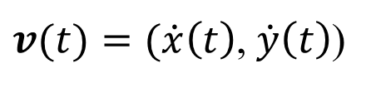
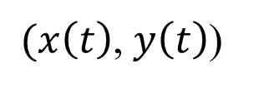
Mire jó? Pálya animáció + egyebek
$v(t)=(\dot{x}\left(t\right)$,$\dot{y}\left(t\right)$)
$(x\left(t\right)$,$y\left(t\right)$)
$x\left(t\right)=\frac{\sin\left(t\right)\left(\sin\left(t\right)+3\right)3}{\sin\left(t\right)+2}$,$y\left(t\right)=\frac{\cos\left(t\right)4+1}{\sin\left(t\right)+2}$
Pálya:
void Animate(float t) {
Cliff x = Sin(t) * (Sin(t) + 3) * 3 / (Sin(t) + 2); // path
Cliff y = (Cos(t) * 4 + 1) / (Sin(t) + 2);
float v = sqrtf(x.d * x.d + y.d * y.d); // velocity
vec2 it(x.d/v, y.d/v), jt(-y.d/v, x.d/v); // rotation
Draw(vec2(x.f, y.f), it, jt); // position, i’, j’
}

Slide 31
Ellenőrző kérdések
Mondj egy-egy axiómát az euklideszi, hiperbolikus és projektív geometriából, amely a többi geometriának nem érvényes állítása.
Kommutativitás, asszociativitás, disztributivitás mely vektorműveletekre érvényes? Bizonyítás?
Bizonyítsd be, hogy a fő görbületi irányok egymásra merőlegesek.
Vezesd le a kör parametrikus egyenletének racionális változatát.
Írd fel egy adott vektorral való vektoriális szorzást, mint transzformációs mátrixot.
Egészítsd ki a Clifford osztályt inverz és összetett függvény deriválásával.
2D: Írd fel az egyenletet!
A parabola implicit egyenlete (azon pontok mértani helye, amelyek egyenlő távolságban vannak a p ponttól és az (r0, n) egyenestől),
Hiperbola (a p1, p2 pontoktól mért távolságkülönbség = C)
Koordinátatengelyekkel párhuzamos tengelyű ellipszis paraméteres egyenlete
3D: Írd fel az egyenletet!
Gömb, henger és paraboloid implicit egyenlete
Két kitérő egyenes (r1, v1) és (r2, v2) távolsága
Azon pontok, amelyek p1, p2 pontoktól mért távolságnégyzet összege = C.

