Slide 1
Számítógépes grafika Bevezetés
Szirmay-Kalos László
email: szirmay@iit.bme.hu
http://cg.iit.bme.hu/

Slide 2
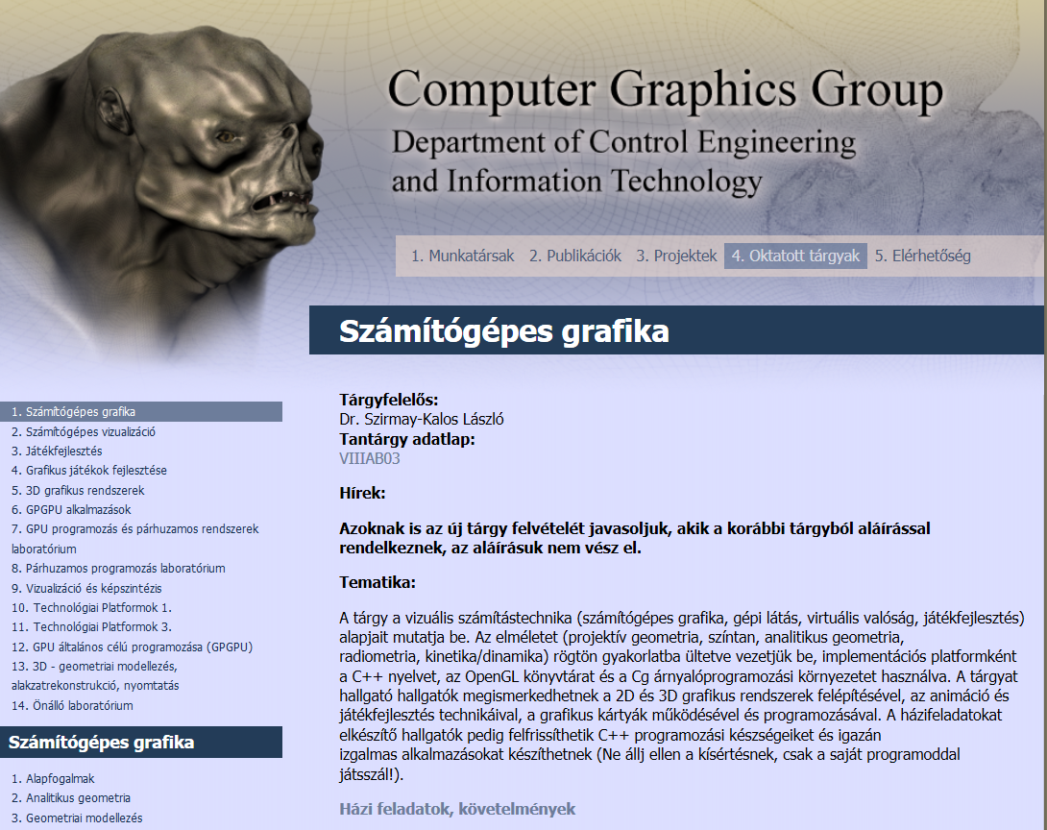

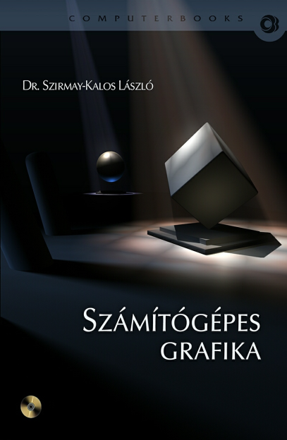
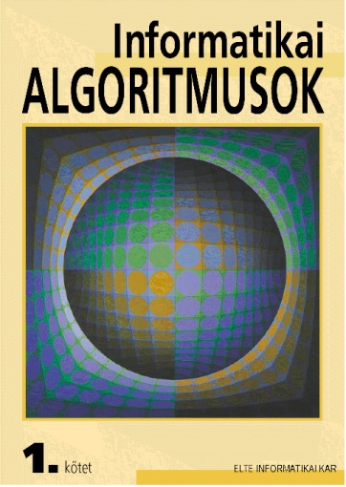
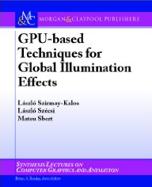
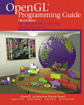
http://cg.iit.bme.hu
3 db (kötelező) kisházi
1 db önkéntes nagyházi
ZH (pótZH)

Slide 3
Számítógépes grafika
illuzió
modellezés
számok
Virtuális világ
képszintézis
Számítás
pixelek:
piros
zöld
kék
Analógia:
3D: optika
2D: kockás füzetbe
rajzolás
stb.
mérés
Notes:
In computer graphics we render virtual worlds by taking a photo of them and presenting their image to the user. The virtual world is stored in the computer memory. The virtual world model can be the result of an interactive modeling process, simulation, measurement, etc.
Rendering can be regarded as an abstract mapping from the virtual world model to the intensity and color values of the computer screen. There are infinite number of possibilities to define this mapping. If we wish to have images that look like real images, we should simulate the image creation process or the real world. For example, we can simulate light transport, i.e. optics, or manual drawing.

Slide 4
2D képszintézis analógia: rajzolás
Modell
Kép
szín
(200, 200)
topológia
viewport
window
(200, 100)
geometria
Saját színnel rajzolás
2D világ koordináta rendszer: Egység!!!
Notes:
Let us look at the details when the virtual world is two dimensional, so objects are in a plane. A convenient reference system is a Cartesian coordinate system with an origin, two axes and also a unit. Using these every point of the plane can be specified by two numbers defining the distance traveled along the two axes and measured with respect to the unit.
With pairs of numbers, points can be defined, which can form primitives by adding topology information. For example, we can say that these three points define a triangle. Primitives are given material properties, which usually include the color.

Slide 5
3D képszintézis analógia: optika
Tone
mapping
pixel
Virtuális világ
λ
λ
szín
Valós világ
λ
λ
λ
Notes:
If we want to create photo like images, we should simulate the light transport and provide the user with the illusion that he watches the real world and not a computer screen.
If we could guarantee that the human eye gets the same photons (i.e. the same number and of the same frequency) from the solid angle subtended by a pixel as the eye got from the real world, then it would not be possible for the user to distinguish between the computer monitor and the real world since the same photons result in similar color impressions. So in computer graphics, we should compute the number and frequency of photons, i.e. the power spectrum of the light that would enter the eye from the solid angle of each pixel. Then the display should be controlled to emit similar photons. Fortunately, we do not have to emit exactly the same spectrum since the human eye is very bad in measuring a spectrum. In fact, the illusion of most of the spectra can be provided by carefully selected red, green and blue intensities. So having calculated the spectrum, we convert it to an equivalent red/green/blue intensity triplet and get the monitor to emit it.
The calculation of the light spectrum requires the solution of the photon transfer or the transfer of electromagnetic waves. The equations describing these phenomena are the Maxwell equations, so in fact, graphics should solve these fundamental equations to obtain the image.

Slide 6
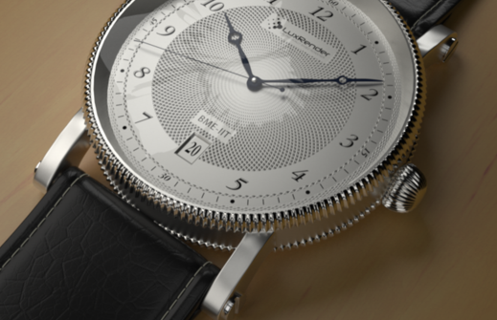
Optika:Fotorealisztikus képszintézis
Notes:
The results of the simulation of optics laws or Maxwell equations are indeed like real photos.

Slide 7
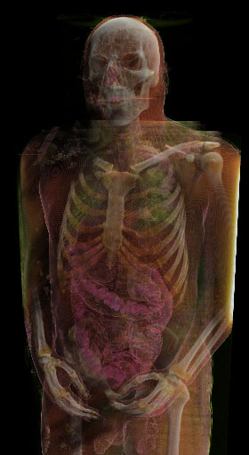
Kihívások
Nagy modell(giga/terabyte)
Valós idő: pár nsec/pixel

Slide 8
Tematika
Geometriák és algebrák ismétlés
Modellezés: görbék, felületek
Transzformációk, homogén koordináták
2D képszintézis, freeglut+OpenGL 3
3D képszintézis fizikai alapjai
Sugárkövetés
Inkrementális képszintézis, freeglut+OpenGL+GLSL
Animáció, Játék
Fraktálok

