Slide 1
R?
Python?
UNIX command line/ shell?
Galaxy?

Slide 2
There is almost always more than one way to solve a scripting problem

Slide 3
R
Pro:
Great packages for statistics, plotting, bioconductor
Built for interactive analysis with data
Con:
Not a serious programming language for very large projects

Slide 4
Python
Pro:
Powerful programming language with many users and libraries
Designed to be easy to read
Con:
Confusion between v2 and v3
Somewhat high learning curve to write simple scripts than R/ perl etc

Slide 5
UNIX
Pro:
Incredibly powerful, simple scripting tools – e.g sort, join, diff, awk, sed …
Con:
Not so good on Windows
Hard to read and understand sometimes

Slide 6
Galaxy
Pro:
GUI based. No scripting need.
All tools installed for you
Records history.
Con:
Not as flexible as your own scripts

Slide 7
Code writing equation
In approaching a problem, consider –
How long will it take to code?
How long will it take to run?
How many times will you use the code?
Will anyone else ever use it?

Slide 8
In all cases, keep detailed notes about your scripts and which versions were used for your analysis
THIS IS IMPORTANT!

Slide 9
Reproducible Research
Tim Read

Slide 10
Examples of movements that should not be oxymoronic(!)
Real Food
Evidence Based Medicine
Reproducible Research

Slide 11
Reproducible research
“The term reproducible research refers to the idea that the ultimate product of academic research is the paper along with the full computational environment used to produce the results in the paper such as the code, data, etc. that can be used to reproduce the results and create new work based on the research. The concept of "computational reproducibility guarantees a model of 'best practices' in an era of 'Big Data' by offering up information for greater scrutiny and skepticism by peers and an informed public."
http://en.wikipedia.org/wiki/Reproducibility#cite_note-8 /Feb 2014

Slide 12
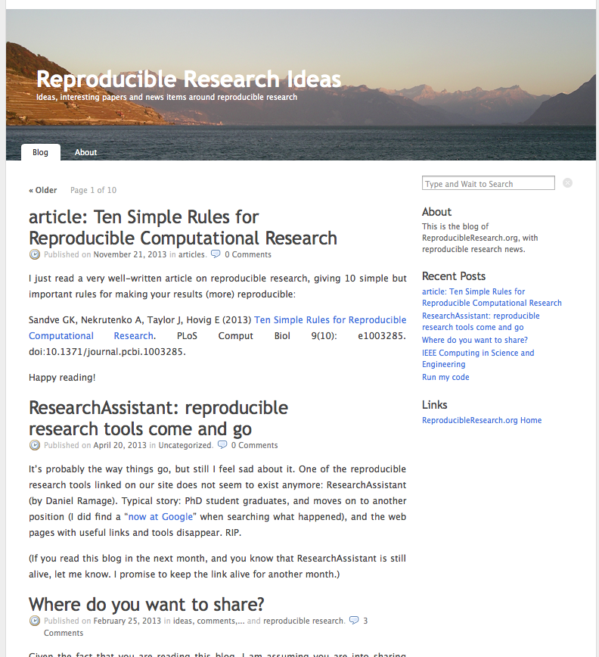
The Reproducible Research movement
Primarily in computational fields, e.g statistics, physics, computer science
Now gaining notice in biological sciences
http://www.reproducibleresearch.net/blog/

Slide 13
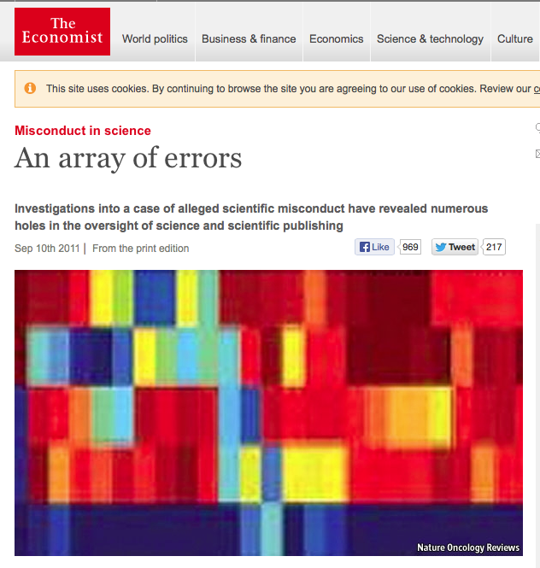
The Anil Potti Debacle
http://www.economist.com/node/21528593

Slide 14
Anil Potti/ Duke University
Potti and Nevin published NEJM article in 2006 demonstrating lung cancer prediction from microarray data
Launched clinical trials based on this and other results
Other investigators could not replicate the analysis or the findings
E.g one gene (ERCC1) was not on the arrays used but was claimed to be a critical biomarker
Subsequently, the trials were stopped and publications all retracted

Slide 15
Major Problems revealed
Poor supervision by PI
Poor data analysis procedures – Potti did not check his work properly
Observer bias/ fraud: the results were cherrypicked to obtain a useful conclusion (also Conflict Of Issues issues)
Defensiveness by the Researchers and Journals
Critically: no way for outside investigators to reproduce the published analysis

Slide 16
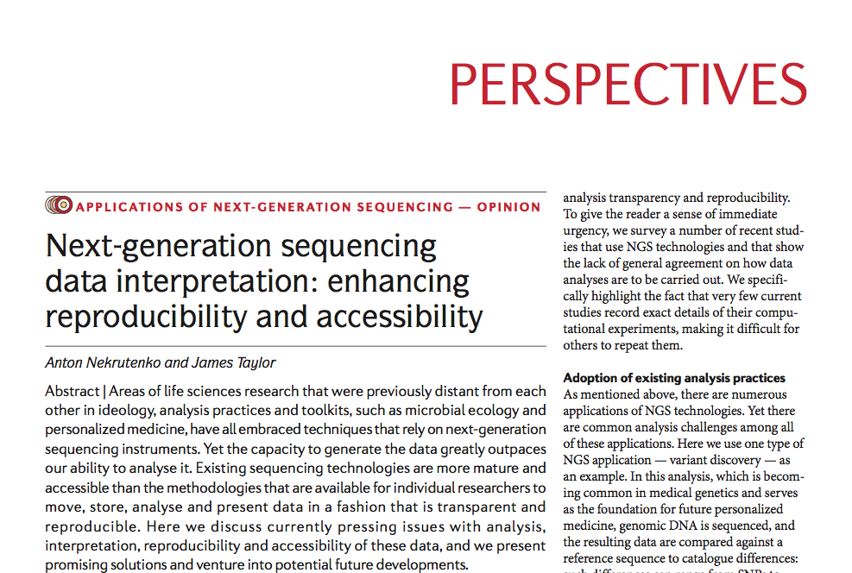

Slide 17
Problems with Computational Data Analysis in NGS
Computational data is becoming more complex and also more commonly used (often by non-specialists)
Key findings come from highly processed forms of raw data
Most NGS articles contain figures and assertions that cannot be reproduced based on descriptions in the methods
(BTW – these problems are not limited to Computational Data)

Slide 18
Guidelines
“Accept that the computational component is becoming an integral component of biomedical research. As the life sciences are becoming increasingly data-driven, there will be no escape from computation and data handling. Familiarize yourself with best practices of scientific computing using existing educational resources, such as the Software Carpentry project. Implementing good computational practices in your group will automatically take care of many of the points listed below”

Slide 19
Guidelines
“Always provide access to primary data. It is obvious that without access to the original data sets, any claims made in a publication cannot be verified”

Slide 20
Guidelines
“Record versions of all auxiliary data sets used during the analysis. For example, in most NGS analyses, such as variant discovery detailed here, sequencing reads are compared against a reference genome. It is crucial to record which reference genome was used because, just as software has versions and cars have model years, genomes have build identifiers..”

Slide 21
Guidelines
“Note the exact versions of software used. Different versions of the same software often produce different results, and important bug fixes may have implications to results produced with a particular version of a tool. “

Slide 22
Guidelines
“Record all parameters, even if defaults are used. Although the reason to record all parameters requires no explanation, we emphasize the importance of explaining default settings for reproducibility. A clause ‘software was used with default settings’ is found in many publications. However, the meaning of default settings often changes between versions of software and can be quite difficult to track down when a substantial amount of time has passed since publication. Thus, record what the default settings actually are. “

Slide 23
“Do not reinvent the wheel. It pays to reuse existing software. Integrative frameworks and associated application stores already house hundreds of tools (for example, as of May 2012, Galaxy ToolShed contains ~1,700 tools). It is likely that a script for a particular problem has been already written. Ask around through existing resources such as SEQanswers and BioStar. (and StackOverflow)

Slide 24
“Provide all custom scripts. With the complexity of NGS analysis, it is often unavoidable to create simple scripts that carry out such straightforward tasks as, for example, changing data formats. Such scripts must be made accessible as any other part of the analysis. “

Slide 25
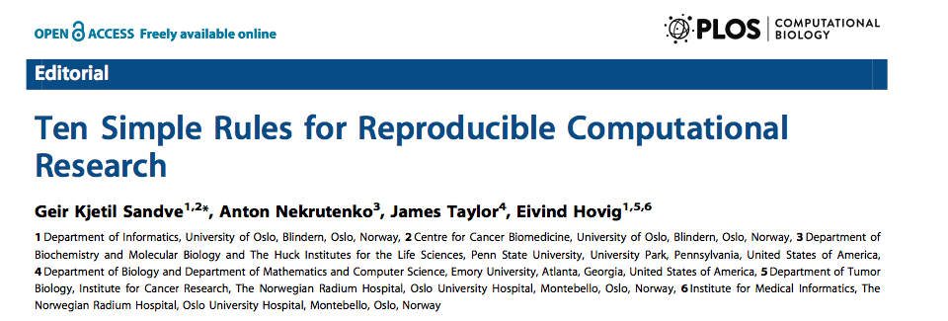

Slide 26
Tools for Reproducible Research
Version Control: Git/ Mercurial etc
Electronic Notebooks: Sweave, iPython, KnitR
Integrated Development Environments that incorporate these features: Rstudio
Galaxy: Save analysis parameters and workflows
Virtual Machines that reproduce analysis and original data

Slide 27
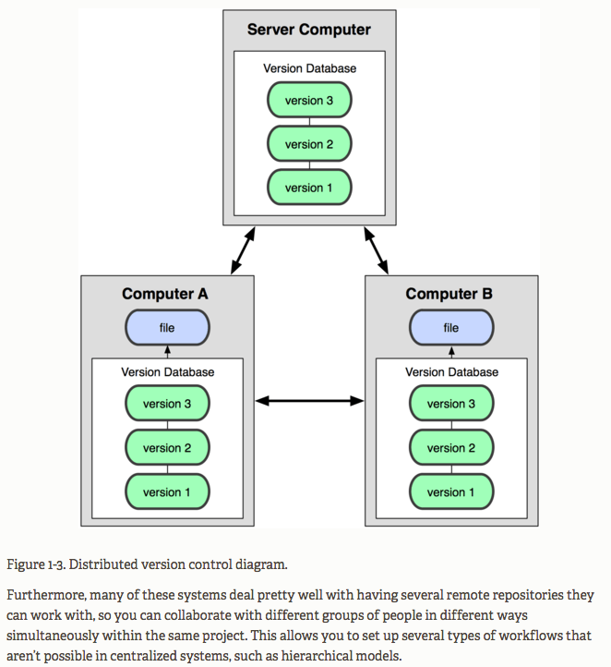
Git
Tracks versions of software
Makes it easy to reproduce earlier software versions
Allows collaborative development
Backup code
Makes public release easy

Slide 28
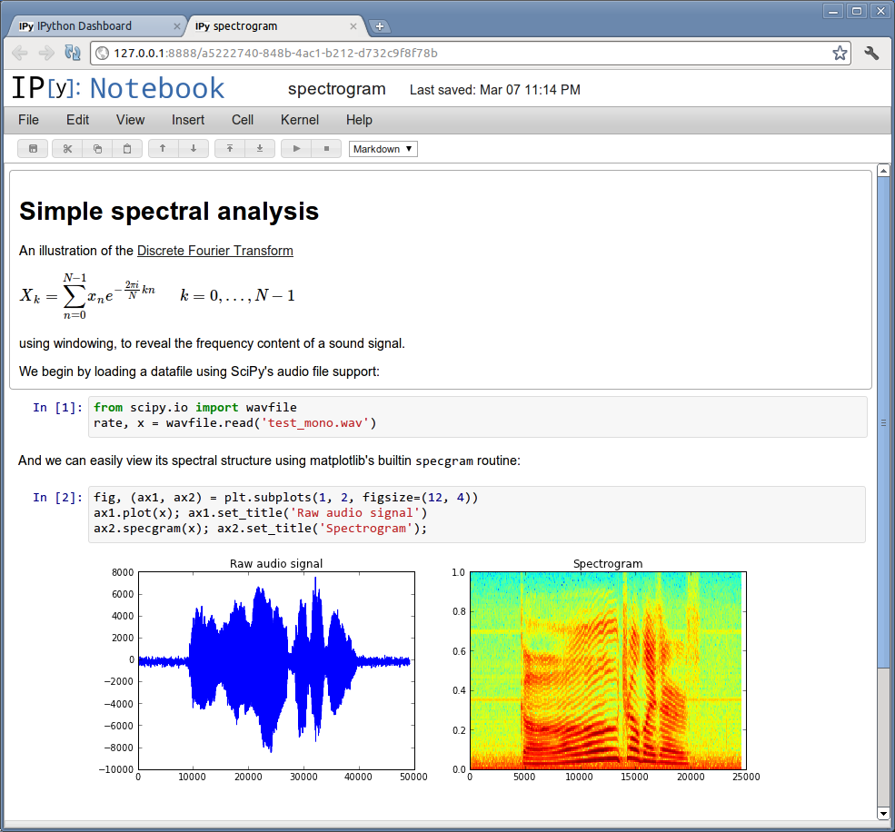
iPython
The IPython Notebook is a web-based interactive computational environment where you can combine code execution, text, mathematics, plots and rich media into a single document
Notebooks can be shared over the web
Example: http://nbviewer.ipython.org/gist/pschloss/9815766/notebook.ipynb

Slide 29
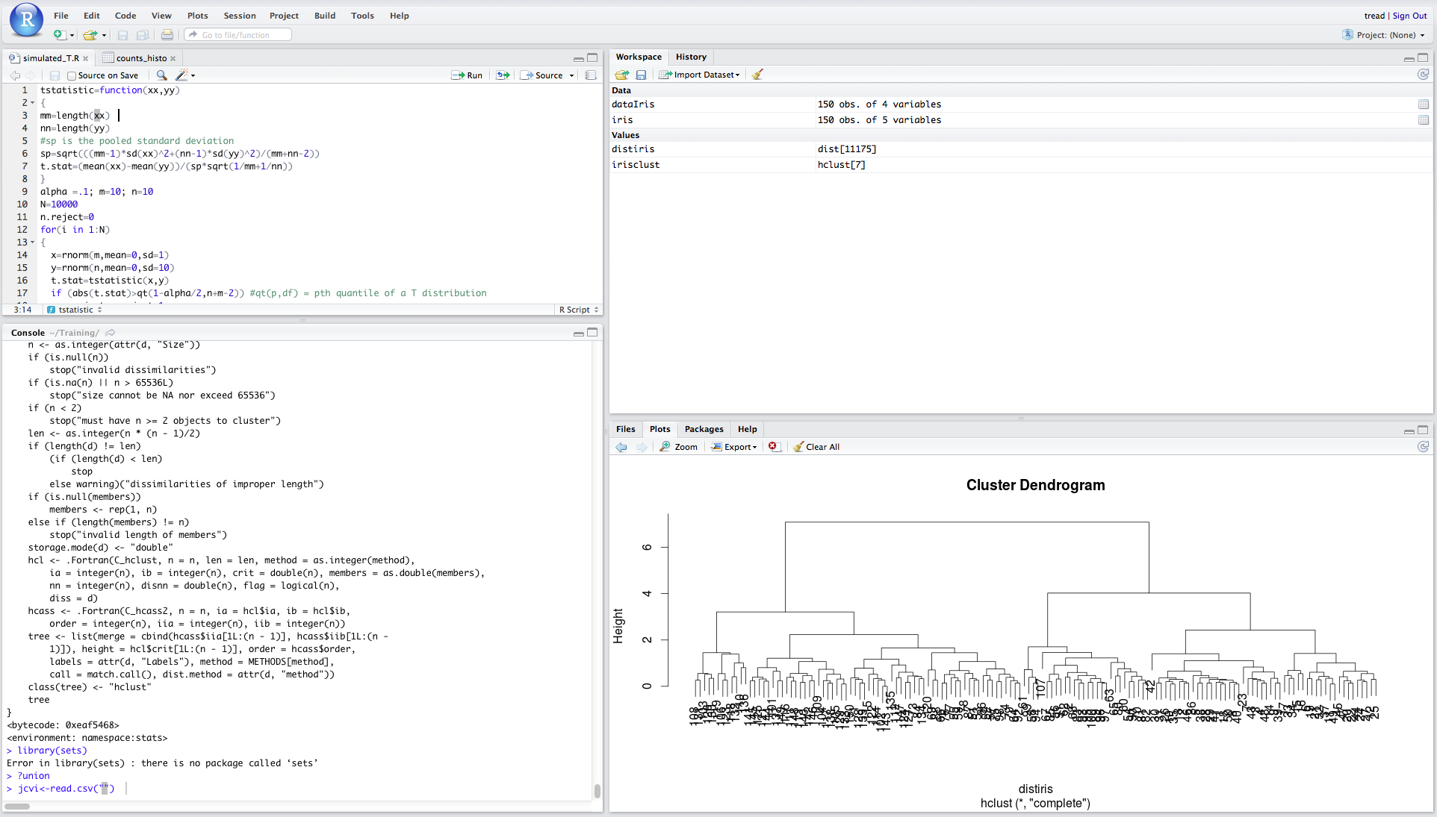
RStudio

Slide 30
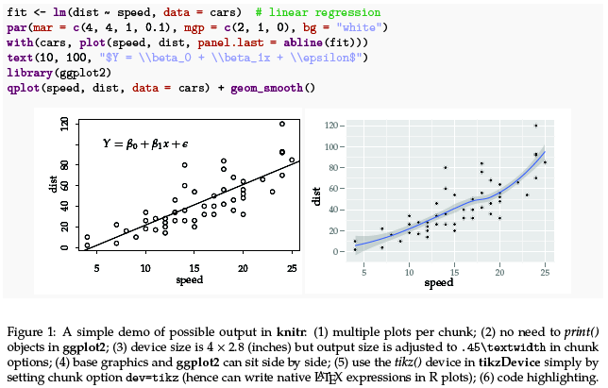
knitr
Opensource package for combining R code and results
Uses simple text markdown
Can produce results in HTML format or PDF

Slide 31
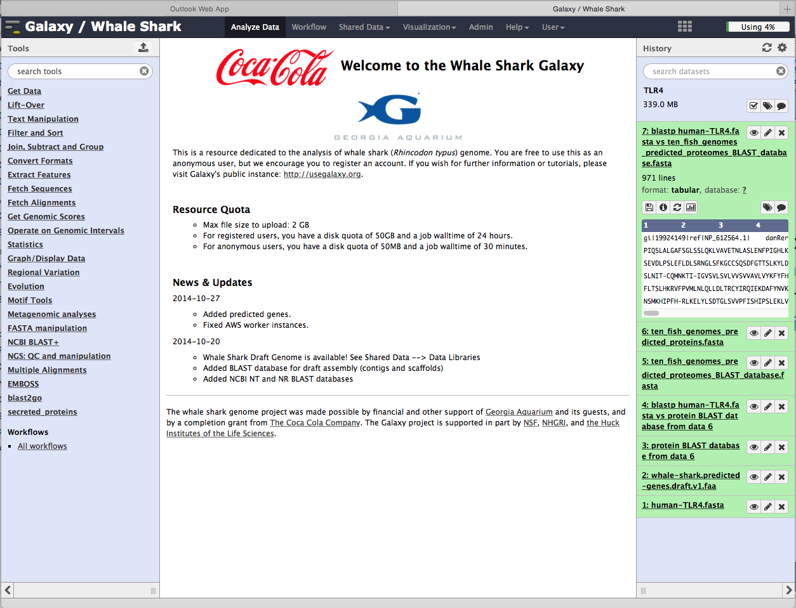
Galaxy
Galaxy histories record all information about input files, software version etc

Slide 32
Virtual machines/ data buckets
Take an image (snapshot) of the environment used to create the data
Saves software, input, output and intermediate files
Often available on the Cloud. E.g. 1000 genomes project:
http://aws.amazon.com/1000genomes/

Slide 33
Recommendations
Become familiar with Reproducible Research guidelines
For existing projects, try to adapt workflows as well as possible.
For future projects, design workflows at the outset to be compatible
Always, take good notes (backup plan)

Slide 34
Markdown
Markdown is a simple text language standard that can be processed (rendered) by third party software
Think HTML, LaTeX, MediaWika but much simpler
Fast becoming a web standard
Used in Github, Rstudio and many other places

Slide 35
Go to http://markdowntutorial.com and spend 5 min learning the easy syntax

