Slide 1
IBS574
Genome Assembly

Slide 2
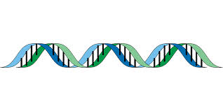
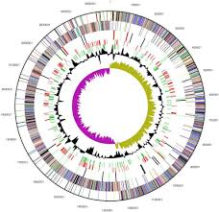
Sequence reads to genome sequences
DNA
Sequence reads
Assembled genome sequence

Slide 3
Outline
Basic approaches: clone-by-clone and shotgun
A Theoretical Model
Different algorithmic approaches to assembly
newbler
Velvet
Finishing Genomes
Perspectives

Slide 4
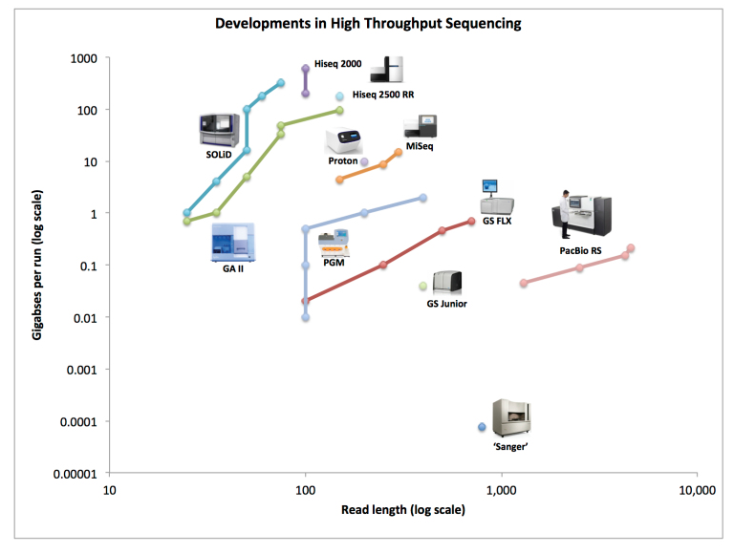
How do we generate data today?: many sequencing technologies
Lex Lederbragt

Slide 5
In the 1990s there was just one
Lex Lederbragt

Slide 6
In the 1990s two genome sequencing strategies vied for dominance
“Clone-by-Clone”
Whole genome shotgun
Make clone library (cosmid, fosmid etc)
Map clones and create tiling across the genome
Sequence each clone by primer walking / random shotgun
Merge clone sequences
Randomly fragment genome
Sequence fragments
Put together sequences using genome assembly software

Slide 7
Genome Assembly Terminology
Assembly = Overlapping individual reads based on sequence similarity to form contigs or assemblies of sequences.

Slide 8

Overlapping sequence reads
Test each read pairwise to see if it overlaps
If it does it can be merged into a contig
Can use the Needleman-Wunsch/ or S-W but in practice it is very compute expensive for large projects

Slide 9
“clone by clone” - Divide and conquer
Make BAC/ cosmid clone maps of genomes
Select clones that span the genome
For example the 4.2 Mb Bacillus subtilis genome was sequenced by a cartel of 46 Institutions in Europe and Japan (Kunst et al 1997, Nature 390:249-56)

Slide 10
Clone sequencing
Primer Walking
Nested deletion

Slide 11
Shotgun sequencing became the dominant approach because …
Costs to mass produce high quality DNA sequence fell dramatically
Labor costs did not
“Clone by Clone” is labor intensive but uses fewer sequences than “Shotgun Sequencing”

Slide 12
Shotgun sequencing
Four technological developments led to large scale shotgun sequencing
Automated DNA sequencing technologies
Development of theoretical model (Lander-Waterman)
Large scale de novo sequencing software
Cheaper compute storage and processing

Slide 13
Shotgun cloning/sequencing
DNA extraction
Mechanical DNA
shearing
Assembly of
Whole Genome
Cloning into
sequencing vector
Random sequencing
Consensus

Slide 14
Random shotgun assembly typically leaves gaps
Contigs/ assemblies
reads
Notes:
Why does the central contig have greater depth

Slide 15
How much sequence do you need? -The Lander-Waterman Equation
A mathematical model for whole genome shotgun experiments.
Used for experimental design of complete microbial genome studies and later the human genome.
Lander, E. S., and M. S. Waterman. 1988. Genomic mapping by fingerprinting random clones: A mathematical analysis. Genomics. 2:231-239.

Slide 16
Terminology: genome coverage (a.k.a redundancy)
G = genome length (bp)
w = average sequence length
n = number of sequences
Mean number of sequences per bp is equivalent to coverage (c)
c = wn/G
e.g If w = 500, n = 20,000 and G = 1,000,000 bp the average genome coverage c = 10

Slide 17
From the Poisson distribution, probability of zero coverage
P(0) = e^{-c}
Expected number of gaps(contigs)
E(contigs) = n.e^{-c}
n = number reads
c = coverage
Notes:
Number of gaps = G.e^-cs where s is the ratio of the clone overlap w/L (L is the minumum overlap depth).
What are the oversimplifications of the model.

Slide 20
Why isn’t genome assembly perfect?
Repeats
Sequence errors (break overlaps between contigs)
Imperfect representation (systemic errors in sequencing technology, e.g. G+C bias)

Slide 21
Computational Strategies for de novo assembly
Greedy algorithms (SSAKE)
Overlap-Layout-Consensus (Celera, Newbler)
De Bruijn (SOAP, Euler, Velvet, AllPaths, ABySS)

Slide 22
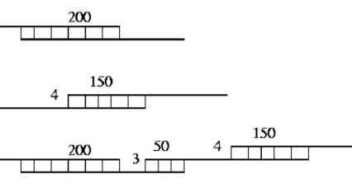
Simple Greedy Assemblers
“The greedy algorithms apply one basic operation: given any read or contig, add one more read or contig. The basic operation is repeated until no more operations are possible. Each operation uses the next highest-scoring overlap to make the next join. T.”
http://www.cbcb.umd.edu/research/assembly_primer.shtml

Slide 23
Overlap-Layout-Consensus
Overlap: Create a node for each read, and for each overlap create a directed edge.
Layout: Simplify the graph, by discarding sub-optimal reads. Find the Hamiltonian Path, a path that goes through each node only once.
Consensus: Create progressive alignments, and create a contig of the consensus.

Slide 24
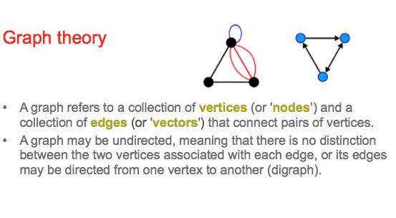
Graphs
http://en.wikipedia.org/

Slide 25
newbler
Developed by 454 Inc (later Roche) for 454 assembly
Adapted to use output of multiple technologies
See http://contig.wordpress.com/2010/02/09/how-newbler-works/

Slide 26
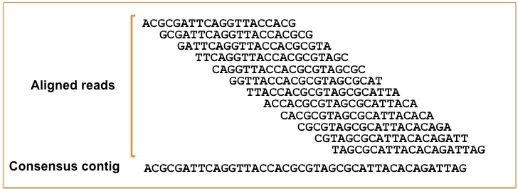
Create overlaps
Note: This is where sequencing read length really matters

Slide 27
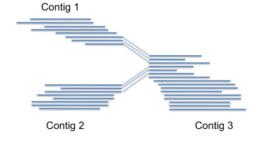
Identify edges
Dotted reads begin in one contig and end in another contig

Slide 28
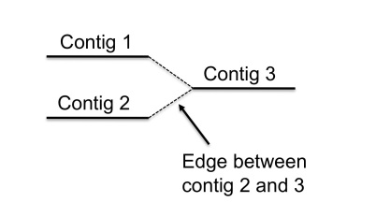
Layout graph

Slide 29
Resolve contig graph
Looking for Hamiltonian path – path that includes each node only once (computationally – this is NP hard)
Repeats mess this up of course
Ideally, try to resolve into one graph, but usually the software beaks genomes into multiple Hamiltonian paths

Slide 30
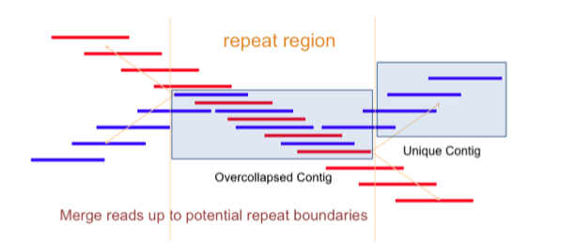
Repeat regions mess up assemblies
Gymrek, Tsai, Taft, Dhandhania

Slide 31
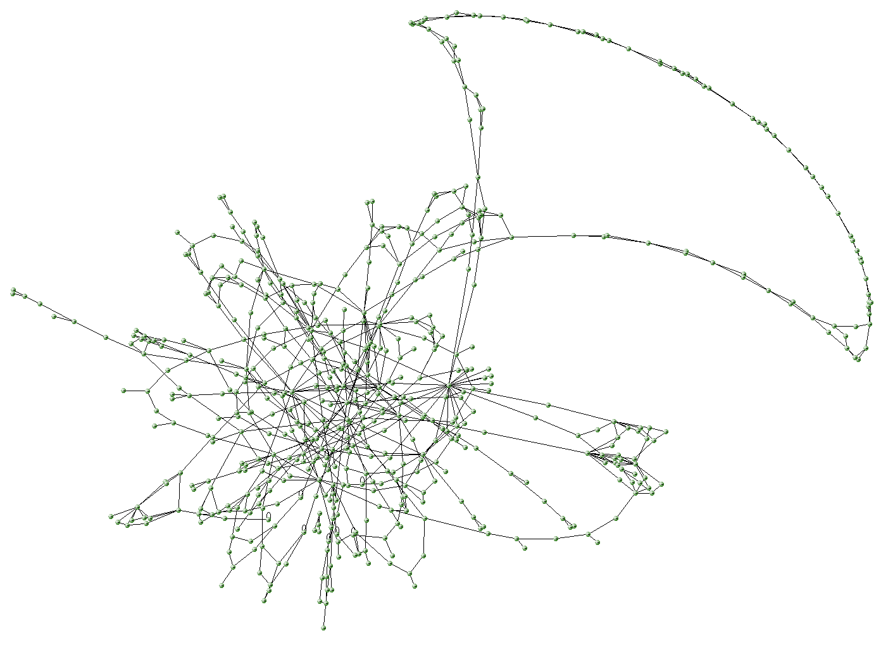
Real contig graph

Slide 32
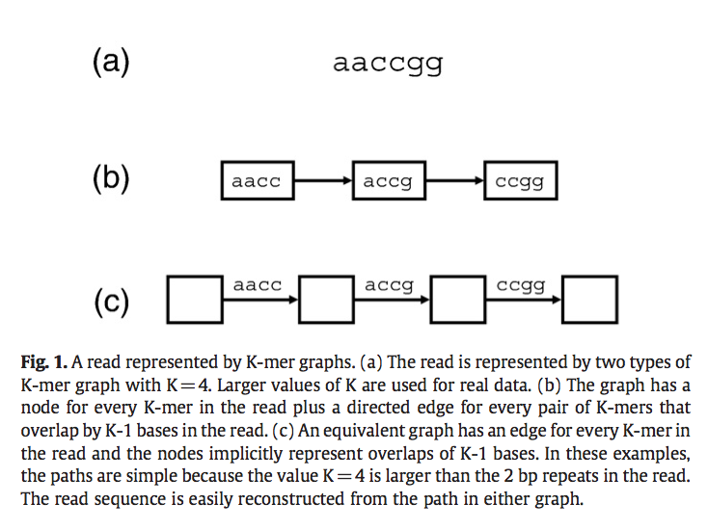
Short read mapping requires new graphs
De Bruijn Graphs - K-mer maps
“The DBG approach is more appropriate for the large volumes of reads associated with short-read sequencing. DBG avoids the computationally expensive all-against-all pair-wise read comparisons. DBG avoids loading all the replicate sequences associated with high-coverage sequencing.”
Miller et al Genomics 2010 95:315

Slide 33
Terminology: k-mers
A k-mer (also called n-mer) is an oligonucleotide ‘word’ of length k.
DNA sequences can be decomposed into shorter k-mers
Often the number of times the k-mer occurs will be counted e.g the k-mer “TTT” occurs 3 times in the sequence:
ATTTTTGCTAGCT

Slide 34
De Bruijn Graph Assembly
Break reads into overlapping k-mers where the overlap length is k-1
Each k-mer is a node, directed edges connect k-mers which share k-1 overlaps
Find a Eulerian Path, a path which visits every edge exactly once. Derive a contigs from this path.

Slide 35
Velvet
First successful de Bruijn graph assembler
Two programs:
velveth = creates k-mer table
velvetg – resolves graph
Zerbino, D. R. & Birney, E. Velvet: algorithms for de novo short read assembly using de Bruijn graphs. Genome Res. 18, 821–829 (2008).

Slide 36
Velvet – how long should the k-mer be?
Guess?
Determine empirically using an optimizing software
Use a “rule of thumb”
k = L+ 1 – C * G / n
Where G = genome size, L = read length, n = number of reads

Slide 37
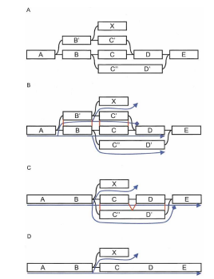
velvetg processing
Remove topological errors
Tips
Bubbles
Detect sequencing errors post-assembly
“Tour bus” error correction

Slide 38
Pros and Cons
RAM available
Greedy
OLC
De Bruijn
Genome Size

Slide 39
Some stats to assess assembly quality
Number of contigs
Contig sizes
Number of discordant bases
N50

Slide 40
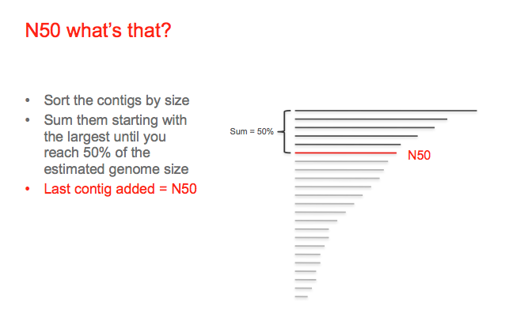
Laurent Falquet

Slide 41
Genome Finishing Terminology
Sequence gap = gap between contigs where sequences cannot be reliably placed but where there is information linking the contigs
Physical gap = gap with no information linking contigs
Scaffolds = Groups of contigs linked by sequencing gaps. Scaffolds are separated by physical gaps

Slide 42
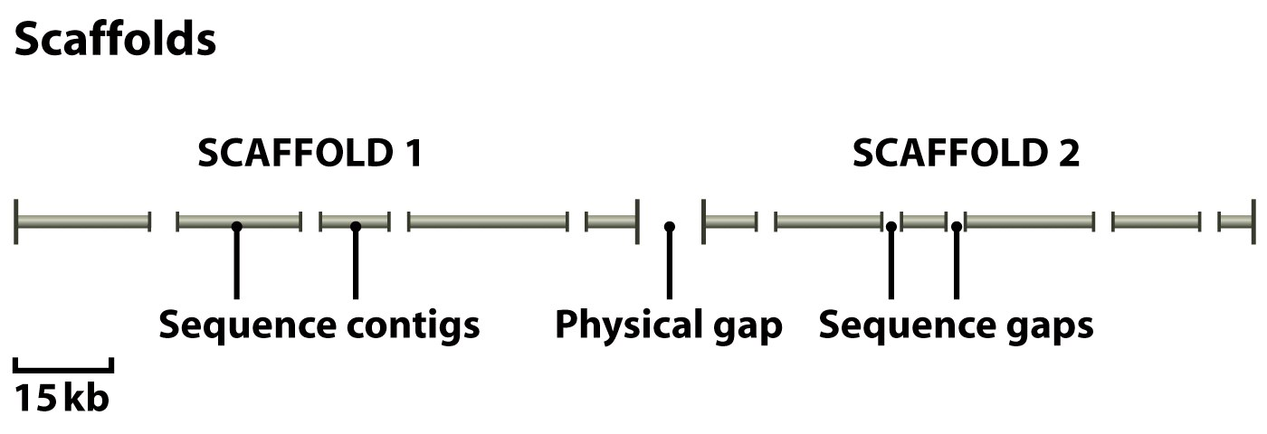
Gaps and Scaffolds
Scaffold are subgraphs of the overall Assembly graph
Figure 4.17a from Brown, Genomes 3 (© Garland Science 2007) No redistribution outside AHPL servers without publishers permission.

Slide 43
Scaffolding
Mate pair reads
Optical Maps
Other methods (e.g. Pacific Bio strobe reads)

Slide 44
Mate Pair
Two reads from the same DNA fragment separated by 2-200 kb
Traditionally clone libraries (BAC, pUC18) but there are next generation strategies for mate pair creation without cloning
Also used for structural variation studies
Insert DNA (red) in cloning vector. Sequence reads (blue)

Slide 45
Scaffolding with mate pairs
Mate pair
contig
Seq. gap
SCAFFOLD

Slide 46
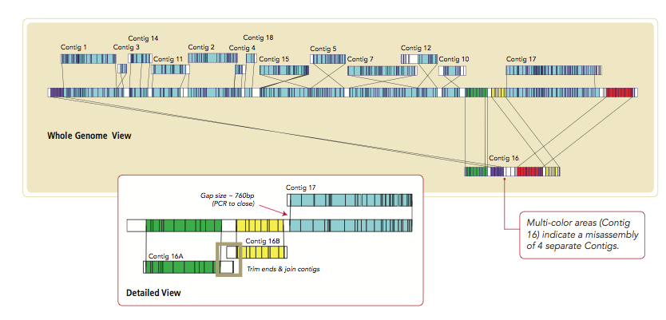
Mapping against restriction barcoded genomes
e.g. OpGen (http://www.opgen.com/)

Slide 47
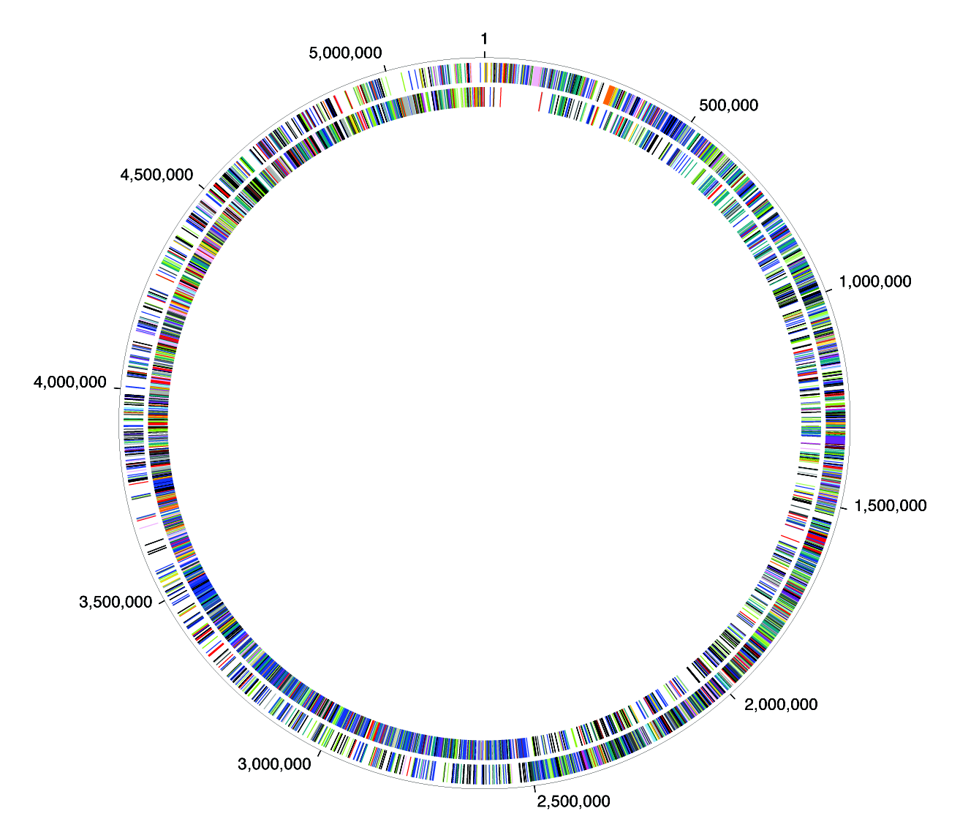
Genome Closure
Shotgun Random Sequencing
+
Remove rRNA
+
Assembly
Gap’s PCR
+
Sequencing PCR Products
+
Individual PCR Product Assembly
Reassembly
B. anthracis

Slide 48
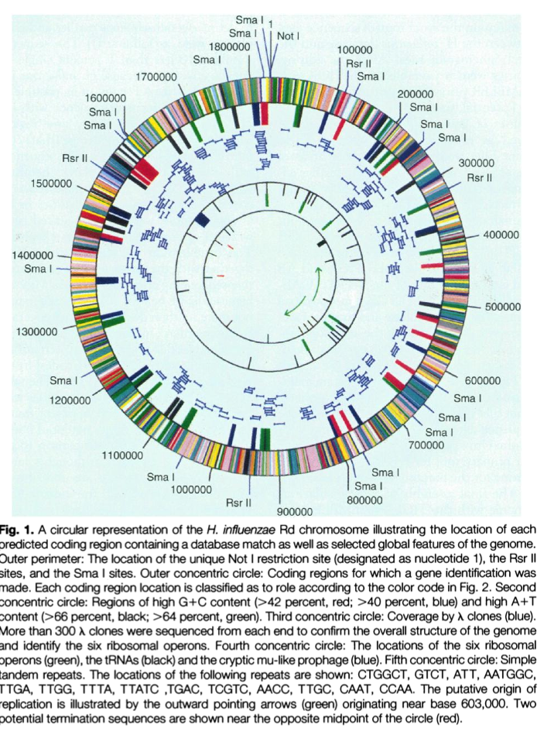
The complete genome
Haemophilus influenzae Rd (Fleischmann et al 1995, Science).
1.8 Mb Genome
24,000 reads of about 460 nt ~ 11.040 Mb
c = 6.13
210 contigs from whole genome shotgun

Slide 49
Draft or Complete Genome Sequence?
Draft
Sequence to high redundancy but no closure.
Quick.
Cheap.
>90% genes of genome
Complete
Sequence to high redundancy and close gaps between contigs.
Closure can take a long time (years).
Generally more accurate.
Get sequence of all genes in the genome.

Slide 50
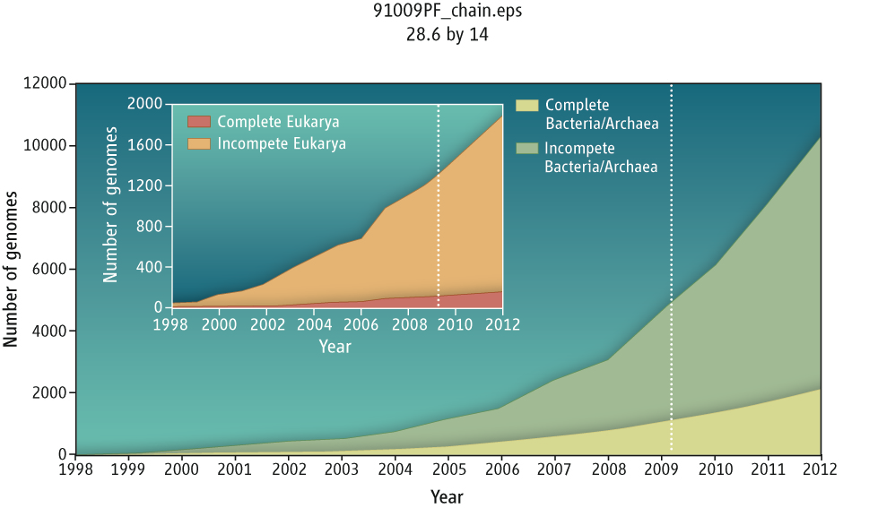
Microbial genomes production

Slide 51
Will the future be all complete genomes?

Slide 52
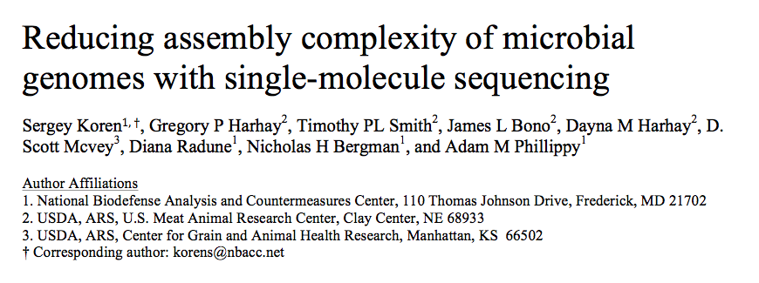
End of the draft genome era?
Genome Biol 14, R101 (2013).

Slide 53
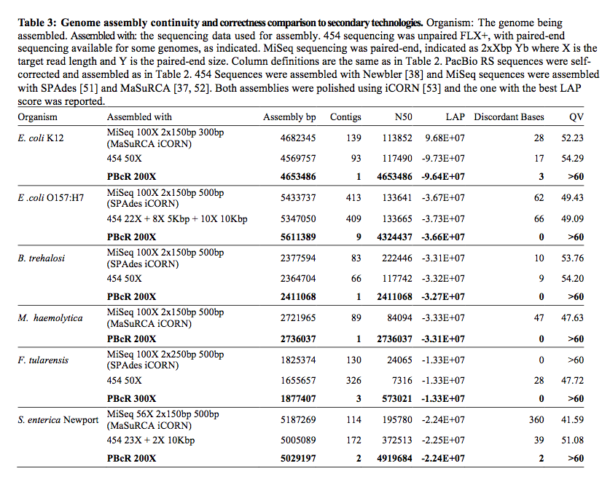

Slide 54
10x Genomics
https://vimeo.com/120429438

Slide 55
Summary
Shotgun genome sequencing is the dominant approach for de novo assembly
Involves generating random sequence data to excess followed by bioinformatic post-processing
Multiple approaches to assembly
Typically genomes are incomplete and need to be finished manually
This may change in the near future …

