Slide 1
IBS574 – Python Tutorial
Part I

Slide 2
Why do Biologists Need to Learn to Write Code?
A variety of reasons
Formatting data for input to GUI programs
Writing simple analysis tools
Stringing together command line programs to make your own informal pipelines
Understanding and modifying other people’s code
… and other reasons

Slide 3
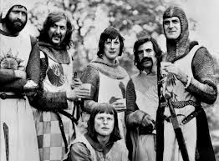
What is Python?
A programming language
Free open source software
First released in 1991
Named after Monty Python’s Flying Circus

Slide 4
Where can I get it?
Installed by default on many computers (Apple Desktops, Linux)
Otherwise, easy to install from www.python.org

Slide 5

An Interpreted Language
Every times the program is run an interpreter translates the text of the program to machine code before execution.
Other languages (e.g Java, C++) must be compiled into machine code before they are run.
Interpreted languages are a bit slower than compiled but easy to modify on the fly.

Slide 6
Why Python?
Readability: Python forces users to write code that is easy for others to understand.
Lots of built in features and 3rd party modules
Large range of applications: Suitable for both creating informal scripts and complex ‘production’ software (e.g Galaxy).

Slide 7
Python versus R
R has been developed as a flexible scripting software for mostly statistical applications.
R is very strong in handling large data sets, computing statistics, and generating graphics. Python can also do many of these functions but not as intuitively.
Python is better than R at most other applications.
It is useful to know both R and Python for genomics data analysis.

Slide 8
Python versus C, C++, Java etc
Python programs are not quite as fast as complied languages (although Python can be compiled).
It’s easier to develop applications in Python in a short time frame.
Unless you are interested in developing very performance demanding algorithms you generally do not need to know these languages for bioinformatics if you know Python.

Slide 9
Python versus Perl
Both are highly flexible interpreted languages that are used extensively in bioinformatics.
Perl (might) have a larger user base – BioPerl is a very useful toolkit.
Python (might) execute slightly faster and is growing rapidly.
The advantage of Python is that it is has much stricter syntax.

Slide 10
Python versus Perl (cont.)
It doesn’t hurt to know both but they essentially fall in the same niche and if you have to know one, Python is probably better.

Slide 11
Lesson Plan
Unix recap
Python interactively
Python scripts
Python Exercises

Slide 12
Key UNIX commands
cat | cd | chmod | cp
date | diff | file | find
ftp | grep | gzip/gunzip | kill
ls | man | mkdir | more/less
mv | passwd | ps | pwd
rm | rmdir | sort | ssh/sftp
tar | awk | sed | tr
find | vi/vim | bzip2/bunzip2 | wget/curl
which/locate | head/tail | history | pushd/popd

Slide 13
Piping UNIX commands
The pipe ( ‘|’ ) is a powerful tool to string together commands
%ls
%sort
%wc
%ls | wc
%ls | sort
%ls | sort > temp.file
%more temp.file

Slide 14
wget/curl
Used to download data using Universal Resource Locators (URLs)
Example: downloading from the Sequence Read Archive:
Browse to http://www.ncbi.nlm.nih.gov/sra
Click on “Trace Archive Home”
Click on “SRA”, then “Browse”, Enter “Zwick” in the Search
Click on #3 (SRP008982), then Runs: 2, then SRR353693
Right-click on SRR353693.sra and select “Copy link address”
In terminal window type “wget [space]” then paste from browser or application menu

Slide 15
wget/curl

Slide 16
Python Basics
Python can be used in two modes:
Scripted (more on that later)
Interactive

Slide 17
Python Data Types
Variable
String
Number
Bool (True or False)

Slide 18
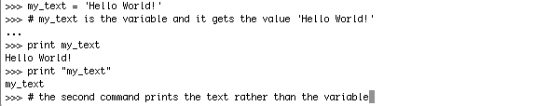
Variables
A way to label and access information
You must assign a value to a variable
BTW – notice the comments marked with #

Slide 19
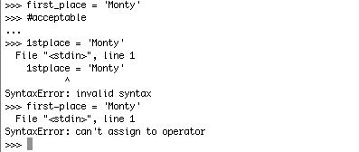
Variables (2)
Case sensitive
Must begin with a letter
May only contain letters, number and underscores

Slide 20
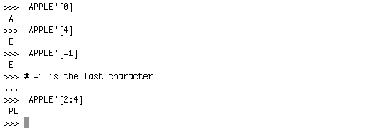
Strings
Special characters
\n - newline
\t - tab
\ - escape (e.g. \’ or \’’)
Strings are indexed per character

Slide 21
String Functions
Python has a rich set of functions to manipulate strings. Some examples
len(seq) # where seq is a variable
seq.find(str1)
seq.replace(str1,str2)
seq.count(“X”)
seq.split(“X”)
NOTE – how functions are appended to variables

Slide 22
Exercises
seq = ‘ATTGAXTTAGCC’
Print the 2nd to the 4th letters
Replace all the G letters with C
Count the numbers of letters
Split the sequence into two subsequences at letter ‘X’
Notes:
print seq[2:4], however indices start at zero
seq.replace(“G”,”C”)
len(seq)
seq.split(“X”)

Slide 23
Numbers
int – whole numbers
float – numbers with decimal point
Operators +-*/%

Slide 24
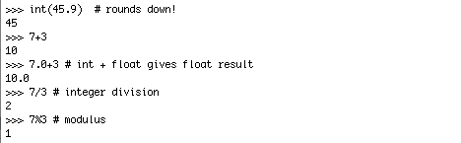
Some things about Numbers

Slide 25
+=
>>> x=20
>>> x+=5
>>> print x
25
>>> # += is an iterative operator, also works for *= , -=, etc

Slide 26
Common number functions
math.pi, math.e
math.sqrt(x)
range(x,y,step) – outputs a list of integers between x and y incrementing by value ‘step’
mathematically: [x,y) or [x,y[ or {x <= range < y}
i.e. y is not included in the list

Slide 27
Exercise
# note – need to first run import math
Calculate the square root of 48 times 67
Output a range of numbers from x to 100, going up in increments of x, for values of x of 2 and 4
Notes:
math.sqrt(48*67)
range(start, stop, step) stop is not included
range(2,100,2)
range(4,100,4)

Slide 28
Using Python in Batch mode
Python commands are most commonly stored in script files
In a text editor such as vi, type and save the following
print “Hello World!”

Slide 29
Running Python Scripts
$ python HelloWorld.py
Hello World!
# but the script will not run without the python command
$ HelloWorld.py
-bash: HelloWorld.py: command not found

Slide 30
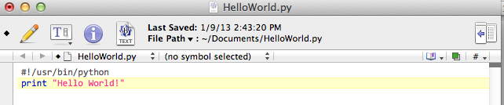
Python Scripts
Commonly a tag is added to the header of the script to tell the computer where to look for Python on execution

