Slide 1
IBS574 – Python Tutorial
Part III

Slide 2
File Input: read(), readline(), or readlines()?
read()
reads the entire file into memory as one big string
may fail if your computer does not have enough memory
returns empty string on end-of-file
readline()
reads one line from the file, including the terminating newline (‘\n’) character
returns empty string on end-of-file
readlines()
reads the entire file as a list

Slide 3
Other Common Data Types
Lists
Tuples
Dictionaries

Slide 4
Lists
A list is a collection of objects (other data types, including lists)
Lists are specified by including objects in square brackets; objects are separated by comma.
>>> first_list = [1,2,"three",4,"five"]
>>> first_list[2]
'three'
>>> len(first_list) # len() also used for single variables
5
sys.argv is an example of a list

Slide 5
List Demonstration

Slide 6
Tuples and Dictionaries
Tuples – immutable lists i.e. can’t be changed
Specified using parentheses instead of square brackets
e.g.
dna_bases = ('A', 'C', 'G', 'T', 'N')
Dictionaries – stores arbitrary indexed unordered data types. Useful for referencing.
e.g
IUPAC = {'A':'Ala', 'C':'Cys', 'E':'Glu'}
Print IUPAC['A']

Slide 7
Exercises: extending gc_content.py
Report the number of ‘GC’ dinucleotides
If you have time - reverse translate the sequence

Slide 8
Flow Control
Mechanisms to control how and when instructions are executed
Python has only three structures
if … else … elif
for
while

Slide 9
If-Else
if EXPRESSION:
Block1
else:
Block2
Note – the colons and the tab indentation are essential

Slide 10
If-Elif-Else
Elif is an Else-if condition. There can be as many elifs as make sense
if EXPRESSION:
Block1
elif EXPRESSION2:
Block2
elif EXPRESSION3:
Block3
else:
Block4

Slide 11
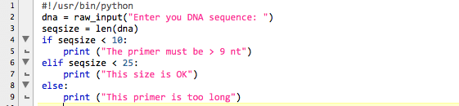
if-elif-else example

Slide 12
$ ./elifExmpl.py
Enter you DNA sequence: hdhdgunskmnskdn
This size is OK
$ ./elifExmpl.py
Enter you DNA sequence: dndnd
The primer must be > 9 nt
$ ./elifExmpl.py
Enter you DNA sequence: sdjslknwlfhjsldcknmsljfghdlsmnvlrkgjhdl
This primer is too long

Slide 13
For Loops
for VARIABLE in ITERABLE:
BLOCK
e.g.
>>> bases = ["C", "T", "G", "A"]
>>> for x in bases:
... print(x)
...
C
T
G
A

Slide 14
prot_charge.py
1 #!/usr/bin/python
2
3 # Name: Viren Patel
4 # Date: 2015-01-22
5 # File: prot_charge.py
6 # Desc: A program to compute protein charge
7
8 import sys # for argv
9
10 protseq = sys.argv[1]
11
12 charge = -0.002
13
14 AACharge = {'C':-0.45,'D':-0.999,'E':-0.998,'H':0.091,'K':1,'R':1, 'Y':-0.001}
15
16 for aa in protseq:
17 if aa in AACharge:
18 charge += AACharge[aa]
19 print(charge)

Slide 15
$ ./prot_charge.py
Enter you Protein sequence: dgbbtysdttttf
-0.002
$ ./prot_charge.py
Enter you Protein sequence: DGTTTHCYTH
-1.27

Slide 16
Exercise
Convert to uppercase if the protseq variable contains any lower case letters

Slide 17
While Loops
while EXPRESSION:
BLOCK
e.g …
>>> a = 10
>>> while a < 40:
... print (a)
... a = a+10 #what happens if this is not here?
...
10
20
30
>>>

Slide 18
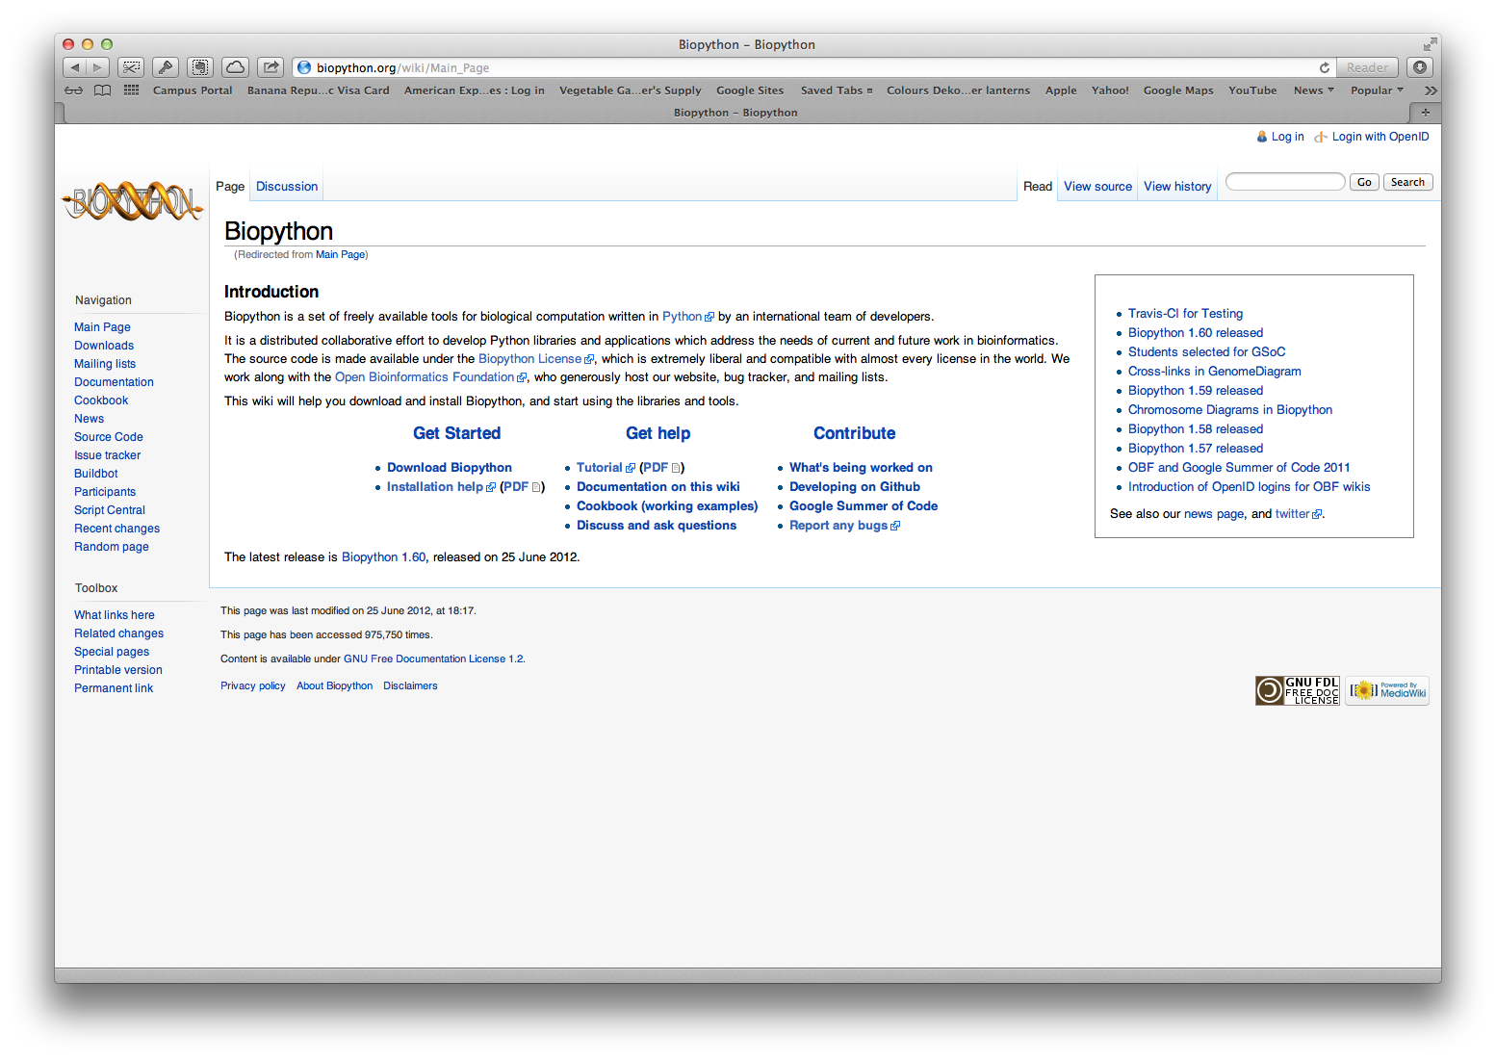
Biopython.org

Slide 19
Python Program Using BioPython
1 #!/usr/bin/python
2
3 # Name: Viren Patel
4 # Date: 2015-01-22
5 # File: biopython_demo.py
6 # Desc: A program illustrating the use of Biopython
7
8 import sys
9
10 from Bio import SeqIO
11
12 for seq_record in SeqIO.parse(sys.argv[1], "fasta"):
13 print(seq_record.id)
14 print("===\n")
15 print(repr(seq_record.seq))
16 print("===\n")
17 print(seq_record.seq)
18 print("===\n")
19 print(len(seq_record))

Slide 20
Biopython Tutorial

Slide 21
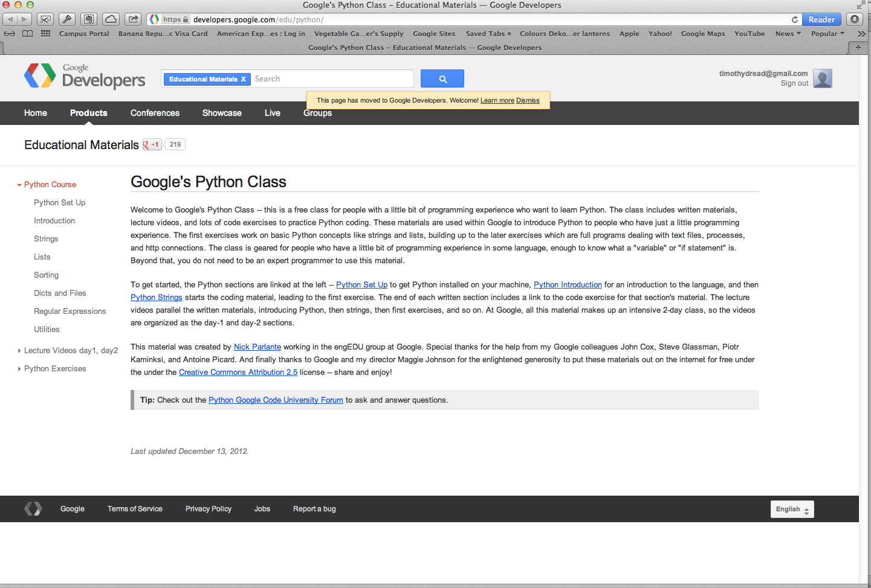
https://developers.google.com/edu/python/

