Slide 1
TADAM model summary

Slide 2
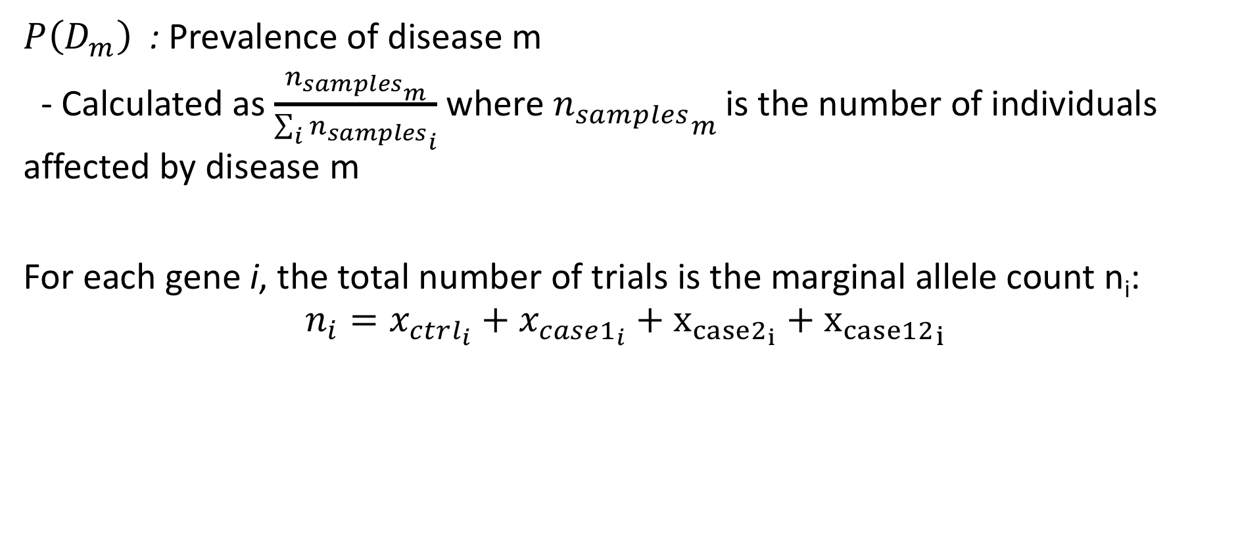
Notation
$P\left(D_{m}\right)$ : Prevalence of disease m
- Calculated as $\frac{{n_{samples}}_{m}}{\sum_{i}{{n_{samples}}_{i}}}$ where ${n_{samples}}_{m}$ is the number of individuals affected by disease m
For each gene i, the total number of trials is the marginal allele count n_{i}:
$$n_{i}=x_{ctrl_{i}}+x_{case1_{i}}+x_{case2_{i}}+{x_{case12}}_{i}$$

Slide 3
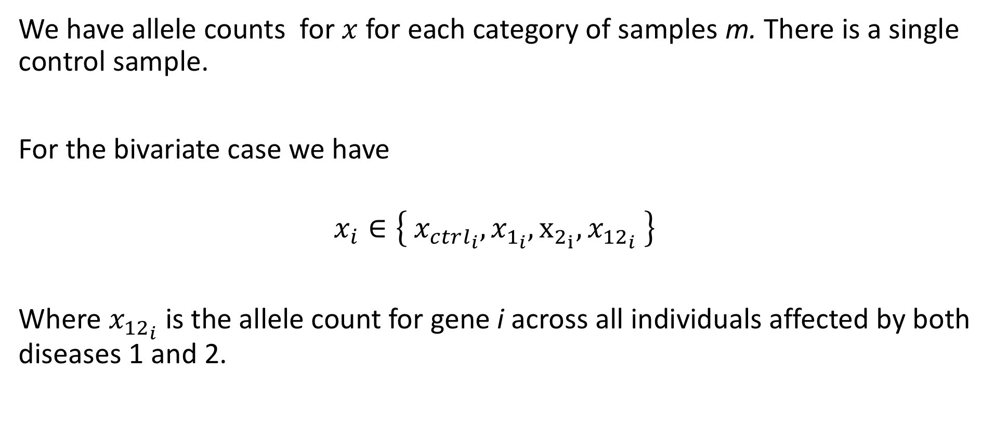
Notation
We have allele counts for $x$for each category of samples m. There is a single control sample.
For the bivariate case we have
$$x_{i}∈\left\{{{ x}_{ctrl_{i}}, x}_{1_{i}}, x_{2_{i}}, x_{{12}_{i}} \right\}$$
Where $x_{{12}_{i}}$ is the allele count for gene i across all individuals affected by both diseases 1 and 2.

Slide 4
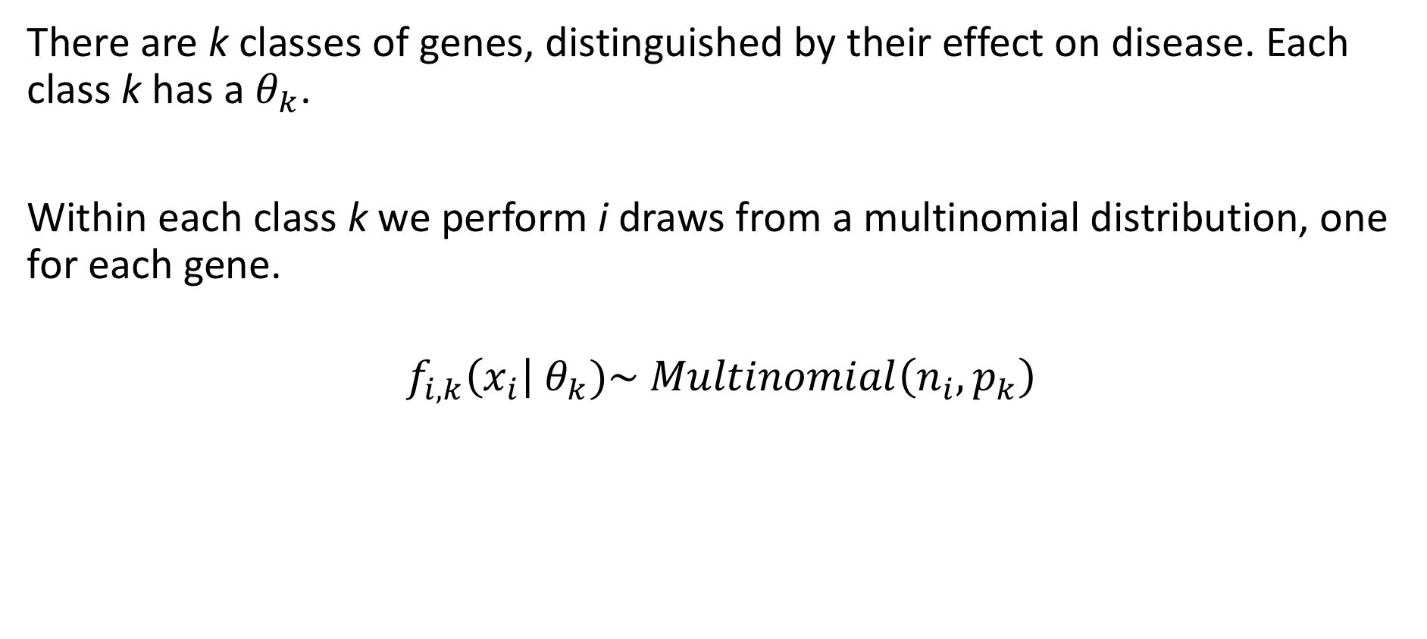
Model summary
There are k classes of genes, distinguished by their effect on disease. Each class k has a $θ_{k}$.
Within each class k we perform i draws from a multinomial distribution, one for each gene.
$$f_{i,k}\left(x_{i}\right| θ_{k})\sim Multinomial\left(n_{i}, p_{k}\right)$$

Slide 5
Model summary
There is an indirect relationship between the effect genes have on disease, and the resulting allele counts in individuals affected by those diseases. The former is the latent state, the latter observed.

Slide 6
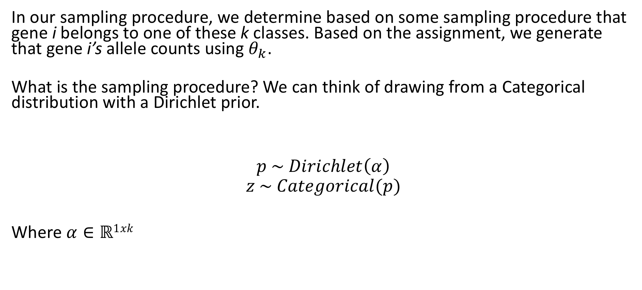
Model summary
In our sampling procedure, we determine based on some sampling procedure that gene i belongs to one of these k classes. Based on the assignment, we generate that gene i’s allele counts using $θ_{k}$.
What is the sampling procedure? We can think of drawing from a Categorical distribution with a Dirichlet prior.
$$p \sim Dirichlet\left(α\right)$$
$$z \sim Categorical(p)$$
Where $α∈ℝ1xk$

Slide 7

H₀ class
$$p_{ }∈\{ P\left(D_{ctrl}\right), P\left(D_{1}\right), P\left(D_{2}\right), P\left(D_{12}\right) \}$$
$$n_{i}=x_{ctrl_{i}}+x_{1_{i}}+x_{2_{i}}+x_{{12}_{i}}$$
$$x_{i}∈\left\{x_{ctrl_{i}},x_{1_{i}}, x_{2_{i}}, x_{{12}_{i}}\right\}$$
$$f_{H12}\left(x_{i}\right| θ_{k})\sim Multinomial\left(n_{i}, p_{k}\right)$$

Slide 8
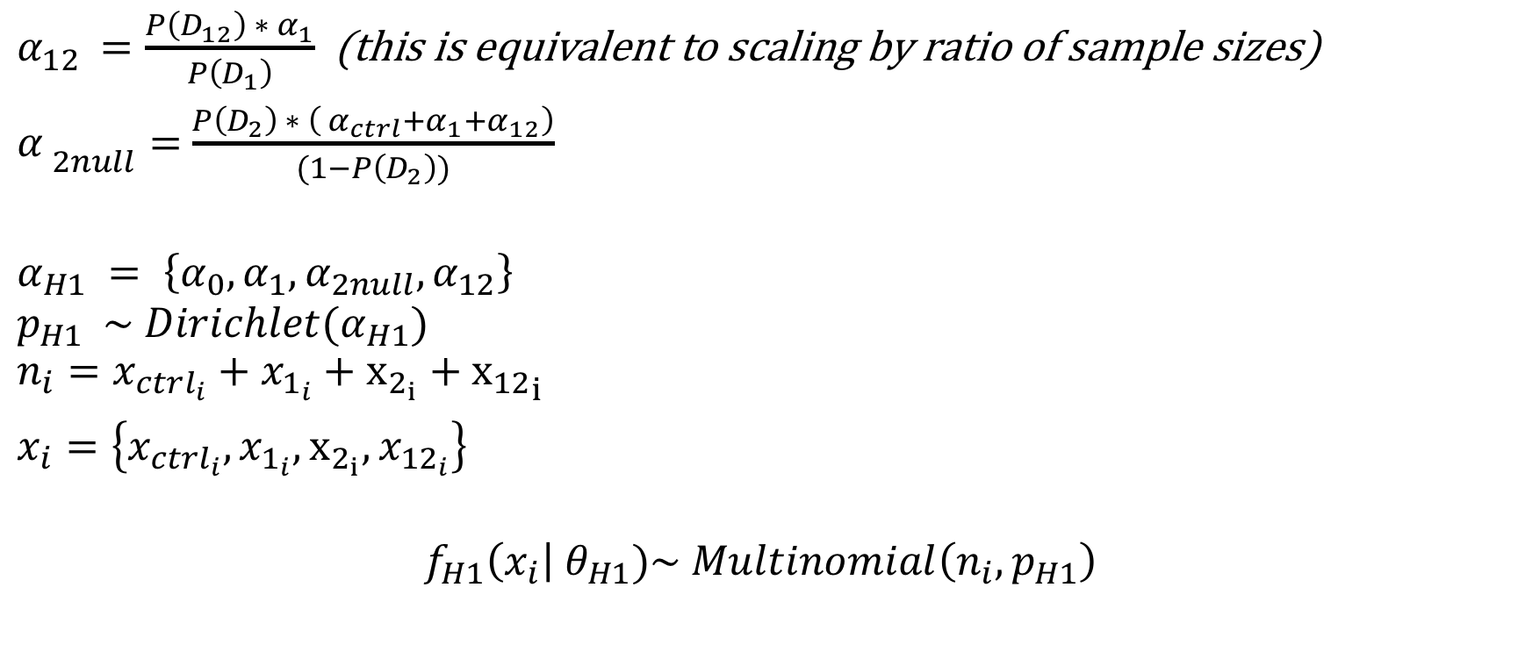
H₁ class
$α_{12 }=\frac{P\left(D_{12}\right) ∗{ α}_{1}}{P\left(D_{1}\right)}$ (this is equivalent to scaling by ratio of sample sizes)
${α_{ }}_{2null}=$ $\frac{P\left(D_{2}\right) ∗ \left( α_{ctrl}+α_{1}+α_{12}\right)}{(1−P\left(D_{2}\right))}$
$${α_{H1}}_{ }= \left\{α_{0}, α_{1}, α_{2null}, α_{12}\right\}$$
$$p_{H1} \sim Dirichlet(α_{H1})$$
$$n_{i}=x_{ctrl_{i}}+x_{1_{i}}+x_{2_{i}}+{x_{12}}_{i}$$
$x_{i}=\left\{{x_{ctrl_{i}}, x}_{1_{i}}, x_{2_{i}}, x_{12_{i}}\right\}$
$$f_{H1}\left(x_{i}\right| θ_{H1})\sim Multinomial\left(n_{i}, p_{H1}\right)$$

Slide 9

H₂ class
$α_{12 }=\frac{{P\left(D_{12}\right) ∗ α}_{2}}{P(D_{2})}$
${α_{ }}_{1null}=$ $\frac{P\left(D_{1}\right) ∗ \left( α_{ctrl}+α_{2}+α_{12}\right)}{(1−P\left(D_{1}\right))}$
$${α_{H2}}_{ }= \left\{α_{0}, α_{1null},α_{2}, α_{12}\right\}$$
$${p_{H2}}_{ } \sim Dirichlet(α_{H2})$$
$$n_{i}=x_{ctrl_{i}}+x_{1_{i}}+x_{2_{i}}+{x_{12}}_{i}$$
$x_{i}=\left\{{x_{ctrl_{i}}, x}_{1_{i}}, x_{2_{i}}, x_{12_{i}}\right\}$
$$f_{H2}\left(x_{i}\right| θ_{H2})\sim Multinomial\left(n_{i}, p_{H2}\right)$$

Slide 10
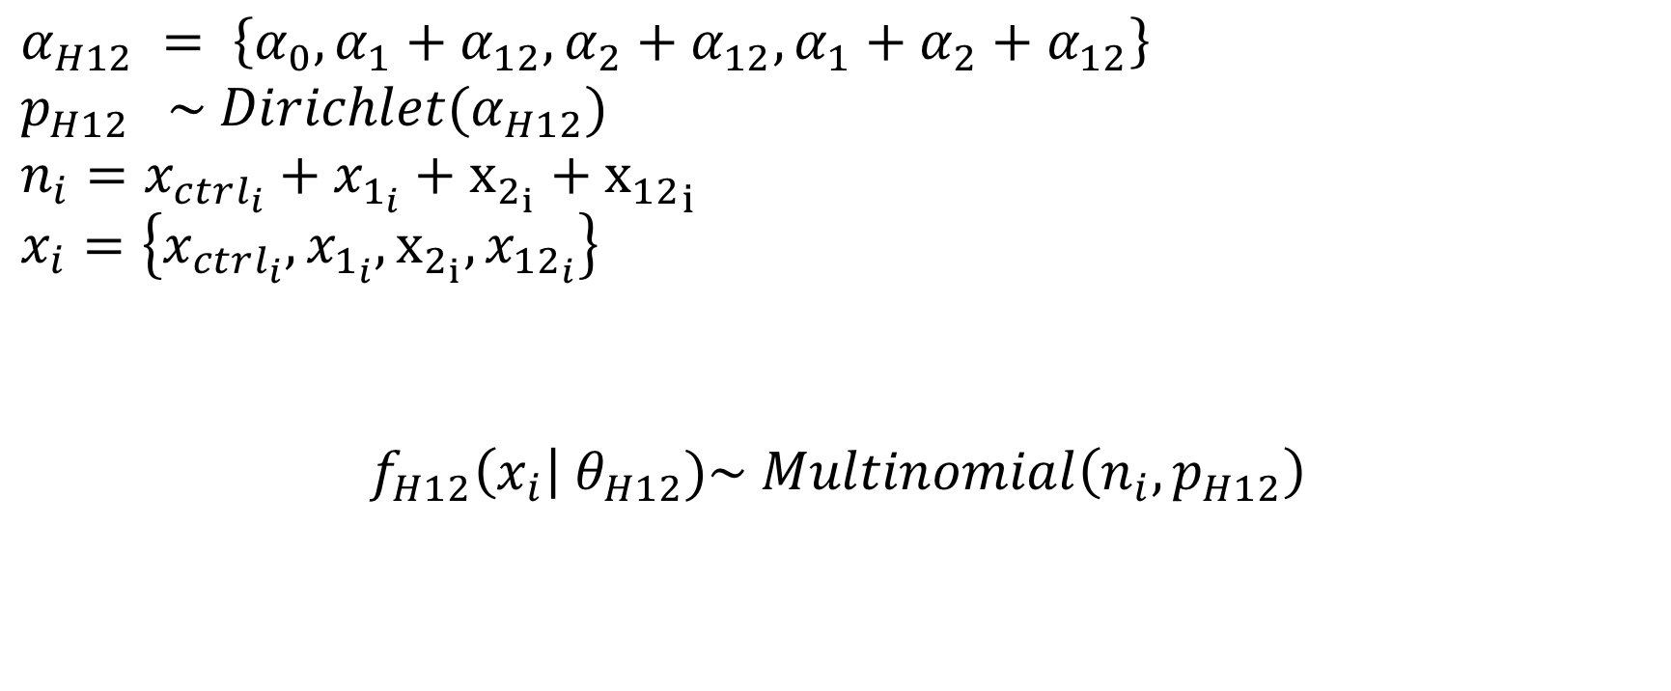
H₁₂ class
$${α_{H12}}_{ }= \left\{α_{0}, α_{1}+α_{12}, α_{2}+α_{12},α_{1}+α_{2}+α_{12}\right\}$$
$${p_{H12}}_{ } \sim Dirichlet(α_{H12})$$
$$n_{i}=x_{ctrl_{i}}+x_{1_{i}}+x_{2_{i}}+{x_{12}}_{i}$$
$$x_{i}=\left\{{x_{ctrl_{i}}, x}_{1_{i}}, x_{2_{i}}, x_{{12}_{i}}\right\}$$
$$f_{H12}\left(x_{i}\right| θ_{H12})\sim Multinomial\left(n_{i}, p_{H12}\right)$$

Slide 11
Data generation
For each gene:
1) Categorize it as increasing risk of none, 1, 2, or both
2) Sample a relative risk from a gamma distribution
- all gamma’s have same shape (alpha), different means
- mean for none case is 1
Call these situations: h₀, h₁, h₂, h₁₂
Call these rr’s: rr₀, rr₁, rr₂, rr₁₂

Slide 12
Data generation
Individuals are affected by none, disease 1, disease 2, or both
Their observed counts are distinguished solely by differences in their genetic relative risk, determined by their affectation status

Slide 13
Data generation
Cases₁ :
h₀ : rr = rr₀
h₁ : rr = rr₁
h₂ : rr = rr₀
h₁₂ : rr = rr₁ + rr₁₂

Slide 14
Data generation
Cases₂ :
h₀ : rr = rr₀
h₁ : rr = rr₀
h₂ : rr = rr₂
h₁₂ : rr = rr₂ + rr₁₂

Slide 15
Data generation
Cases₁₂ :
h₀ : rr = rr₀
h₁ : rr = rr₁
h₂ : rr = rr₂
h₁₂ : rr = rr₁ + rr₂ + rr₁₂

Slide 16

Data generation
Using these relative risks, we calculate the probability of seeing an allele for each affectation sample category m (Cases₁, Cases₂, Cases₁₂)
P(V|D_{m}) = $\frac{rr_{m}∗ P\left(V\right)}{rr_{m} ∗P\left(V\right)+(1 −P\left(V\right))}$

Slide 17
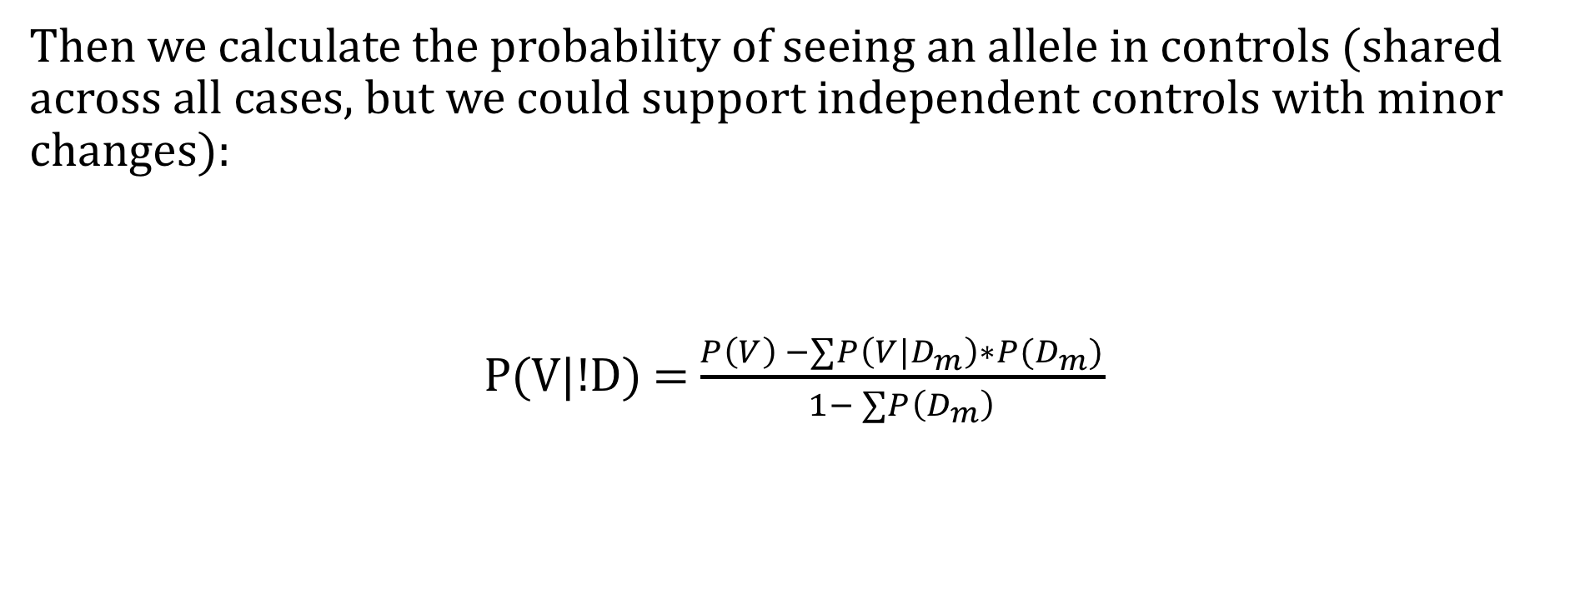
Data generation
Then we calculate the probability of seeing an allele in controls (shared across all cases, but we could support independent controls with minor changes):
P(V|!D) = $\frac{P\left(V\right) −∑P\left({V|D}_{m}\right)∗P(D_{m})}{1− ∑P\left(D_{m}\right)}$

Slide 18

Data generation
Then generate allele counts for each gene i and sample category m:
$$X_{i,m} \sim Binomial(n_{i}, p_{m})$$

Slide 19
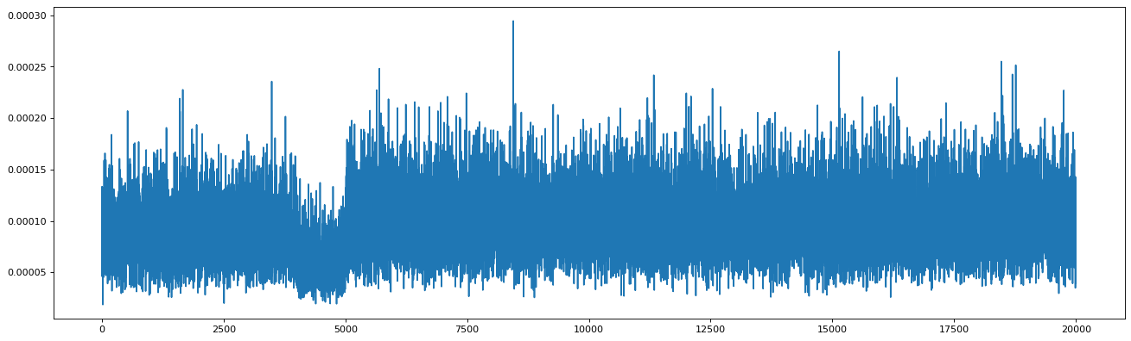
Generated data (allele frequencies): Ctrls

Slide 20
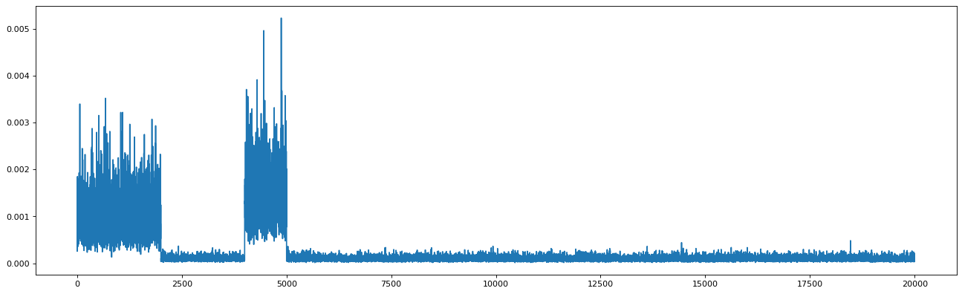
Generated data (allele frequencies): Cases₁

Slide 21
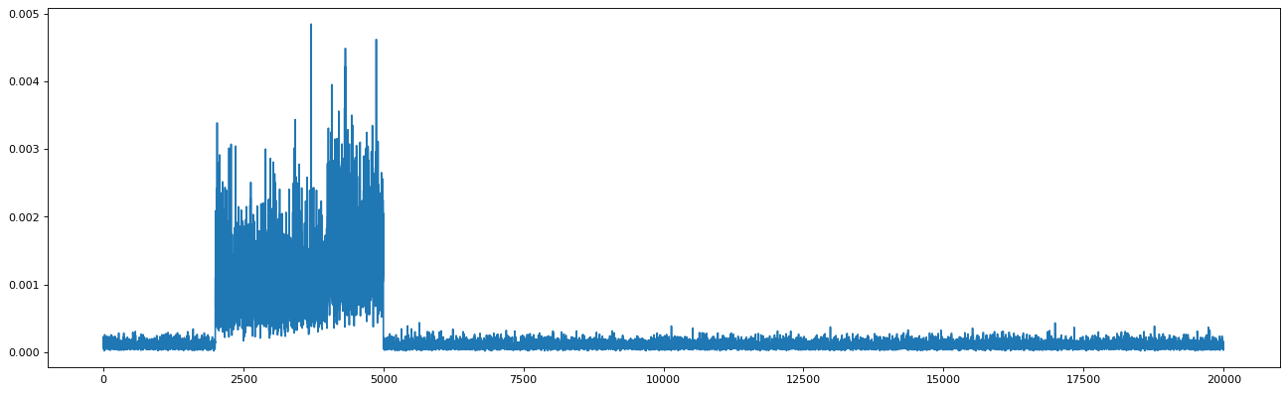
Generated data (allele frequencies): Cases₂

Slide 22
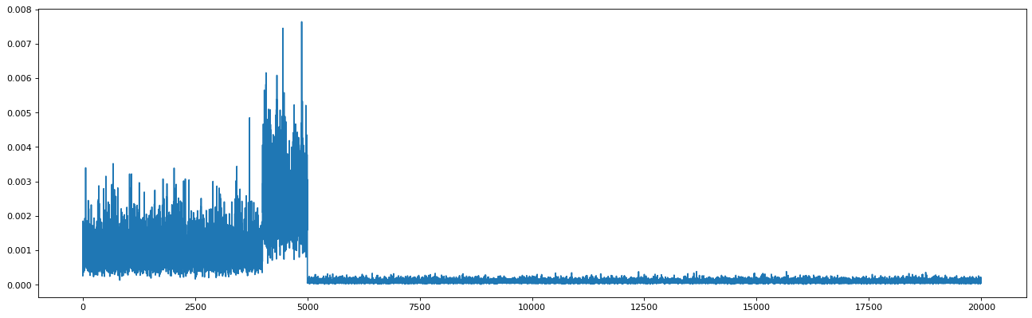
Generated data (allele frequencies): Cases₁₂

Slide 23
Note on data generation
In the simulation we correlate P(V|D) rather than the binomial allele counts
There are somewhat more complicated, copula-based approaches. I tried something stupider, inspired by the trivariate-reduction method of generating correlated Poisson random variables
This gives us a simple mental model: a linear combination of latent genetic risk factors

Slide 24
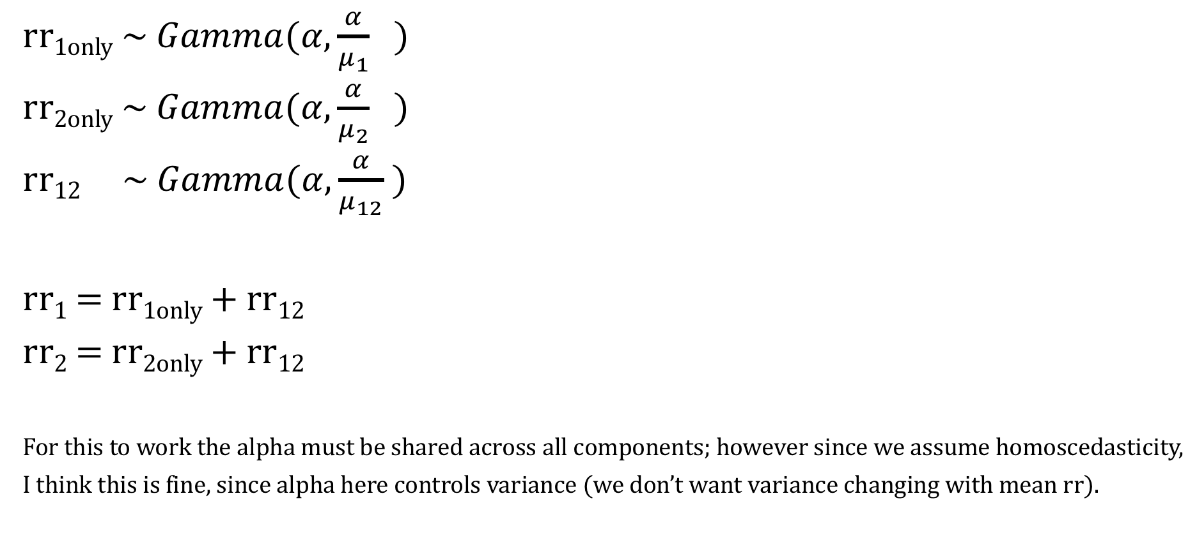
Note on data generation
rr_{1only} ~ $Gamma(α,\frac{α}{μ_{1}} )$
rr_{2only} ~ $Gamma(α,\frac{α}{μ_{2}} )$
rr₁₂ ~ $Gamma(α,\frac{α}{μ_{12}} )$
rr₁ = rr_{1only} + rr₁₂
rr₂ = rr_{2only} + rr₁₂
For this to work the alpha must be shared across all components; however since we assume homoscedasticity, I think this is fine, since alpha here controls variance (we don’t want variance changing with mean rr).

Slide 25
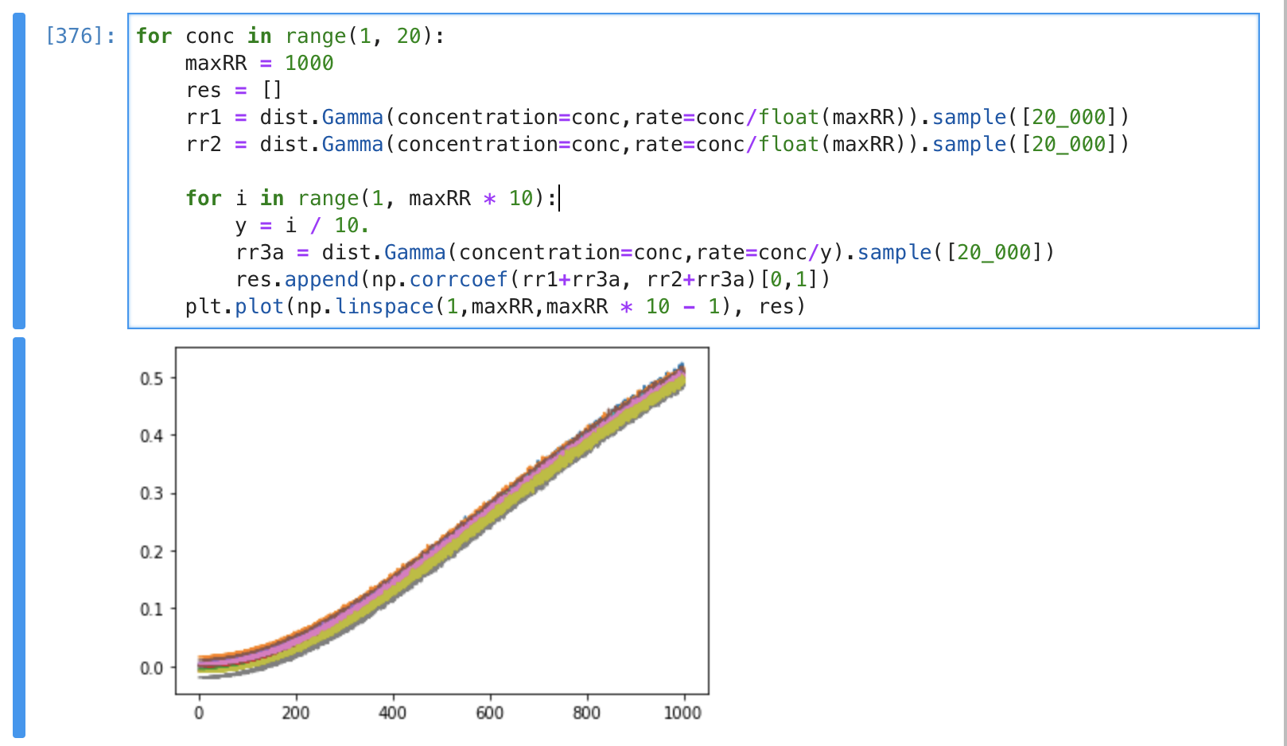
Resulting correlations

Slide 26
Questions
Dirichlet Multinomials have been criticized for having a restrictive correlation structure (like a multinomial, each category can only be negatively correlated). This doesn’t seem particularly troublesome given that we’re fixing the marginal allele counts. I’m open to alternatives: generalized dirichlet multinomial (also fits the Danish blood spot data well), multivariate normal. Thoughts?
Gamma priors have some advantages: give us a comparison point back to TADA (Negative Binomial), and are conjugate priors for normal distribution variance (if we want to explore multivariate normal model comparison). Could also simulate using Beta.

Slide 27
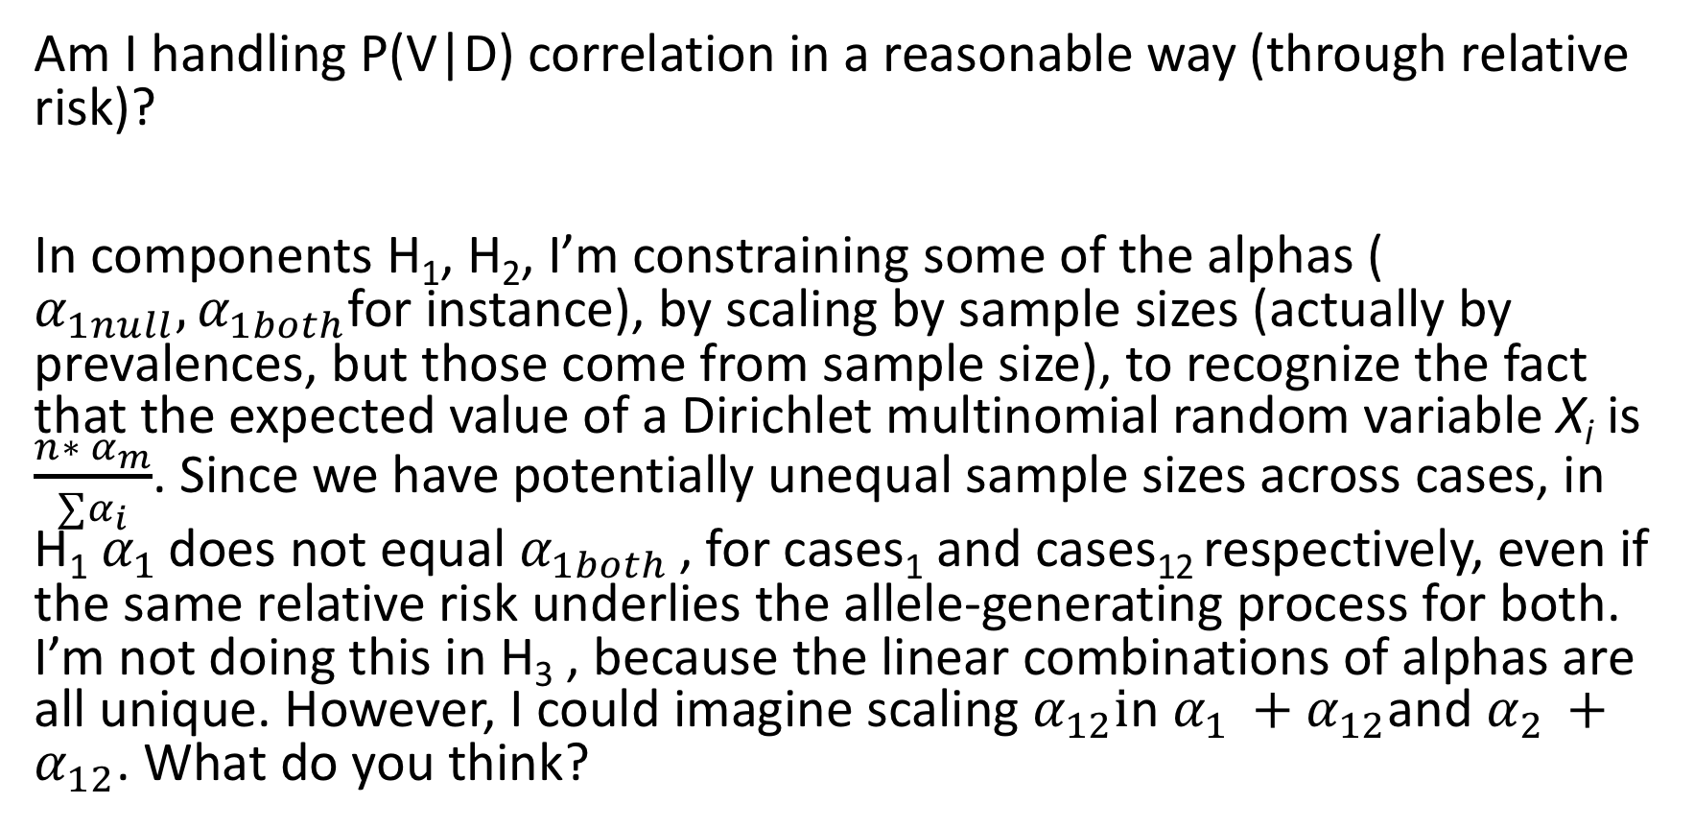
Questions
Am I handling P(V|D) correlation in a reasonable way (through relative risk)?
In components H₁, H₂, I’m constraining some of the alphas ( $α_{1null}, α_{1both}$for instance), by scaling by sample sizes (actually by prevalences, but those come from sample size), to recognize the fact that the expected value of a Dirichlet multinomial random variable X_{i} is $\frac{{n∗ α}_{m}}{∑α_{i}}$. Since we have potentially unequal sample sizes across cases, in H₁ $α_{1 }$does not equal $α_{1both }$, for cases₁ and cases₁₂ respectively, even if the same relative risk underlies the allele-generating process for both. I’m not doing this in H₃ , because the linear combinations of alphas are all unique. However, I could imagine scaling $α_{12}i$n $α_{1 }+α_{12}$and $α_{2 }+α_{12}$. What do you think?

Slide 28
Addendum
Evidence in Danish blood-spot data that in those genes where cases that are affected by both ADHD and ASD have non-zero counts, ASD-only, and ADHD-only cases have more alleles.
vs

