Slide 1
Barrel Shifter

Slide 2
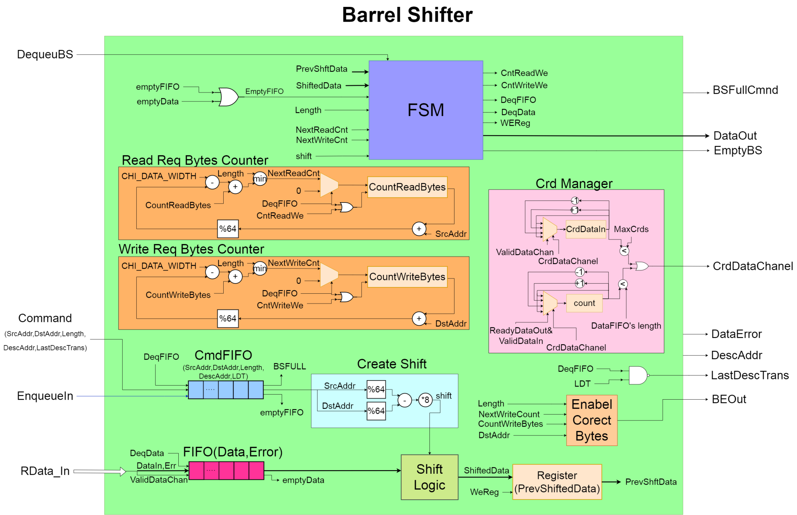
Barrel Shifter implementation

Slide 3
Blocks in Barrel Shifter
Command FIFO : keeps commands that come from CHI-Converter when it makes the first request of each chunck
Data FIFO : keeps the Data and error that come from CHI- Inbound Data channel
Crd Manager : counts and give Crds on inbound data channel
Create Shift : Create the appropriate shift for Data based on the Src and Dst Addr of Command
Shift Logic : Combinational logic that shifts Data based on shift
Enable Correct Bytes : creates BE field for Data out
Read-Write Req Bytes Counter : counts the Data that have been Read-Write for each command
FSM : Finite State machine

Slide 4
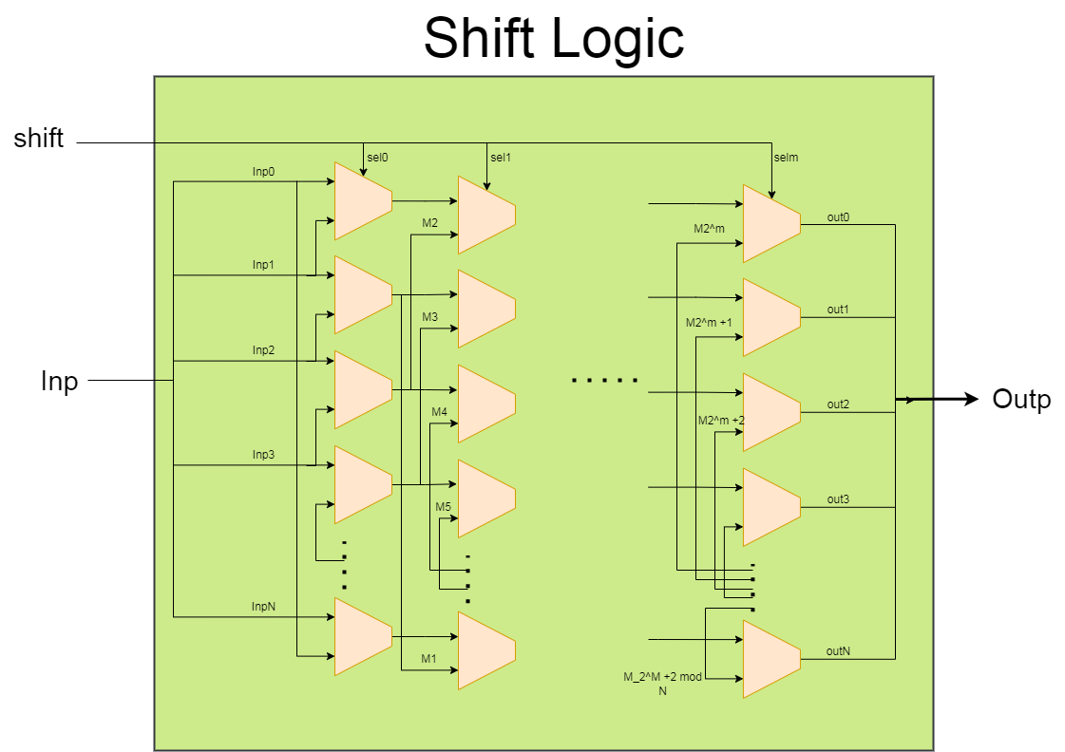
Combinational logic that shifts Data

Slide 5
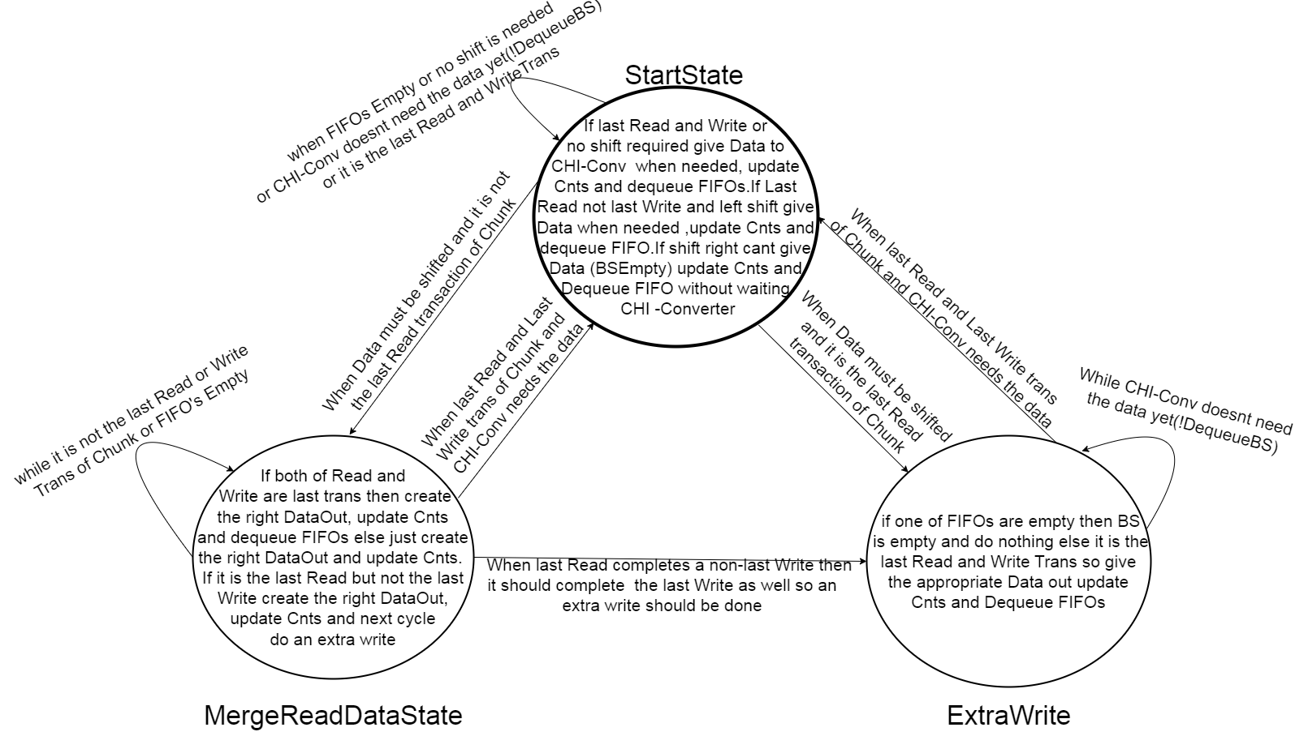
FSM of BS

Slide 6
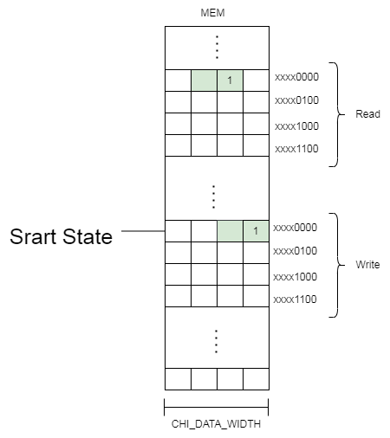
Case 1
all Read and Write Bytes are in one line

Slide 7
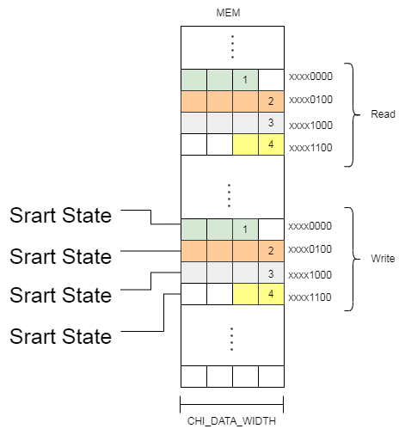
Case 2
aligned Addresses

Slide 8
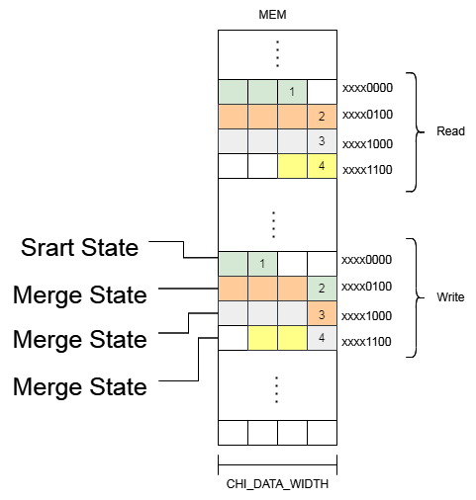
Case 3
Shift left
NumbOfRead == NumOfWrite

Slide 9
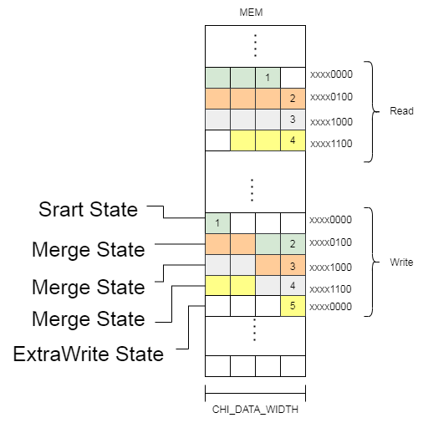
Case 4
Shift left
NumbOfRead != NumOfWrite

Slide 10
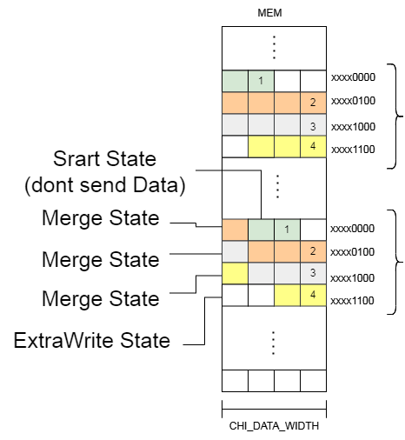
Case 5
Shift right
NumbOfRead == NumOfWrite

Slide 11
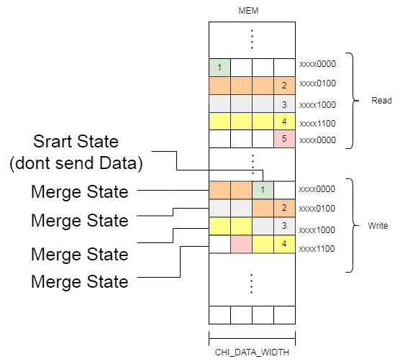
Case 6
Shift right
NumbOfRead != NumOfWrite

Slide 12
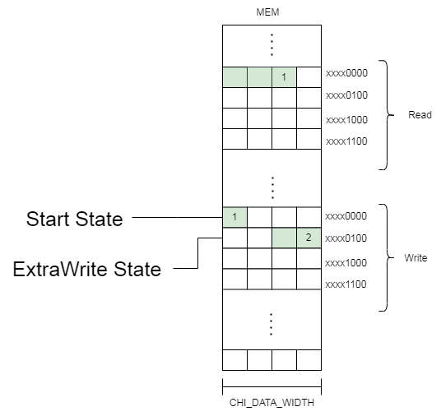
Case 7
1 Read 2 Writes

