Slide 1
Barrel Shifter

Slide 2
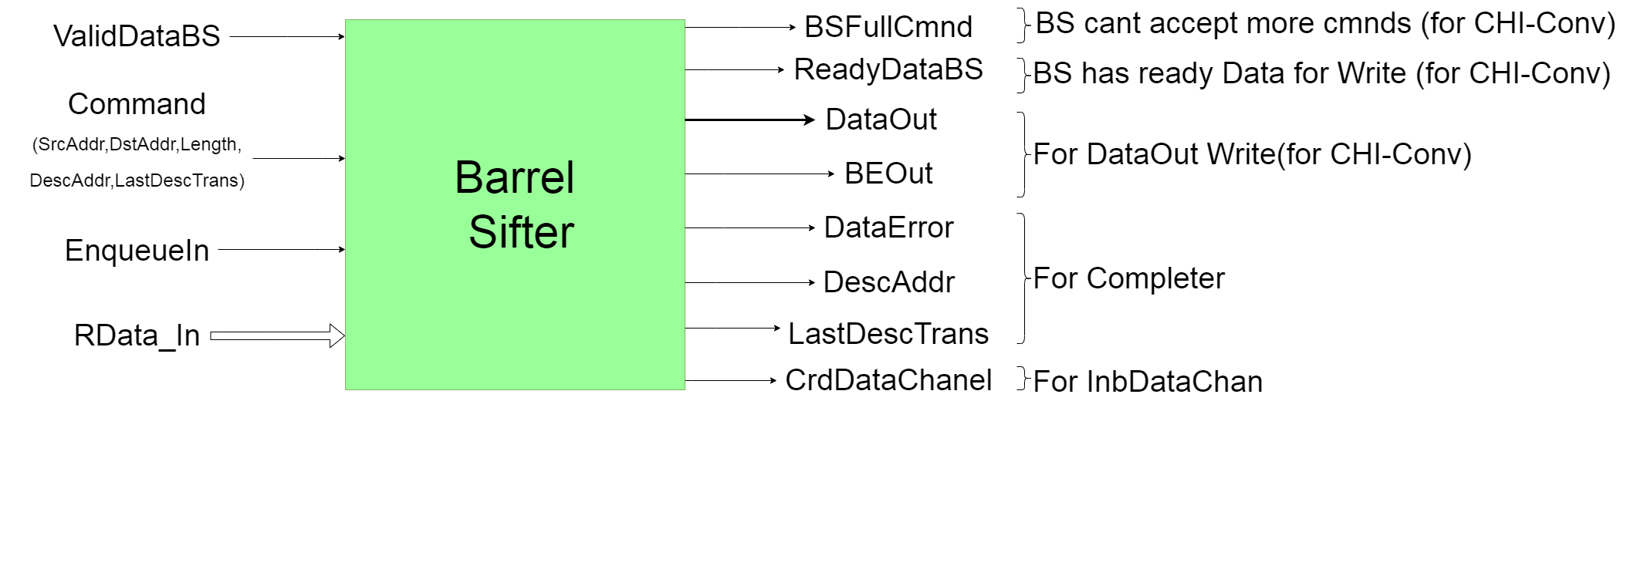
Barrel Shifter

Slide 3
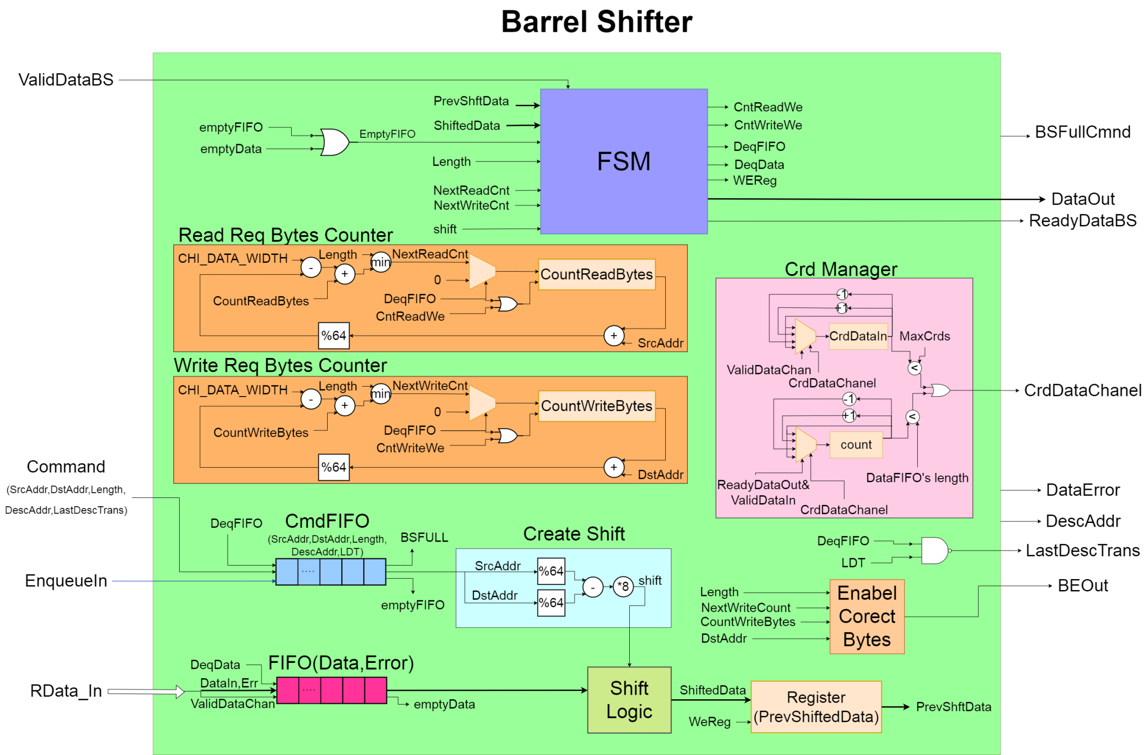
Barrel Shifter implementation

Slide 4
Blocks in Barrel Shifter
Command FIFO : keeps commands that come from CHI-Converter when it makes the first request of each chunck
Data FIFO : keeps the Data and error that come from CHI- Inbound Data channel
Crd Manager : counts and give Crds on inbound data channel
Create Shift : Create the appropriate shift for Data based on the Src and Dst Addr of Command
Shift Logic : Combinational logic that shifts Data based on shift
Enable Correct Bytes : creates BE field for Data out
Read-Write Req Bytes Counter : counts the Data that have been Read-Write for each command
FSM : Finite State machine

Slide 5
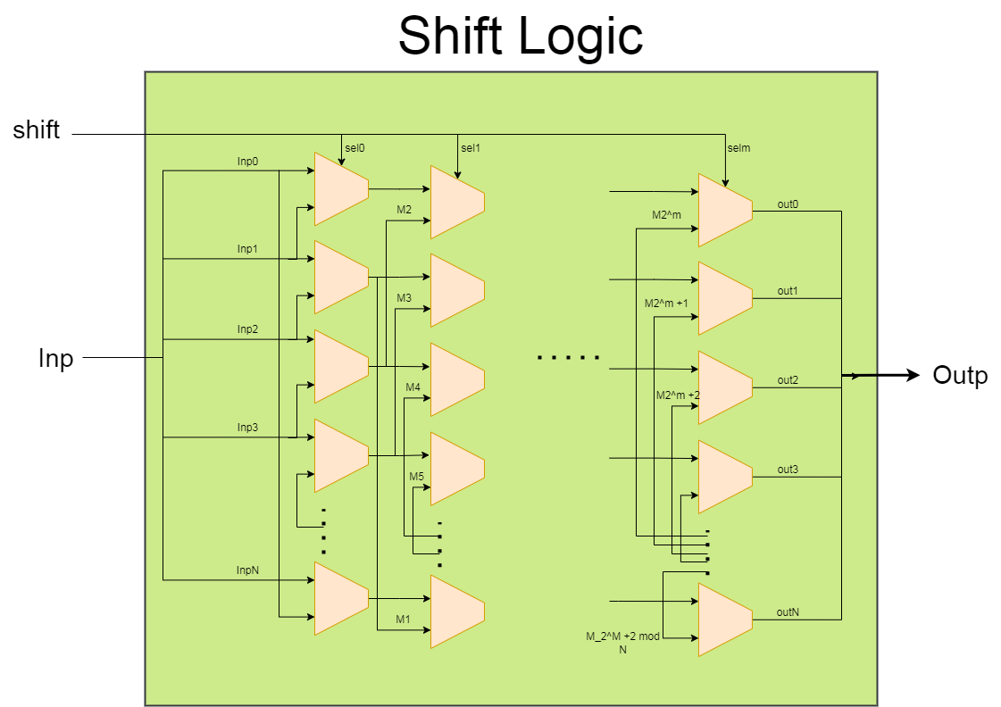
Combinational logic that shifts Data

Slide 6
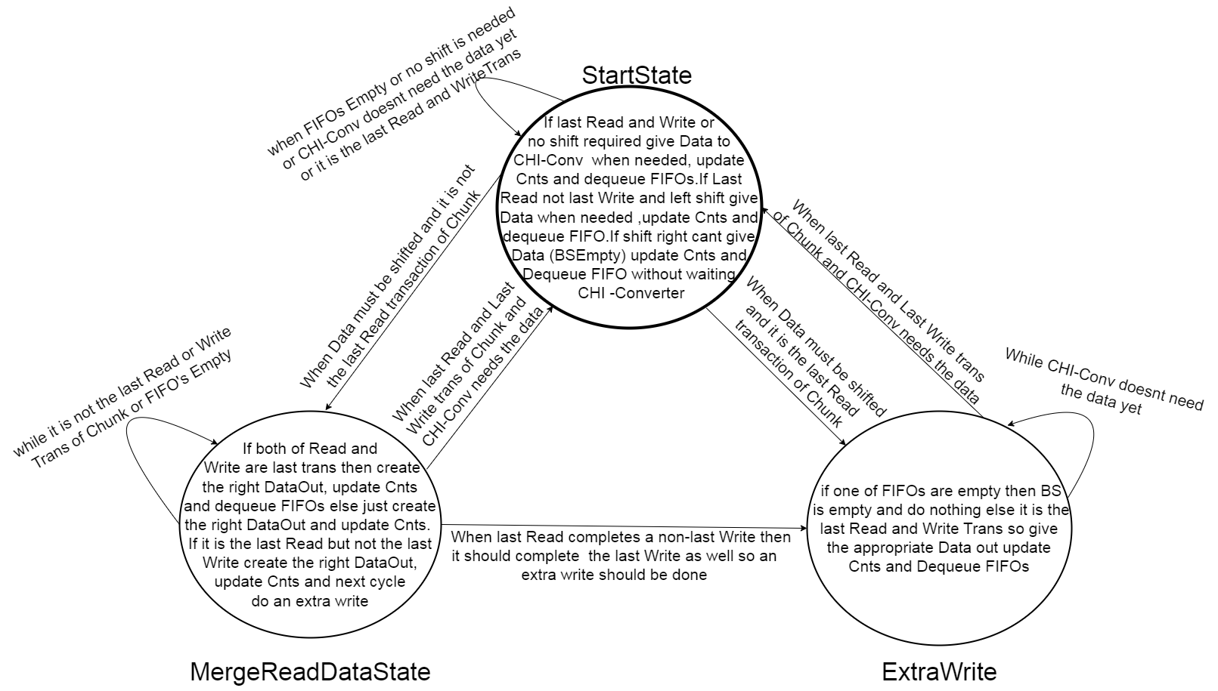
FSM of BS

Slide 7
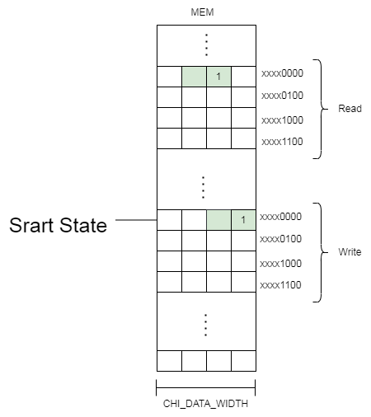
Case 1
all Read and Write Bytes are in one line

Slide 8
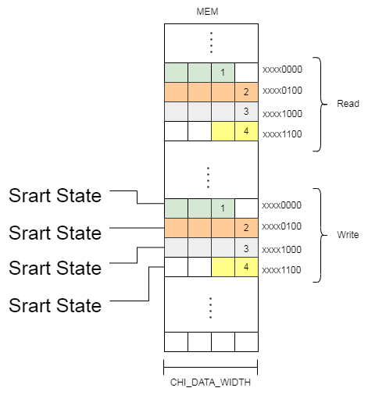
Case 2
aligned Addresses

Slide 9
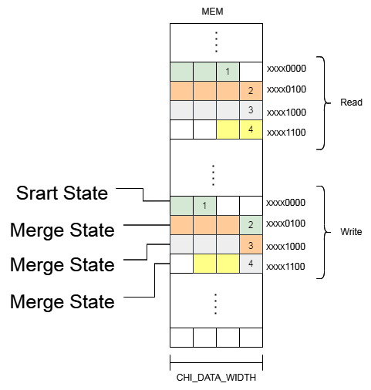
Case 3
Shift left
NumbOfRead == NumOfWrite

Slide 10
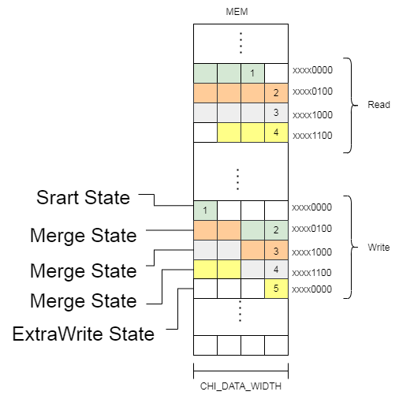
Case 4
Shift left
NumbOfRead != NumOfWrite

Slide 11
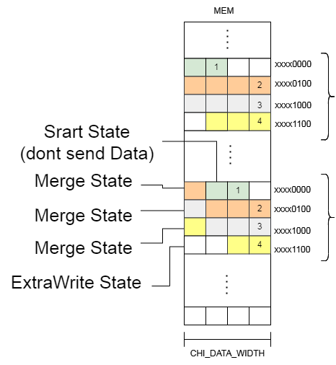
Case 5
Shift right
NumbOfRead == NumOfWrite

Slide 12
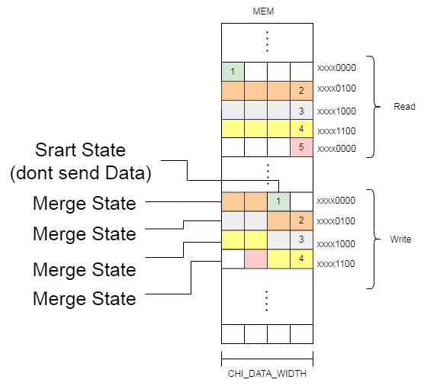
Case 6
Shift right
NumbOfRead != NumOfWrite

Slide 13
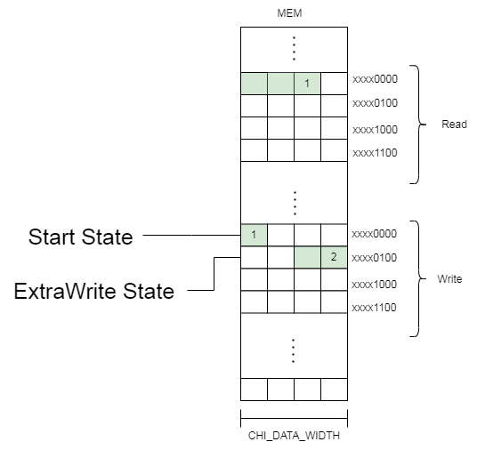
Case 7
1 Read 2 Writes

Slide 14
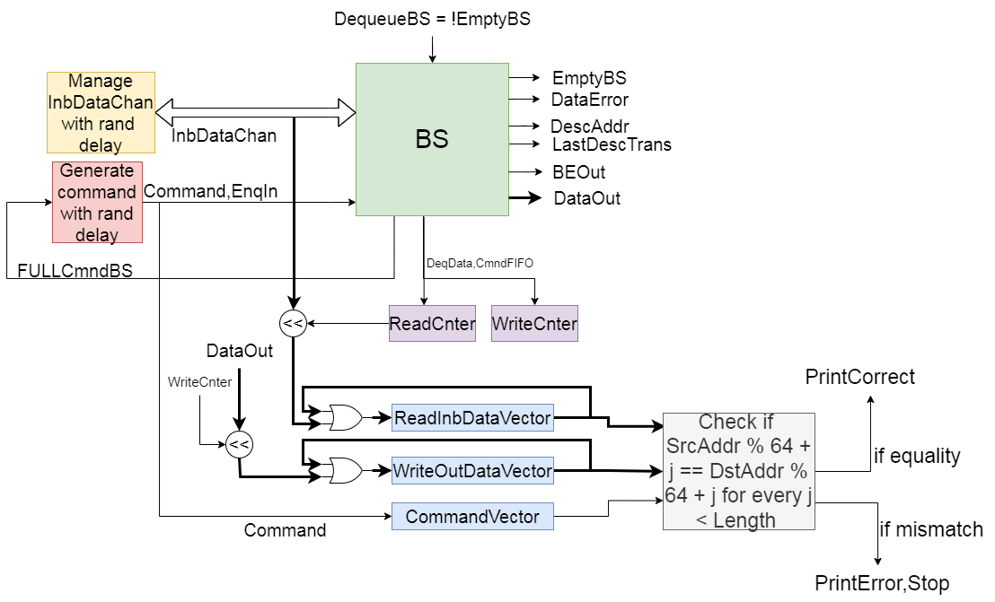
Test Barrel Shifter

Slide 15
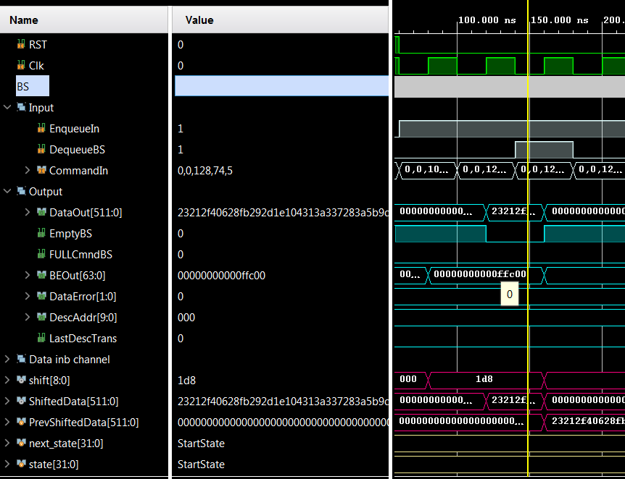
Case 1 (all of Read and Write Data of transfer are in one line respectively )
After 1st Data Write all of Bytes have been because all of Read and Write Data of transfer are all in one line respectively sent so state stays in Start State

Slide 16
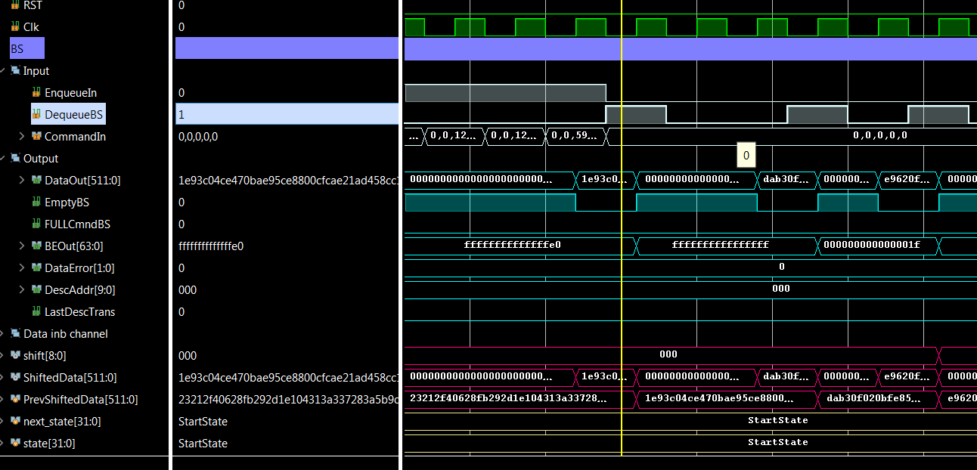
Case 2 (Aligned Transfer)
1 aligned Data transfer contains 3 Data Writes which do not need Shift and for this reason State stays in Start State for all of 3 Txns.

Slide 17
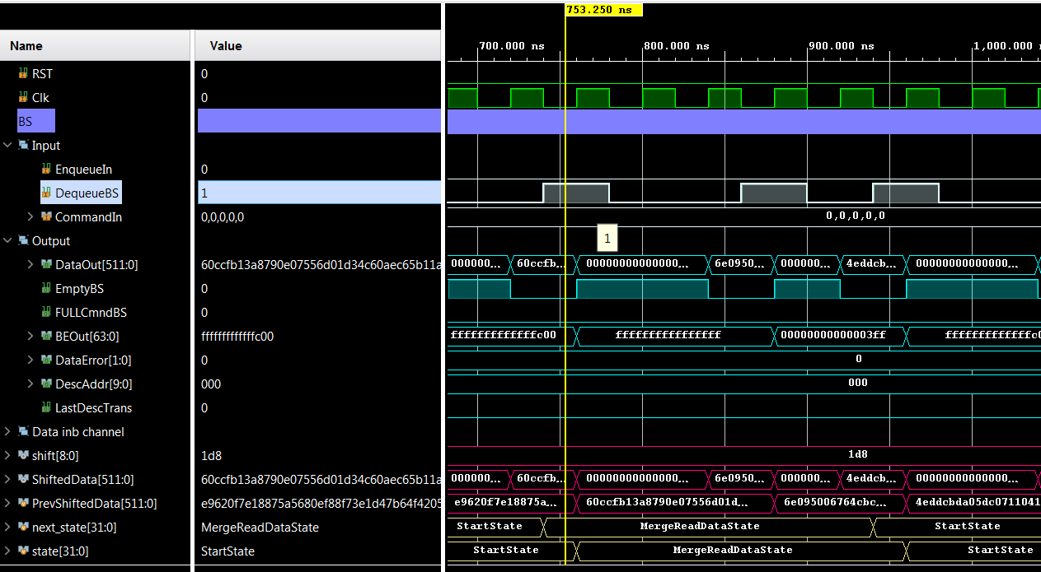
Case 3 (Shift left NumbOfRead == NumOfWrite )
Because of left shift after first Dequeue BS State goes to Merge State where executes the next shift and merge for the next Write and finally after the last transaction it returns to Start State

Slide 18
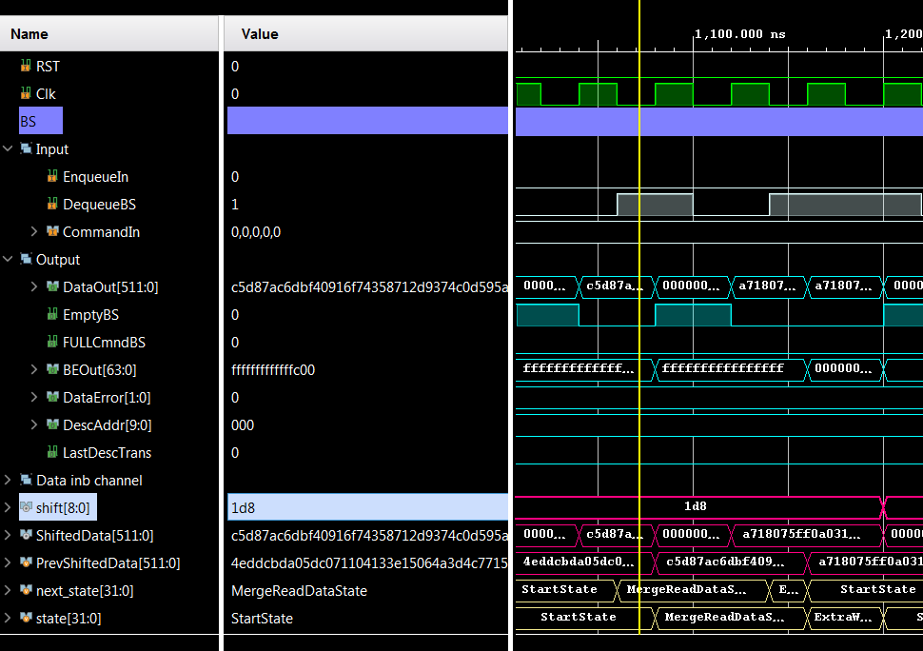
Case 4 (Shift left NumbOfRead != NumOfWrite )
After First Write State goes to Merge State where executes the next transaction and then it goes to Extra Write State where for the last write transaction

Slide 19
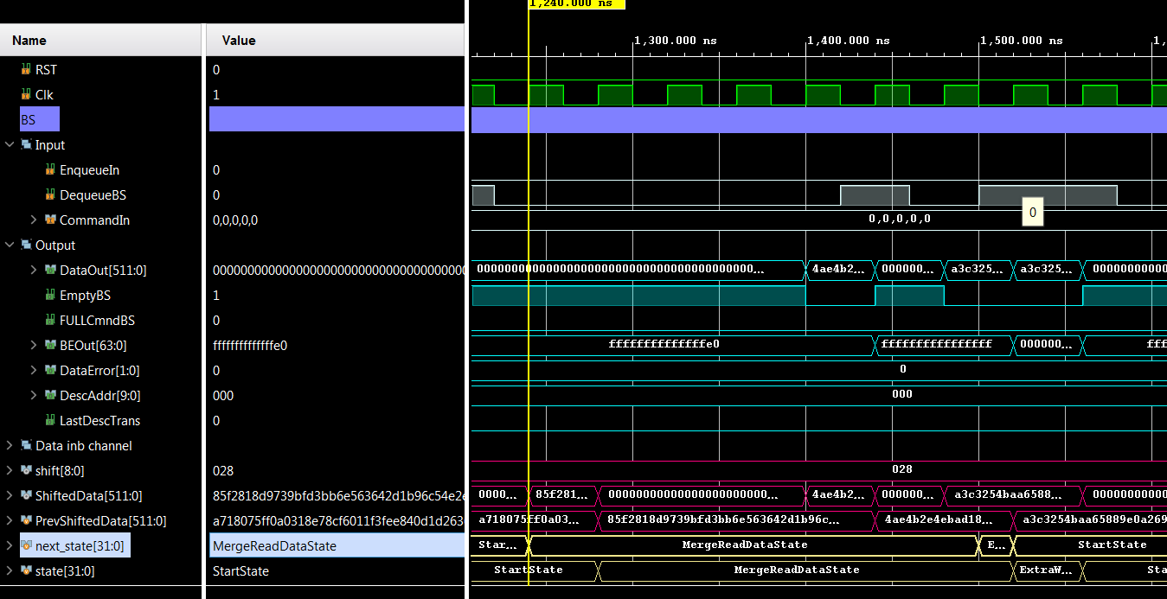
Case 5 (Shift right NumbOfRead == NumOfWrite )
Because of shift right State goes from Start to Merge without waiting Dequeue signal where BS does the next 2 shift end merge transaction and then State goes to Extra Write where happens the last Txn and goes to Start State

Slide 20
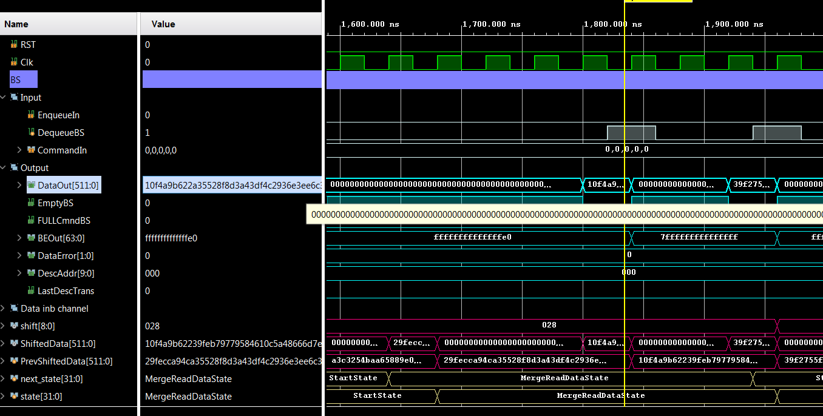
Case 6 (Shift right NumbOfRead != NumOfWrite )
This case is the same with the last one except State doesn’t go to Extra Write State instead after all Txns are finished it returns to StartState

Slide 21
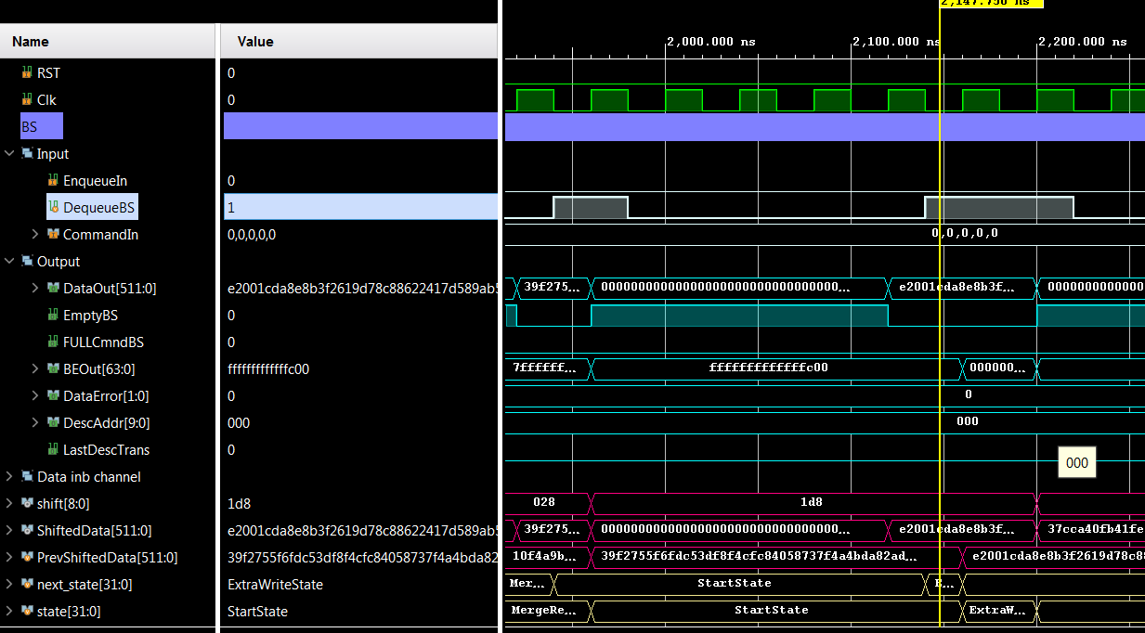
Case 7 (1 Read 2 Writes)
In this case only one Date In causing 2 writes with the first happen in Start State and the second in Extra Write State before return back to Start State

