Slide 1
CHI-DMA
Both Aligned and Misaligned Addresses Version

Slide 2
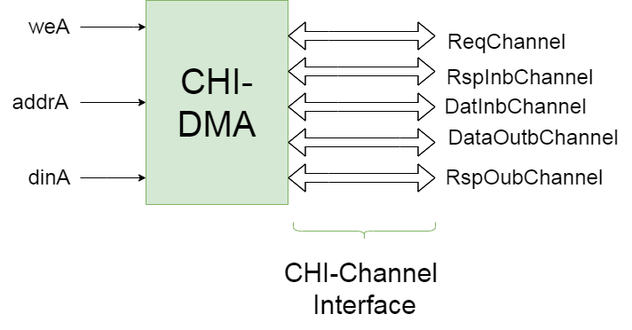
DMA

Slide 3
Pseudo CPU
Module that inserts Transfers in DMA :
Inputs:
PhaseIn : Determines the operation mode of CPU
NewPhase: Valid for PhaseIn ( changes the phase)
BRAMData: Read Data from BRAM’s Descriptor
Outputs:
weA : WE for port A of BRAM
addrA: Address of Descriptor in BRAM
dinA : Data to be written in BRAM

Slide 4
Pseudo CPU
Phases :
Insert a small Transfer in DMA (one CHI-Read and Write)
Insert a small misaligned Transfer in DMA (2 CHI-Read and 1 Write)
Insert a small misaligned Transfer in DMA (1 CHI-Read and 2 Write)
Insert a large Transfer in DMA (many CHI-Reads and Writes)
Insert many(250) small Transfers (one CHI-Read and Write each)
Insert many(250) small misaligned Transfers (1 or 2 CHI-Read and 1 or 2 CHI-Write each)
Insert many large (15) Transfers
Insert a random combination of Large and small Transfers in DMA with a random time delay between insertions
Insert in DMA a lot of(450) completely random size Transfers in random Desc Addresses with random insertion delay

Slide 5
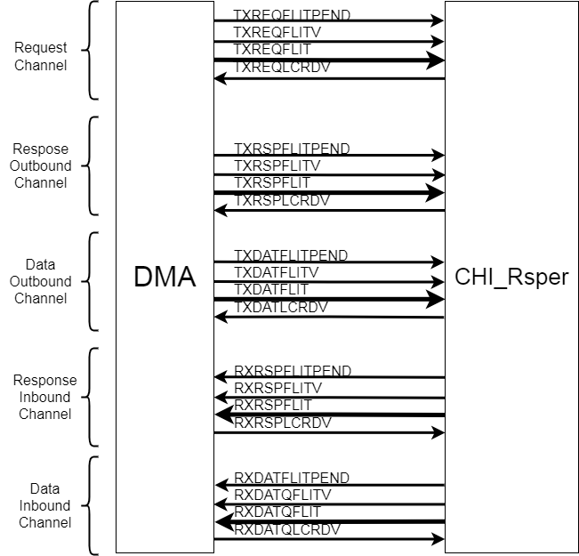
CHI-Responser
Module that responds to every CHI-Request of DMA.
Inputs-Outputs : only CHI-Channels
(CHI-Channel : FLITPEND,FLITV,FLIT,LCRDV)
CHI-Responser answers every CHI Request 11 cycles after the request received and there are enough Crds. Also it gives infinite Crds to DMA

Slide 6
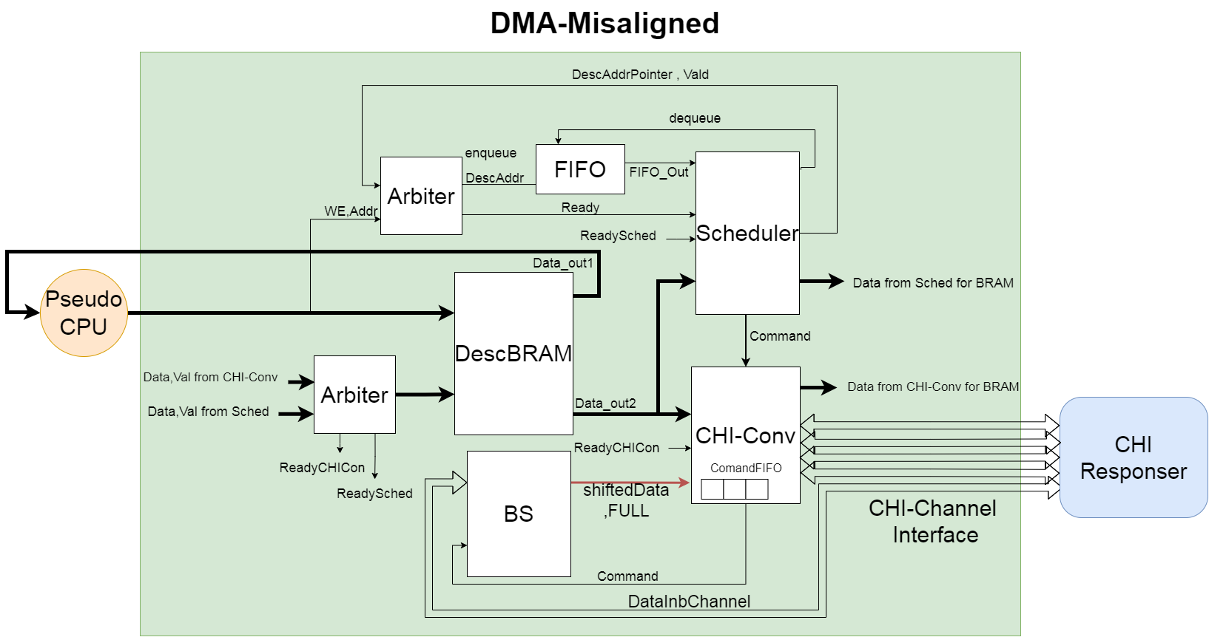
FULL System

Slide 7
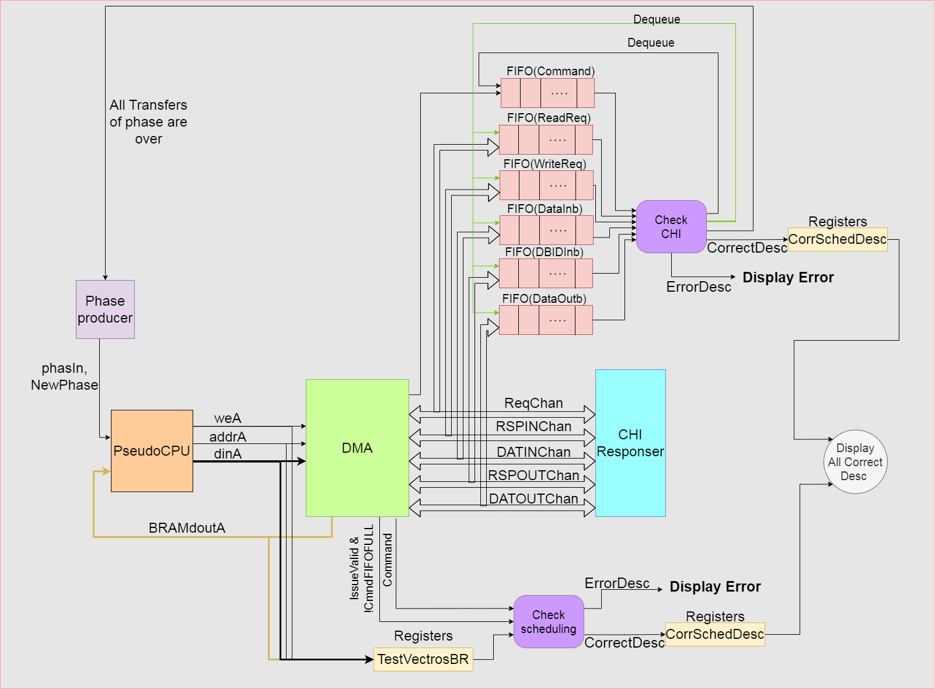
Test Full System

Slide 8
Test Full System
The testing of the full system is divided into 2 parts :
1st part : store every Transfer is inserted in a TestVectorBRAM and every time a command is scheduled check if its fields are correct based to the corresponding inserted Transfer.
2nd part : enqueue in FIFOs every scheduled command and CHI-transaction which sent on any channel and when all FIFOs are non-Empty check if the first element of every FIFO satisfies the appropriate requirements of CHI and transactions are correct based to the command .

Slide 9
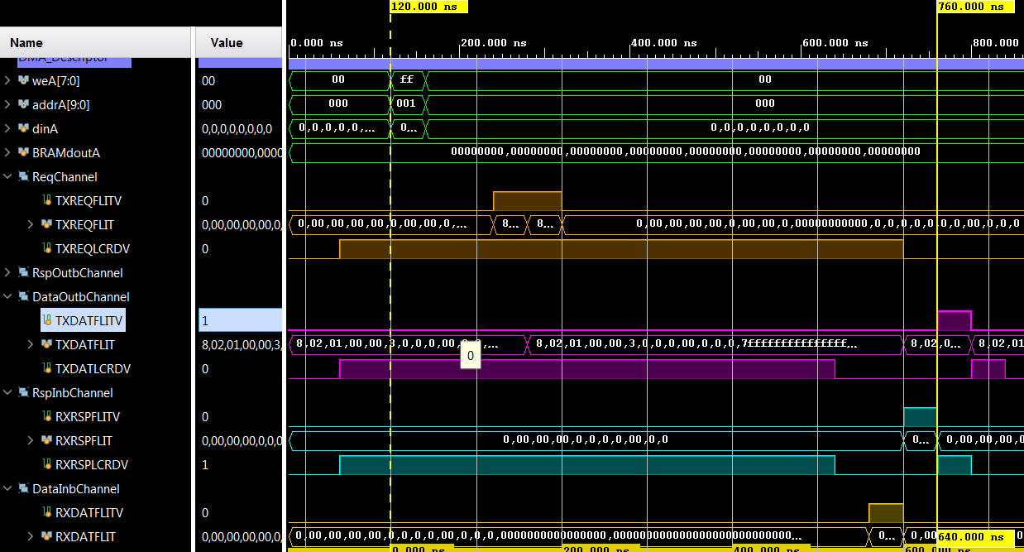
Results: Phase 1
Clk : 40 ns
Latency (until DataOut): 640 ns
Latency (until Request): 120 ns (3 cycles)

Slide 10
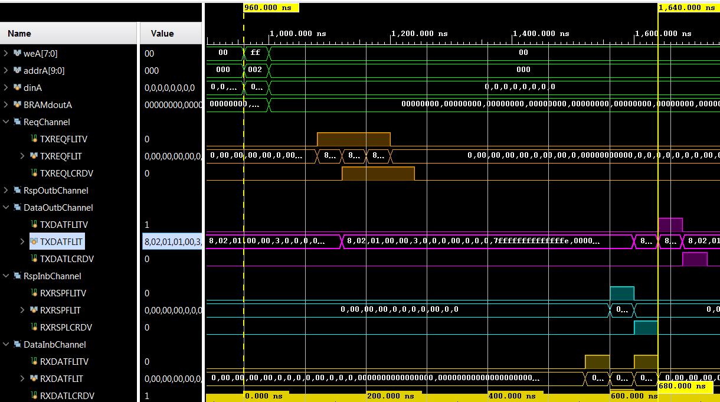
Results: Phase 2(2Read-1Write)
Latency (until DataOut): 680 ns (one more cycle because 2 Reads)
Latency (until Request): 120 ns (3 cycles)

Slide 11
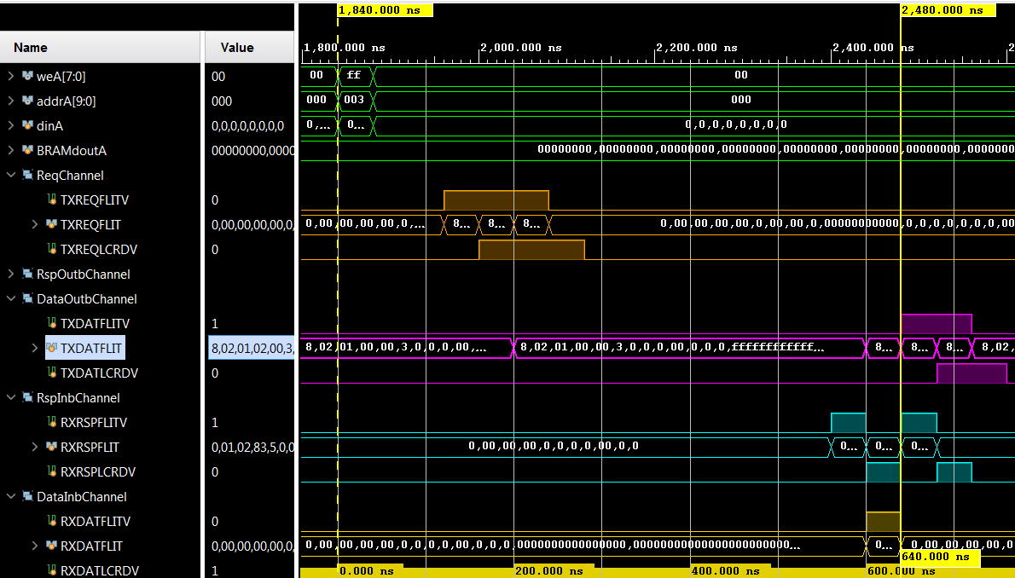
Results: Phase 3(1Read-2Write)
Latency (until DataOut): 640 + 40 ns (one more cycle because 2 Writes)
Latency (until Request): 120 ns (3 cycles)

Slide 12
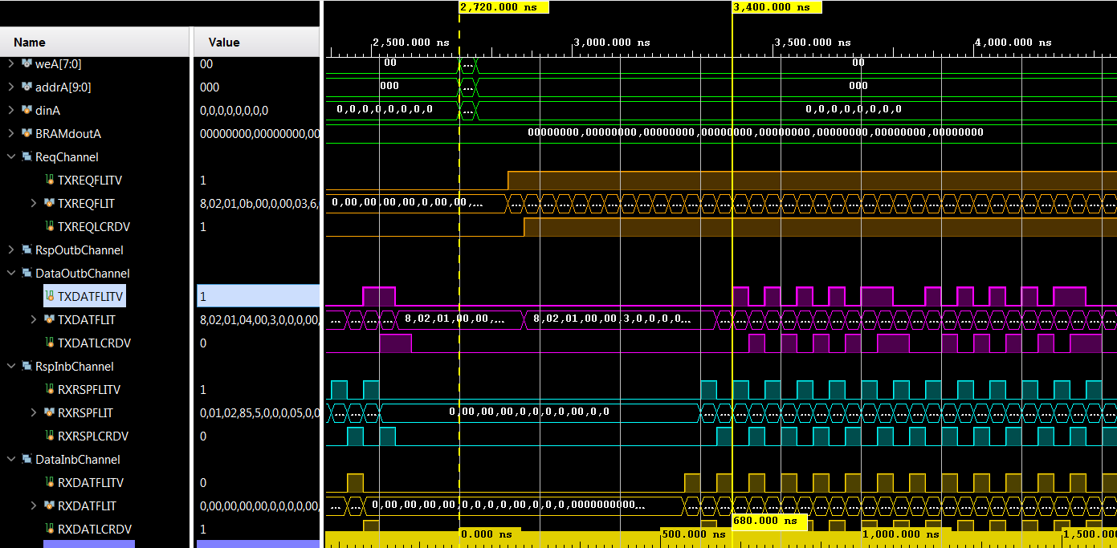
Results: Phase 4 (One Large Trans)
Latency (until DataOut): 640 + 40 ns (one more cycle because 2 Reads for a Write)
Throughput: max because Requesting every cycle 512 bit/2cycles = 512/(40*2) = 6.4 bit/ns =6400000000bit/s =745 MB/s. Data out Throughput not max because of bad scheduling.

Slide 13
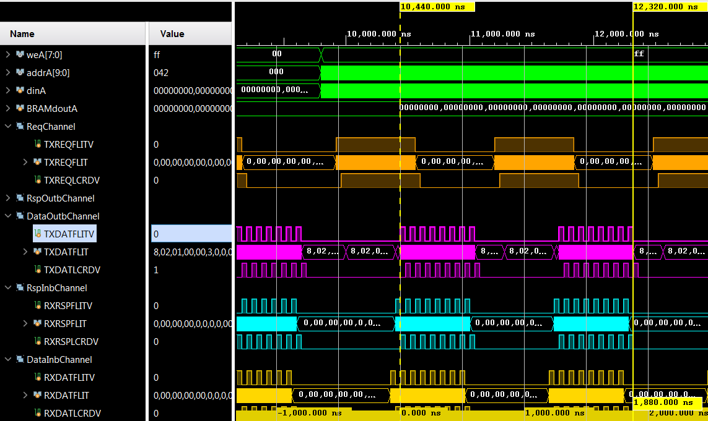
Results: Phase 5(many single Txn Trans)
Same Latency.
Throughput here is not max because there are many small transfers and scheduler cant schedule a full chunk. Also Completer stops Scheduler from Reading BRAM to update the status and for this reason CHI–Converter has not enough commands to Request on every cycle . Throughput is : 16*512/1880 bit/ns = 4.36bit/ns = 532 MB/s

Slide 14
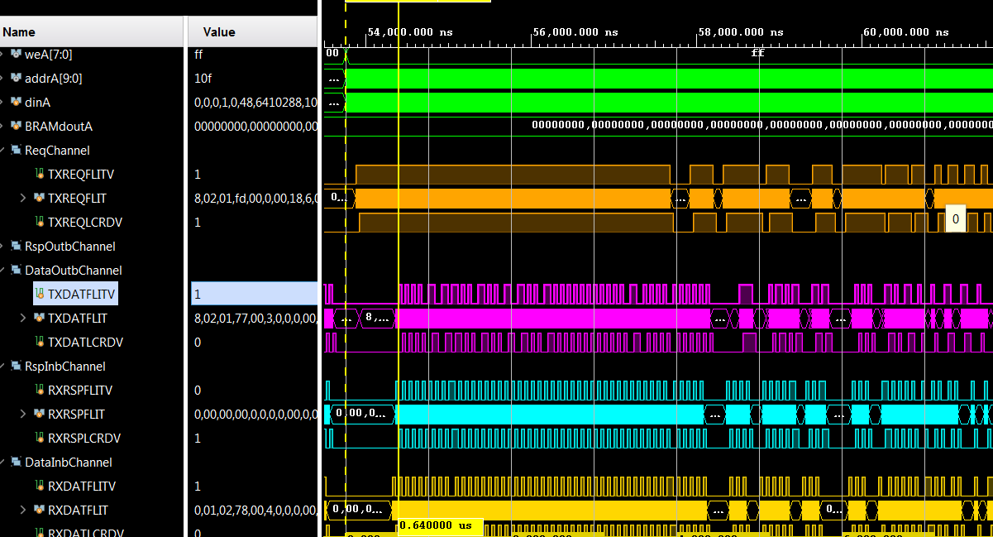
Results Phase 6(many misaligned small Trans)
Same Latency.
Throughput better than last case but not max because of small Trans. Throughput is better because many 1-2 or 2-1 Read/Write txns for each Trans so more requests. Throughput of usefull bits are worse because of misaligned trans

Slide 15
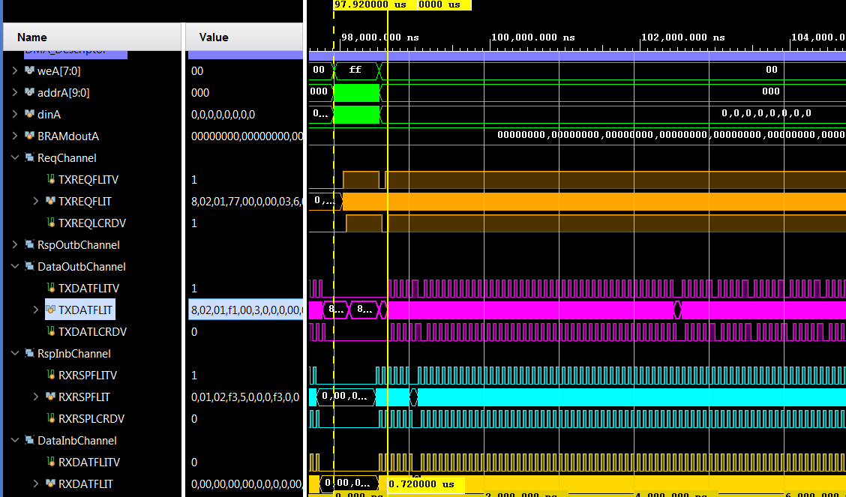
Phase 7 (many Large Transfers)
Latency DataOut 720 because starts with a write Req and needs 2 Reads to send Data. Throughput DataOut not max because bad scheduling (when BS start State there is a gap on DataOut). The gap on Request is because scheduler cant WriteBack the pointer because CPU is writing BRAM continuously

Slide 16
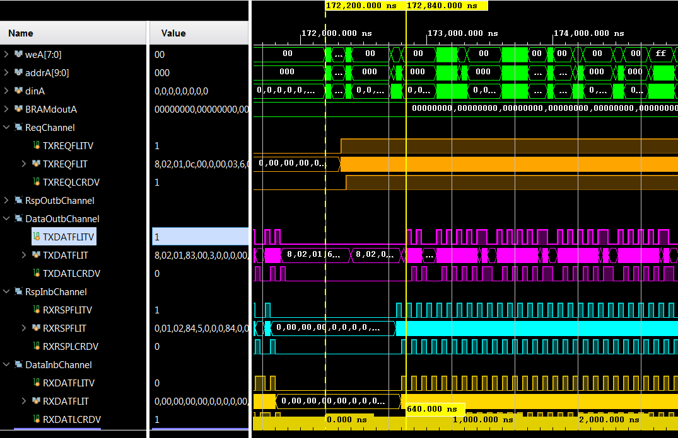
Phase 8 (some random Transfers)
Latency DataOut 640 (same). Throughput DataOut not max because bad scheduling and misaligned transfers. Throughput Request FULL.

Slide 17
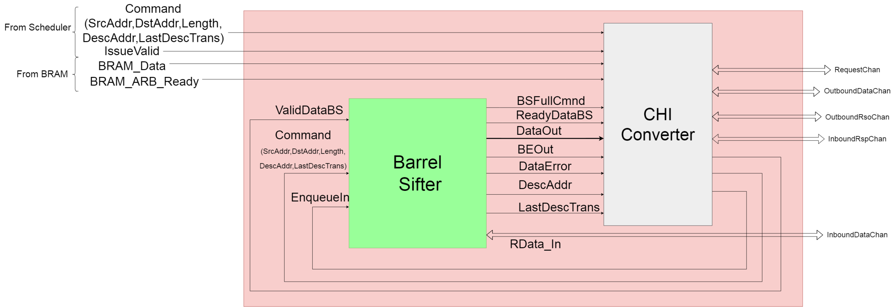
BS-CHI-Conv

