Slide 1
PHP: Lecture 1
Avanindra Kumar Pandeya

Slide 2
Assignment Discussion and Feedback
How to check the page source

Slide 3
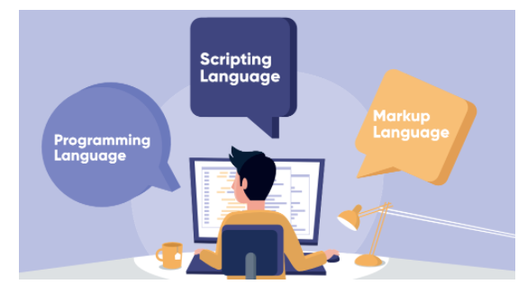
Programming
What is programming?
Programming is a way to “instruct the computer to perform various tasks”.
Programming Language vs Scripting Language vs Markup Language
Photo Courtsey: GeekForGeeks
PHP is a scripting Language

Slide 4
PHP
“PHP (recursive acronym for PHP: Hypertext Preprocessor) is a widely-used open source general-purpose scripting language that is especially suited for web development and can be embedded into HTML.” – PHP Manual
It can do three major things:
Server side Scripting
Command line scripting
Writing Desktop Applications
We will focus on Server side Scripting
You need three things to make this work: the PHP parser (CGI or server module), a web server and a web browser.
XAMPP is a free and open-source cross-platform web server solution stack package developed by Apache Friends, consisting mainly of the Apache HTTP Server, MariaDB database, and interpreters for scripts written in the PHP and Perl programming languages – Wikipedia

Slide 5
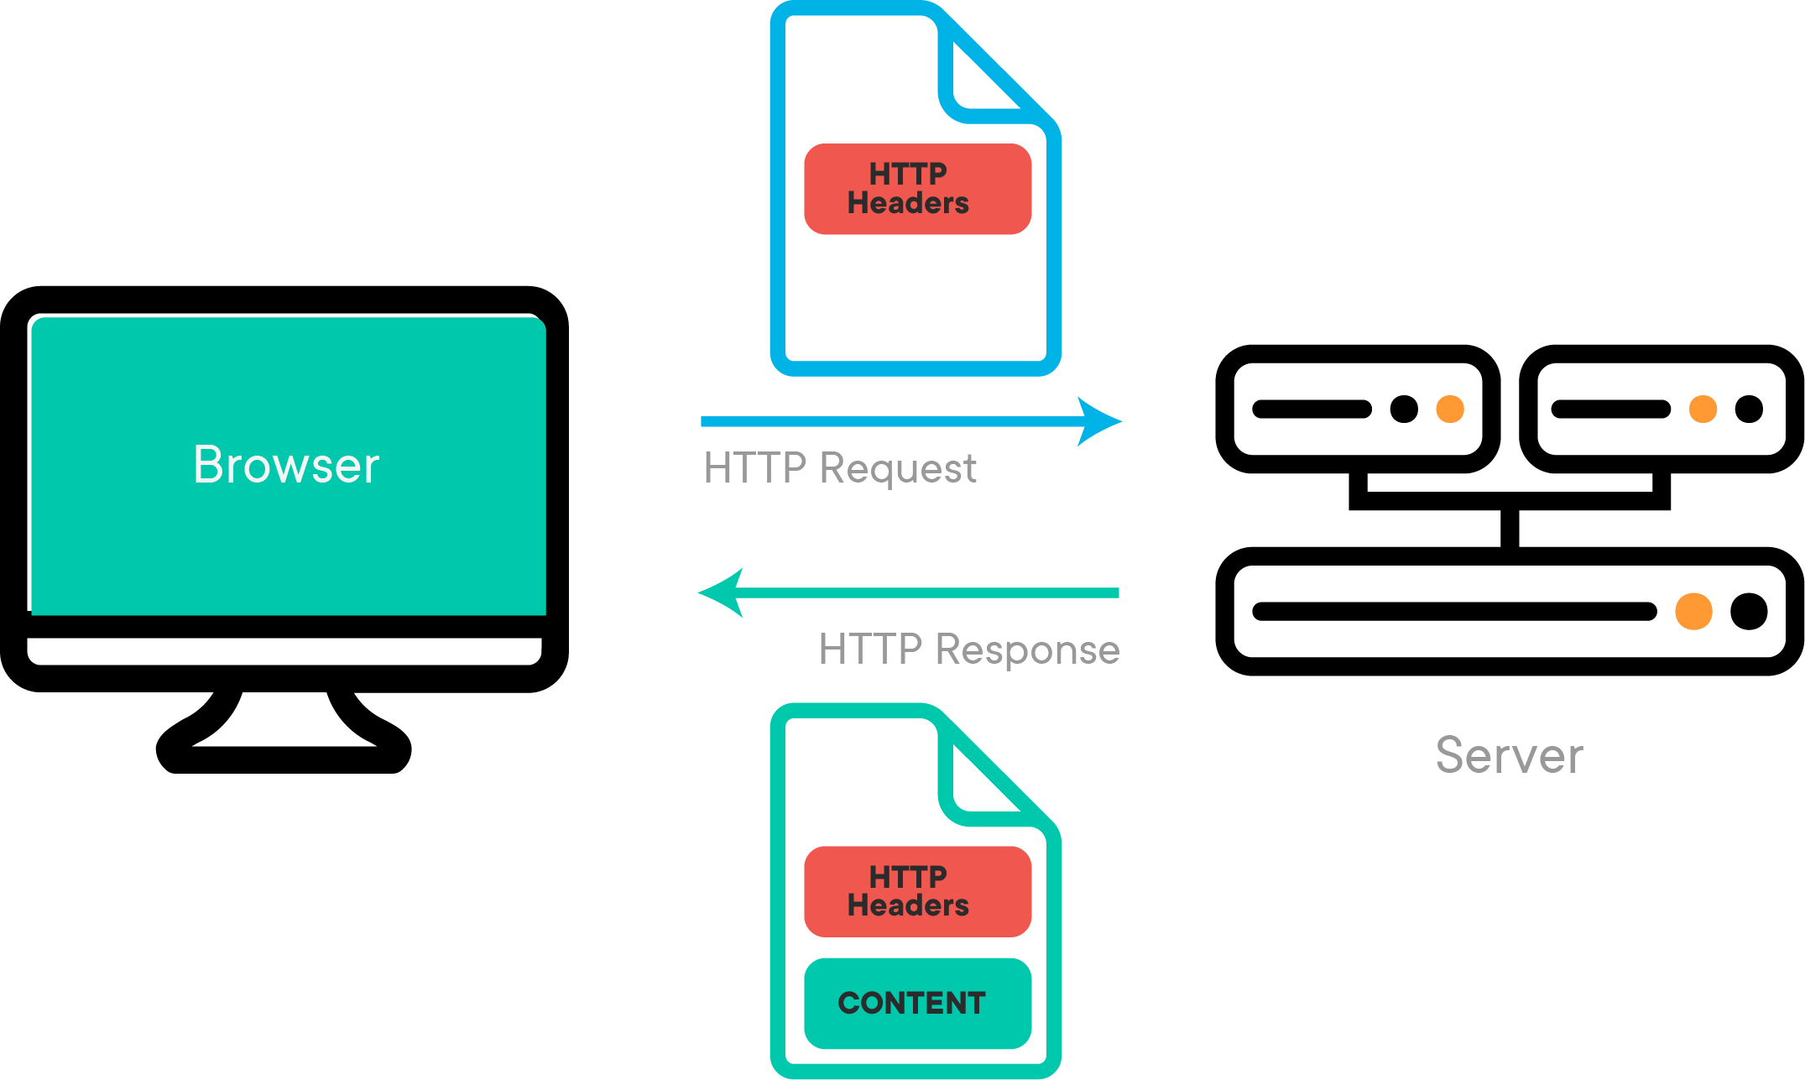
How the web works?
Web Programming
Demonstration!
Photo Courtsey: Learn.Co

Slide 6
Demonstration
Example 1 – Hello World

Slide 7
Variables
Variables in PHP are represented by a dollar sign followed by the name of the variable. The variable name is case-sensitive.
A variable name cannot start with any thin other than a letter or a underscore
For our purposes here, a letter is a-z, A-Z, and the bytes from 128 through 255 in the ASCI Table

Slide 8
Variables
Variables
Scalar
Compound
Special
String
Float
Integer
Array
Object
Callable
Iterable
Resource
Null
Single Quoted
Double Quoted
Heredoc Syntax
Nowdoc Syntax (>5.3)
Boolean

Slide 9
Demonstrations
Example 2 – Need of Variables
Example 3 – How to use variable
Example 4 – What are acceptable variable names
Example 5 – How to copy a variable in the right way?
Example 6 – Boolean data Type
Example 7 – String Data Type

Slide 10
Double Quoted
Escaped characters
Sequence | Meaning
\n | linefeed (LF or 0x0A (10) in ASCII), New Line
\r | carriage return (CR or 0x0D (13) in ASCII)
\t | horizontal tab (HT or 0x09 (9) in ASCII)
\v | vertical tab (VT or 0x0B (11) in ASCII) (since PHP 5.2.5)
\e | escape (ESC or 0x1B (27) in ASCII) (since PHP 5.4.4)
\f | form feed (FF or 0x0C (12) in ASCII) (since PHP 5.2.5)
\\ | backslash
\$ | dollar sign
\" | double-quote
\[0-7]{1,3} | The sequence of characters matching the regular expression is a character in octal notation, which silently overflows to fit in a byte (e.g. "\400" === "\000")
\x[0-9A-Fa-f]{1,2} | The sequence of characters matching the regular expression is a character in hexadecimal notation
\u{[0-9A-Fa-f]+} | The sequence of characters matching the regular expression is a Unicode codepoint, which will be output to the string as that codepoint's UTF-8 representation (added in PHP 7.0.0)

