Slide 1
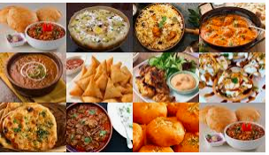
New York City – Identify a place for upcoming Indian Restaurant
Coursera Applied Data Science Capstone Project
April 06, 2020

Slide 2
introduction
New York City, is the largest and the most populous city in the United States.
United States with a long history of international immigration. The New York region continues to be by far the leading metropolitan gateway for legal immigrants admitted into the United States.
The city is having various cuisine restaurants. A large population search for good Indian cuisines.
This project aims to analyze various restaurants locations and find suitable place for upcoming Indian restaurant by using Foursquare location data.

Slide 3
Data acquisition
The following sources were used in this project
New York City data that contains list Boroughs, Neighborhoods along with their latitude and longitude.
Data source: https://cocl.us/new_york_dataset
All restaurants and Indian restaurants in area of interest near to Manhatten of New York city.
Data source: Fousquare API
GeoSpace data
Data source: Google Maps API reverse geocoding
Foursquare (for venue information data and location)
The data was gathered using google API, making calls to the Foursquare API, and downloading geojson files.

Slide 4
Exploratory data analysis
The majority of our exploratory data analysis focused on using longitude and latitude information to make maps and other visuals in order to better understand where landmarks and other points of interests were located
We utilized folium maps, heatmaps and content tables

Slide 5
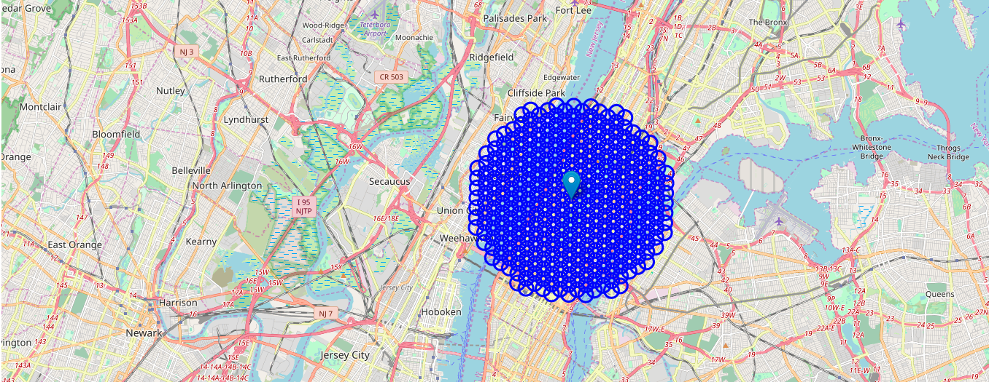
Map of New York CITY
NYC MAP
The first exploratory data analysis performed a folium and boundary map of New York City to get a visual of how and where the restaurants are located.
Focused area near to city center (Manhatten) – 12 x12 km grid

Slide 6
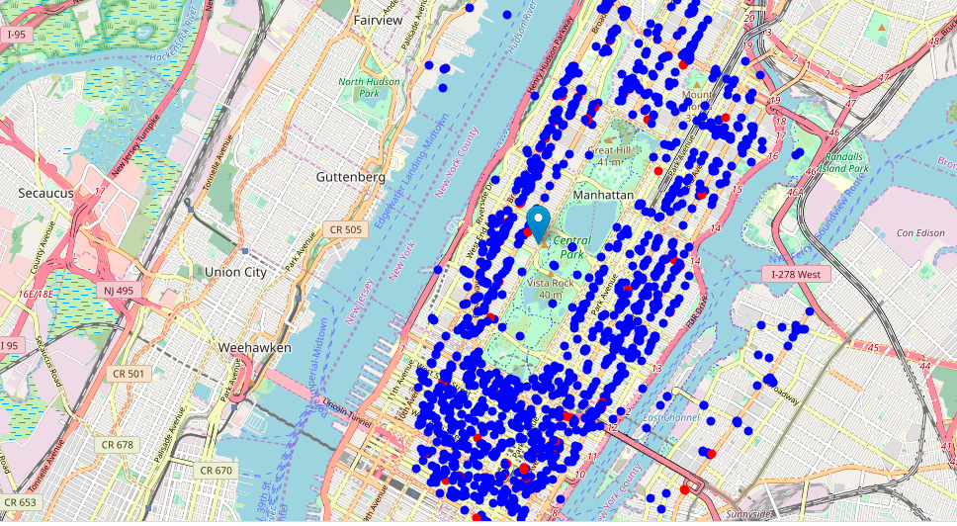
All restaurants location on map
I created a map that showed restaurants in New York City and red circles are Indian restaurants.

Slide 7
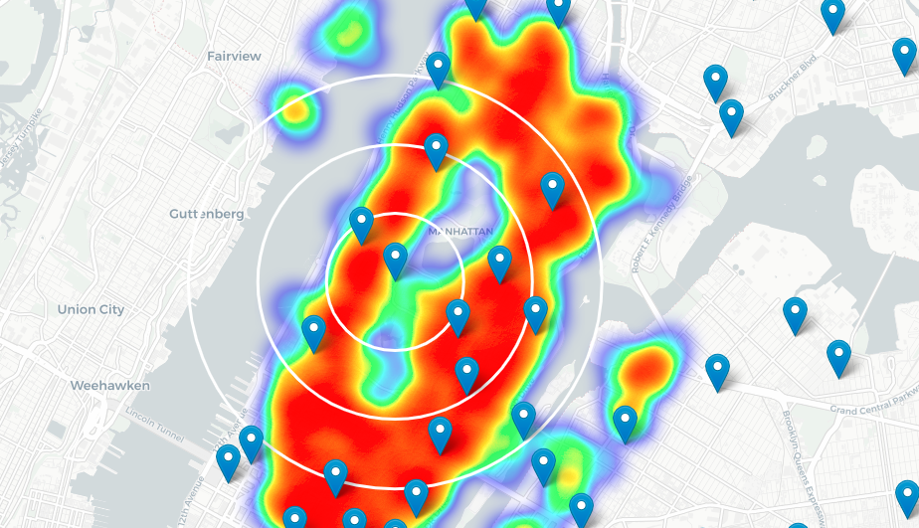
Heatmap of all restaurants
This heatmap shows the proximity of restaurants

Slide 8
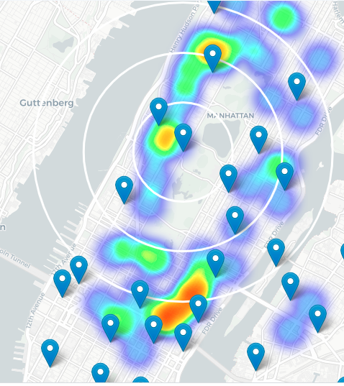
Heatmap of Indian restaurants
This heatmap shows the proximity of Indian restaurants

Slide 9
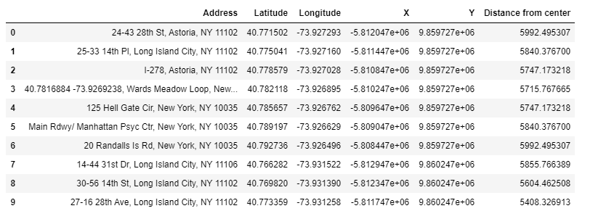
Clustering Venues using Foursquare Data
We downloaded restaurants data from Foursquare and calculated distance from city center

Slide 10
Results & Conclusion
Total number of restaurants: 1492
Total number of Indian restaurants: 64
On average Indian restaurant can be found within ~1400m** from every area center candidate.
The map is not so 'hot' (Indian restaurants represent a subset of ~4.29% of all restaurants in NYC) but it also indicates higher density of existing Indian restaurants between 42nd street and 57th street between 2nd and 3rd ave, with closest pockets of low Indian restaurant density positioned near East Harlem.
Based on this, we recommend East Harlem area as the preferred location for new Indian Restaurant

