Slide 1

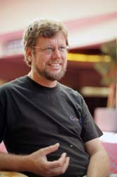
Python Meetup 1
Python, by definition, is a programming language. The most common implementation is that in C (also known as CPython) and is what is mostly refered to as “Python”. Apart from the programming language and interpreter, Python also consists of an extensive standard library.
Goals listed on the DARPA Python proposal for:
An easy and intuitive language just as powerful as major competitors
open source, so anyone can contribute to its development
code that is as understandable as plain English
suitability for everyday tasks, allowing for short development times
Alek Petty / @alekpetty / alekpetty.com
Founder and
“Benevolent Dictator For Life”
Notes:
Quick talk about Python
Ask people to introduce themselves
Show off the GitHub repo.

Slide 2
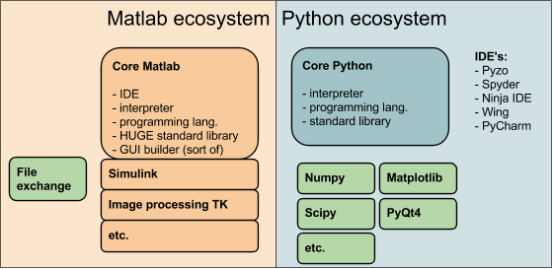
Python Meetup 1
Matlab to Python…
Notes:
Much bigger standard Matlab library

Slide 3
Python Meetup 1
Matlab cons..
well-known memory management deficiencies.
sprawling mess of interconnected m-files.
Matlab is expensive
The algorithms are proprietary
difficult/impossible for 3th parties to extend the functionality of Matlab
lacks the concept of a ‘data table’
MATLAB classes are needlessly complicated
Mathworks puts restrictions on code portability, the ability to run your code on someone else's computer
Figures are hard to render well
Notes:
Quick talk about Python
Ask people to introduce themselves
Show off the GitHub repo.

Slide 4
Python Meetup 1
Matlab pros..
It has a nice IDE
So let’s help each other make the switch…
Notes:
Quick talk about Python
Ask people to introduce themselves
Show off the GitHub repo.

Slide 5
Python Meetup 1
Introductions
Notes:
Quick talk about Python
Ask people to introduce themselves
Show off the GitHub repo.

Slide 6
Python Meetup 1
Introductions
Cryoscripts GitHub repo
Notes:
Quick talk about Python
Ask people to introduce themselves
Show off the GitHub repo.

Slide 7
Python Meetup 1
Introductions
Cryoscripts GitHub repo
V quick Python demo!
Notes:
Quick talk about Python
Ask people to introduce themselves
Show off the GitHub repo.

Slide 8
Python Meetup 1
Questions?
Plans for future meetups?

