Slide 1
A Tutorial on Static Binary Analysis Tools
0856520 鄭人豪

Slide 2
Outline
1. Introduction
2. Installation of tools
3. Usage

Slide 3
Introduction
The malware sample will go through YARA identification, it was scanned for find specific strings. After that, we disassembly and decompilation of binary executables. Finally, use BinDiff to tell if two binaries contain similar code pieces.
YARA for identification
Ghidra for disassembly
BinDiff for comparison

Slide 4
Introduction
Malware for our tutorial, malware name: Win32/Hupigon [1]
This family of backdoor trojans can steal your personal information, such as your online user names and passwords.
They can also give a malicious hacker access and control of your PC.
[1] https://github.com/ytisf/theZoo/tree/master/malwares/Binaries/Win32.Hupigon
Notes:
Case1 from email.

Slide 5
Installation tools
YARA
In terminal use sudo apt install yara to install YARA.
Then you can use ‘’yara’’ command in terminal.
Ghidra
Download .zip from https://ghidra-sre.org/, and then unzip.
Click GhidraRun, then open GUI.
BinDiff
Download .deb from https://zynamics.com/software.html Click to install Bindiff.

Slide 6
Installation tools
Ghidra BinExport entension [1]
Build Dependencies
OpenJDK 11
Gradle 5.6 (https://services.gradle.org/distributions/gradle-5.6.3-all.zip)
Build
Form terminal, start the build with gradle
After that, it download dependency and compiling the java sources, the extension is in “dist/ghidra_9.1.2_PUBLIC_YYYYMMDD_BinExport,zip”
The import the extension in Ghidra GUI.
[1] https://github.com/google/binexport/tree/master/java/BinExport

Slide 7
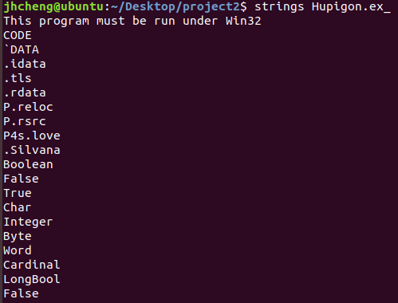
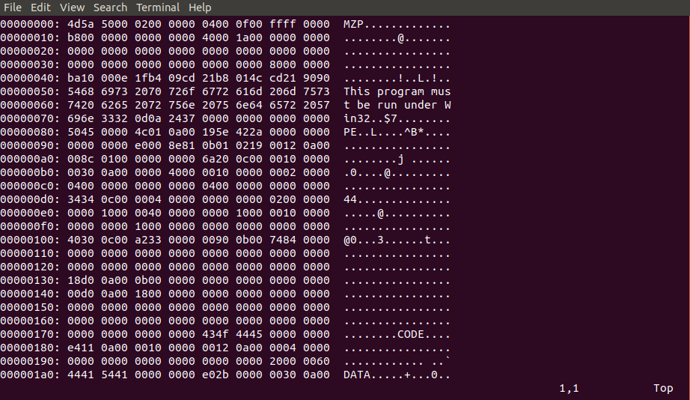
Usage
For find specific string in malware sample, we use strings command to print the strings of printable characters in files, and we also use the :%! xxd command to transform a file in Vim to hex representation.

Slide 8
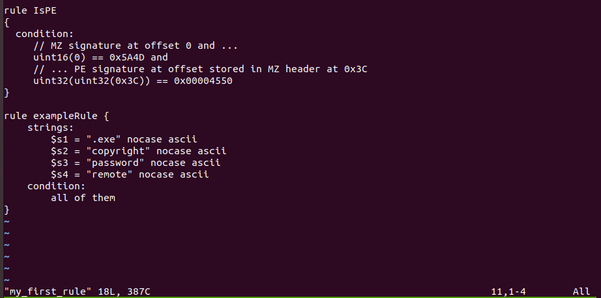
Usage
After that, we can start to write YARA rules.
For distinguish PE files
For match strings and
condition

Slide 9
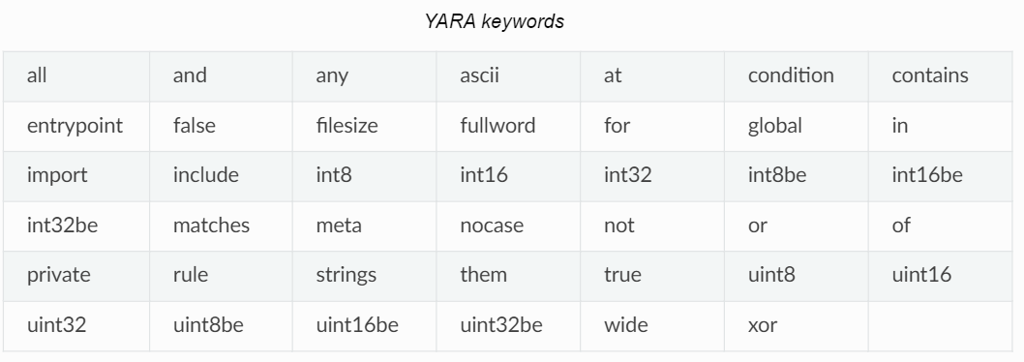
Usage
YARA rule [1]
[1] https://yara.readthedocs.io/en/stable/writingrules.html

Slide 10
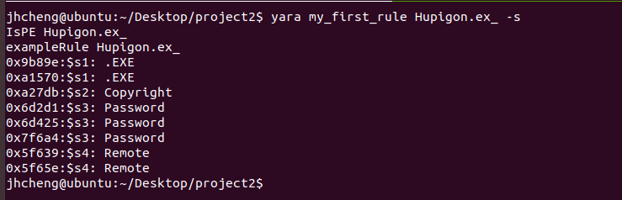
Usage
Execute YARA rule (-s for print string found in file)

Slide 11
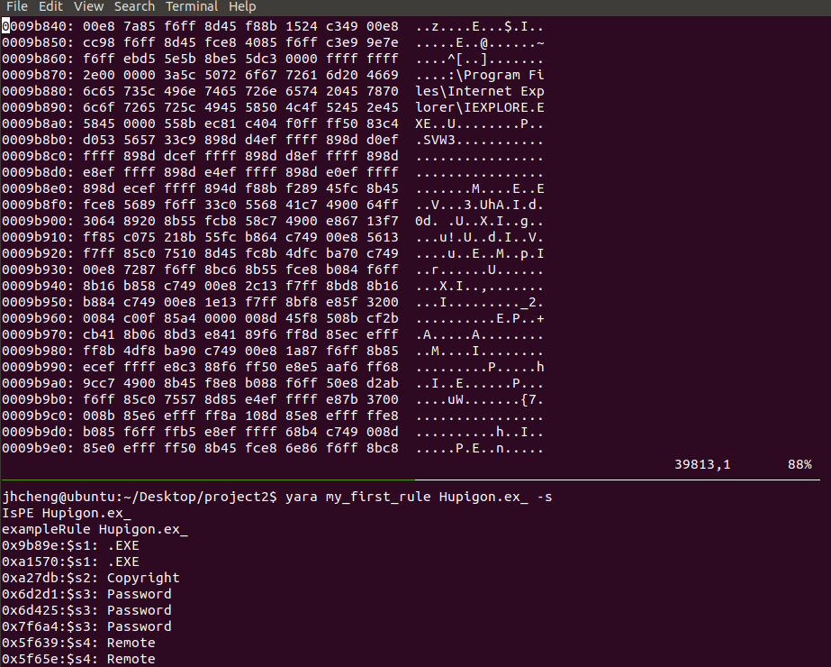
Usage

Slide 12
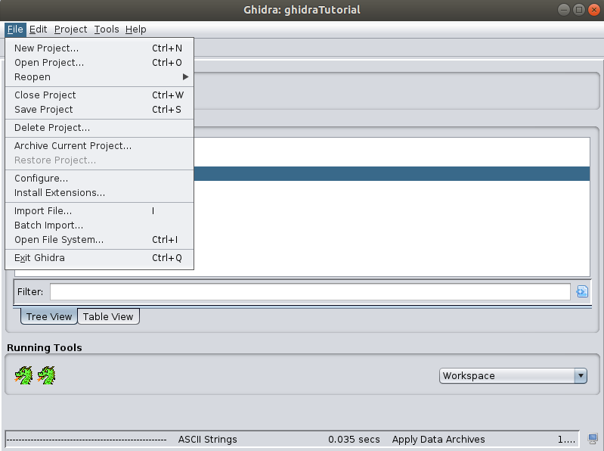
Usage
Ghidra
Open Ghidra GUI, import our malware program.
And decompile the binary executables.

Slide 13
Usage
Ghidra
Double-clicking the imported file within the project window launches the CodeBrowser with a prompt to analyze the file.

Slide 14
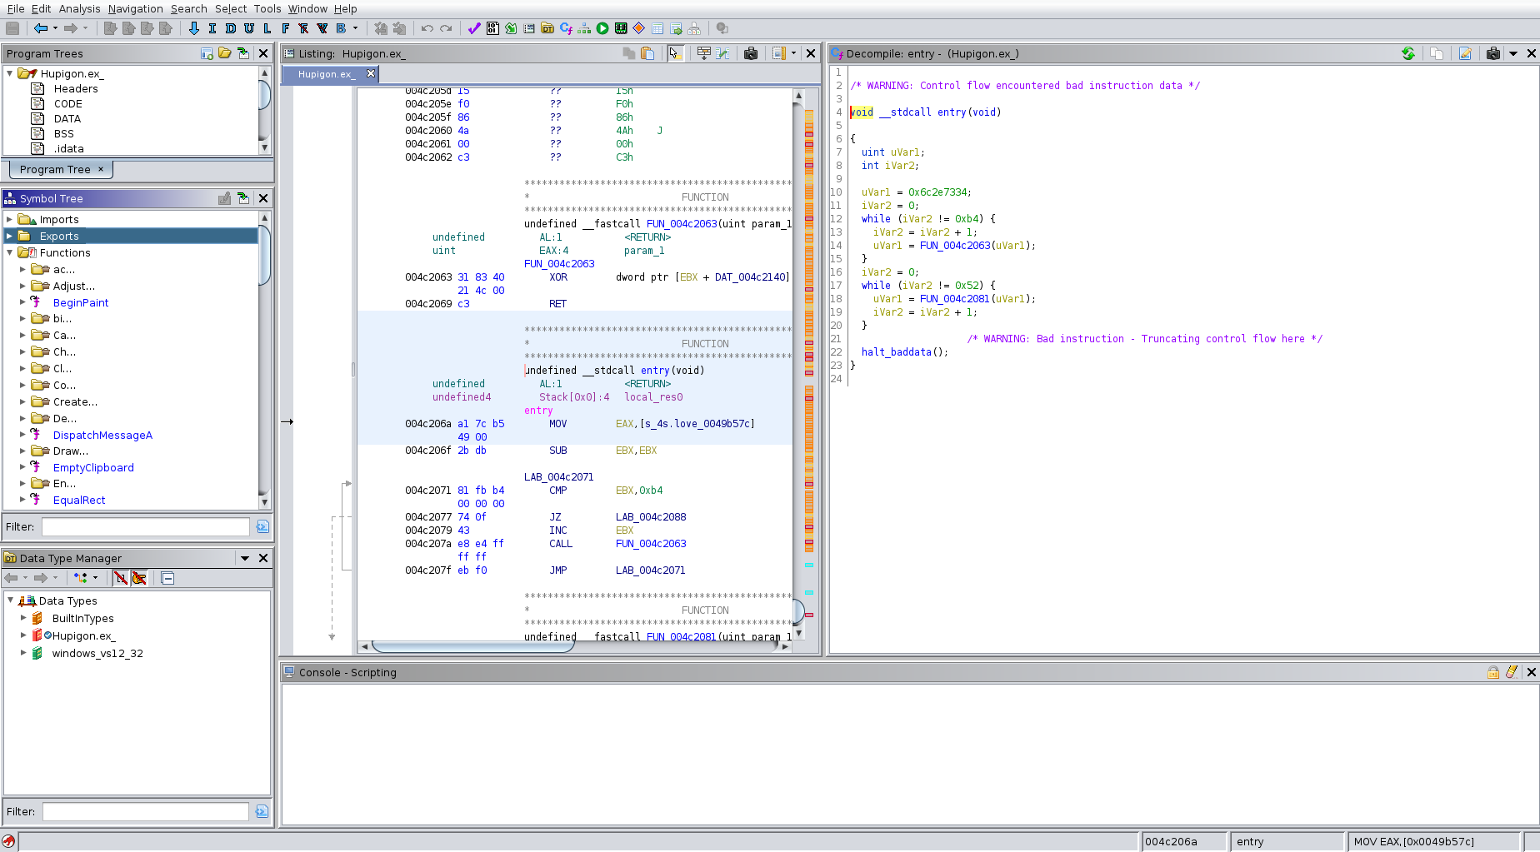
Usage

Slide 15
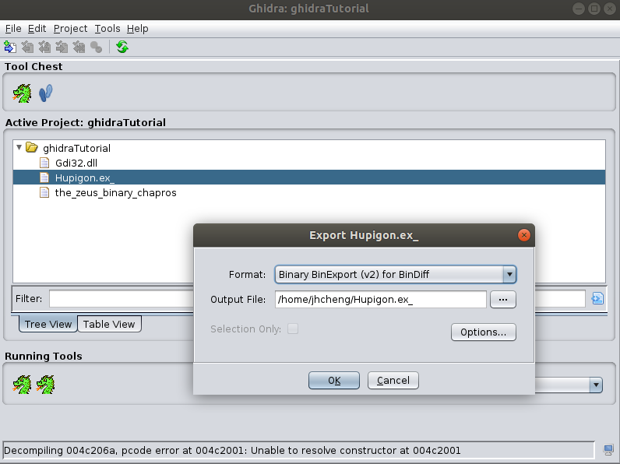
Usage
BinExport
After analysis is done, click binary to export.

Slide 16
Usage
BinDiff
Use of BinDiff to tell if two binaries contain similar code pieces.
a known library example: Gdi32.dll [1]
(Gdi32.dll contains functions for the Windows GDI (Graphical Device Interface) which assists windows in creating simple 2-dimensional objects.)
[1] https://www.dll4free.com/gdi32.dll.html

Slide 17
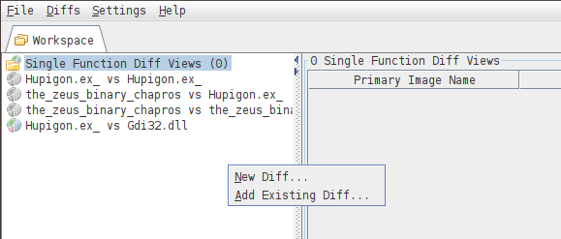
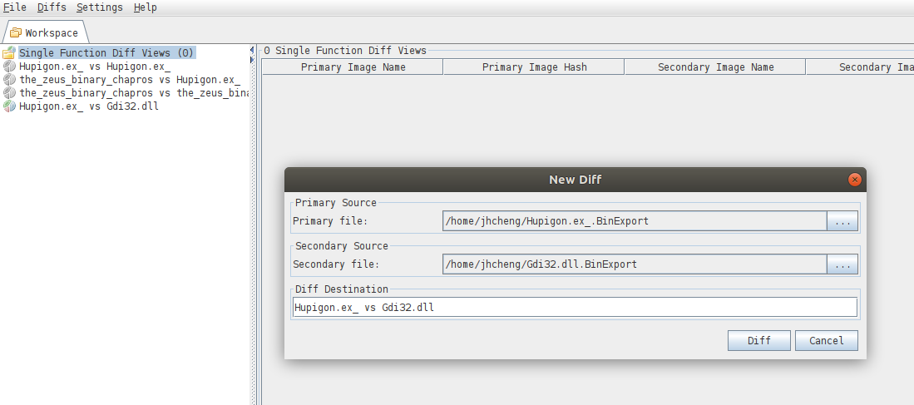
Usage
BinDiff
Add ‘new diff’ -> Select Primary Source(BinExport of the malware) and Secondary Source(BinExport of known library) -> Click Diff

Slide 18
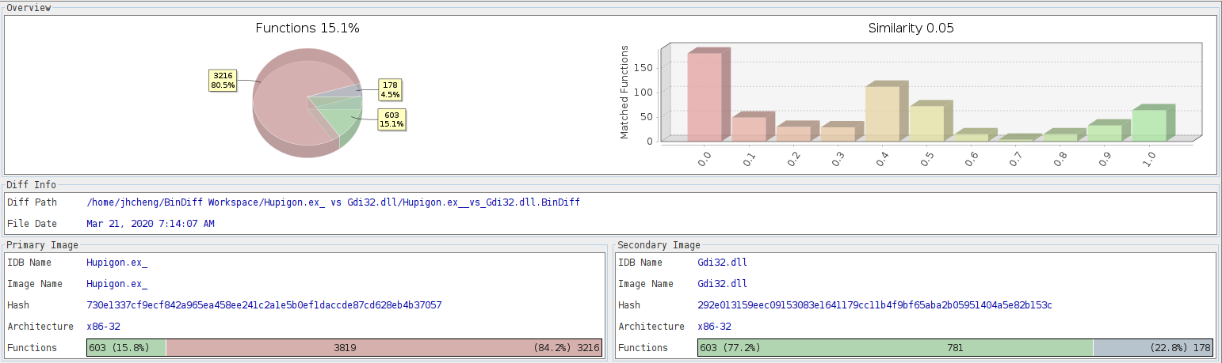
Usage
Hupigon.ex_ v.s. Gdi32.dll

Slide 19
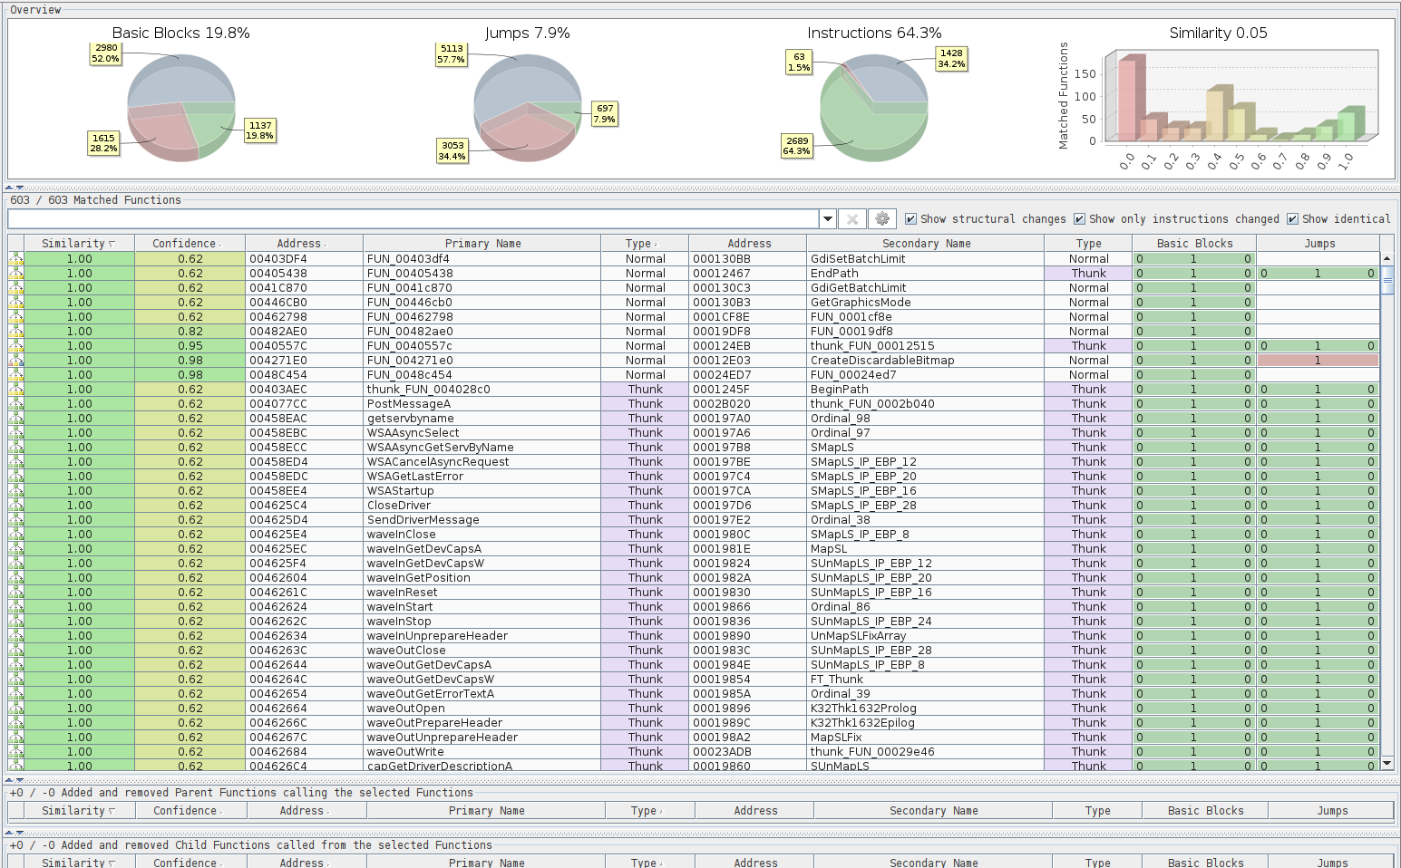
Usage

Slide 20
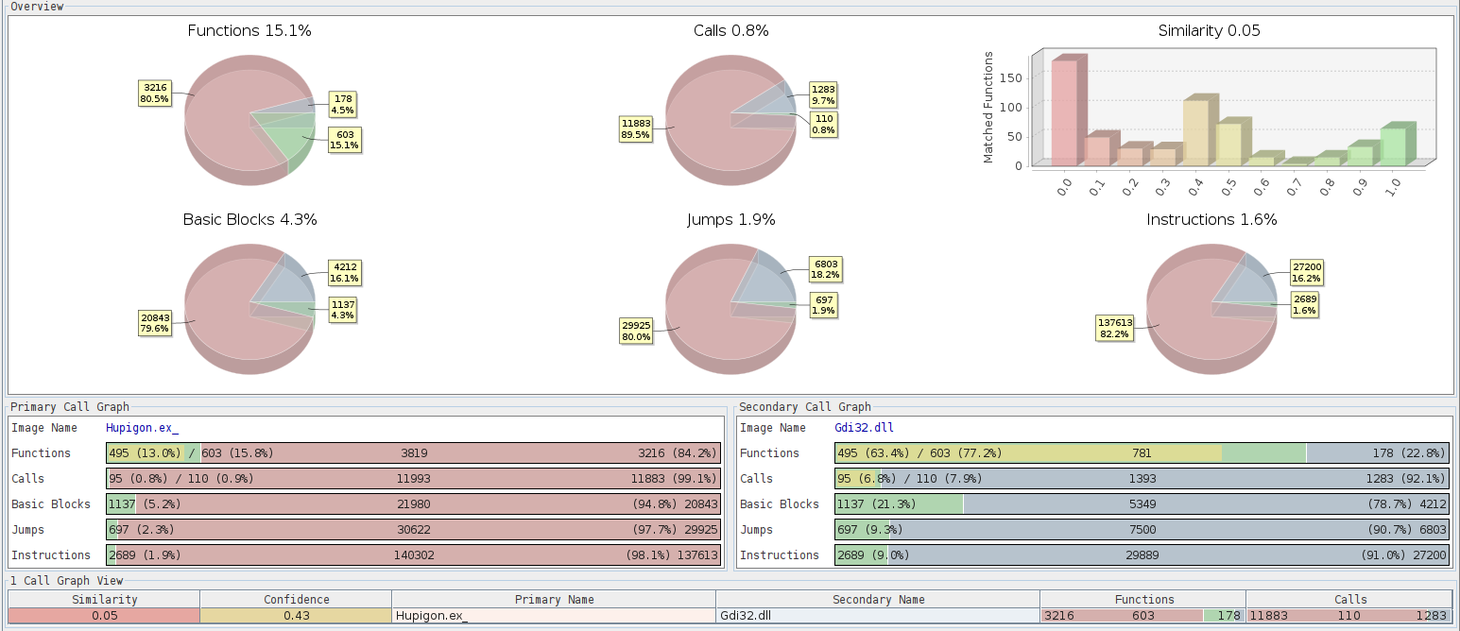
Usage

