Slide 1
Vacation Homez Case Study
Abhash Kumar Padhy

Slide 2
INTRODUCTION:-
VacationHomez is a global company renting out vacation homes around the world. They recently acquired a company in the US and are seeking to understand more about how they should be setting prices for these new properties.
You have been asked by VacationHomez to analyze a dataset pertaining to these newly acquired properties to understand and explain the relationship between the log-price of their listings and the rest of the data that is provided.

Slide 3
OBJECTIVE:-
The objective is to identify and capture the dependency pattern of the log-price of the listing.
The historical dataset contains information such as number of bedrooms, amenities, facility location, reviews and a log-price indicator.

Slide 4
DATASET:-
The training data for the competition consist of the following columns, which consists of numerical, categorical and geographical features
'id', 'log_price', 'property_type', 'room_type', 'amenities', 'accommodates', 'bathrooms', 'bed_type', 'cancellation_policy', 'cleaning_fee', 'city', 'description', 'first_review', 'host_has_profile_pic', 'host_response_rate', 'host_since', 'instant_bookable', 'last_review', 'latitude', 'longitude', 'name', 'neighbourhood', 'number_of_reviews', 'review_scores_rating', 'zipcode', 'bedrooms', 'beds‘.
It consists of of some numerical features and categorical features.
Numerical features are:
'accommodates', 'bathrooms', 'number_of_reviews', 'review_scores_rating', 'bedrooms', 'beds'
categorical features are:
'bed_type', 'cancellation_policy', 'cleaning_fee', 'city', 'host_has_profile_pic', 'instant_bookable'

Slide 5
DATA ANALYSIS:-
In our given data, we have dependent variable of log_price. let’s us discuss about the correlation co-efficient of this log_price with other independent variables.
Our dataset consists of 36795 rows and 27 columns
The log_price column has a positive correlation with several features, indicating that these features may influence the pricing of vacation homes. Notable features with a positive correlation include:
Accommodates: 0.593015
Bedrooms: 0.487783
Beds: 0.484544
Room_type_Entire home/apt: 0.624791
The log_price also has a negative correlation with some features, implying that these features might have a negative impact on the pricing of vacation homes. Notable features with a negative correlation include:
Room_type_Private room: -0.561153
Location_cluster: -0.123495
Property_type_Apartment: -0.057409

Slide 6
STATISTICAL ANALYSIS & EDA:-
Missing / Null values: We can find many null in out dataset.
I have handled those missing / null values using different statistical methods(mean, media, mode) based on their type.
I have dropped some of the feature which are having more than 11,000 missing values.
I have used KNN imputer and One Hot encoding techniques to handle the categorical features.
Performed statistical analysis, it provided the valuable insights into the distribution and characteristics of the dataset.
Findings:
log_price: The average log price of the vacation homes is approximately 4.73, with a minimum of 2.30 and a maximum of 7.60. This indicates that the prices of vacation homes vary significantly, and most of them are concentrated around the lower price range.
bathrooms: The average number of bathrooms in vacation homes is approximately 1.21, with a minimum of 0 and a maximum of 8. This indicates that most vacation homes have one or two bathrooms.
bedrooms: The average number of bedrooms in vacation homes is approximately 1.23, with a minimum of 0 and a maximum of 10. This suggests that most vacation homes have one or two bedrooms.
beds: The average number of beds in vacation homes is approximately 1.62, with a minimum of 1 and a maximum of 16. This indicates that most vacation homes have one or two beds.
property_type_ columns: The columns related to property types have values of 0 or 1, indicating whether the vacation home belongs to that specific property type (e.g., Apartment or House).
room_type_ columns: The columns related to room types have values of 0 or 1, indicating whether the vacation home is offered as a specific room type (e.g., Entire home/apt, Private room, Shared room).
number_of_amenities: The average number of amenities offered by vacation homes is approximately 16.49, with a minimum of 1 and a maximum of 77. This suggests that vacation homes offer a variety of amenities to guests.
accommodates_times_bedrooms: The average value of the product of 'accommodates' and 'bedrooms' is approximately 4.86, with a minimum of 0 and a maximum of 160. This suggests that the size of the vacation home, as indicated by the product of the number of accommodates and bedrooms, varies widely.

Slide 7
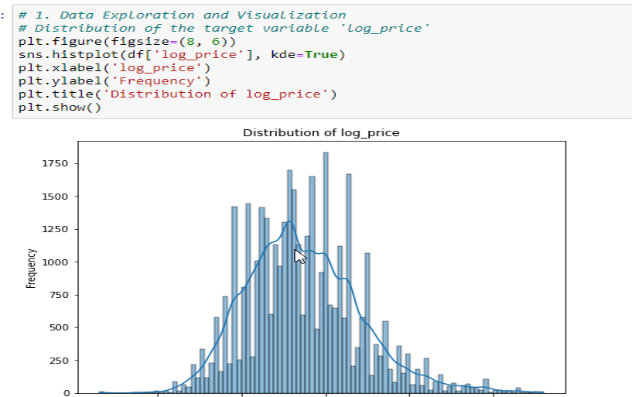

Slide 8
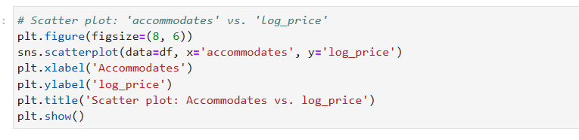
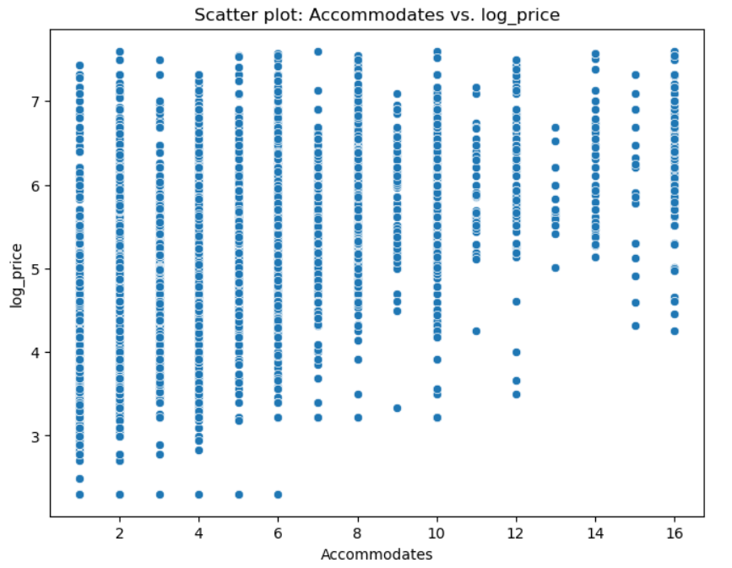

Slide 9
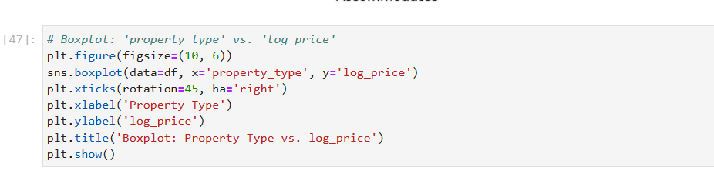
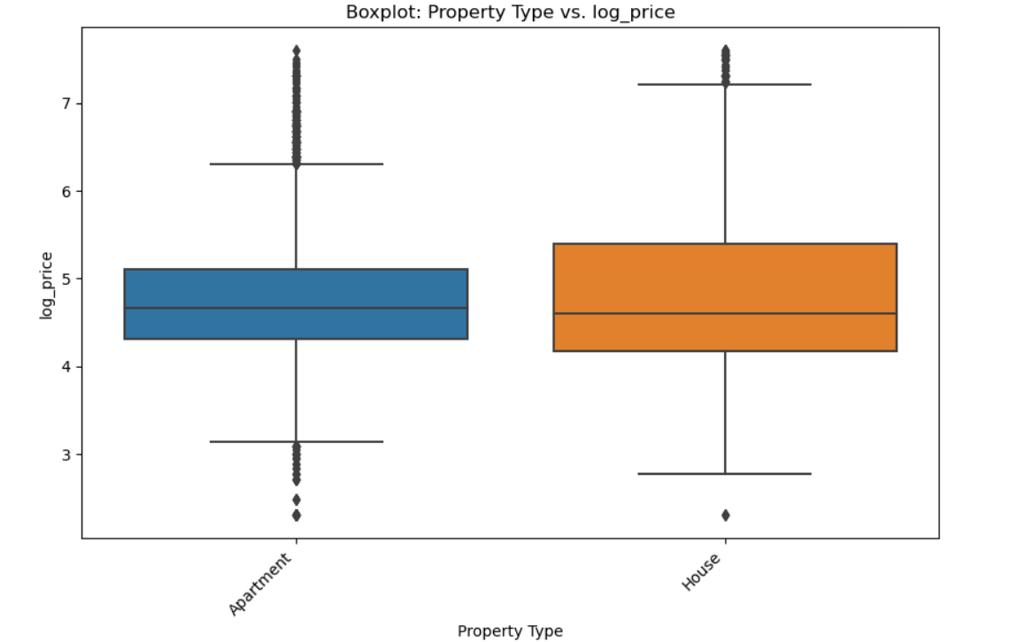

Slide 10
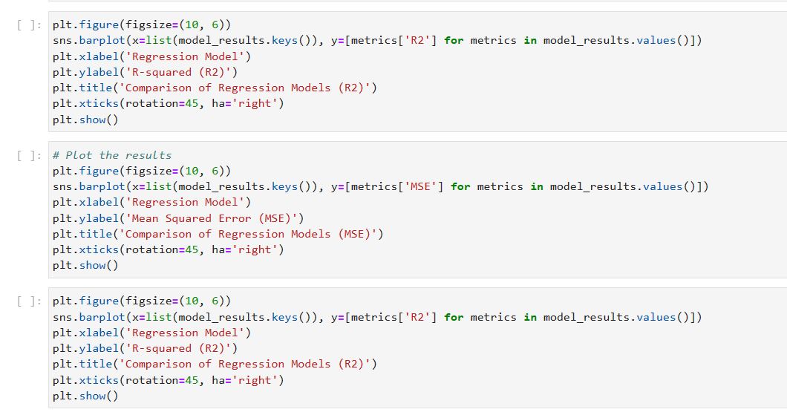
MODEL SELECTION:-
Since it is regression problem, I have used all regression algorithms to build a model.
Those algorithms are
LinearRegression,
DecisionTreeRegressor,
RandomForestRegressor,
GradientBoostingRegressor,
SVR(kernel='linear'),
XGBRegressor,
I have used Mean Squared Error and R2 score to check the performance of the training data
From above all the algorithms, got a good R2 score of 82% with XG boost regressor.

Slide 11
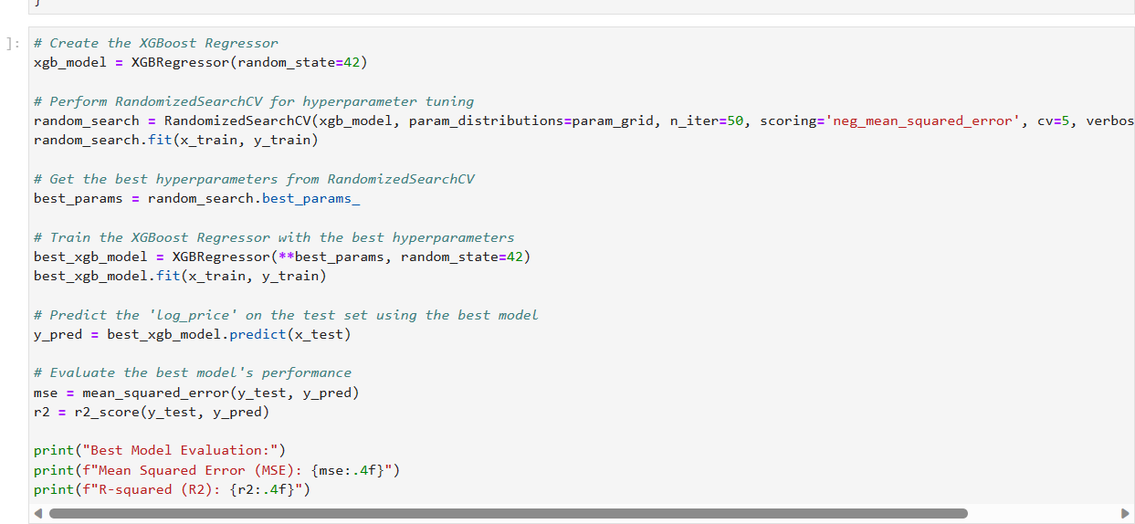
HYPER PARAMETER TUNING:-
Performed Randamized search CV.

Slide 12
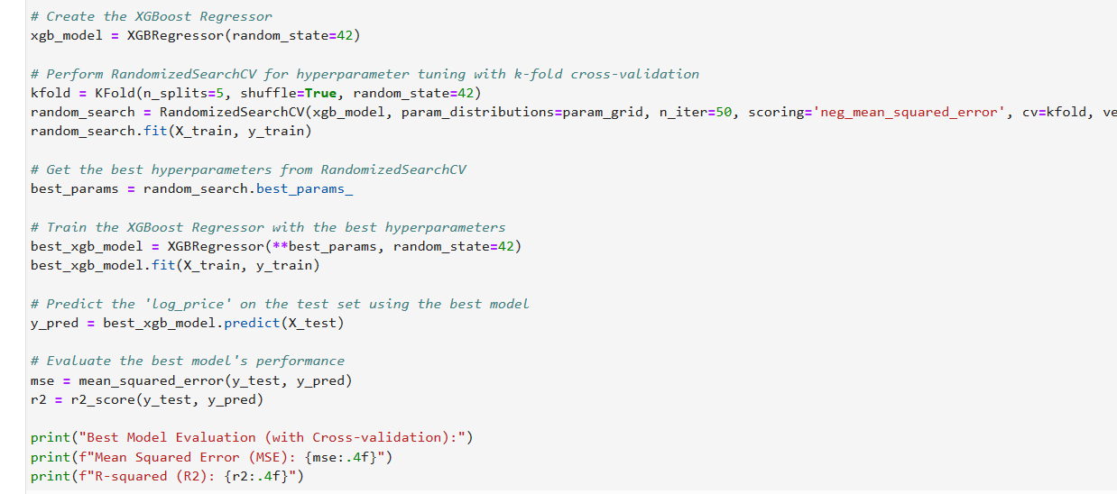
HYPER PARAMETER TUNING WITH K-FOLD CROSS VALIDATION:-

Slide 13
CONCLUSIONS:-
In conclusion, our analysis revealed key drivers of log_price and provided actionable insights for VacationHomez's pricing strategy. Our end-to-end solution pipeline is scalable and can be expanded to other business areas.
From the given dataset, we can conclude that the most important features are
Property Type (Apartment)
Amenities
Bedroom and Bathroom
Room Type Preference(Private room)

Slide 14
THANK YOU

