Slide 1
Intermediate Code Generation
Nitin Manoj (RA201102601083)
Aravind Krishnan (RA2011026010077)

Slide 2
Introduction
Compiler design is a complex and challenging task that involves transforming source code written in one language into executable machine code in another language. One important step in the compiler design process is intermediate code generation, which involves generating an intermediate representation of the source code that can be further optimized and transformed before being translated into machine code.
The goal of our project is to design and implement an intermediate code generator that can take input in a high-level programming language and produce 3-address code as output. This intermediate code can then be used for further optimization and transformation before being translated into machine code.

Slide 3
Problem Statement
The task of designing and implementing a compiler that can translate high-level programming languages into executable machine code is a complex and challenging one. One of the most important steps in this process is intermediate code generation, which involves producing an intermediate representation of the source code that can be further optimized and transformed before being translated into machine code.
The problem we are addressing is the need for a robust and efficient intermediate code generator that can produce 3-address code from input in a high-level programming language. Our goal is to develop a generator that can accurately represent the semantics of the input language and produce code that is easy to optimize and transform into machine code.

Slide 4
Methodology
Our approach to solving the problem of intermediate code generation involves the following steps:
Lexical analysis: The first step in our methodology is to perform lexical analysis on the input source code to identify the tokens and their types.
Syntax analysis: The next step is to perform syntax analysis to identify the structure of the program and check if it adheres to the grammar rules of the input language.
Semantic analysis: After the syntax analysis, we perform semantic analysis to check if the program is semantically correct and to assign types to the variables and expressions.
Intermediate code generation: Once the program has been analyzed and verified, we generate the intermediate code in 3-address format. Our approach involves generating code for each statement in the input program and using a symbol table to keep track of the variables and their addresses.
Optimization: Finally, we perform optimization on the generated intermediate code to improve its performance and efficiency. Our approach involves applying common optimization techniques such as constant folding, common subexpression elimination, and loop optimization.

Slide 5
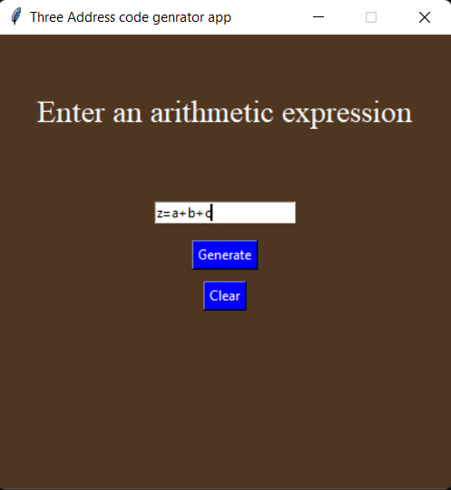
Implementation:
Enter the productions in the editor box
Enter only atomic characters.
The prototype built cannot handle duplicate productions.

Slide 6
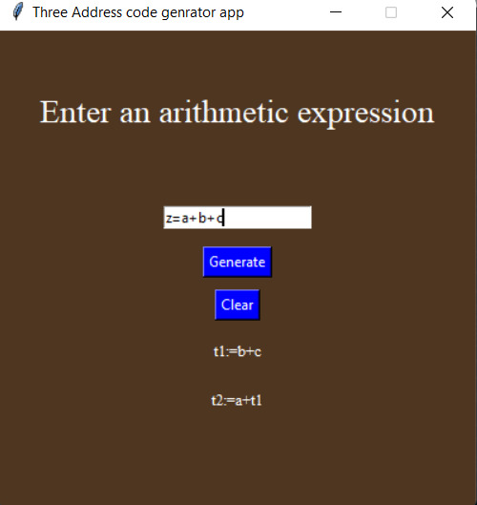
Output
Our intermediate code generator was implemented using the Python programming language and the tkinter framework for creating the user interface. The generator takes input in a high-level programming language from the user and produces 3-address code as output.

Slide 7
Working
The implementation of our generator involved the following components:
User interface: We used the tkinter framework to create a user-friendly interface for the generator. The interface allows the user to input source code in a high-level programming language and provides feedback on the generated 3-address code.
Scanner: We implemented the lexical analyzer using Python's built-in regular expressions module, which reads the input source code and generates a stream of tokens.
Parser: We implemented a recursive descent parser to perform syntax and semantic analysis on the input source code. The parser checks the input code for adherence to the grammar rules of the input language and assigns types to the variables and expressions.
Intermediate code generation: Once the program has been analyzed and verified, we generate the intermediate code in 3-address format. Our approach involves generating code for each statement in the input program and using a symbol table to keep track of the variables and their addresses.

Slide 8
THANK YOU

