Slide 1

Built for the Algerian university classroom.
Hosted in Algeria. Priced in DZD.
ENSIA Incubator — Demo Day · 2026-05-09
[Founder 1] · [Founder 2] · [Founder 3]
3rd-year ENSIA students

Slide 2
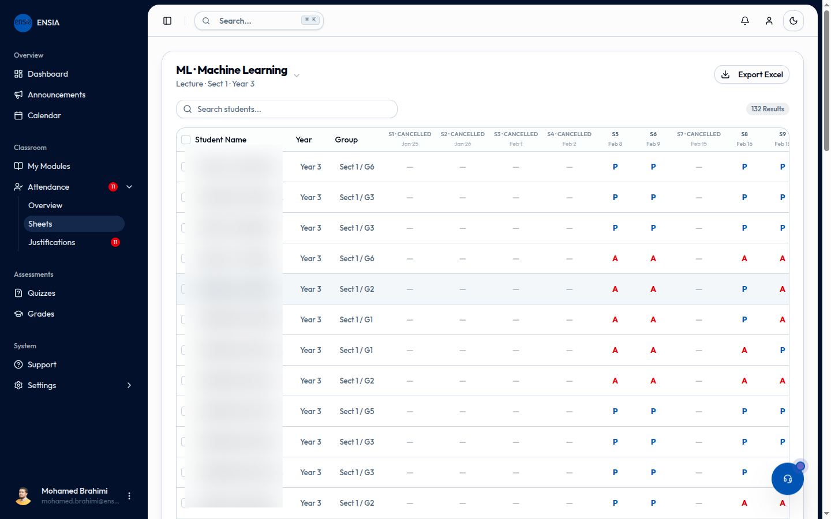
DEMO · 02
In 90 seconds:
A teacher opens Lectu → Generates a QR code → 90 students check in → A live quiz happens → The teacher walks out with attendance, engagement, and grades — all captured.
This is happening at ENSIA right now.
02 · 16

Slide 3
THE PROBLEM · 03
How Algerian universities run their classrooms today.
WHAT TEACHERS DO TODAY
WHAT IT COSTS
Pass paper sign-in sheets in 200-person lectures
Lost time, miscounts, fraud
Track attendance in personal Excel files
No analytics, no consolidation
Coordinate justifications via WhatsApp
No audit trail, no compliance
Run live quizzes via Kahoot (paid out of pocket)
$15–25 per teacher / month, not in DZD
Enter grades in Progres at end of semester
No real-time feedback to students
Progres is a registrar. Moodle is a PDF dropbox. Nothing is built for the classroom.
03 · 16

Slide 4
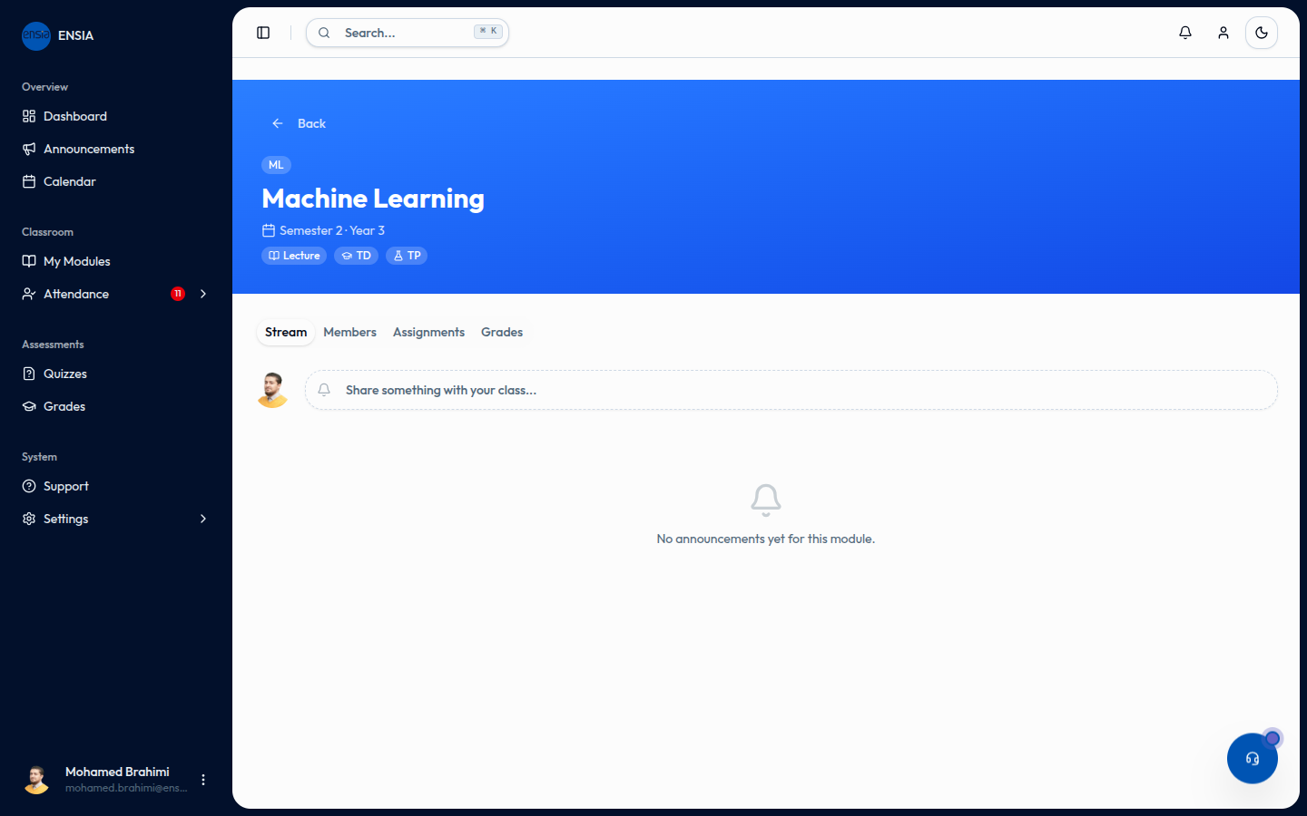
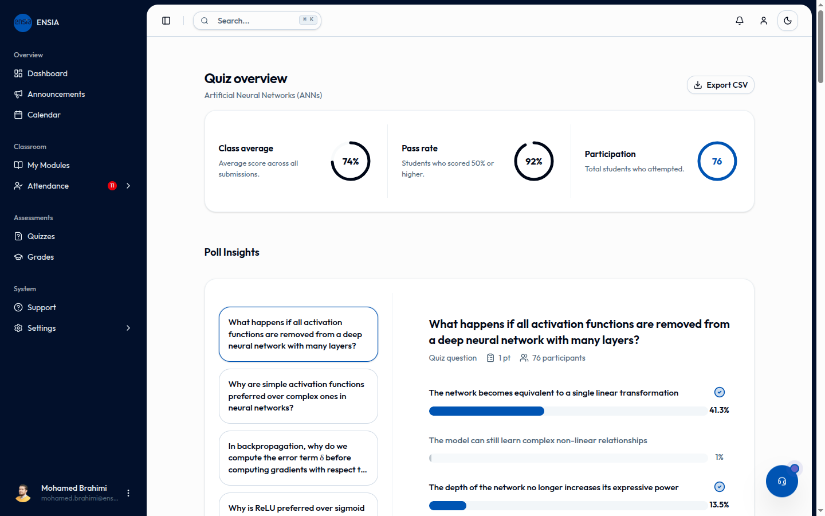
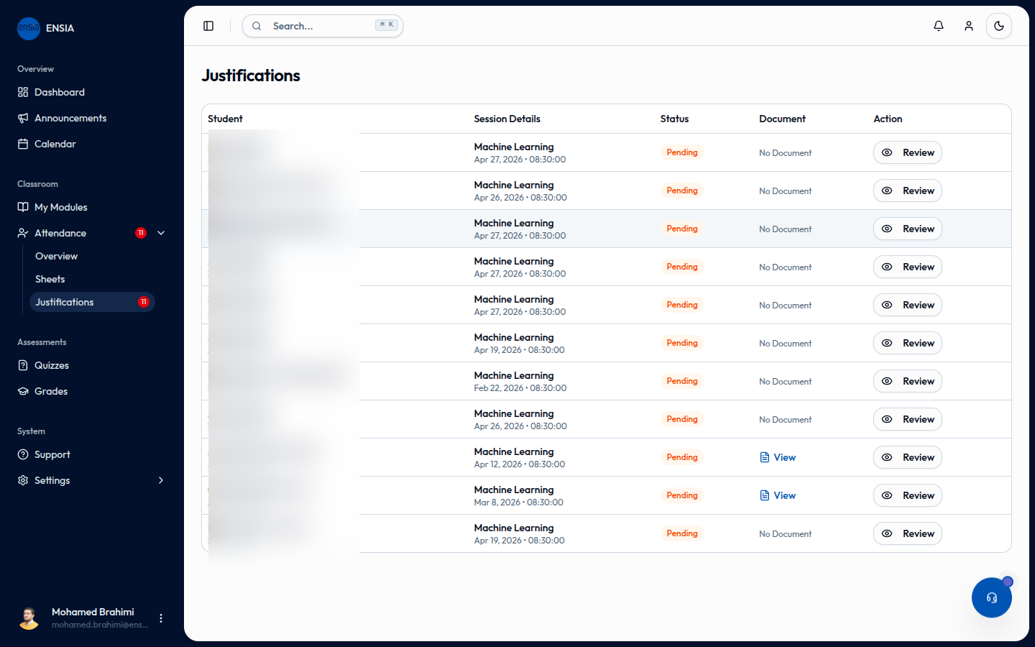
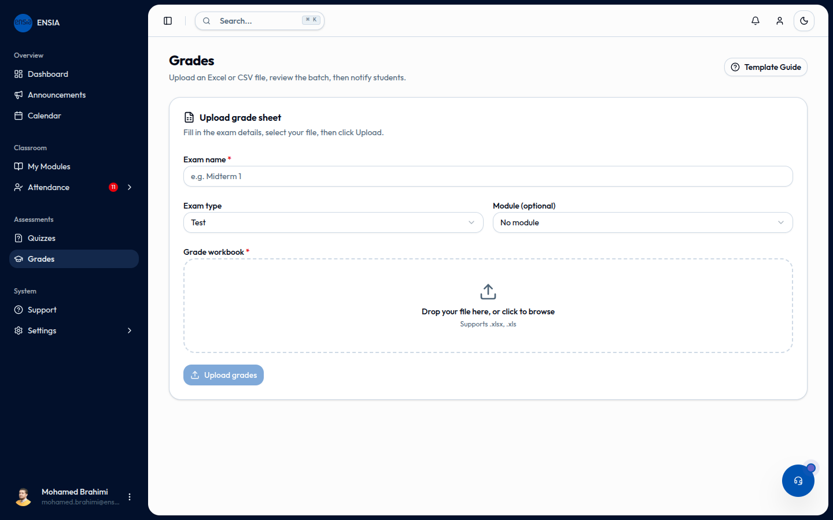
THE SOLUTION · 04
Four features, one platform.
Attendance
Live & Async Quizzes
QR check-in · Manual mark · Card scan · Geofence verification · Offline mode
In-class real-time leaderboard · Scheduled async with auto-grading
Justifications
Grades & Reports
Students submit with file attachments · Teachers/admin review and approve
Per-module tracking · 15-week attendance Excel export · Auto-notify students
Plus: announcements, real-time notifications, calendar integration, role-based dashboards.
04 · 16

Slide 5
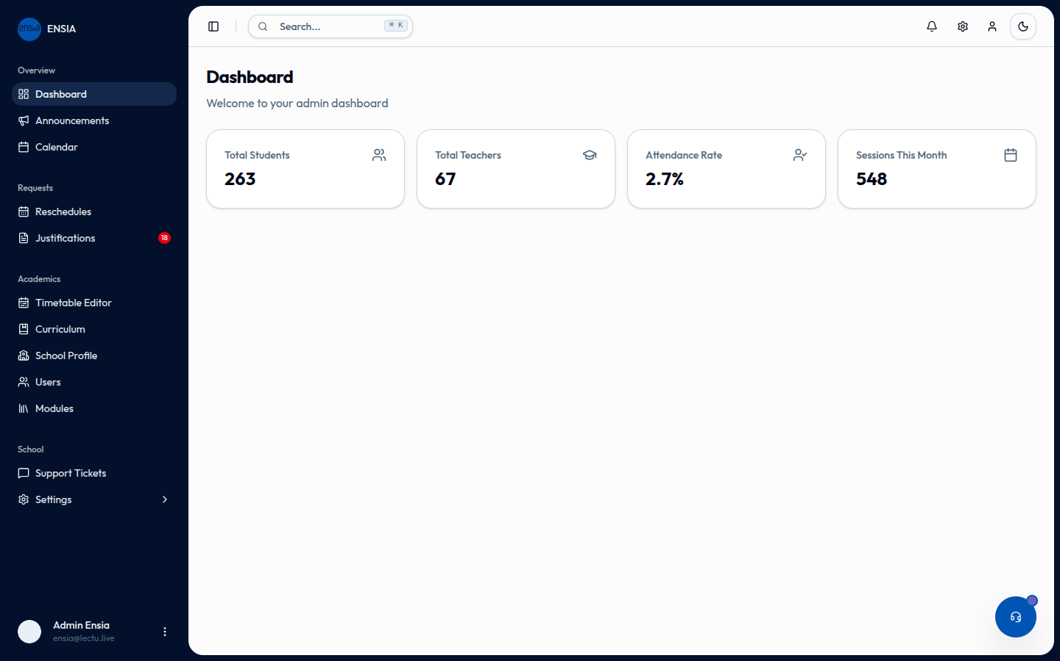
PRODUCTION · 05
In production at ENSIA since February 2026.
1,480
208
attendance records
distinct students
76
14,677
in 1 live quiz
notifications
31 sessions · 510 device fingerprints · 18 justifications
Pilot module: Machine Learning, 3rd Year
05 · 16

Slide 6
TECH · 06
Built for production.
Frontend
Next.js 16 · React 19 · TypeScript · Tailwind CSS · Real-time WebSockets
Backend
FastAPI · Async SQLAlchemy · PostgreSQL · Redis · APScheduler · Azure Blob
Real-time
Live attendance dashboard, live quiz leaderboards, push notifications
Offline-first
IndexedDB attendance cache + batch sync (handles classroom WiFi failures)
Production-grade: structured logging, async-first, role-based authorization, anti-cheat device fingerprinting.
06 · 16

Slide 7
DEFENSIBILITY · 07
Algerian law made local hosting non-negotiable.
Loi 18-07
June 2018
Personal data protection. Cross-border transfer requires ANPDP authorization. Penalties up to 5 years imprisonment.
Law 22-39
January 2022
Public cloud providers must host on Algerian territory under ARPCE authorization.
ANPDP active
August 2022
Law 11-25 (July 2025) tightens requirements further — mandatory DPO, processing records, DPIA.
Foreign LMS — Google Classroom · Microsoft Teams · Canvas · Schoology — all process Algerian student data outside Algerian jurisdiction.
Lectu is the only platform built compliant by architecture.
07 · 16

Slide 8
SOVEREIGNTY · 08
Today: Microsoft Azure (Europe) Tomorrow: Algerian-hosted infrastructure.
TODAY
TOMORROW
Lectu currently runs on Microsoft Azure (European region) for development velocity. ENSIA's on-campus datacenter is currently saturated, so on-campus hosting wasn't available for the soft launch.
FastAPI + Postgres + Redis is portable by design. Migration to Algerian-hosted infrastructure is a one-week deployment, gated only on capacity availability.
WHAT WE'RE ASKING FROM ENSIA
Help us secure on-campus hosting capacity, OR an introduction to an Algerian hosting partner (Algérie Telecom Cloud, ICOSnet, AventureCloudz). The technical migration is ready — what we need is the institutional resource.
08 · 16

Slide 9
MARKET · 09
The Algerian higher-education market.
114
universities + colleges nationally (~1.54M students)
381,428
new bac entrants in 2024 — 97.84% admission rate
11
private HEIs + autonomous-budget grandes écoles
BOTTOM-UP MARKET MATH
SIDI ABDELLAH POLE — OUR BEACHHEAD
1.54M students × ~600 DZD avg = ~900M DZD/yr addressable.
Sidi Abdellah pole alone = ~20,000 students = up to 12M DZD ARR at full pole adoption.
ENSIA ~2,000 students (us, 10% utilization)
NHSM (mathematics) TBD
ESI Algiers (Oued Smar) ~1,340
Pole expansion: 6+ grandes écoles by 2028
Designed for ~20,000 students total
85% smartphone penetration among DZ students
We start with the cohort that already knows us.
09 · 16

Slide 10
COMPETITION · 10
What else is out there?
COMPETITOR
WHAT IT DOES
WHAT IT DOESN'T
PRICING (~2,000 STUDENTS)
LECTU WINS ON
Progres / WebEtu
Enrollment, transcripts, grades
No live attendance, no in-class tools
Free (centrally funded)
Live in-class flow
Moodle (UMBB, USTHB, M'sila)
Course materials
Documented unused for attendance
Free + IT staff cost
Actual classroom usage
Google Classroom · Teams · Canvas
International features
Not Loi 18-07 compliant; USD-billed
$60–250k / yr (~8–33M DZD)
Loi 18-07 + DZD pricing
Kahoot · Wooclap · Mentimeter
Live quizzes only
Per-teacher, no attendance, no DZD
~$30k / yr at institution scale
All-in-one platform
"This service is horrible, it never works, and when it does work, it shows grades for a certain time then stops working." — Apple App Store review of Progres, 2024
Lectu = 1,000,000 DZD / year. 10–30× cheaper than enterprise LMS, and the only DZ-native product that covers attendance + quizzes + grades + LMS.
10 · 16

Slide 11
PRICING · 11
Per-school annual flat license.
GRANDES ÉCOLES & SMALL UNIVERSITIES
LARGER UNIVERSITIES
1,000,000 DZD
Custom
per year · all-inclusive
pricing
< 2,000 students
> 2,000 students
All features · Unlimited users · Hosted in Algeria · Fr / Ar localization · Onboarding + training
No per-seat fees. No per-feature gating. Annual budget cycle aligned.
11 · 16

Slide 12
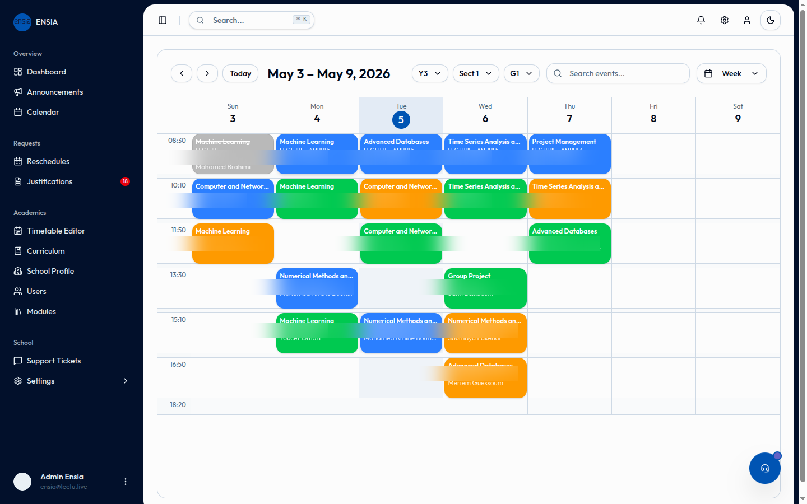
ROADMAP · 12
Two-year horizon.
Phase 0
Activate all 7 ENSIA modules. Pull all 67 teachers into active use. Migrate to Algerian hosting.
Now → Sept 2026
Phase 1
Sidi Abdellah pole expansion. Target: 3 schools live (ENSIA + 2 pole partners).
Sept 2026 → Sept 2027
Phase 2
Other DZ grandes écoles (Polytechnique, ESAA) + select public universities.
Sept 2027 → Sept 2028
International expansion is explicitly out of scope for 24 months.
12 · 16

Slide 13
LOOKING AHEAD · 13
Looking ahead — two horizons.
NATIVE MOBILE APPS (iOS + Android)
2026–27 academic year
A native mobile app on both platforms — primary goal: limit cheating attempts in lecture attendance. Hardware-bound device IDs, real-time push, offline-first check-in.
AI & THE FUTURE OF HIGHER EDUCATION
Research-driven · Ongoing
The AI wave is reshaping how students do assignments, how teachers grade, and how universities measure learning. Three open questions:
• How do you grade an assignment when ChatGPT writes a credible draft?
• How do you redesign coursework for AI-native students?
• How do you keep human judgment central without ignoring the tools?
Lectu wants to be the research partner ENSIA uses to figure this out.
13 · 16

Slide 14
WHAT WE NEED · 14
What we need from ENSIA.
1.
Continuation in the incubator — keep the slot, lab access, mentorship through end of 2026.
WHAT'S BLOCKING US
2.
Formal ENSIA pilot agreement — official deployment for the 2026–27 academic year, multi-department rollout.
· Hosting depends on capacity
· Multi-teacher activation slow without endorsement
· No formal pilot agreement yet
· No design or marketing capacity
3.
On-campus hosting capacity — Phase 1 migration to ENSIA datacenter, OR introduction to an Algerian hosting partner.
4.
Pole introductions — warm intros to NHSM, ESI Algiers, and other Sidi Abdellah grandes écoles.
5.
Design + marketing recruiting — help connect us with ENSIA students for the open team roles.
14 · 16

Slide 15
THE TEAM · 15
Meet the team.
[ Founder Photo ]
[ Founder Photo ]
[ Founder Photo ]
[Founder 1]
[Founder 2]
[Founder 3]
Founder & Full-Stack Lead
Backend & Infrastructure
Frontend & UX
3rd-year ENSIA
3rd-year ENSIA
3rd-year ENSIA
Backend (FastAPI · Postgres · Redis) + frontend (Next.js · Tailwind) + product.
Async SQLAlchemy · WebSocket real-time · Alembic migrations.
Editorial design system · Attendance grid · Quiz editor · Offline-first sync.
15 · 16
We are hiring · Design lead · Marketing / outreach lead

Slide 16
Thank you.
Special thanks to Dr. Brahimi Mohamed and the ENSIA incubator program
for ongoing mentorship and guidance.
Lectu — Built for the Algerian university classroom.
[contact email] · [Lectu URL]
Questions?

