Slide 1
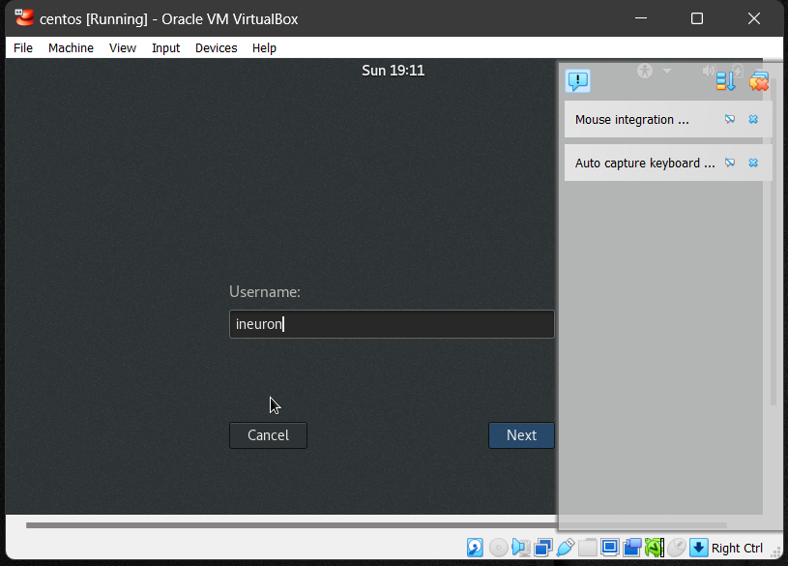
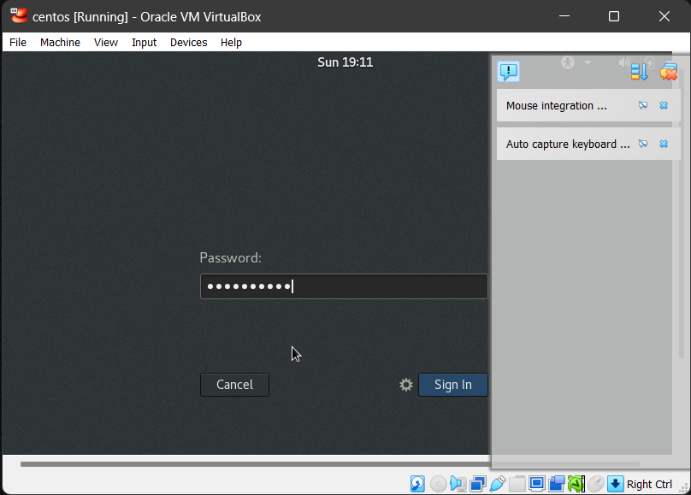
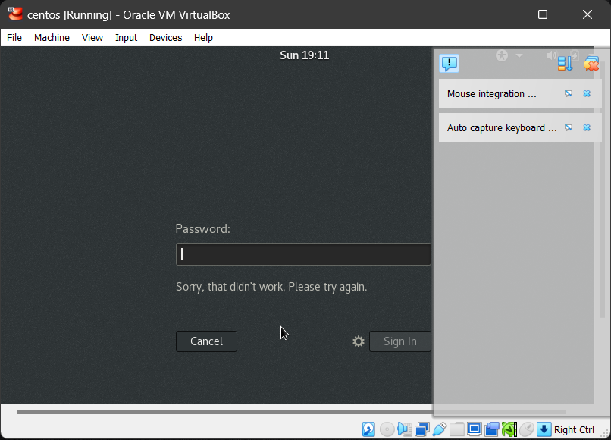
Assignment-1
Connect and disconnect with login Access
What happens when you login a non-existent users or username?
Provide Screenshot and What you understand, explain in short brief?
Solution: As the user (ineuron) is not created so we are not able to login in to the system. To login into the system we need to have the existing username and password.

Slide 2
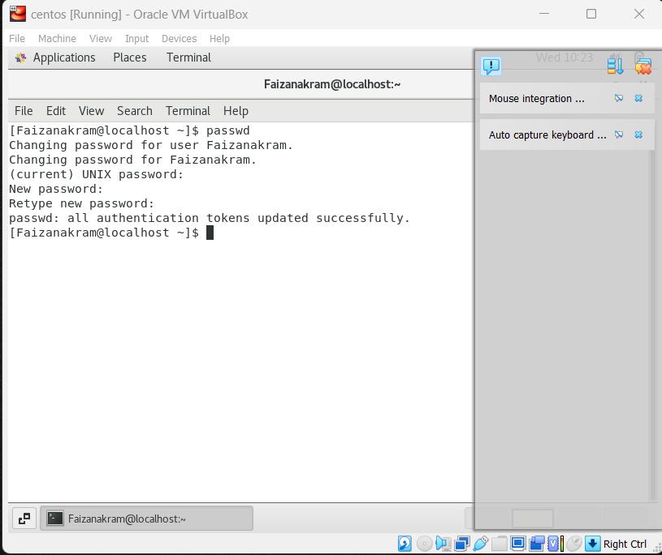
Assignment-2
Password changing
Login into your account and then change password?
Change your password into IneuR0n#42 and hit the Enter key
Explain what happen and give screenshot?
SOLUTION: By using passwd command in the terminal we are able to change the password, where we no to give the old password (existing password) and new password.

Slide 3
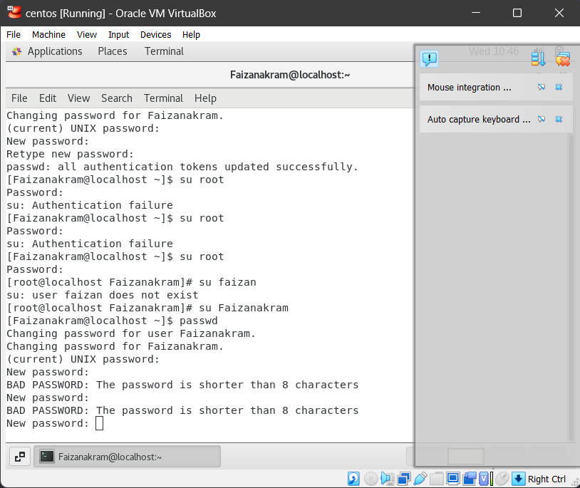
Try again to change password but use like password 1234 or abcd
Explain what happen and give screenshot?
SOLUTION: Password was unable to change to 1234 or abcd as it less than 8 character.

Slide 4
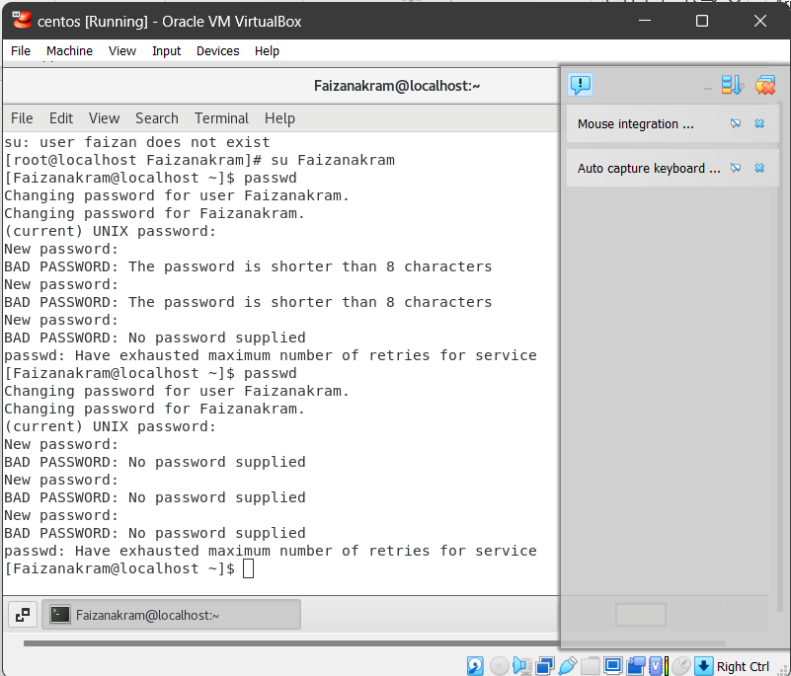
Try again to change password but now don’t use any password just hit Enter key
Explain what happen and give screenshot?
SOLUTION: As we didn't provide the new password it didn't take into consideration to change the new password. So after several attempts, it automatically exists.

Slide 5
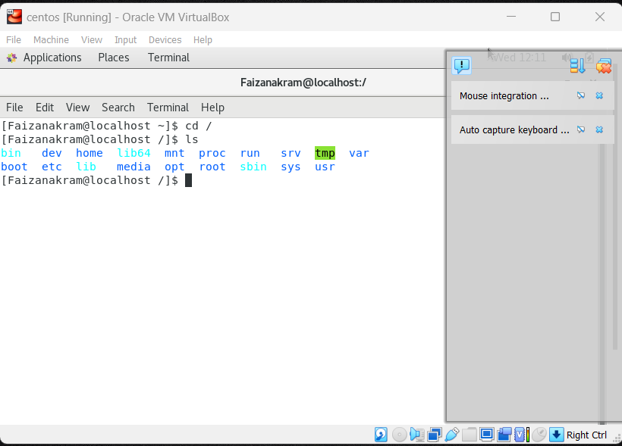
Assignment-3
Working with Directories
Enter the command cd / and then ls and then hit Enter key
Take screenshot and explain what output we got?
SOLUTION: The ‘ cd / ’ command in Linux is used to change the current working directory to the root directory. T he root directory, denoted by “/” , is the top-level directory in the file system hierarchy. It is the parent directory for all the others directories and file system.
‘ls’ command in Linux is used to list the files and directories in the current working directory. It provides a way to view the contents of a directory and obtain information about files and directories within it.

Slide 6
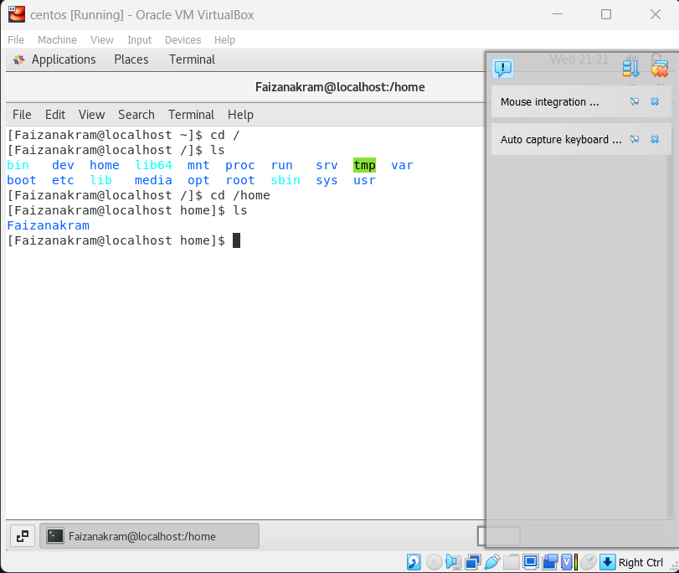
Enter the command now cd /home and then hit Enter key
Do ls, provide screenshot and explain what is /home directory used for?
SOLUTION: The command “cd /home” is used to change the current directory to the “/home” directory in a Linux operation system. By changing the directory, you can navigate to different locations in the file system.
The home directory is used to store the user related data such as script, files, user information etc.

Slide 7
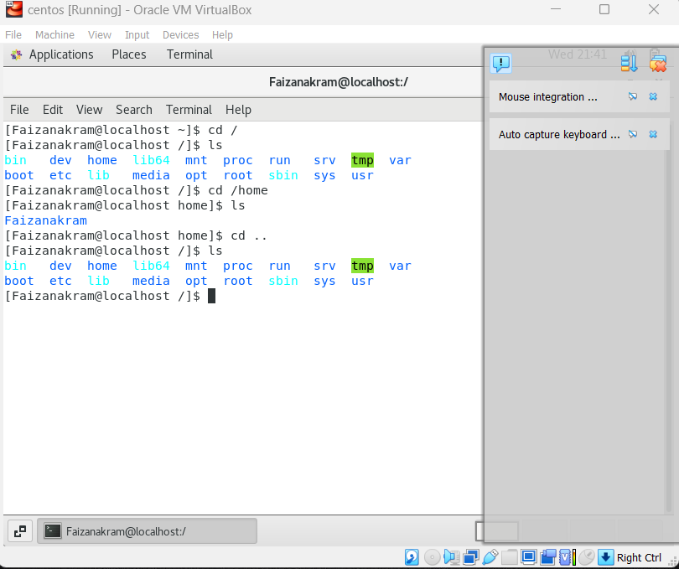
Enter cd .. and hit Enter key [ Note: here we have space after cd then use double dot]
Check what happen and give screenshot?
Solution: As we use this command it change the directory from home directory to the/(root directory). Now we are at the top level or root directiory.

Slide 8
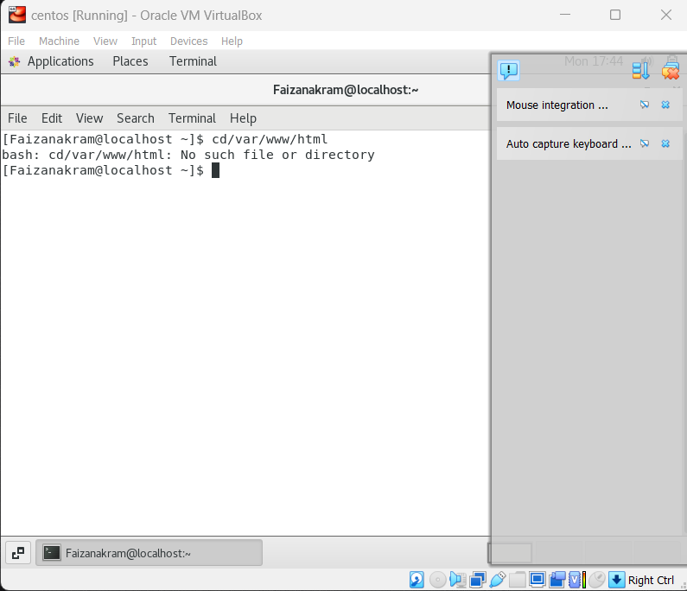
Now enter cd /var/www/html and then type cd and hit Enter key
Explain what happen and give screenshot?
SOLUTION: There is no such directory in my system as I haven't installed Apache server.

Slide 9
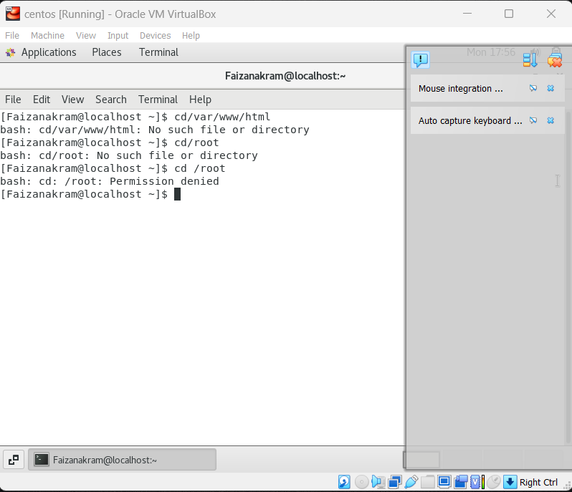
Now type cd /root and then hit Enter key
Do ls, check any output we have on screen if yes then take screenshot?
SOLUTION: As I was not login as root user or I don't have the required permission to access this root folder.

Slide 10
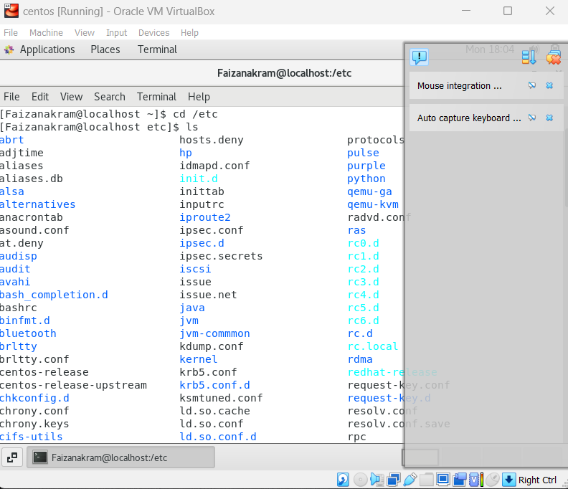
Assignment-4
Working with File Listing
Go to cd /etc and type ls
Take screenshot and explain what files you have seeing?
Take screenshot and explain what different output you found compare to previous command you used?
SOLUTION: It is a directory where all the Linux configuration file is present.

Slide 11
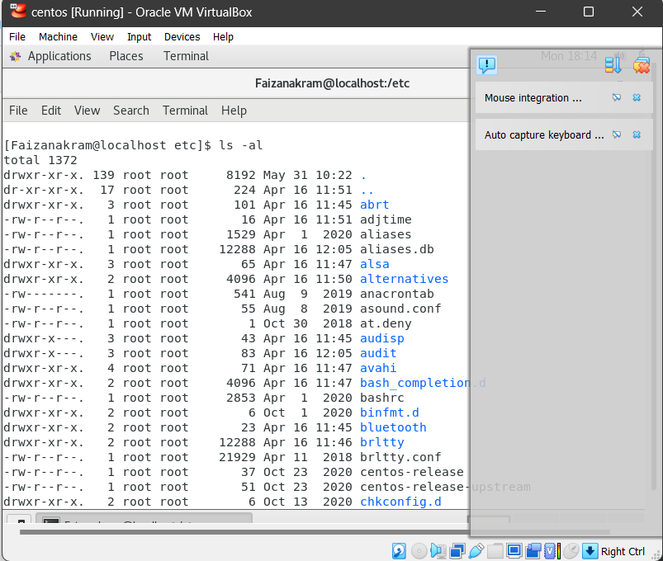
Then type ls -al and hit Enter key
Take screenshot and explain what new file or directory you found?
SOLUTION: This command provides the details of the file such as the permissions, modification date,size of the file, group, etc.

Slide 12
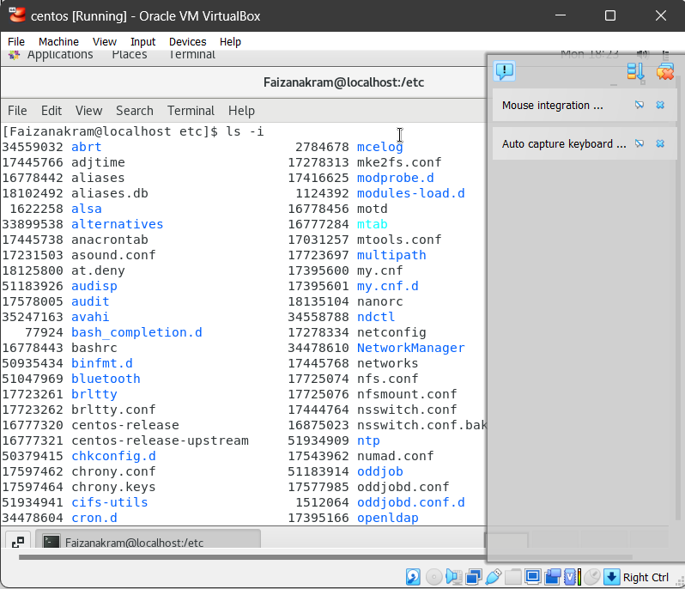
Then use ls -i and hit Enter key
Now see what different output its shows and take screenshot?
SOLUTION: Displays file serial numbers along with files name

Slide 13
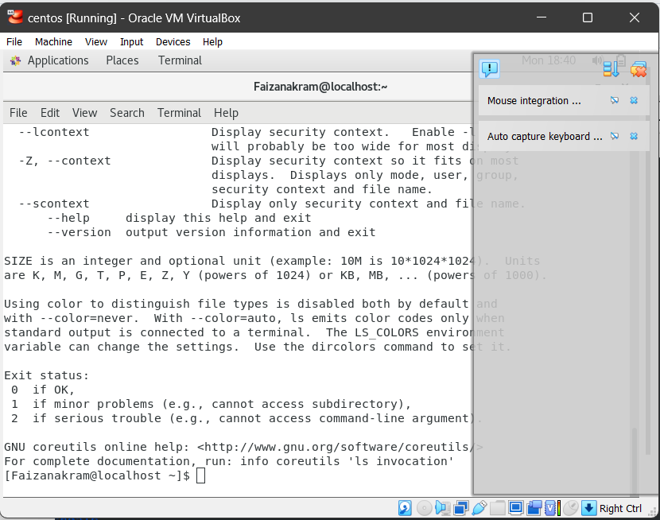
Then use ls –help and see other options about ls command
Explore it and try with other attribute we can use with ls command
SOLUTION: Some of the command used are…
ls –A, ls –a, ls -l, ls –C.

Slide 14
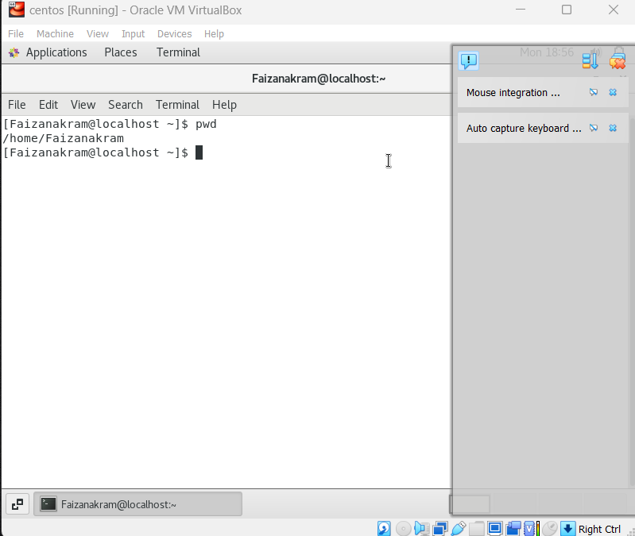
Assignment-5
Know where you are and where you working
Here we use pwd, cd and ls as combine task to understand where you working on terminal and how you can switch from one directory to another one.
Open terminal after restart the linux
Check which location you working, type pwd and take screenshot

Slide 15
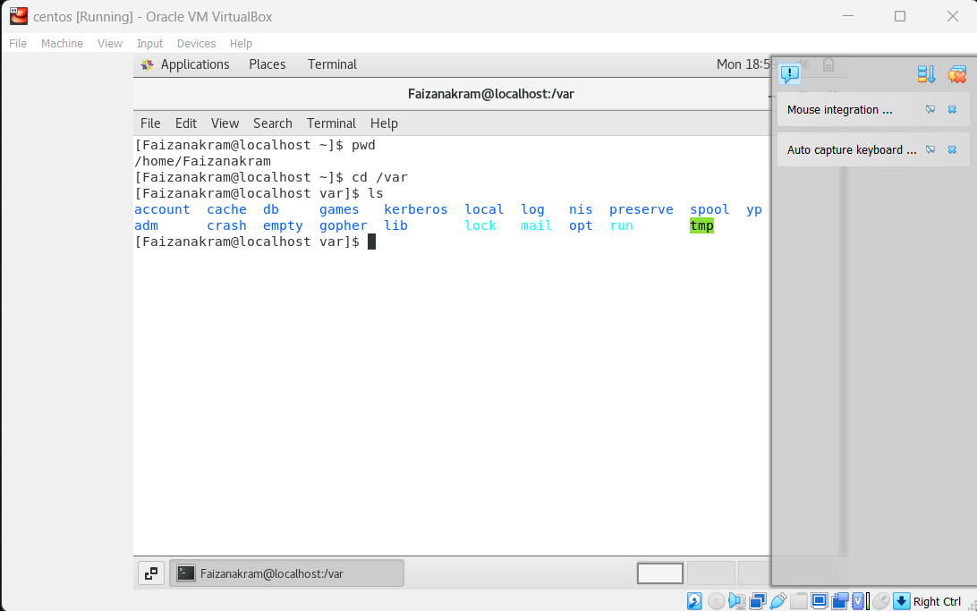
Now use cd /var and hit Enter key
Do ls, and see what output comes, give screenshot?

