Slide 1
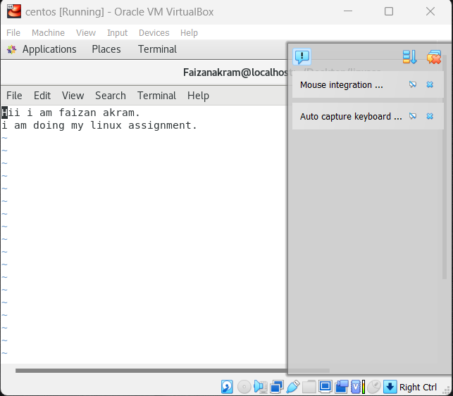
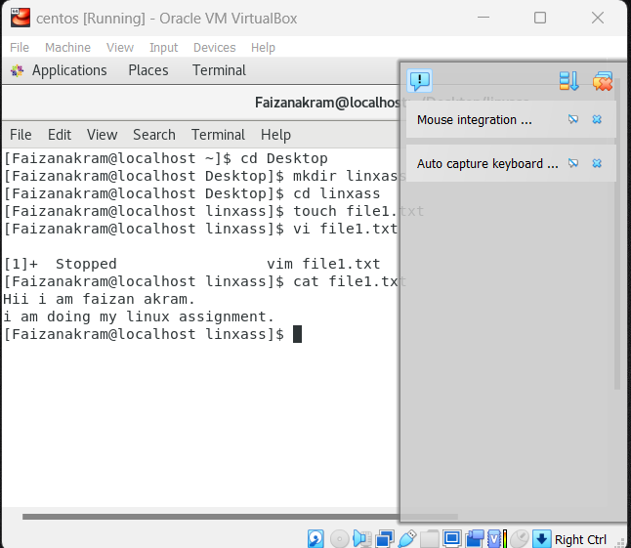
Assignment :- 3
Playing with files:-
Create a file like nano file1.txt
o Edit some data and then save the file.

Slide 2
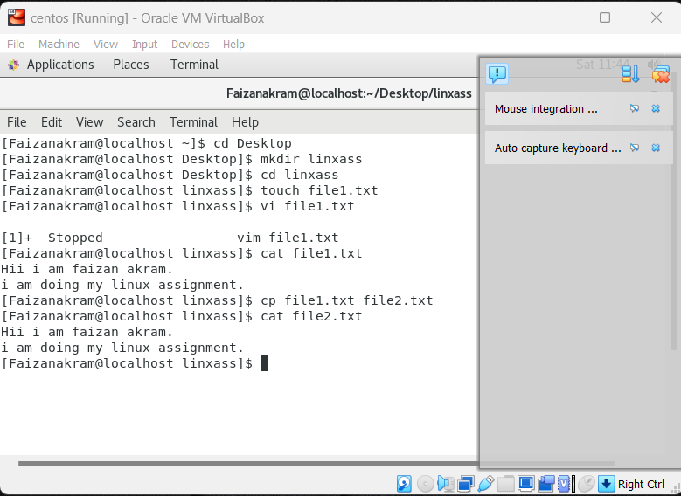
2. Now we will copy date from file1 to new file2
o cp file1.txt file2.txt
o Then see the output of file2.txt, cat file2.txt
o Give screenshot

Slide 3
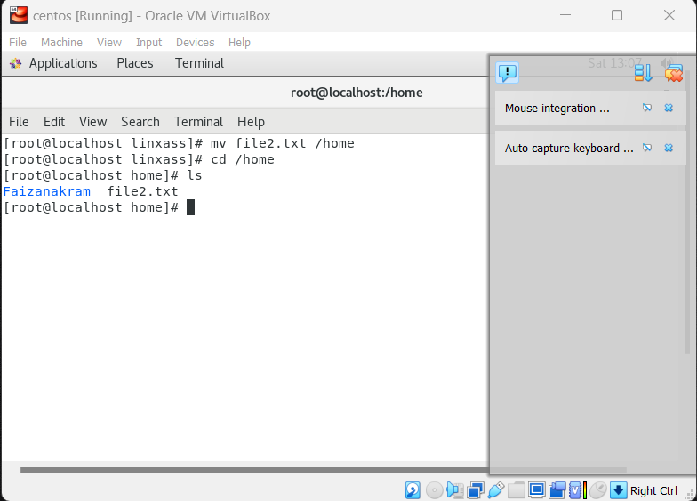
3. Now we will move the file2.txt to new folder /home
o mv file2.txt /home
o Then go to home directory and check ls, file exits or not?
o Given screenshot

Slide 4
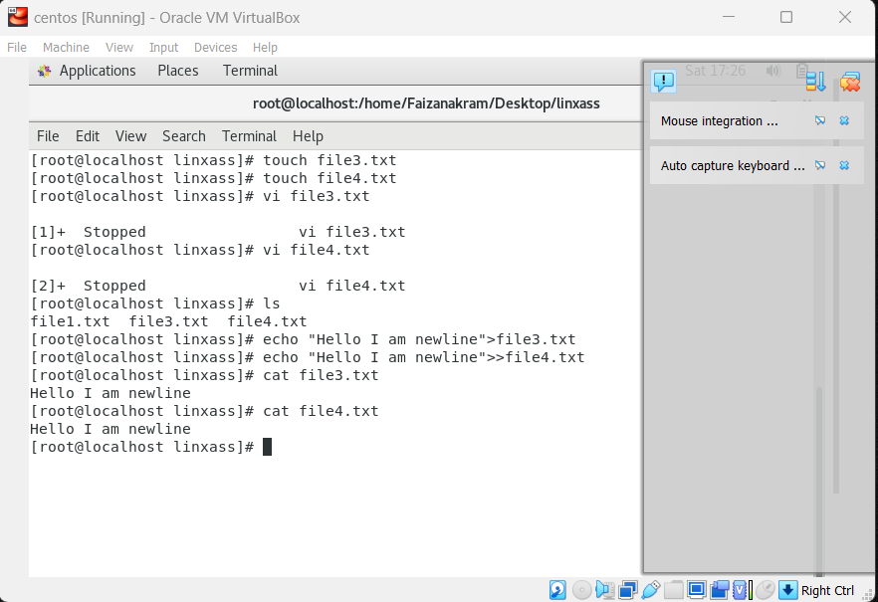
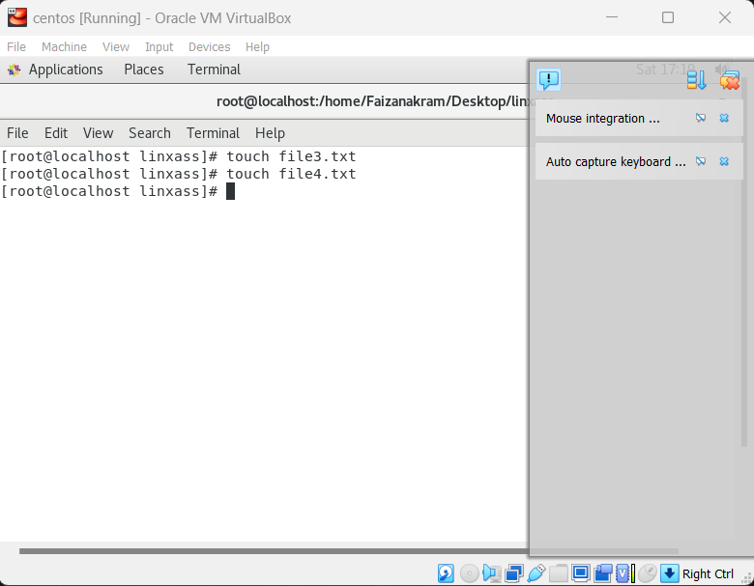
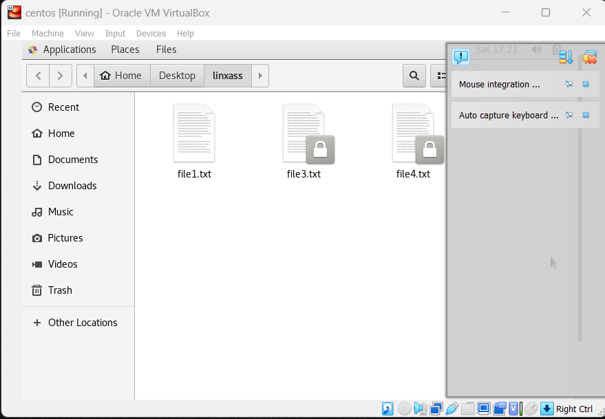
4. Then we create a new file3.txt and file4.txt in home directory and add content in it.
o Now do echo “Hello I am newline” > file3.txt and provide the output of file3.txt
o Now do echo “Hello I am newline” >> file4.txt and provide the output of file4.txt
o Tell the different between both step you follow and the reason behind it
Solution: When we use the command echo “Hello I am newline” > file3.txt it replaces the existing content or overrides the file3. While the command echo “Hello I am newline” >> file4.txt add the data or append data into the existing data in the file4

Slide 5
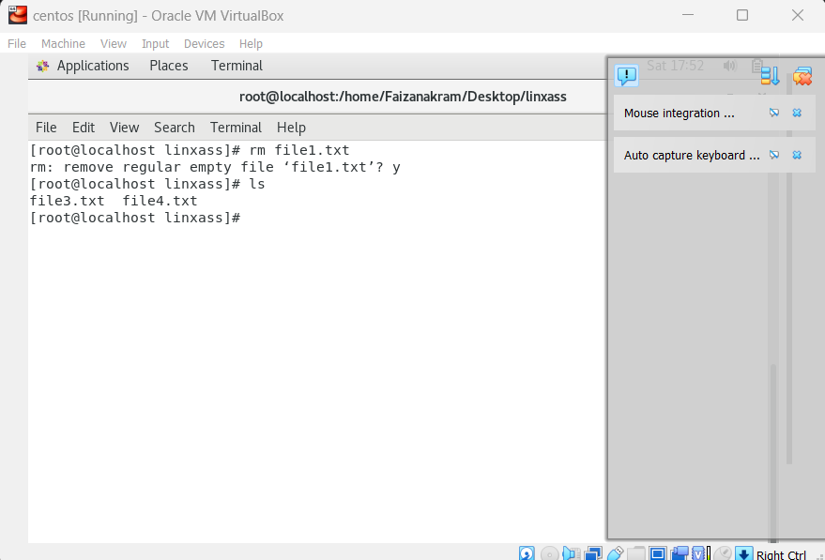
5. For remove a file or directory you can use the below two commands
o To delete a file – rm

Slide 6
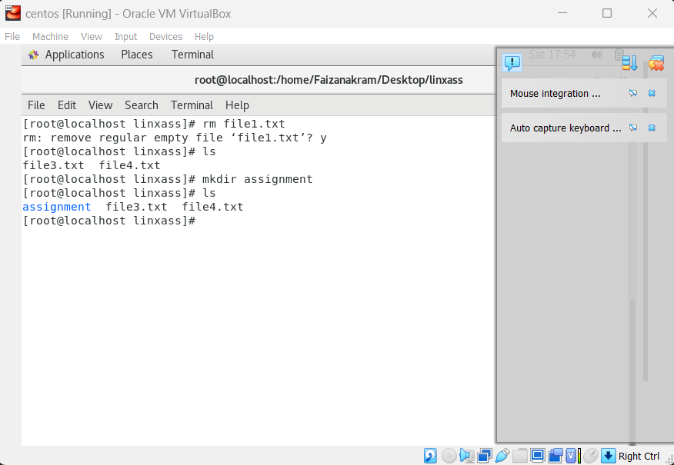
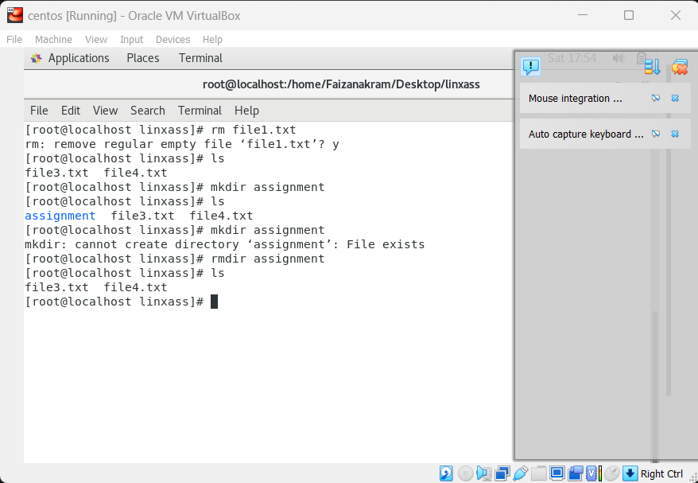
o To d ele t e a dir e c t o r y - r m d i r < a n y _ d i r e c t o r y n a m e >

