Slide 1


AL-ZAYTOONAH UNIVERSITY OF JORDAN
LECTURE 2 · BLOCK 2: KNOW WHERE YOU ARE
ROBOT LOCALIZATION
AND STATE ESTIMATION
Introduction to Robotics for AI and Data Science
Dr. Akram Fatayer
a.fatayer@zuj.edu.jo
linkedin.com/in/akram-fatayer/
Notes:
Welcome to Lecture 2, Robot Localization and State Estimation. This is the start of Block 2: Know Where You Are. Every robot that moves needs to answer one question before anything else: where am I? Today we see how a robot answers it with imperfect sensors, using the Kalman filter, first with single numbers and then with vectors and matrices.

Slide 2
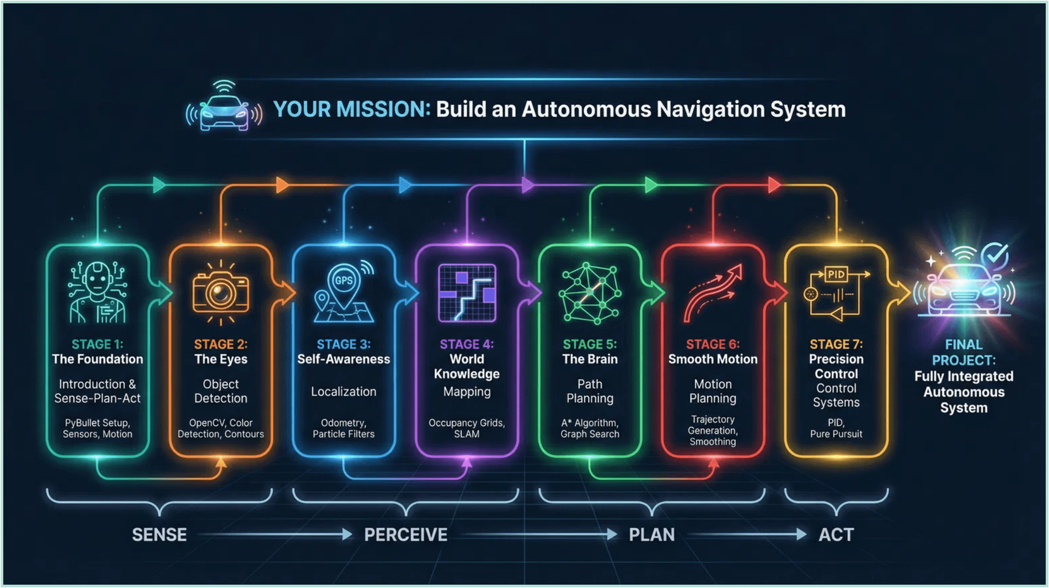
Integration Map: You Are Here
Block 2: Know Where You Are
Before your robot can plan a path, it must know where it is.
Notes:
Here is where we are in the course. We built the foundation in Block 1: spawning a robot, reading its sensors and driving it. Now in Block 2 the robot learns where it is. You cannot plan a road trip without knowing your starting point, and a robot cannot plan a path without knowing its position.

Slide 3


The Fundamental Problem: Where Am I?
A robot never knows exactly where it is. Two things are always uncertain:
Its motion
Its sensing
Wheels slip and floors are uneven: after a move, the robot is only roughly where it planned to be.
Every sensor reading is noisy, and some sensors are slow: no reading tells the exact truth.
→ the predict step
→ the update step
So instead of one position, the robot keeps a probability distribution.
How do we reason with uncertain motion and uncertain sensing?
Notes:
Before any equation: why can a robot never be sure where it is? Two reasons. Its motion is uncertain: you command one metre, the wheels slip, and it moves 0.97 metres slightly to the left. And its sensing is uncertain: every reading has noise. These two uncertainties are the two halves of today's lecture, the predict step and the update step. The tool that handles both is probability, so that is where we start.

Slide 4
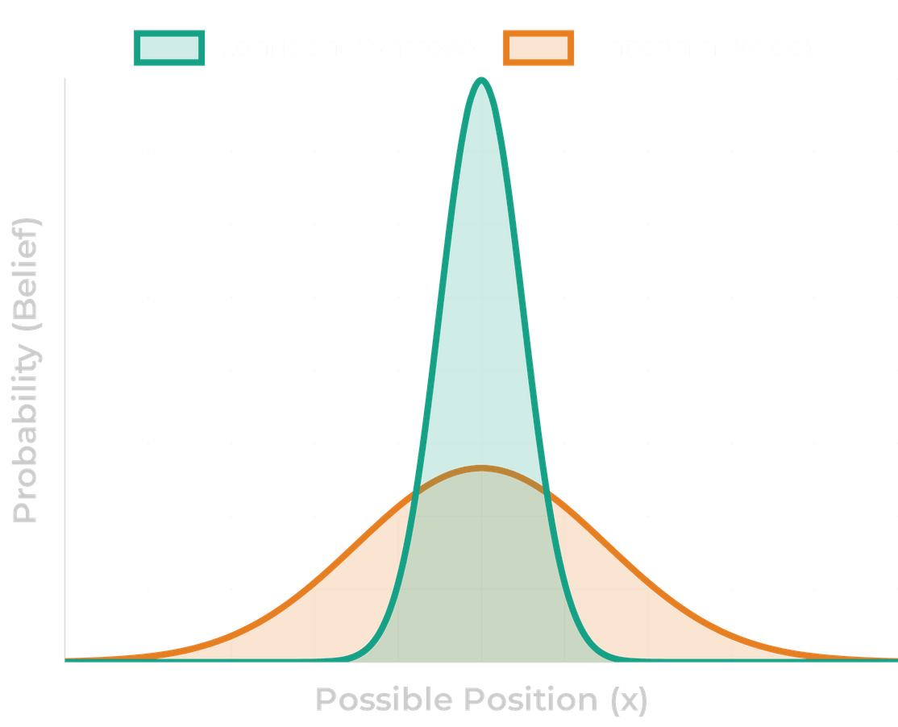
A Belief Is a Probability Distribution
A robot never knows its exact position. It keeps a belief: a probability distribution over where it might be.
The Kalman filter uses a Gaussian, described by two numbers:
μ mean: the best guess of the position
σ standard deviation: how unsure the robot is
Narrow curve: confident. Wide curve: lost.
p(x) = 1 / (σ√(2π)) · exp( −(x − μ)² / (2σ²) )
About 95% of the belief lies within μ ± 2σ: the shaded band in the Lab 3 plots. The variance σ² is what the filter tracks; it calls it P.
Probabilistic Robotics (Thrun, Burgard and Fox, 2005)
Notes:
Instead of a single position, the robot keeps a belief: a bell curve over all positions. Its centre, mu, is the best guess; its width, sigma, is the uncertainty. A narrow curve means the robot is confident, a wide one means it is lost. Remember mu plus or minus two sigma: about 95% of the belief is inside it, and you will see that band in every Lab 3 plot. The filter keeps track of the variance, sigma squared, and calls it P.

Slide 5
Motion Alone: The Predict Step
x̂⁻ = F · x + B · u
1D EXAMPLE
The robot is at x = 1 m with P = 0.25 m². Odometry reports it moved u = 1 m; Q = 0.1 m².
P⁻ = F · P · Fᵀ + Q
Here F = 1 and B = 1, so:
F
How the state evolves on its own (here 1)
x̂⁻ = 1 + 1 = 2 m
B · u
Odometry's report: distance moved since the last step
P⁻ = 0.25 + 0.1 = 0.35 m²
P
Variance of the estimate (uncertainty², m²)
Odometry alone: P only grows. Over five laps of a 5 m circle, the error reaches 4.9 m: it drifts.
Q
Odometry's error per step: slip, bias, noise
Some books, and Lab 3 Activity 2, treat odometry as a velocity measurement in the update step instead. The result is almost the same.
Notes:
Start with motion alone. The predict step uses the motion model, and the motion comes from odometry: the wheel encoders report how far the robot moved since the last step, and that is the control input u. The mean moves by u, and the variance grows by Q, odometry's error per step. Do it three times and P keeps growing: on its own, odometry drifts. In the simulation used in the module, five laps of a circle leave odometry 4.9 metres off. Mention once that some books and Activity 2 put odometry into the update step as a velocity measurement instead; the answer is almost the same.

Slide 6

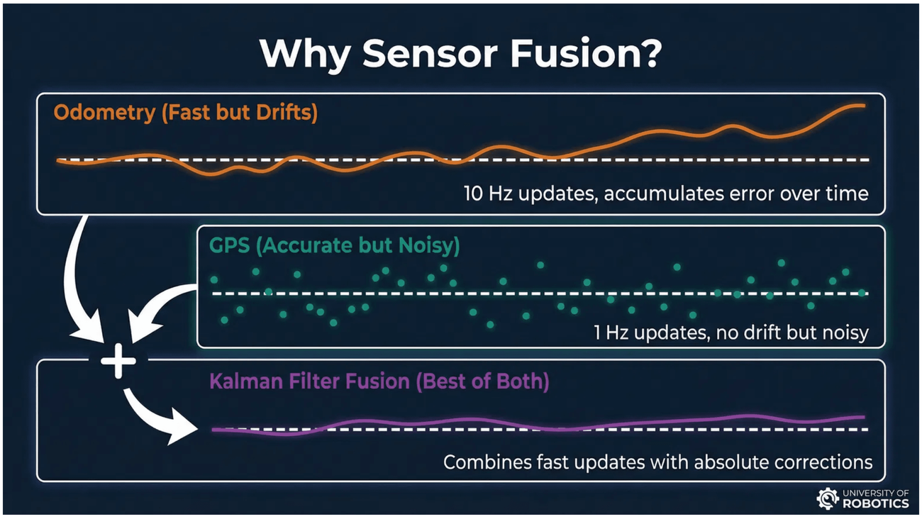
Sensing Alone: GPS
GPS
Measures the absolute position.
It never drifts.
Noisy and slow: about 3 m error, once a second.
In the filter it is a measurement:
z = position, H = 1, R = 3² = 9 m²
GPS alone (hold the last fix): 4.4 m error, and the estimate jumps every second.
Odometry is smooth but drifts; GPS is noisy but never drifts. They fail in opposite ways.
Notes:
Now sensing alone. GPS measures the absolute position and never drifts, but it is noisy, about 3 metres, and slow, once a second. In the filter, a sensor is described by z, what it reads, H, which part of the state it measures, and R, how noisy it is. GPS alone, holding the last fix, is 4.4 metres off and the estimate jumps every second. Point at the picture: odometry is smooth but drifts, GPS is noisy but stays centred. They fail in opposite ways, so combining them should help. How?

Slide 7
First Idea: The Gated Reset
A natural first attempt: trust odometry, and let GPS stop the drift.
1
Follow odometry between GPS fixes.
RESULT: 5 LAPS, GPS σ = 3 m, 20 RUNS
Odometry only
4.85 m
2
When a GPS fix arrives, compare it with the odometry position.
GPS only
4.43 m
Gated reset
4.05 m
3
Within the gate (2σ = 6 m)? Keep odometry. Outside? Jump to the GPS fix and restart odometry from there.
Largest jump in one 0.1 s step
12.7 m
(the robot really moves 0.26 m per step)
Simple, and the drift can no longer grow forever.
Better than either sensor, but only a little. Why?
Notes:
Ask the class first: how would you combine them? Most students propose exactly this: follow odometry, and when GPS disagrees too much, jump to GPS and start again. It is a sensible engineering idea and it does stop the drift growing forever. But look at the numbers from the simulation, averaged over 20 runs: 4.05 metres, only a little better than odometry or GPS alone, and the estimate sometimes jumps 12.7 metres in a tenth of a second, when the robot really moves 26 centimetres. A controller following that estimate would swerve. Why does such a reasonable idea do so badly?

Slide 8
Why the Reset Fails
1
It copies the GPS error
2
It accepts drift up to the gate
Right after a reset you are exactly as wrong as that one GPS fix, about 3 m. You can never beat GPS.
Between resets, odometry may wander up to 6 m before anything happens.
3
It throws information away
4
Noise triggers false resets
Fixes inside the gate are ignored; at each reset the odometry history is lost. Averaging many fixes would cancel their noise.
One unlucky GPS fix can make good odometry jump: the 12.7 m jumps.
The problem is all-or-nothing. What if each GPS fix moved the estimate only part of the way?
Notes:
Four reasons. One: every reset copies one GPS reading, so right after a reset you are exactly as wrong as GPS. Two: between resets you tolerate up to six metres of drift. Three: you throw information away, the fixes inside the gate and the odometry history at each reset; many noisy GPS fixes averaged together would be far more accurate than any one. Four: noise itself triggers resets, which is where the big jumps come from. The root problem is that the decision is all or nothing. The fix: move only part of the way towards GPS, by an amount that depends on how much we trust each source.

Slide 9
Better Idea: Weigh by Uncertainty
Two GPS units measure the same position. Trust each in proportion to 1 / σ².
GPS A reads 10 m (σ = 1 m)
GPS B reads 12 m (σ = 2 m)
THE SAME THING AS A CORRECTION
Start from A (P = 1 m²) and correct towards B (R = 4 m²):
x = (10/1 + 12/4) / (1/1 + 1/4) = 10.4 m
K = P / (P + R) = 1 / (1 + 4) = 0.2
σ = 1 / √(1 + 1/4) = 0.89 m
x = 10 + 0.2 × (12 − 10) = 10.4 m
More certain than either unit alone.
K is the Kalman gain.
A soft reset: the gated reset uses K = 0 or K = 1. The Kalman filter uses the K that the uncertainties call for.
Notes:
Forget time for a moment: two GPS units read 10 and 12 metres, one twice as precise as the other. The best combination weights each by one over its variance, giving 10.4 metres, and the result is more certain than either unit. Now write the same arithmetic as a correction: start from A and move a fraction K towards B, with K equal to P over P plus R. That fraction is the Kalman gain. This is the key link to the previous slide: the gated reset is K equals 0 or 1; the Kalman filter chooses K from the uncertainties.

Slide 10
The Update Step
K = P⁻ · Hᵀ · (H · P⁻ · Hᵀ + R)⁻¹
1D EXAMPLE (H = 1)
x̂ = x̂⁻ + K · (z − H · x̂⁻)
Prediction x̂⁻ = 4 m, P⁻ = 1.5² = 2.25 m². GPS reads z = 6.5 m with R = 1 m².
P = (I − K · H) · P⁻
K = 2.25 / (2.25 + 1) = 0.69
z
The measurement: what the sensor reads
x̂ = 4 + 0.69 × (6.5 − 4) = 5.73 m
H
Which part of the state the sensor measures
P = (1 − 0.69) × 2.25 = 0.69 m²
R
Measurement noise: the sensor's variance
σ = 0.83 m: smaller than both the prediction (1.5 m) and GPS (1 m).
z − H · x̂⁻
Innovation: reading minus prediction
K
Kalman gain: 0 trusts the prediction, 1 the sensor
Notes:
Here is the update step in full. With H equal to 1 it is exactly the weighting from the previous slide. The innovation is the gap between the reading and the prediction, and K decides how much of it to believe. In the example the prediction is less certain than GPS, so K is 0.69 and the estimate moves most of the way. The new sigma, 0.83, is smaller than both: combining two uncertain beliefs always gives a more certain one.

Slide 11
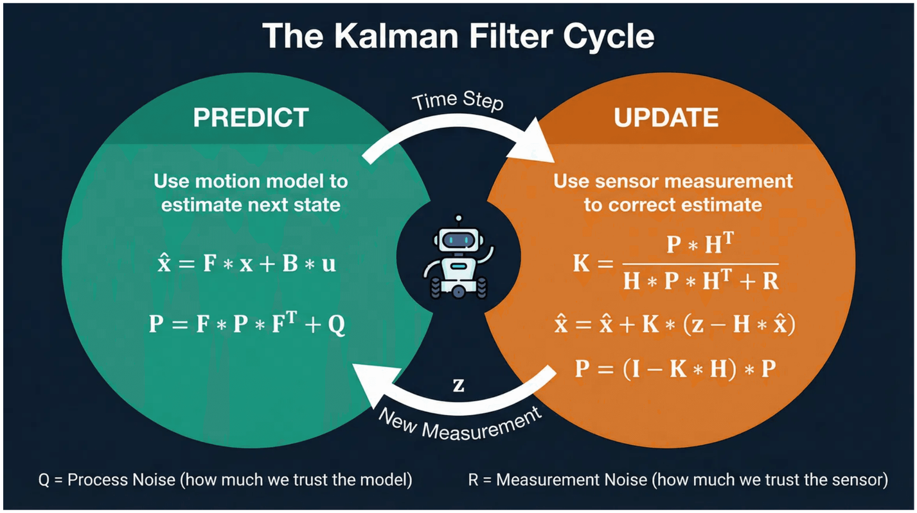
Predict + Update over Time: The Kalman Filter
Every step: predict with odometry. P grows.
Every GPS fix: update. P shrinks.
K is small while odometry is fresh, and grows with P: the longer since the last fix, the more GPS counts.
Odometry only
4.85 m
GPS only
4.43 m
Gated reset
4.05 m
Kalman filter
1.35 m
Notes:
Put the two steps in a loop and you have the Kalman filter. Every step, odometry moves the belief and P grows; every GPS fix, the update pulls it back and P shrinks. Notice how K behaves: just after a fix, P is small, so a new fix moves the estimate only a little; long after a fix, P is large and GPS counts more. That is the gated reset done properly. The result: 1.35 metres, three times better than either sensor or the reset.

Slide 12
Sensor Fusion vs the Kalman Filter
Sensor fusion is the goal: combine several sensors into one estimate better than any of them.
The Kalman filter is one method: the best one when the models are linear and the noise is Gaussian.
 | Uses a Kalman filter | No Kalman filter
Fuses sensors | Lab 3 Activity 3: odometry + GPS | Two GPS units averaged by 1/σ²; Lecture 4's occupancy grid fuses LiDAR beams with Bayes' rule
One sensor only | Lab 3 Activity 1: one noisy sensor + a motion model | Dead reckoning: just add up odometry
Other fusion methods: complementary filters (common for IMUs), extended and unscented Kalman filters (Lecture 3), particle filters, learned fusion.
Notes:
A common confusion: is sensor fusion the same as a Kalman filter? No. Fusion is the goal, the filter is one way to reach it, like classification and logistic regression. The table shows all four combinations from this course. Fusion without a Kalman filter: the two-GPS average, and next week's occupancy grid. A Kalman filter without fusion: Activity 1, one sensor plus a motion model. And Activity 3 is both. Whether odometry enters the predict step or the update step, combining odometry and GPS is fusion.

Slide 13
From Numbers to Matrices
In 2D the equations stay exactly the same. Every number becomes a vector or a matrix.
 | 1D (one number) | 2D (the robot in the plane)
State | x | x = [x, y]ᵀ a column vector
Uncertainty | P a variance | P = [[P₁₁, P₁₂], [P₂₁, P₂₂]] a covariance matrix
Gain | K = P / (P + R) | K = P · Hᵀ · (H · P · Hᵀ + R)⁻¹
Picture | a bell curve | an ellipse
4
3
2
1
P₁₂ = 0
P₁₂ > 0
0
0
1
2
3
4
5
6
Diagonal P₁₁, P₂₂: the variances in x and in y.
Off-diagonal P₁₂ = P₂₁: how the errors in x and y move together. It tilts the ellipse.
Lab 3 Activity 2 tracks x = [x, y, vx, vy]ᵀ: the same equations with 4×4 matrices.
Notes:
Nothing new in the equations: in 2D every number becomes a vector or a matrix. The state is a column vector, the uncertainty is a 2 by 2 covariance matrix, and dividing by P plus R becomes multiplying by an inverse. The picture changes from a bell curve to an ellipse. The diagonal entries are the variances in x and y. The off-diagonal entry says whether the errors move together: when it is zero the ellipse is aligned with the axes; when it is positive the ellipse tilts. Activity 2 uses position and velocity, so four by four matrices, but the rules are the same.

Slide 14
The Matrix Toolkit You Need
Add: entry by entry
Multiply: row × column
1.5
0.75
+
0.5
0.25
=
2
1
2
1
·
1
=
1.5
0.75
1.5
0.25
0.5
1
2
1
2
-0.5
0
Used in P⁻ = P + Q and S = P⁻ + R
Each entry: a row on the left times a column on the right
Transpose: rows become columns
Inverse of a 2×2 matrix
[1 0]ᵀ =
1
a
b
⁻¹ = 1/(ad − bc) ·
d
−b
0
c
d
−c
a
H = [1, 0] gives Hᵀ = [1, 0]ᵀ, a column
Divide by det = ad − bc; swap a and d; negate b and c
Notes:
These four operations are all you need for the Kalman filter by hand. Adding matrices is entry by entry. Multiplying is row times column: for the top entry, two times one plus one times minus a half gives 1.5. Transposing turns rows into columns, so H transposed for a sensor that measures x is a column. And the 2 by 2 inverse: one over the determinant, swap the diagonal, negate the off-diagonal. NumPy does this with np.linalg.inv, which you will use in every Lab 3 activity.

Slide 15
2D Example, Step 1: Predict
The robot was at [3, 2.5] m. Odometry reports it moved u = [1, 0.5] m since the last step, so F = I and B = I.
6
5
x̂⁻ = F·x + B·u =
3
+
1
=
4
4
2.5
0.5
3
3
1.5
0.75
0.5
0.25
2
1
2
P⁻ = F·P·Fᵀ + Q =
+
=
0.75
1.5
0.25
0.5
1
2
1
0
0
1
2
3
4
5
6
7
8
With F = I, F·P·Fᵀ is just P. Q has an off-diagonal term because wheel slip happens mostly along the direction of travel, so the uncertainty grows along it.
Previous position
Prediction x̂⁻ with its 2σ ellipse
Notes:
Our 2D example. The robot was at 3, 2.5 and odometry reports it moved 1 metre in x and half a metre in y. The predicted position is 4, 3. For the covariance, F is the identity, so F P F transposed is just P, and we add Q. Q has an off-diagonal term of 0.25: slipping wheels push the robot forward or back along its path, so x and y errors move together. The result P minus equals 2, 1, 1, 2: a tilted ellipse.

Slide 16
2D Example, Step 2: The Kalman Gain
A GPS fix arrives: z = [5, 2.5] m. GPS measures both x and y, so H = I, with R = I (σ = 1 m in each axis).
S = H·P⁻·Hᵀ + R =
2
1
+
1
0
=
3
1
det S = 3·3 − 1·1 = 8
1
2
0
1
1
3
S⁻¹ = 1/8 ·
3
-1
=
0.375
-0.125
-1
3
-0.125
0.375
K = P⁻·Hᵀ·S⁻¹ =
2
1
·
0.375
-0.125
=
0.625
0.125
1
2
-0.125
0.375
0.125
0.625
Check the top-left entry: 2 × 0.375 + 1 × (−0.125) = 0.625. The diagonal of K says how much to trust GPS in x and in y; the off-diagonal lets a correction in one axis move the other.
Notes:
Now the update. S is the uncertainty of the innovation: the prediction's covariance plus the sensor's. Its determinant is 8, so its inverse is one eighth times the swapped and negated matrix. Then K is P minus times S inverse. Walk through one entry with the class: row one of P, 2 and 1, times column one of S inverse, 0.375 and minus 0.125, gives 0.625. The diagonal says we trust GPS about 62% in each axis; the off-diagonal 0.125 will let an x correction nudge y.

Slide 17
2D Example, Step 3: The New Estimate
5
4
1
6
z − H·x̂⁻ =
−
=
2.5
3
-0.5
5
4
x̂ =
4
+
0.625
0.125
·
1
=
4.56
3
0.125
0.625
-0.5
2.81
3
2
P = (I − K·H)·P⁻ =
0.375
-0.125
·
2
1
=
0.625
0.125
1
-0.125
0.375
1
2
0.125
0.625
0
0
1
2
3
4
5
6
7
8
The estimate moved most of the way towards the GPS reading, and the new ellipse is smaller than both the prediction and the GPS ellipse.
Prediction (x̂⁻, P⁻)
GPS (z, R)
Updated estimate (x̂, P)
Notes:
The innovation is the GPS reading minus the prediction: 1 metre in x, minus half a metre in y. Multiply by K and add: the new estimate is 4.56, 2.81. The covariance shrinks to 0.625 on the diagonal. On the picture, the purple ellipse is smaller than both the orange prediction and the teal GPS ellipse. This is the whole Kalman filter: everything else is repeating these steps.

Slide 18
What If the Sensor Measures Only x?
A sensor on the wall measures only x: z = 5 m, with R = 0.25 m². Now H = [1, 0], so S is a single number.
6
5
S = H·P⁻·Hᵀ + R = P₁₁ + R = 2 + 0.25 = 2.25
4
3
K = P⁻·Hᵀ / S =
2
/ 2.25 =
0.889
1
0.444
2
1
x̂ =
4
+
0.889
· (5 − 4) =
4.89
3
0.444
3.44
0
0
1
2
3
4
5
6
7
8
Prediction
y moved by 0.44 m although only x was measured. K has a second entry because P⁻₁₂ = 1 ≠ 0: the filter knows the x and y errors move together. With P⁻₁₂ = 0, y would not change.
Wall sensor: x = 5 ± 1 m (2σ)
Updated estimate
Notes:
This is the slide that makes matrices worth it. The wall sensor measures only x, so H is 1, 0 and S is just a number. K is the first column of P divided by S, and it has two entries. The y estimate moves by 0.44 metres even though nobody measured y. Why? Because P12 says the x and y errors are correlated: if we were wrong in x, we were probably wrong in y in the same direction. If the predicted P12 were zero, y would not move at all. Students can check this in section 4 of the interactive module.

Slide 19
Tuning Q and R: Whom Do You Trust?
Small Q: trust the motion model
Large Q: distrust the model
Smooth estimate that ignores noise, but slow to notice when the motion really changes.
Follows the measurements closely, noise and all.
Small R: trust the sensor
Large R: distrust the sensor
Each reading pulls the estimate hard (K close to 1).
Readings barely move the estimate (K close to 0).
Lab 3, Activity 1: on a steady train a small Q works best. On a train that stops at a station, the same small Q makes the filter overshoot the stop for many steps. There is no single best Q: it depends on how the robot really moves.
Notes:
Q and R are the two knobs. Q says how much you trust the motion model, R how much you trust the sensor; only their balance matters for K. In Activity 1 you will see both failure modes: a small Q is smooth on a steady train but overshoots when the train stops; a large Q reacts quickly but follows the noise. Section 5 of the interactive module lets students feel this before the lab.

Slide 20
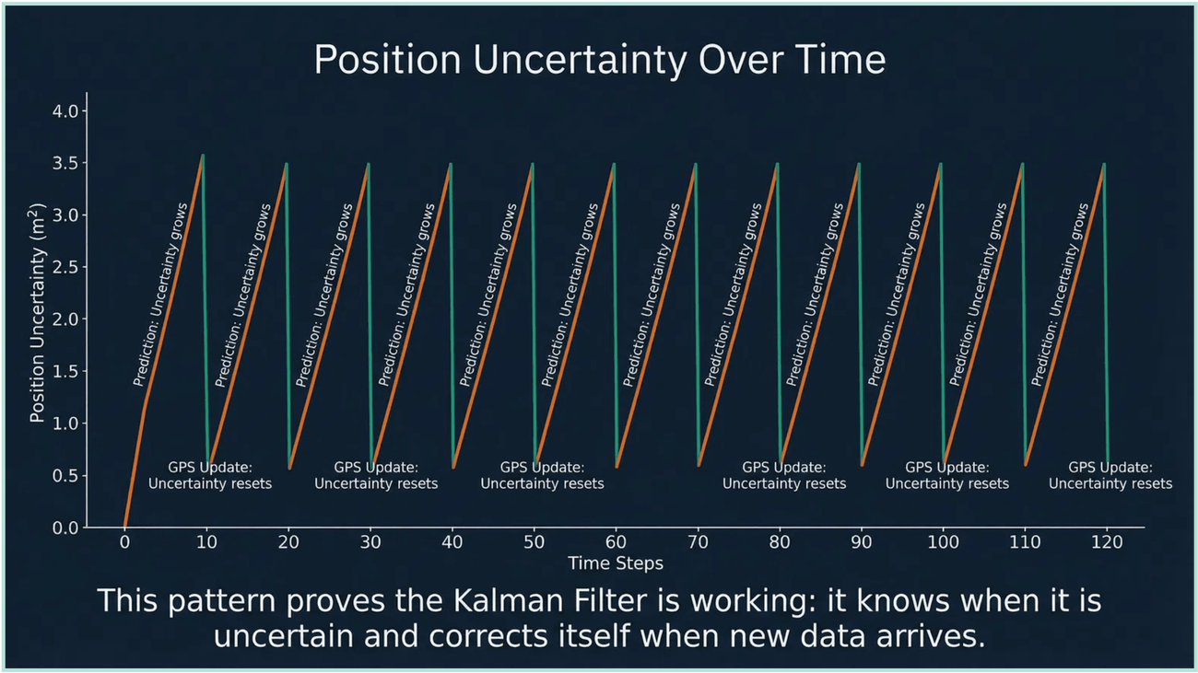
The Uncertainty Sawtooth
Predict: P climbs
Each step adds Q: odometry's error builds up between GPS fixes.
GPS update: P drops
Each GPS fix pulls the uncertainty down at once: the sharp drops.
It settles
After a few fixes, every tooth has the same peak and low. They depend only on Q, R and the GPS rate.
Lab connection: you will plot this in Activity 3 and explain its shape.
Notes:
Plot the position variance over time and you get a sawtooth. Between GPS fixes the filter keeps predicting with odometry, so P climbs by Q every step. At each GPS fix P drops sharply. After a few cycles the pattern settles. This proves the filter is working: it knows when it is uncertain and corrects itself when new data arrives. Activity 3 asks you to explain exactly this plot.

Slide 21

From Theory to Your Robot: Lab 3
Activity 1: Pure Math
Activity 2: The Robot
Activity 3: Sensor Fusion
1D Kalman filter in NumPy: the predict and update equations, on a train.
2D Kalman filter on the R2D2 robot in PyBullet, tracking an L-shaped path.
Compare odometry, GPS, the gated reset and the Kalman filter, and explain the sawtooth.
PRACTISE BEFORE THE LAB
Interactive module 2, Know Where You Are: the same examples as this lecture, with eight challenges and a completion code.
akramfatayer.github.io/courses/robotics/learn/2
Notes:
Lab 3 builds the localization engine in three steps: the pure equations in 1D, the 2D filter on the robot, then fusion of odometry and GPS. Before the lab, students should work through interactive module 2. It uses the same numbers as this lecture, so the worked examples carry straight over.

Slide 22




Key Takeaways
Uncertainty is inevitable. A robot keeps a belief, a mean and a variance, not a single position.
Predict, then update. Odometry moves the belief and widens it; GPS corrects it and narrows it.
Weigh, don't switch. The gated reset's all-or-nothing gives 4.05 m; weighting by uncertainty (K) gives 1.35 m.
Matrices change nothing but the bookkeeping. In 2D, P is a covariance matrix; its off-diagonal lets one measurement improve another axis.
NEXT LECTURE
Lecture 3: Motion Models
Real robots turn. What happens when the motion is not a straight line?
Notes:
Four ideas to keep. The robot keeps a belief, not a position. Odometry predicts and widens it, a measurement updates and narrows it. Weigh the sources by their uncertainty instead of switching between them. In 2D the same equations run on matrices. Next lecture: motion models. Today the robot moved in straight lines; real robots turn, and that makes the predict step non-linear.

Slide 23
Questions & Discussion
Thank you for your attention.
Dr. Akram Fatayer
a.fatayer@zuj.edu.jo
linkedin.com/in/akram-fatayer/
Introduction to Robotics for AI and Data Science
Al-Zaytoonah University of Jordan
Notes:
Questions and discussion.

