Slide 1

WEEK 2 - LECTURE 2
Computer Vision for Warehouse Robots
Giving Robots the Gift of Sight
Course: Introduction to Robotics for AI and Data Science
Instructor: Dr. Akram Fatayer
linkedin.com/in/akram-fatayer
Institution: Al-Zaytoonah University of Jordan

Slide 2

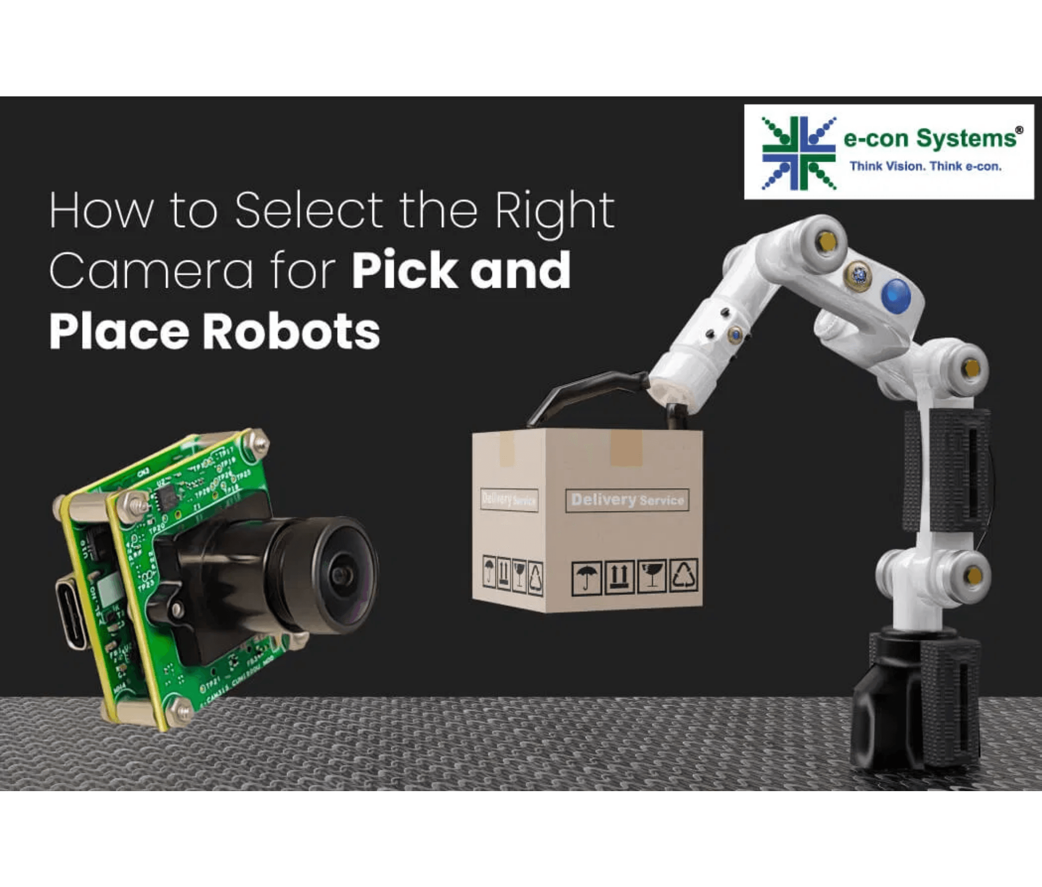


The Warehouse Robot Challenge
Your warehouse robot has a mission: locate and retrieve a specific red box among hundreds of items.
Human Approach
Look around the warehouse, visually scan for red objects, recognize the target box, navigate to it.
Current Robot
Can move around the warehouse, but cannot see or identify objects. It's essentially blind.
The Problem: How do we give the robot the ability to perceive and understand its visual environment?

Slide 3





Why Computer Vision is Critical for Robotics
$214B
80%
$50B+
Global Robotics Market by 2030
Of Robots Need Vision Systems
Warehouse Automation Market
Real-World Applications
Warehouse Automation
Autonomous Vehicles
Amazon, FedEx: Item picking, sorting, inventory management
Tesla, Waymo: Object detection, lane keeping, navigation
Manufacturing
Agriculture
Quality inspection, assembly guidance, defect detection
Crop monitoring, fruit picking, precision farming

Slide 4


Breaking Down the Vision Problem
Complex problems become manageable when decomposed into steps
1
2
3
4
5
Image Capture
Image Processing
Object Detection
Recognition
3D Localization
Get raw pixels from camera sensor
Filter, enhance, transform color spaces
Find regions containing objects
Classify what each object is
Estimate position in 3D space
Each step uses techniques you already know from AI/DS: data preprocessing, feature extraction, classification,
regression

Slide 5

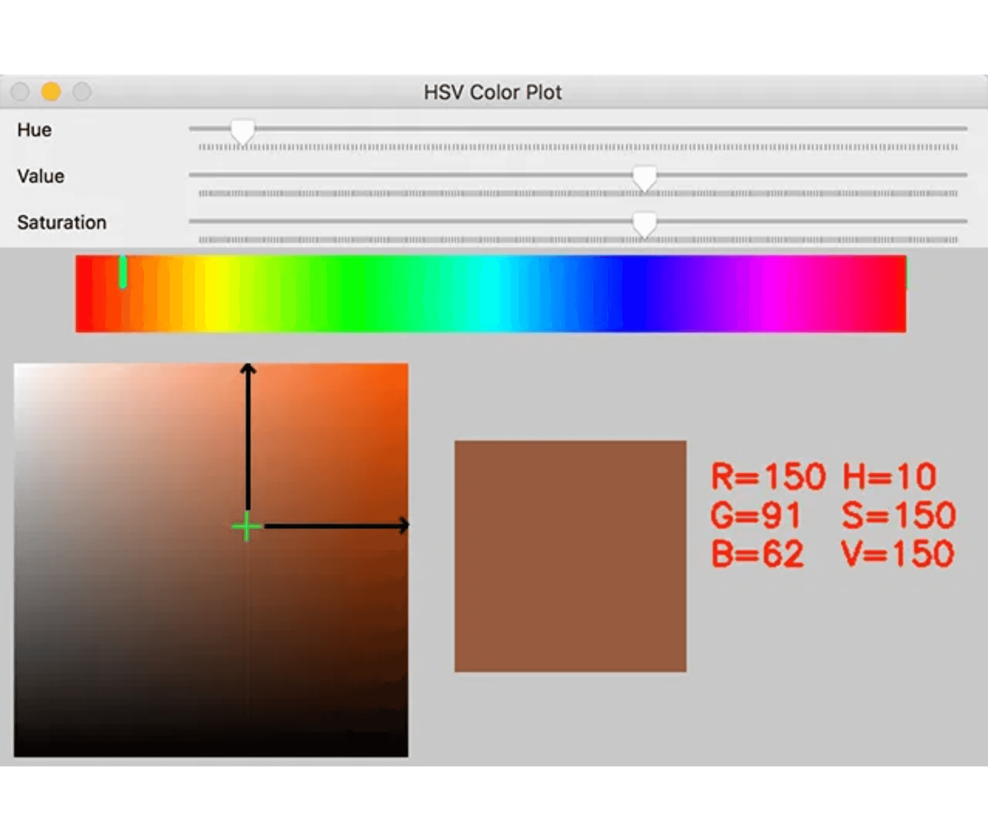
Cameras as Data Sensors
1. Lens System
Focuses incoming light rays from the 3D world onto a 2D sensor plane. Controls field of view and depth of field.
2. Sensor Array
Grid of photodetectors (pixels) that convert photons into electrical signals. Each pixel measures light intensity.
3. Color Filters
Bayer filter pattern separates light into Red, Green, Blue channels. Three measurements per pixel location.
Data Output
Image: H × W × 3 array
Each pixel stores [R, G, B] values (0-255) Example: 640×480 image = 921,600 numbers

Slide 6

Camera Parameters and Trade-offs
Choosing the right camera configuration for robotic applications
Parameter
Description
Benefit
Trade-off
Resolution
Number of pixels (e.g., 640×480, 1920×1080)
Higher detail, better object recognition
More computation, slower processing
Frame Rate
Images per second (e.g., 30 FPS, 60 FPS)
Smoother tracking, faster response
Higher bandwidth, more processing load
Field of View
Angular extent of observable world (narrow vs. wide)
Wide: see more area
Wide: distortion
Narrow: more detail
Narrow: limited context
Focal Length
Distance from lens to sensor (short vs. long)
Long: zoom capability
Long: narrow FOV
Short: wider view
Short: less detail
For warehouse robots: Balance is key — 640×480 at 30 FPS with moderate FOV provides good performance without overwhelming the processor

Slide 7

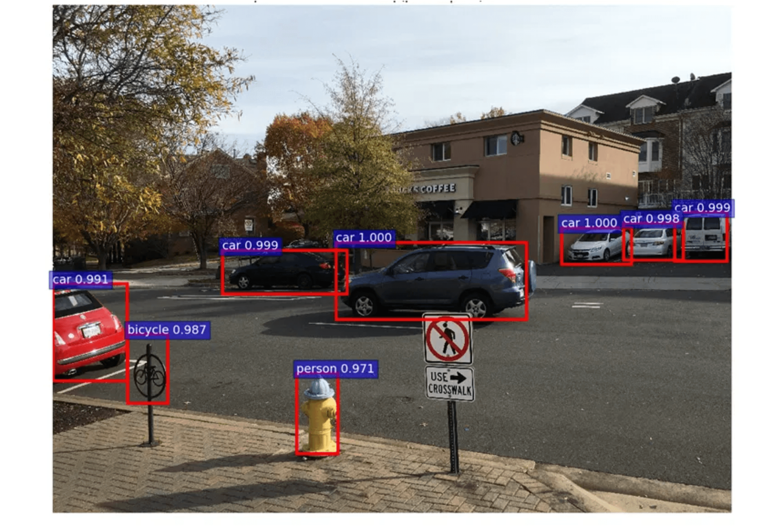
From 3D World to 2D Image
Pinhole Camera Model
Light rays from 3D points pass through a single point (optical center) and project onto the image plane. This creates perspective projection.
Perspective Projection
Objects farther away appear smaller. Parallel lines converge to vanishing points. This is how humans see the world too.
x_image = f × (X_world / Z_world)
The Fundamental Challenge
Depth information is lost! A 2D point in the image could correspond to any 3D point along a ray. We need additional information (stereo vision, depth sensors, or learned priors) to recover 3D structure.

Slide 8

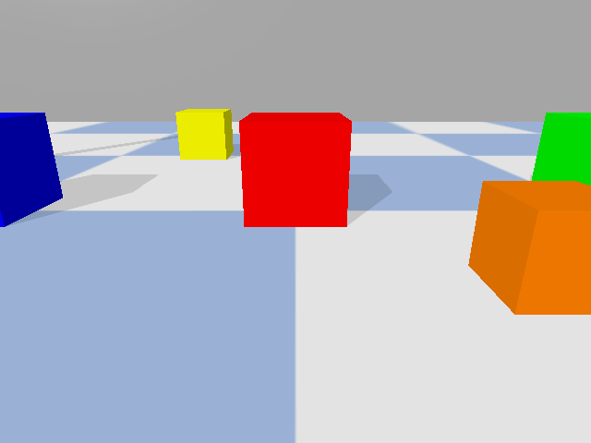

Images as Data: The AI/DS Perspective
Images are just structured numerical arrays — familiar territory for data scientists
# Load image as NumPy array import cv2 import numpy as np img = cv2.imread('robot_view.jpg') print(img.shape) # (480, 640, 3) # Access pixel at row 100, col 200 pixel = img[100, 200] # [R, G, B] # Slice region of interest roi = img[100:200, 150:250] # Apply operations (just like any array) mean_color = np.mean(img, axis=(0,1))
Array Representation
shape: (480, 640, 3)
dtype: uint8 (0-255)
size: 921,600 values
Key Insights
Images are 3D arrays: Height × Width × Channels
Use familiar tools: NumPy, PyTorch, Pandas
Same operations: slicing, indexing, broadcasting
Computer vision = structured data processing

Slide 9

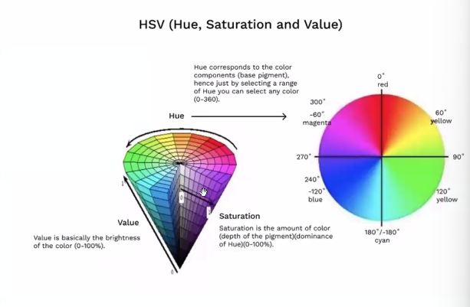

Color Spaces: RGB vs HSV
RGB Color Space
HSV Color Space
Red, Green, Blue — How cameras capture light
Hue, Saturation, Value — How humans perceive color
Three channels: R, G, B (0-255 each)
Hue:
The actual color (0-180°)
Mixes color and brightness together
Saturation:
Color intensity (0-255)
Same red appears different in shadow vs. sunlight
Value:
Brightness (0-255)
Hard to define "red" with simple thresholds
Separates color from lighting conditions
Problem: Sensitive to lighting variations
Why HSV for Robotics?
Warehouse lighting changes throughout the day. HSV allows us to detect "red objects" regardless of whether they're in bright light or shadow — just threshold the Hue channel!

Slide 10



Color-Based Detection Pipeline
1
2
3
4
5
RGB → HSV
Threshold
Morphology
Find Contours
Bounding Box
Convert image to HSV color space
Create binary mask for target color range
Clean noise with erosion and dilation
Detect connected regions in mask
Draw rectangles around detected objects
# Complete color detection pipeline hsv = cv2.cvtColor(image, cv2.COLOR_BGR2HSV) mask = cv2.inRange(hsv, lower_red, upper_red) mask = cv2.morphologyEx(mask, cv2.MORPH_OPEN, kernel) contours, _ = cv2.findContours(mask, cv2.RETR_EXTERNAL, cv2.CHAIN_APPROX_SIMPLE) # Draw bounding boxes for contour in contours: x, y, w, h = cv2.boundingRect(contour) cv2.rectangle(image, (x,y), (x+w,y+h), (0,255,0), 2)
Advantages
Limitations
Fast and simple to implement
Sensitive to lighting changes
Works well for distinct colors
Cannot recognize object types
No training data needed
Fails with similar colors

Slide 11

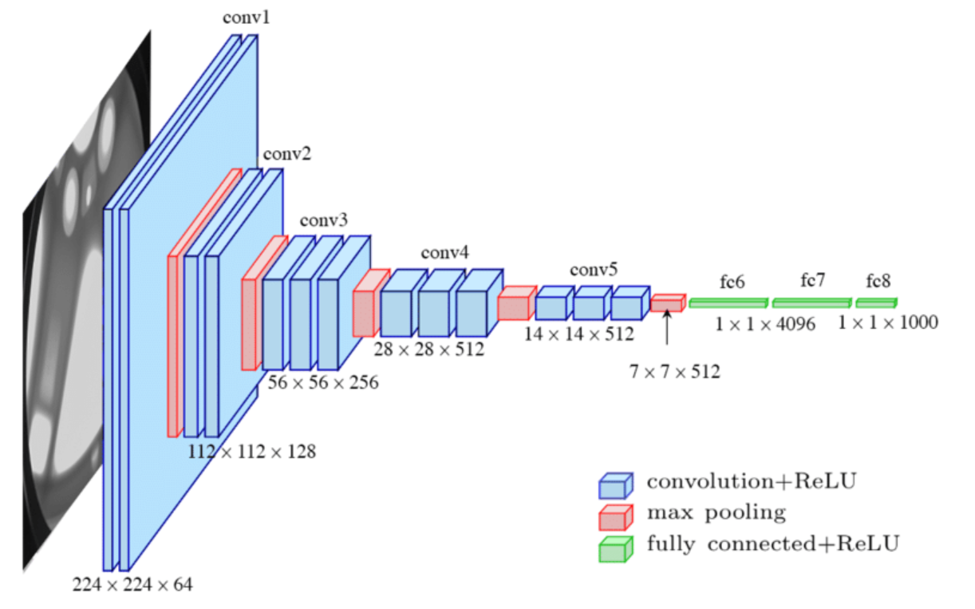
CNNs Learn Visual Features
Why CNNs Work
CNNs automatically learn relevant features from data instead of requiring hand-crafted feature engineering. Early layers detect simple patterns (edges), deeper layers combine them into complex representations (objects).
Convolutional Layers
Apply learned filters across the image. Each filter detects a specific pattern. Spatial structure is preserved, unlike fully-connected layers.
Hierarchical Feature Learning
Layer 1
Layer 2-3
Layer 4-5
Layer 6+
Pooling Layers
Edges
Textures
Parts
Objects
Reduce spatial dimensions while keeping important features. Provides translation invariance — object detected regardless of exact position.
Connection to Your ML Knowledge
Same backpropagation training
Same loss functions (cross-entropy)
Same optimization (SGD, Adam)
Just different architecture!

Slide 12

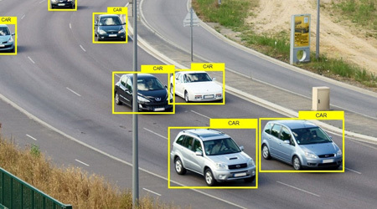
Object Detection for Robotics
Two-Stage Detectors
One-Stage Detectors
Examples:
R-CNN, Faster R-CNN
Examples:
YOLO, SSD, MobileNet
Step 1: Propose regions
Single pass through network
Step 2: Classify each region
Predict boxes and classes together
Higher accuracy
Good accuracy
Slower inference (2-5 FPS)
Fast inference (30+ FPS)
Accuracy
Speed
Accuracy
Speed
High
Slow
Good
Fast
For Warehouse Robots: Use One-Stage Detectors
Real-time performance is critical. We'll use MobileNet-SSD (lightweight, fast) and YOLO (more accurate) in the lab. Both run at 30+ FPS on modest hardware.

Slide 13






Transfer Learning: From COCO to Warehouse
Pre-training
Transfer
Fine-tuning (Optional)
Model trained on large dataset (ImageNet: 1M images, COCO: 330K images) learns general visual features
Use pre-trained weights as starting point. Early layers (edges, textures) transfer well across domains
Train on warehouse-specific data to adapt to your domain. Only needed if pre-trained model insufficient
Why Transfer Learning?
In Practice
No need to collect millions of training images
Download pre-trained MobileNet-SSD or YOLO
Faster training (hours instead of weeks)
Use directly for common objects (boxes, people)
Better performance with limited data
Fine-tune if detecting custom objects
Leverages knowledge from large datasets
Same concept from your ML course!

Slide 14
Deploying CNNs on Robots
Robots have limited compute power, memory, and battery — we need efficient models
Model
Size
Speed (FPS)
Accuracy (mAP)
Use Case
ResNet-101
170 MB
5 FPS
76%
Cloud/Server
YOLOv5
28 MB
45 FPS
65%
Desktop/Laptop
MobileNet-SSD
6 MB
60 FPS
60%
Embedded/Robot
TinyYOLO
4 MB
80 FPS
55%
Microcontroller
Efficient Architectures
Model Quantization
Edge AI Accelerators
MobileNet, EfficientNet use depthwise separable convolutions to reduce parameters while maintaining accuracy
Convert 32-bit floats to 8-bit integers. 4× smaller, 2-4× faster, minimal accuracy loss
Google Coral TPU, NVIDIA Jetson, Intel Neural Compute Stick provide hardware acceleration

Slide 15

Object Tracking for Navigation
Tracking maintains object identity across frames — more efficient than detecting from scratch each time
Detection Only
Detection + Tracking
Run CNN on every frame independently. No memory of previous frames.
Detect occasionally, track between detections. Predict object location based on motion.
Pros: Simple, no state management
Pros: Faster, stable IDs, motion prediction
Cons: Computationally expensive, no temporal consistency, ID switching
Cons: More complex, can lose track
Centroid Tracking
Kalman Filter
DeepSORT
Match objects by distance between centroids in consecutive frames. Simple but effective.
Predict next position using motion model. Optimal for linear motion with Gaussian noise.
Combines appearance features (CNN) with motion (Kalman). Handles occlusions well.
Use: Slow-moving objects
Use: Predictable trajectories
Use: Complex scenarios
Warehouse Robot Application
Track target item as robot approaches. Detect every 10 frames, track in between. Predict item location if temporarily occluded. Maintain stable ID for grasping system.

Slide 16
Computer Vision as Machine Learning
Generic ML
Data
Preprocessing
Model
Evaluation
Tabular, text, time series
Normalization, encoding
Neural net, tree, SVM
Accuracy, F1, AUC
Computer Vision
Data
Preprocessing
Model
Evaluation
Images (H×W×3 arrays)
Resize, augment, normalize
CNN (ResNet, YOLO)
mAP, IoU, precision
Same Concepts, Different Data Type
Everything you learned in ML applies to CV: train/val/test splits, overfitting, regularization, transfer learning, hyperparameter tuning. Images are just high-dimensional structured data!
Data
Training
Loss
Frameworks
NumPy arrays, PyTorch tensors
Same optimizers (Adam, SGD)
Cross-entropy, MSE, IoU
PyTorch, TensorFlow, Keras

Slide 17

Sim-to-Real Gap in Vision
Simulation (PyBullet)
Real World
Perfect lighting, no shadows
Variable lighting, shadows, reflections
Clean textures, no noise
Sensor noise, motion blur
Ideal camera (no distortion, blur)
Lens distortion, chromatic aberration
Consistent colors
Color variations (manufacturing, wear)
No occlusions or clutter
Background clutter, occlusions
Bridging the Gap
Domain Randomization
Realistic Rendering
Real-World Fine-tuning
Vary lighting, textures, colors in simulation. Train on diverse conditions so model generalizes better to real world.
Use physics-based rendering with shadows, reflections, noise. Makes simulation closer to reality.
Train in sim, collect small real dataset, fine-tune. Combines sim efficiency with real-world accuracy.
In This Course
Weeks 1-3: Develop algorithms in PyBullet simulation. Week 4+: Test on real hardware (Raspberry Pi camera, Arduino). Experience the sim-to-real challenge firsthand and learn to adapt!

Slide 18


Week 2 Lab: Computer Vision for Warehouse Robot
1
2
3
Camera Setup
Color Detection
CNN Detection
Configure virtual camera in PyBullet. Capture and display RGB images from robot's perspective.
Implement HSV-based color detection. Detect and localize colored objects in warehouse scene.
Use MobileNet-SSD and YOLO for object detection. Compare performance and accuracy.
30 points
25 points
30 points
Deliverables
Timeline & Support
Python code files (all parts)
Due: Next class (1 week) Lab Hours: TBD for hands-on help Starter Code: Available on GitHub Office Hours: For questions and debugging
Screenshots showing detection results
Lab report (3-5 pages) answering questions
Comparison analysis (color vs CNN)

Slide 19




Warehouse Robot Project Progress
Module 1: Basics
Module 2: Vision
Module 3: LIDAR
Module 4: Navigation
Robot simulation, motion control, sensor reading
Camera setup, object detection, visual perception
Distance sensing, obstacle detection, mapping
Path planning, obstacle avoidance, autonomous movement
✓ COMPLETED
▶ CURRENT
UPCOMING
UPCOMING
Capability Added This Week
Your warehouse robot can now see and recognize objects using its camera! It can detect items by color or use deep learning to identify specific object types. This is the foundation for autonomous item retrieval.
Next Week: LIDAR and Sensor Fusion
We'll add distance sensing to complement vision. Learn how to combine camera and LIDAR data for robust perception in cluttered warehouse environments.

Slide 20

Key Takeaways
1
Computer vision is critical for autonomous robots
80% of robots need vision systems. Cameras provide rich information about the environment for perception and decision-making.
2
Break complex problems into manageable steps
Vision pipeline: capture → process → detect → recognize → localize. Each step builds on the previous one.
3
HSV is better than RGB for robotic applications
HSV separates color from brightness, making detection robust to lighting variations in real-world environments.
4
CNNs learn hierarchical visual features automatically
Early layers detect edges, deeper layers combine them into objects. Transfer learning lets us use pre-trained models.
5
Real-time performance requires efficient models
MobileNet and YOLO provide good accuracy at 30+ FPS. Trade-offs between model size, speed, and accuracy.
6
Computer vision is just another ML problem
Same concepts you know: training, validation, overfitting, transfer learning. Images are structured data arrays!

Slide 21



Questions?
Email: a.fatayer@zuj.edu.jo
Office Hours: email me to book a meeting
linkedin.com/in/akram-fatayer
Thank you!
Dr. Akram Fatayer • AI and Data Science Department Al-Zaytoonah University of Jordan

