Slide 1





INTRODUCTION TO ROBOTICS FOR AI & DATA SCIENCE
Lab 1: Hello, Robot! Your First Step to Autonomy
Implementation Guide & Code Walkthrough
Dr. Akram Fatayer
Al-Zaytoonah University of Jordan
a.fatayer@zuj.edu.jo
linkedin.com/in/akram-fatayer/

Slide 2
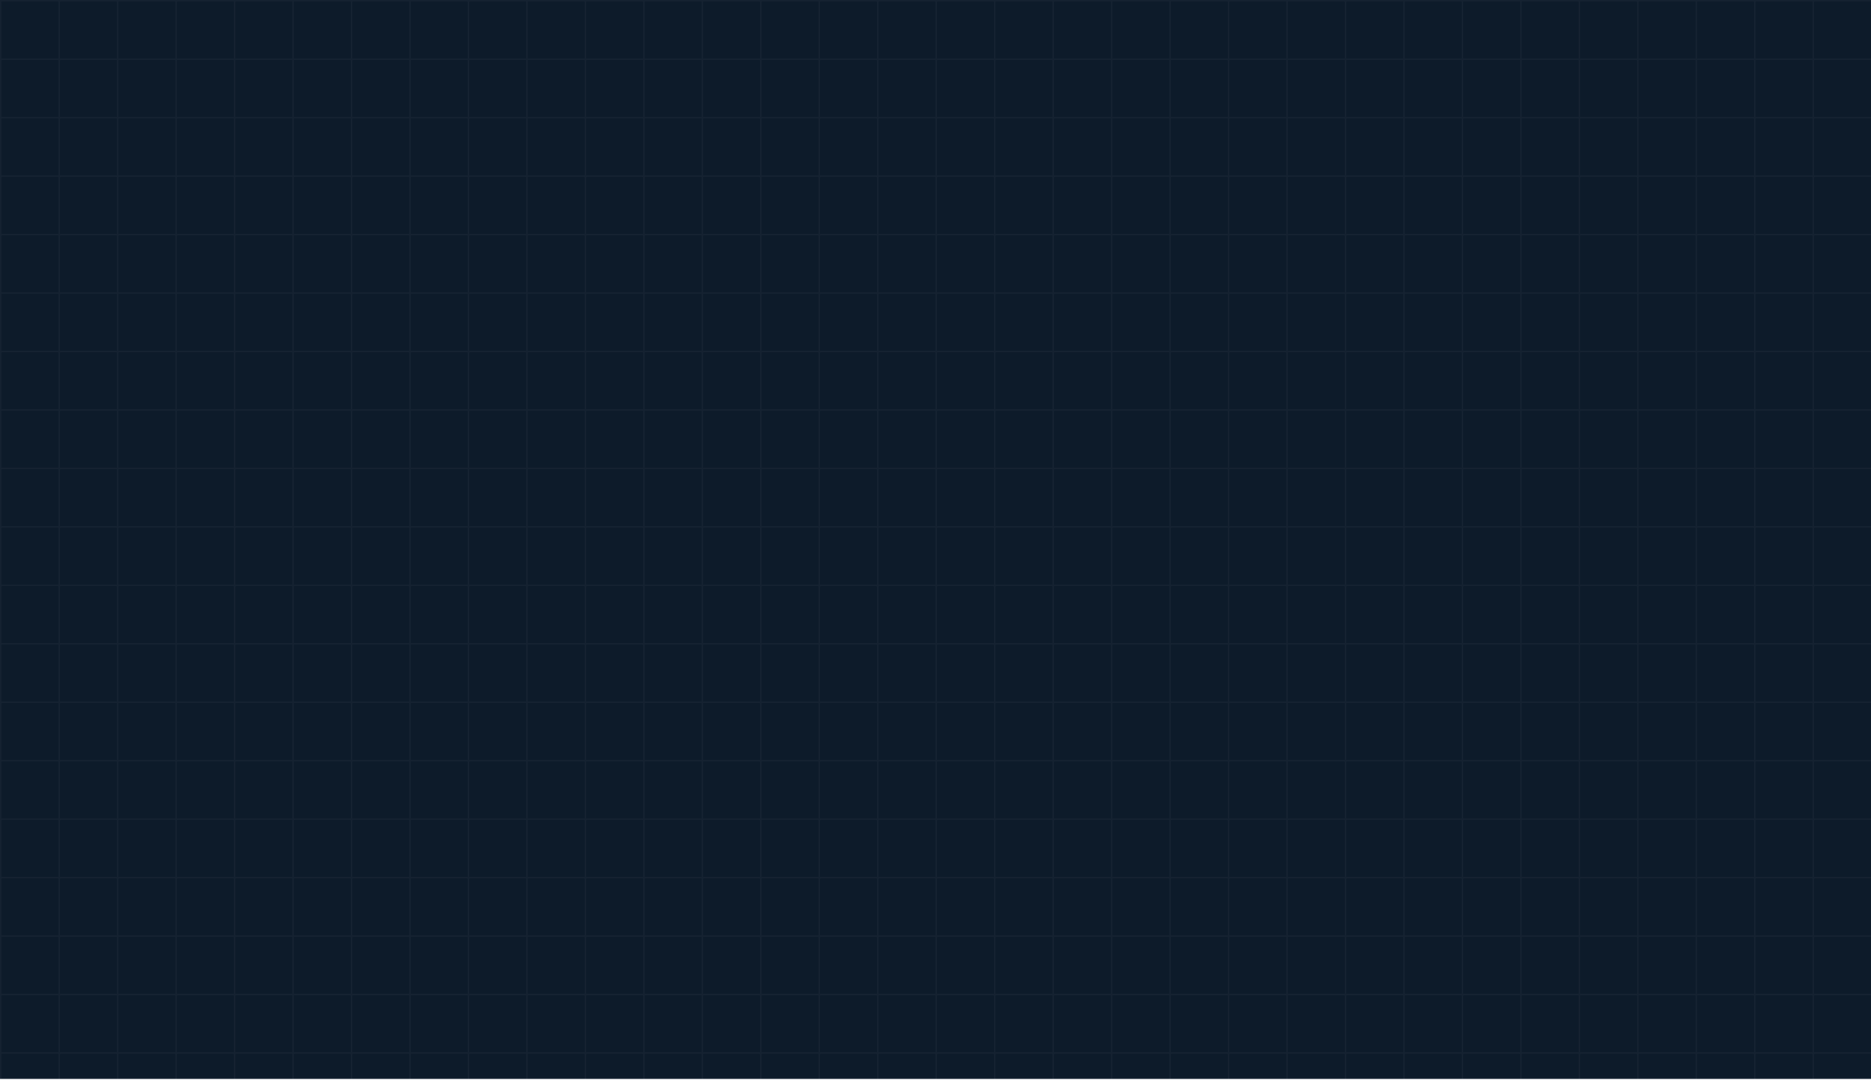

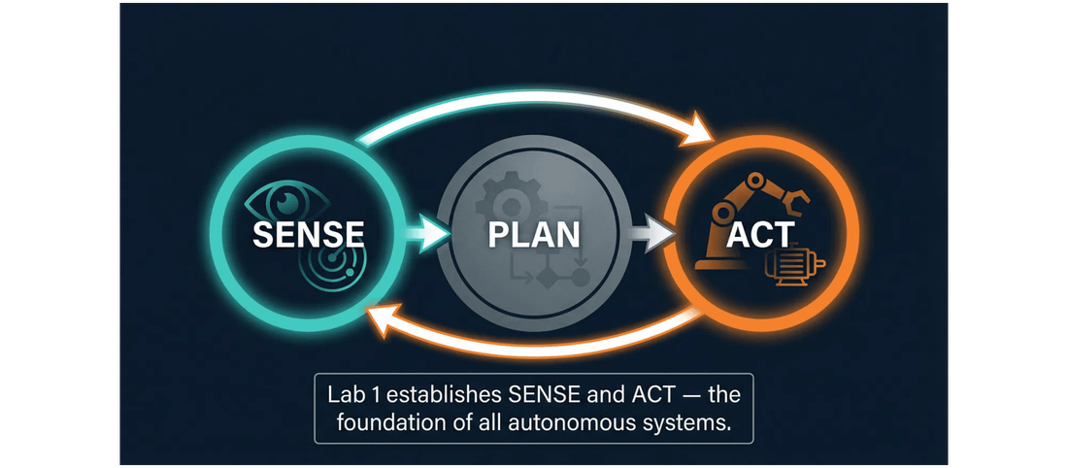
This Lab Builds the Foundation of Your Autonomous System
The Primitives of Autonomy
By the end of today, you will have a robot that can: spawn in a simulation, read its own state, and move in a controlled pattern.
Sense & Act
This lab establishes the "Sense" and "Act" components of the Sense-Plan-Act cycle. Everything we do from now on builds upon this foundation.
Real-World Relevance
These are the exact same primitive operations used in real autonomous vehicles, drones, and industrial robotic arms.
Lab 1: Hello, Robot!
Block 1: Perception

Slide 3
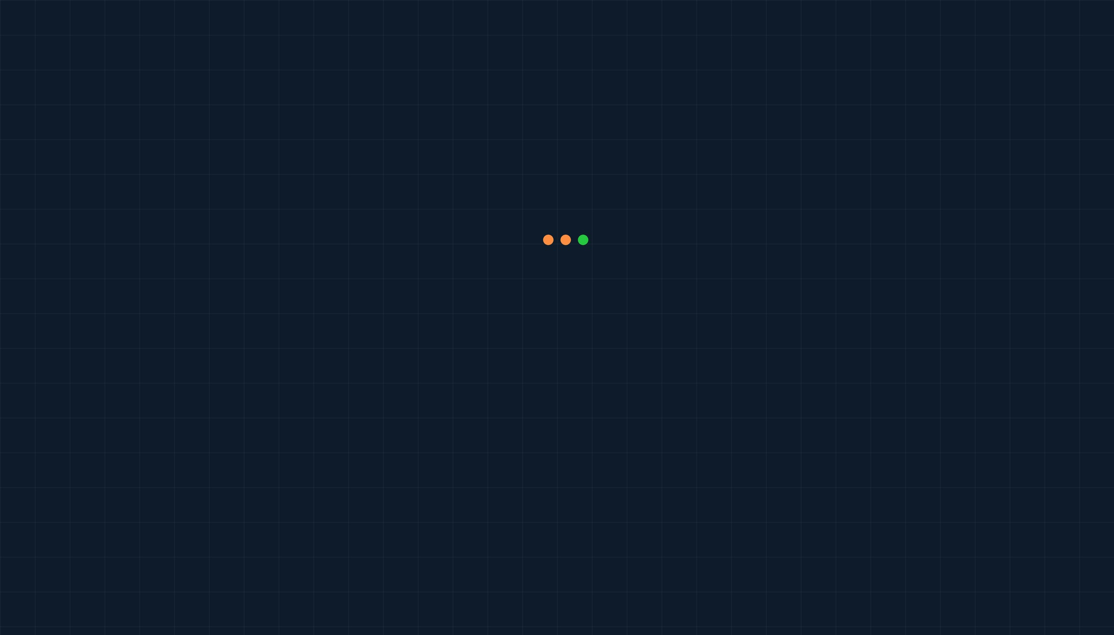




Each Student Creates a Unique, Isolated Conda Environment
Why Unique Environments?
Shared lab computers mean shared conflicts. Creating your own environment ensures your code runs exactly the same way every time, unaffected by other students' changes.
bash - conda setup
# 1. Create your unique environment (Do this ONCE)
$ conda create -n robotics_Ahmad python=3.11 -y
Why conda-forge?
Conda manages both Python and non-Python dependencies together. The conda-forge channel provides the most reliable, up-to-date scientific packages (like PyBullet).
# 2. Activate it (Do this EVERY TIME you open a terminal)
$ conda activate robotics_Ahmad
# 3. Install required packages from conda-forge
(robotics_Ahmad) $ conda install -c conda-forge pybullet numpy matplotlib opencv -y
The Golden Rule
Always try
conda install
first. Only use
pip install
as a fallback if a package is not available on Conda.
Lab 1: Hello, Robot!
Block 1: Perception

Slide 4
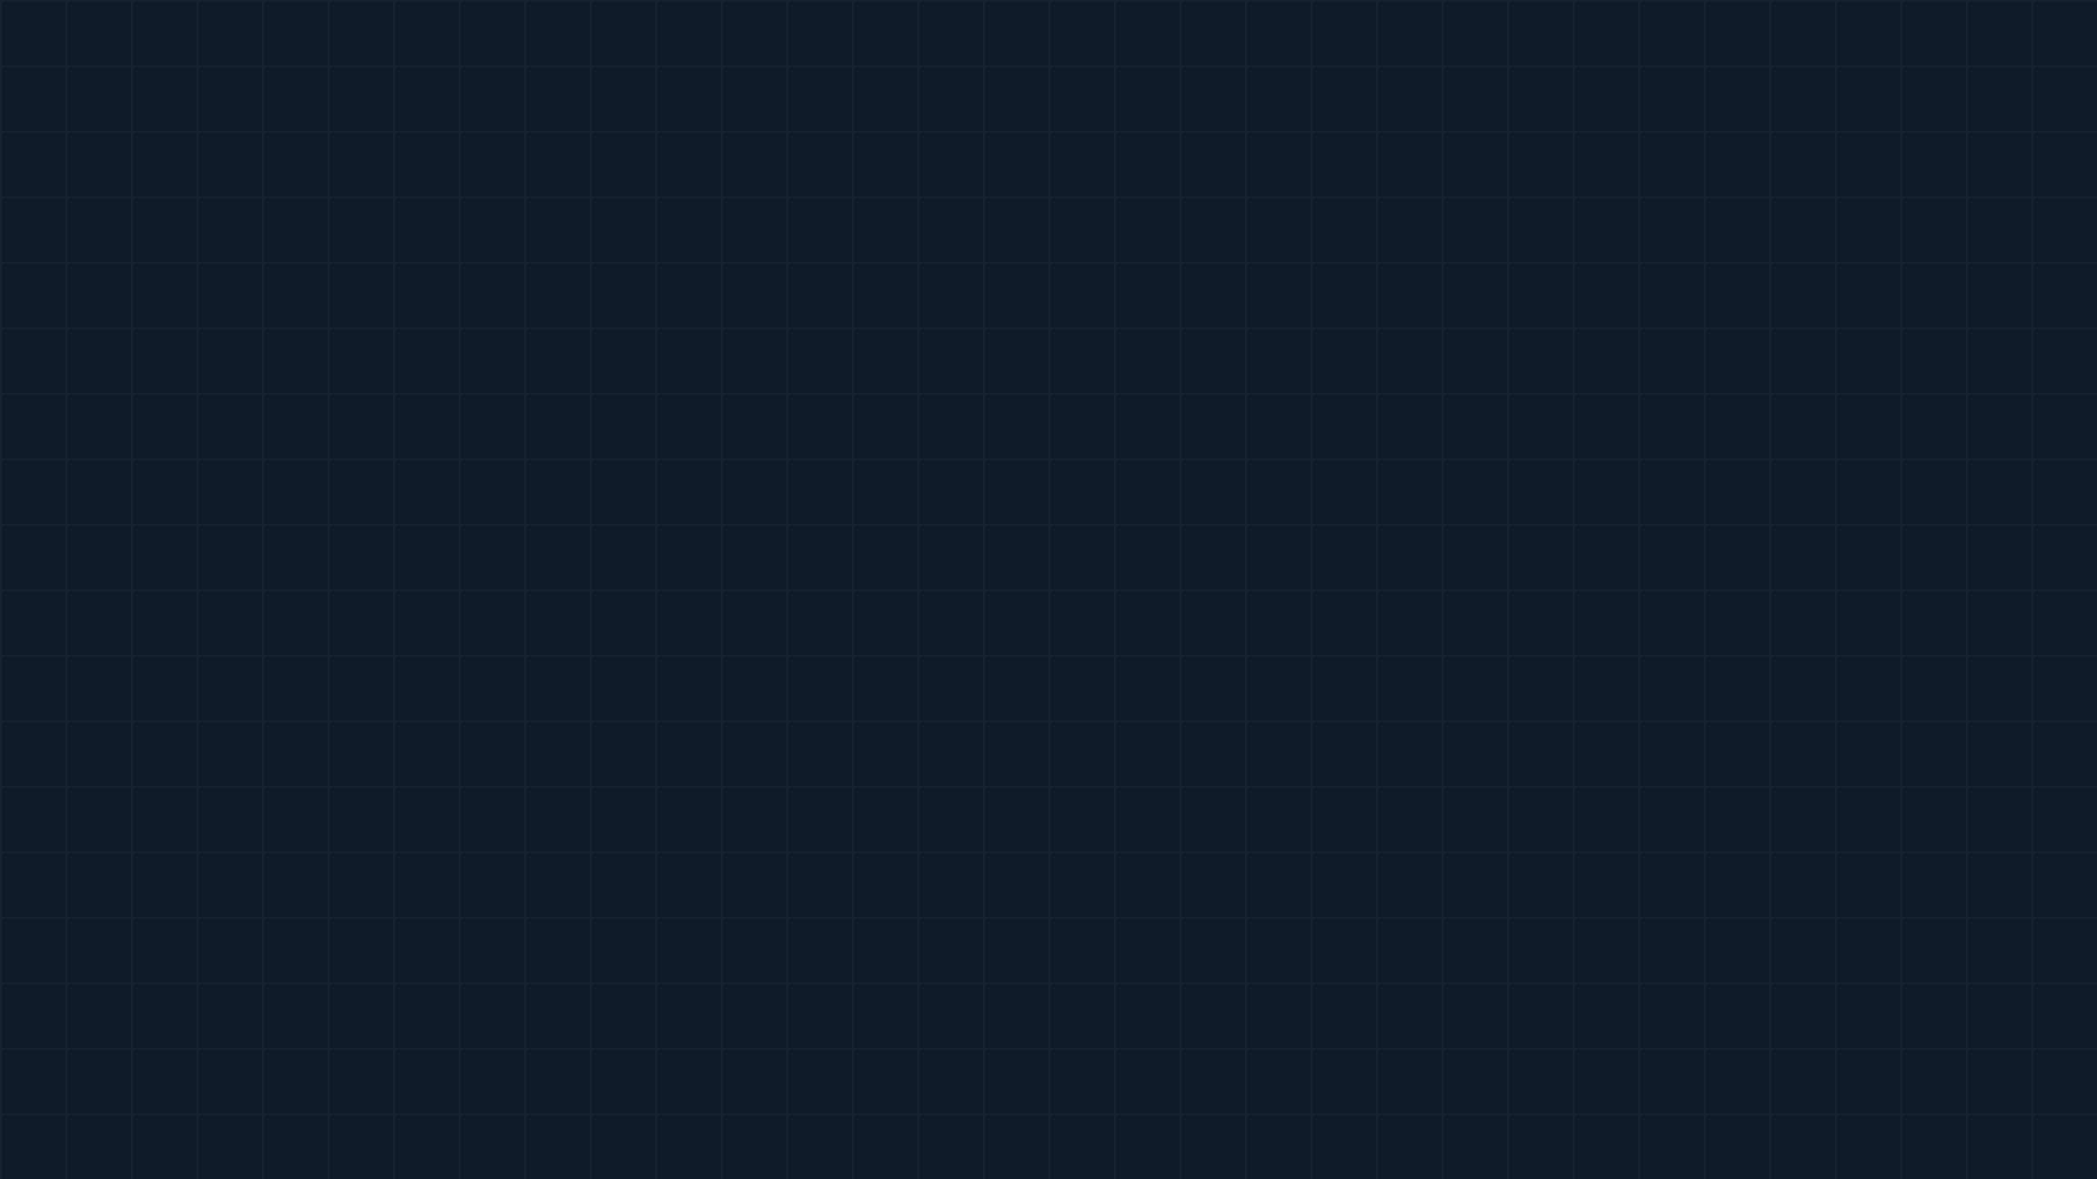




Four Scripts, Four Skills, One Complete Foundation
Incremental Integration
Automated Self-Grading
Each script builds directly on the previous one. You start by creating the world, then sensing it, acting within it, and finally analyzing your performance. This is the core methodology of the course.
Plus:
check_my_lab.py
Before submission, run this script to get instant feedback. It
verifies your robot's trajectory, reinforcing test-driven
development principles.
Lab 1: Hello, Robot!
Block 1: Perception

Slide 5
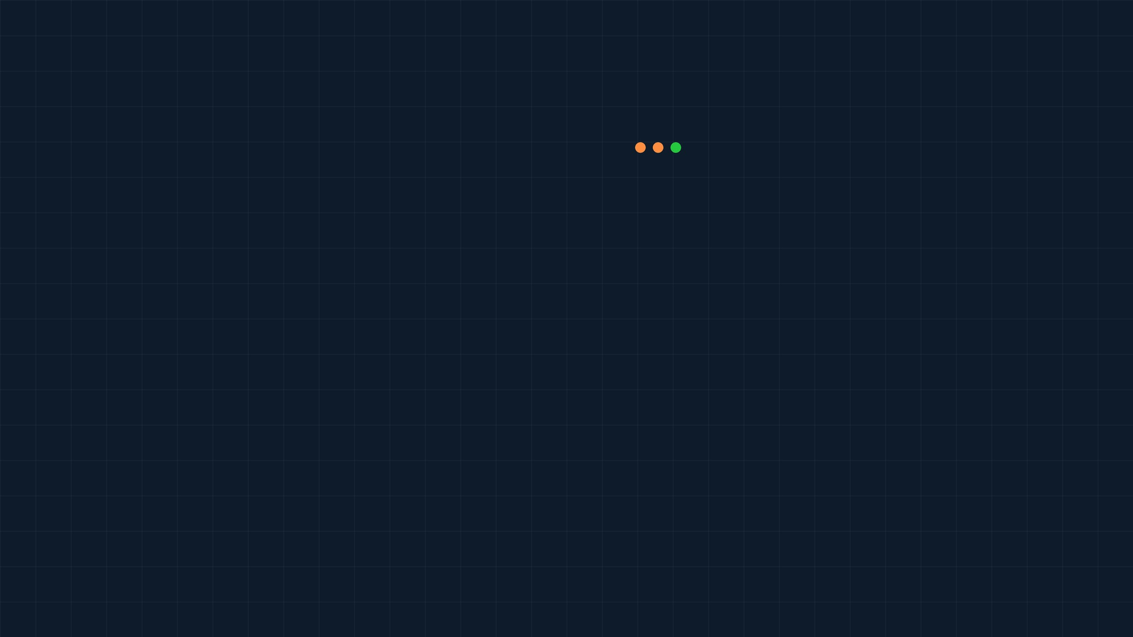


spawn_robot.py: Five Steps to Create a Simulated World
1
Connect to Physics Engine
Use
p.GUI
for visual, or
p.DIRECT
for headless.
spawn_robot.py
2
Set Search Path
import
pybullet
as
p
import
Tell PyBullet where to find
plane.urdf
and
r2d2.urdf
.
pybullet_data
# 1. Connect
p.
3
Set Gravity
(p.GUI)
# 2. Search path
p.
Establish gravity (Z = -9.8 m/s²).
connect
4
Load URDF Models
())
# 3. Gravity
p.
Load robot & plane URDFs to the world.
setAdditionalSearchPath
(pybullet_data.
getDataPath
5
Run Simulation Loop
(0,0,-9.8)
# 4. Load URDFs
p.
setGravity
Advance the physics one step at a time.
("plane.urdf")
p.
Expected Output:
A GUI showing R2D2 on a plane.
loadURDF
("r2d2.urdf", [0,0,0.1])
# 5. Run loop
for _ in range(1200):
p.
loadURDF
stepSimulation
()
Lab 1: Hello, Robot!
Block 1: Perception

Slide 6
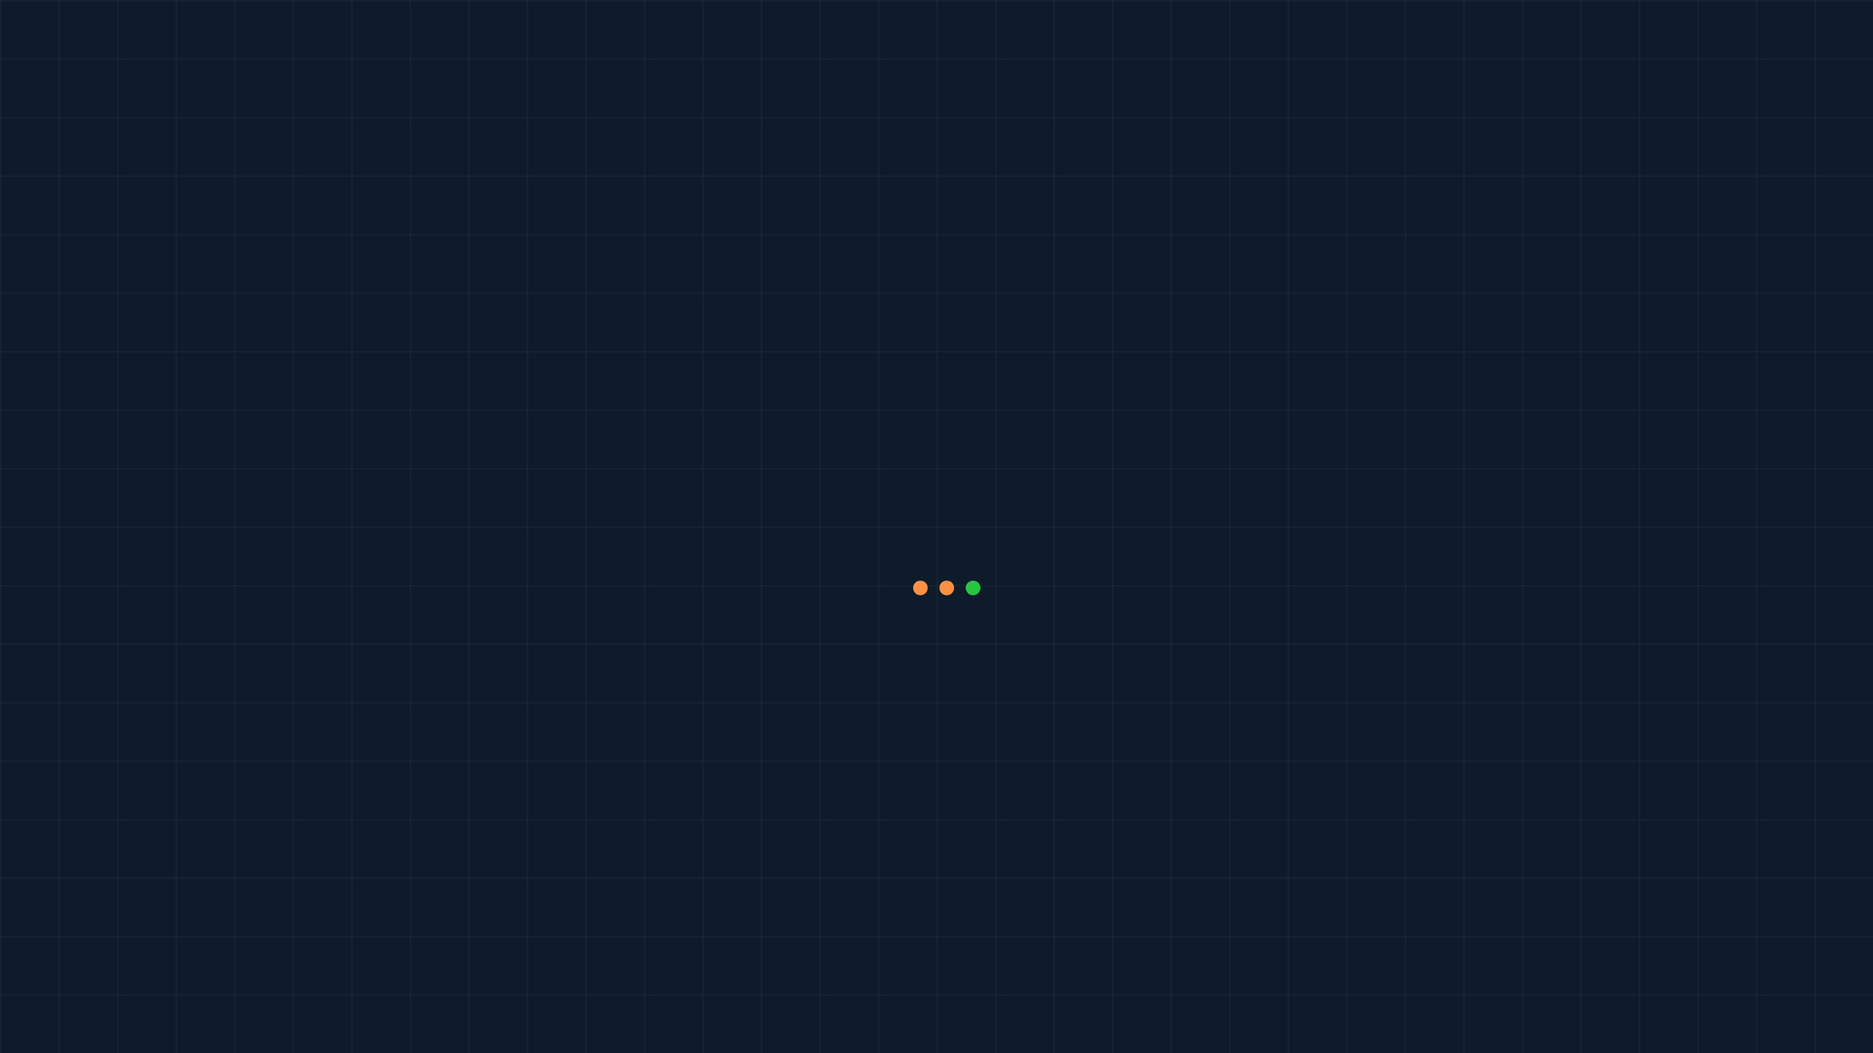




read_sensors.py
: Teaching Your Robot to "Feel" Its Own State
Proprioceptive Sensing
pos, orn = p.getBasePositionAndOrientation(robotId)
Sensing the robot's own internal state (position, orientation, speed). This is how the robot knows where its body is in space.
Returns the (x, y, z) position and the orientation as a quaternion (x, y, z, w).
lin_vel, ang_vel = p.getBaseVelocity(robotId)
Returns linear velocity (vx, vy, vz) and angular velocity (wx, wy, wz).
Exteroceptive Sensing
euler = p.getEulerFromQuaternion(orn)
Sensing the external world (cameras, lidar, ultrasonic). We will cover this in future labs when we add "eyes" to the robot.
Converts complex quaternions into human-readable (roll, pitch, yaw) angles.
Expected Console Output (Every 0.5s)
Time: 2.50s
The Golden Rule
Position (x,y,z): (0.000, 0.000, 0.500)
Orientation (r,p,y): (0.000, 0.000, 0.000)
You cannot control what you cannot measure. Before we can make the robot move accurately, we must be able to read its current state.
Linear Velocity: (0.000, 0.000, 0.000)
Angular Velocity: (0.000, 0.000, 0.000)
Lab 1: Hello, Robot!
Block 1: Perception

Slide 7







move_robot.py: Commanding Motion with resetBaseVelocity
The Core Function
Movement Parameters (2x2m Square)
import pybullet as p # Directly sets the robot body's velocity p.resetBaseVelocity(robotId, linearVelocity=[vx, vy, 0], angularVelocity=[0, 0, wz])
1.0 m/s
2.0 s
LINEAR SPEED
MOVE DURATION
This function directly commands the robot's base. It is simple, reliable, and perfect for learning the fundamentals of motion control before dealing with complex wheel physics.
π/2 rad/s
1.0 s
TURN SPEED (90°/S)
TURN DURATION
The Control Loop
The Body-to-World Frame Problem
To draw a square, we repeat the sequence 4 times:
Robot thinks: "Move forward/backward" (Body Frame)
For i in range(4)
Move Forward (2s)
Turn Left (1s)
Physics engine thinks: "Move along X/Y/Z" (World Frame)
Solution: Use the current yaw angle to convert: vx = speed * cos(yaw), vy = speed * sin(yaw)
Expected Output: The robot traces a visible square in the GUI window and returns to its starting position.
Lab 1: Hello, Robot!
Block 1: Perception

Slide 8
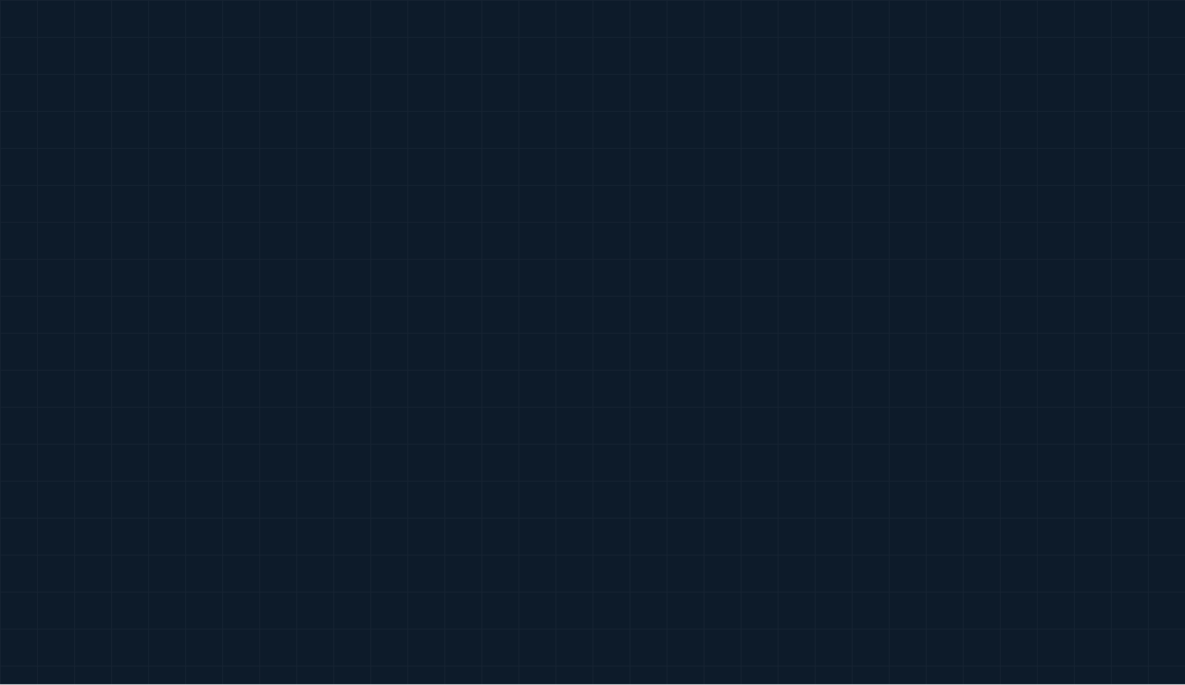

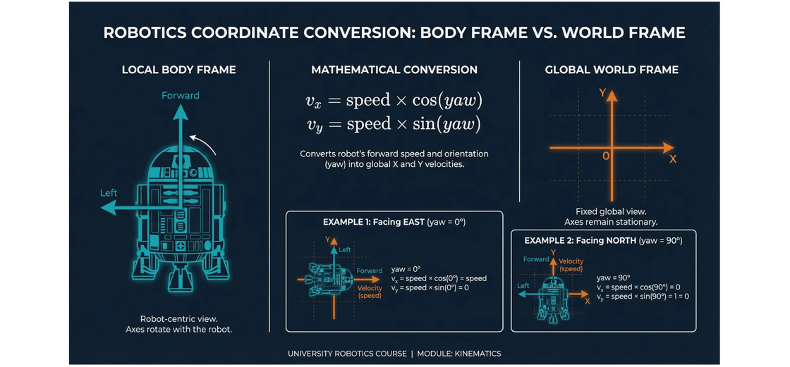
Why cos(yaw) and sin(yaw)? Converting Body Frame to World Frame
The Core Problem
The robot thinks in "forward/backward" (Body Frame), but the physics engine thinks in absolute "X/Y/Z" coordinates (World Frame).
The Trigonometric Solution
We use the robot's current heading (
yaw
) to convert its
forward speed into global X and Y velocities:
Facing East (yaw=0): vx = speed × cos(0) = speed vy = speed × sin(0) = 0
Key Insight
The robot's "forward" direction changes as it turns, but the world's X and Y axes stay fixed. This is why we must recalculate vx and vy at every simulation step.
Lab 1: Hello, Robot!
Block 1: Perception

Slide 9





visualize_trajectory.py: From Raw Data to Actionable Insights
Step 1: Data Logging
Step 2: Plotting with Matplotlib
Instead of just watching the robot move, we need to record its position at every step to analyze its performance later.
We convert the list into a NumPy array and plot the X and Y coordinates to visualize the path.
# Initialize empty list trajectory = [] # Inside simulation loop: pos, _ = p.getBasePositionAndOrientation(robotId) trajectory.append([pos[0], pos[1], pos[2]])
import matplotlib.pyplot as plt import numpy as np traj_array = np.array(trajectory) plt.plot(traj_array[:, 0], traj_array[:, 1]) plt.show()
Headless Mode (p.DIRECT)
When collecting data, we don't need the GUI. Using p.DIRECT runs the simulation thousands of times faster in the background.
Generates a 2D Top-Down View of the Square Path
Lab 1: Hello, Robot!
Block 1: Perception

Slide 10
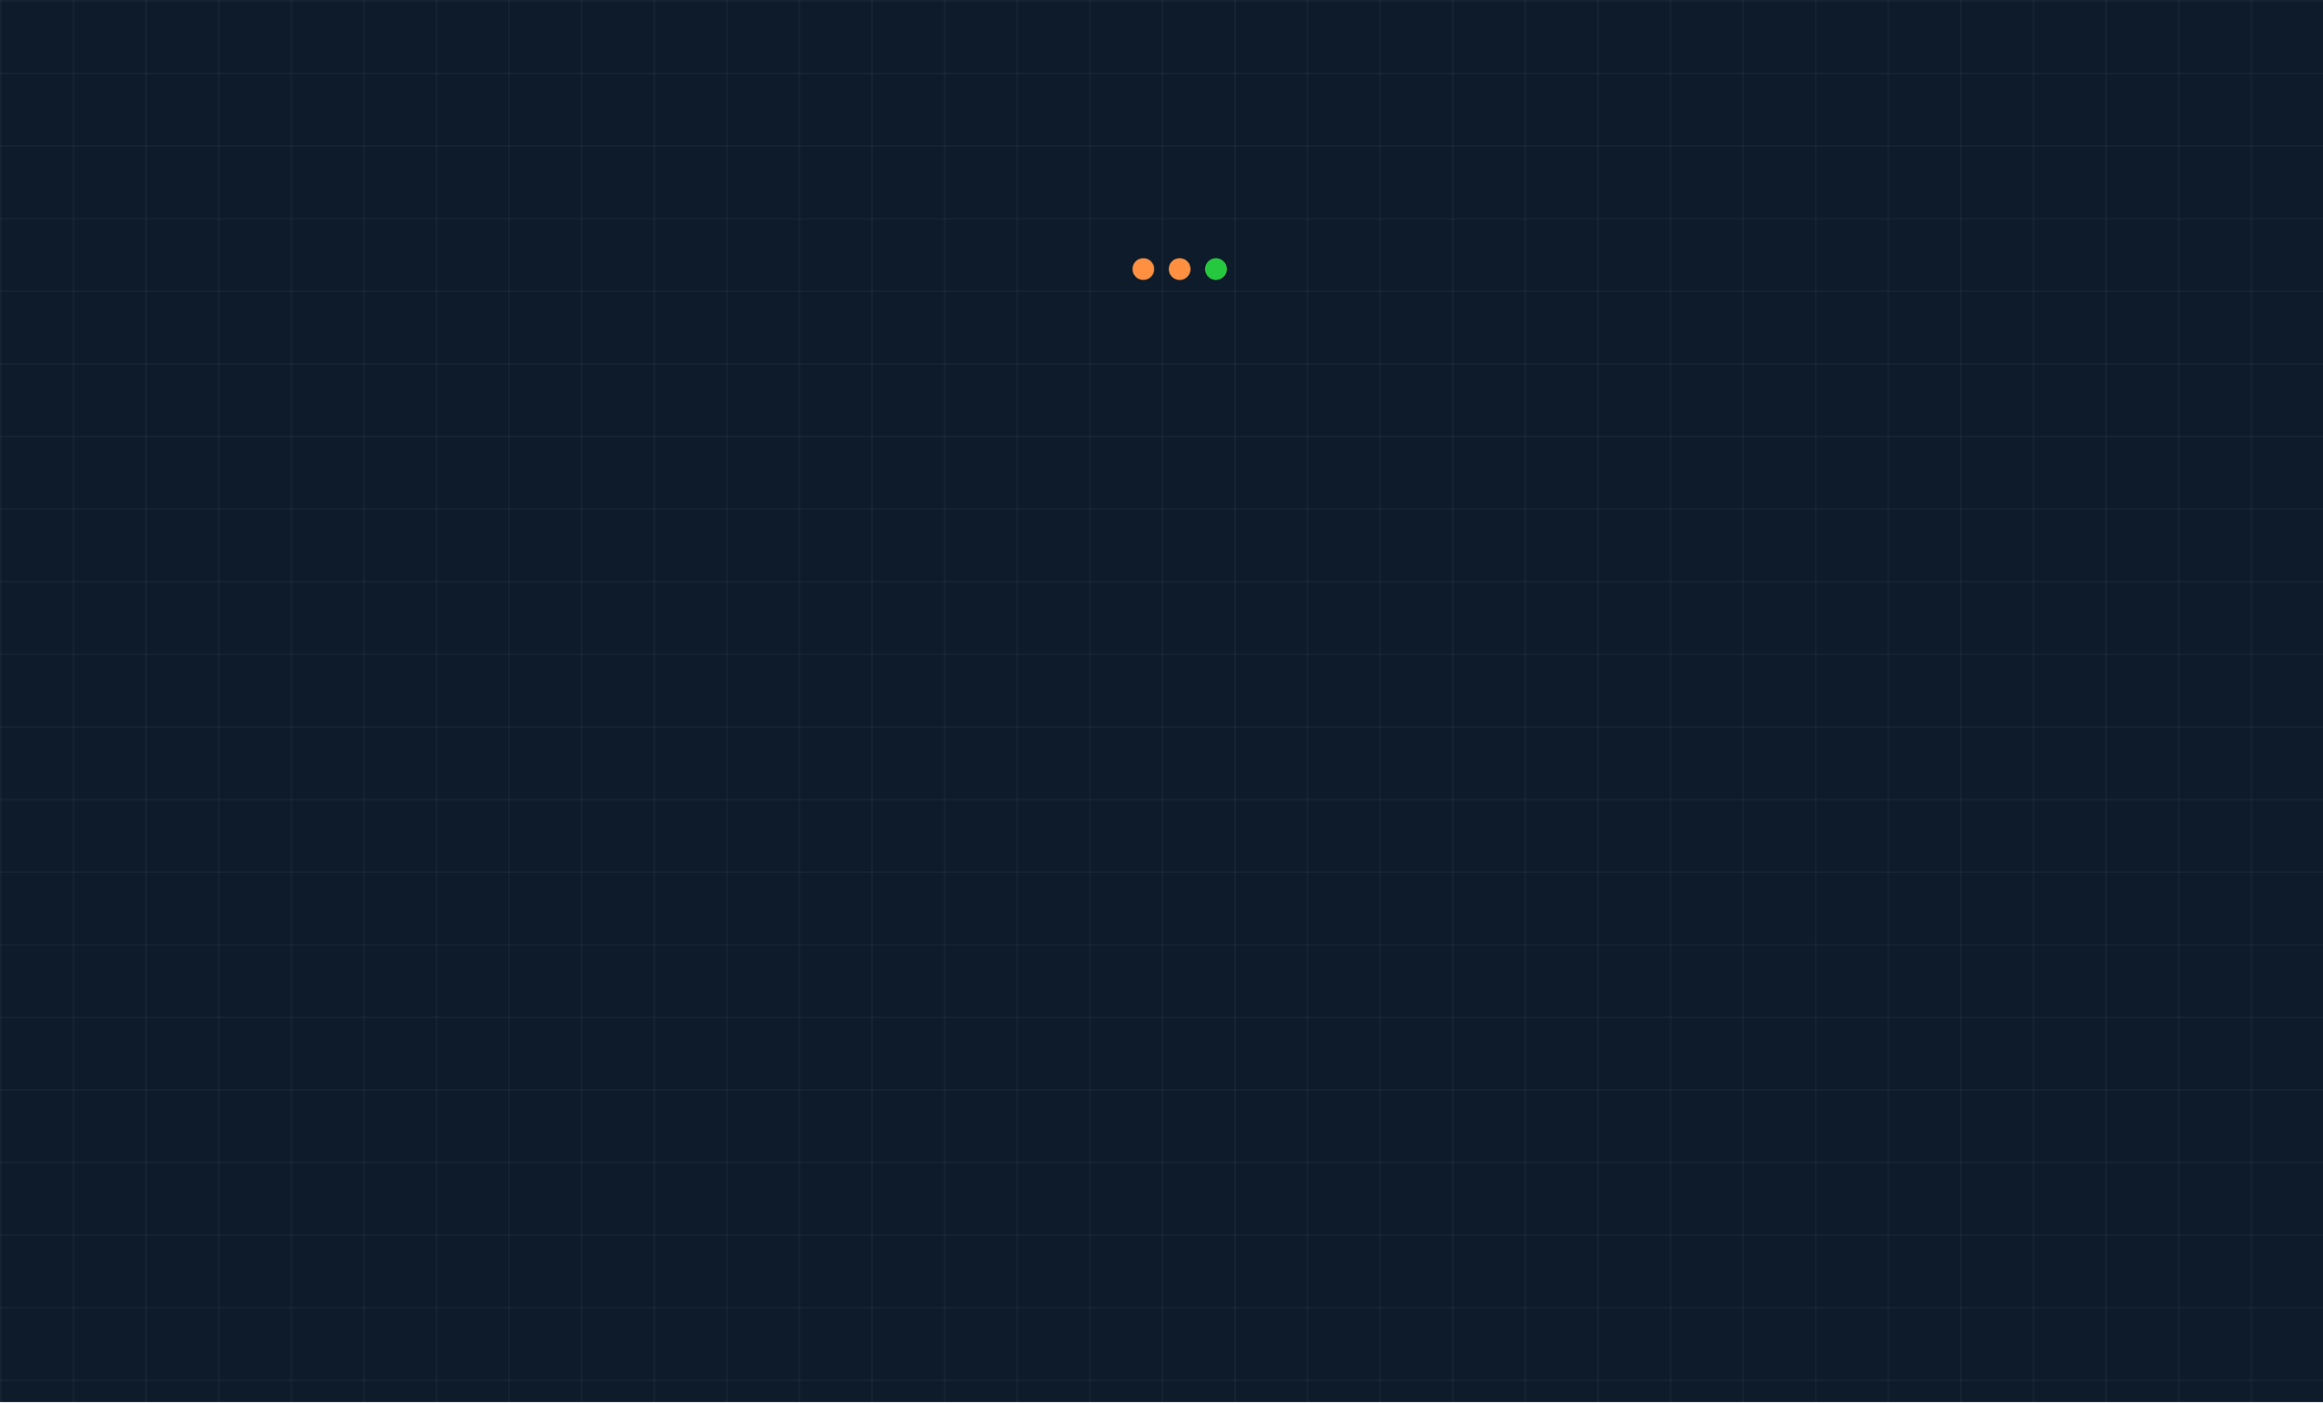




Verify Your Work Before Submission
Automated Testing
Terminal
In industry, code is never deployed without automated
(robotics) user@zuj:~$ python check_my_lab.py
tests. We introduce this concept in Lab 1 with the
check_my_lab.py
script.
--- Running Automated Lab Check for Week 1 ---
Importing your 'move_square' function...
What It Checks
Running simulation in background...
Shape: Did the robot make exactly 4 turns?
[PASS] 4 Corners Detected
Distance: Are the sides approximately 2 meters long?
Found exactly 4 distinct turning points.
Closure: Did the robot return to its starting point?
[PASS] Side Lengths are ~2m
Measured sides: ['2.01', '1.98', '2.03', '1.99']
Instant Feedback
[PASS] Returned to Origin
Run this script as many times as you need. If all tests pass, you are guaranteed full marks for the coding portion of the lab.
Final distance from start: 0.05m (Threshold: 0.2m)
=========================================
FINAL RESULT: 3/3 TESTS PASSED
=========================================
Ready for submission!
Lab 1: Hello, Robot!
Block 1: Perception

Slide 11






What to Submit and How to Succeed
Submission Checklist
Pro Tips for Success
move_robot.py Your completed script that successfully drives the robot in a 2x2m square.
Read the Comments: The provided code is heavily commented. Read them to understand the why, not just the how.
trajectory.png
Test Incrementally: Don't write the whole square at once. Make it move forward first. Then make it turn. Then combine them.
The plot generated by
visualize_trajectory.py
showing your robot's path.
check_output.txt
Mind the Units: PyBullet uses meters for distance and radians for angles. (90 degrees = π/2 radians ≈ 1.57).
A screenshot or text copy showing that your code
passed all 3 tests in
check_my_lab.py
.
Use Your Unique Environment:
Always remember to
Zip File Format
conda activate robotics_YourName
before running
Package all files into a single zip named
any scripts.
Lab1_YourName_YourID.zip
.
Lab 1: Hello, Robot!
Block 1: Perception

Slide 12




You Just Built the Foundation of an Autonomous System
Today you learned to spawn a world, read sensors, command motion, and analyze data. Next week, we give the robot "eyes" with Computer Vision.
Dr. Akram Fatayer
a.fatayer@zuj.edu.jo
linkedin.com/in/akram-fatayer
Lab 1: Hello, Robot!
Al-Zaytoonah University of Jordan

