Slide 1
Predicting Glucose Levels
A Complete Data Science Pipeline
DATASET
RECORDS
COURSE
Pima Indians Diabetes
768 patients · 9 features
Data Analysis & Data Science
1 / 14

Slide 2
The Problem
Objective — Predict a patient's Glucose level from other physiological measurements using Linear Regression.
Dataset — 768 patient records: age, BMI, insulin, blood pressure, pregnancies, skin thickness, and diabetic status.
Target variable — Glucose (continuous, 44–199 mg/dL) — valid for Linear Regression.
Goal — End-to-end pipeline from raw data to a deployed interactive dashboard.
2 / 14

Slide 3
Our Methodology
1
Collection & Preprocessing
Identify and fix erroneous zero values in physiological columns.
2
Exploratory Data Analysis
Visualize distributions, correlations, and feature relationships.
3
Modeling
Apply Linear Regression to predict continuous Glucose levels.
4
Deployment
Build an interactive Streamlit web app with real-time prediction.
3 / 14

Slide 4
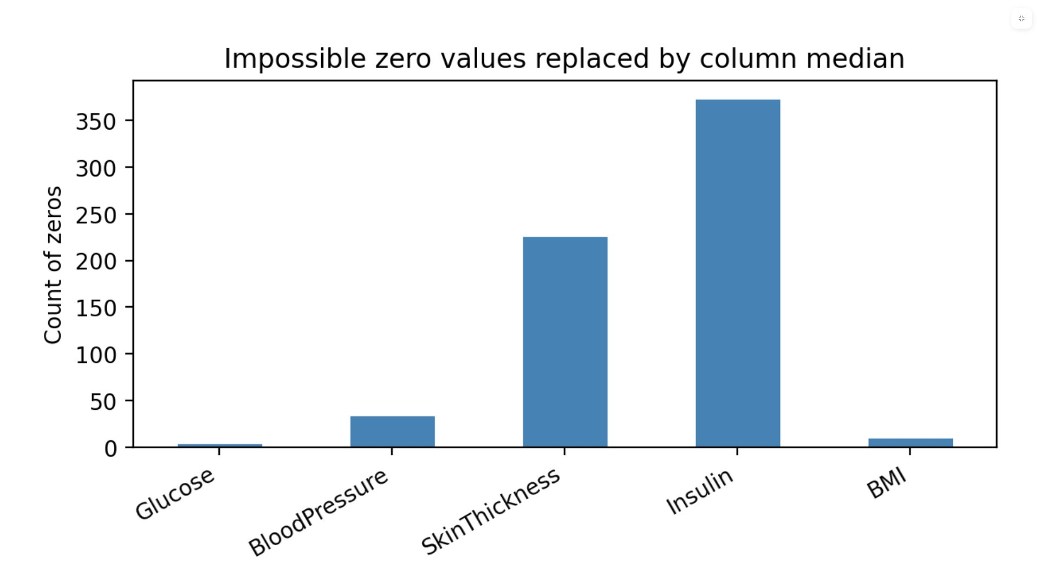
Data Preprocessing
The problem — BMI, BloodPressure, Insulin, SkinThickness, Glucose had impossible 0 values.
The fix — Zeros replaced with NaN, then imputed with column median.
Why median? — Resistant to outliers, unlike the mean.
Pregnancies left as-is — Zero is a valid value there.
4 / 14

Slide 5
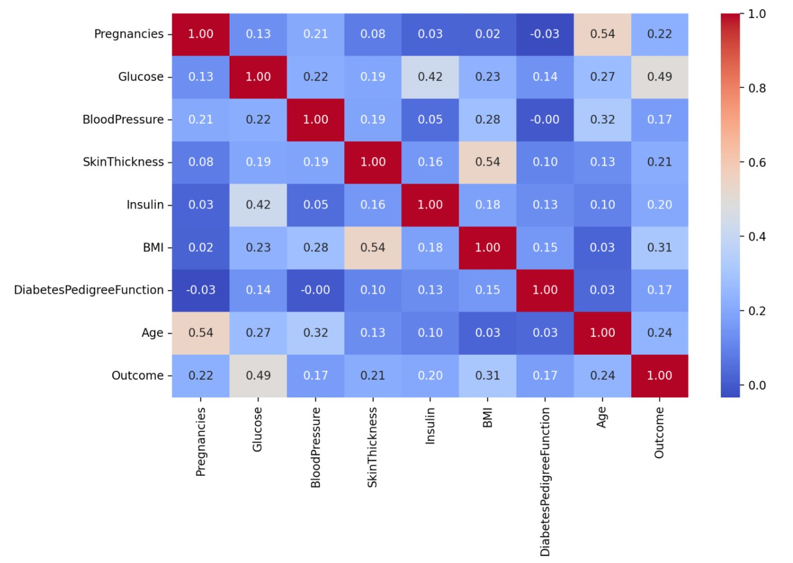
Correlation Heatmap
5 / 14

Slide 6
EDA — Key Findings
Glucose ↔ Insulin: 0.42 — Strongest pairwise correlation, reflects insulin resistance.
Glucose ↔ Outcome: 0.49 — Diabetic patients have higher glucose, as expected.
Glucose ↔ Age: 0.27 — Older patients trend toward higher glucose levels.
Glucose ↔ BMI: 0.23 — Higher body mass links to glucose dysregulation.
These correlations confirm Glucose can be reasonably predicted from the other features.
6 / 14

Slide 7
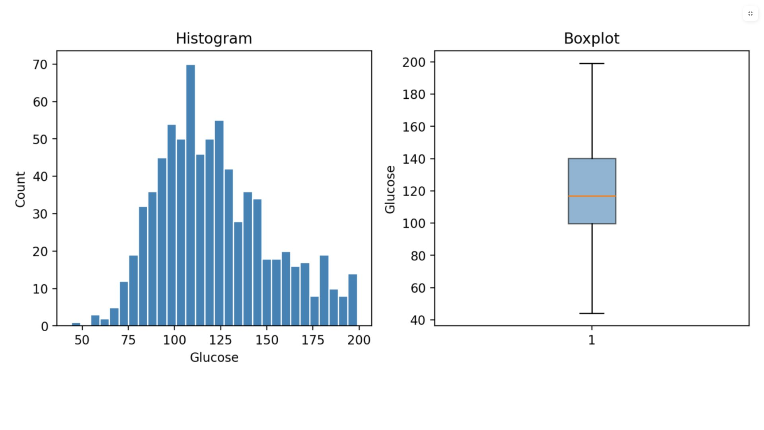
Glucose Distribution — Target Variable
7 / 14

Slide 8
Modeling — Setup
Target — Glucose (mg/dL) — continuous, valid regression target.
Features — Pregnancies, BloodPressure, SkinThickness, Insulin, BMI, DiabetesPedigreeFunction, Age, Outcome.
Split — 80% training / 20% testing, random_state=42.
Scaling — StandardScaler applied so coefficients are comparable across features with different units.
Model — sklearn.linear_model.LinearRegression
8 / 14

Slide 9
Model Results
0.33
672
~20
~26
R² SCORE
MSE
MAE (MG/DL)
RMSE (MG/DL)
Outcome & Insulin — Strongest positive predictors by far.
Age & BloodPressure — Moderate positive effect on Glucose.
SkinThickness & Pregnancies — Slight negative coefficients after standardization.
9 / 14

Slide 10
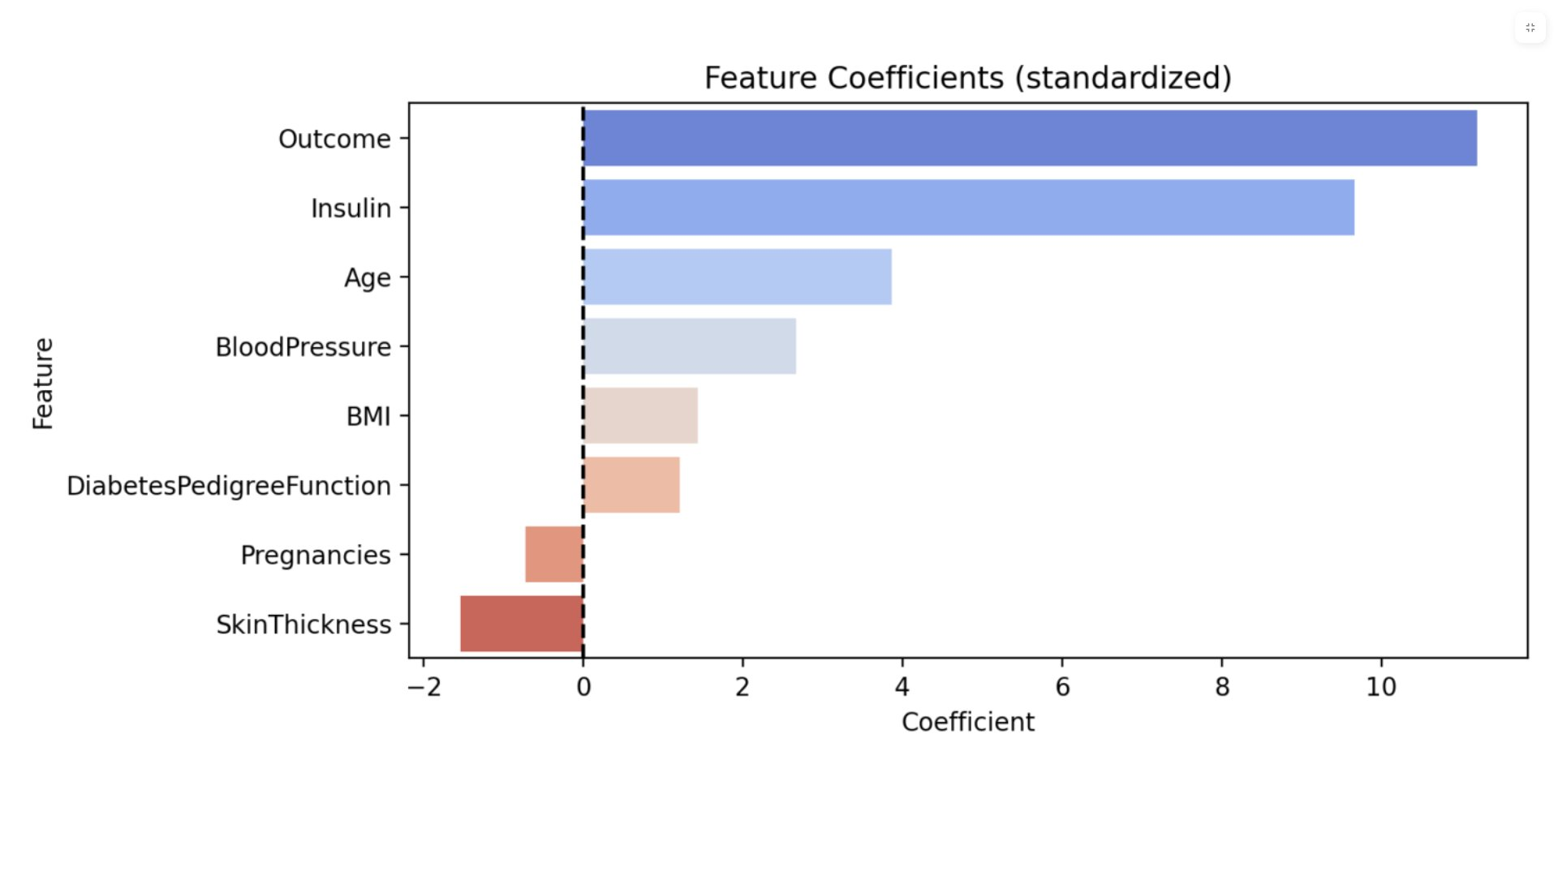
Feature Coefficients (standardized)
10 / 14

Slide 11
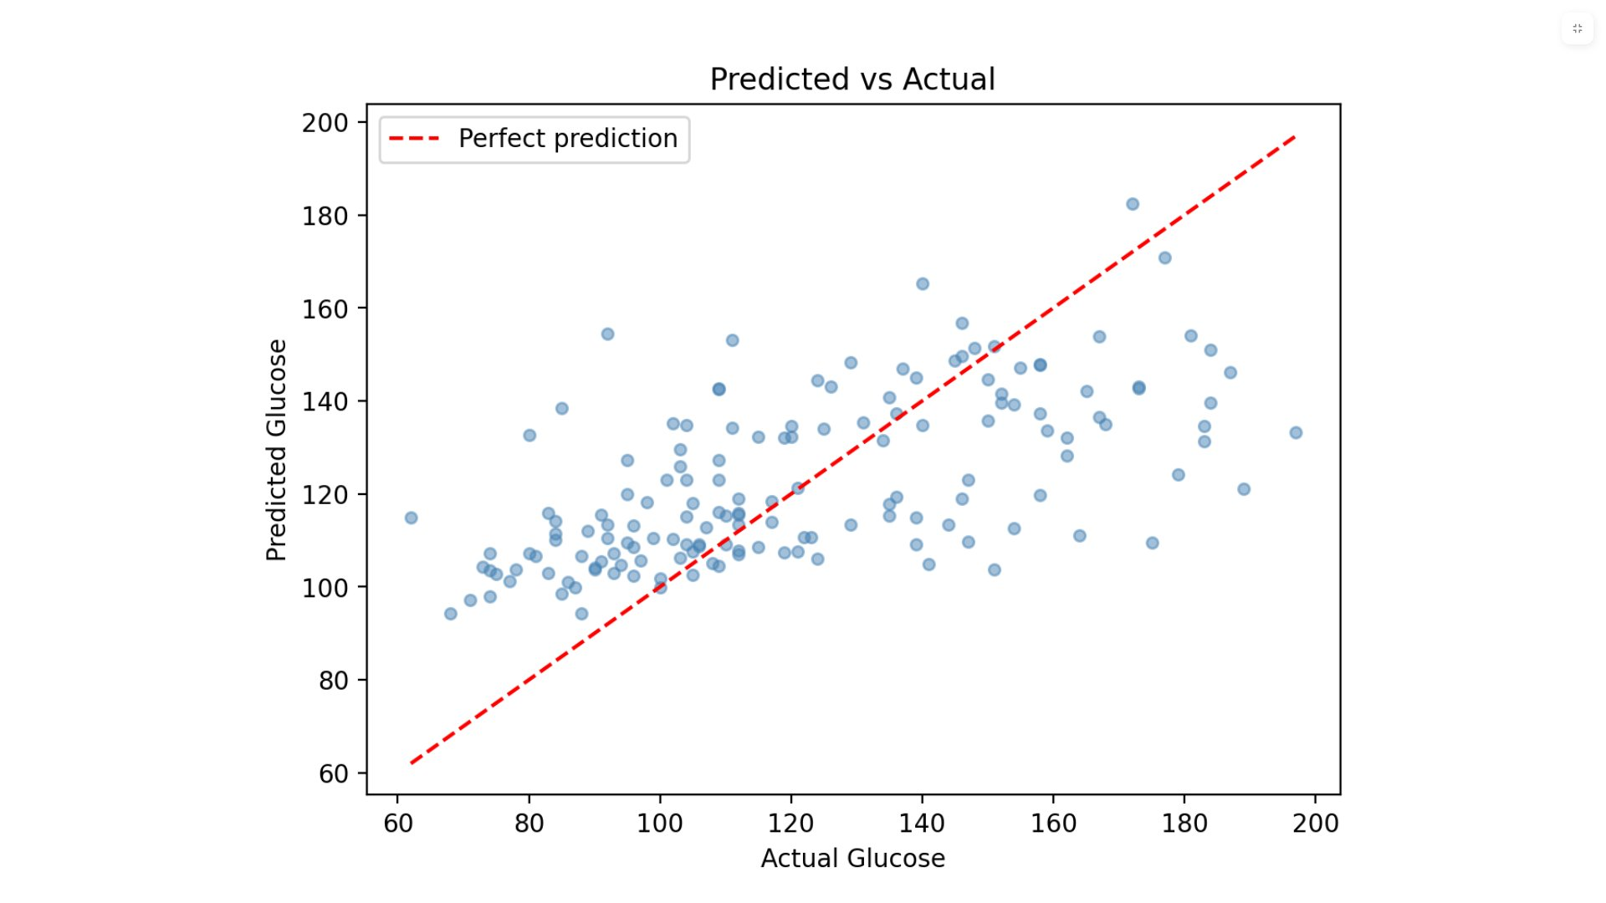
Predicted vs Actual Glucose
11 / 14

Slide 12
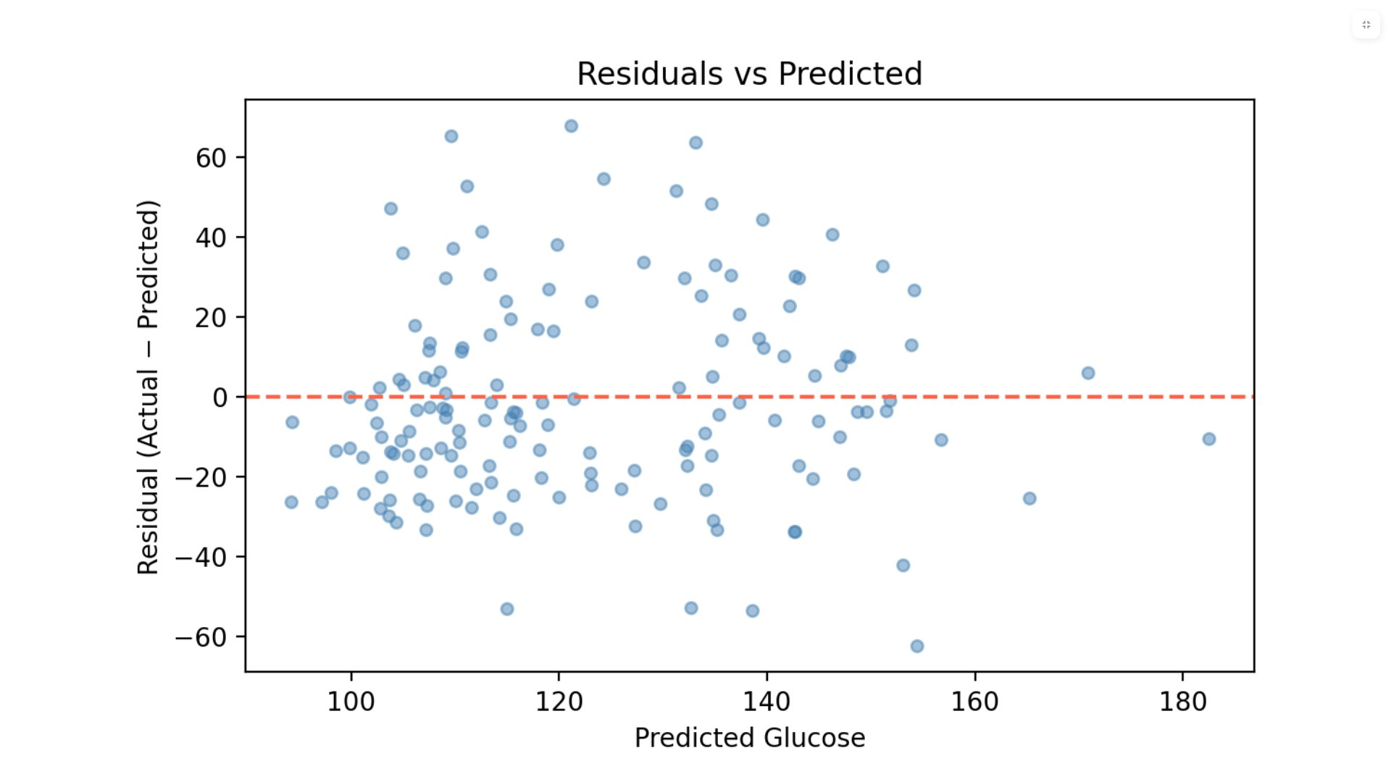
Residuals vs Predicted
12 / 14

Slide 13
Streamlit Dashboard
Page 1 — Raw vs clean data side-by-side + zero counts bar chart.
Page 2 — Correlation heatmap, Glucose distribution, feature scatter plots.
Page 3 — Predicted vs Actual, Residuals plot, Coefficient bar chart, metrics.
Page 4 — Interactive predictor: adjust patient sliders → real-time Glucose prediction.
✓ Normal <100 mg/dL
⚠ Pre-diabetic 100–125
! Diabetic ≥126 mg/dL
13 / 14

Slide 14
Conclusion
Pipeline completed — Preprocessing, EDA, modeling, and deployment done end-to-end.
R² of 0.33 — Reasonable for a linear model; Glucose is influenced by external factors not in this dataset.
Interpretability — Coefficients clearly show which features drive Glucose.
Future work — Random Forest or Gradient Boosting would capture non-linear relationships and push R² significantly higher.
Thank You · Questions welcome · Full code on GitHub
14 / 14

