Slide 1


Netflix Data: Cleaning, Analysis and Visualization

Slide 2
Below are contents of the Project :
1.Description
2.Data Collection
3.Describing Dataset
4.Data Cleaning
5.Analysis & Data Visualization

Slide 3
1.Description : This project involves loading, cleaning, analyzing, and visualizing data from a Netflix dataset. We'll use Python libraries like Pandas, Matplotlib, and Seaborn to work through the project. The goal is to explore the dataset, derive insights, and prepare for potential machine learning tasks.
2.Data Collection : The Data has been collected in the form of a CSV file named "netflix_data.csv".
3.Describing Dataset: Netflix is a popular streaming service that offers a vast catalog of movies, TV shows, and original contents. This dataset is a cleaned version of the original version which can be found here. The data consist of contents added to Netflix from 2008 to 2021. The oldest content is as old as 1925 and the newest as 2021. This dataset will be cleaned with PostgreSQL and visualized with Tableau. The purpose of this dataset is to test my data cleaning and visualization skills. The cleaned data can be found below and the Tableau dashboard can be found here .

Slide 4
4.Data Cleaning:
There were no Null values or blank fields date_added column was in String datatype. So we converted it to datetime datatype using Python.
There were no Duplicates values in the dataset.

Slide 5
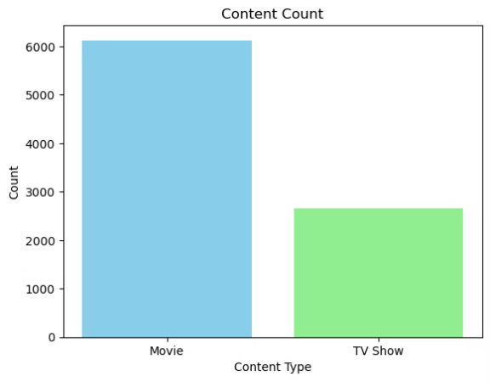
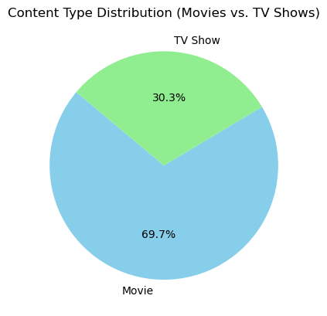
5.Analysis and Visualization:
Charts showing the count of content types, with movies having a higher count than TV shows.
Both charts shows majority of ths users watch movies on netflix.

Slide 6
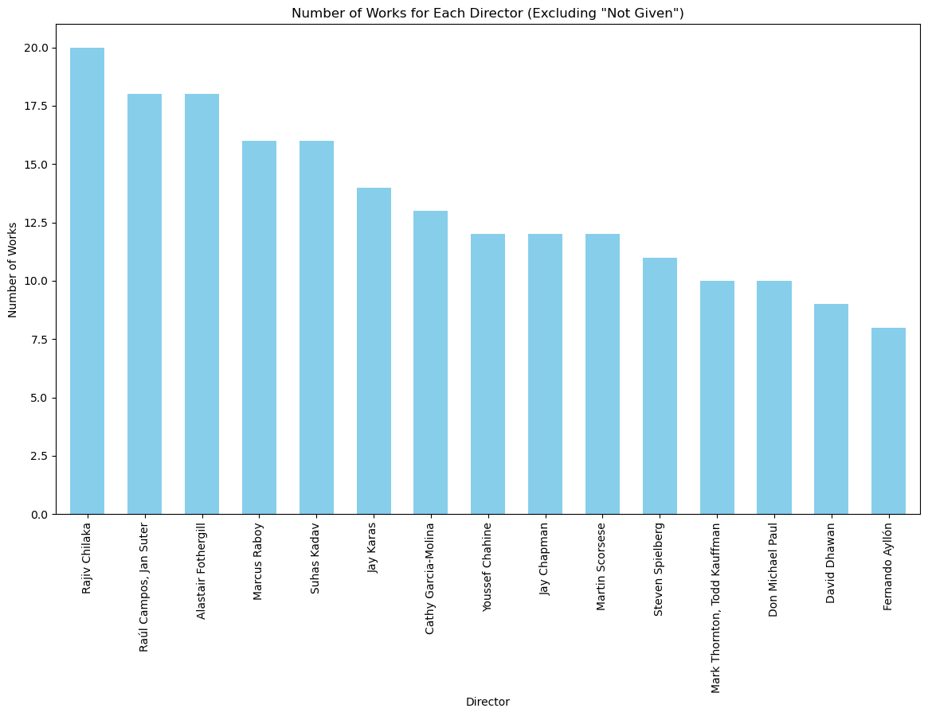
bar chart showing the number of works directed by various directors.
Rajiv Chilaka has higest number of works as director.

Slide 7
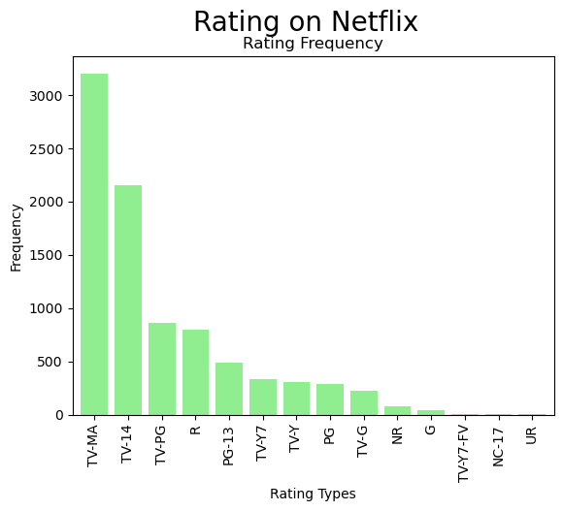
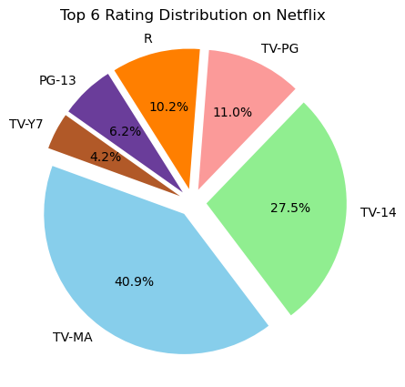
Frequency of different content ratings on Netflix, with TV-MA being the most common and showing top 6 distribution.
TV-MA & TV-14 both has the highest rating distribution.

Slide 8
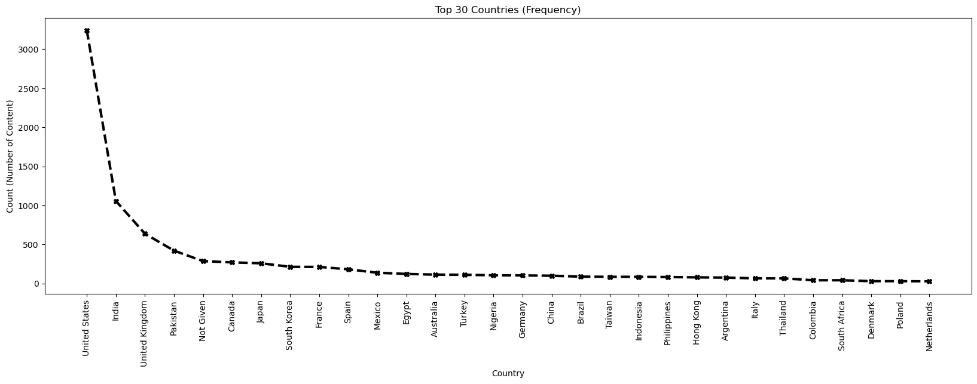
Number of content count by Top 30 Countries.
United States,India and United Kingdom are top 3 in number of content.

Slide 9
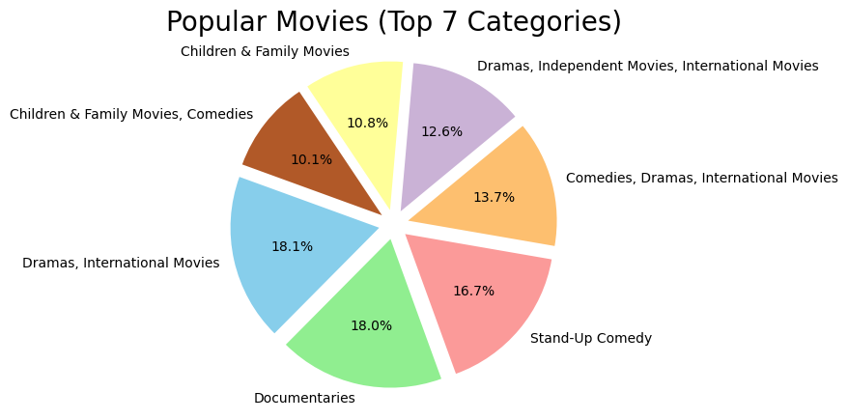
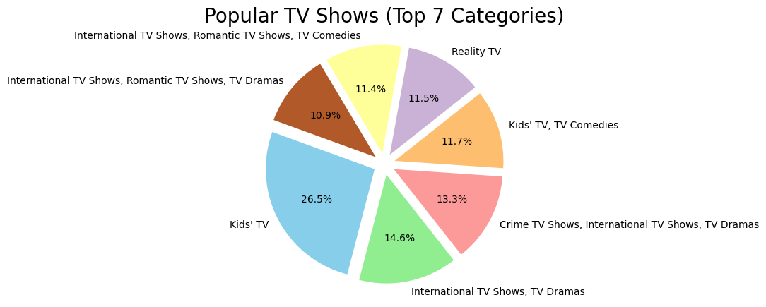
Pie charts showing top 7 categories of popular movies & tv shows.
Dramas,International Movies and Documtaries are most watched categories in Popular Movies.
Kids Tv and Tv dramas and International Tv shows are most watched categories in Popular Tv shows.

Slide 10
Thank You

