Slide 1
Project Title : Enhancing Rail Madad with Al-powered Complaint Management (SIH1711)
DEPARTMENT OF CSE-AIML (CSM) – III-II Sem
Batch #: 02
Team Members (Regd #) : III – II :: CSM – A
1. Aienampudi Suhnitha (22BQ1A4204)
2. Chandragiri Manoj Krishna (22BQ1A4225)
3. Chirala Nandini (23BQ5A4204)
4. Galam Ravi Koti Kiran (22BQ1A4246)
Project Guide:
Dr.V.Muralidhar,
VVIT

Slide 2
DEPARTMENT OF CSE-AIML (CSM) – III-II Sem
Problem Statement:
The existing Rail Madad platform for passenger grievance redressal faces challenges due to manual processes, inefficiencies, and the inability to effectively process multimedia inputs.This project aims to enhance Rail Madad by integrating AI-powered complaint management focus on. The Indian Railways' existing Rail Madad platform is pivotal in addressing passenger complaints, yet it faces limitations in handling the growing volume and complexity of grievances efficiently. The reliance on manual processes often results in delayed responses, inadequate categorization, and reduced passenger satisfaction. The enhanced system will significantly reduce resolution times, increase transparency, and elevate passenger satisfaction, aligning with the vision of transforming Indian Railways' service quality through technology .

Slide 3
DEPARTMENT OF CSE-AIML (CSM) – III-II Sem
Description:
The proposed solution consists of four core modules: AI-Powered Complaint Categorization and Prioritization, AI-Based Chatbot for Smart Routing, Predictive Maintenance System, and Sentiment Analysis and Feedback Mechanism. These modules work together to enhance the Rail Madad platform by leveraging AI technologies for efficient grievance management.
The categorization module processes multimedia inputs using TensorFlow, OpenCV, and OCR, enabling accurate classification of complaints. Deep learning models assess complaint severity, ensuring prompt prioritization of critical issues.
The AI chatbot provides instant acknowledgment, status tracking, and real-time assistance to users. Powered by NLP models like GPT and BERT, it routes complaints to the appropriate department, reducing delays and enhancing satisfaction.
The predictive maintenance system analyzes complaint data to identify recurring issues and forecast potential disruptions. Time series models enable proactive scheduling, preventing escalations and ensuring smoother operations.
Sentiment analysis evaluates user feedback using SpaCy and NLTK, categorizing emotional tones as positive, neutral, or negative. Dashboards visualize sentiment scores and resolution metrics, guiding stakeholders to refine processes for improved passenger experience.
Additional features include automated report generation for performance tracking and AI-driven anomaly detection to highlight unusual patterns, enhancing system reliability and operational efficiency.

Slide 4
DEPARTMENT OF CSE-AIML (CSM) – III-II Sem
E2E Project Review - 1
Project Functional Requirements: (Features)
Image/Video Recognition
OCR and Metadata Analysis
Automated Complaint Severity Detection
Smart Routing and Acknowledgment
Real-Time Assistance
Multilingual Support
Recurring Issue Prediction
Data-Driven Maintenance Scheduling
Failure Pattern Analysis
Sentiment Analysis of Complaints
Analytics-Driven Feedback
User Satisfaction Scoring
Project modules:
AI-Powered Complaint Categorization and Prioritization
AI-Based Chatbot for Smart Routing
Predictive Maintenance System
Sentiment Analysis and Feedback Mechanism

Slide 5
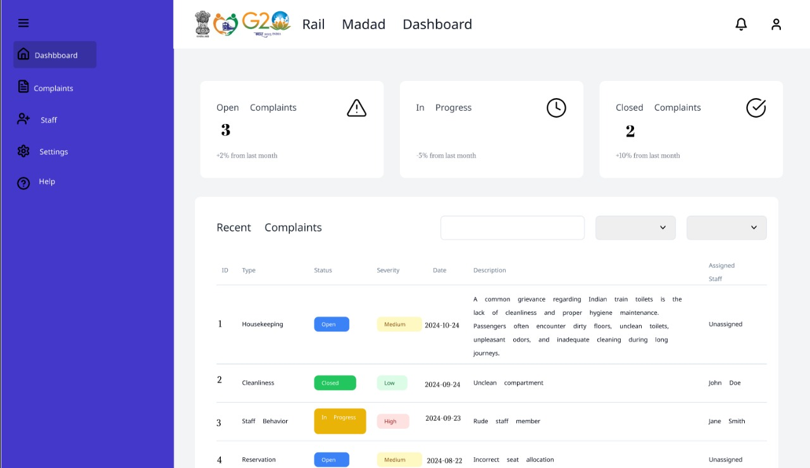
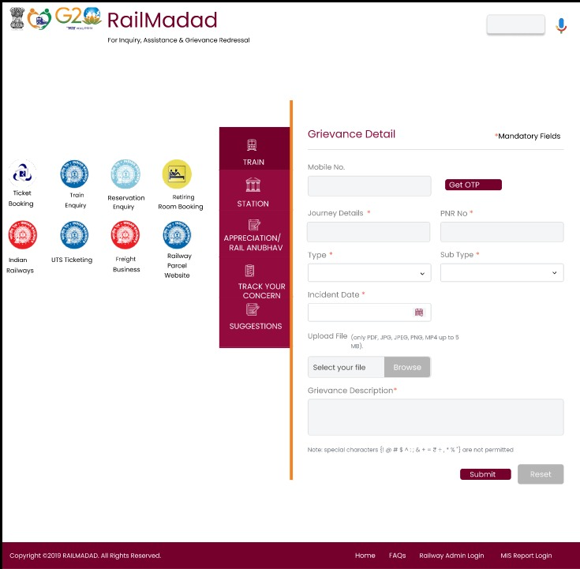
DEPARTMENT OF CSE-AIML (CSM) – III-II Sem
AI-Powered Complaint Categorization and Prioritization:
Tools /Frameworks /Models : OpenCV, TensorFlow, OCR Techniques
Main Rolls : A. Suhnitha, Ch. Manoj Krishna, Ch. Nandini, G. Ravi Koti Kiran
Workflow:
This module processes complaints with multimedia inputs like images, videos, or audio. Tools like OpenCV and TensorFlow analyze these inputs, while OCR models extract text from scanned documents. Together, these technologies ensure accurate and comprehensive data processing.
Deep learning models classify complaints into categories such as safety concerns, service delays, or maintenance issues. This classification simplifies grievance management and ensures complaints are handled efficiently.
Severity detection algorithms prioritize complaints based on urgency, flagging critical issues for immediate attention. This structured workflow reduces response times and improves operational efficiency.

Slide 6
DEPARTMENT OF CSE-AIML (CSM) – III-II Sem
AI-Based Chatbot for Smart Routing:
Tools /Frameworks /Models : Dialogflow, Python NLP Libraries, GPT, BERT
Main Rolls : A. Suhnitha, Ch. Manoj Krishna, Ch. Nandini, G. Ravi Koti Kiran
Workflow:
The chatbot interacts with users, assisting in complaint registration and inquiries. Powered by GPT, BERT, and Dialogflow, it processes natural language inputs to understand user intents, even in multiple languages.
After extracting details like complaint type and urgency, the chatbot uses algorithms to route issues to the correct department. For example, IT issues are sent to technical support, ensuring streamlined handling.
The chatbot also provides real-time updates and status tracking, offering users a seamless experience. This automation reduces staff workload and improves user satisfaction.

Slide 7
DEPARTMENT OF CSE-AIML (CSM) – III-II Sem
Predictive Maintenance System:
Tools /Frameworks /Models : Scikit-learn, Pandas, Time Series Analysis Models
Main Rolls : A. Suhnitha, Ch. Manoj Krishna, Ch. Nandini, G. Ravi Koti Kiran
Workflow:
This module uses historical complaint data to identify recurring issues and predict potential failures. Scikit-learn and predictive analytics models analyze patterns to detect early warning signs.
Time series analysis forecasts maintenance needs, enabling proactive scheduling to avoid disruptions. This prevents escalations and reduces the likelihood of repeated complaints.
Feedback from resolved maintenance tasks refines predictive models, improving accuracy over time. This ensures continuous system reliability and optimal resource utilization.

Slide 8
DEPARTMENT OF CSE-AIML (CSM) – III-II Sem
Sentiment Analysis and Feedback Mechanism:
Tools /Frameworks /Models : NLTK, SpaCy, Sentiment Analysis (Logistic Regression, Transformers)
Main Rolls : A. Suhnitha, Ch. Manoj Krishna, Ch. Nandini, G. Ravi Koti Kiran
Workflow:
The sentiment analysis module evaluates user feedback to measure satisfaction. Tools like SpaCy and NLTK analyze the emotional tone of feedback, categorizing it as positive, neutral, or negative.
Generated sentiment scores, combined with resolution metrics, are visualized through dashboards. These insights help track system performance and identify areas for improvement.
Continuous feedback allows stakeholders to refine processes and enhance system functionality. This ensures a better user experience and aligns services with user expectations.

