Slide 1
AI-Enhanced Log Analysis for Threat Detection in Wazuh
Network Security
AKRASH BASHIR-47571,MUHAMMAD ARHUM-44889

Slide 2
Abstract
SIEM (Wazuh) generates many false positives
Integrate ML classifier in real time
Dataset: CICIDS 2023
PCA for dimensionality reduction (95% variance)
Models: LR, Perceptron, MLP, Random Forest (best: 97.67% accuracy)
Deployed as Flask microservice → AI‑enriched Kibana alerts

Slide 3
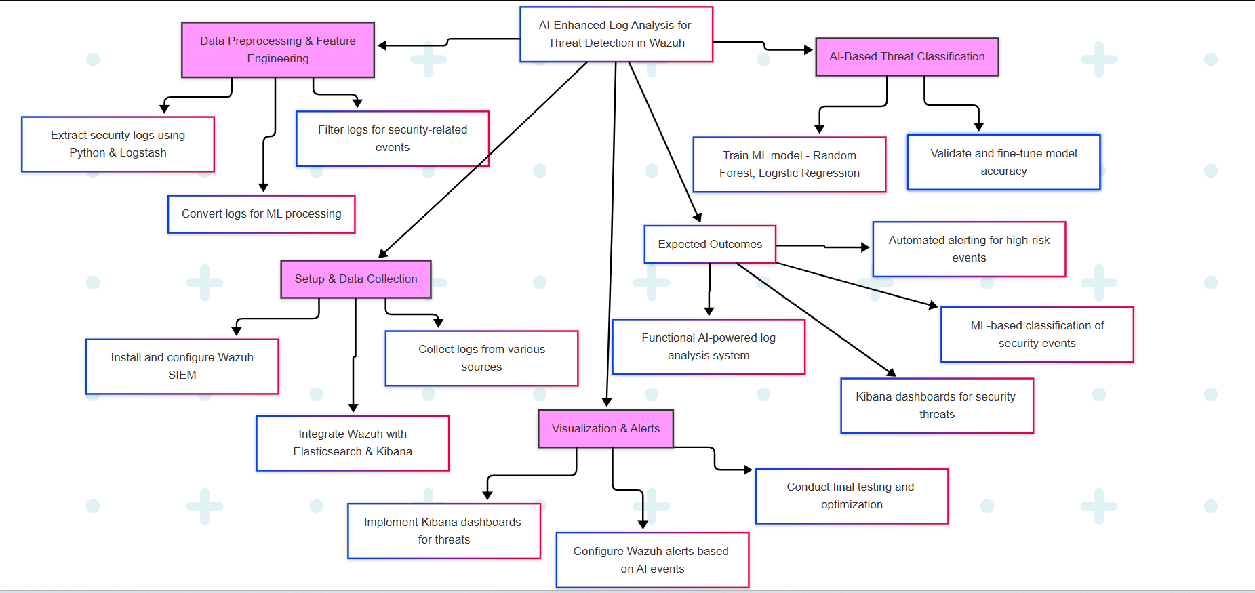
System Architecture

Slide 4
Introduction
Growing volume of security logs → alert fatigue
Wazuh: open‑source SIEM with rule‑based alerts
Need for data‑driven anomaly detection
Goal: Embed ML inference in Wazuh pipeline

Slide 5
SIEM Challenges
Static signatures → outdated detections
High false‑positive rates (> 60%)
Manual triage burdens analysts
Delayed response to real threats

Slide 6
AI/ML for Intrusion Detection
Supervised learning on labeled traffic
PCA for feature reduction
Ensemble methods (Random Forest) & neural nets
Previous work: Splunk ML Toolkit, offline analysis

Slide 7
CICIDS 2023 Dataset
Modern attack scenarios: brute‑force, botnets, DDoS
Balanced benign vs. malicious flows
80+ raw features per flow
Publicly available from UNB

Slide 8
System Architecture & Workflow
Extraction: Logstash & Python scripts parse JSON logs
Filtering: Focus on security‑relevant events
Cleaning: Drop > 20% missing; median/mode imputation
Encoding: One‑hot for categorical; Min‑Max scaling

Slide 9
Phase 1: Setup & Data Collection
Original: 80+ features
PCA → 10 principal components
Retains 95% of variance
Benefits: faster training, less overfitting

Slide 10
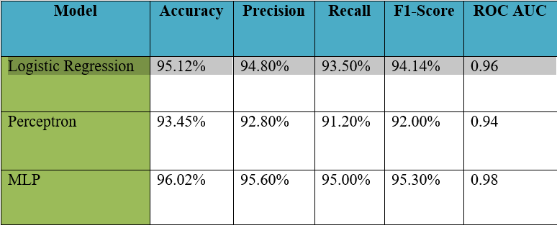
Model Performance

Slide 11
Phase 3: AI-Based Threat Classification
True Negatives: 14,650
False Positives: 350 (2.3%)
False Negatives: 210 (1.4%)
True Positives: 14,790

Slide 12
Integration Architecture
Wazuh Agents → Manager → Elasticsearch
Flask AI Microservice on manager: /predict endpoint
Wazuh rules forward events via curl
Annotated events re‑indexed in Elasticsearch
Kibana dashboards visualize AI alerts

Slide 13
Alert Reduction & Throughput
False‑positive↓15%: 2,500 → 2,120 alerts/day
Precision↑: 6.00% → 6.99%
Recall: 100% → 98.67%
Performance:
Throughput: 8,000 events/sec
Latency: 120 ms/event
CPU: 65% (8 vCPUs), RAM: 4.5 GB

Slide 14
Project Timeline
Improved Accuracy: RF catches subtle anomalies
Prioritization: Threat scores guide triage
Reduced Fatigue: Fewer false alarms
Scalable: Handles enterprise‑scale load
Challenges: Model drift, explainability needs

Slide 15
Future Work & Extensions
Conclusion:
Seamless ML integration in Wazuh
97.67% accuracy, 15% fewer false positives
Real‑time AI alerts in Kibana
Future Enhancements:
Online/incremental learning
Unsupervised anomaly detection
Explainable AI (SHAP/LIME)
Threat‑intel fusion (MISP, VirusTotal)
Expand to cloud & endpoint logs

Slide 16
References
Wang et al., Deep CNN for Intrusion Detection (2019)
Kim & Park, LSTM-based DDoS Detection (2020)
Lee et al., Autoencoder Anomaly Detection (2021)
Wazuh Documentation, Real-Time SIEM (2025)

Slide 17
Q&A / Contact Information
Thank you!
Questions?
Contact: your.email@example.com

Slide 18
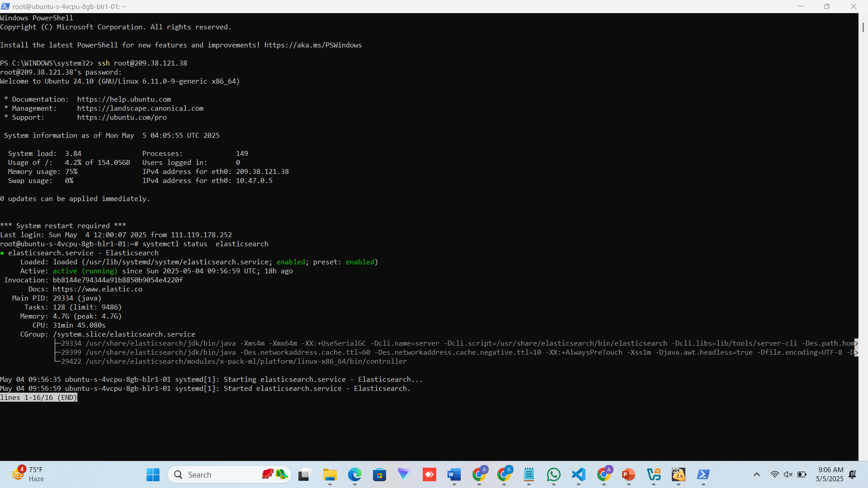

Slide 19
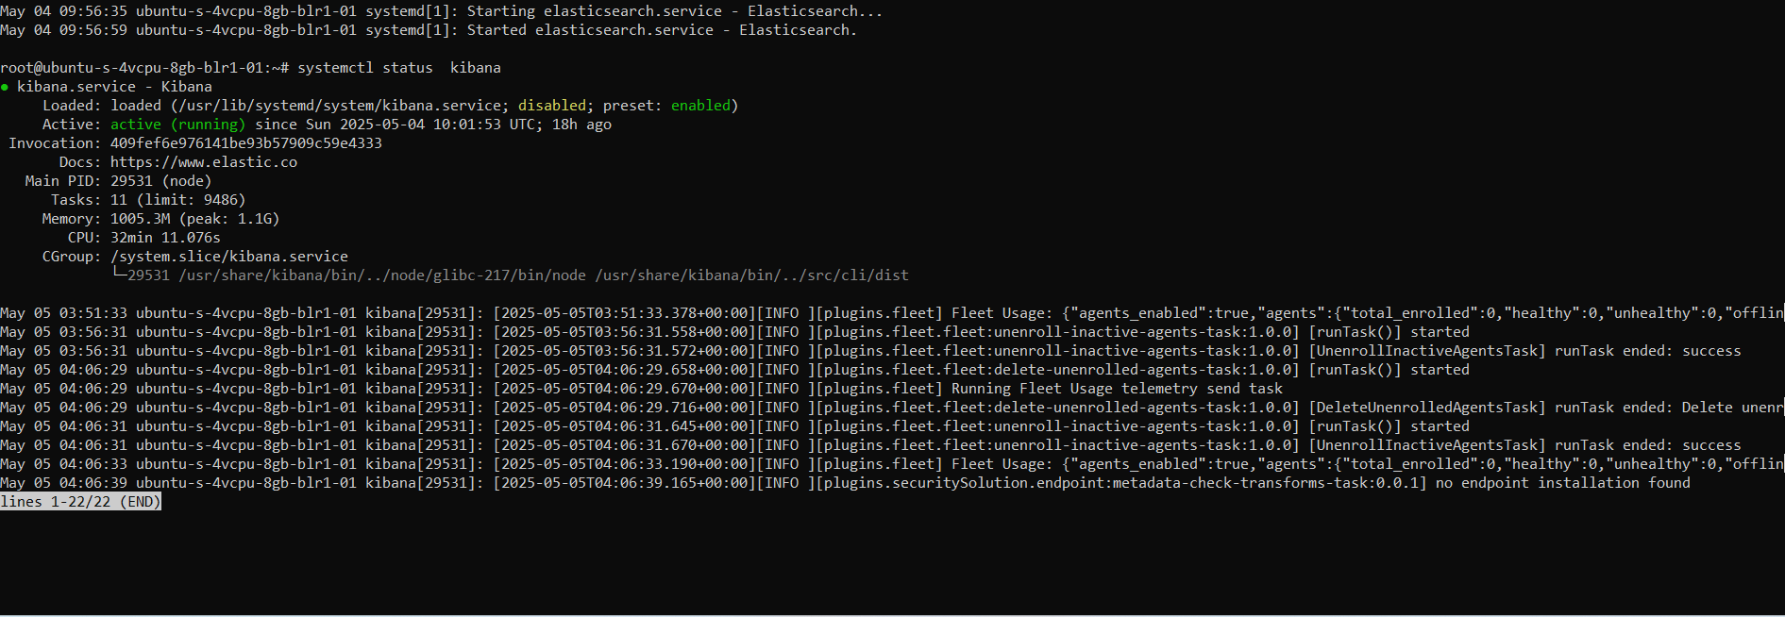

Slide 20
