Slide 1


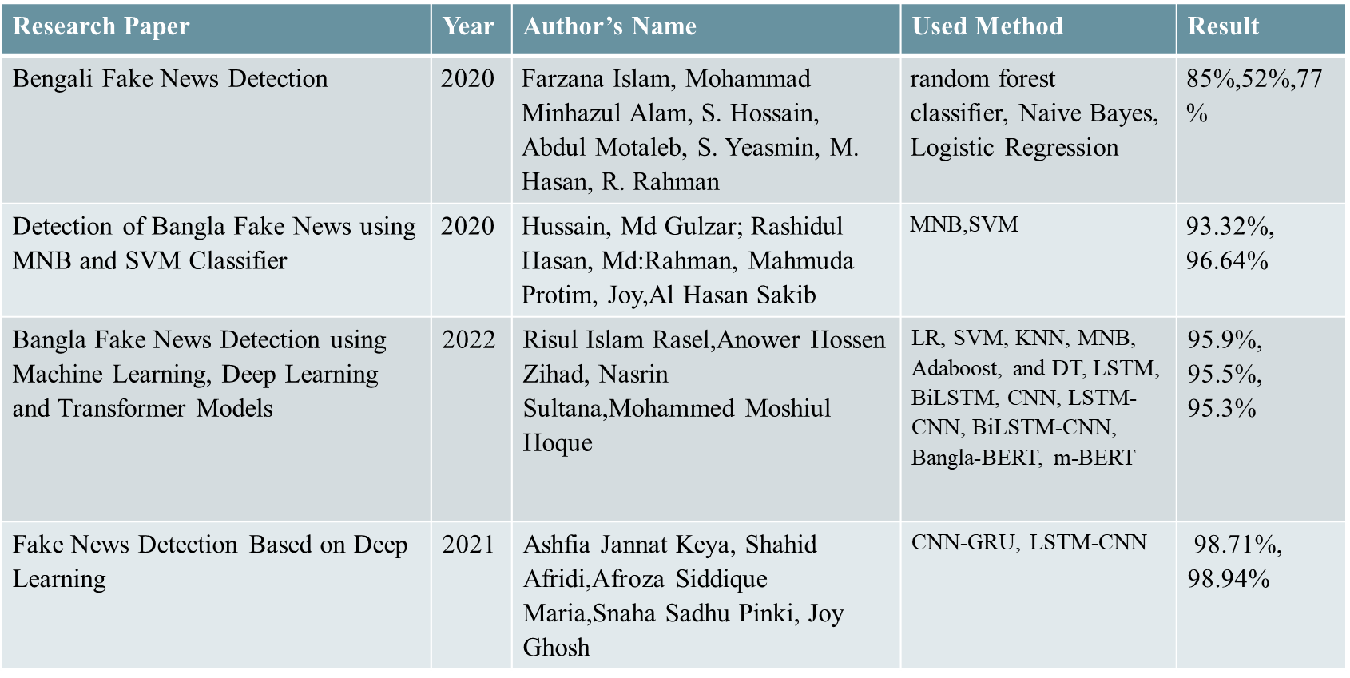
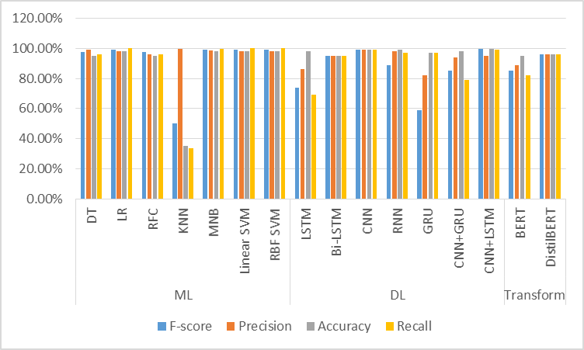
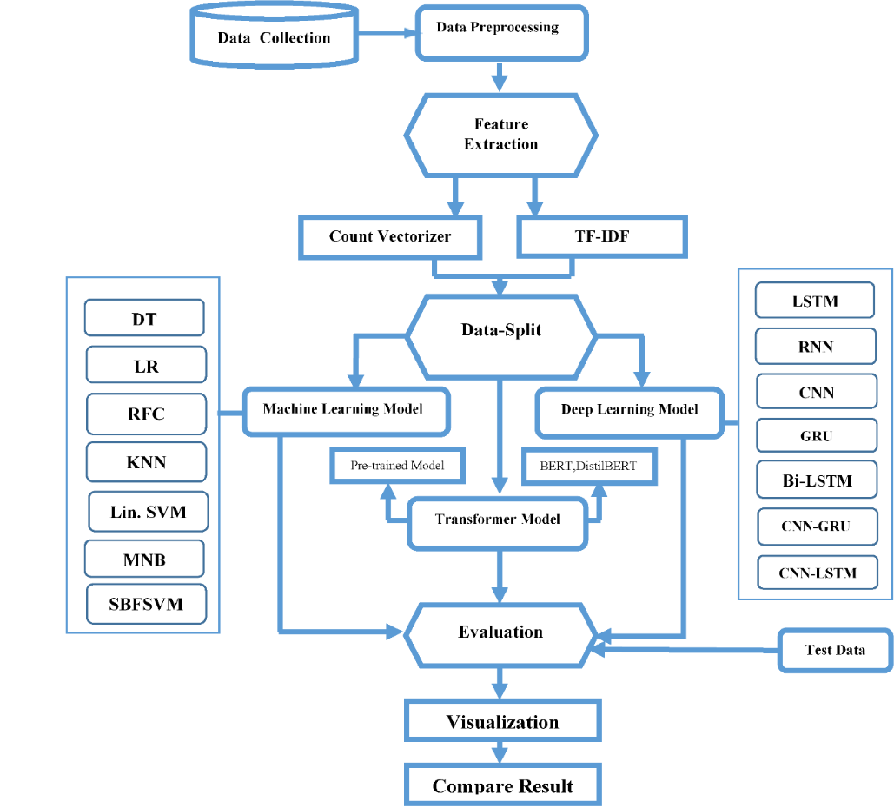
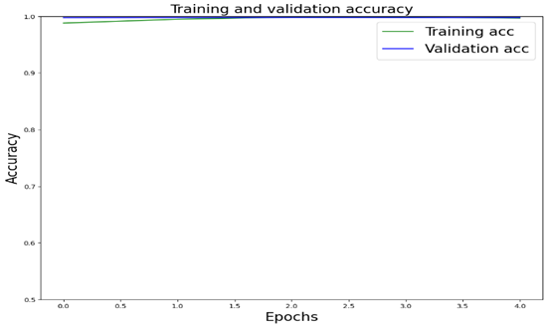
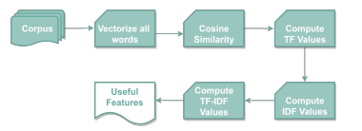
Approaches for Improving the Performance of Fake News Detection in Bangla using ML, DL & Transformer Model
Supervised by : Pintu Chandra Paul
Lecturer
Department Of Information & Communication Technology
Comilla University,Comilla
Presented By : Group-7 ID : 11809024,11809045,11809051
Figure 4.1 Process flow of Bangla Fake News Recognize
Figure 4.1 Process flow of Bangla Fake News Recognize
Literature Review: Related Work
Figure 4.1 Process flow of Bangla Fake News Recognize
Abstract
Result Analysis & Discussion
The rise in the amount of puzzling details in traditional media outlets, such as social networking websites, news blog announcements, and online platforms as well has created it difficult to recognize legitimate news sources, increasing the demand for computer applications that are able to expressing simplicity into the reliability of information on social networking sites.
The spread of Bengali untrue information as well as its broadcast on social media websites has been a serious subject to discuss due to its propensity to demolish sovereignty We applied sophisticated Neural Network algorithms that performed well in identifying False information. In our research-based project, we also created ML models as well as applied transformer methods .
We utilize basic and diligently chose Bangla news to precisely recognize fake news. The test results show a 99.68% accuracy utilizing the CNN-LSTM model as our Corresponding Dataset.
This part will discuss the mathematical algorithms we used for our research's accuracy, precision, and recall and F-score.
Precision = TP / (TP+FP) Recall = TP / (TP+FN)
Accuracy = (TP+TN) / (TP+FP+FN+TN) F1-score= 2TP / (2TP+FP+FN)
Machine Learning
Model | Accuracy | Precision | Recall | F1 Score
DT | 95.06% | 99.04% | 95.84% | 97.42%
LR | 98.12% | 98.10% | 100% | 99.04%
RFC | 95% | 95.75% | 96.07% | 97%
KNN | 35.40% | 99.82% | 33.66% | 50.34%
MNB | 98.16% | 98.50% | 99.63% | 99.06%
Linear SVM | 98.14% | 98.20% | 99.92% | 99.05%
RBF SVM | 98.14% | 98.20% | 99.92% | 99.05%
Deep Learning
LSTM | 98% | 86% | 69% | 74%
Bi-LSTM | 95% | 95% | 95% | 95%
CNN | 99% | 99% | 99% | 99%
RNN | 97.56% | 98% | 97% | 89%
GRU | 96% | 82% | 97% | 59%
CNN+GRU | 98% | 94% | 79% | 85%
CNN+LSTM | 99.78% | 95.06% | 99% | 97.28%
Transformer Model
BERT | 95% | 89% | 82% | 85%
Distil BERT | 96% | 96% | 96% | 96%
Objectives
Methodology : Architecture Overview
Table : Accuracy, Precision, Recall and F1 Score features of ML, DL and Transformer Model
The goal of this research is to provide an overview of the many models for detecting deception in the field of ML,DL & Transformer Models. This could help future researchers locate detection models that are comparable to the recognition models they are building, or to determine what categorization algorithms are under-researched. The purpose is to offer a user-friendly overview of previous research datasets, the algorithms for classification most typically employed in novel algorithms as well as baseline classifications for comparison by and classification method performance.
This paper can help all humanity, as well as save a town from a wave of violence.
The primary goal of our research is to develop a sophisticated model capable of detecting fraudulent or spurious information produced in the Bengali language.
Our suggested approach operates in stages.The stages of our approach are illustrated below :
Chart : F-score, Precision, Accuracy, Recall
In the above figure, We can see that the highest F-score will be found from the Machine Learning Algorithms MNB (99.06%), The highest Recall will be found from the Machine learning Algorithm Logistic Regression (100%). The highest Precision will be found from the Machine learning Algorithm KNN (99.82%). The highest Accuracy will be found from the Deep learning Algorithm CNN-LSTM (99.78%).
Introduction
Figure 5: CNN+LSTM Model Loss Graph
Fake news is the news that is false and inaccurate but is designed to make people think that they are true and accurate. The reason for fake news is either commercial or political to make money or change opinion. Fake news manipulates people’s minds to think a certain way and makes people support a particular opinion. Fake news is not always just lies; more often it is a mixture of lies and truths.
As information spreads very quickly and freely on digital technologies and social media, fake news also spread much more quickly and to many more people. Fake news can have serious consequences when they come out of the online world and enter into the offline world.
Fake news affects people psychologically and spreads hatred.it is clear that some of the most famous false information was significantly more widely shared on Social than the most favorite legitimate mainstream news. fake news purposefully leads consumers to believe biased or misleading information.
The fundamental purpose of this research is to create a mechanism that can discern between fake and legitimate news by employing three separate ways NLP text vectorization is used to train various ML,DL models .
So, to develop a system like this, our proposed approach is to use machine learning ,deep learning techniques for fake news detection.
Figure 1 : Process flow of Bangla Fake News Recognize
Conclusion
A) Data Collection B) Data Preprocessing C) Feature Extraction D) Data Split E) Data Train F) Classifiers
As a result, we developed the identification of fake news framework, which takes user input and determines if it is true or false. Different machine learning , Deep Learning and Transformer methods need to hired to carry it out. The model is trained on an appropriate dataset, and a variety of performance indicators are employed to assess its performance. The most accurate model, also known as the best model, is used to categorize articles or news headlines. As can be seen from the static search example above, CNN+LSTM emerged as the best approach, with a success rate of 99.78 percent. Therefore, if a user provided a news piece or its headline to our program, there is a 99 percent chance that they would classify it accurately. Online research is available for reports, terms, and the legitimacy of websites. All of the newest information and real-time news will be kept in an application that combines a computerized database with a web spider and data.
Data Collection
Figure 2: Pie Chart Representation of Our Dataset
Future Work
Data Preprocessing
To increase accuracy, we might combine the successful classifiers. For example, CNN can enhance prediction results for the LSTM, SVM, and neural network models that use CNN.
We will try to work with a larger dataset in the future and add more features.
New features can be added to improve the accuracy of the findings.
Punctuation Removal
Stopwords
Corpus
Data Preprocessing
Number Removal
URL Removal
References
Figure 3: Data Preprocessing
Feature Extraction
Y. C. a. N. J. C. Victoria L. Rubin, "Deception Detection for News: Three Types of Fakes," ASSIST, pp. 1-4, 2015.
S. S. Y. L. Natali Ruchansky, "CSI: A Hybrid Deep Model for Fake News Detection," International Conference on Information and Knowledge Management, pp. 797-806, 2017.
S. Gilda, "Evaluating Machine Learning Algorithms for Fake News Detection," 2017 IEEE 15th Student Conference on Research and Development (SCOReD), pp. 110-115, 2017.
V. M. Mykhailo Granik, "Fake News Detection Using Naive Bayes Classifier," IEEE First Ukraine Conference on Electrical and Computer Engineering (UKRCON), 2017.
V. L. R. a. Y. C. Nadia K. Conroy, "Automatic Deception Detection: Methods for Finding Fake," ASSIST, vol. 52, no. 1, pp. 1-4, 2015.
M. A. R. M. S. I. S. K. Md Zobaer Hossain, "BanFakeNews: A Dataset for Detecting Fake News in Bangla," 2020.
M. M. A. S. H. A. M. S. Y. M. H. Farzana Islam, "Bengali Fake News Detection," pp. 281-285, 2020
Motivation
In Bangladesh, a large proportion of people who use the internet lack sufficient digital literacy.
As a result, there is much misinformation in Bangla Language is spreading online and People are in fact believing them.
But not many works have been done yet on Bangla news for monitoring the fake information in many Issues on social media
To combat the dissemination of fake news, we propose a strategy that employs multiple classifiers based on machine learning to detect fake news with greater efficiency with Bangla Dataset.
Figure 4: Feature Extraction with TF-IDF
Model Design
Machine Learning Model
Linear SVM
MNB
KNN
Random Forest
Decision Tree
Logistic Regression &
RBF-SVM.
Deep Learning Model
LSTM
CNN
BiLSTM
RNN
CNN-LSTM
CNN-GRU
GRU
Transformer Model
BERT
Distil-BERT

