Slide 1

Profound Technical Interview
A pipeline for extracting actionable insights from conversational AI data.
Adam Kravitz
September 5th, 2025

Slide 2
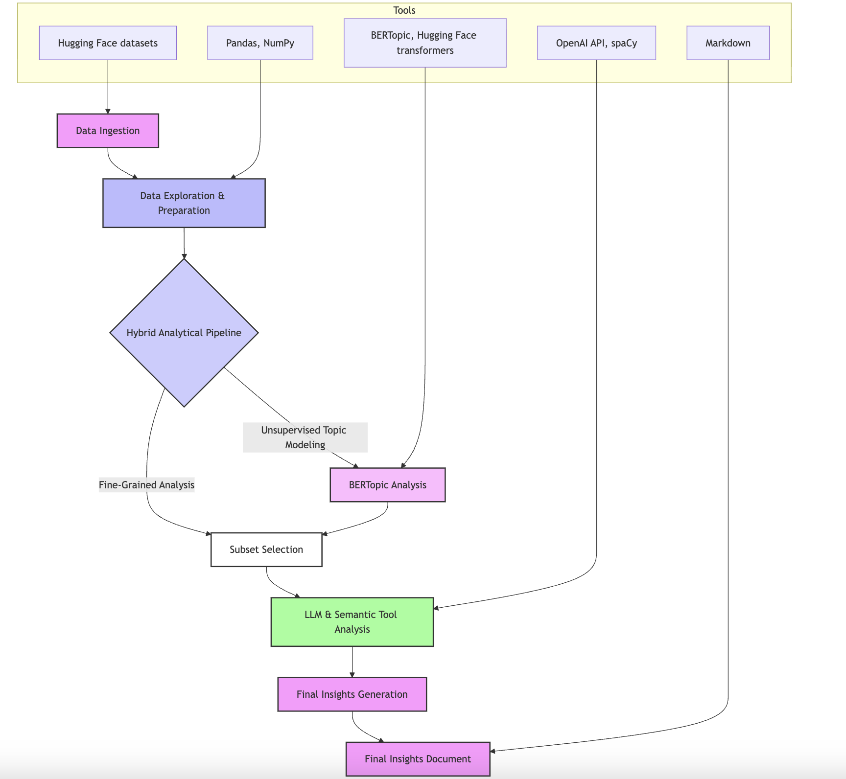

Objectives
A pipeline to addresses the challenge of extracting insights from conversational AI data. Key objectives include:
Analyze Real-World AI Conversations
Ensure Reproducibility
Provide reproducible visuals and queries for consistent analytics workflows
Extract insights from messy, real-world conversational data for brands and products.

Slide 3







Pipeline Overview
Load & Filter
Preprocess
English, non-toxic subset
Clean & normalize text
Topic Modeling
Sentiment Analysis
BERTopic (UMAP + HDBSCAN)
Rule-based + LLM extraction
Synthesis
Entity Clustering
Visualizations
Merge to unified table
Group similar entities
Actionable insights
This pipeline provides a systematic approach to extract structured insights from unstructured conversation data.

Slide 4
Data Sources & Pipeline Order
Data Sources
Order of Operations (Why)
Source: WildChat subset (English, non-toxic)
Preprocess to improve topic quality and reduce noise
Outputs: Nested LLM JSONL, flat entity-level CSV/JSONL
Generate Topics to provide context fields for later analysis
Analysis table: data/04_analysis/unified_table.csv
Rule-based sentiment for complete sentiment features
I focus on English, non-toxic content for US brands to reduce noise, with configurable sample size to balance coverage and computational resources.
LLM extraction to enable per-entity analytics
Synthesis to align all fields into a single table
6. Visualization to provide quick overview of analysis
This order prioritizes data quality and ensures each component has the necessary inputs from previous stages.

Slide 5

Tools & Libraries
Core Technologies
NLP & ML Components
Python 3.13
VADER, TextBlob for rule-based sentiment
pandas for data manipulation
matplotlib, seaborn for visualization
BERTopic for topic modeling
UMAP for dimensionality reduction
numpy for numerical operations
HDBSCAN/KMeans for clustering
Advanced Features
sentence-transformers for embeddings
OpenAI LLM for extraction (intent/entities/sentiment)
asyncio for concurrent processing
scikit-learn for fallback algorithms

Slide 6
Load & Preprocess
Load & Filter
Preprocess
# src/hf_loader.py (lines: 27-44)
ds = load_dataset("allenai/WildChat", split=split, token=token)
df = pd.DataFrame(ds)
mask = (df["language"] == language) & (df["toxic"] == False)
filtered = df.loc[mask]
if limit is not None:
filtered = filtered.head(limit)
# src/text_cleaning.py (lines: 12-20)
s = _URL_RE.sub(" ", s)
s = _KEEP_CHARS_RE.sub(" ", s)
s = _WHITESPACE_RE.sub(" ", s).strip()
s = s.lower()
What we do: Remove URLs, collapse whitespace, keep common punctuation, lowercase, and normalize each conversation turn consistently.
Filters focus on English, non-toxic content with configurable sample size to balance coverage and computational resources.
Why: Improves vectorization and topic stability while reducing noise from junk tokens.

Slide 7
Topics (BERTopic) & Sentiment Analysis
BERTopic Implementation
Rule-based Sentiment
We implement a robust topic modeling pipeline with built-in fallbacks:
We leverage two complementary sentiment analysis approaches:
Remove stopwords to capture meaningful content words
# src/sentiment_rule_based.py (lines: 33-44)
analyzer = SentimentIntensityAnalyzer()
scores = analyzer.polarity_scores(text)
tb = TextBlob(text)
polarity, subjectivity = tb.sentiment
Use MiniLM and UMAP to reduce dimensionality while preserving
structure
Cluster with HDBSCAN (density-based, src/bertopic_pipeline.py
lines 85 - 103)
4. Keep Topic -1 (Other) to preserve uncategorizable documents
5. Use CountVectorizer and c-TF-IDF to get readable topic names
# src/bertopic_pipeline.py (lines 106-148)
try:
topics_eff, probs_eff = topic_model.fit_transform(eff_docs)
except ValueError:
topic_model = build_model(min_df=1, max_df=1.0, ngram=(1, 1))
topics_eff, probs_eff = topic_model.fit_transform(eff_docs)
Why dual methods: VADER and TextBlob provide methodological redundancy, increasing confidence when they agree and highlighting ambiguity when they diverge.
What we compute: VADER produces positive/negative/neutral/compound scores, while TextBlob provides polarity and subjectivity metrics.

Slide 8
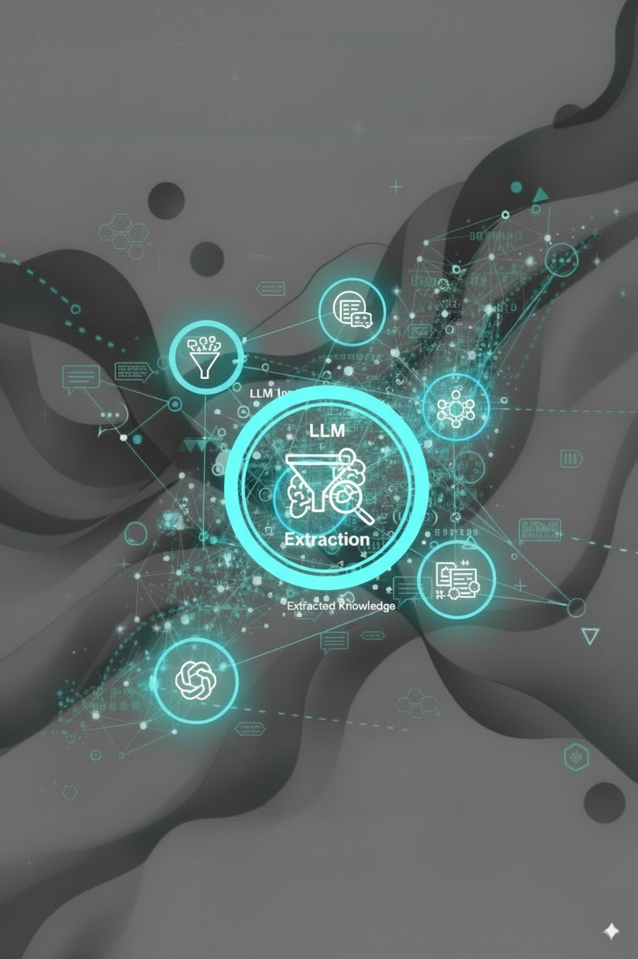
LLM Extraction
Goals & Implementation
Our LLM pipeline extracts conversation intent, entities, entity category, and per-entity sentiment:
Extraction Targets
Overall conversation intent & sentiment
Nested entities with category classification
Per-entity sentiment (may diverge from conversation sentiment)
Performance Optimization
Semaphore-bounded async calls (limit parallel requests)
Add retry/backoff
Progress logging for visibility into long-running jobs
# src/llm_analysis.py (lines: 198-233)
sem = asyncio.Semaphore(concurrency)
async def bound_analyze(r): async with sem: # Controls max concurrent requests
return await _analyze_single_async(client, r, model)

Slide 9
Synthesis & Entity Clustering
Synthesis to Unified Table
Entity Clustering
We merge multiple data streams into a unified analysis table:
Load cleaned full_text
# src/entitiy_clustering.py (lines 37-63)
# Entity clustering fallback pipeline
try:
# HDBSCAN (auto-discovers clusters)
clusterer = hdbscan.HDBSCAN( min_cluster_size=min_cluster_size, metric="euclidean" )
labels = clusterer.fit_predict(embeddings).astype(int)
except:
try: # Fallback 1: KMeans (fixed clusters)
km = KMeans(n_clusters=k, n_init=10, random_state=42)
labels = km.fit_predict(embeddings).astype(int)
except: # Fallback 2: Simple bucketing
labels = np.arange(n, dtype=int) // bucket
Merge doc_topics with human-readable topic names (src/synthesis Lines 79-84)
Merge rule-based sentiment by conversation_id (src/synthesis Lines 96-104)
Merge LLM flat outputs (duplicating rows for per-entity analytics, src/llm_analysis.py
Lines 267 - 306)
Write unified CSV/XLSX for analysis
# src/synthesis.py (lines: 66-132)
base = cleaned_df.merge( doc_topics[["conversation_id","topic_id","topic_name"]], on="conversation_id", how="left")
if not rule_df.empty:
base = base.merge(rule_df, on="conversation_id", how="left")
if not llm_df.empty:
base = base.merge(llm_df, on="conversation_id", how="left")

Slide 10
Visualizations & Performance Optimizations
Visualization Types
Performance Optimizations
Mentions distributions: Entity frequency across conversations
Entity-weighted averages: Sentiment by entity importance
LLM Processing
Co-mention heatmaps: Entity relationships with sentiment coloring
Async with bounded concurrency and retry/backoff logic to maximize throughput while respecting API limits
Conversation sentiment by intent: Emotional patterns by conversation purpose
--max_llm_rows for iteration; --skip_llm to reuse
Robust Fallbacks
HDBSCAN → KMeans → buckets cascading fallbacks ensure the pipeline never fails even with weak data structure
Run the complete pipeline with: python -m src.run_pipeline --limit 1000 --llm_model gpt-4.1-nano --max_llm_rows all --concurrency 1

Slide 11
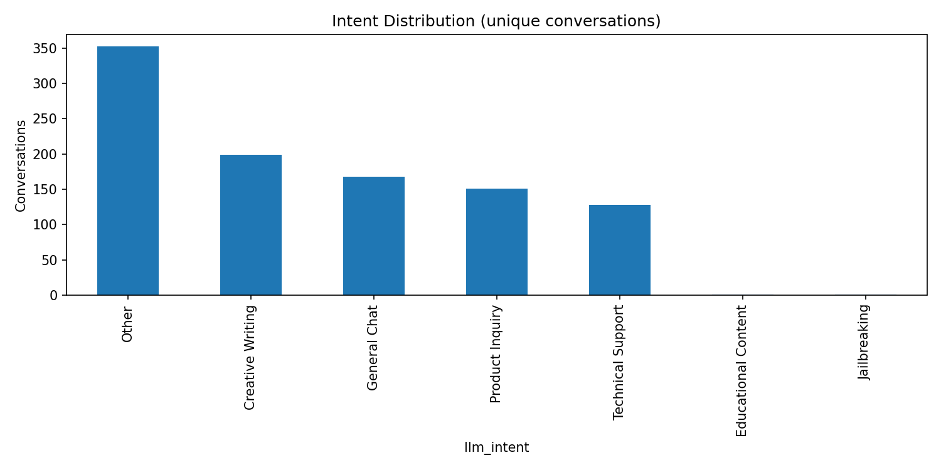
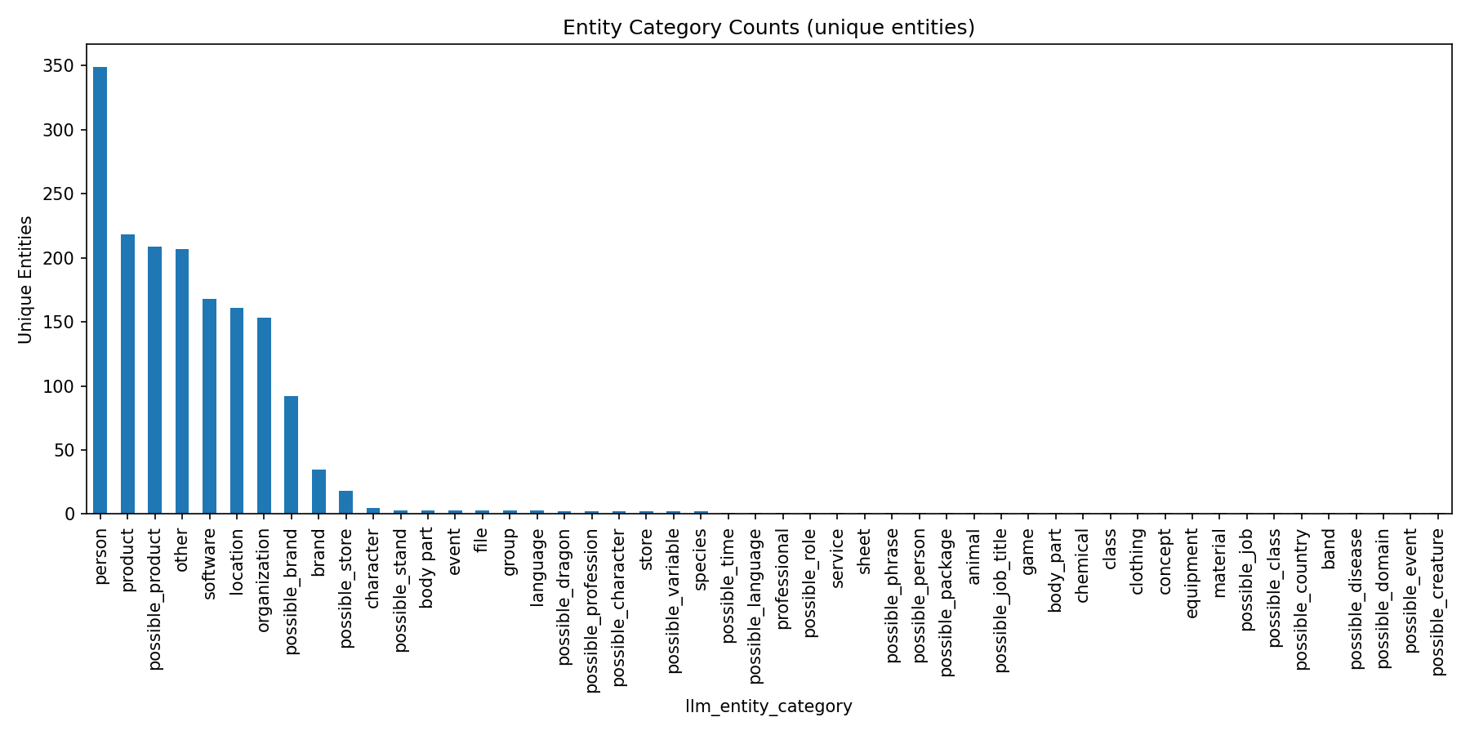
Intent and Entity Distribution Analysis
Intent Distribution
Entity Category Counts
This visualization breaks down conversation by category to reveal topics. Understanding intent distribution helps organize conversations into topics that are more likely to mention product, brands, or stores.
Reveals categories with the highest number of unique entities mentioned, essential for scoping brand/product analytics. For example, in the Software category, mentions of "Nike," "nike," and "adidas" would count as 2 unique entities.
Key insight: Focus resources on categories with high entity diversity to capture competitive intelligence.
Key insight: Identify which conversation categories require immediate attention based on volume and strategic importance.

Slide 12
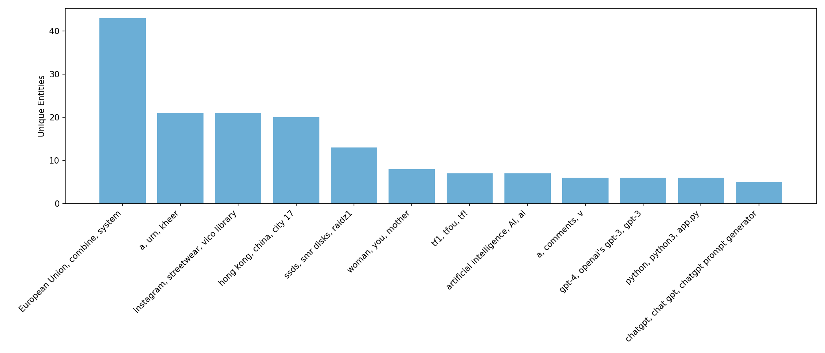
Entity Clustering Analysis
Cluster Formation
Labeled Visualization
Strategic Application
Entities are grouped based on similarity metrics, creating meaningful thematic clusters that reveal related brands, products, or concepts.
The top clusters by number of unique entities are displayed with labels showing normalized names per cluster, making it easy to identify major themes and competitor groups.
Use clusters to track competitive landscapes, identify emerging market segments, and understand how customers group products or services.
Entity Cluster Creation

Slide 13
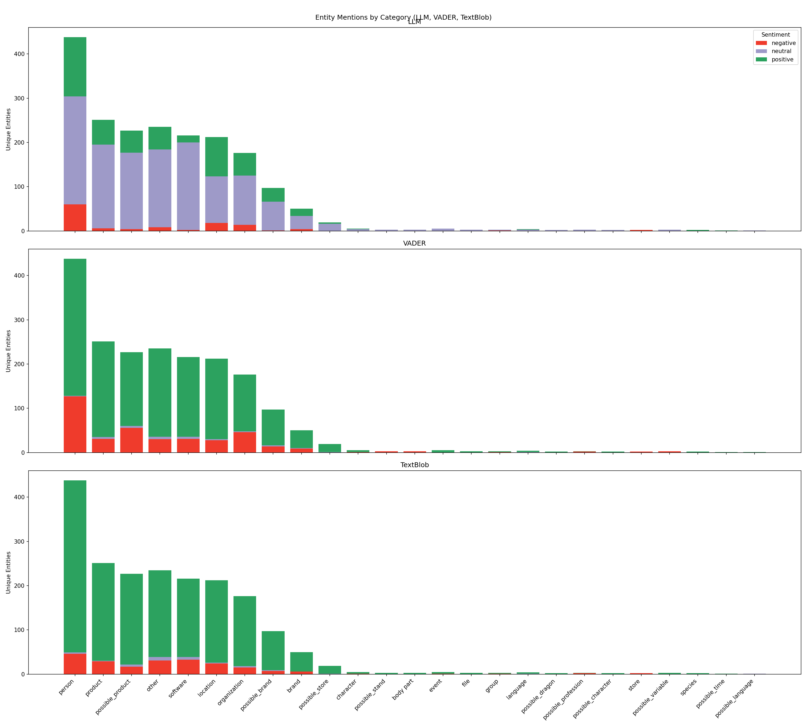
Entity Sentiment by
Category
Frequency-Based Analysis
For each entity category (Brand, Organization, Product, etc.), frequency charts display the distribution of sentiment across three buckets:
Negative: Expressions of dissatisfaction, criticism, or problems
Neutral: Factual references without emotional content
Positive: Expressions of satisfaction, praise, or preference
Important: Mixed sentiment is not averaged. An entity with both positive and negative mentions contributes to both buckets according to mention frequency, preserving the full complexity of sentiment data.
Visualization allows quick identification of categories with disproportionate sentiment patterns requiring deeper investigation.

Slide 14
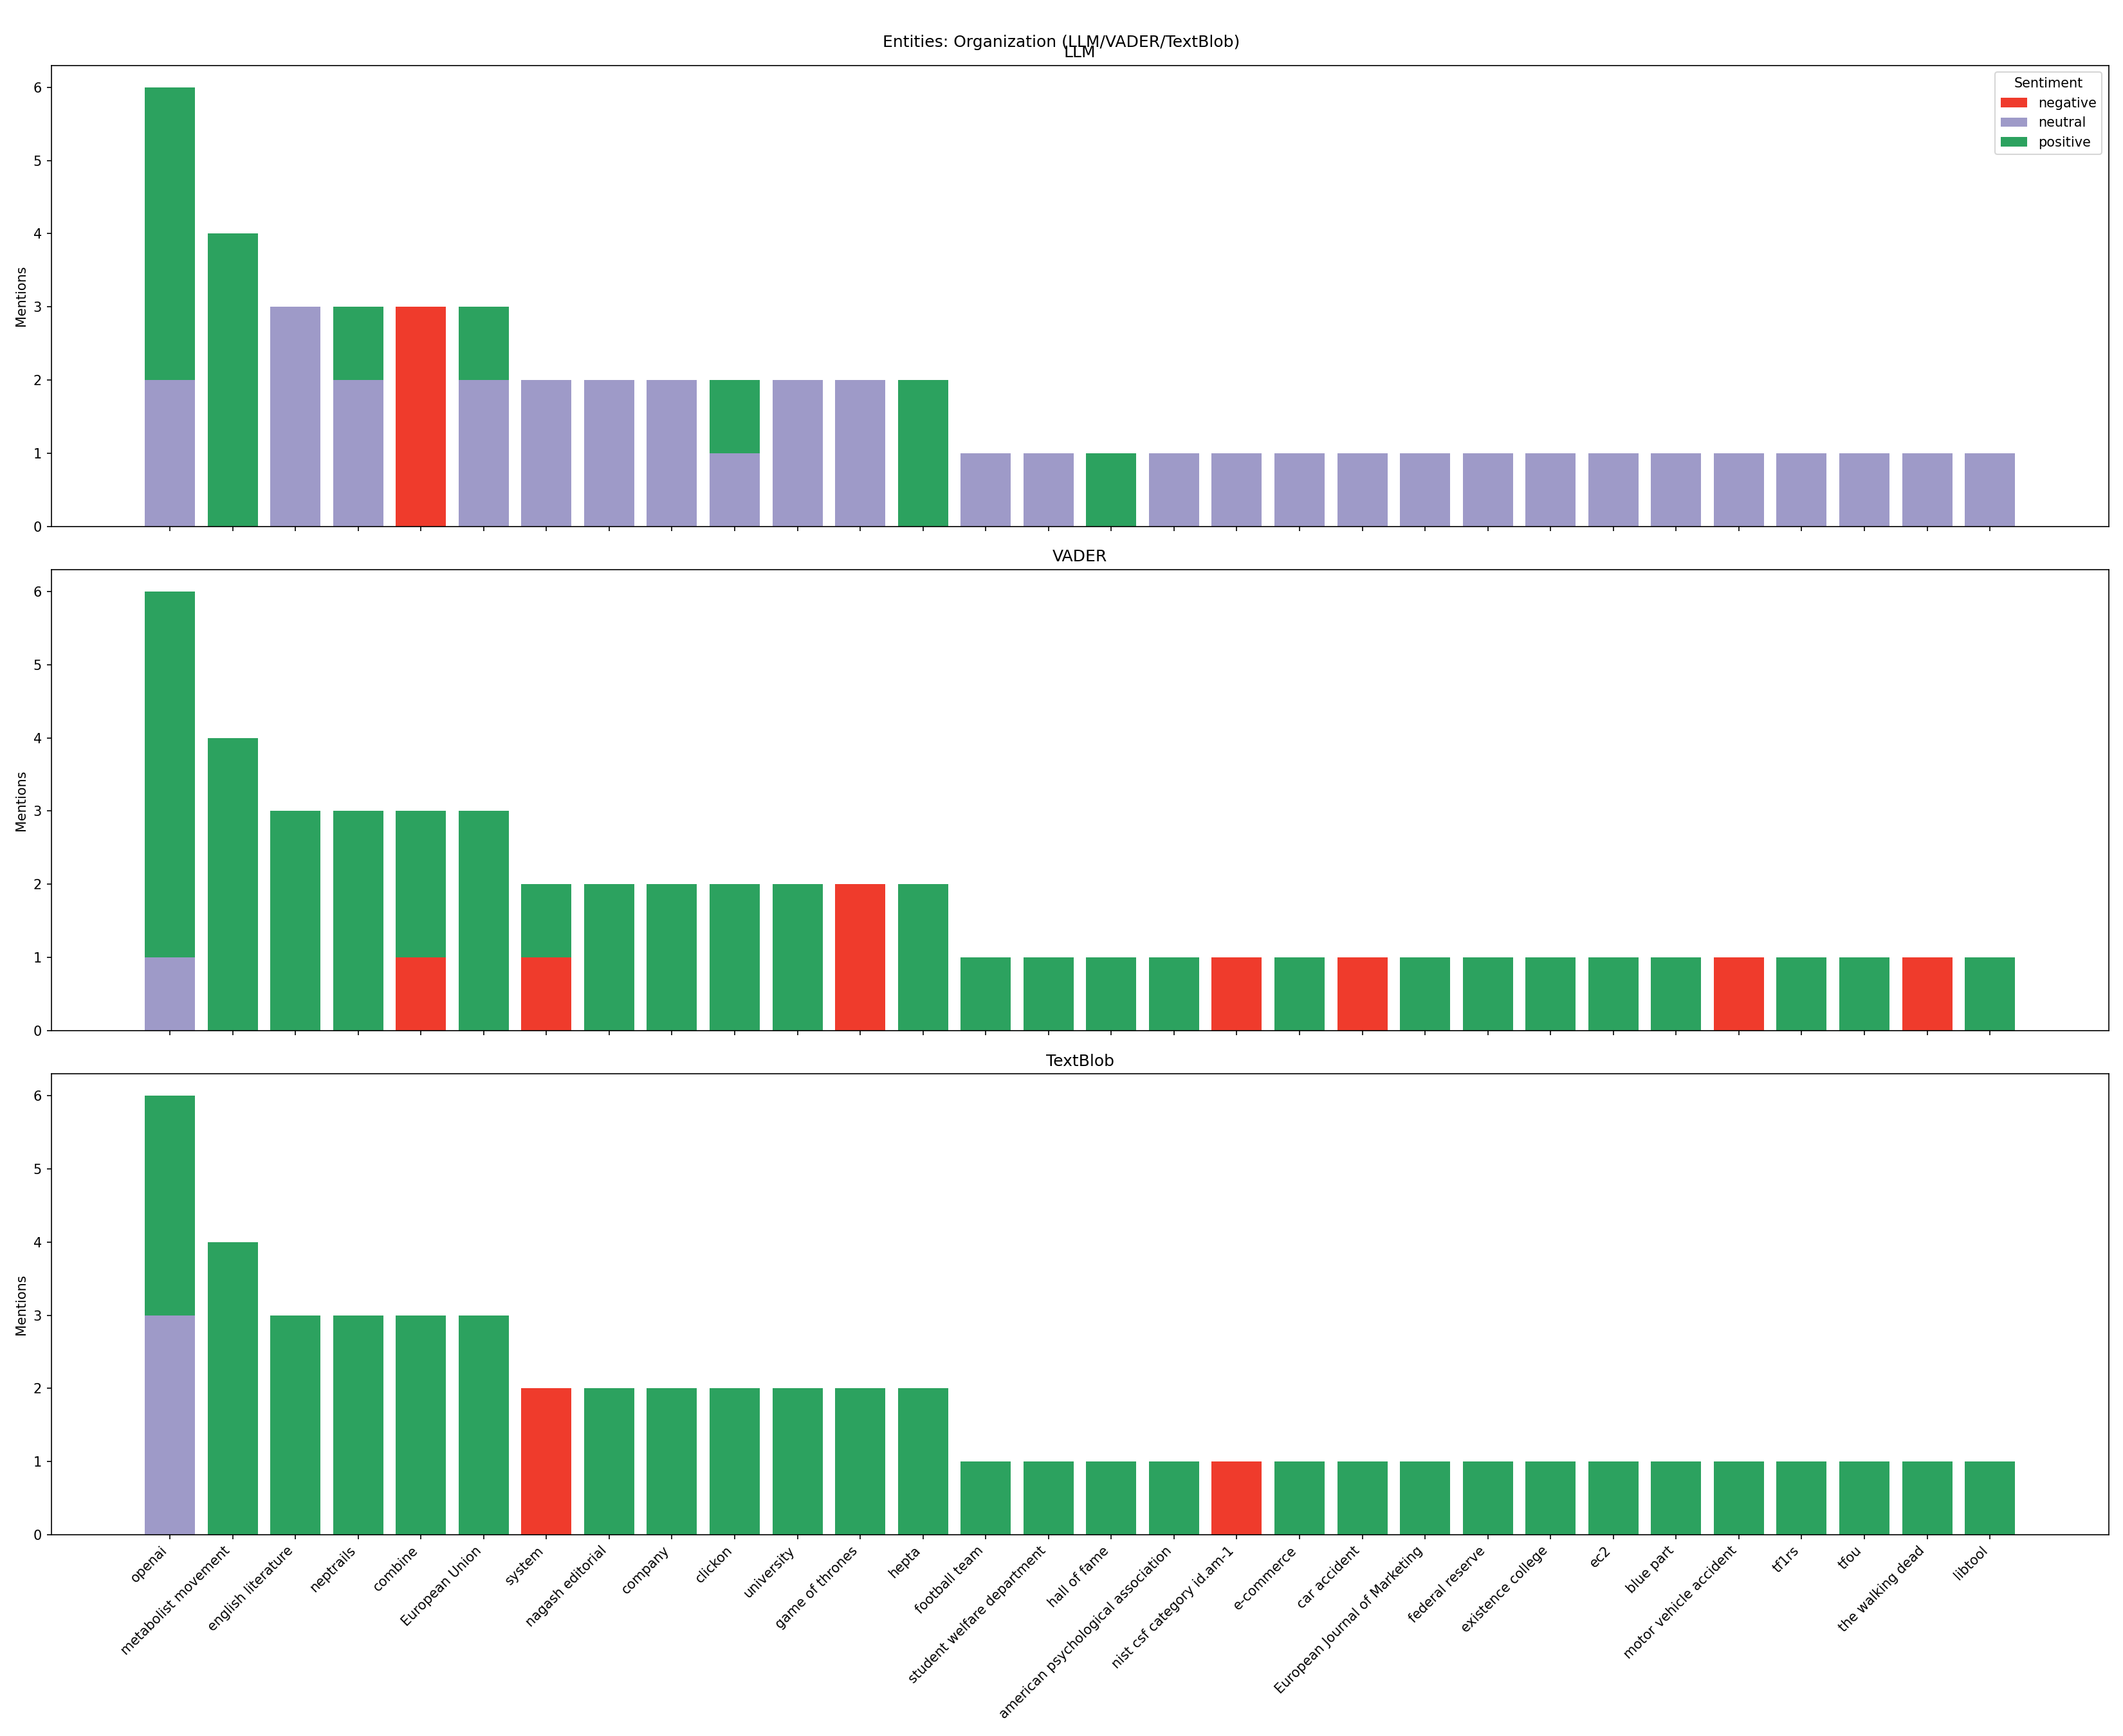
Entity Sentiment Analysis By Organization
Granular Entity-Level Insights
Multi-panel frequency charts for specific categories (Brand, Organization, Possible Store, Product, Possible Brand) reveal sentiment patterns for individual entities:
Each entity's stacked bar shows sentiment distribution across three methods
Strategic application: Compare sentiment profiles between direct competitors to identify competitive advantages and vulnerabilities in customer perception.

Slide 15
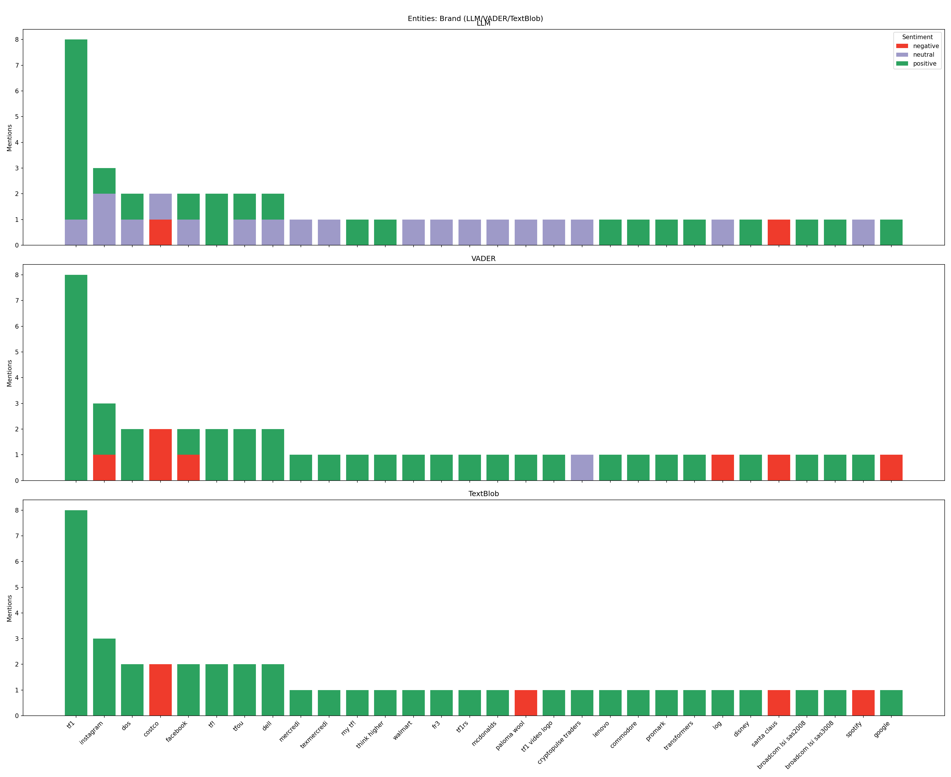
Entity Sentiment Analysis By Brand
Granular Entity-Level Insights
Multi-panel frequency charts for specific categories (Brand, Organization, Possible Store, Product, Possible Brand) reveal sentiment patterns for individual entities:
Each entity's stacked bar shows sentiment distribution across three methods
Strategic application: Compare sentiment profiles between direct competitors to identify competitive advantages and vulnerabilities in customer perception.

Slide 16
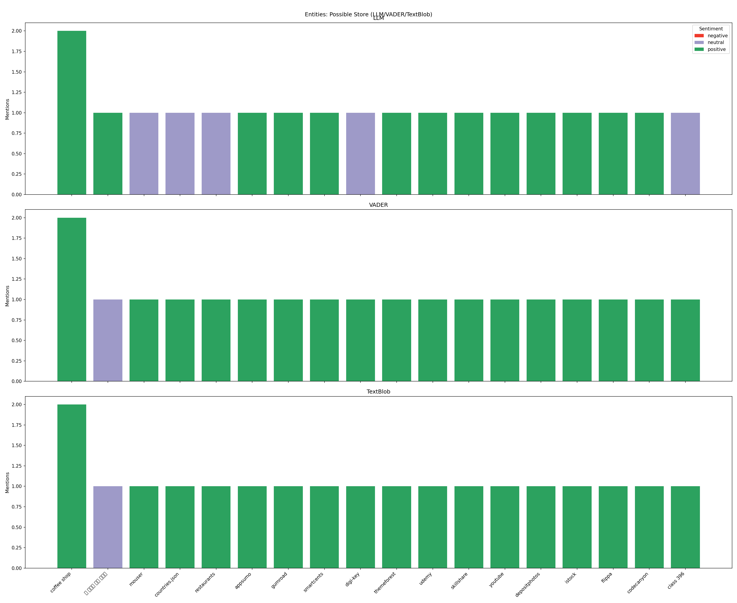
Entity Sentiment Analysis By Possible Store
Granular Entity-Level Insights
Multi-panel frequency charts for specific categories (Brand, Organization, Possible Store, Product, Possible Brand) reveal sentiment patterns for individual entities:
Each entity's stacked bar shows sentiment distribution across three methods
Strategic application: Compare sentiment profiles between direct competitors to identify competitive advantages and vulnerabilities in customer perception.

Slide 17
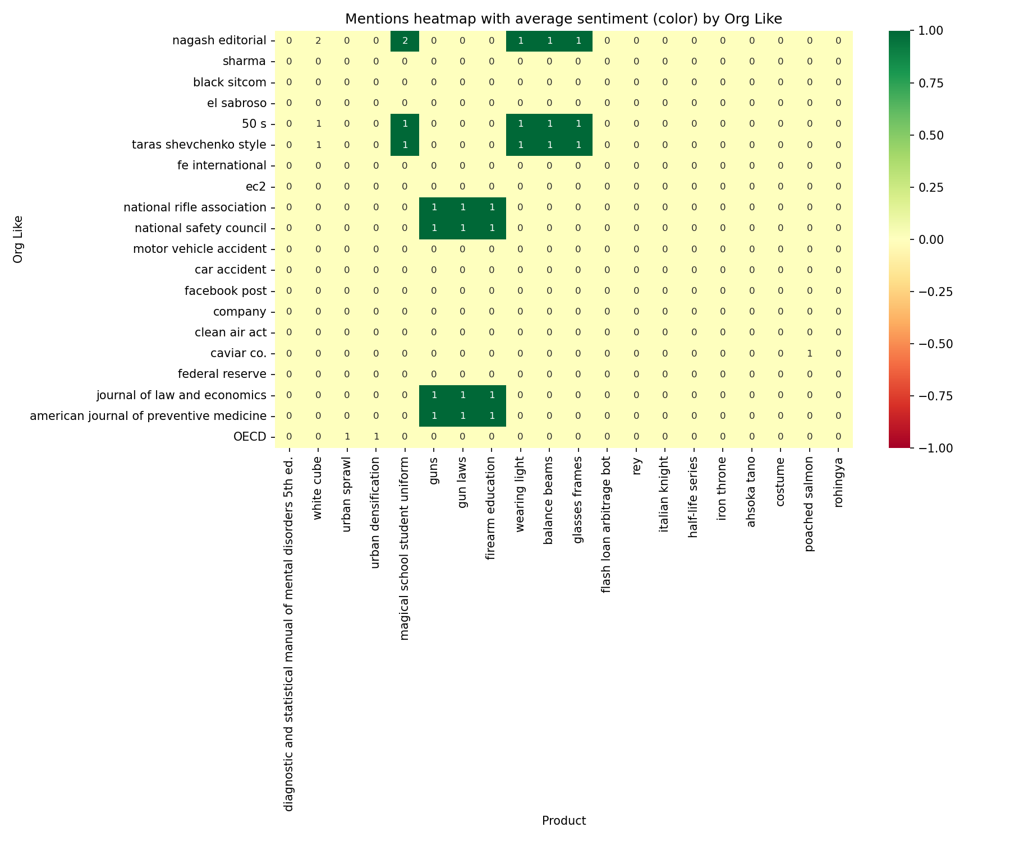
Entity Relationship Heatmaps By Store
Store → Product Mentions
Rows represent top stores.
Columns show top products.
Cells indicate mention counts.
Reveals which products are most frequently associated with specific stores, highlighting strong and weak brand-product associations.
These heatmaps provide critical insights for retail analytics, merchandising decisions, and competitive intelligence. High mention counts with positive sentiment indicate strong market associations.

Slide 18
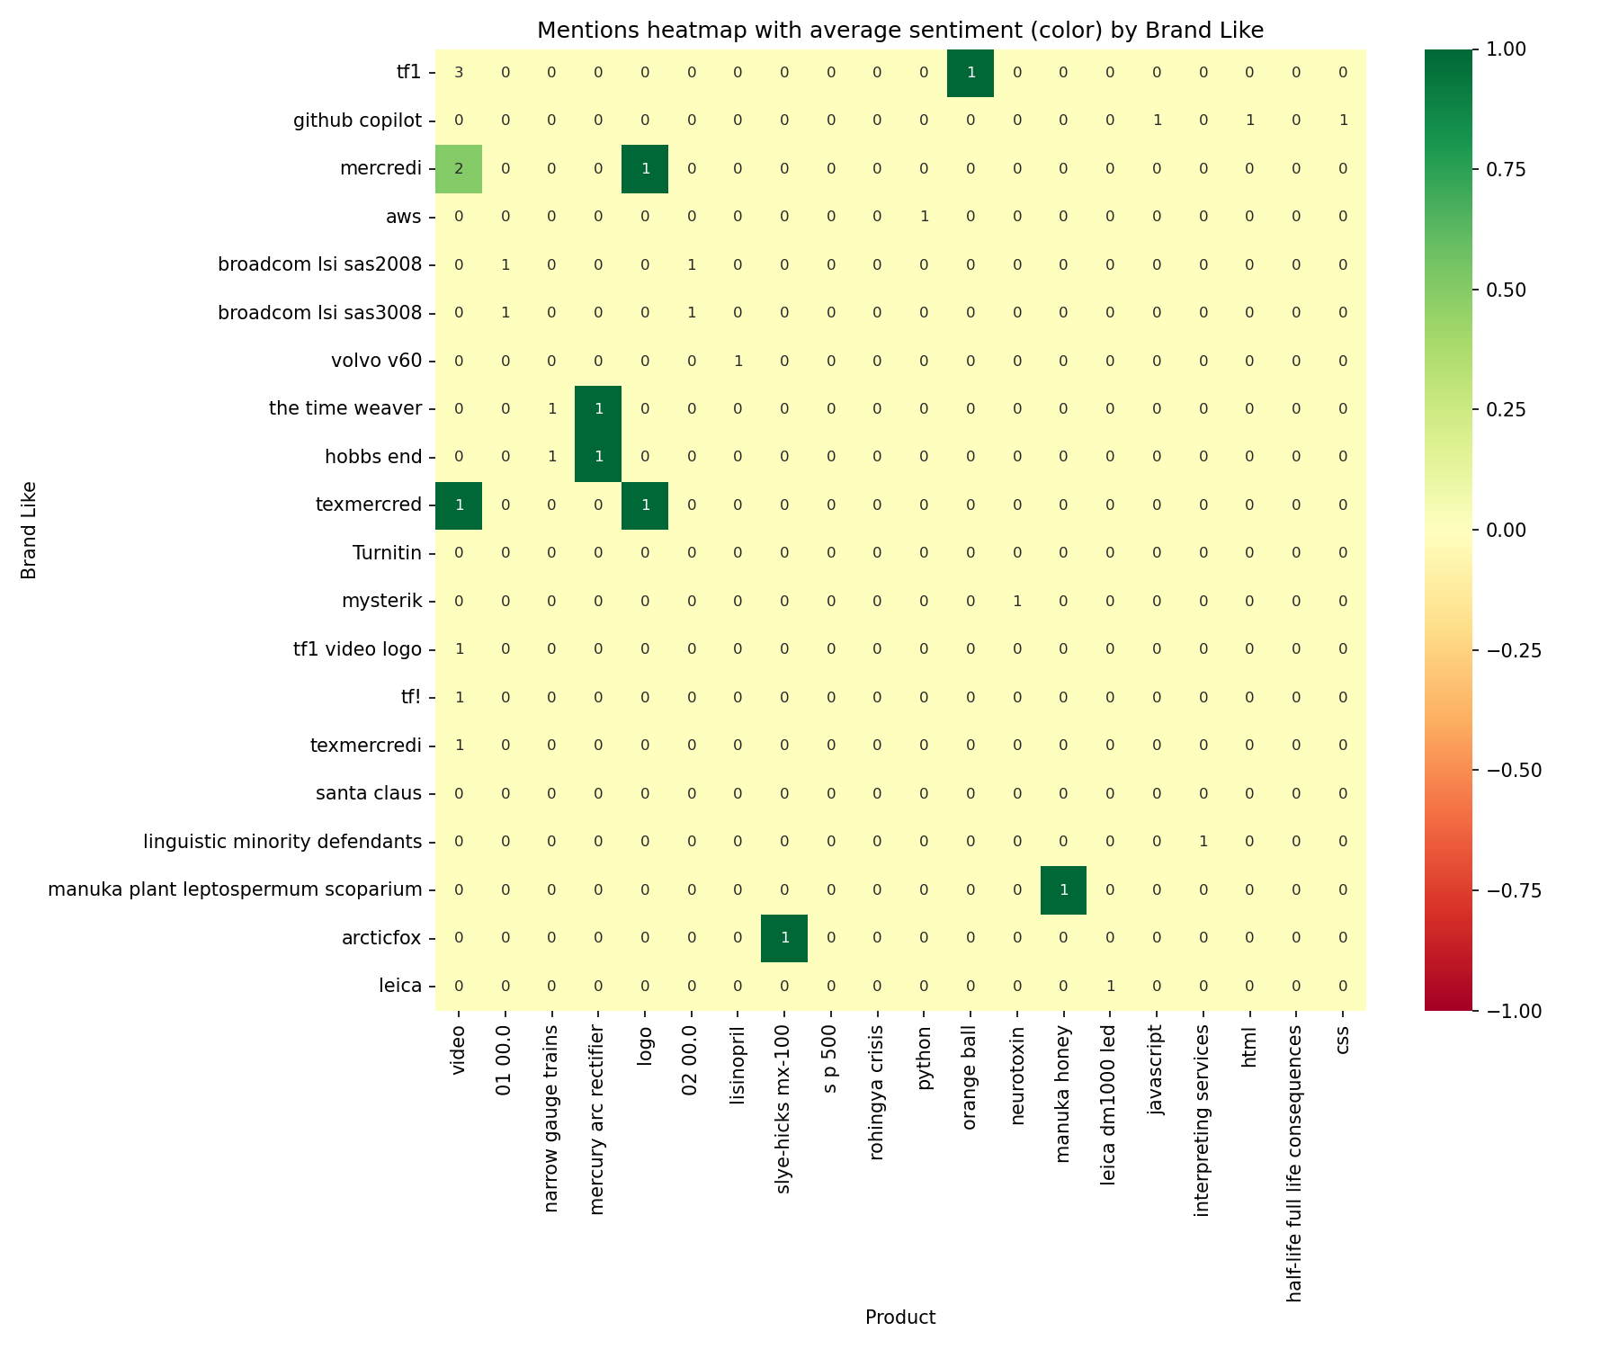
Entity Relationship Heatmaps By Brand
Brand → Product Mentions
Rows represent top brands.
Columns show top products.
Cells indicate mention counts.
Reveals which products are most frequently associated with specific brands, highlighting strong and weak brand-product associations.
These heatmaps provide critical insights for retail analytics, merchandising decisions, and competitive intelligence. High mention counts with positive sentiment indicate strong market associations.

Slide 19
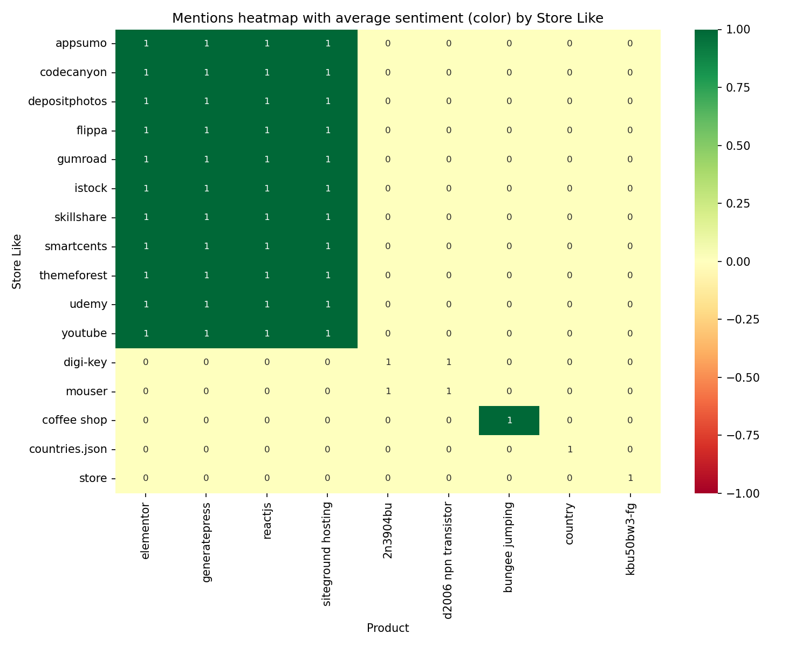
Entity Relationship Heatmaps By Organization
Organization → Product Mentions
Rows represent top organization.
Columns show top products.
Cells indicate mention counts.
Reveals which products are most frequently associated with specific organization, highlighting strong and weak brand-product associations.
These heatmaps provide critical insights for retail analytics, merchandising decisions, and competitive intelligence. High mention counts with positive sentiment indicate strong market associations.

Slide 20
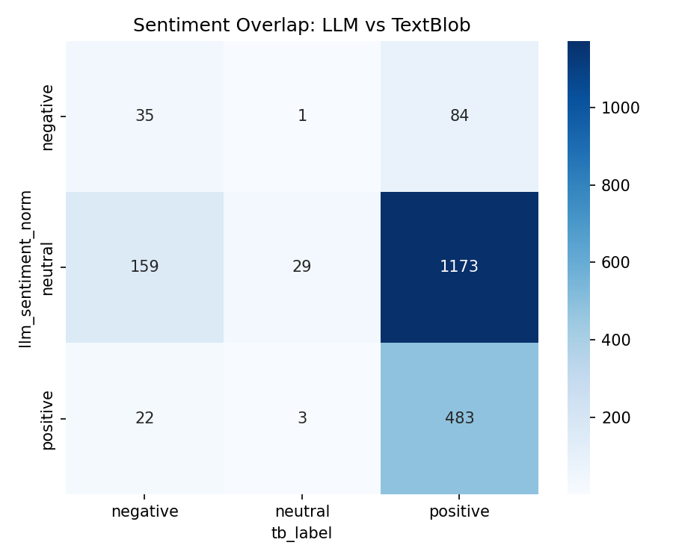
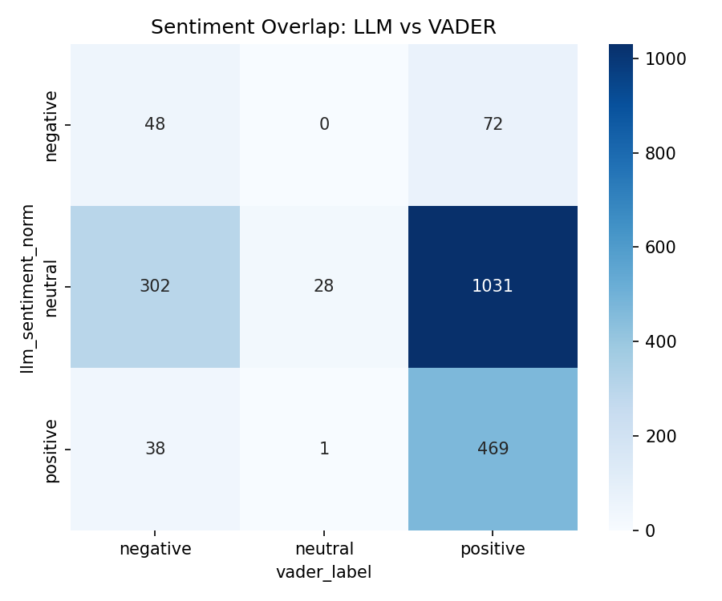
Sentiment Analysis Methodology Comparison
Agreement/Mismatch Matrices
These visualizations quantify how often different sentiment analysis methods agree or disagree on the same conversational data:
LLM vs. VADER comparison matrix
LLM vs. TextBlob comparison matrix
High agreement areas indicate confident sentiment assessment, while discrepancies highlight conversations requiring human review.
Methodology comparison helps calibrate confidence in sentiment analysis and identifies which types of conversations present challenges for automated sentiment detection.
When methods disagree significantly, consider examining raw conversation data to understand contextual nuances that automated systems might miss. These insights can inform ongoing refinement of sentiment analysis approaches.

Slide 21
Future Methodologies
Three Approaches
LLM vs User Comparison
External Entity List/Rag Storage
Multi-Model Extraction
Flatten the AI conversations to separate User chats and LLM responses. Analysis can be done on an LLM perceived perception of a product, store or brand and frequency of recommendation, as well as the corresponding users perceived perception of a product store or brand.
Due to computational limitation this was attempted but not completed
Prime an LLM model with a list of important entities, clients are interested in. Priming a LLM model while extracting will help reduce noise and hallucinations of entities extracted and increase the confidence of the data analysis of the desired target.
Requires outside collaboration to organize a set list.
Use multiple different models for data extraction. Redundancy in multi-model extraction, increases the confidence of the extraction data, while also allowing for analysis of gaps, and optimizations between models.
Requires and analysis of increase in cost, and ground truth accuracy.

