Slide 1
Virtual Private Networks
Group Members
Nitin Chauhan 22
Gurpal Singh 23
Neha Ahuja 24
Prativa Rai 25
Internal Guide: Prof. Ganesh D Bhutkar
Asst. Internal Guide : Prof. B.A. Ghaytidak
External Guide: Mr. Devendra Dharm

Slide 2
What is a VPN?
A Virtual Private Network is a way to simulate a private network over a public network, such as the internet.
Secure virtual connections are created between two machines, a machine and a network or two networks.

Slide 3
VPNs
In a virtual private network (VPN), "virtual" implies that there is no physical network infrastructure dedicated to the private network.
Instead, a single physical network infrastructure is shared among various logical networks.
In VPNs, various networking technologies are applied toward the goal of providing secure private communications within the public Internet infrastructure.

Slide 4
Why VPNs?
Separate private networking solutions are expensive and cannot be updated quickly to adapt to changes in business requirements.
The Internet is inexpensive but does not by itself ensure privacy.
Remote access to the corporate network is required (individual users and business branches)
Connectivity – access can be gained from virtually anywhere

Slide 5
Elements of VPN
Hardware and Software that make VPNs possible
A VPN server is a stand-alone device that enables authorized access to the protected network resources. The resources are not located on the same physical device with the VPN gateway.
A VPN client, on the other hand, is installed on the same network device it is supposed to protect. Usually, the client is a software package installed on the host computer.

Slide 6
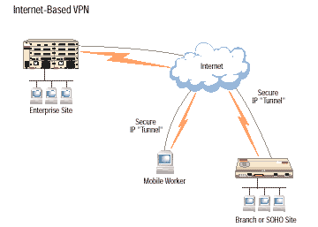
VPN using Internet

Slide 7
How Does VPN work?
VPN Server uses SSH daemon for establishing a connection with the client. SSH allows the server to be accessed by clients by using public and private key.
VPN client should have SSH installed in order to initiates connection.
The Server and Client connects and creates a “tunnel” using SSH in order to transfer the data.

Slide 8
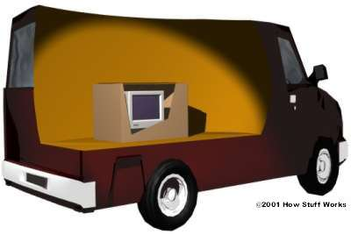
What is SSH?
SSH uses the data packet used inside the network and puts an ssh header on it and gives it same destination address as of the original packet, so that no one can know about the destination of the packet.

Slide 9
SSH server and client use digital signature to verify the identity.
SSH daemon should be running on both the client and server . And should be configured so thet each time client logs on , it doesn’t have to give password.

Slide 10
VPN Technology
Tunneling – using encapsulation
Authentication
Access Control
Data Security

Slide 11
Tunneling
Most VPNs rely on tunneling to create a private network that reaches across the Internet. Essentially, tunneling is the process of placing an entire packet within another packet and sending it over a network.
Tunneling requires three different protocols:
Carrier protocol - The protocol used by the network that the information is traveling over
Encapsulating protocol - The protocol ( IPSec, SSH,L2F, PPTP, L2TP) that is wrapped around the original data
Passenger protocol - The original data (IPX, NetBeui, IP) being carried

Slide 12
VPN Security
Firewalls - A firewall provides a strong barrier between your private network and the Internet. You can set firewalls to restrict the number of open ports, what type of packets are passed through and which protocols are allowed through.
Encryption - This is the process of taking all the data that one computer is sending to another and encoding it into a form that only the other computer will be able to decode.
- Symmetric-key encryption
- Public-key encryption

Slide 13
Advantages
wider coverage compared with the private data network infrastructures offered by telecommunication providers.
Leased lines are not used , so cost is reduced upto 60-70%.
VPNs provide both interconnectivity and security.
No need for static IP address.Works fine with dialup connection.

Slide 14
Drawbacks
Problem in getting public keys securely from new roaming clients.
When network load gets high, one tunneled TCP connection tends to get all the bandwidth and the others get ignored. This leads to timeouts and dropped connections.

Slide 15

Remember… somebody may be watching you!

