Slide 1
Technical Academy – Single page applications
13/12/2016

Slide 2
Content
Part I
Introduction
SPA vs Server generated pages
SPA Frameworks
Angular 2
Demo
Questions
Part II
(Optional) Hands on session

Slide 3
Part I
Introduction
SPA vs Server generated pages
SPA Frameworks
Angular 2
Demo
Questions

Slide 4
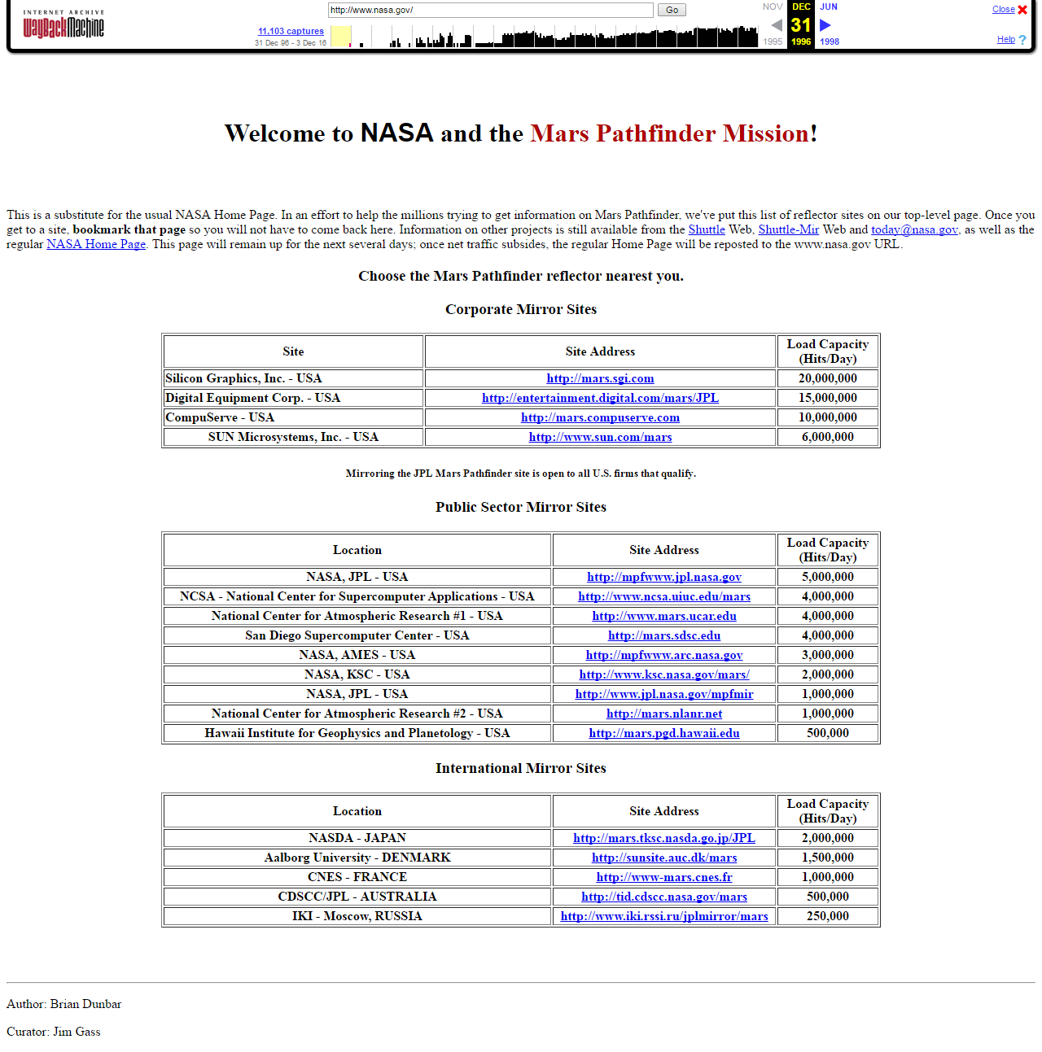
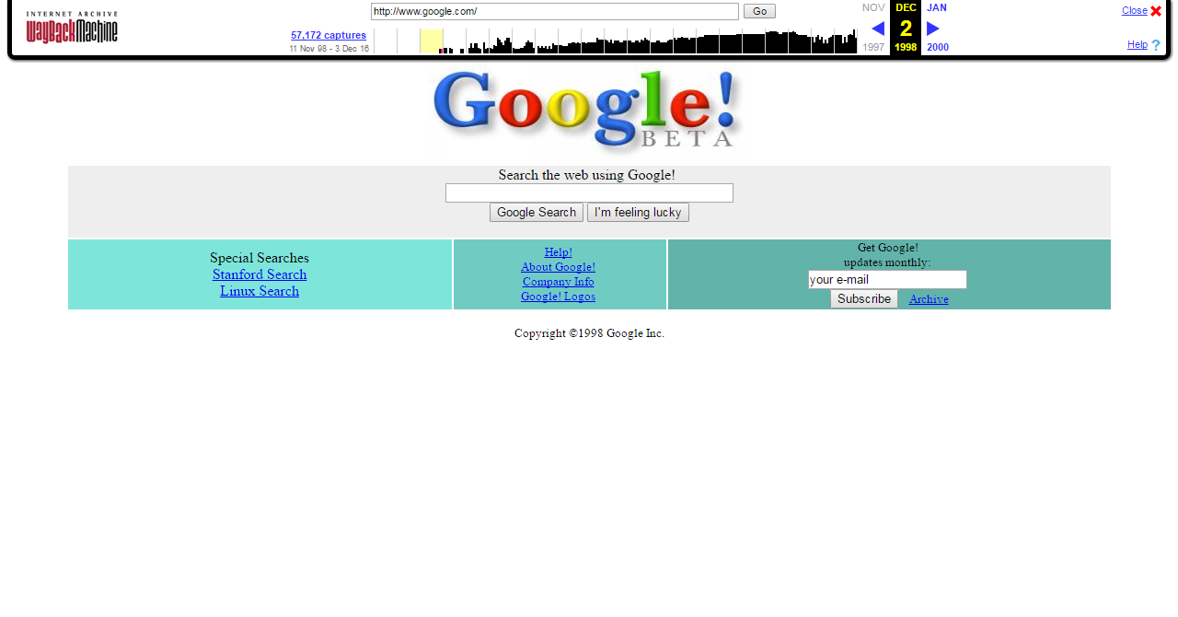
Introduction: Evolution of web
Web 1.0 (Static)

Slide 5
Introduction: Evolution of web
Web 2.0 (Interactive)
user-generated content
usability (ease of use, even by non-experts)
interoperability (interaction different systems)
Web standards (HTML, CSS, Javascript, JSON, etc..)
user input (data)
Blogs
Social networks
E-banking, etc…
Rich user experience

Slide 6
Introduction: Evolution of web
Web 3.0 (Intelligent)
Ubiquitous Connectivity (Mobile)
Data mining, machine learning
Open standards and APIs
Distributed systems and micro services

Slide 7
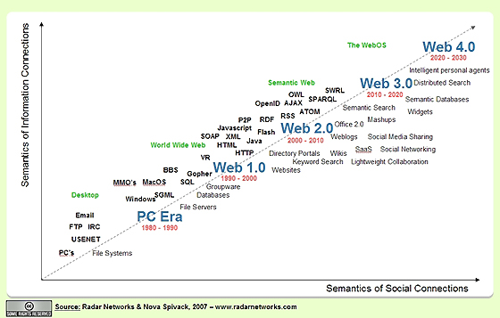
Introduction: Evolution of web

Slide 8
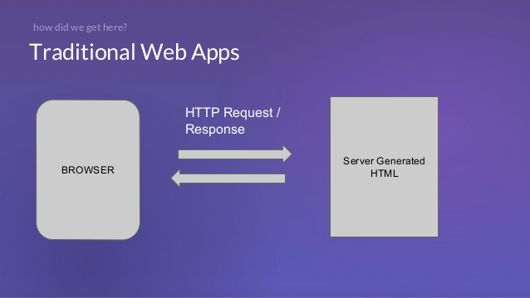
SPA vs Traditional Web Apps
Template based
Data & page
~Dynamic

Slide 9
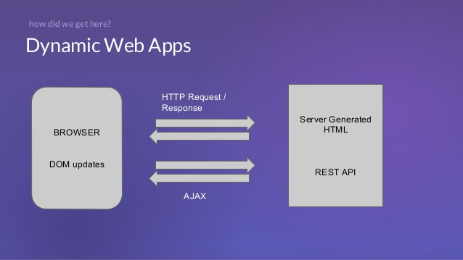
SPA vs Traditional Web Apps
Slow

Slide 10
SPA vs Traditional Web Apps
Slow

Slide 11
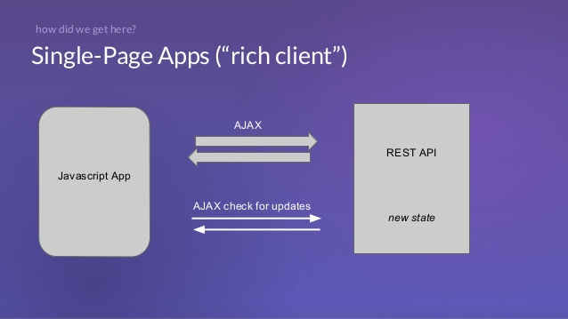
SPA vs Traditional Web Apps
Exchange of data only => ~native apps

