Slide 1
Website, Climate Data, and Real Time Processing
31 Oct 2019
@akrherz

Slide 2
Breadth of Processing
483,637 hillslopes
4,299 HUC12s covered
257,075 climate files
Climate files are provided on a 0.01 x 0.01 degree analysis grid, so some spatially close hillslopes share a single climate file
Presently producing yesterday’s estimates at ~4:30 AM each morning

Slide 3
Computing Hardware
RAID1 2TB SATAIII SSD provides small flat file storage
RAID10 900GB 12Gb/s SAS SSD provides PostgreSQL 12 database
Compute cluster
(1) Dell PowerEdge R820 (4 processor Xeon) does much of the heavy lifting
(10) Dell PowerEdge R410 (2 proc Xeon) help with WEPP run
(1) Dell PowerEdge R420 (2 proc Xeon) help with WEPP runs
Climate file processing is chunked into 2x2 degree tiles
WEPP jobs are distributed via RabbitMQ to ~60 workers

Slide 4
Computing Software
Generally a Python 3 stack
Github code projects https://github.com/dailyerosion
“dep” -> real time execution, WEPP mods
“depmap” -> website map application
“depbackend” -> API services for the map and others

Slide 5
Daily Processing Timeline
Start Time | Job
12:53 AM | Wake up and edit climate files (~35 minutes)
~1:30 AM | Proctor script enqueues hillslope tasks into RabbitMQ and runs made (~2.5 hours, ~ 60 WEPP runs per second).
~4:00 AM | Post-process the WEPP output files into the database (~30 minutes)
~4:30 AM | Spam twitter with post including summary image of results, wait for @realDonaldTrump to retweet the post. Done.
5:30 AM | Daryl awakens to see what fun failure may have happened with the above.

Slide 6
Climate File Generation
File every 0.01 x 0.01 degrees lat/lon for where we have hillslopes to model.
File every 0.25 x 0.25 degrees for land points “East of the Rockies, Hello.”
for future domain expansion.
Variable | Source
Max/Min Air Temperature | 0.125 deg grid analysis of airport weather stations
Average Dew Point | 0.125 grid, IEM computed average of airport stations
Average Wind Speed and Direction | 0.125 grid of airport stations, vector averaged direction
Total Solar Radiation | 0.125 sampled analysis of hourly 3km HRRR analysis
Precipitation | 0.01 grid of MRMS, Stage IV, NEXRAD Mosaics, and PRISM oh my. 2 minutes resolution in time.

Slide 7
Precipitation Acronym Soup
 | Spatial | Time
MRMS RADAR-Only | 0.01 deg | 2 minute | Realtime
IEM NEXRAD Mosiac | 0.005 deg | 5 minute | Realtime
MRMS Guage-Corr | 0.01 deg | Hourly | Hour + lag
NCEP Stage IV hourly | ~4km | Hourly | < Hour lag
NCEP Stage IV “daily” | ~4km | 12 UTC – 12 UTC | N/A for real time
PRISM | 0.04 deg | ~7 AM – 7 AM local | N/A for real time
Disparate data requires desperate measures!

Slide 8
10,000 foot summary of precipitation
MRMS “RADAR –Only” and NEXRAD Mosaic are providing the “wave form” of precipitation intensity over a given hour.
Whatever presently available 24 hour precip totals (Stage IV / PRISM) are used to bias correct the hourly totals.
Whatever presently available higher quality control hourly totals bias correct the sub-hourly intensities.
Reprocessing occurs days later once more data is available for usage.

Slide 9
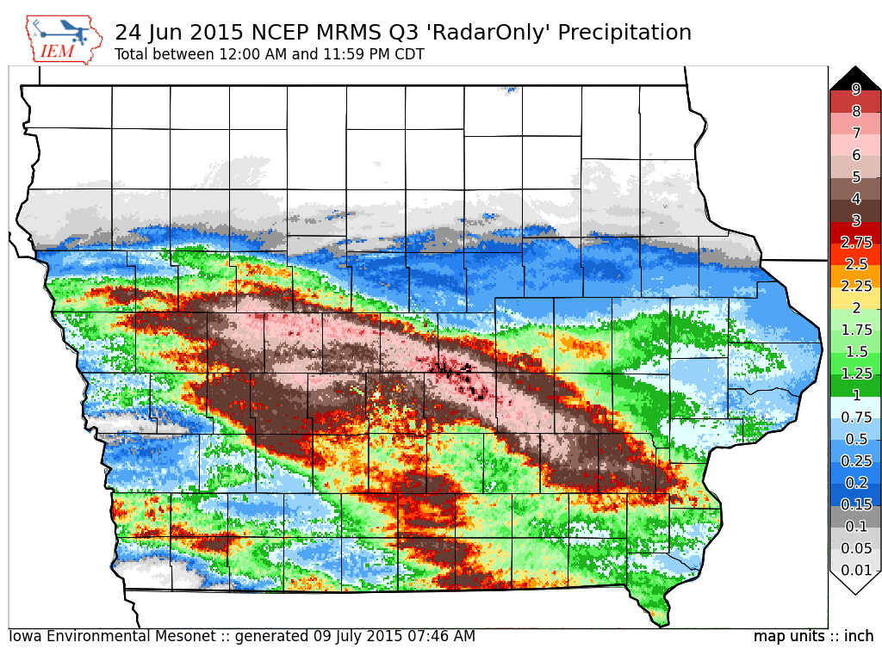
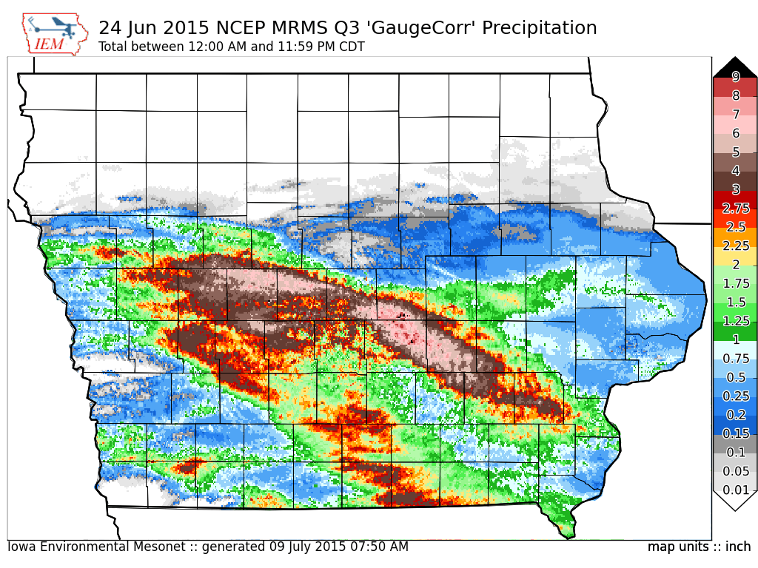
Enough Text, more Pictures Please

Slide 10
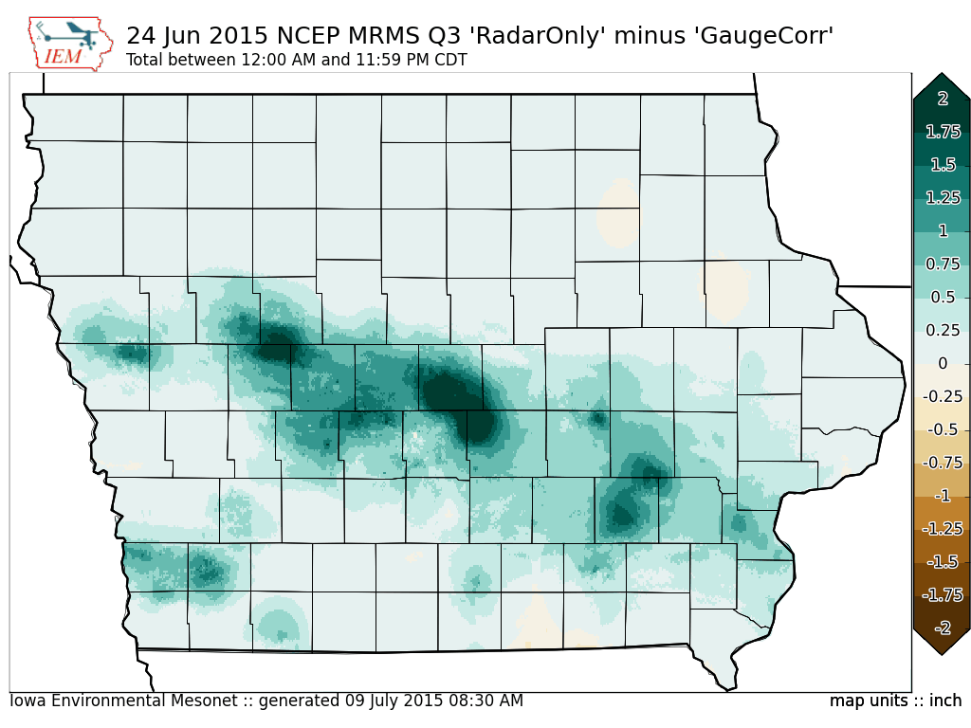
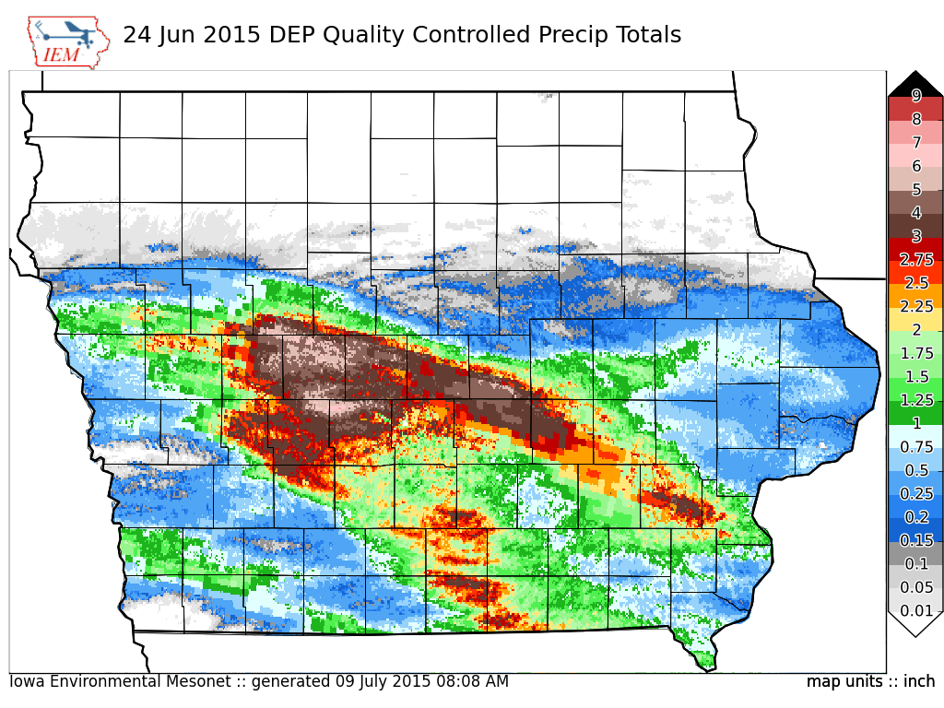
Enough Text, more Pictures Please

Slide 11
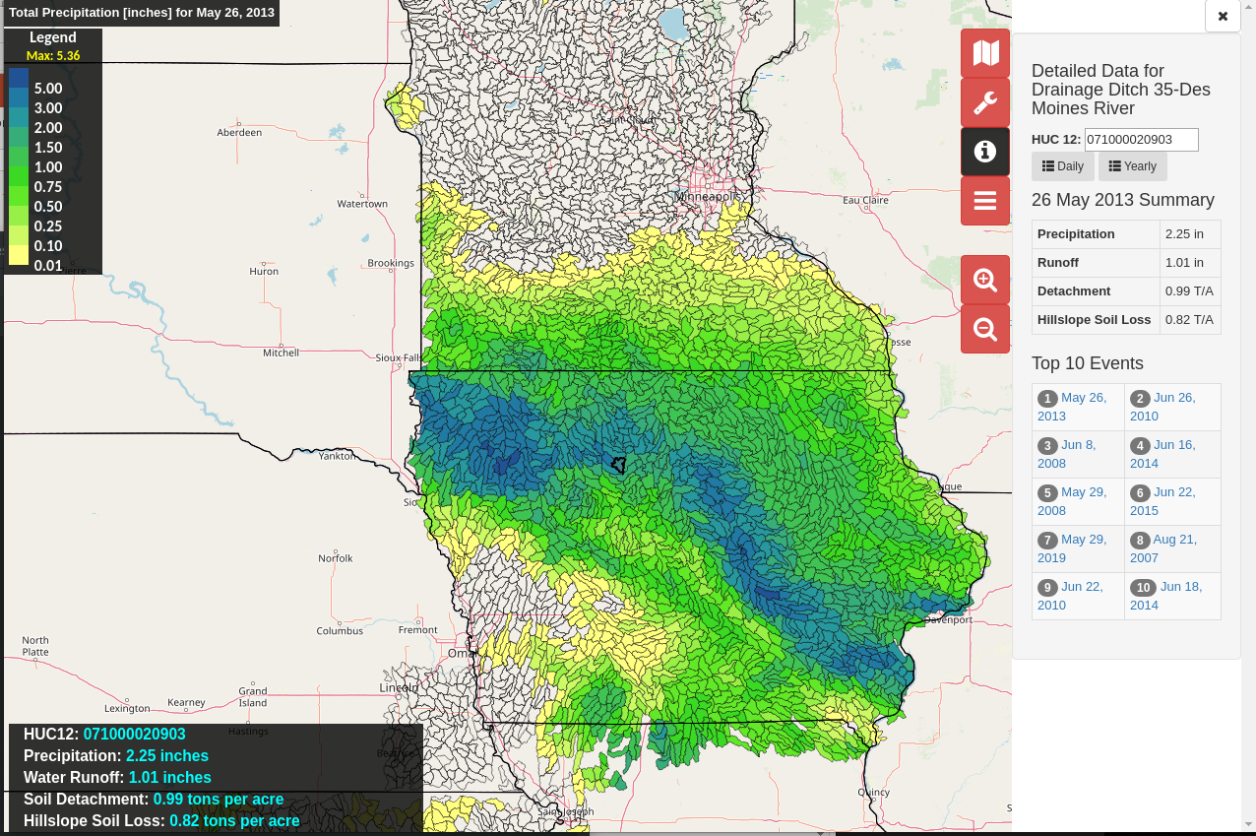
Dailyerosion.org/map/
Openlayers based slippy map
GeoJSON provided HUC12 data via web service
On-the-fly aggregation in time
Version 2 of map will be using mapbox-gl and have new UI layout

