Slide 1

The illusion of Storm Based Warnings
Daryl Herzmann
Iowa State University

Slide 2
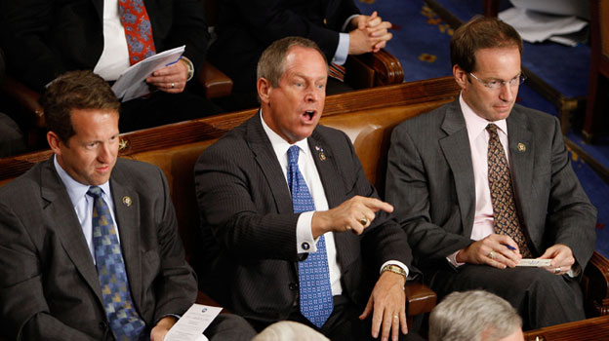
Don’t agree with something you see? Do what this guy did!
I’ll act indignant and ignore you.

Slide 3

Why am I so bitter?
Old Age
The calendar says 2011, our NWS is stuck in 1970s technology (ASCII Text)
Too many warnings are issued. Do you know how many?

Slide 4
NWS County SVR/TOR Warnings
Storm Based Warnings
NEXRAD

Slide 5
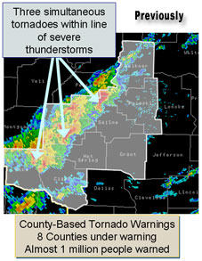
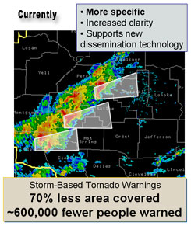
1 Oct 2007, warnings changed
http://www.weather.gov/sbwarnings/
“Storm-Based Warnings show the specific meteorological or hydrological threat area and are not restricted to geopolitical boundaries.”

Slide 6
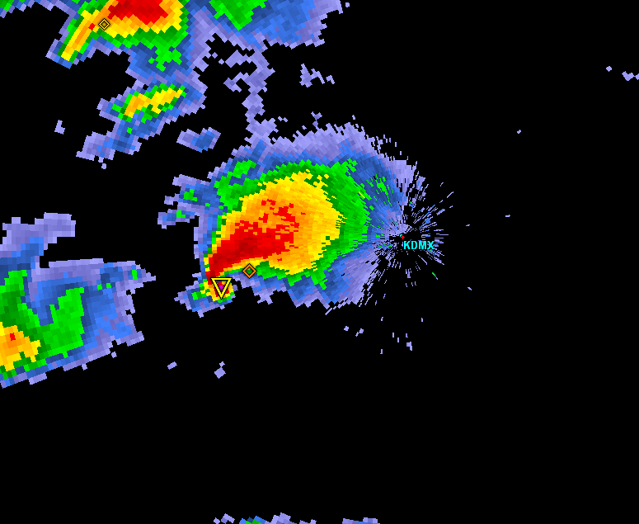
Warning Process Evaluation
Garden Variety Tornado
We had better warn.

Slide 7
Warning Process Evaluation
Yippee, we can use our fine education and draw a polygon!

Slide 8
Warning Process Evaluation
I draw my fancy pants polygon out for 30 minutes.
I’m done, right?

Slide 9
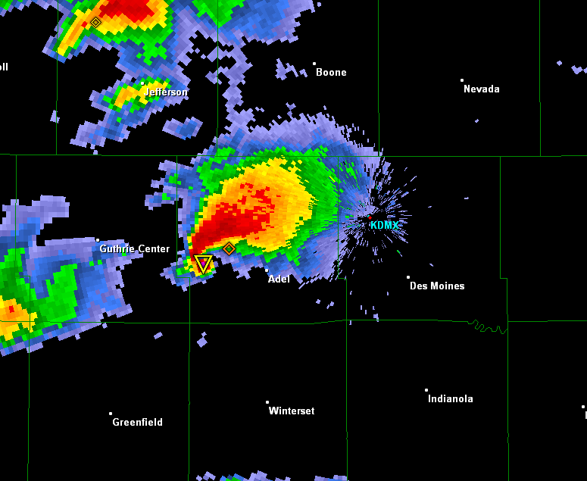
daryl’s here
Warning Process Evaluation
Gasp, I’m warning for 5 counties! Sirens will go off
In all 5!

Slide 10
daryl’s stays asleep
Warning Process Evaluation
WarnGen clipping to the rescue!

Slide 11
Warning Process Evaluation
Whoa, what happened?

Slide 12


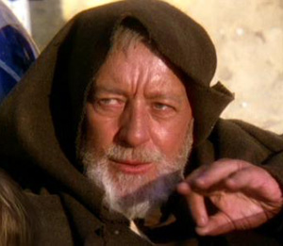
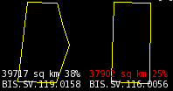
These aren’t the polygons you’re looking for
(Maryland == 26,000 sq km)

Slide 13
Ye ole text product You can’t read this, nor can the public!
291
WUUS53 KDMX 182302
SVRDMX
IAC007-117-125-135-181-182345-
/O.NEW.KDMX.SV.W.0171.100618T2302Z-100618T2345Z/
BULLETIN - IMMEDIATE BROADCAST REQUESTED
SEVERE THUNDERSTORM WARNING
NATIONAL WEATHER SERVICE DES MOINES IA
602 PM CDT FRI JUN 18 2010
THE NATIONAL WEATHER SERVICE IN DES MOINES HAS ISSUED A
* SEVERE THUNDERSTORM WARNING FOR...
NORTHWESTERN APPANOOSE COUNTY IN SOUTH CENTRAL IOWA...
NORTHEASTERN LUCAS COUNTY IN SOUTH CENTRAL IOWA...
SOUTHWESTERN MARION COUNTY IN SOUTH CENTRAL IOWA...
MONROE COUNTY IN SOUTH CENTRAL IOWA...
SOUTHEASTERN WARREN COUNTY IN SOUTH CENTRAL IOWA...
* UNTIL 645 PM CDT
* AT 600 PM CDT...NATIONAL WEATHER SERVICE DOPPLER RADAR INDICATED A
SEVERE THUNDERSTORM CAPABLE OF PRODUCING GOLF BALL SIZE HAIL...AND
DAMAGING WINDS IN EXCESS OF 60 MPH. THIS STORM WAS LOCATED 10
MILES NORTHEAST OF CHARITON...OR 36 MILES SOUTHEAST OF DES
MOINES...AND MOVING SOUTHEAST AT 30 MPH.
* LOCATIONS IMPACTED INCLUDE...
ALBIA...RUSSELL...MELROSE AND LOVILIA.
PRECAUTIONARY/PREPAREDNESS ACTIONS...
MOVE TO AN INTERIOR ROOM AND STAY AWAY FROM WINDOWS. IF YOU ARE IN A
MOBILE HOME...GET OUT NOW...AND SEEK SHELTER IN A REINFORCED
BUILDING.
A TORNADO WATCH REMAINS IN EFFECT FOR THE WARNED AREA. SEVERE
THUNDERSTORMS CAN PRODUCE TORNADOES WITH LITTLE OR NO WARNING. IF A
TORNADO IS SPOTTED...IMMEDIATELY MOVE TO THE BASEMENT OR SMALL
INTERIOR ROOM OF A REINFORCED BUILDING.
TORRENTIAL RAINFALL IS ALSO OCCURRING WITH THIS STORM...AND MAY LEAD
TO FLASH FLOODING. DO NOT DRIVE YOUR VEHICLE THROUGH FLOODED
ROADWAYS. TURN AROND DON'T DROWN.
&&
LAT...LON 4089 9310 4090 9310 4090 9313 4112 9357
4116 9357 4116 9358 4135 9335 4105 9272
4084 9301
TIME...MOT...LOC 2302Z 300DEG 28KT 4114 9321
WIND...HAIL 60MPH 1.75IN
$$
SMALL

Slide 14
Confusion
UGC Code says we have 5 full counties
IAC007-117-125-135-181-182345-
/O.NEW.KDMX.SV.W.0171.100618T2302Z-100618T2345Z/
The product text gives 4 partial counties, 1 full one:
* SEVERE THUNDERSTORM WARNING FOR...
NORTHWESTERN APPANOOSE COUNTY IN SOUTH CENTRAL IOWA...
NORTHEASTERN LUCAS COUNTY IN SOUTH CENTRAL IOWA...
SOUTHWESTERN MARION COUNTY IN SOUTH CENTRAL IOWA...
MONROE COUNTY IN SOUTH CENTRAL IOWA...
SOUTHEASTERN WARREN COUNTY IN SOUTH CENTRAL IOWA..
Yet the official warning is actually for:
LAT...LON 4089 9310 4090 9310 4090 9313 4112 9357
4116 9357 4116 9358 4135 9335 4105 9272
4084 9301

Slide 15
Quiz Question #1 How do you cancel a portion of the warning?
Answer: Cancel one of the counties in the warning!
IAC181-182341-
/O.CAN.KDMX.SV.W.0171.000000T0000Z-100618T2345Z/
...THE SEVERE THUNDERSTORM WARNING FOR SOUTHEASTERN WARREN COUNTY IS
CANCELLED...
IAC007-117-125-135-182345-
/O.CON.KDMX.SV.W.0171.000000T0000Z-100618T2345Z/
...A SEVERE THUNDERSTORM WARNING REMAINS IN EFFECT FOR SOUTHWESTERN
MARION...MONROE...EASTERN LUCAS AND NORTHWESTERN APPANOOSE COUNTIES
UNTIL 645 PM CDT...

Slide 16
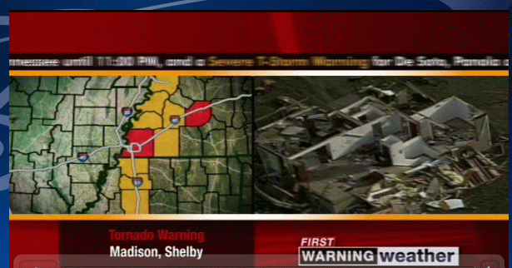
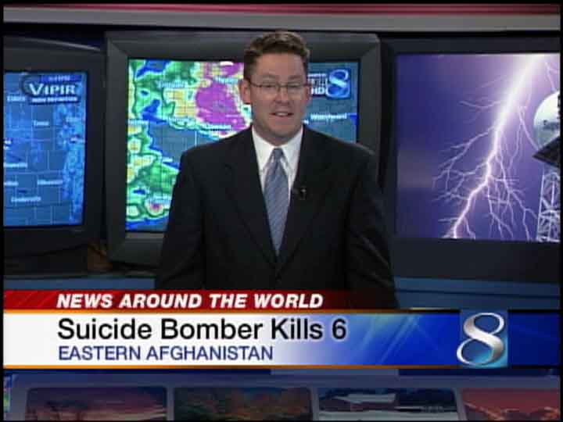

Thankfully, we have TV Weather
Comic Relief
Lifted from Barons and WXC website. Those
are county warnings!

Slide 17


Thankfully, we have social media
Great job daryl on iembot !
….. FAIL .…

Slide 18
Quiz Question #2 What’s wrong with this picture?

Slide 19
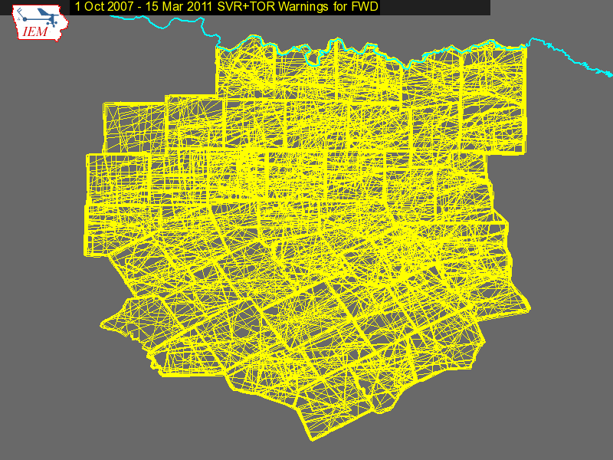

Slide 20
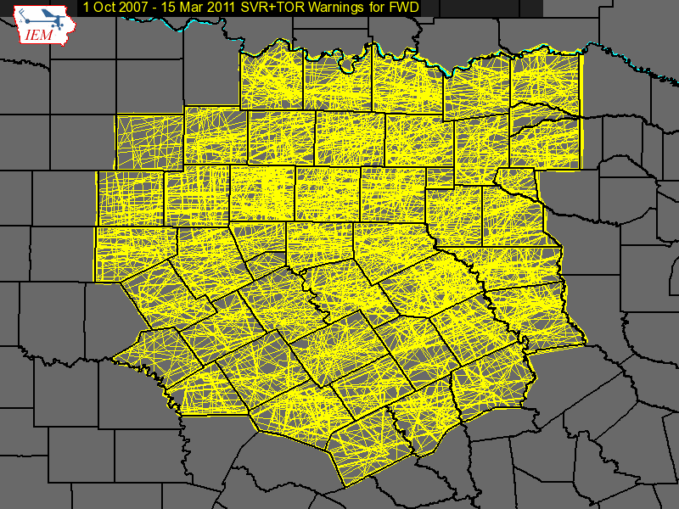

Slide 21
1 Oct 2007 – 15 Mar 2011: Number of Polygon Vertices (SVR+TOR)

Slide 22
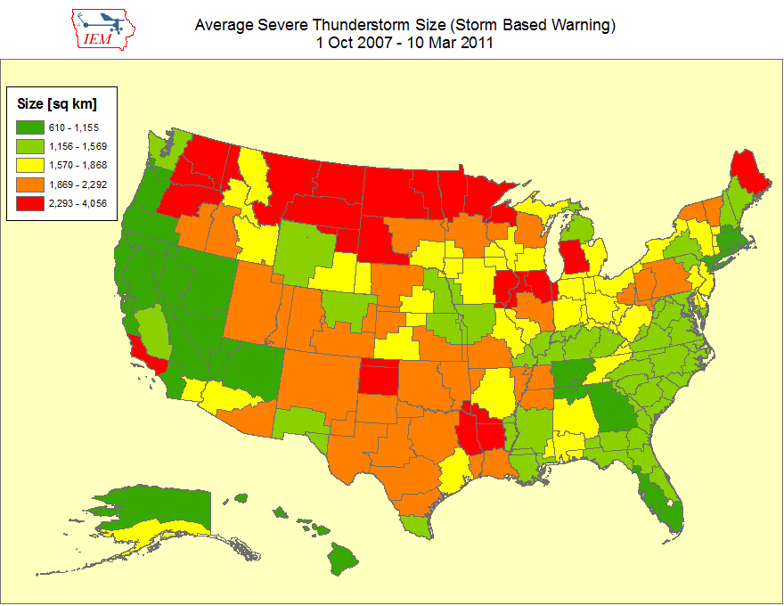

Slide 23
Average SBW Size Versus County Size per WFO (SVR+TOR shown, Alaska not included)

Slide 24
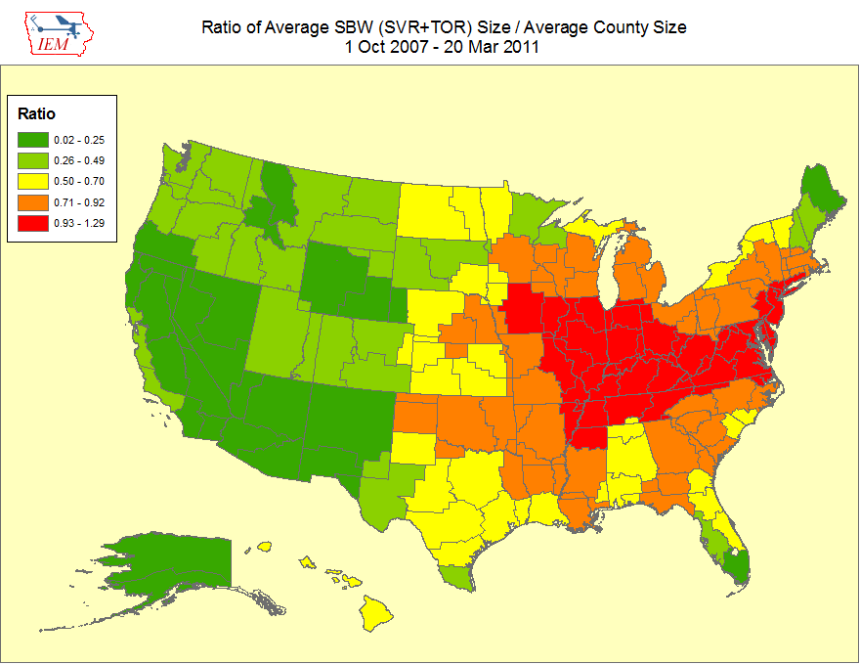

Slide 25
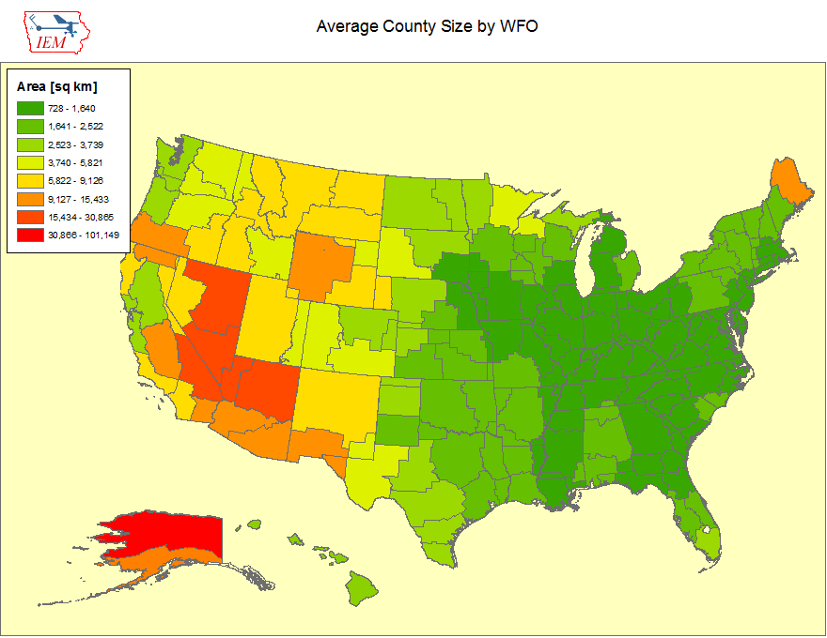

Slide 26
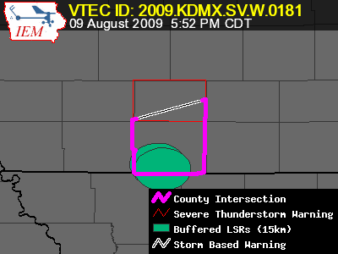
Lets get quantitative
Perimeter Influence
How much of the polygon perimeter coincides with a political boundary
Areal Verification
If the LSRs are buffered, what areal percentage verified
Size Reduction
How much smaller was the warning than the counties it was issued against.

Slide 27
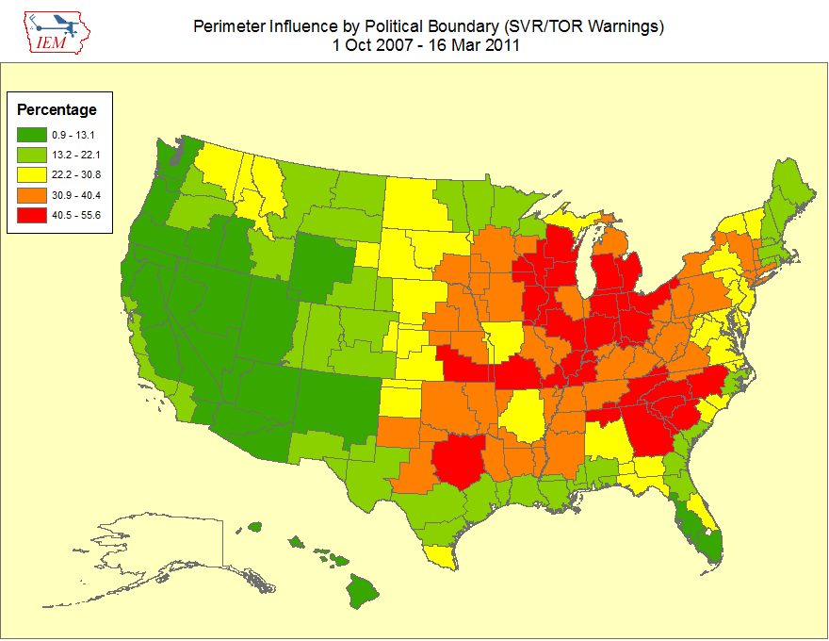

Slide 28
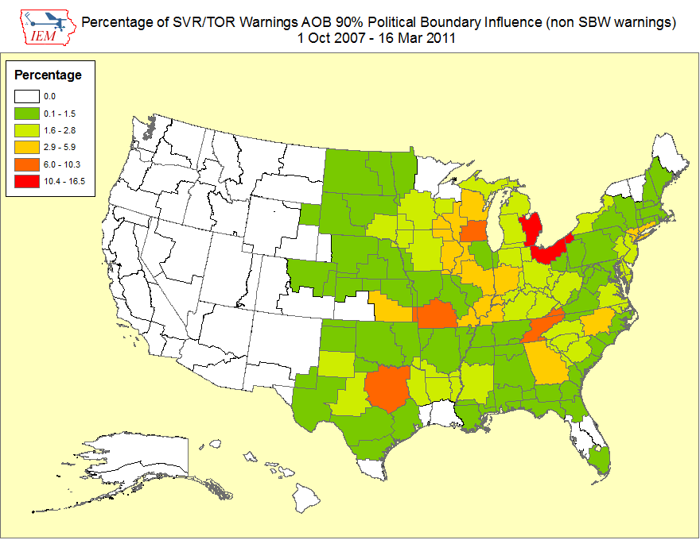
~ 2 % of all warnings

Slide 29
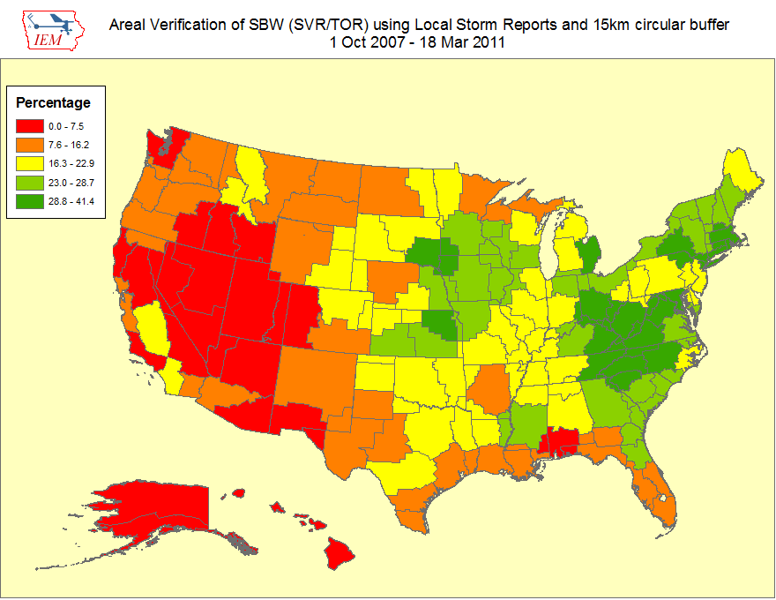
Nationwide is around 25%

Slide 30
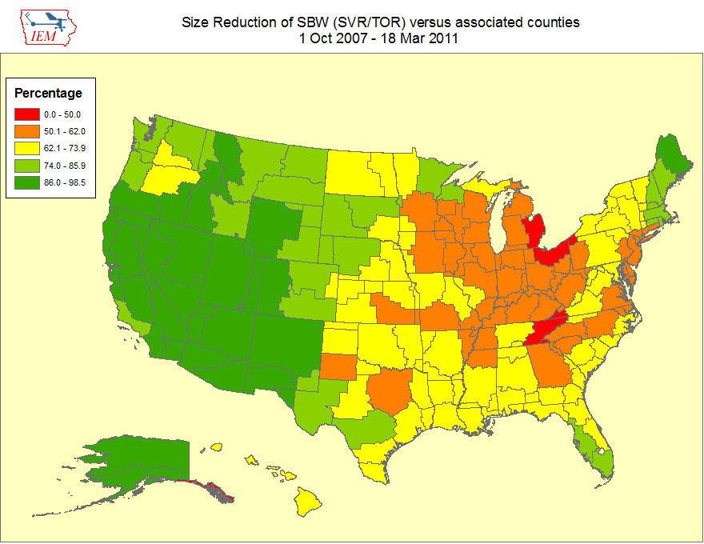
Nationwide Average: 65%

Slide 31
Oh daryl, what about this?
Perimeter ratio is small
So lets compute another metric measuring distance of vertex to county border
County
Warning

Slide 32
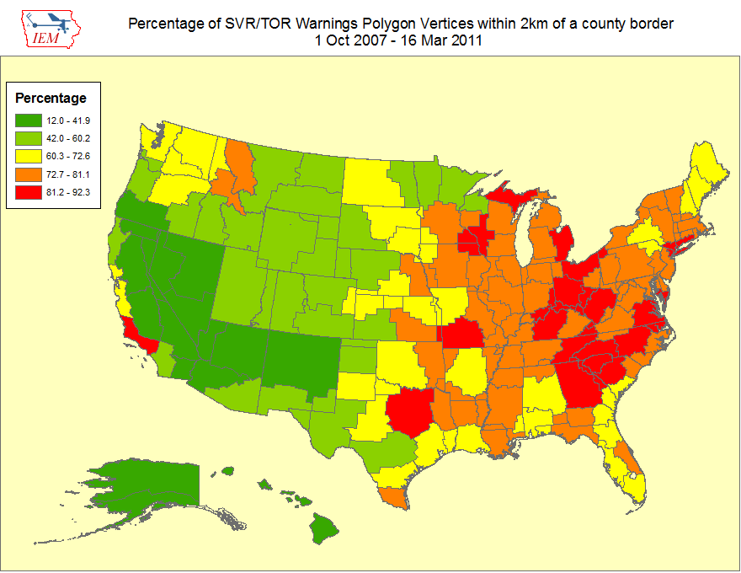
Overall Average: 75%

Slide 33
What is broken?
The warnings are constrained by political boundaries!
NWS Office can’t issue outside CWA
Warning product (VTEC) is still bound to UGC codes
Can’t issue SVR/TOR over Marine Zones, why ?!?!
No penalty for warning size in verification
Warning issuance software
Warning dissemination software (bad daryl)
Warning display software (bad daryl)
Some local NWS Office policies conflict with NWS directives, where’s the sheriff?
No topology checks, invalid geometries are OK

Slide 34
Summary
~ 50% of TOR/SVR Warnings are 4 sided
Only ~ 2 % of all SVR/TOR warnings are pure county retracements
75% of polygon vertices are guided by county borders
SBWs have cut the size of warnings by over 50%, but the number of warnings has increased by 60%.
The Cubs will not win the World Series this year

Slide 35


Is this the solution?

Slide 36
Equally, unrealistic solutions
Warnings should be data, not products
Computers are the most important readers…
UGC codes should not be included
Warnings should come from NWS, not WFOs
NWS should be working as a team, instead of theifdoms
Polygons should be limited to 4 to 6 sides.
The Cubs develop talent from their farm system and not overpay for free agents that struggle with the rigors of playing left field.

Slide 37
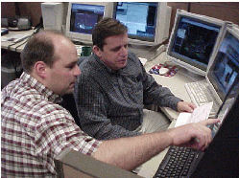



NWS Issues Products
Forecaster tries to figure out what the public wants
Disseminates
Public doesn’t call
Congress.
Computer angry!
NWS Issues Data
Computers deal with various users
Disseminates
Computer happy!
Meathead happy!

Slide 38

Time for Questions?
mesonet.agron.iastate.edu
Daryl Herzmann
515.294.5978
akrherz@iastate.edu

