Slide 1
Data Management
Daryl Herzmann
Lori Abendroth
Bob Zhou

Slide 2
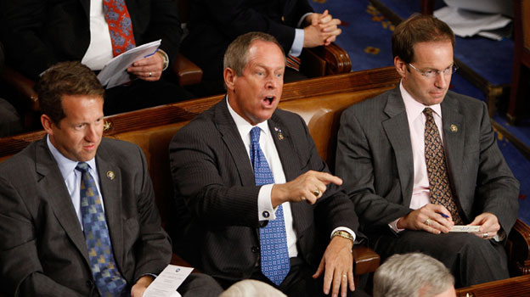
Don’t agree with something you see? Do what this guy did!
AP Photo

Slide 3

Better yet, join the database committee!!!
Three of us so far
Recruiting more members at Chicago meeting!
Nothing you see is set in stone, so speak up if you think something smells fishy.

Slide 4
Data Management Goals
Make things easy for you, no really!
Minimize problems from data versioning
Allow simultaneous editing of data, so your grad students can do all the work
Standardize collection protocols into online data entry spreadsheets that you can design!
Create an easy page for modelers and users to download project data

Slide 5
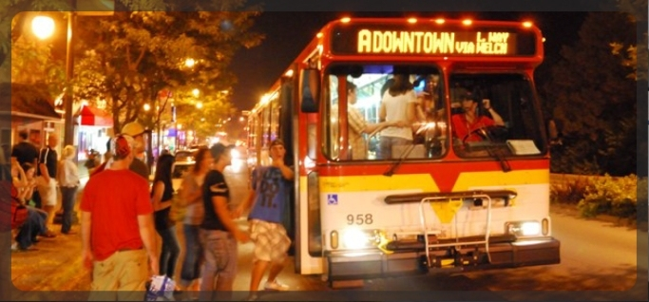
Why use Google?
Common Authentication
Infinite Versioning of content
Support for mobile devices
Access Control Lists
Shared synchronous editing
Mostly “Cyride Proof”
Cyride.com

Slide 6
Terminology bUSTER

Slide 7
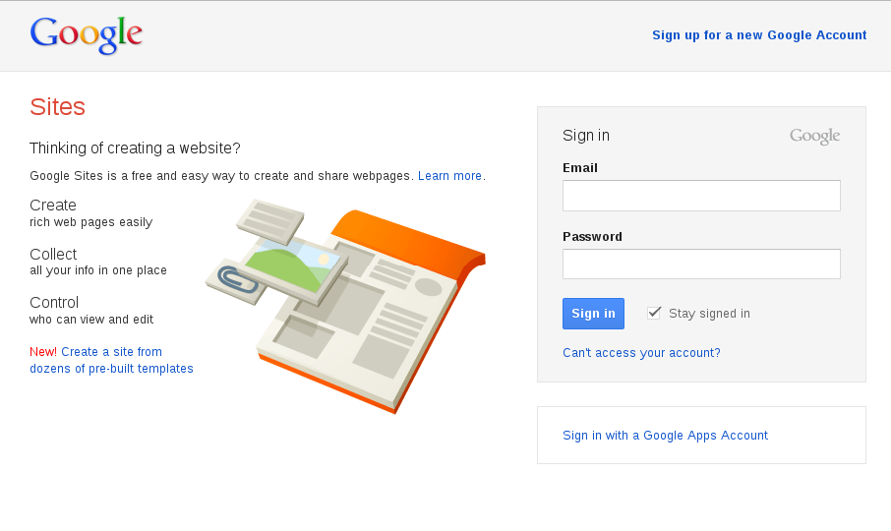
Must have a “Google Account”
Google is “simplifying” accounts this year
Your account is simply your email address made known to google
A “gmail account” is a google account that also uses Gmail, but not required for this project
Sorry about the confusion on this topic

Slide 8
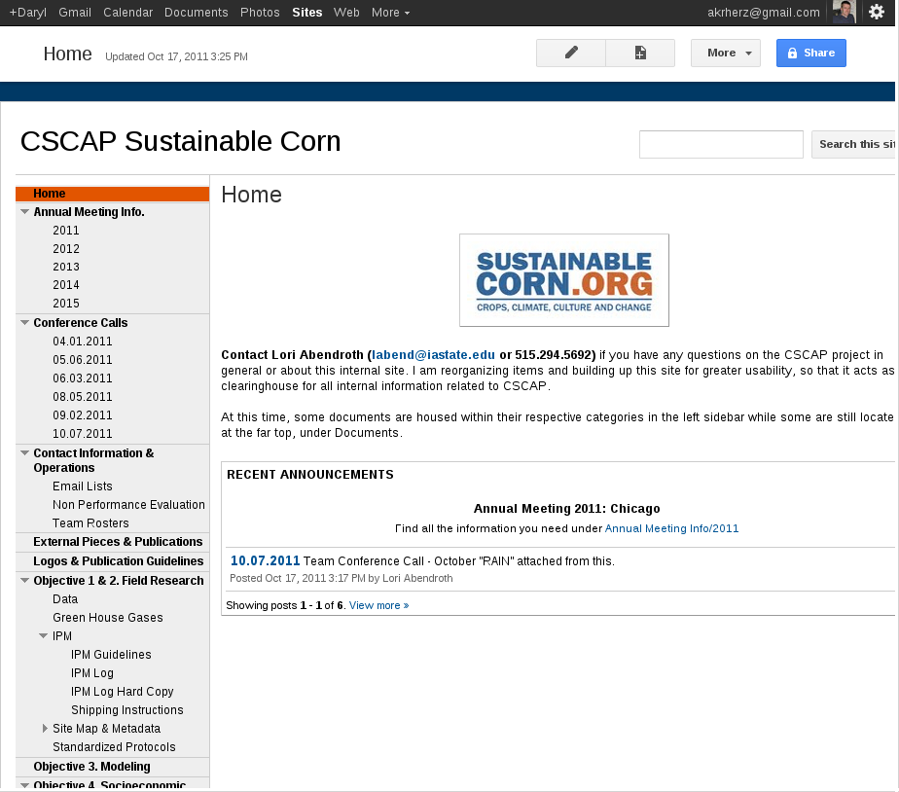
Our Internal Website
“Google Site” application
Access is restricted to team members
Anybody on the team can edit most anything you see
Most of the content are in WIKIs

Slide 9
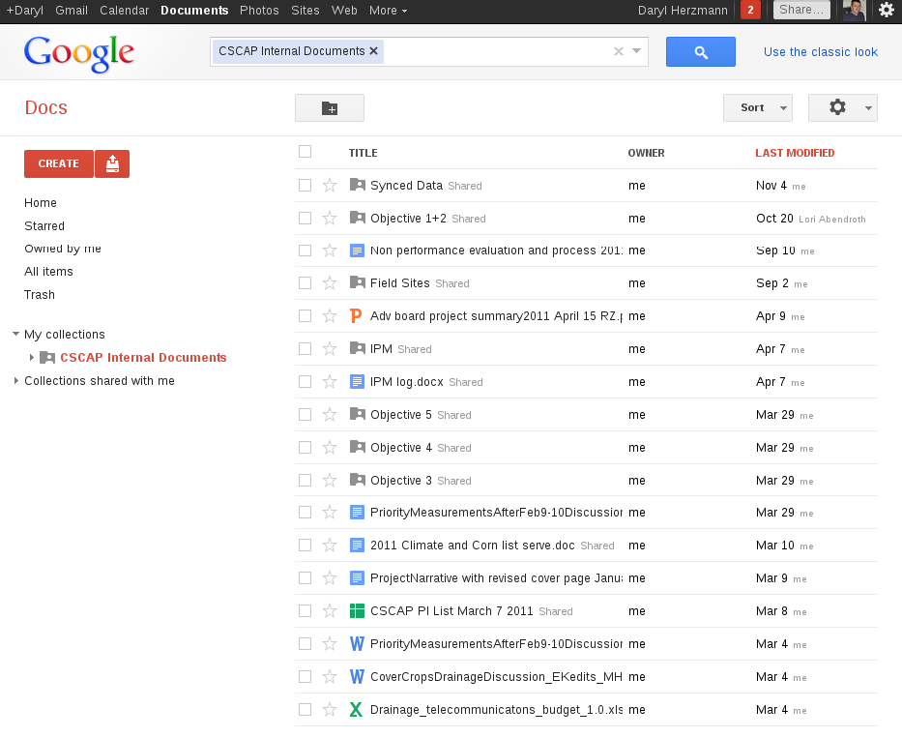
“Google Docs”
Google’s document management system
Allows simultaneous editing of files online
Manages access control lists for files
Converts files to and from different formats
“CSCAP Internal Documents”

Slide 10
Two types of “Google Docs”
Google Docs native
These files are directly editable on the website with your web browser
Can be downloaded in conventional formats (Excel, Word, PDF)
You can import files into “Google Docs” format
Non-Google Docs native!
These files can be previewed ‘read-only’ with your web browser
Files are stored at Google in their native format
You can freely upload, download, and share

Slide 11
So lets review…
With my Google Account, I can
Access our “Google Site” to edit and view internal information
Access “Google Docs” to enter data and collaborate on content
Chat with others in-realtime on documents as you edit them together.
Access most any Google application from your smart phone, tablet, computer, or toaster

Slide 12
Lets TALK PROJECT specifics

Slide 13




Obligatory Data Flow Chart
Data Collectors
(most of you)
Most Data
Big
Datasets
I can’t wait
for Daryl.
Auto-Sync
Project
Database @
ISU
Custom Interfaces
Data Users
Modelers
(the rest of you)
Daryl @ISU

Slide 14
This is not MY workflow!
Data Collectors
(most of you)
Most Data
OK, talk to me about what you have. We’ll make it work!
(could upload as Excel)
(could automate text file parsing)

Slide 15
How will this work?
We’ll have a fancy pants process for GHG processing
There are spreadsheet unfriendly data:
ISU Database is a spatial one
Managed binary formats, netCDF
We have file storage space
Insert another hand-waving soothing comment here
Data Collectors
(most of you)
Big
Datasets
Daryl @ISU

Slide 16
This, I am not too sure about this.
Building a mechanism to synchronize data on “Google Docs” and the project database
Programs can read and write automagically
Can auto-generate spreadsheets for data entry
Auto-Sync
Project
Database @
ISU

Slide 17
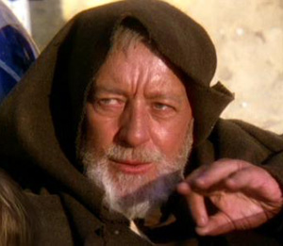
Darn it Daryl, this is not the data management you are looking for!
Join the Database Committee, you must.

Slide 18

Demonstration Time!
Play around with Google Docs
Using Google Docs to enter data
Example download interface from these Google Docs
Lame excuses as to why technology demos are not working.

Slide 19
Summary of things that will happen
Make sure spreadsheets match reality of Obj1 and Obj2 work.
Resolve remaining known-unknowns for data coming to roost in the database
Document this system for approval.
Make everybody happy, no really.

Slide 20

Time for Questions?
Daryl Herzmann
515.294.5978
akrherz@iastate.edu

