Slide 1
Project Collaboration & Data Management Daryl Herzmann ← blame Lori Abendroth ← credit
Place this name on the “Nomination Form”

Slide 2

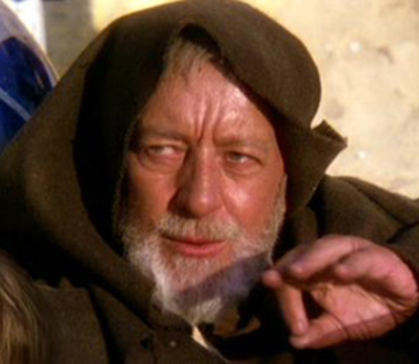
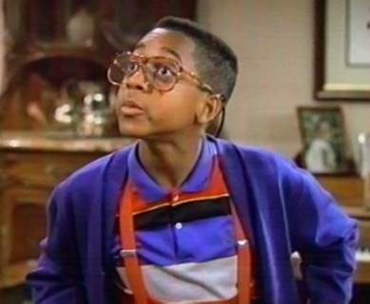
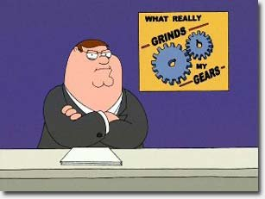
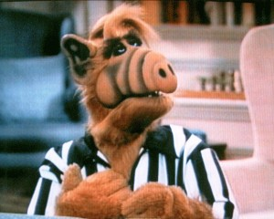
Recapping my last presentation, Nov 9
#1 Goal: Make things easy!
Form a database committee
Get my scheme approved by leadership team
Do 4 years of work in 9 months of time.

Slide 3
So, what has happened since then? (emails from daryl to Lori)
November (35 emails)
21: Got database committee formed
December (32 emails)
January (54 emails)
26: Management Form
February (41 emails)
5: Added IPM to Management Form
March (53 emails)
15: GHG PAS Form
April (44 emails)
1: Completed Project
May (61 emails)
31: Released Management DataStore Description
June (130 emails)
4: Virtual TeleConn with other CAP projects on Data
25: Weather Data Download app
29: Agronomic Data Sheets
July (71 emails)
17: Soil Texture Sheets
25: Soil Nitrates Sheets

Slide 4
Data Management Goals from last meeting
Make things easy for you, no really!
Altruistic goal, but why not keep trying!
Minimize problems from data versioning
We are doing good with this one.
Allow simultaneous editing of data, so your grad students can do all the work
On track here as well.
Standardize collection protocols into online data entry spreadsheets that you can design!
Uffffffffffffffffffffffff-Da. Slowly, but Shirley.
Create an easy page for Obj 3 and users to download project data
#NBCFail here. It is coming, but so is Christmas.

Slide 5
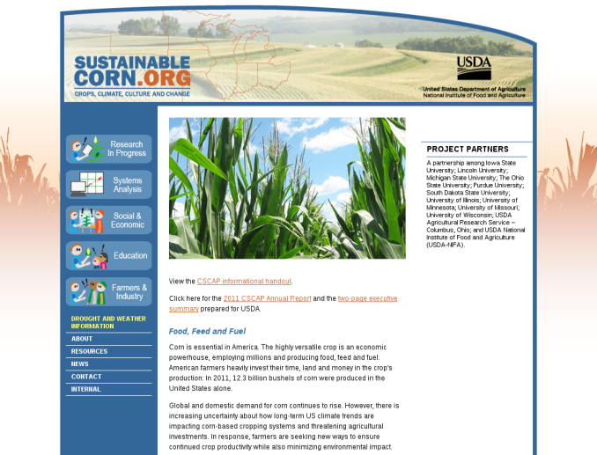



15,240 meter view
Traditional Database @ISU
External/Public Website
Internal Collaboration Website
Google Docs / Spreadsheets

Slide 6
External / Public Website http:///sustainablecorn.org
Purpose
Communicate our project to the public
Provide warm fuzzies
Who to yell at about it:
Lynn Laws
Daryl Herzmann

Slide 7
Internal Collaboration Website
Purpose
Facilitate trans-disciplinary collaboration!
Organize the data entry spreadsheets
Who to yell at:
Lori Abendroth
Daryl Herzmann

Slide 8
Google Drive / Docs / Spreadsheets
Purpose:
Allow entry of most of the project data
Allow managed editing and sharing of documents
Who to yell at:
Daryl Herzmann

Slide 9
Traditional / Relational Database @ISU
Purpose:
Be a traditional database that makes things easier for me.
Redundantly store Google Drive content
Support the coming Obj3 download interfaces
Who to yell at:
Daryl Herzmann
This should be Iowa State’s
current mascot, but I digress.

Slide 10
9,144 meter view
Our Project Data Collaboration according to daryl
Data
Collectors
Basic, better be easy
Island Dwellers
Monitor Progress
New & Scary Things
daryl Too Slow!
Central
Database
Data
Analyzers
Other
Data
Data
Collectors
+ Analyzers
Admin Types

Slide 11



Central Database? Shirely, you jest.
Gadgets dump
data into
Internal site
organizes
Google Spreadsheets
Valuable
Team
Members
Within Google Drive
Scripts sync data
to ISU Database

Slide 12
Three Primary Metadata Spreadsheets
“Site Data Collected”
Which site is collecting which data?
Listing of project data variables
“Site Metadata + History Master”
Metadata on field sites (lat/lon, FIPS, PI, etc)
“Site Treatments”
Which sites are doing which treatments?
Which years are these treatments being done?

Slide 13
How Site Data is Collected
Agronomic Spreadsheet
Soil Nitrate Spreadsheet
Management Form
AGR1 AGR2 AGR4
AGR5 AGR6 AGR7
AGR9 AGR10 AGR13
AGR14 AGR15 AGR16
AGR17 AGR18 AGR19
AGR20 AGR23 AGR24
AGR25 AGR26 AGR27
AGR28 AGR31 AGR32
AGR33
IPM1
SOIL15 SOIL16
Soil Bulk Density + Water Retention Spreadsheet
Soil Texture Spreadsheet
SOIL1 SOIL2
SOIL6 SOIL9 SOIL12
SOIL13 SOIL20
GHG PAS Form
GHG2
Quasi-Automated
To Be Determined
CLIM1 CLIM2 CLIM3
CLIM4 CLIM5 CLIM6
CLIM7 CLIM8 CLIM9
CLIM10 GHG1
AGR3 AGR8 AGR11 AGR12 AGR21 AGR22
AGR29 AGR30 SOIL7 SOIL8 SOIL10 SOIL11
SOIL14 SOIL17 SOIL18
SOIL19 IPM2 IPM3 IPM4 IPM5 IPM6
IPM7 IPM8 IPM9 IPM10 IPM11 IPM12
WAT1 WAT2 WAT3 WAT4 WAT5

Slide 14
What are the other CAPs doing?
REACCH (Wheat)
Collaborating with a Northwest Knowledge Network
Attempting to do some advanced things with metadata and discovery
Hope to internally release to rest of project by end of this year
Pinemap
“TerraC” platform
Locally developed data management system
Data is uploaded and staged for review, before going to database
Not open source software, but we were invited to play with it

Slide 15
Help Wanted!
10-20 hours per week
Targeting an underfunded grad student or staff ☺
Tasks
Quality Control of entered data
Followup with field sites to solicit needed data
Make sure protocols and data entry mechanism matches
Skills Desired (the anti-daryl)
Organized
Detail oriented
Good communication skills

Slide 16
TODO List / High Priority Items (…you will see this slide next year…)
Cleanup storage of Management Form to include treatments.
Download interface for Objective 3.
Get the metadata finalized!
Decagon Soil Moisture
Complete data entry forms!
Make sure we are aligned to fullfill USDA data requirements.
Come up with a sexy name for this database system / concept.

Slide 17

Demonstration Time?

Slide 18

Time for Questions?
Daryl Herzmann
515.294.5978
akrherz@iastate.edu

