Slide 1
Project Collaboration & Data Management Daryl Herzmann Lori Abendroth

Slide 2
Goals for the next 45 15 minutes of your life
Instill confidence that data is being properly managed for this project
Be informative about data management concepts and how they apply to this project
Be honest about issues encountered so far and how they are being mitigated
Be entertaining to keep you awake
Get your feedback on improvements

Slide 3
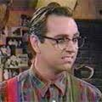
In the beginning, there was the lone scientist
I want to do
To get I need to collect
I collect
I (grad student) covert into via
some arcane method that I don’t even understand, nor document
I publish

Slide 4
Then, two scientists got together
I collect
I can do
A few emails are sent back and forth, done!

Slide 5
Then a whole team of scientists get together
USDA Funds us to do
Our team collects
Trans-disciplinary science problems!
I can collect
I can do
I can do
But I need
For 50 years,
I collected
I don’t have enough funding
To do
Or Collect

Slide 6
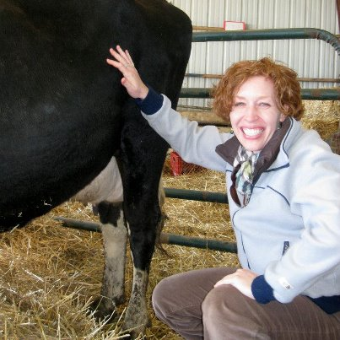
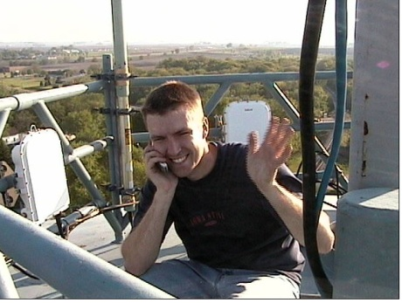
Altruistic Collaborative World
I collect
I can do
I need
Central
Database
Data Import
Data Conversion
Lori and daryl understand this entire process.
Daryl properly codes interfaces to handle it all.

Slide 7
The “Traditional” Approach
Input Webpage
Download
Webpage
Central
Database
This approach generally works, but is so 1990s!!!
Fancy Pants
Computer Server

Slide 8
Traditional Problems with Traditional Approach
Long spin up time of central database and webpages for input / download, thousands of lines of code to be written
Data input / download interfaces are lame
Data versioning unaccounted for
Limited collaboration, maybe a web forum and email lists
These systems devolve into “silos” with only one entry and one exit point.

Slide 9
Yeah, so we came up with a solution that solves all these issues and will share that today with you. I also have beachfront property in Arizona to sell you.

Slide 10
Data Management Goals
Make things easy for all, no really!
Minimize problems from data versioning
Allow collaborative editing of data, let grad students do all the work
Standardize collection protocols into online data entry spreadsheets that behave like Microsoft Excel documents.
Create an easy page for modelers and users to download project data
Don’t reinvent wheels, use “The Cloud.”

Slide 11
“The Cloud” and data management
Concept is to provide your data:
To you and perhaps others on demand
In a form usable by the application and Internet device you are currently using
Data in the cloud advantages
Can be searched
Is physically stored redundantly
Near infinite versioning
Is an authoritative source, no copies existing on various servers in various revisions
Collaboratively edited

Slide 12
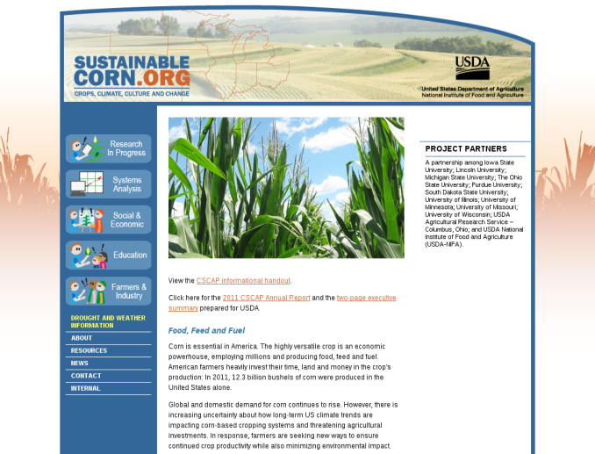



15,240 meter view of current solution
Traditional Database @ISU
External/Public Website
Internal Collaboration Website
Google Docs / Spreadsheets

Slide 13
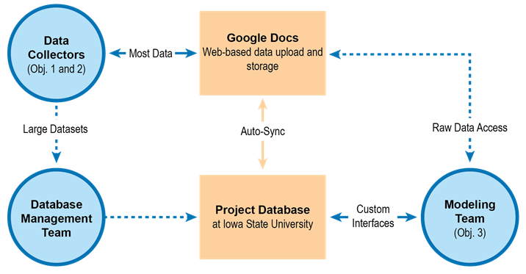
Project Data Flow

Slide 14
More simply stated
We have web pages that behave like Microsoft Excel spreadsheets
These spreadsheets are setup to replicate data collection spreadsheets that already exist.
These spreadsheets are stored in the Google Docs Cloud
Programic interfaces exist to easily manipulate, populate, and download these datasets

Slide 15
General Problems Encountered
The cloud can be fickle some days
Problems are quickly fixed
The terminology / technology thrown at team members is difficult to understand
Hand-holding is happily done, when requested
The cloud technology is in constant flux, great for 5 year projects ☺
Unknown Unknowns
Daryl’s ignorance / incompetence
Resolution is Hopeless

Slide 16
Specific Problems Encountered
Lori and daryl’s understanding of protocols and data collection procedures
Iterative and difficult process
Google Docs is new concept for most.
More creative with training?
Getting folks to at least try out this system.
Better and more communication needed
Larger datasets needing manual QC will be a challenge
Unresolved, gonna take some time

Slide 17

Time for Questions?
Daryl Herzmann
515.294.5978
akrherz@iastate.edu

