Slide 1
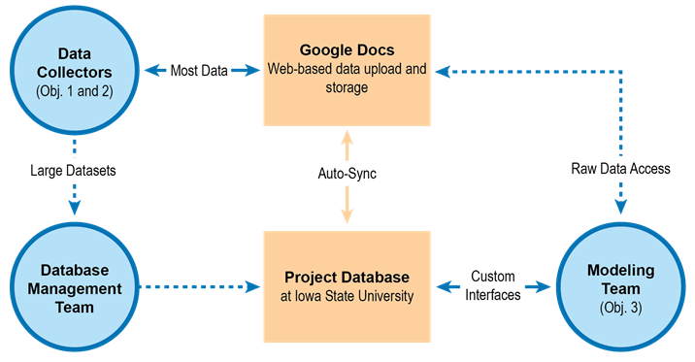
CSCAP Data Management
Traditional Techniques
Central Database
Email / Phone Collab.
Novel Approaches
Use of Google’s Cloud
Google Spreadsheets
Difficulties Encountered
Unfamiliar Technologies
Collaboration is Hard

