Slide 1
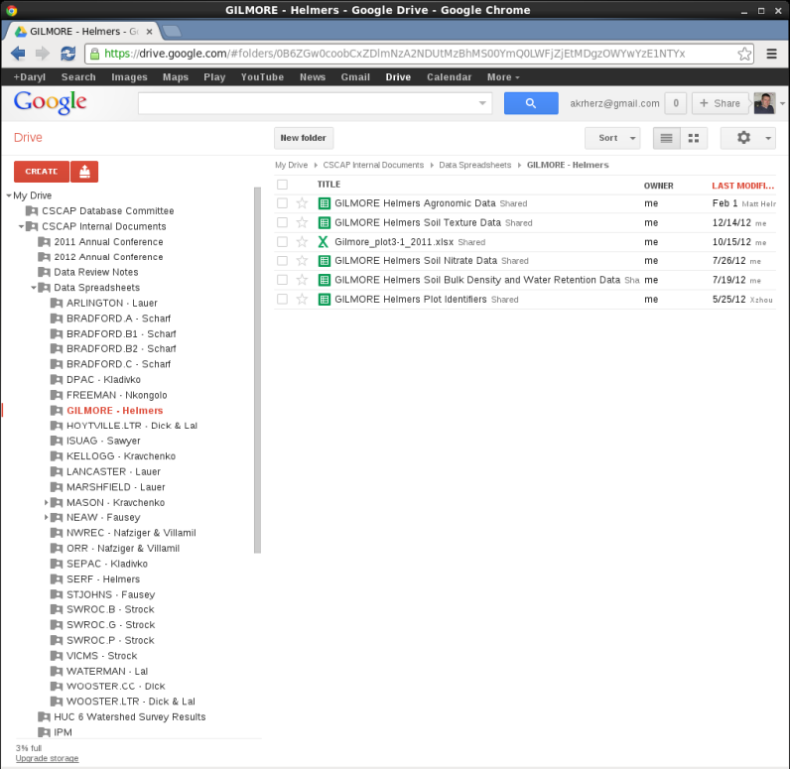
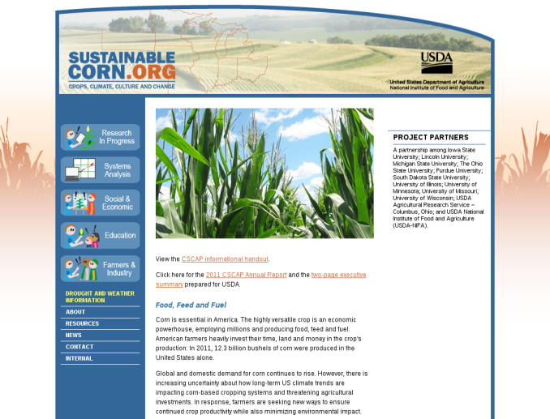

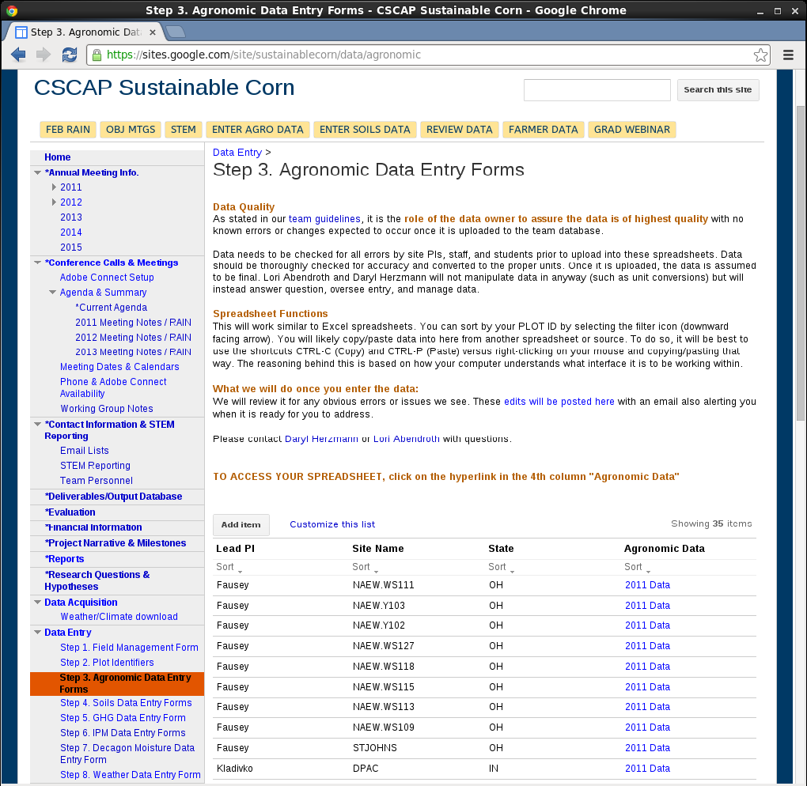




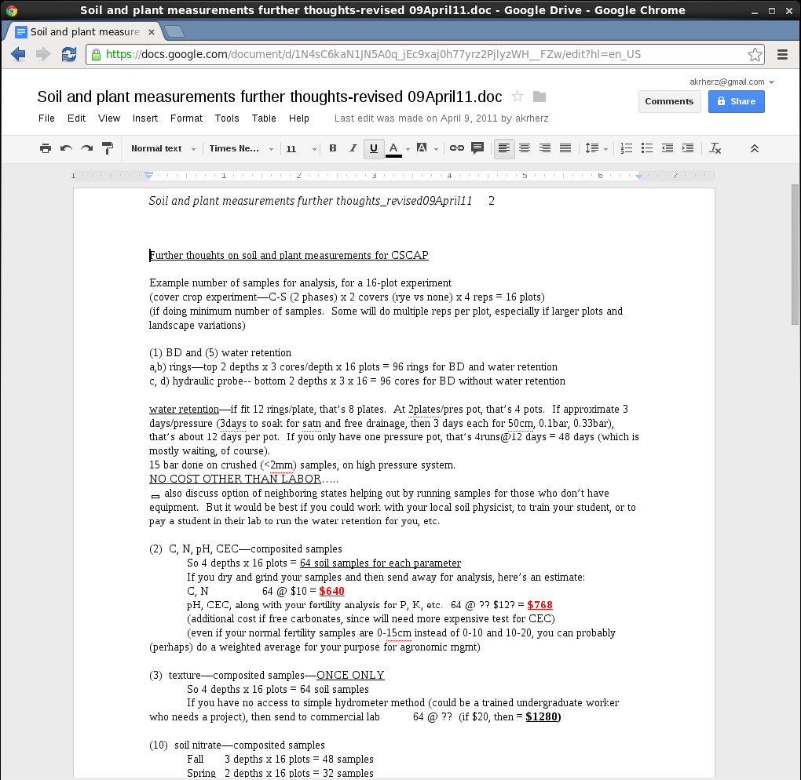
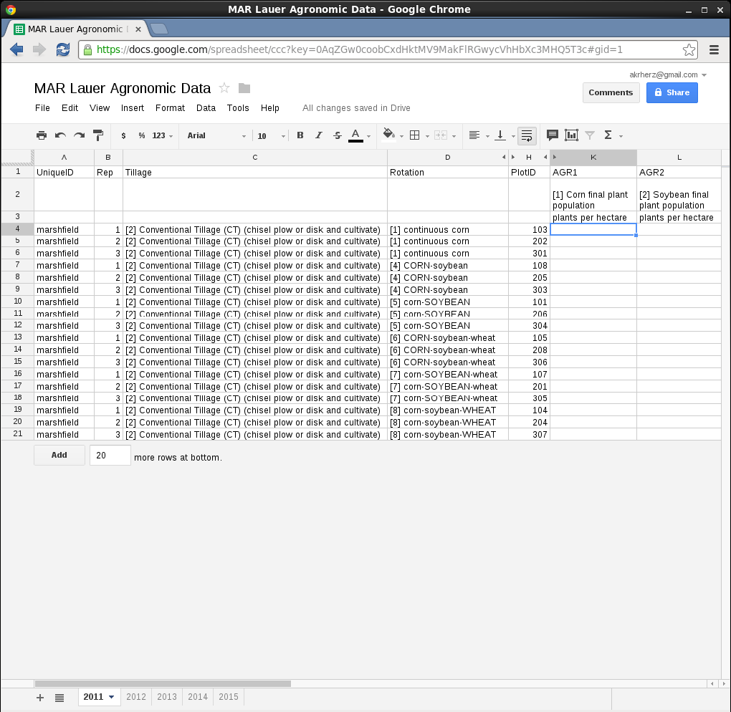
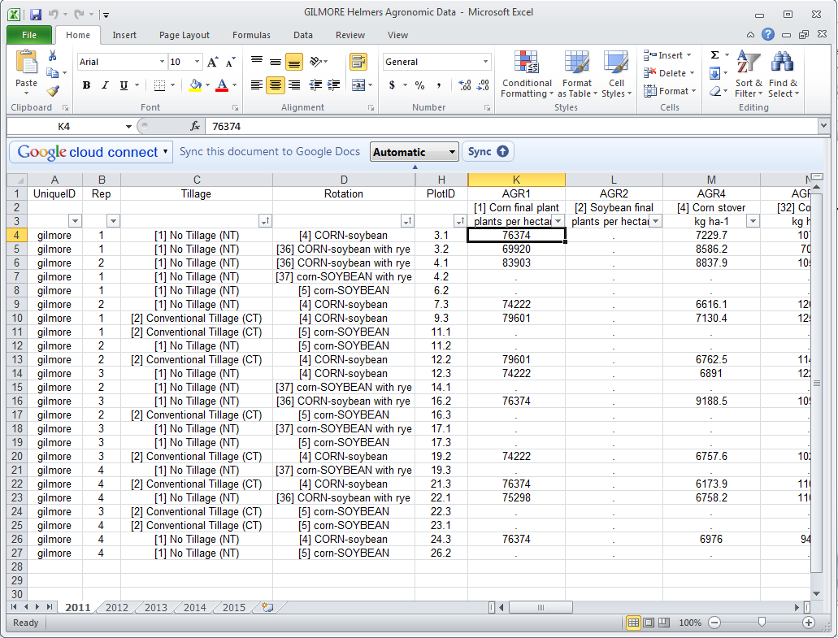
Corn Systems CAP - Data Management
Document Storage
Public Website
Scope of Data Collected
GHG Fluxes
Soil Sampling
Farmer Surveys
Soil Water Retention
Plot Management
Integrated Pest Management
Ancillary Weather
Data Management Goals
#1. Make things easy for team, no really!
Minimize problems from data versioning
Allow simultaneous editing of data, so grad students can do all the work
Standardize collection protocols into online data entry spreadsheets that users can customize!
INTRODUCTION
TECHNOLOGIES
Collaboration WIKI
Central Database
1. Standardize Protocols
2. Spreadsheet Template
3. Programatic Replication
4. Central Database
5. Download Reports, etc
WORKFLOW

