Slide 1
Iowa Environmental Mesonet
25 Years of Bliss

Slide 2
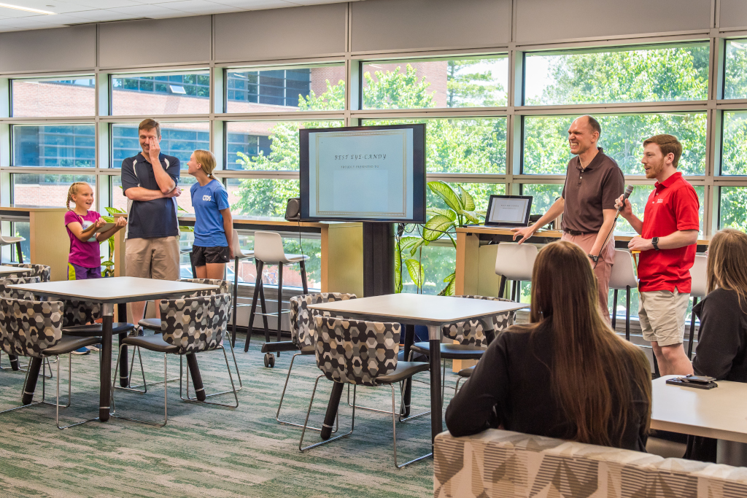
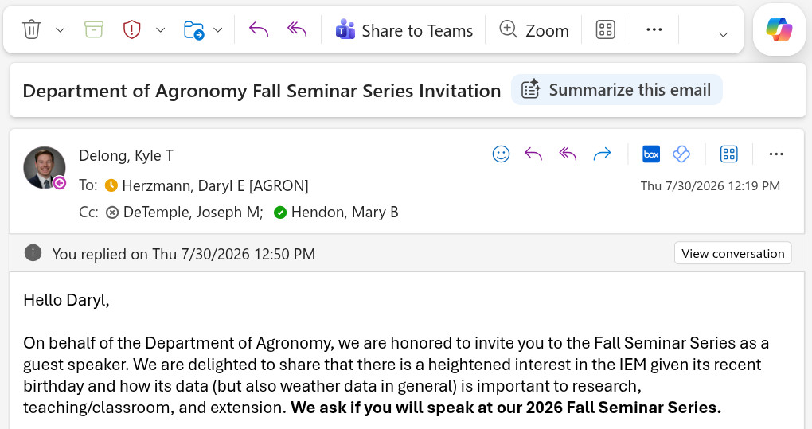

First, an observation…
July 2026, see Kyle in picture giving me an award. Free food not pictured…
Shortly thereafter, see Kyle in email asking me to do something.
Oct 2026, see me on the hook for departmental seminar…
Notes:
There is no such thing as a free lunch

Slide 3
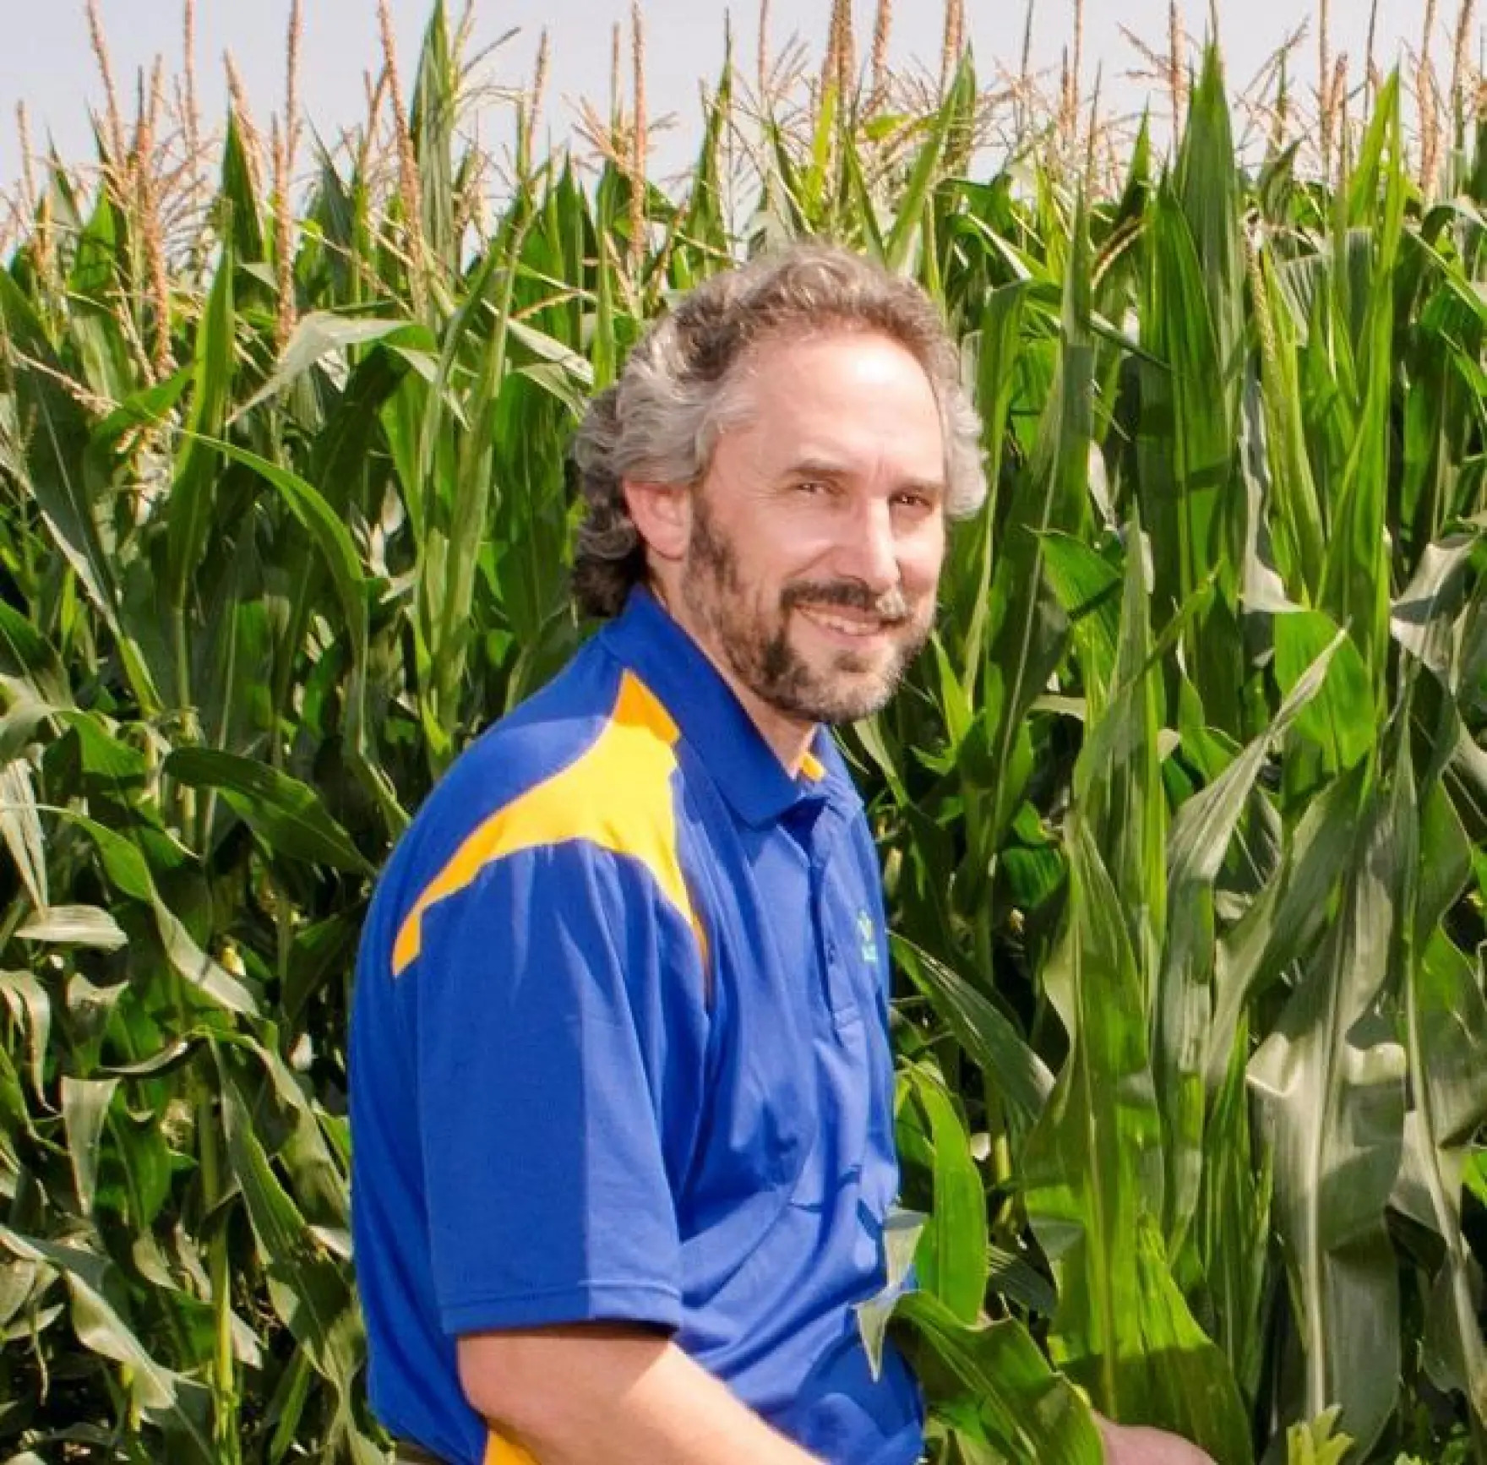
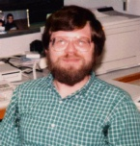

Second, a word from my sponsors…
2001-2003
Dr Dennis Todey
2003-2018
Dr Ray Arritt
2018-∞
Dr Rick Cruse

Slide 4
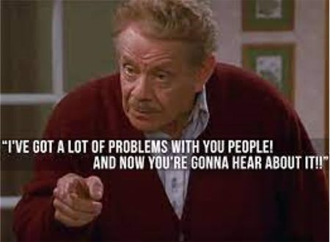
Things requested of me for this presentation
Use lots of memes. ✅
Use considerable dry wit. ✅
Interactively show how to use the IEM to make money. 🤷
Show how the sausage gets made. 🔴
Show YouTube videos ✅ of me 🔴.
There will be 1.5 surprises announced at the end, if the audience behaves.

Slide 5
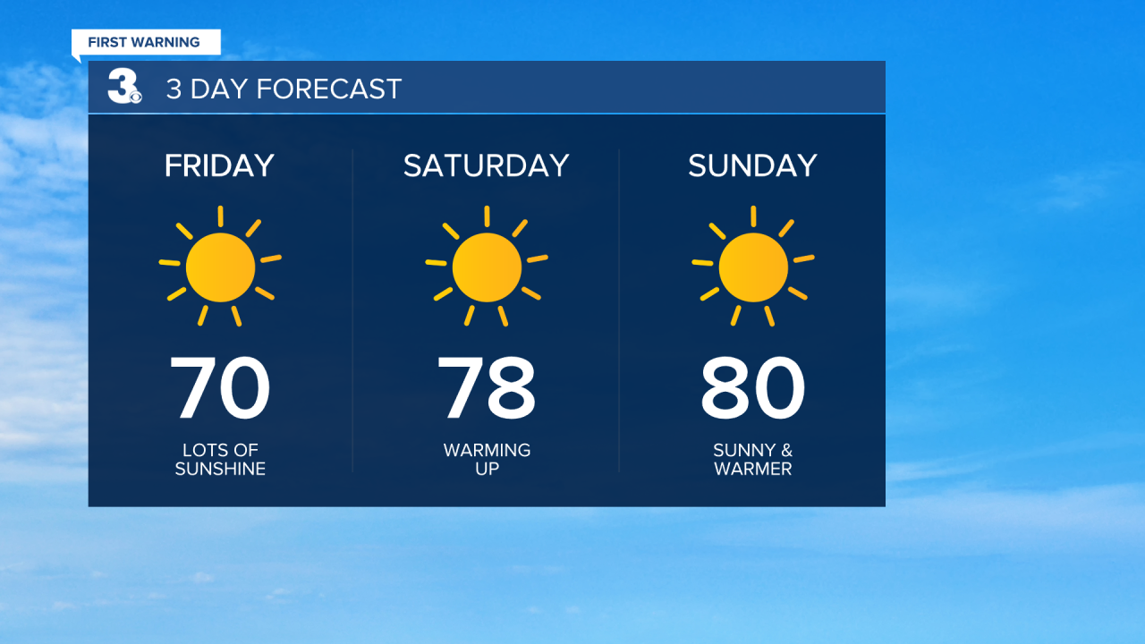
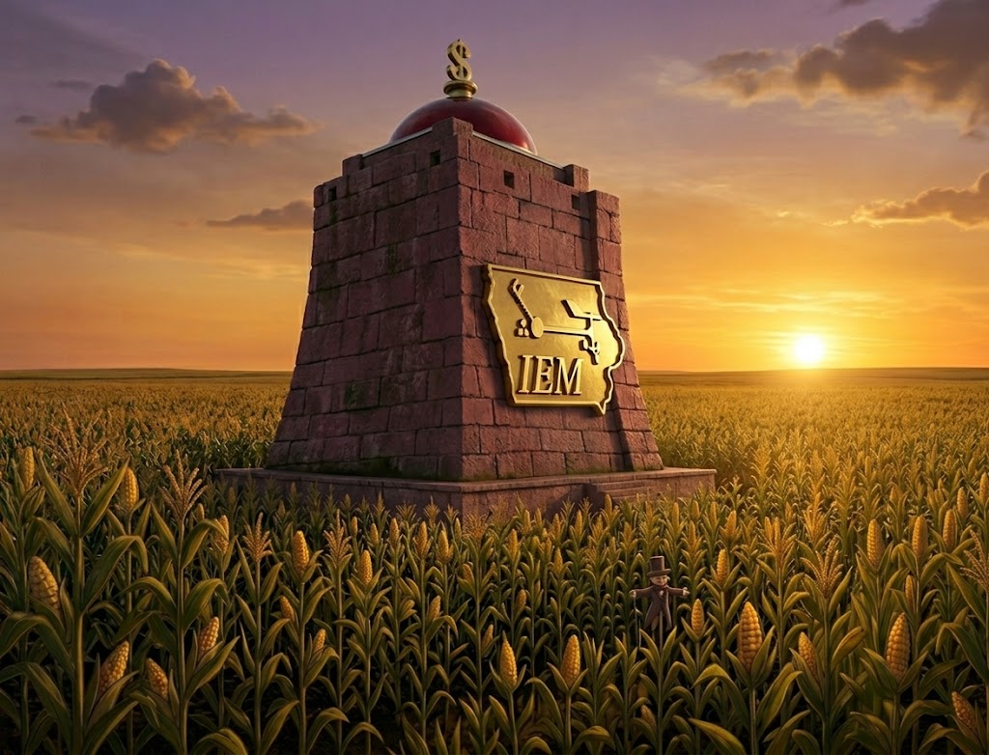
My unabridged career summary
How it started…
How it is going…
Grew up on a dairy farm in NE Iowa and loathed how bad the 3 day forecast was for baling hay. Figured I would go to ISU and “fix it”.
Built a colossal archive of environmental data that resides within the middle of a corn field in Iowa.

Slide 6
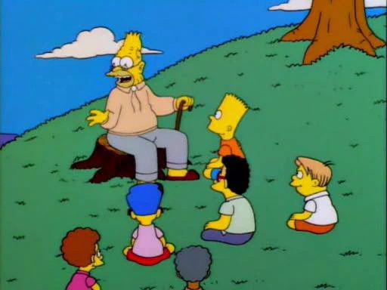
Back in 2001.
Data sharing was not common.
GIS + Meteorology were not friends.
Al Gore’s Internet had near real-time data, but hardly anything was archived.
Many entities were building networks to observe things for only their immediate needs, but had no desire to support archival and public usage.
The “dot com” bust just happened and our potential “big pot of money” disappeared.
So a “mesonet” was built with bailing wire and duct tape.

Slide 7
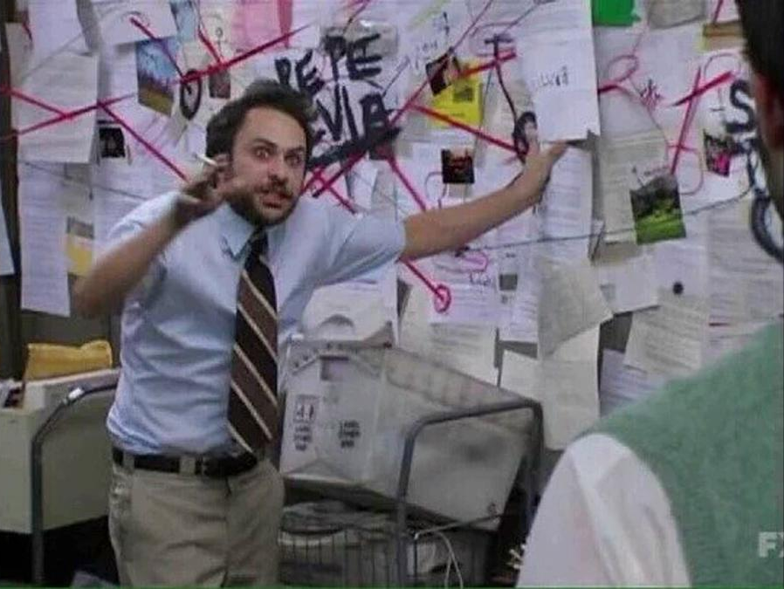
What exactly is the IEM?
A website and/or daryl.
Naming things is hard
  “Iowa” , but most data for outside of Iowa
  “Environmental”, vague/fancy term
  “Mesonet”, unlike 99% mesonets in the wild
Formal Definition: “An ad hoc collection of disparate datasets and half-baked tooling curated over 25 years from
  supporting 10s of funded research projects for eternity,
  answering every email request I get,
  and inability to say no to most anything.”
Most consider it to be “Magic”.

Slide 8
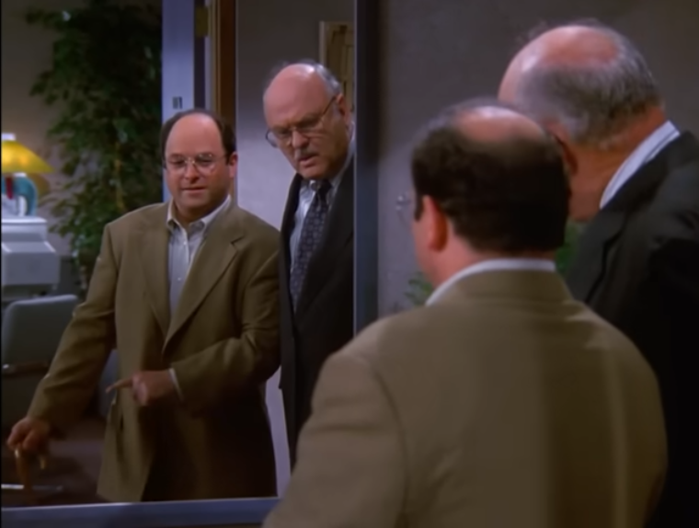
IEM ≠ ISU Soil Moisture Network
ISU Ag Climate / Soil Moisture Network dates back to the mid 1980s.
Data/products for the network are primarily found on the IEM website.
Some folks think I run the soil moisture network, but I am unsure if I do…
IEM’s “success” has been a detriment to moving the soil moisture network forward. (note to self: scan room for ISU administrators before saying too much).

Slide 9

The IEM as Scrooge McDuck’s Money Bin
Scrooge enjoyed collecting money for the purpose of swimming in it and not spending it.
Scrooge always knew, to the penny, the bin contents.
Scrooge discouraged anybody else from swimming in his money.
daryl hoards data to generate obscure charts and never wants to delete any of it.
daryl monitors all the data, all the time!
daryl wants everybody else to swim in the data too.

Slide 10
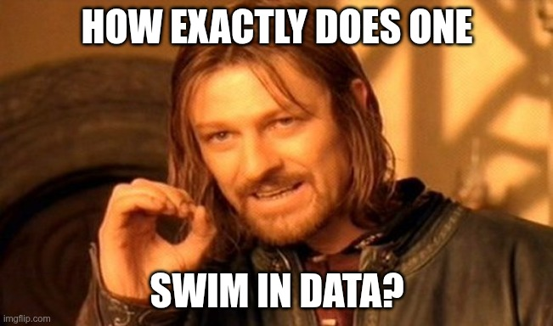
The IEM as Open Swim
Data ≠ Products
Infrastructure built to support various funded projects is done openly, so anybody else can use it.
Considerable tooling exists to support beginner, advanced, and olympic swimmers
  Here’s a product/plot, great, I’m done.
  Oh, nice plot, I want the data behind the plot so that I can make it pretty, OK done.
  Oh nice data, I want Claude to automate the workflow to generate an updated report each morning. OK done.
daryl actually never learned to swim, so…

Slide 11
ENOUGH MEMES, I CAME HERE TO SEE ACRONYMS.
IEM Archives Legend: [🎉 = Popular] [❗= Only Known/Usable Archive]
ASOS 1 Minute Data 🎉
Bufkit Profiles 🎉 ❗
CoD Satellite Imagery ❗
CLI Data ❗
Flash Flood Guidance ❗
Global METAR 🎉
HML (River Stage Forecasts) ❗
Iowa+ Webcams ❗
Local Storm Reports 🎉 ❗
MADIS / “HFMETAR” ❗
MRMS
NCEP F000 Models
NEXRAD Level II Live Data 🎉
NLDN (Not Public)
NRCS SCAN
NWS Text Archive 🎉 ❗
NWS “WaWA” Map ❗
PIREPs ❗
Public RWIS Networks 🎉 ❗
RADAR Products
RTMA
SHEF HADS/DCP/COOP 🎉 ❗
SIGMETs ❗
SPC MCD/Watches/Outlooks 🎉 ❗
SMOS Satellite (Midwest)
Soundings
Text MOS 🎉 ❗
USCRN
Various Iowa-Only one-offs
VTEC WaWA 🎉 ❗
15minute Fisher/Porter

Slide 12
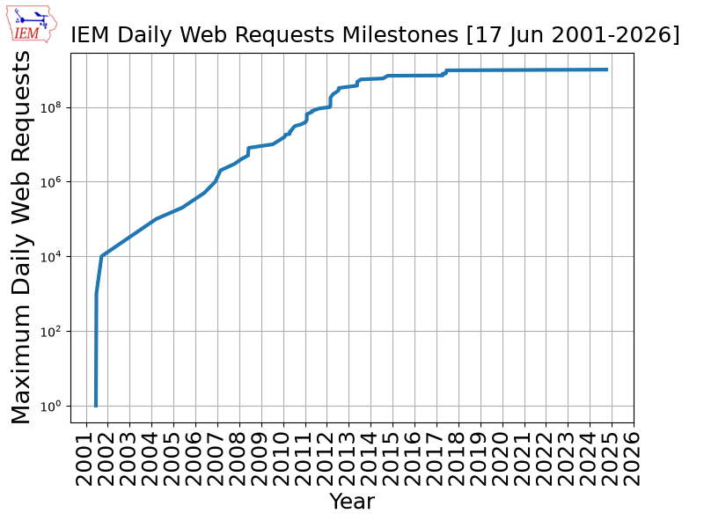
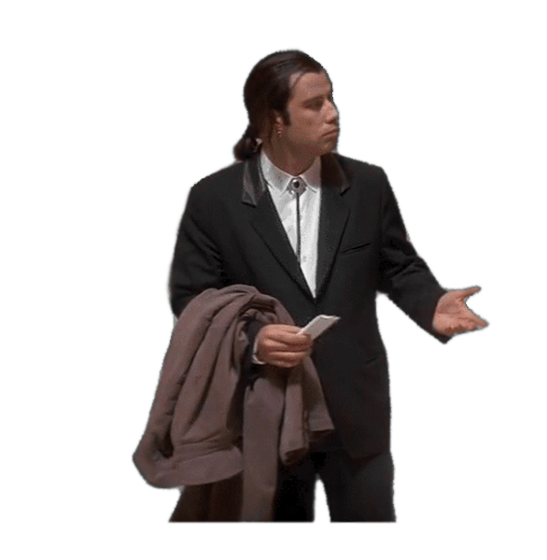
Iowa State’s most trafficked website?
Circa 2019, it was. Assume it still is, you know what assuming does.
Average 250M requests per day
~350K unique IP address per day
The daily max requests plot shown failed to reach the moon due to a number of CDNs now fronting the IEM, which I have no visibility into.
Did ~1B daily requests shortly after Hurricane Helene (2024).
https://mesonet.agron.iastate.edu/usage/

Slide 13
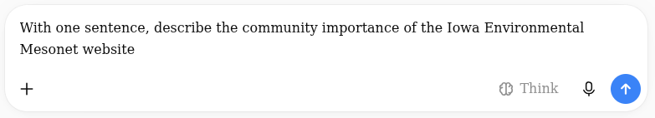
What do our LLM chatbot overlords think?
🤖 Chat GPT: The Iowa Environmental Mesonet serves its community by providing reliable weather and environmental data that helps people make safer, better-informed decisions.
🤖 Claude: The Iowa Environmental Mesonet (IEM) is a vital public resource that aggregates and archives weather, climate, and environmental data for Iowa and beyond, supporting researchers, farmers, emergency managers, and the public in making informed decisions related to agriculture, safety, and climate analysis.
🤖 Grok: The Iowa Environmental Mesonet website serves as a vital free public hub that aggregates, archives, and freely disseminates high-resolution weather and environmental data from multiple networks, enabling farmers, researchers, agencies, businesses, and the public to make informed decisions on agriculture, emergency management, and climate-related issues across Iowa and beyond.
🤖 Gemini: The Iowa Environmental Mesonet serves as a critical community resource by aggregating and archiving high-resolution meteorological data from diverse networks into free, accessible tools that support precision agriculture, academic research, severe weather monitoring, and public safety decision-making across Iowa and beyond.

Slide 14
Top 5 scholarly references to IEM datasets *
Abbreviation | Name | Count | 28 Sep 2026 Downloads
ASOS | Airport Weather Data | 484 | 2.4M
CLIMODAT | Daily Long-term Climate Obs | 146 | 1.4K
ISUSM | ISU Soil Moisture Network | 122 | 3.6K
VTEC | NWS Watch, Warnings, Advisories | 82 | 25.8K
NWSTEXT | NWS Raw Text Products | 40 | 2.2M
* 1,128 Known total as of 24 Sep 2026
“Info Tab” -> “Referenced By” : https://mesonet.agron.iastate.edu/info/refs.php

Slide 15
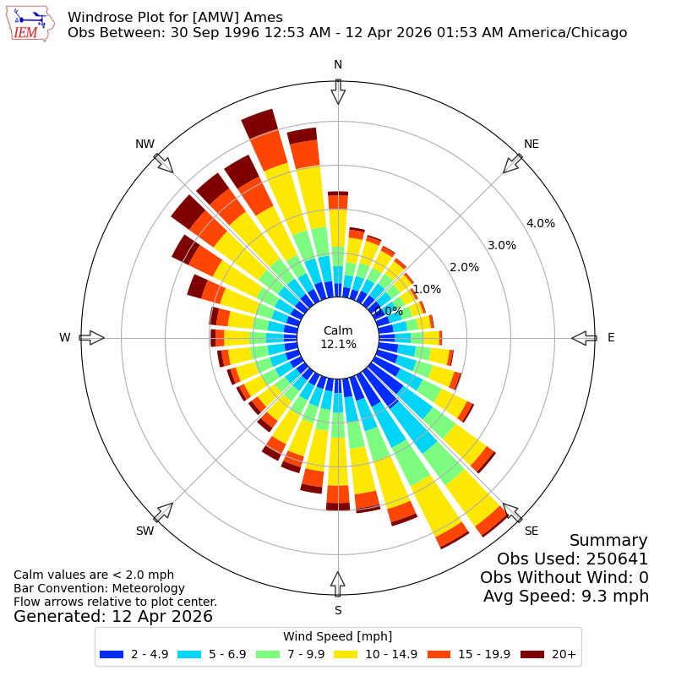
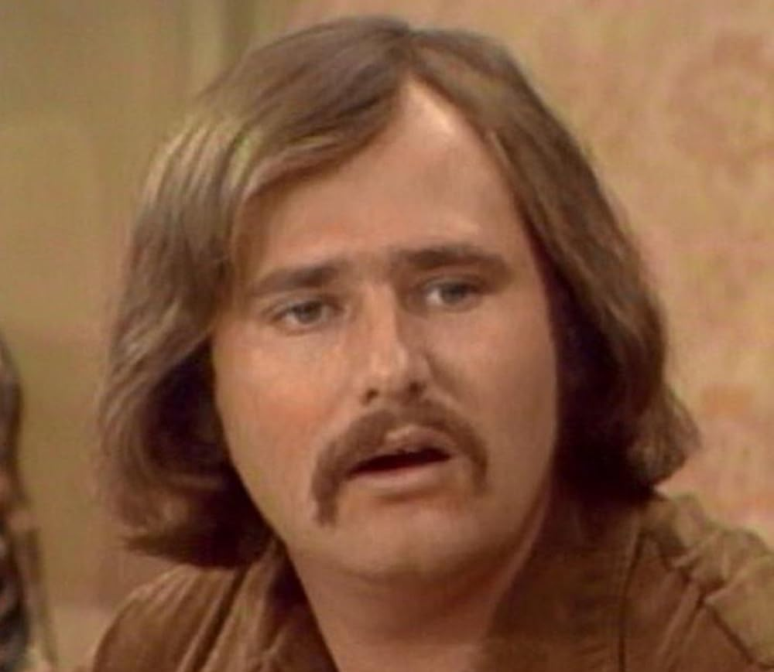
Dataset #1 Airport weather station data (ASOS)
What makes the IEM archive of public airport weather data unique / popular ?
  Global scale
  Simple download portal emitting CSV/Excel, simple on-demand APIs
  Fast services / reduced latency
Many different “autoplots” generate summaries, wind roses are very unique
NCEI targets FORTRAN users,
IEM targets this guy:

Slide 16
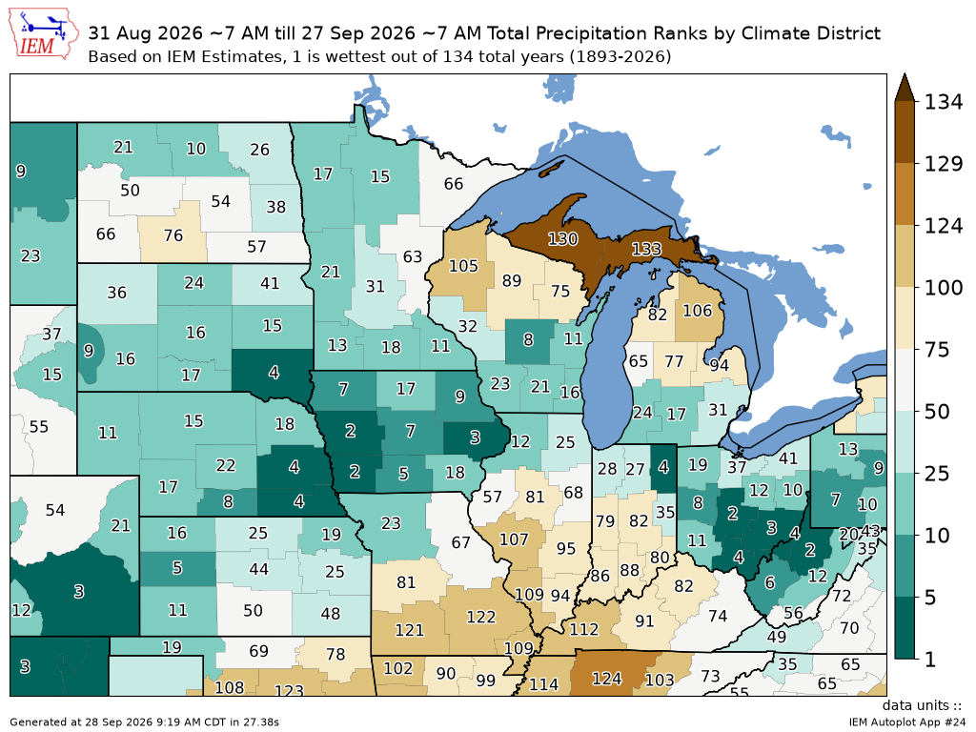
Dataset #2 ”Climodat” / NWS COOP
ISU Project dating back to the 1960s(?)
Drs Shaw, Carlson, Taylor, Todey
The dataset is once daily high+low air temp, precipitation, snowfall and snow depth with some sites back to the 1800s
Generally matches “official” data, *cough*
IEM gap fills using reanalysis
Auxiliary values point sampled from model products, like rad, soil temp
IEM has a workflow not dependant on NCEI/ACIS
IEM generates spatial aggregates

Slide 17
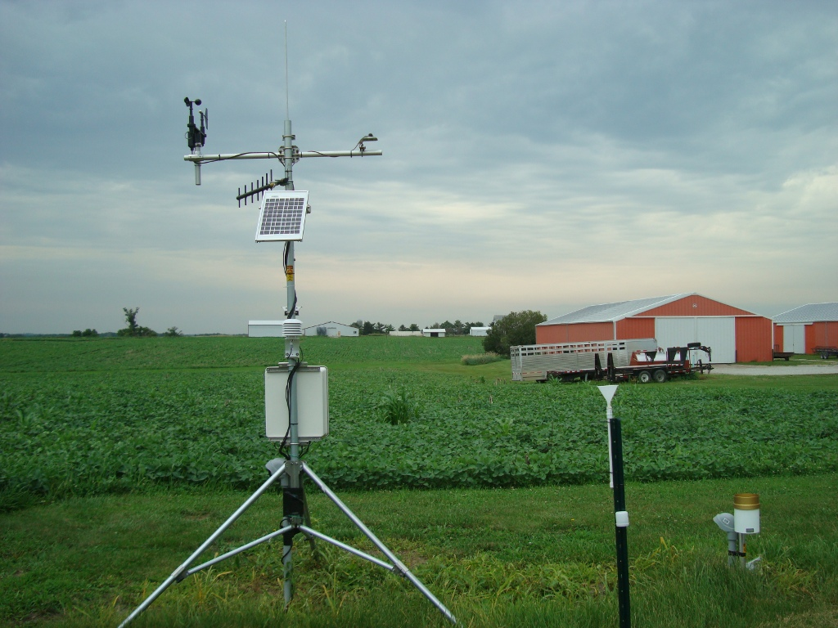
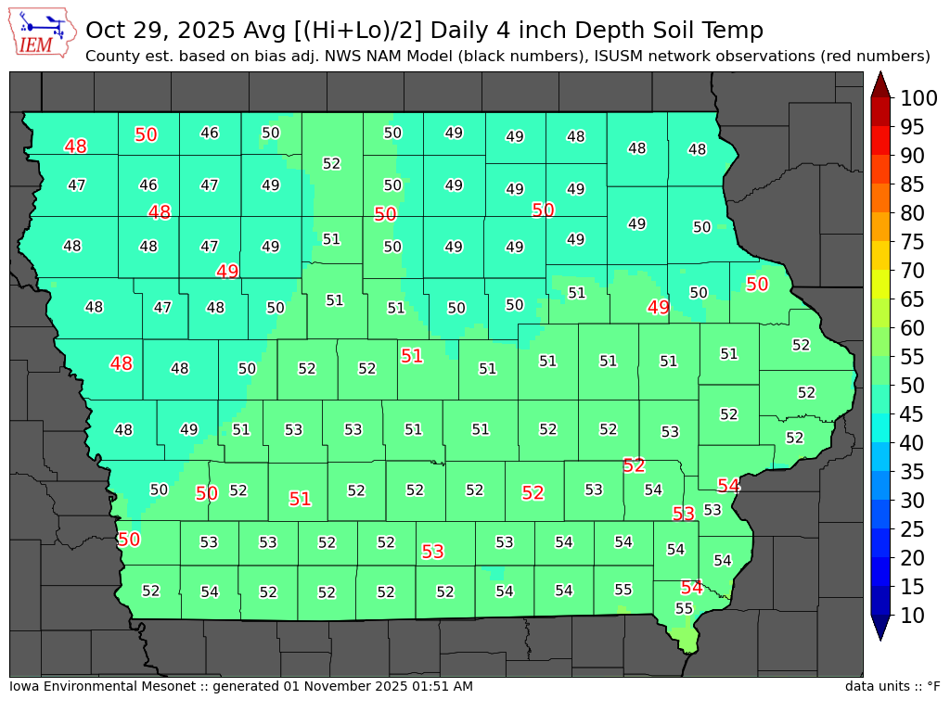
Dataset #3 ISU Soil Moisture Network
For all its warts, Iowa State operates a unique-for-Iowa ag-focused observation network with data back to the 1980s.
If you need solar radiation and soil temperature observations in Iowa, you have nearly no alternatives.

Slide 18
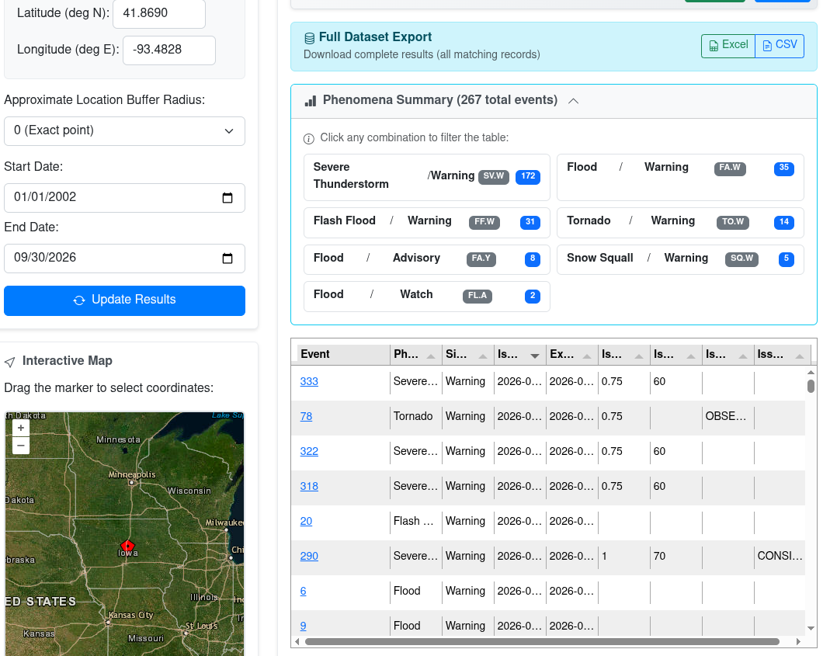
Dataset #4 NWS Watch,Warnings, and Advisories
Yet another dataset exclusively curated by the IEM due to daryl’s high pain tolerance
Common email “Why are you the only one with this data archived?”. Reply: “Well…”
Next common email “How do you have more events than NWS published bulk stats claim?” Reply: “Well…”
Tooling and products very popular with the Ag consultants sector to find damaging weather events many days/weeks/months after they occurred.

Slide 19
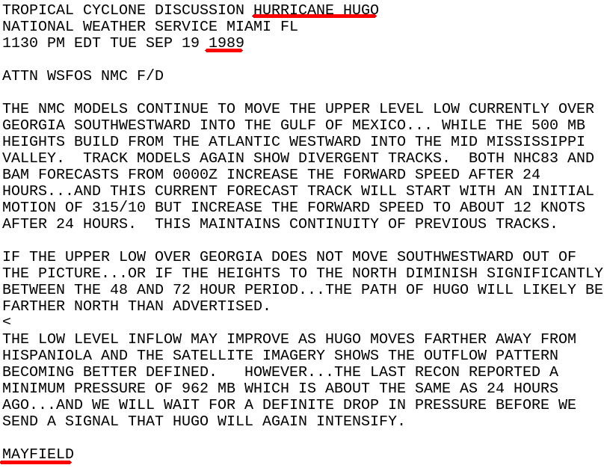
Dataset #5 NWS Raw Text
NWS text product archive dating back into the early 1980s with stable URLs, gasp.
More complete than “official” / inaccessible archives at NCEI.
Goldmine for AI/ML weather forecast trainers.
Plenty of Ag related usages
  View historical forecasts and forecast narratives.
  View warning text, local storm reports, and event summaries
  A number of places have Ag related text products written by the NWS.

Slide 20
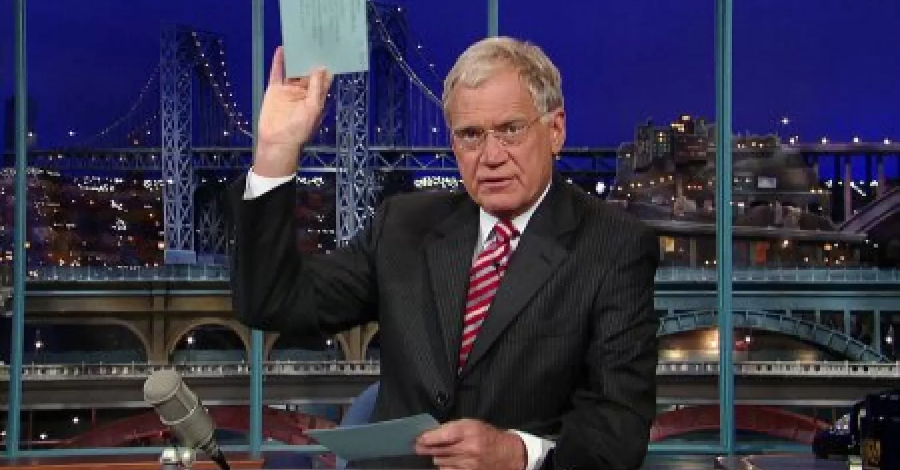
Top 10 Blissful Things

Slide 21
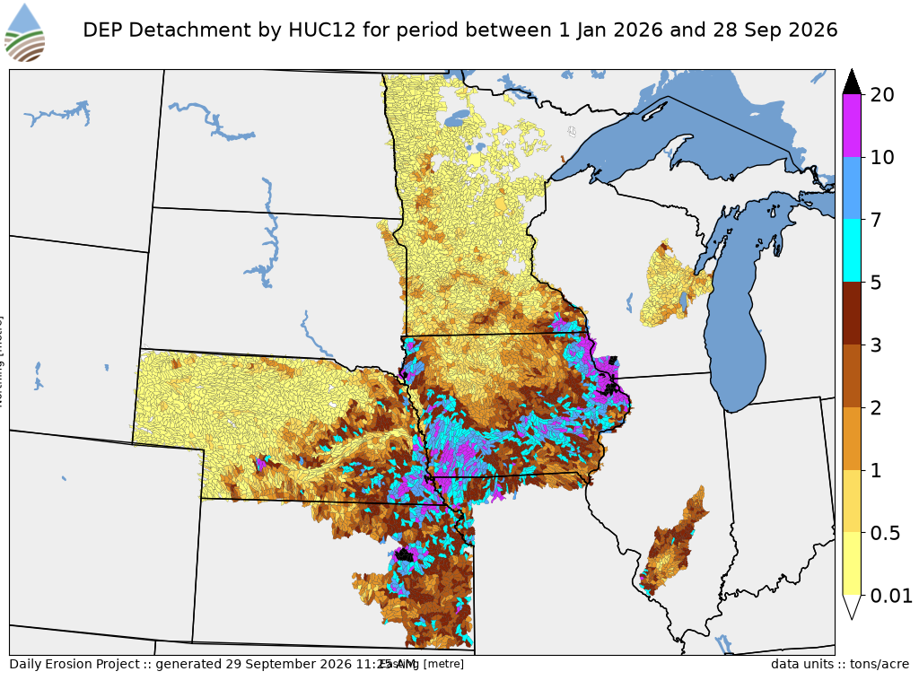
Bliss #10 Daily Erosion Project (DEP).
Drs Brian Gelder and Rick Cruse project since 2002 estimating sheet/rill soil erosion by water.
DEP project needs have driven many IEM datasets, tooling, and infrastructure.
Majority of daryl’s funding comes from DEP 🙏
IEM as infrastructure to make modelling efforts like DEP possible.

Slide 22
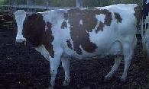
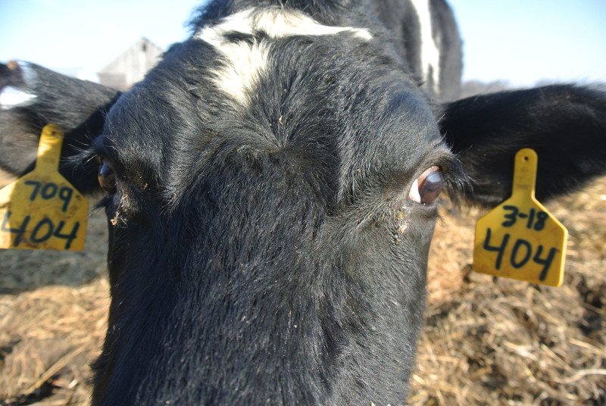
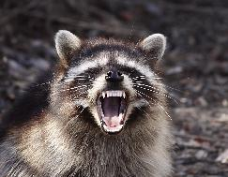
Bliss #9 Barnyard Animals
My favorite cow named “1 East Side” now adorns a heavily trafficked webapp called “IEM Cow”. Some folks refer to the entire website as “IEM Cow”...
Dr Ranae Dietzel contributed a cow picture which adorns the IEM HTTP 404 status (file not found) page.
Another random IEM app is called “IEM Raccoon”, which was just an excuse to use this picture.

Slide 23
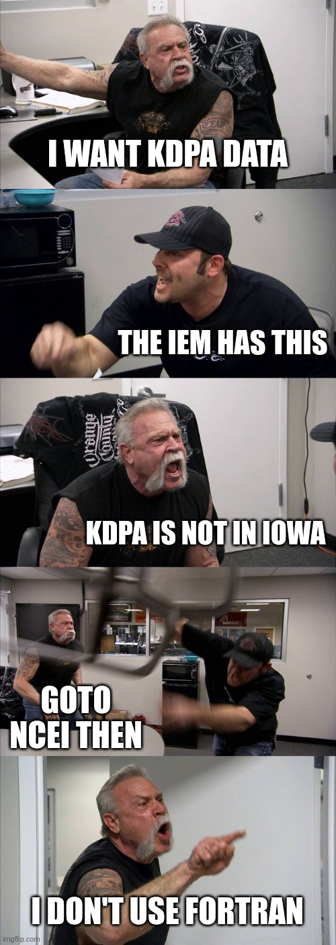
Bliss #8 Enjoy the Irony
Hiding all kinds of data / functionality in broad daylight under an innocuous name like Iowa Environmental Mesonet
Seeing #circleref dataflows within the NWS with NWS data sourced from IEM.
Noticing folks having the desire and willingness to explore convoluted rabbit holes, memorize autoplot numbers and share obscure plots on social media.
The sense of wonder folks express in emails for a .edu website.
The operational SLA demands folks express for a .edu website.

Slide 24
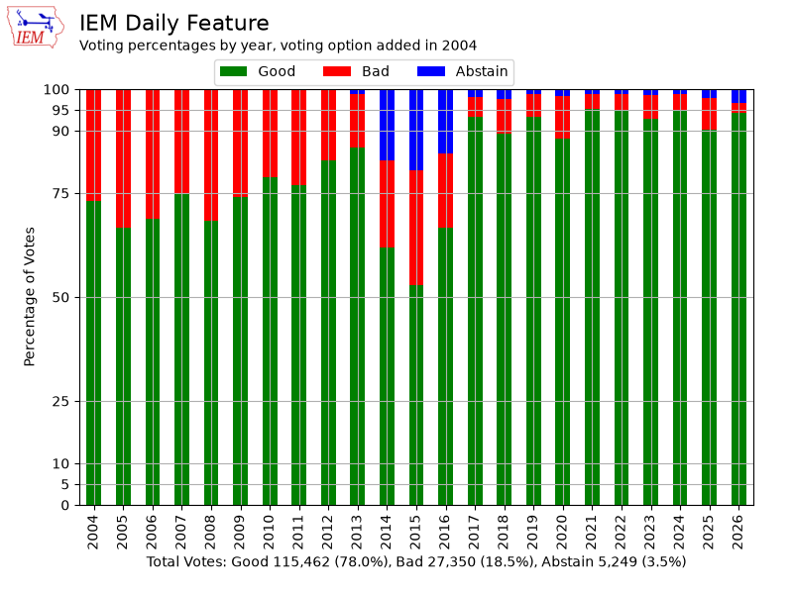
Bliss #7 IEM Daily Feature
6,356 daily blurbs posted to homepage with something currently relevant.
Abstain voting was added by obstinate NWS user wanting a less-bad “bad” option
2014-2016 blip was a website bug, sigh
Most see feature via RSS reader or daily bulletin email
Some features intentionally obscure to provoke Dr Hornbuckle 😎

Slide 25
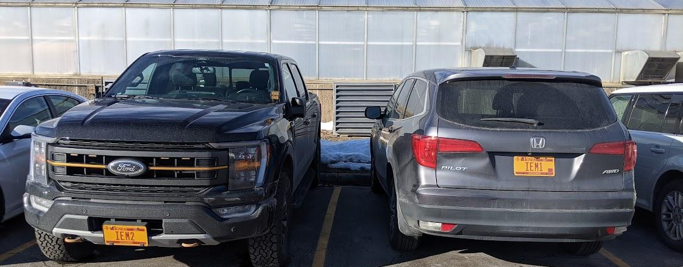
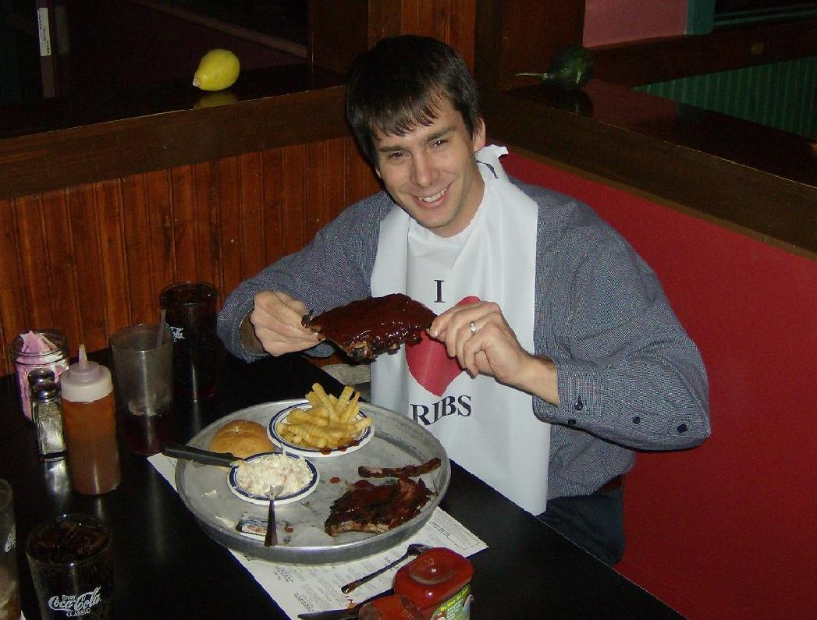
Bliss #6 My partner in crime, Dave Flory
Been helping me since the IITAP/PIRCS days! ~1999
Owner of egregious and light bar equipped IEM2
Ensures I am doing things useful for the students
Ensures science rigor of daily feature

Slide 26
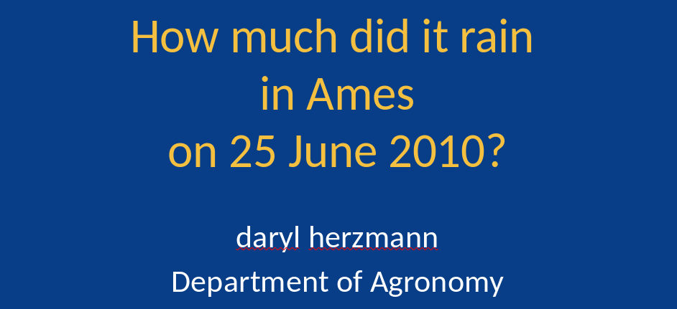
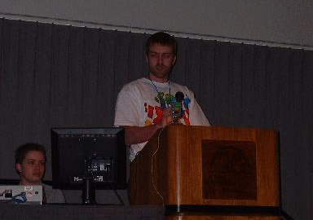
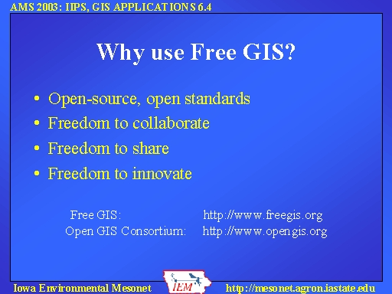
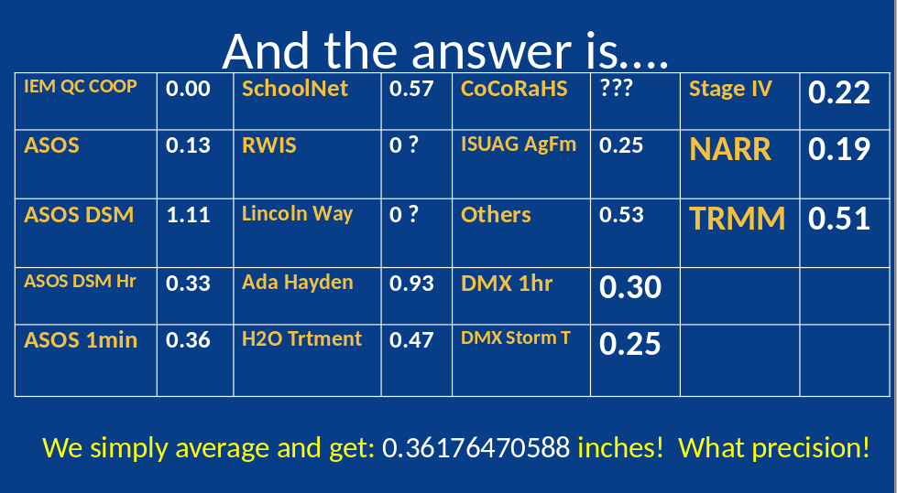
Bliss #5 Delivering memorable addresses, like today.
Circa 2003, daryl delivered an epic rant against ESRI and horrors of shapefiles. Got cornered afterwards.

Slide 27
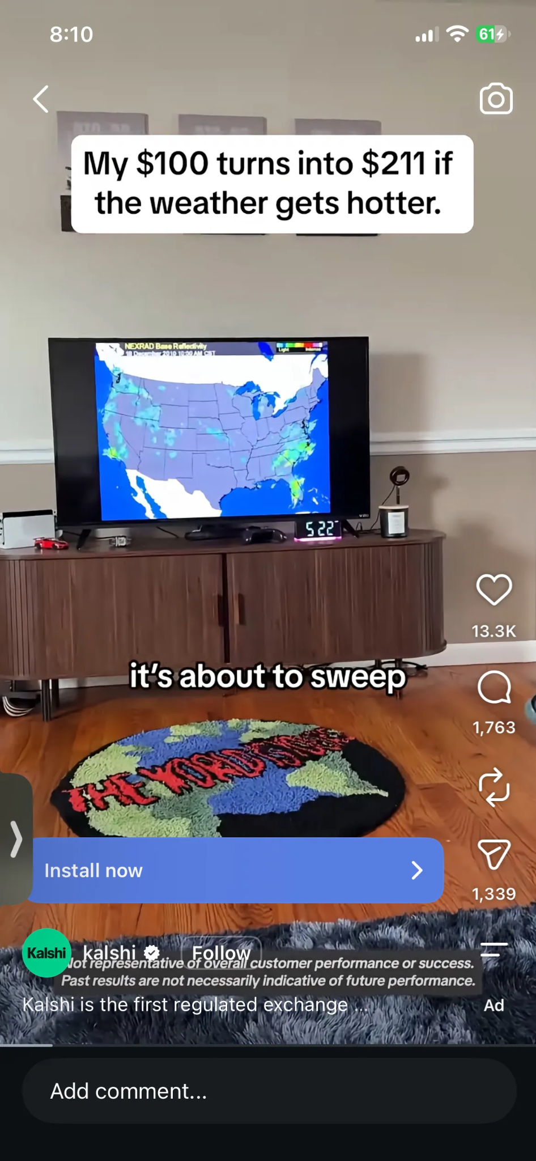
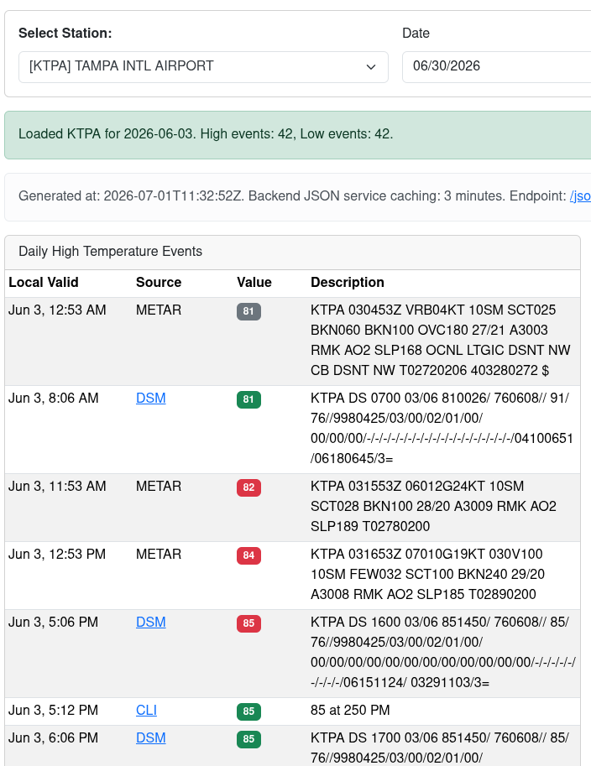

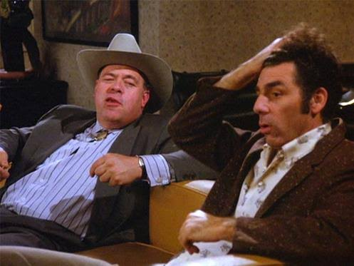
Bliss #4 The virtuous weather gamblers.
Lo and behold. For a number of minutes each day, the IEM website has a correct afternoon airport high temperature before most anybody else, including an incorrect NWS website data presentation.
The gamblers noticed.
Kramer only bet on airplane arrivals, folks now bet on airport weather station temperatures.
What a time to be alive.

Slide 28
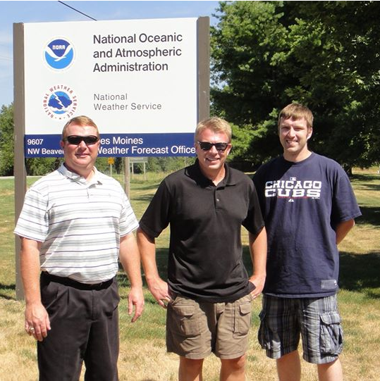
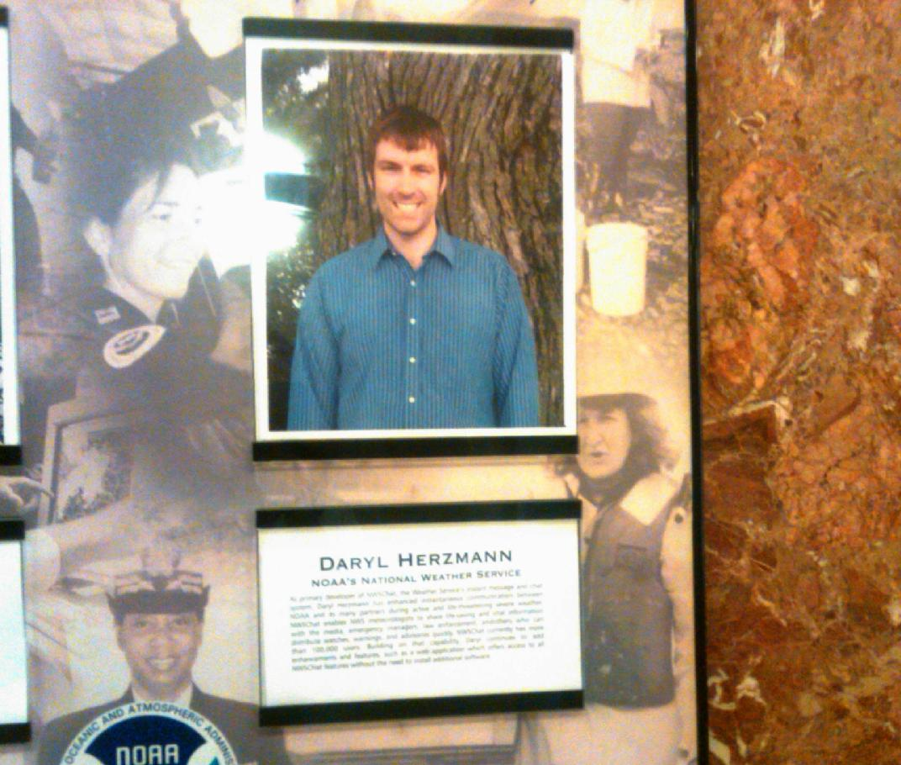
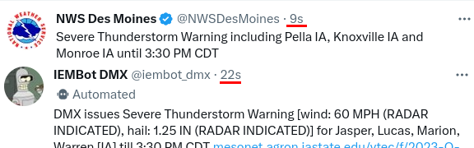
Bliss #3 IEMBot / IEMChat / NWSChat.
Building off of NWS/media/IEM partnership, an instant messaging platform was developed to support real-time collaboration needs of Emergency Management, Media, NWS, and others
Started as “IEMChat” in 2005, later rebranded as “NWSChat” in 2008, replaced by Slack in 2023.
Upper right picture, NOAA “employee of the month” award with me standing in front of a tree at the ISU Ag Farm. 🤷
This project drove significant nationwide usage of the IEM as it powered this all.
Notes:
Upper left picture (left to right). Shane Searcy (NWS Des Moines), Darone Jones (NWS Manager), daryl (IEM)

Slide 29
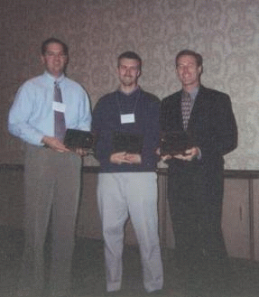
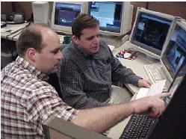
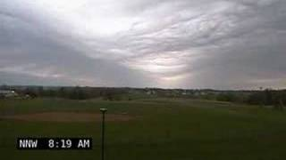
Bliss #2 KCCI-TV Des Moines
Pioneering Academia (IEM), Private (KCCI-TV), Government (NWS) partnership started in 2002
At the time, NWS was not permitted to engage the private sector for data, but IEM could be intermediary.
Started public webcam / school-based obs partnership in 2003, which spread to other TV stations.
This partnership was fortuitous for IEM nationwide popularity and notoriety
Coleman, T., K. Knupp and D. Herzmann. 2010, An Undular Bore and Gravity Waves Illustrated by Dramatic Time-Lapse Photography. Journal of Atmospheric and Oceanic Technology. Vol 27, Iss 8
Notes:
Upper right picture (left to right). Andy Kula (NWS Des Moines), daryl (IEM), John McLaughlin (KCCI-TV)

Slide 30
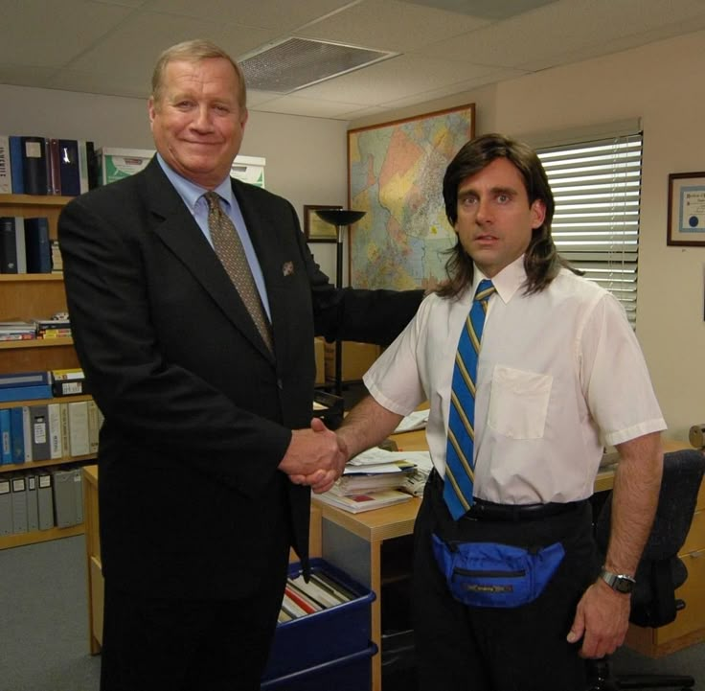
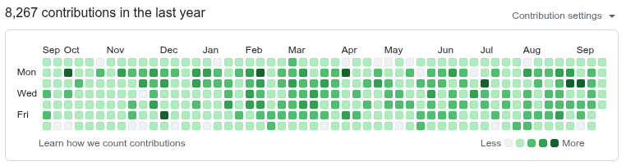
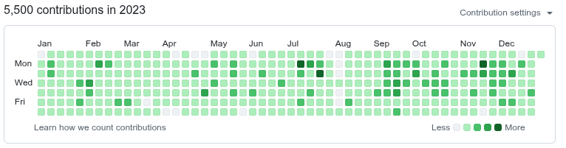
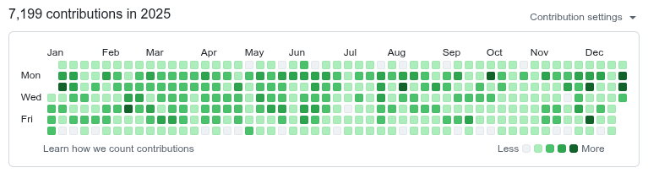
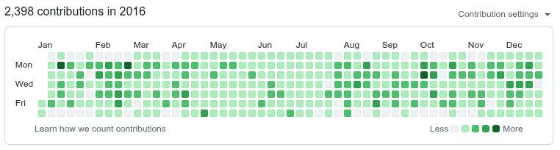
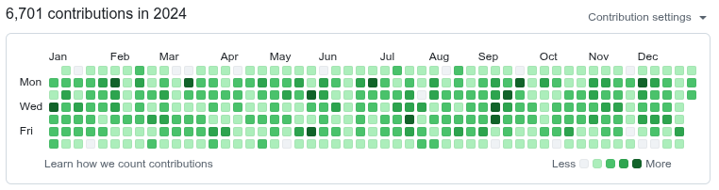
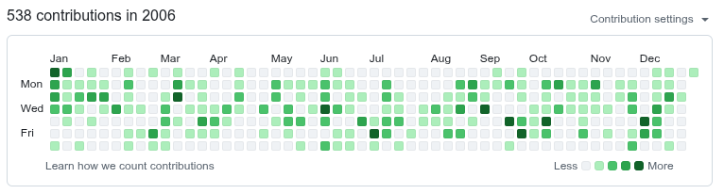
Bliss #1 DO NOT CONGRATULATE.
Extreme altruistic levels of open source software.
^^ Maintaining 25 years of technical debt on Github.

Slide 31

Last slide of memes and dry wit.
So send me a feature request email and let us add to the website trainwreck as I have bailing wire and duct tape to spare.
So put a month of my time on your research project and see how long I can sustain it, hehe.
So stop by my office (3027) anytime to experience more dry wit and pessimism about environmental data.
Thank you!
“If the women do not find you handsome, they should at least find you handy.”
“Quando Omni Flunkus Moritati.”

Slide 32

Quasi Surprise DERECHOS Project
Department of Energy (DOE) / Atmospheric Radiation Measurement (ARM) Mobile Facility #2 is coming to Iowa!
Operation 2028-2029
Operating from MRF (Muscatine) and SERF (Crawfordsville) Ag Farms
~$10M worth of equipment, 4-5 employees onsite, 24/7 ops
Collaborations strongly encouraged!

Slide 33

Actual Surprise ISU Soil Moisture App
Probably most requested thing I have not done over the past 25 years, a smartphone app for the ISU Soil Moisture Network.
iOS AppStore and Google Play submissions in progress.
My first ever app and I am 48 years ago, so this is great pain bliss, but we vibe maxxing
Please let me know if you want to test and drive features forward.
Maybe this will atone for the IEM sins against the ISU Soil Moisture Network.

