Slide 1






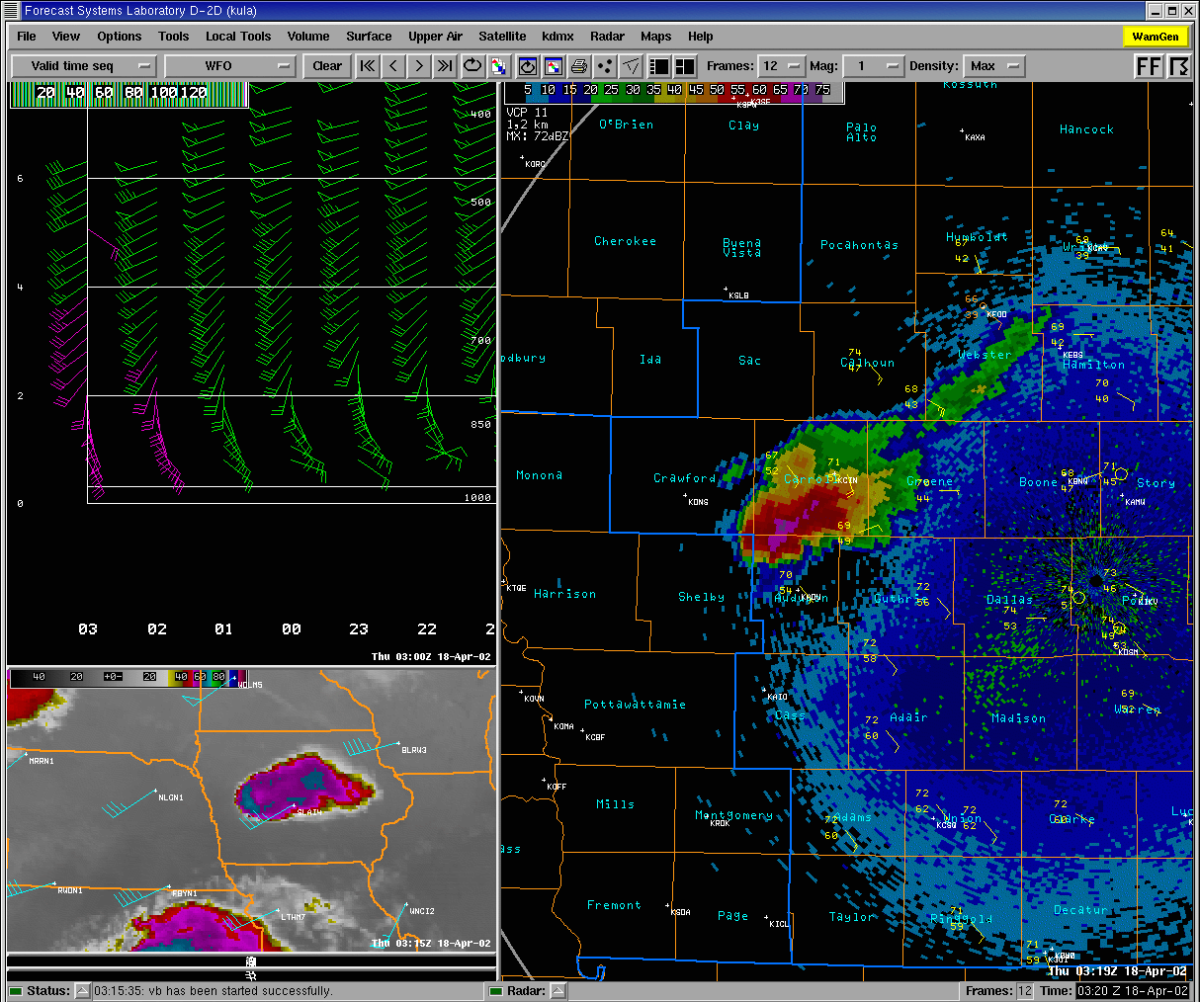
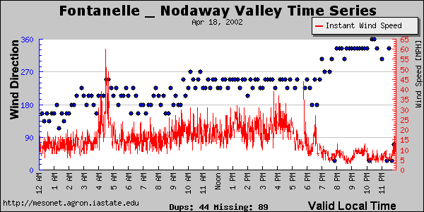
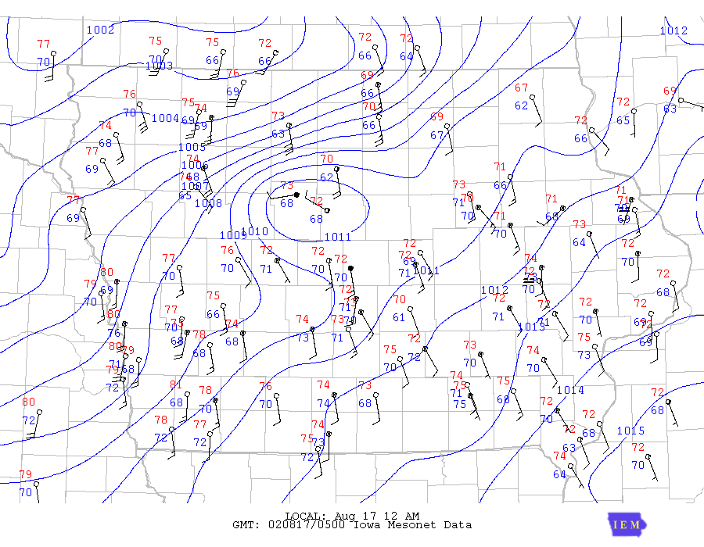
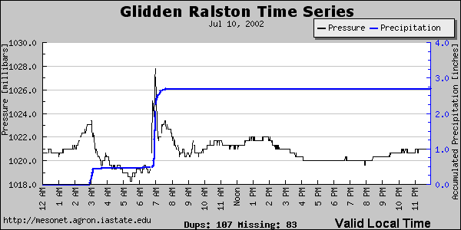
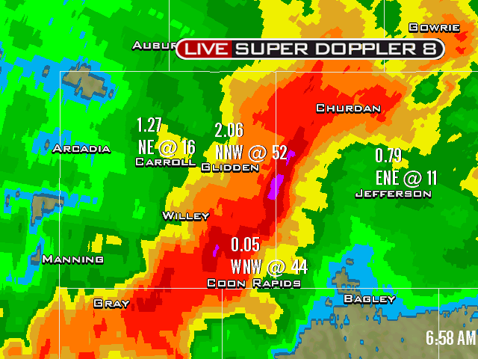
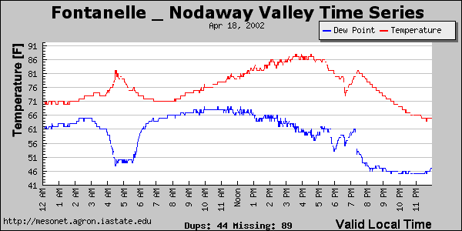
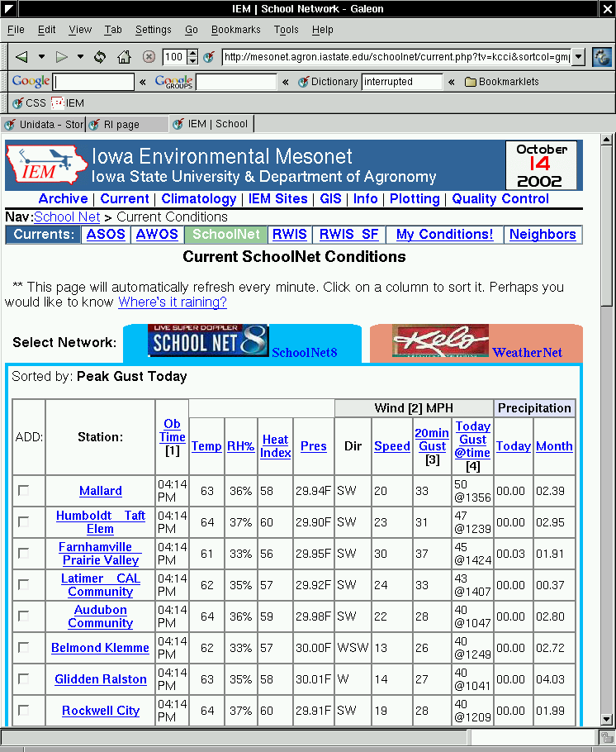
The IEM – KCCI – NWS Partnership: Working Together To Save Lives and Increase Weather Data Distribution
John McLaughlin¹, Andy Kula², Dr. Dennis Todey³ and Daryl Herzmann³
WFUS53 KDMX 180327
TORDSM
IAC009-180400-
BULLETIN - EAS ACTIVATION REQUESTED
TORNADO WARNING
NATIONAL WEATHER SERVICE DES MOINES IA
1027 PM CDT WED APR 17 2002
THE NATIONAL WEATHER SERVICE IN DES MOINES HAS ISSUED A
* TORNADO WARNING FOR...
NORTHERN AUDUBON COUNTY IN WEST CENTRAL IOWA
* UNTIL 1100 PM CDT
* AT 1024 PM...NATIONAL WEATHER SERVICE DOPPLER RADAR INDICATED A
TORNADO 7 MILES NORTH OF AUDUBON...OR ABOUT 61 MILES SOUTHWEST OF
FORT DODGE...MOVING EAST AT 35 MPH.
* THE TORNADO WILL BE...
IN RURAL AREAS OF
NORTHERN AUDUBON COUNTY.
IF YOU ARE CAUGHT OUTSIDE...GO TO A NEARBY REINFORCED BUILDING. AS A
LAST RESORT...GET IN A CULVERT OR DITCH AND COVER YOUR HEAD WITH YOUR
HANDS.
IF IN MOBILE HOME OR NON-MOVING VEHICLE...EVACUATE AND GO TO A
SUBSTANTIAL SHELTER.
LAT...LON 4185 9509 4169 9510 4169 9476 4186 9475
JOHNSON/KINNEY
Since December of 2000, KCCI-TV of Des Moines, IA has installed 44 school network weather stations. These stations report live weather conditions via the Internet. The network was providing valuable information, but the sheer volume of the data was over-whelming. At this time development of the Iowa Environmental Mesonet [IEM] began.
As a project of the Iowa State University Department of Agronomy, the IEM’s goal is to gather, collect, compare, disseminate and archive environmental data from all networks in the state of Iowa. The IEM added the KCCI data feed in February of 2002. Since then, the utilization and distribution of the KCCI SchoolNet data has dramatically increased.
The primary user of the IEM processed SchoolNet information is the National Weather Service office in Des Moines, IA. The addition of the 44 rainfall observing sites has increased their automated observing network by 70%. Real-time severe wind gusts are automatically displayed on their AWIPS workstations. Hydrological information is used by their office and the River Forecast Centers (RFC). Surface observations are collected and used by the Storm Prediction Center (SPC).
The cooperation has been beneficial to each group and ultimately, the people of Iowa by improved forecasts and severe weather warnings.
Improved boundary detection provides warning meteorologists with crucial information of the near storm environment. In this case, the warning meteorologist decision to issue a tornado warning was aided by an increased density of observations provided by the IEM, KCCI SchoolNet, and Iowa Department of Transportation.
Background
Near Storm Environment
IAZ004-005-015-023-024-170500-
EMMET-HUMBOLDT-KOSSUTH-PALO ALTO-POCAHONTAS-
INCLUDING THE CITIES OF...ALGONA AND ESTHERVILLE
954 PM CDT FRI AUG 16 2002
...A HIGH WIND WARNING HAS BEEN ISSUED UNTIL MIDNIGHT...
WINDS WILL SUDDENLY INCREASE TO 50 TO 60 MPH SUSTAINED WITH GUSTS
NEAR 70 MPH BETWEEN NOW AND 11 PM. THESE WINDS COULD LAST 30
MINUTES TO AN HOUR...PRODUCING TREE AND OTHER STRUCTURAL DAMAGE.
A HIGH WIND WARNING IS ISSUED WHEN SUSTAINED WINDS OF 40 MPH ARE
EXPECTED FOR AT LEAST AN HOUR...OR GUSTS OF 58 MPH OR GREATER OCCUR
AT ANY TIME. DAMAGE TO TREES...POWER LINES AND PROPERTY ARE LIKELY
WITH WIND OF THIS MAGNITUDE.
MOTORISTS SHOULD EXERCISE CAUTION WHILE DRIVING IN THE WARNING AREA.
REMAIN ALERT TO SUDDEN GUSTS OF WIND WHICH MAY CAUSE YOU TO LOSE
CONTROL OF YOUR VEHICLE. EXTRA ATTENTION SHOULD BE GIVEN TO CROSS
WINDS WHEN DRIVING.
$$
KULA
The IEM – KCCI – NWS partnership is aiding flash flood prediction and river level forecasts. The KCCI School Net provides 44 new real-time rainfall observations, accessible to forecasters at the National Weather Service, KCCI and on the IEM web page. This data adds critical up to the minute rainfall information during intense storms that are capable of producing flash floods. The IEM web page provides time series views (shown upper-left), an observation table application (shown lower-left) and GIS precipitation tools. The table application allows users to easily sort rainfall and other weather elements based upon their order of magnitude. KCCI School Net data is provided in ESRI shapefile format for easy use in GIS applications, increasing the distribution of information to decision makers who use GIS, including emergency managers. KCCI meteorologists are able to analyze and broadcast a display of School Net observations, including rainfall, with live radar imagery (shown upper-right). Rainfall observations from the School Net are also fed to National Weather Service River Forecast Centers for use in river flood prediction.
One KCCI SchoolNet site captured a heat burst event on 18 April 2002. Time series from the event are shown above. Forecasters were instantly alerted to the severe non-thunderstorms gusts occurring as this feature propagated northeastward into Iowa from dying convection to the south.
A surface plot depicting an intense pressure gradient caused by a possible gravity wave is shown in the upper right-hand plot. Again, forecasters were instantly alerted for the high winds from the powerful wind event leading to a warning issuance.
High Wind Detection
Intense Rainfall Detection
¹KCCI-TV Des Moines, IA http://www.theiowachannel.com ²Des Moines NWS WFO http://www.crh.noaa.gov/dmx/ ³ Iowa State University (IEM) http://mesonet.agron.iastate.edu

