Slide 1
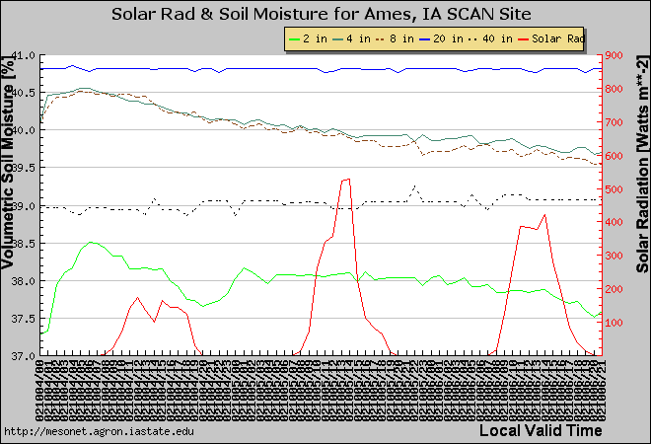
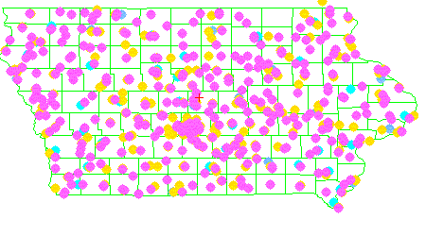
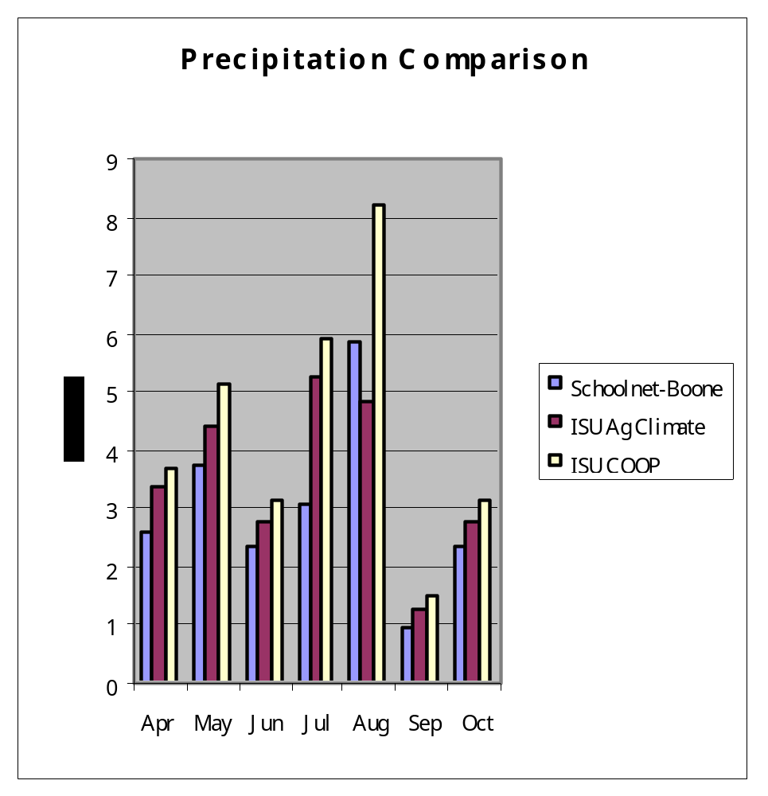
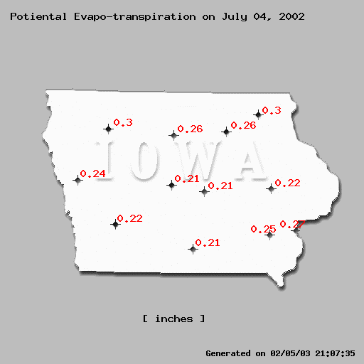
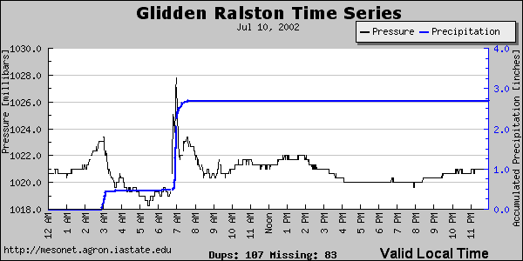
Improving the observation of the water cycle in Iowa using the Iowa Environmental Mesonet
Dennis Todey
Ag Engineering
South Dakota State University
Daryl Herzmann
Department of Agronomy
Iowa State University
Overview
The Iowa Environmental Mesonet (IEM) (Todey et al. 2002) is a project initiated to combine data from all available networks in Iowa into a single data archive. These data are being archived, reviewed for comparisons and used to make a variety of products to observe the weather and climate in the state. The combination of networks has several benefits. One of which is increasing the density and types of observation in the state.
These observations can lead to improving the depiction of the components of the water cycle across the state by improving the density of precipitation measurements, assessing the soil moisture conditions and estimating the surface water transfer via evaporation measurements and evapotranspiration estimates.
Soil Moisture Storage/Change
The soil moisture condition is usually modeled because rarely is it measured. And when measured it is not done on large temporal or spatial scale. Iowa is improving this aspect of the state’s observing capability by installing 5 level soil moisture (Fig. 2) at 13 locations across the state. These will provide real-time point measurements of the soil moisture profile and change over time.
Precipitation
Detailed observation of precipitation is one of the most difficult observational issues. Iowa has the advantage of a large number of rain gauges (Table 1) for the size of the state (Fig. 3). One of the difficulties is the comparison of rain gauges because of the differing temporal scales. The gauges listed range from every minute (Fig. 4) to hourly to daily accumulation. Comparison of automated gauges with cooperative stations provides the best standard, but is particularly difficult because of inconsistency in observing time.
Initial comparisons of monthly total reveal the one of the difficulties in comparing networks (Fig. 5).
Future work will involve using NEXRAD precipitation estimates for a related project to improve the spatial depiction of precipitation.
Table 1
Evaporation/Potential Evapotranspiration
Observations and estimates of evapotranspiration are sometimes estimated by pan evaporation stations. Currently only 4 pan evaporation stations are active in Iowa. But potential evapotranspiration is estimated using atmospheric measurements (Meyer et al, 1989) on a daily basis (Fig. 1) and accumulated over seasonal values.
Observing System | Stations Recording Precipitation
National Weather Service ASOS | 15
Iowa DOT AWOS | 33
NRCS - SCAN | 2
Iowa State University Ag-Climate | 12
USGS/USACOE | 115
National Weather Service COOP | 169
Schoolnet | 49
Fig. 3 Precipitation station distribution
Pink COOP/DCP
Yellow Schoolnets
Blue Airport (ASOS/AWOS)
Fig. 2 Hourly volumetric soil moisture content and solar radiation
Fig. 5 Monthly accumulated precipitation for three stations located within 300 m of each other.
Conclusions
Combining networks, while having some difficulties, such as differing time scales, siting issues, and data collection differences, can be an effective method of improving the observing capability of an area.
References
Meyer, Hubbard, K.G. and D. Wilhite, 1989: Estimating potential evapotranspiration – the effect of random and systematic errors. Agric. For. Meteor., 46, 285-296.
Todey, D.P., D.E. Herzmann, and G.S. Takle, 2002. The Iowa Environmental Mesonet – combining networks into a single network. Preprints 6th Symposium on Integrated Observing Systems, Orlando, FL, Amer. Meteor. Soc.
Fig. 1 Daily PET estimates
Fig. 4 Minute accumulated precipitation and slp for Glidden-Ralston Schoolnet station.
http://mesonet.agron.iastate.edu

