Slide 1
Using GIS for Environmental Data in Iowa
Dr Dennis Todey
South Dakota State University
Daryl Herzmann
Iowa State University

Slide 2
Background Information
Iowa Environmental Mesonet [IEM]
  Project of Iowa State University in Ames, IA
  Built on partnerships between public, private and academic entities
  Utilize environmental data from existing observing networks
  Archive holds more than 300 million observations from the state of Iowa

Slide 3
Why use GIS?
GIS provides a framework for
  application development
  data storage
  data distribution
  data analysis
  scientific collaboration

Slide 4
Why use Free GIS?
Open-source, open standards
Freedom to collaborate
Freedom to share
Freedom to innovate
Free GIS: http://www.freegis.org
Open GIS Consortium: http://www.opengis.org

Slide 5

U of Minnesota’s MapServer
Environment for spatially enabled applications
Open-source
Very fast and extensible system
Some formats supported
  ESRI shapefiles
  Spatial databases
  Raster images
Features
  Template driven
  TrueType fonts
  WMS / WFS support

Slide 6
IEM GIS Efforts
GIS data generation & distribution
Application development with MapServer
Spatial data storage with PostgreSQL using the PostGIS spatial extension
GIS education
Collaboration with Iowa State GIS Lab

Slide 7

GIS Datasets
Climate Observations
  NWS COOP data
Current Conditions
  SchoolNet Data
  NWS COOP observations
  NEXRAD imagery

Slide 8
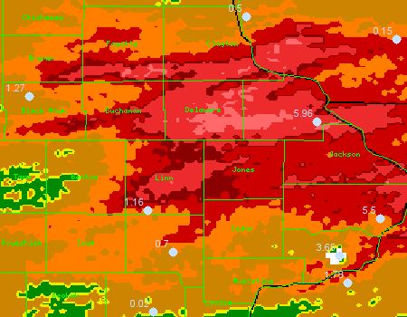
3-4 June 2002 Flooding
DBQ: 5.96 in
NEX: 7+ in
Downtown Cedar Rapids: < 9 in
NEX: 7+ in
CID Airport:
1.16 in
NEXRAD Est:
2 in

Slide 9
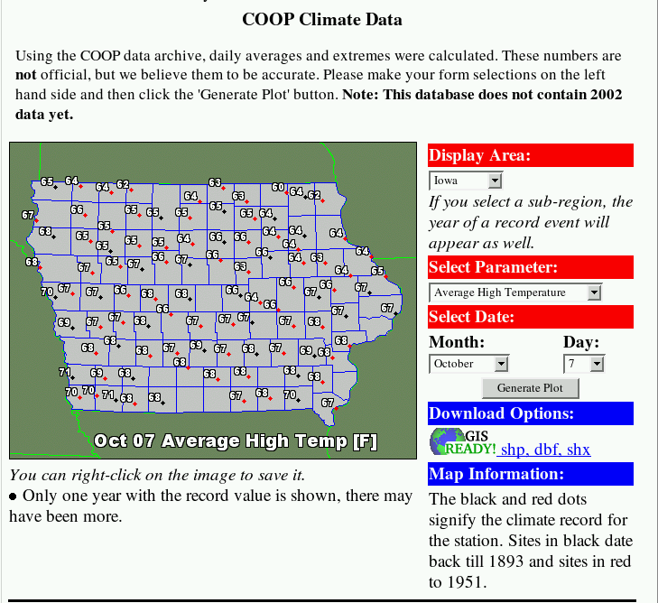
Ex 1: Climatological Data
Data Sources
Climate data in spatial database
Political boundaries in shapefiles
Interface
PHP generated
GIS Ready!

Slide 10
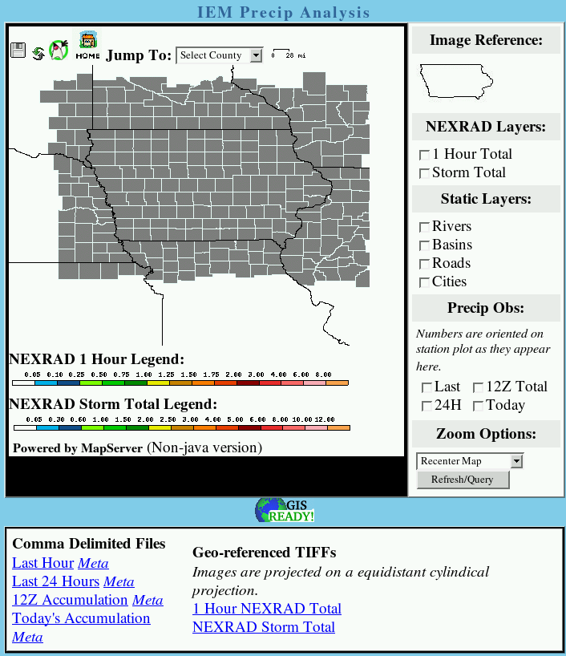
Ex 2: Real-time Rainfall Analysis
Data Sources
Current rainfall observations in spatial database
Current NEXRAD precip RASTERs
Interface
CGI
GIS Ready!
WMS Ready!

Slide 11
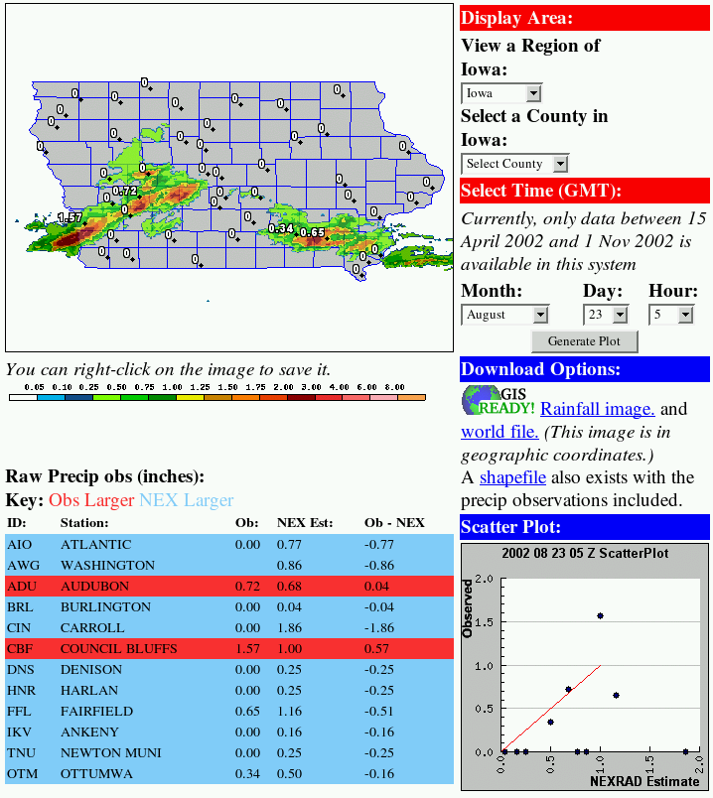
Ex 3: Historical Rainfall Analysis
Data Sources
Spatial database of 2002 precipitation obs and estimates
Archive of NEXRAD RASTERs
Interface
PHP
GIS Ready!
Integrate dynamic analysis charts

Slide 12
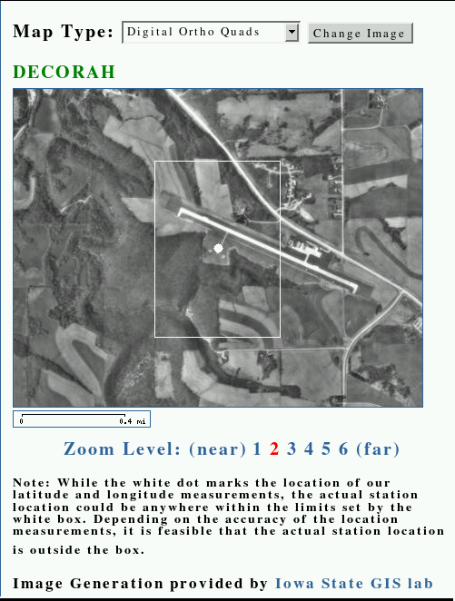
Ex 4: Station Meta-data
Data Sources
Spatial database
Ortho imagery from ISU GIS Lab Ortho server (remote WMS)
Interface
PHP
Dynamic uncertainty box

Slide 13
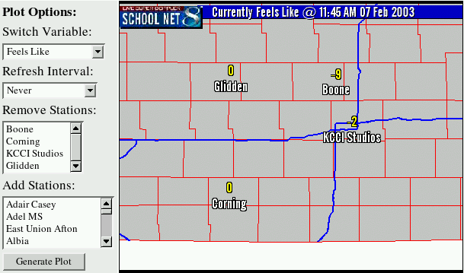
Ex 5: Dynamic Data Plotting
Data Sources
Spatial database current obs
Political shapefile
Interface
PHP
Dynamic extent calculation
Coming soon, NEXRAD layer and looping….

Slide 14
Future Efforts
NEXRAD WMS available.
Development work continues with MapServer.
More datasets available in GIS format.
More data stored in spatial database.
Everything you have seen is Open-Source and available for you to use.

Slide 15

Questions?
Daryl Herzmann
akrherz@iastate.edu
515.294.5978

