Slide 1
KCCI SchoolNet8 and the Iowa Mesonet
Daryl Herzmann
Iowa State University

Slide 2
Iowa Environmental
Mesonet 411
What does ‘mesonet’ mean?
  ‘meso’ - Spatial scale, ‘net’ - network
Why ‘environmental’?
  We are interested in air quality, water quality and other non-weather datasets
Where is ‘Iowa’?
  It is the current state you are in other than confusion.

Slide 3
More on the IEM
Project of the Department of Agronomy at Iowa State University
We are data pigs.
Look to meet the growing data needs of users in the State and elsewhere.
KCCI SchoolNet has provided us a valuable network to meet various needs.

Slide 4
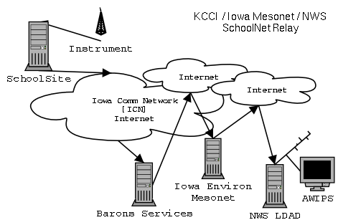
Data Flow

Slide 5
Data Formatting
C 074 Min 02/17/03 ENE 00MPH 000K 460F 007F 084% 30.08" 00.00"D 00.07"M 00.00"R
D 074 Max 02/17/03 ENE 10MPH 050K 460F 021F 100% 30.20" 00.00"D 00.07"M 00.00"R
E 074 12:01 02/17/03 ENE 03MPH 046K 460F 020F 099% 30.09F 00.00"D 00.07"M 00.00"R
Your site produces roughly 6 obs per minute!

Slide 6
Converted Data Formats
METAR
SAUS43 KDMX 171536
METAR
QJEI 171535Z 05004KT M13/M14 A3009 RMK T11281144 P0000 70000=
Comma Delimited
SAEI4,2003/02/17 15:35:00,-11.7, 13.3,2,180,0.0,0.0,30.09

Slide 7
SchoolNet8 Data Users

Slide 8
SchoolNet8 Data Users
Storm Prediction Center [SPC]
  Norman, Oklahoma
  In charge of providing timely forecasts and watches of extreme weather.
  Use schoolNet8 data to identify mesoscale boundaries critical in severe weather forecasting

Slide 9
SchoolNet8 Data Users
River Forecast Center [RFC]
  Chanhassen, MN
  In charge of analyzing and forecasting river flood conditions. Hydrological data.
  Use SchoolNet8 precipitation totals for their water analysis.
  The SchoolNet8 network has doubled the hydrological observing sensors in Central Iowa.

Slide 10
SchoolNet8 Data Users
Forecast Systems Laboratory [FSL]
  Boulder, Colorado
  Data collected under the MADIS project.
  Data is used in very detailed and heavily quality controlled surface analysis programs.
  This data is then included in some NCEP models.

Slide 11
SchoolNet8 Data Users
National Weather Service [NWS]
  Des Moines, IA
  Receiving data in three different formats
  Use data in hydrological applications, surface analysis, severe weather awareness, winter weather awareness.
  Are automatically alerted of 50+ MPH wind gusts and heavy rainfall.

Slide 12
NWS Auto Alerts
Previously, KCCI would have to manually relay observations to the weather service.
Now, the IEM automatically generates warnings that appear on forecaster workstations.

Slide 13
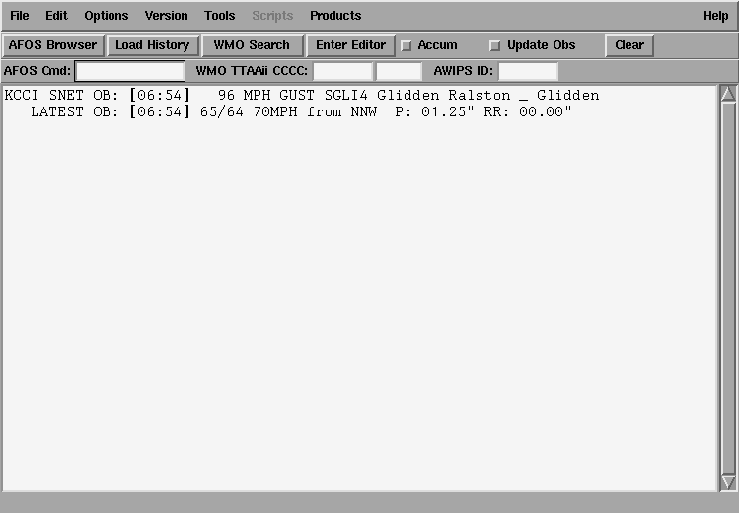
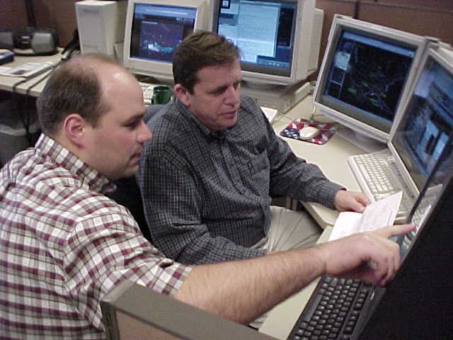
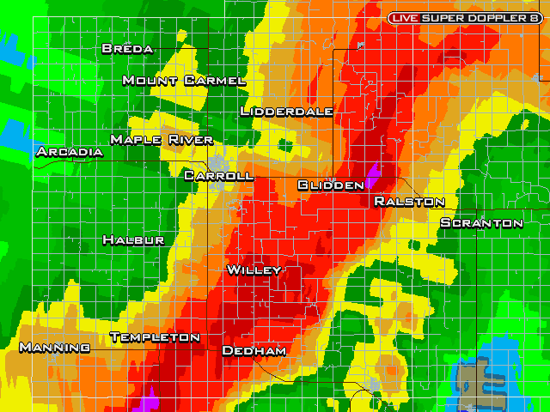
NWS AWIPS alerts

Slide 14
WWW Resources

Slide 15
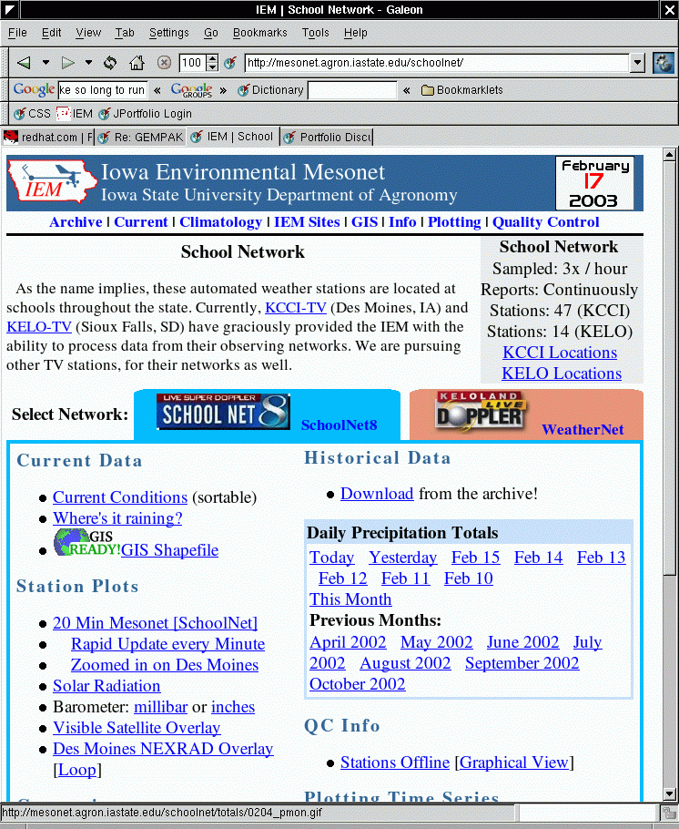
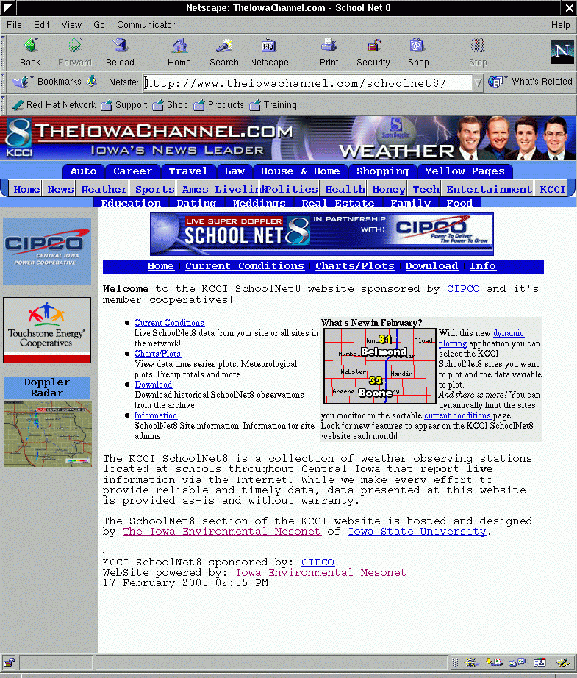
Which website is which?

Slide 16
IEM Tracker

Slide 17
IEM Tracker
System to record metadata about sites
Most of you have probably gotten the emails from “Iowa Environ Mesonet”
Since the system came online on 25 June 2002, it has generated over 3700 tickets
Most of these tickets are generated from the automated data tracking system

Slide 18
What are offline alerts?
When ‘online’, your site is streaming observations to the Internet at roughly 6 obs per minute.
A process on the IEM server monitors this feed and once the most recent ob is 30 minutes old, a trouble ticket is generated and site contacts are emailed.

Slide 19
Understanding the Ticket.
---------------------------------
| *** IEM TRACKER REPORT *** |
------------------------------------------------------------
ID : SCOI4
Station Name : COLO ELEM _ COLO
Status Change : [OFFLINE] Site is NOT reporting to the IEM
Trouble Ticket# : 3704
Last Observation : 2003-02-17 23:53:00.00

Slide 20
More about the tickets
Probably 50% of the tickets are network related and out of your hands.
5% of the tickets are responded to with further information
IEM tracker has improved network performance for each of the networks it monitors.

Slide 21
Trouble Ticket Stats
Fewest Tickets
  5 Jefferson Scranton
  6 Ankeny Christian
  6 Leon
Highest Online %
  94 Perry
  92 Jefferson Scranton
  92 Clarke Osceola
Most Tickets
  44 Mount Ayr
  41 Colo
  36 Panora
Lowest Online %
  54 Pella
  61 Brooklyn
  70 Clarion

Slide 22
Keep those clocks set!
Data on the IEM website is given a timestamp of the current IEM system clock and NOT the timestamp on the observation.
The precipitation counters are adversely impacted by drifting clocks.
It makes it a bit more difficult to calculate daily precipitation totals.

Slide 23
Download Data Archive

Slide 24
Data Archives
1 minute data archive exists since 14 Feb 2002, this is available on-line
Since 10 Jul 2002, every observation is archived, but not readily available
Quickly accessible summary data is coming soon.

Slide 25
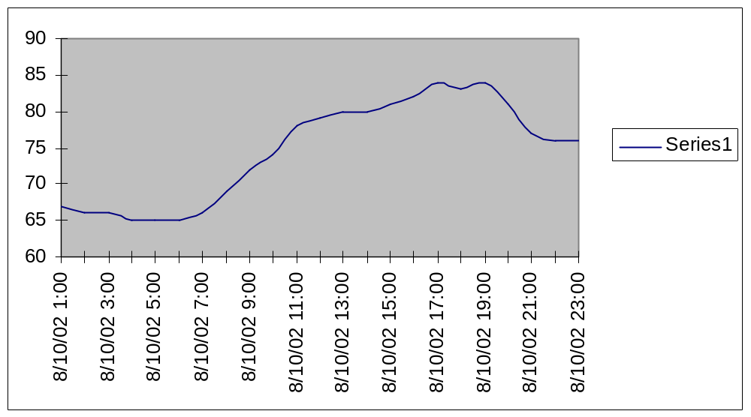
Hourly temperatures

Slide 26
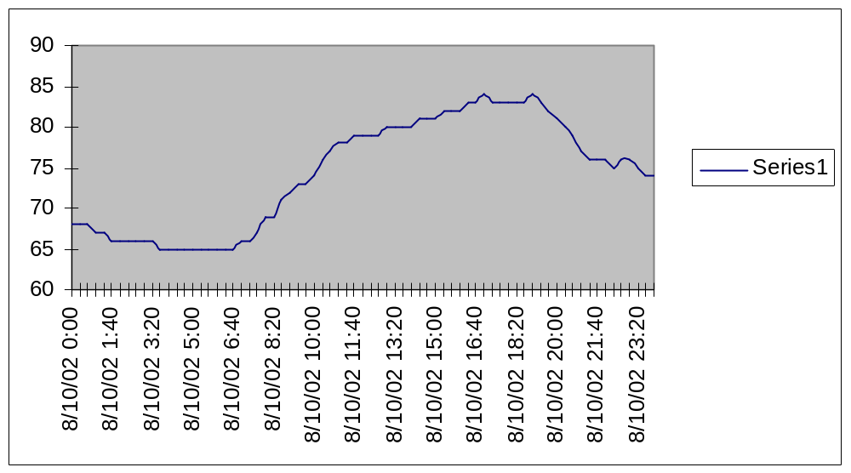
20 minute temperatures

Slide 27
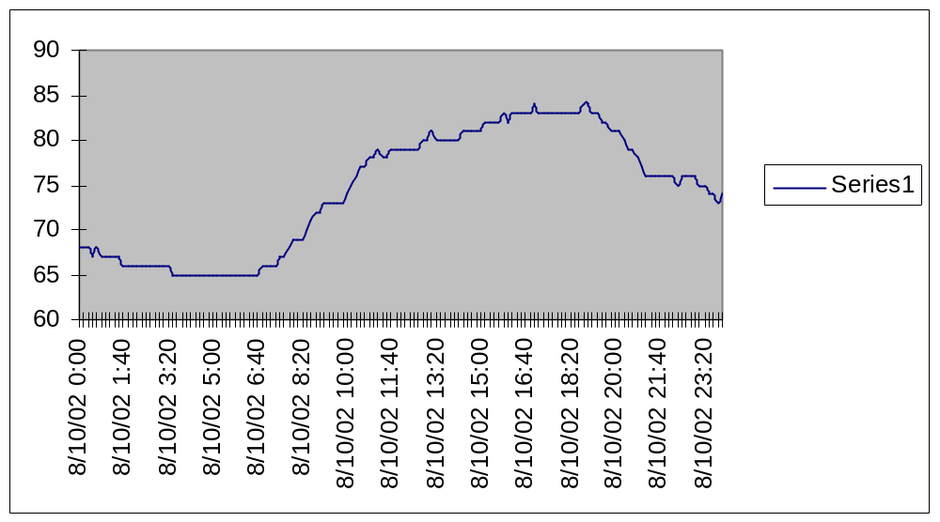
10 minute temperatures

Slide 28
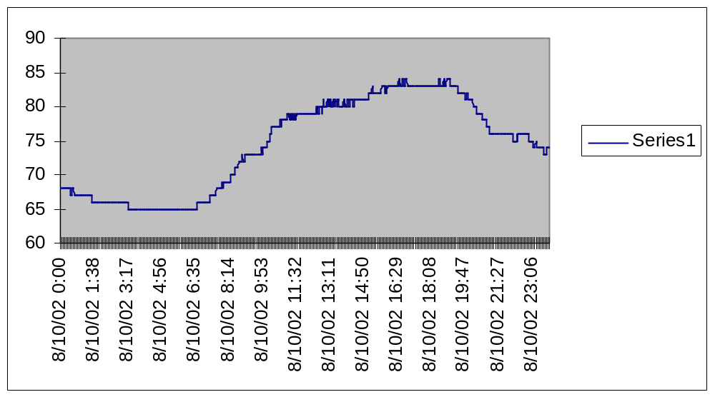
1 minute temperatures

Slide 29
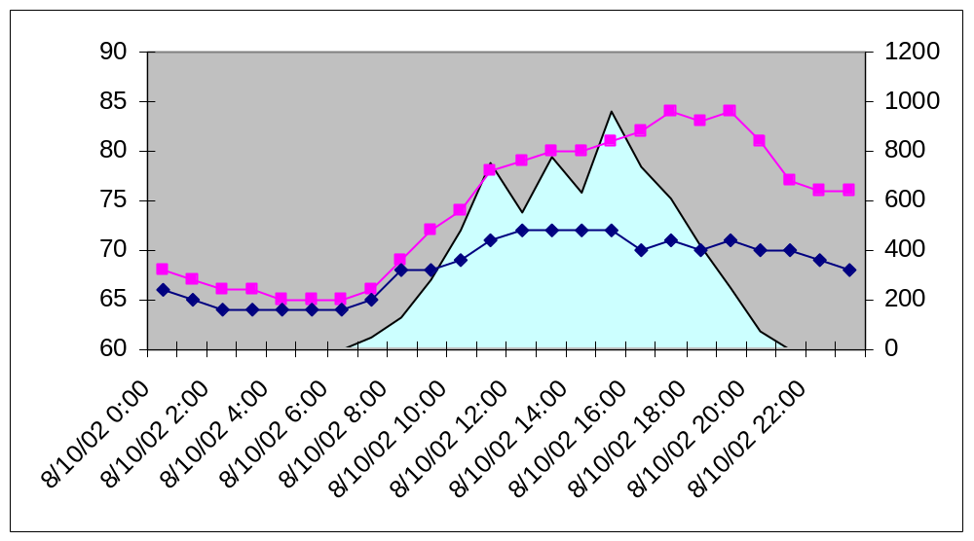
Hourly data
Temperature Dew Point Solar Radation

Slide 30
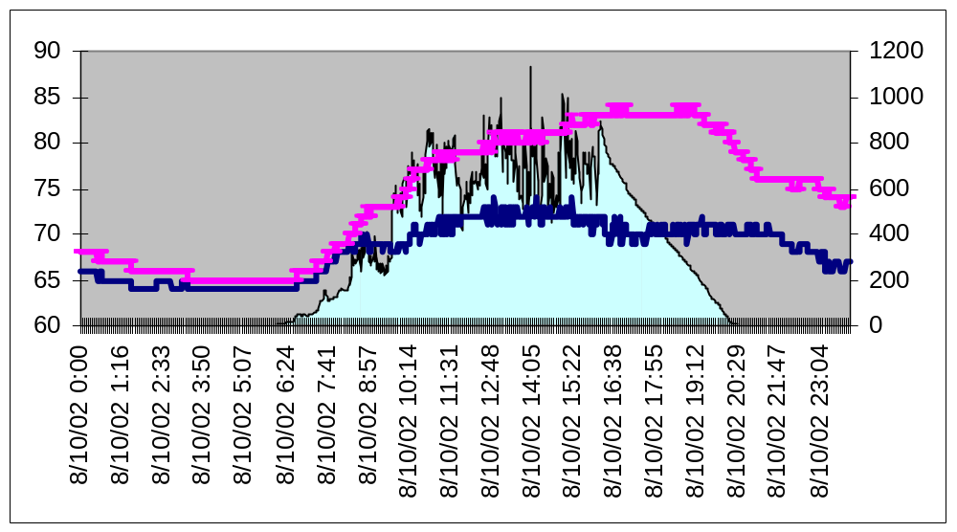
Minute Data
Temperature Dew Point Solar Radation

Slide 31
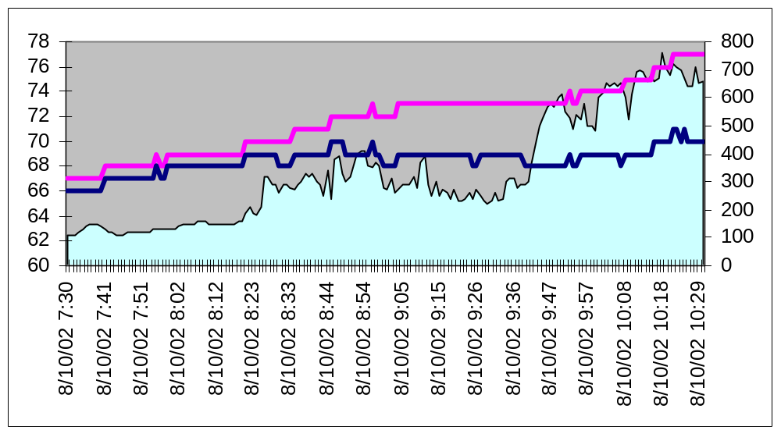
1 minute data!
Temperature Dew Point Solar Radation

Slide 32

Questions?
Daryl Herzmann
3010 Agronomy Hall
Ames, IA 50010
515.294.5978
Cell: 515.451.9249
akrherz@iastate.edu

